Slide 1
EHR platform diagrams
Thomas Beale

Slide 2
Components
patient
Allied
health
other
provider
PAYER
Secondary
users
portal
HILS
Imaging lab
PAS
DSS
billing
ECG etc
Security / access control
Path lab
UPDATE
QUERY
notifications
Enterprise
Comprehensive
Msg gateway
Basic
EHR
Multimedia
genetics
identity
Patient
Record
LAB
workflow
demographics
realtime
gateway
Clinical
ref data
terms
Clinical
models
guidelines
protocols
telemedicine
Online
Demographic
registries
Interactions DS
Local
modelling
Online drug,
Interactions DB
Online
terminology
Online
archetypes

Slide 3
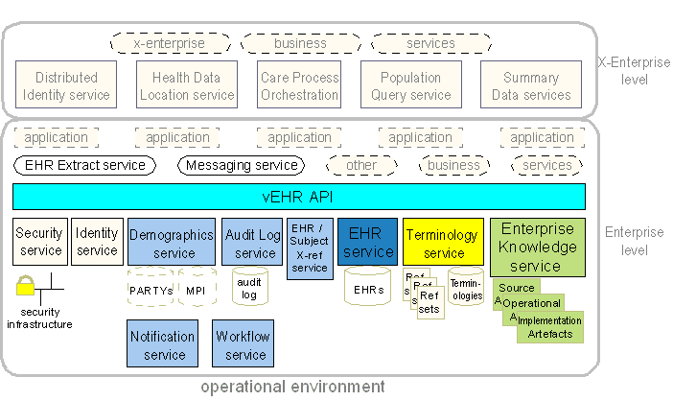

Slide 4
General eopenEHR Platform
Enterprise services
Workflow services
Virtual EHR middleware interface
Rule Engine
Knowledge
Decision Support
MPI interface
Ehr Index
Orders/ data import
EHR
Query Proc essor
EHR admin
Extract Mgr
Auth / RBAC /
policies
Archetypes templates
Termin ology
Inter actions
Guide -lines
Log
Log
User DB
External Systems Interface
Reference data interface
Device data interface
Feeder Systems Interface (W/F based)
Dump /load
Archiving
Data export svc
ETL
export
Patient Registry/ MPI
Provider Registry
Medications database
Device Hub / concentrator
Integration Engine
Std XML
EHR Archive
Data Warehouse
LIS
RIS
etc
Ehr Extract
ERP

Slide 5
Application / presentation
Native display
Native display
Browser
Browser
Mobile Phone
Tablet
Special devices
User app #1 (ward nurse)
User app #2 (oncology)
User app #3 (ICU)
User app #4 (ED)
User app #5 (pathology)
User app #N (etc)
User / context -specific apps
Presentation Bus
Native rendering engine
Browser rendering engine
Form Repository
View manager
Context manager
Mobile device I/F
Enterprise Service Bus
Scheduler
Task list
Patient Pathway
EHR
Order Mgt
Med. Mgt
Pharmacy
Re-im bursement
Enterprise services
Process / WF Foundation
Process Def’n
Task Mgr
Notification Mgr
H/R, Ent. model, provisioning
Episode activity view
Process synch / coordination
Process services
Interoperability Bus
Data
Services
Knowledge
Services
External Systems Interface Bus

