Slide 1
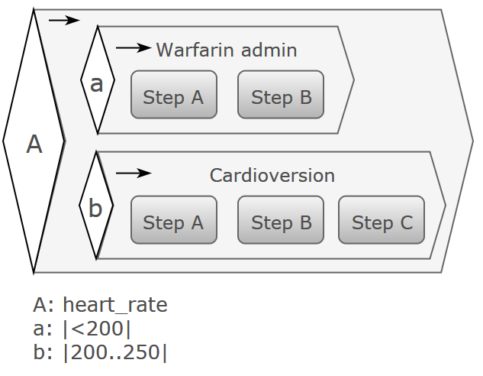

openEHR Task Planning
Thomas Beale
openEHR Management Board
Joint lead, openEHR Specification Program
Principal, Ars Semantica
2nd Arctic Conference on OpenEHR and Archetype-based clinical Information Systems
Copyright 2017 openEHR Foundation

Slide 2

What is ‘Task Planning’?
It’s something to do with workflow…

Slide 3
Are we completely mad?!?!
It can’t be done!
Clinical process is tooooo complicated
Care Pathways, Guidelines, Care Plans, Processes - healthcare is tooooo complicated

Slide 4
Are we completely mad?!?!
It’s been done!
Healthcare:
Published guidelines, NICE, …
IT:
BPEL, XPDL
BPMN
CMMN / DMN
YAWL
Health Informatics:
Arden, GLIF, Asbru
ProForma

Slide 5
We have to do it, because
Clinical process is tooooo complicated
Team-based care becoming normal
Complexity, e.g. sepsis, ARDS, complex birth
Humans can keep 7 +/-2 things in our minds
Some clinical pathways have 20+ concurrent variables to take account of
Existing approaches are either too deterministic (BPM), not semantically well defined (CMMN), or limited uptake (e.g. Arden, GLIF, ProForma).

Slide 6
Key use cases #1 - medication
Routine drug administration
Timed admins but exceptions
Many days → shift changes

Slide 7
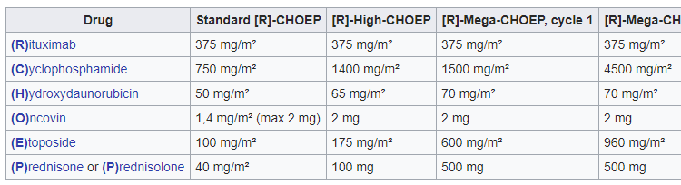
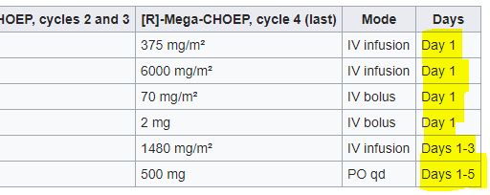
E.g. chemotherapy

Slide 8
Visualisation
Day
0
1
2
3
4

Rituximab IV infusion
R


D
Dexamethasone
PO
D
D
D
2h

2h
Ara-C cytarabine
IV infusion
A
A
24h

Platinol
IV infusion
P

Slide 9
Key use cases #2 - Stroke
Acute ischaemic stroke
Multiple simultaneous performers
Multi-disciplinary
Hand-offs between them
Time-critical

Slide 10
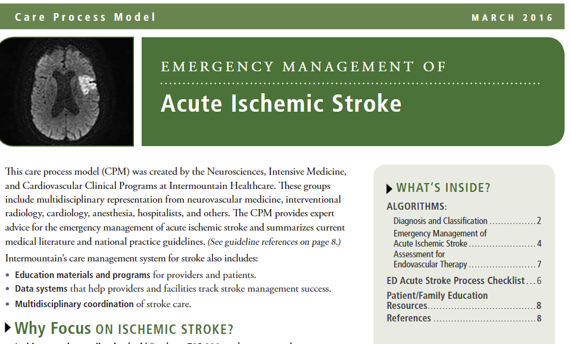


Slide 11
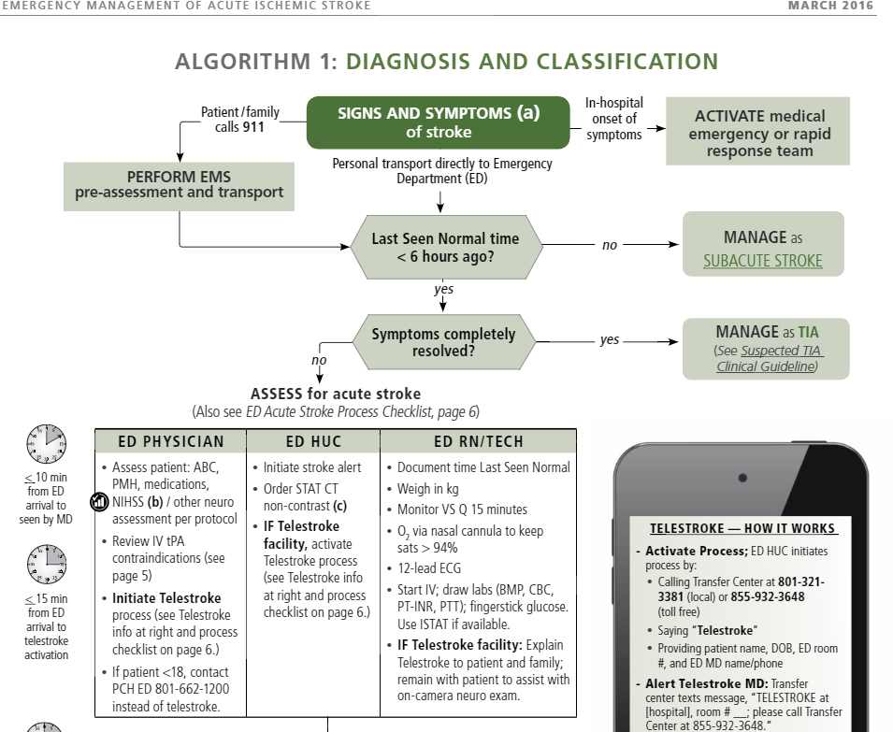
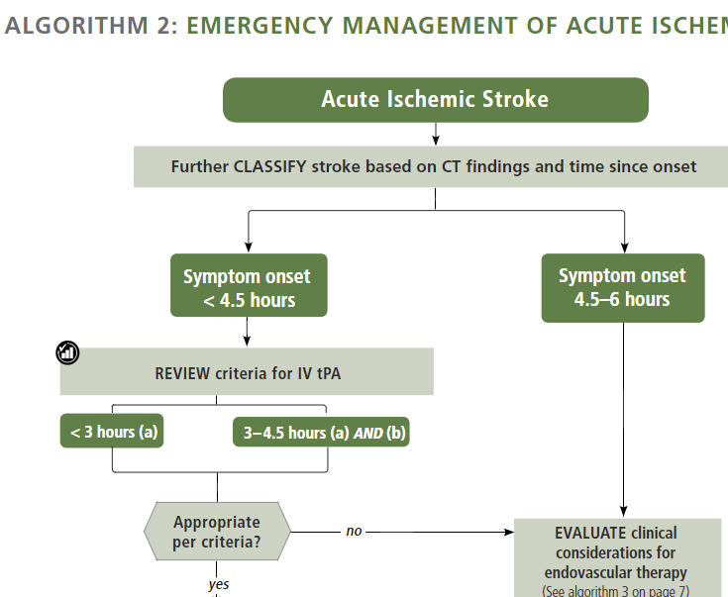
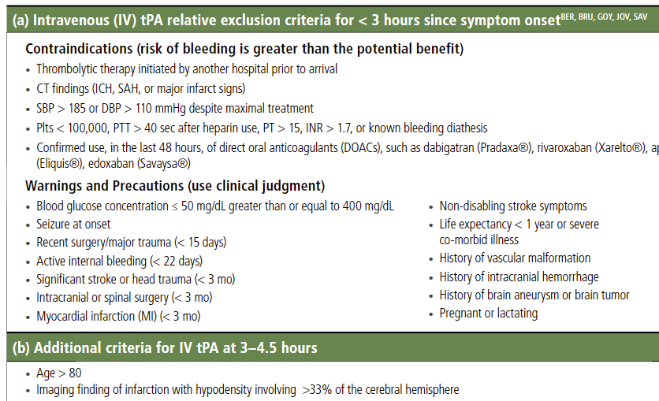
BTW: this keeps changing!

Slide 12
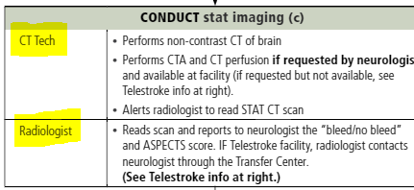
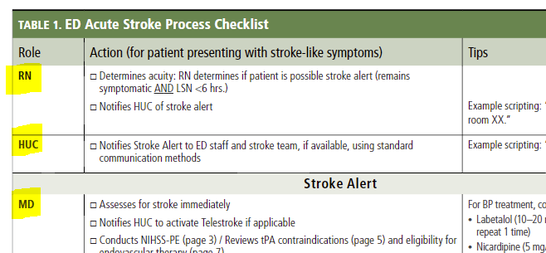
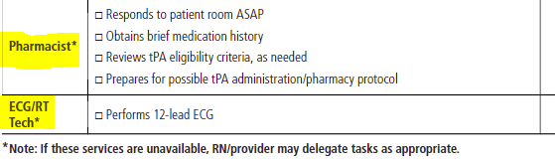
The challenge of team work – Coordination and hand-offs

Slide 13
Key use cases #3 – CDS (cancer)
Breast cancer treatment decision map
Complex decision pathways
Need data items
Decision expressions, representing rules
3 levels of system support
Fully automated – e.g. TNM → category of treatment
Recommendation – e.g. ‘consider contra-indications’
Ad hoc – multiple choices, but criteria only known at execution time

Slide 14
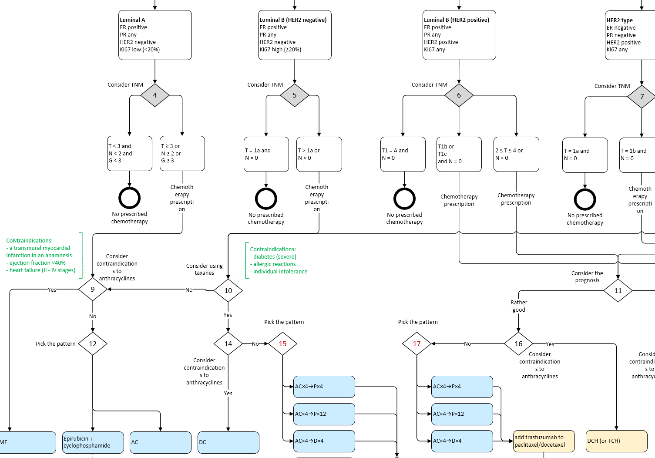

Slide 15
Other requirements
Order sets
Long-term treatments – changes in staff, locations, units, institutions
Checklist / signoff

Slide 16
Other requirements
Adaptiveness
Skip a Task
Cancel a Task
Abandon a Plan
Retry Task(s)
Override preconditions

Slide 17
Other requirements
Task List for worker v Task Plan for patient
Costing info?
Analytics?

Slide 18
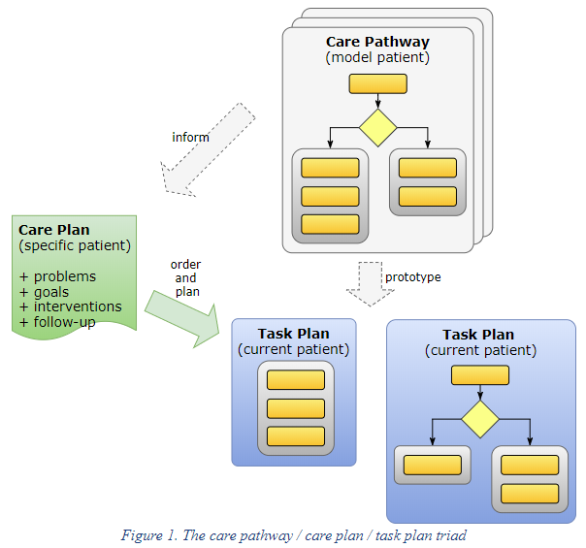
Design concepts

Slide 19
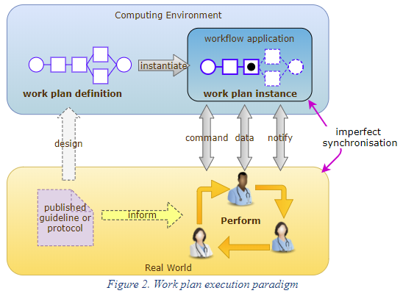
Design concepts
The workflow engine doesn’t do the work – performers do

Slide 20
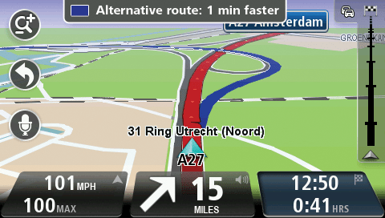
Task Planning as a co-pilot
Where the car is = where the care process is at
Destination = patient goal / target
Always recomputing ‘from here’
…we are trying to build a continuously adaptive patient journey navigation system

Slide 21
Design concepts
Workflow, decision support and the EHR are intimately related…
Do a bit
Decide a bit
Record a bit (side-effect)

Slide 22
Design concepts
A basic choice in the Task Plan architecture is that it is executable in the sense of all elements used in creating Plan definitions have an objective computational meaning and can be executed according to defined semantics.
The intention is that developing task plans is a kind of high level programming, performed using dedicated tools, and whose resulting artefacts are executable.

Slide 23
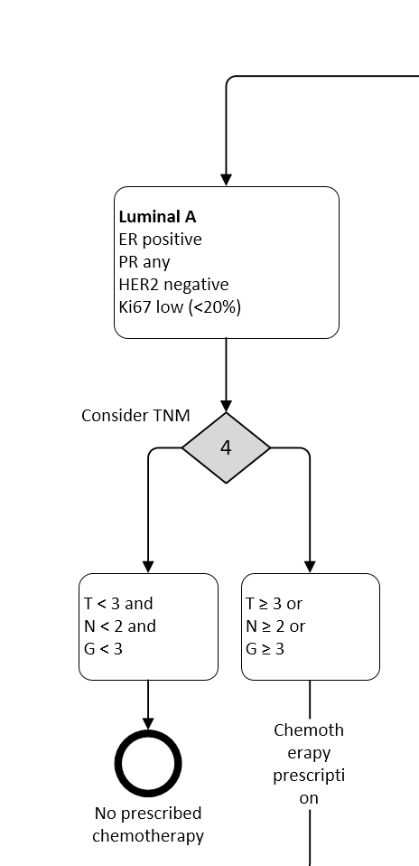
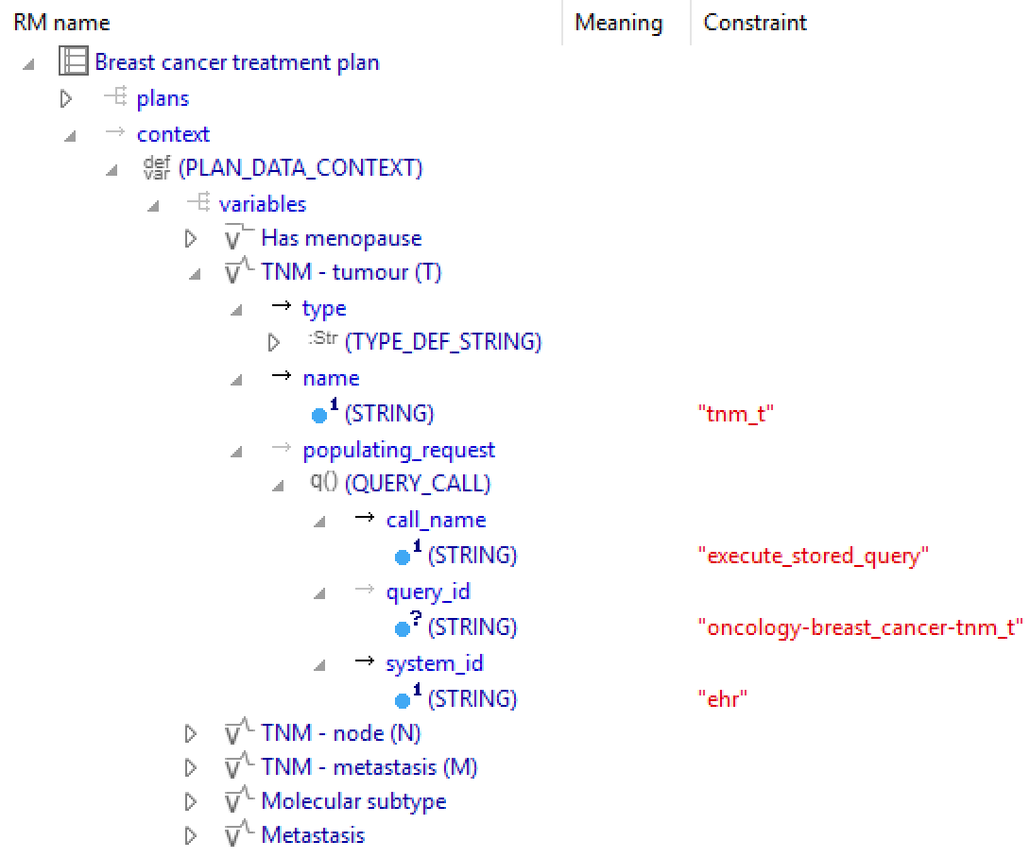
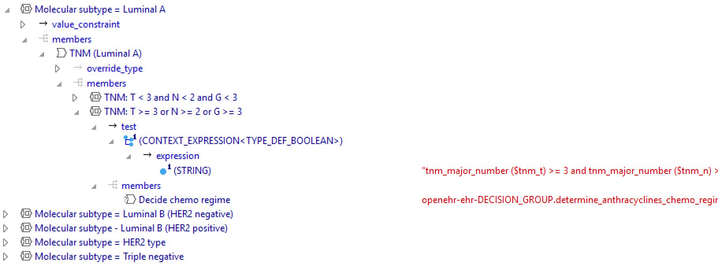
Design concepts
Solving the ‘curly brackets’ problem – how to connect workflow elements to external data: PLAN_CONTEXT

Slide 24
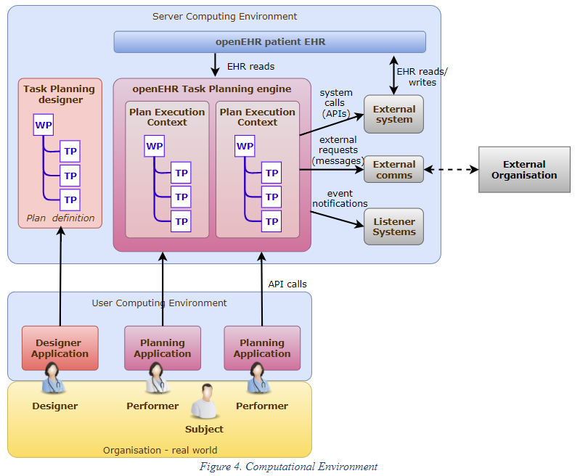
Architecture

Slide 25
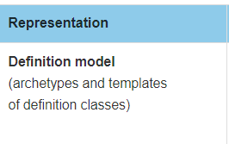
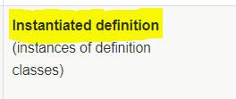
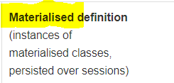
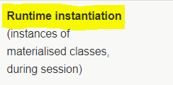
Levels of representation
Execution time

Slide 26
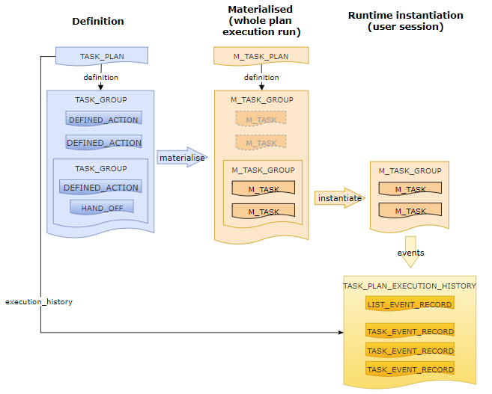

Slide 27
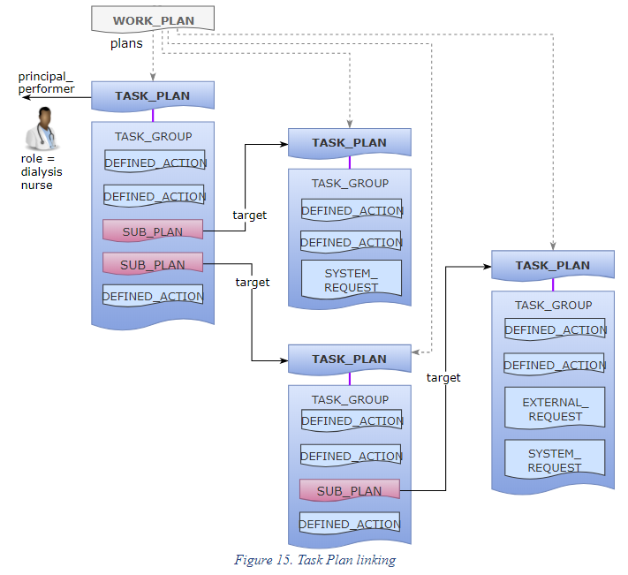
Basic structure

Slide 28
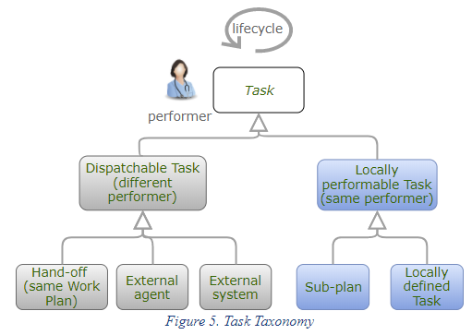
Task Taxonomy

Slide 29
Context switch and fork
Context switch = stop and wait
Context fork = >1 thread of work
Call-back mechanism
Optionally, new restart location

Slide 30
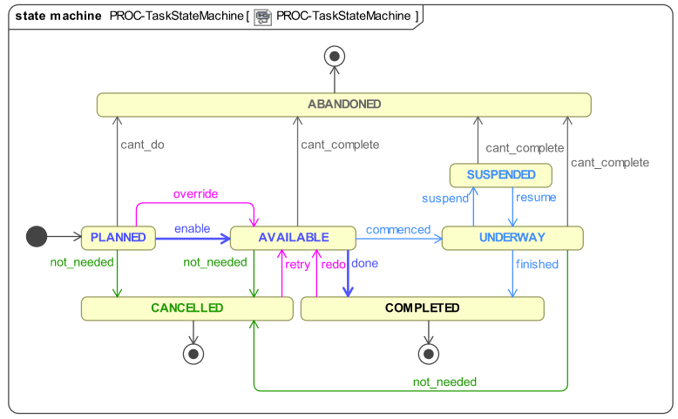
Task lifecycle

Slide 31
Allocation
Tasks can be allocated to two types of worker resource
Individuals
Worker pools
Worker resolved at runtime:
Plan or Task assigned to a real individual or pool
Worker claims a Plan or accepts a Task

Slide 32
Events
Time
Clock
Calendar
Plan Internal
Task transitions
Callback notification
External world
Patient – state changes, e.g. heart rate > 160
Performer tells TP engine something
Another system tells TP engine something

Slide 33
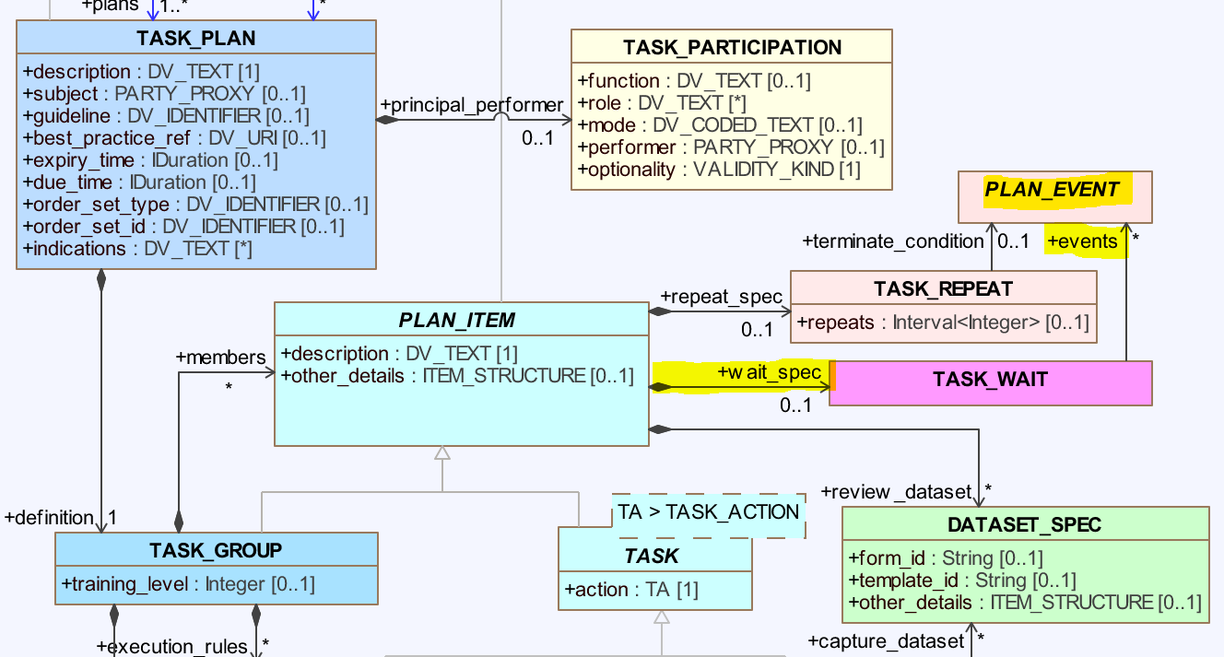

Slide 34
Decision Structures
3 levels of ‘support’
Automated
Recommended
Ad hoc –user-decided at runtime
Considerations:
Many decision criteria not (completely) encodable – clinician often ‘knows better’
Need to record a reason for override

Slide 35
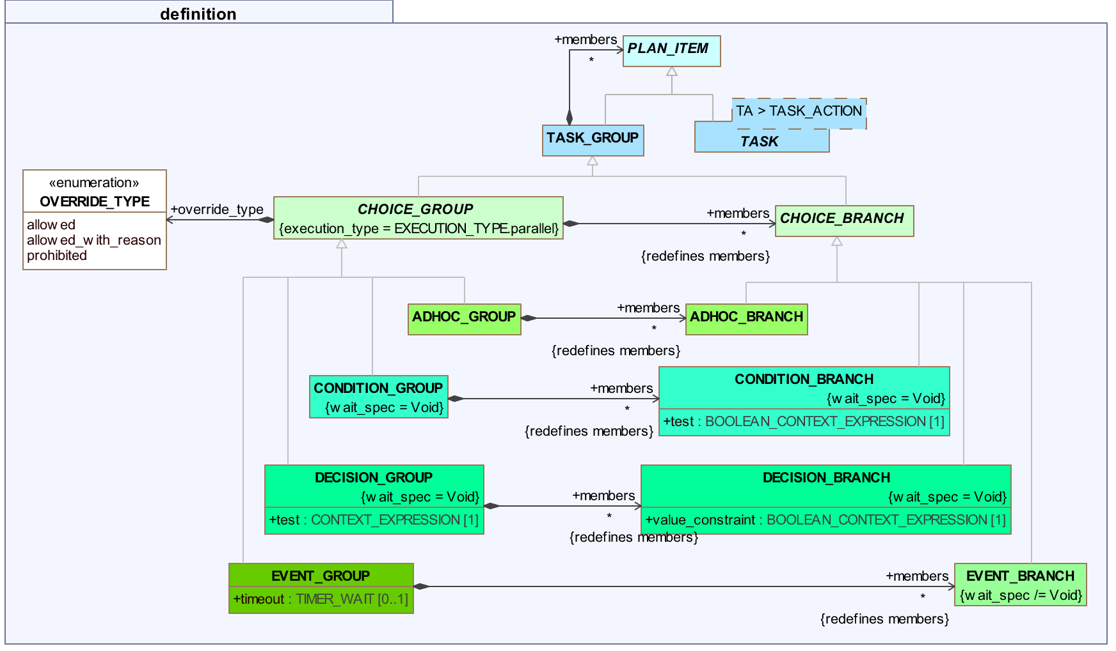
Decision Structures

Slide 36
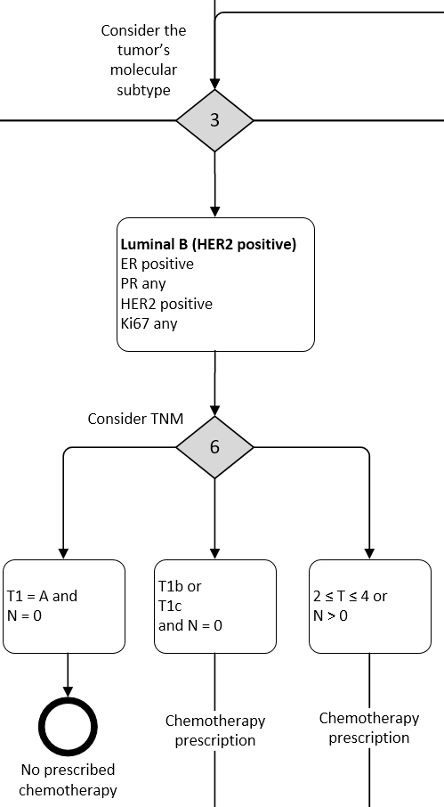
Decision Structures
Type 1: automatable

Slide 37
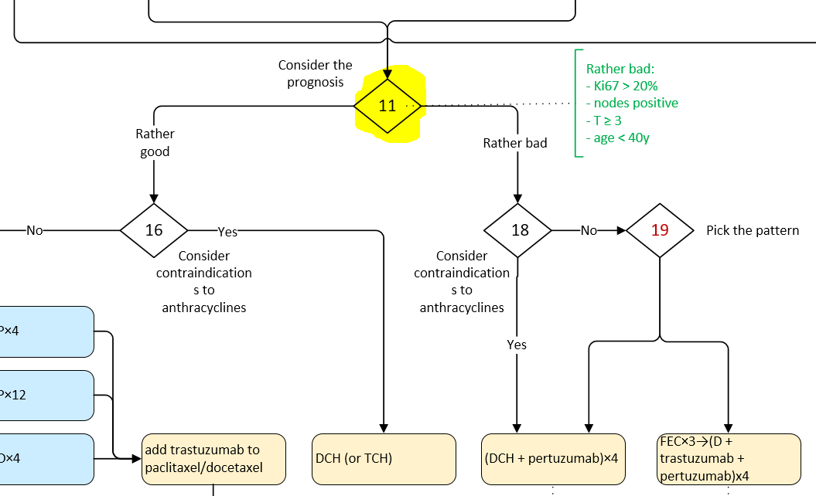
Decision Structures
Type 2: recommendation

Slide 38
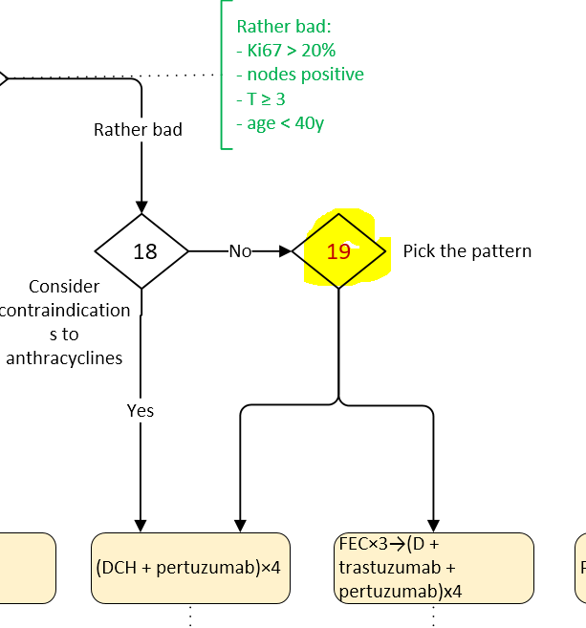
Decision Structures
Type 3: ad hoc

Slide 39
What does execution look like?
Work Plan activated
Each principal performer has a Task Plan
Tasks displayed or notified
Lifecycle applies:
planned → available → … etc
Available often depends on wait-events
Retry, redo, not_needed, cant_complete (abandon)

Slide 40
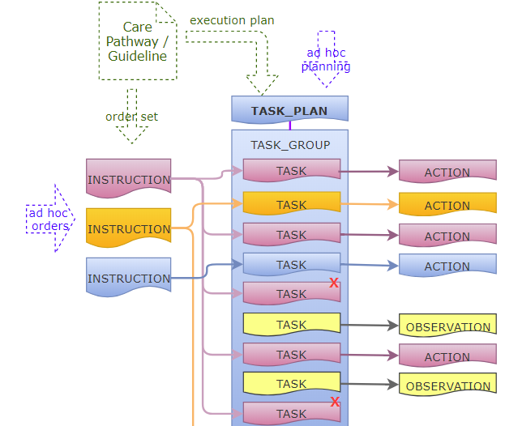
Relationship to openEHR Entries

Slide 41
Summary – Task Planning
Can represent fine-grained mixture of decision points and actions
Connects variables in definition to external data (openEHR or not)
Adaptive – allows Task skipping, repeating
3 levels of decision support
Explicit representation of allocation, data variables

Slide 42
Roadmap
Moscow City implem underway
Visual language underway
May lead to Camunda or draw.io mode
Archetypes being tested
Marand / Moscow – polyclinic workflows
DIPS / Arena – hospital workflows
Tieto - tracking

Slide 43
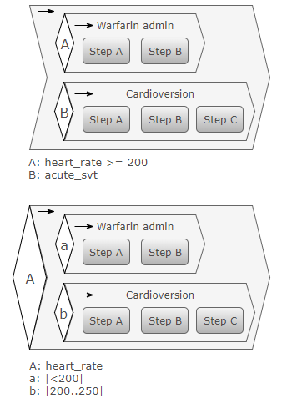
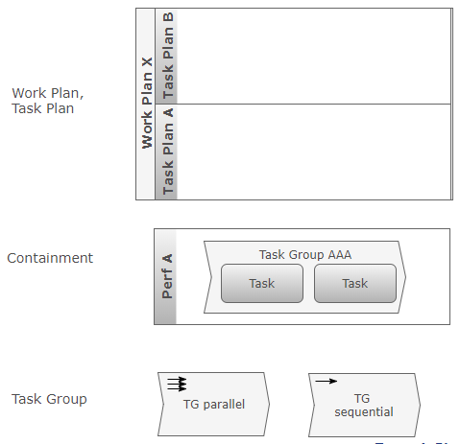
Resources
http://www.openEHR.org
http://www.openEHR.org/releases/PROC/latest/task_planning.html

