Slide 1

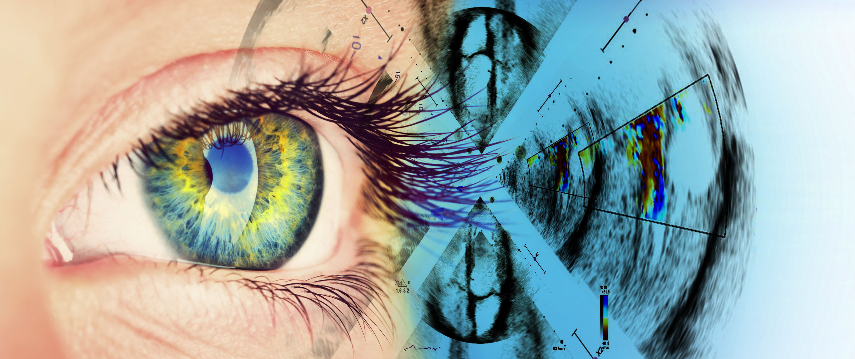
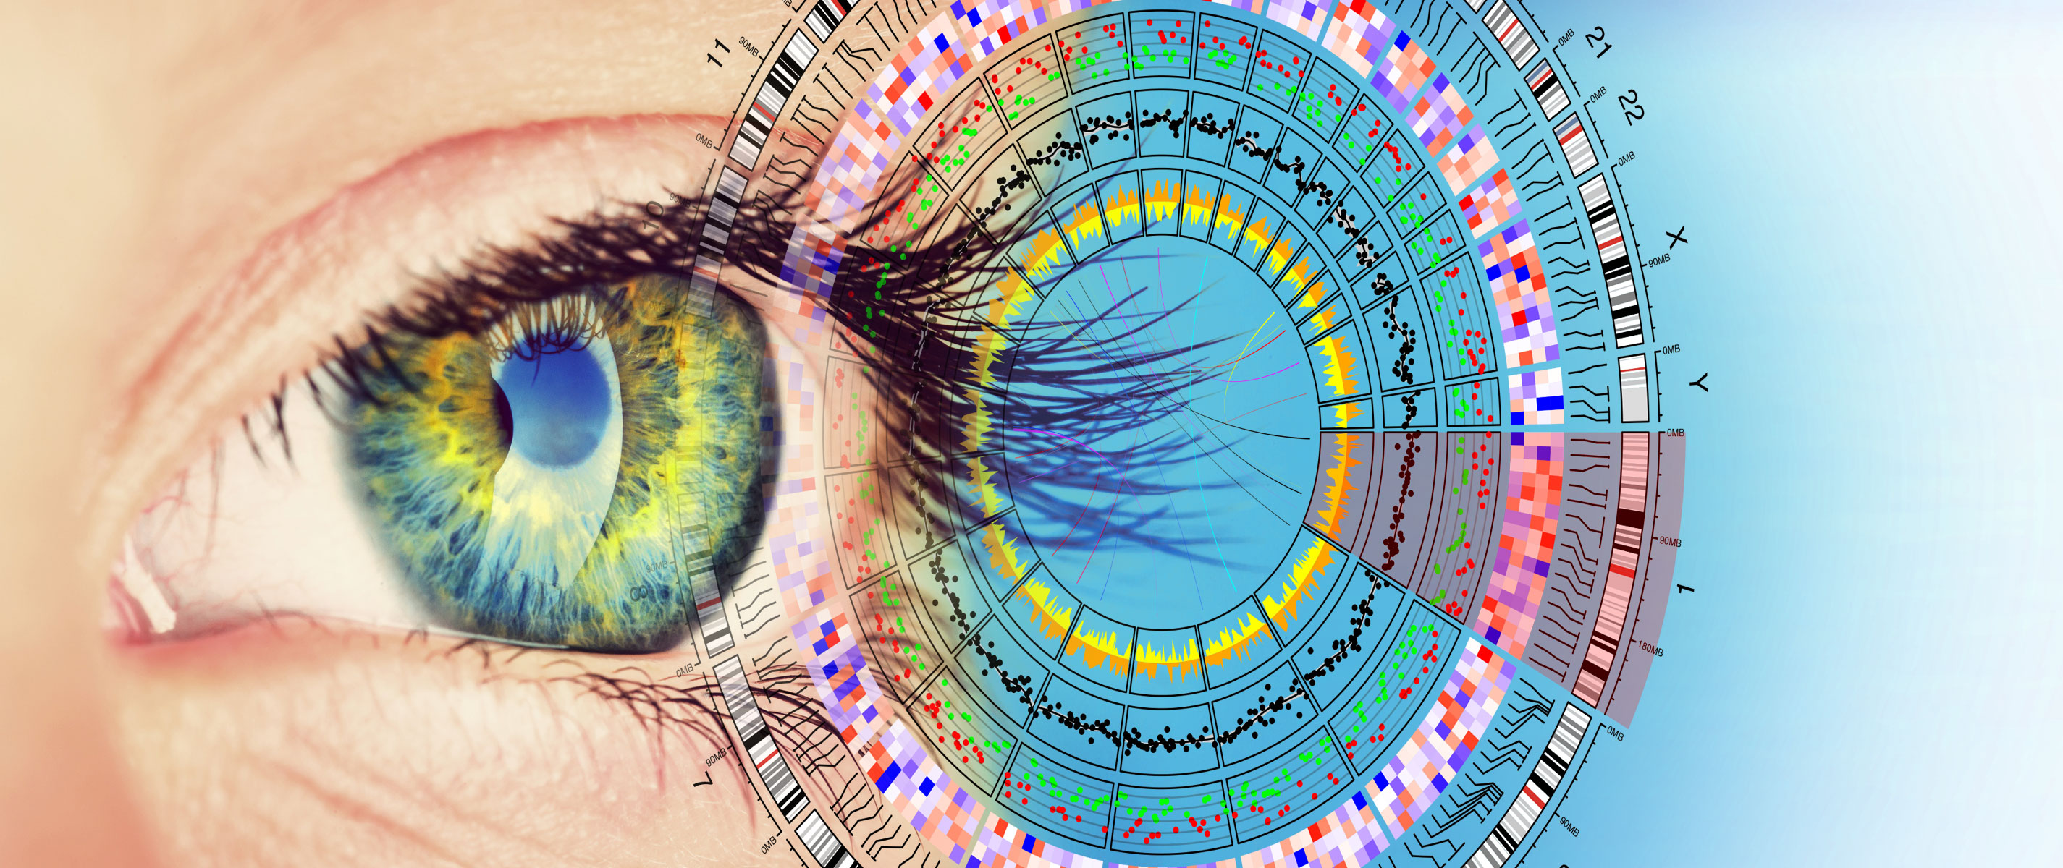

HiGHmed Introduction
Tromsø, January 18th, 2018
2nd Arctic Conference
Birger Haarbrandt

Slide 2
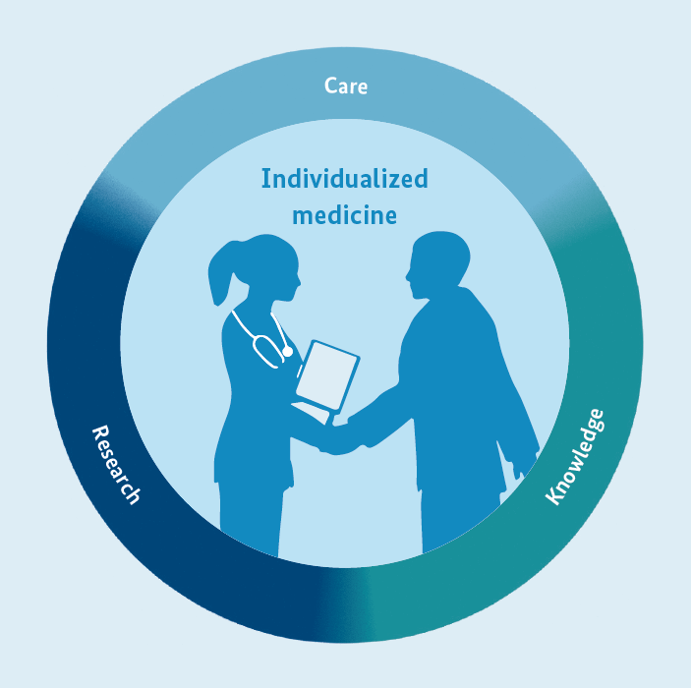

Goals of the Medical Informatics Initiative funding scheme:
Intensify the exchange and sharing of data between research community and health care delivery system
Improve research opportunities and patient care through innovative IT solutions (initially at university hospitals)
Position medical informatics as a progressive field in research, teaching and continuing education
Establishment of a national infrastructure
Notes:
-Digitalisation is healthcare is under-developed in Germany
-Use of Health IT has not come to its full potential, yet
No exchange between healthcare providing organizations
German Federal Ministry of Education and Research (BMBF)
2

Slide 3
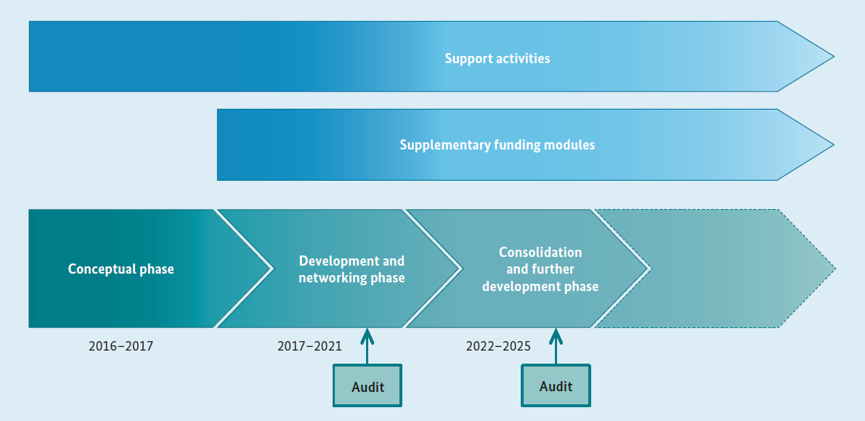
MI-Initiative Timeline
Notes:
Government tires to push this topic

Slide 4
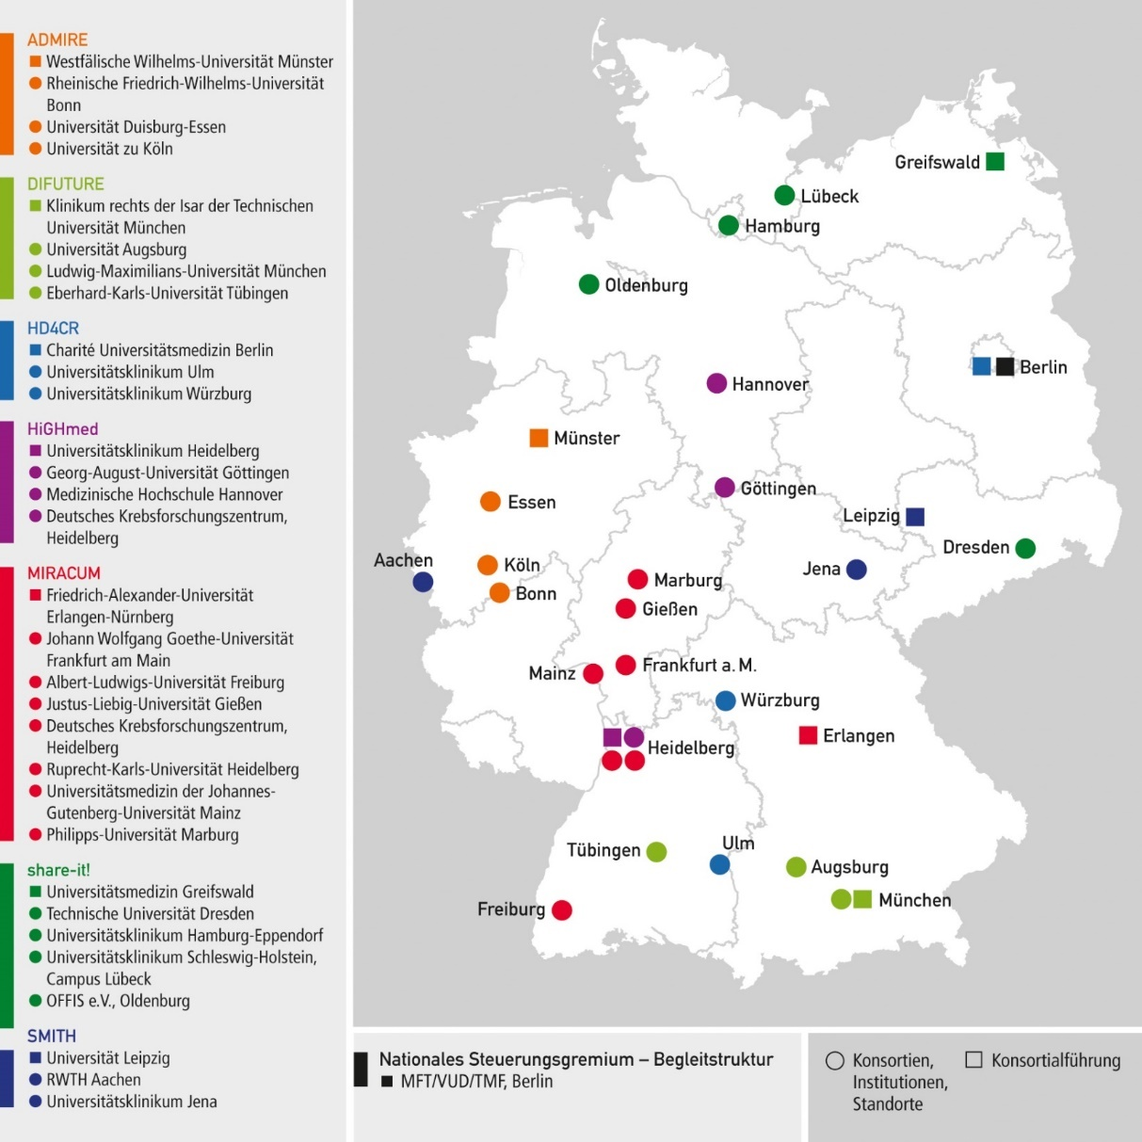
MI-Initiative Concept Phase
Seven consortia competed for funding:
ADMIRE: Münster, Bonn, Köln, Essen, Düsseldorf (NRW Verbund)
DIFUTURE: TU München, LMU München, Tübingen, Augsburg
HD4CR: Charité Berlin, Würzburg, Ulm, Berliner Institut für Gesundheit
HiGHmed: Heidelberg, Göttingen, Hannover, DKFZ
MIRACUM: Erlangen-Nürnberg, Gießen, Frankfurt, Mainz, Mannheim, Marburg, Freiburg
share-it!: Greifswald, Schleswig-Holstein (Kiel, Lübeck), Hamburg, Dresden
SMITH: Leipzig, Jena, Aachen
Kiel

Slide 5








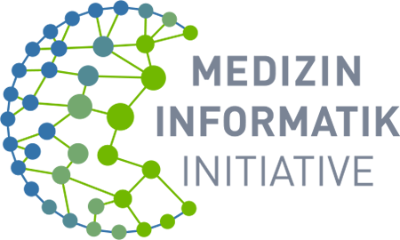
















HiGHmed - Partner
Associate Partners
Private and Networking Partners
Academic Partners
Ada Health
Notes:
Choosen

Slide 6

Basic Principles
Patients first
Data Safety and Privacy
Clinical Relevance
Clinically led Data Modelling
Semantic Traceability
Proven Technology
Scalability
Sustainability
Enable Innovation

Slide 7
Design Principle
Within HiGHmed, we join forces to create Medical Data Integration Centers (MeDICs) based on a generic and scalable platform architecture for integrating data from care, research, and external sources, which will facilitate the development of new solutions for medical data analytics benefitting clinicians, patients and researchers

Slide 8

HiGHmed Platform
Open Service Models: all specifications of the APIs are openly accessible to everybody.
Open Information Models: All clinical models are well defined based on established and open standards.
Open System Specifications: All system components and protocols are openly specified using licenses feasible for commercial and non-commercial use.
Iterative specification, software development and deployment approach.
Notes:
1. Open Platform

Slide 9
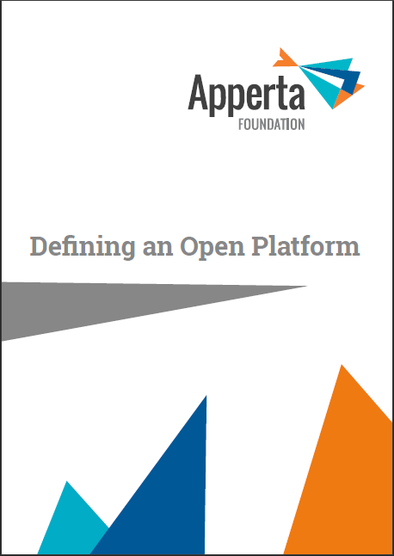


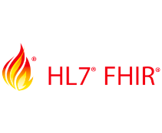


Standards
1. Semantic Modelling: The collaborative semantic modelling approach will be addressed by the definition and management of openEHR Archetypes and Templates.
2. Terminologies: We consider LOINC, SNOMED CT, and ICD as starting points for HiGHmed, and also incorporate a standardized terminology service interface (FHIR Terminology Service).
3. Data Distribution : Coarse-grained and scalable distribution service will be realized by using IHE XDS(-I) and IHE XDR.
Fine-grained APIs for data provision and access will be established by openEHR through the Archetype Query Language (AQL) and a REST interface based on SMART on FHIR.
4. Management Services: services to manage and administer the system (e.g. consent management, identity management, IHE metadata definitions) will be provided via APIs that are part of IHE XD*, openEHR, and HL7 FHIR.

Slide 10
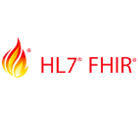




Open Architecture
Patient Facing
Applications
Cross-Enterprise (Research) Applications
Clinical Applications
Clinician Portal
Apps
CDS
Patient Portal
Apps
(PRO)
Cohort Planning
Analytics
Apps
Health Information Access Layer (IHE, openEHR REST, AQL, FHIR)
Process & Orchestration
Service Bus
Management & Monitoring
Security & Privacy
MPI
Terminology Service
Provider Registry
Patient Consent
Images
‘Document’ data
Structured Data
Notes:
We stole this slide from Marand
Clinical Applications optionally and in the second iteration

Slide 11
MeDIC – Hannover (MHH)
De-Identification
+ Mirror
De-Identification (local)
Research Domain
ID Domain

Slide 12
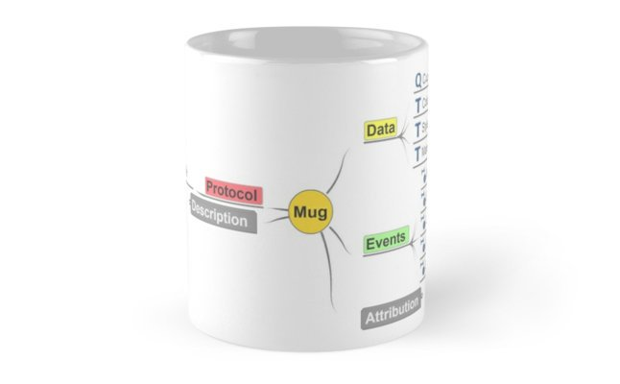
Information Model Governance
FAIR Data Principles: Findable, Accessable, Interoperable, Reusable
Semantic Modelling will generate the necessary knowledge to safely access data in a cross-enterprise environment with high precision and recall.
Data Stewards are incorporated within the clinics at each site to establish FAIR data principles
Information model governance
Ensure data quality
Ensure standardized medical documentation
Adaptation of the national governance model pioneered by Nasjonal IKT

Slide 13

HiGHmed Use Cases
Oncology: The oncology use case will help us to address challenges in Medical Informatics when integrating omics data from genome sequencing, structured documentation and radiology into a cross-organizational molecular tumor board.
Cardiology: Within the cardiology use case, we will systematically explore and address IT challenges related to the integration of data from wearable and connected devices into our IT architecture.
Infection Control: The infection control use case will develop an automated early warning and cluster analysis system to support the algorithmic detection of pathogen clusters.

Slide 14
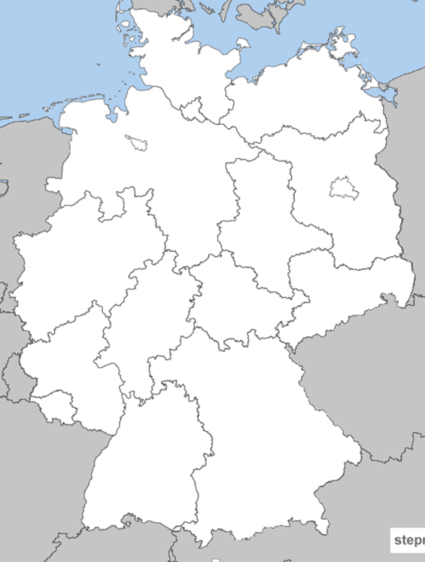

New partners in HiGHmed
Kiel
Accession processes have been initiated with the following sites:
University Hospital Muenster
University Hospital Cologne
University Hospital Wuerzburg
University Medical Center Schleswig-Holstein (Kiel)
Charité Berlin
Hannover
Berlin
Muenster
Goettingen
Colgone
Wuerzburg
Heidelberg

Slide 15



Open Source Strategy
Provide open implementations of vital components of the HiGHmed Platform
Lower hurdles for vendors and (smaller) organisations to get started with openEHR
Ethercis will serve as the foundation for an open source HiGHmed CDR
Align HiGHmed specifications with activities in the NHS and other open platform initiatives (starting with use of FHIR Terminology Service)

Slide 16
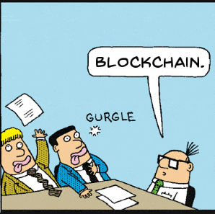
Wrap Up
An open platform architecture promises to be future proof and to avoid vendor lock-in
Combination of IHE, openEHR and FHIR seems capable to foster innovation in care provision and data analytics/research alike
Single-Source Modelling will help us to evolve the platform without affecting the semantic models
We expect an iterative and ongoing process (the platform development will never be fully finished)
We hope for a push of the open platform paradigm in Germany to help overcome semantic interoperability challenges.

Slide 17
Thank you for your attention
http://www.highmed.org/

