Slide 1
Board of Governors
Web Committee
Management
Board
Infrastructure Admin
Specification
Program
Clinical Models
Program
Software
Program
Localisation
Program

Slide 2
Organisational
Partners
Subscribing Members
Industry
Partners
Informal Members
User Community

Slide 3
Localisation Program
Localisation Program
Committee
(LPC)
Up to 2 elected co-chairs (2y)
1 member from each CMG and SAG (2y)
Size: min 5, max 9 members
Qualified Members (QM)
Elected based on criteria
No time or size limit
Chapter
Organisation
Local openEHR Representative(s)
Local openEHR Representative(s)
Local openEHR Representative(s)
Nominated by LPC
Appointed by openEHR Board
One or more reprsentatives
Legal entities designated by openEHR Board
New organisations or part of existing relevant organisation (e.g. HL7 affiliates, health informatics associations etc.)
Local
Members
Local
Members
Local
Members
Nominated by LPC
Appointed by openEHR Board
One or more reprsentatives
Country A
Country B
Country C

Slide 4
Specification Program
Editorial
Committee
Up to 3 elected co-chairs (2y)
1 member from each CMG and SAG (2y)
Size: min 8 members
CMG (core)
AM
CMG (core)
RM
CMG (core)
Archetypes
Maintain core specification components
Minimum 3 members
Entry by Program vote
CMG (non-core)
WS
CMG (non-core)
Java
CMG (non-core)
XML
Maintain other components
Minimum 1 member
Entry by Program vote
SAG (standards)
IHTSDO
SAG (standards)
HL7
SAG (standards)
13606
Advise on standards
Liaise with SDOs
Minimum 1 member
Entry by Program vote

Slide 5
Specifications Editorial Committee (SEC)
Conformance (CONF)
CRs
Implementation Technologies (ITS)
CRs
Clinical Decision Support (CDS)
CRs
Querying (QUERY)
CRs
Process (PROC)
CRs
Integration (INTG)
CRs
PRs
User community
Service Model (SM)
CRs
Archetype Model (AM)
CRs
Reference Model (RM)
CRs
Languages (LANG)
CRs
= SEC elected co-chair
= SEC member
= SEC Component Maintainer
= Change requests
= Problem Reports
= Specifications Component
Base (BASE)
CRs
CRs
Terminology (TERM)
CRs
PRs
aaa

Slide 6
openEHR Specification Components
Service Model (SM)
Conformance (CONF)
Integration (INTG)
Implementation Technologies (ITS)
Querying (QUERY)
Clinical Decision Support (CDS)
Reference Model (RM)
Archetype Model (AM)
Base (BASE)
Terminology (TERM)

Slide 7
Java API
Templates
Operational Template
C# API
Bindings
XSD
Ref
Sets
Archetypes
Forms
Terminology
Queries
Reference
Model
Software
System

Slide 8
generate
generate
Java API
Templates
Operational Template
C# API
Bindings
XSD
Ref
Sets
Archetypes
Forms
Terminology
Queries
Reference Model
Software
data
retrieval
System

Slide 9
Data
Conclusions
Record
Analyze
Clinical
Models
openEHR
Platform
Terminology
commit
query
Health
Information

Slide 10


Users
International, national clinical experts
Vendor product
Data capture apps
View, Analysis apps
services
Clinical
Models
transform
openEHR
Platform
commit
query
Terminology
EHR, Demographics

Slide 11
Domain modellers
Developers
Vendors
Modelling Tool
Modelling Tool
Modelling Tool
Programming artefacts
App dev tool
App dev tool
App dev tool
Model tool platform
App development framework
Archetypes Templates Ref-sets
Universities
Deploy
Researchers
app
app
app
app
app
Governance Tools
health
care
& mgt
services
health
data
services
Model Repository
Operational templates
Health computing platform

Slide 12
Government Bodies
Data-set
specifiers
Developers
Vendors
Standard
data-set
schemas
Modelling Tool
Modelling Tool
Modelling Tool
App dev tool
App dev tool
App dev tool
Model tool platform
App development framework
(Archetypes) Templates Ref-sets
Universities
Deploy
Researchers
app
app
app
app
app
Governance Tools
health
care
& mgt
services
health
data
services
Model Repository
Operational templates
Health computing platform

Slide 13
Vendors / Developers
Domain modellers
Developers
Vendors
Modelling Tool
Modelling Tool
Modelling Tool
Programming artefacts
App dev tool
App dev tool
App dev tool
Model tool platform
App development framework
Archetypes Templates Ref-sets
Universities
Deploy
Researchers
app
app
app
app
app
Governance Tools
health
care
& mgt
services
health
data
services
Model Repository
Operational templates
Health computing platform

Slide 14
Providers / Clinicians
Developers
Vendors
Clinicians
Modelling Tool
Modelling Tool
Modelling Tool
Programming artefacts
App dev tool
App dev tool
App dev tool
Model tool platform
App development framework
Archetypes (Templates Ref-sets)
Universities
Deploy
Researchers
app
app
app
app
app
Governance Tools
health
care
& mgt
services
health
data
services
Model Repository
Operational templates
Health computing platform

Slide 15
Universities / Research
Domain modellers
Developers
Vendors
Modelling Tool
Modelling Tool
Modelling Tool
Programming artefacts
App dev tool
App dev tool
App dev tool
Model tool platform
App development framework
Archetypes Templates Ref-sets
Universities
Deploy
Researchers
app
app
app
app
app
Governance Tools
health
care
& mgt
services
health
data
services
Model Repository
Operational templates
Health computing platform

Slide 16
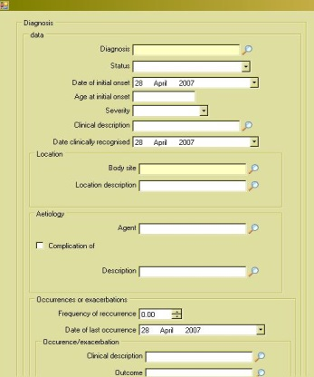
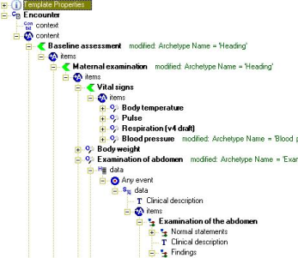
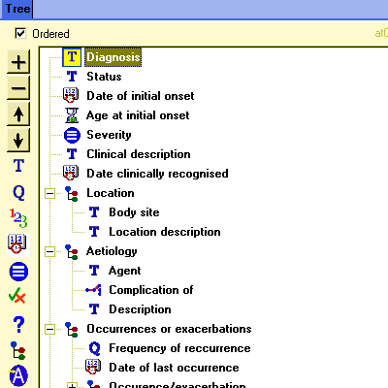
Screen Forms - GUI
1:N
Business-event specific
data sets - Templates
Terminology
1:N
Theme-based models
of content - Archetypes
Querying
1:N
Data Representation and
sharing - Reference Model

