Slide 1
Open-ETCS WP3 : API
Basic Principles on Time, MMU and Balise interfaces
WP3 Workshop - Brussels
09.09.2014

Slide 2
Introduction
This presentation is a working document which aim is :
to support the API document provided by Alstom « OETCS_API Requirements » (please see this document to have full information)
to support technical discussion of the workshop of the 9/9/2014 in Brussels
to ensure that everyone understands in the same way the basic principles for time, MMU and balise API data management ; (principles that are suggested by the Alstom API document and that would/could/should be adopted for the WP3 modelling tasks)
This presentation is NOT exhaustive, it is simplified :
it only provides the BASIC principles ; the nominal CASES, the most usual cases
It does NOT present the degraded and special cases (which nevertheless HAVE to be taken into account for the modelling tasks and for the design the OETCS application in general)

Slide 3
ETCS TIME
ETCS time
OETCS ASW
ETCS time
0.01s * (2exp31-1) = 248 days
(But this value can be limited by the platform)
ETCS Stops working when ETCS Time reaches MAX_ETCS_Time
MAX
ETCS
time
ETCS Time is always increasing as long as the EVC is powered
ETCS Time does not exist anymore when the EVC is crashed or
powered-off
ETCS Time does not exist anymore when the EVC is powered-off
0
POWER-ON
POWER-ON
POWER-ON
« True »
« exact »
Time
ETCS Time is equal to 0 at power-up of the EVC
Not known by the EVC.
See http://en.wikipedia.org/wiki/Time
ETCS Time is equal to 0 at power-up of the EVC
ETCS time is SIL4 and its accuracy is defined by the Unisig. (0,1%)

Slide 4
ETCS MMU
ETCS distance counter will be CONSTANT
ETCS Speed will be ZERO
ETCS Direction will be Undefined (Unkwown)
ETCS Motion will be FALSE
CAB
B
CAB
A
CAB
B
CAB
A
CAB
B
CAB
A
Train Movement
No Movement
Train Movement
ETCS distance counter will ALWAYS INCREASE (SIGNED)
ETCS Speed will ALWAYS be POSITIVE (UNSIGNED)
ETCS Direction will ALWAYS be « from CAB B to CAB A » = « FORWARD »
ETCS Motion will be TRUE
ETCS distance counter will ALWAYS DECREASE (SIGNED)
ETCS Speed will ALWAYS be POSITIVE (UNSIGNED)
ETCS Direction will ALWAYS be « from CAB A to CAB B » = « REVERSE »
ETCS Motion will be TRUE
TRACK

Slide 5
ETCS DISTANCE
ETCS distance
OETCS ASW
Scenario : Train always runs into the same direction (from CABB to CABA)
at a constant speed (not equal to 0)
ETCS Stops working when ETCS distance reaches MAX_ETCS_distance
(e.g 15.000.000 m)
CAB
B
CAB
A
ETCS distance
ETCS distance does not exist anymore when the EVC is powered-off
ETCS nominal distance is always inside the range [min distance, max distance] (SIL4).
Assumption : Imax distance – min distanceI is NEVER DECREASING
ETCS distance does not exist anymore when the EVC is crashed or
powered-off
MAX
ETCS
distance
ETCS distance (min, nom and max) is always increasing as long as the EVC is powered
max
nominal
Confidence interval
min
0
POWER-ON
POWER-ON
POWER-ON
Time
ETCS distance is equal to 0 at power-up of the EVC
ETCS distance is equal to 0 at power-up of the EVC

Slide 6
Track
ETCS DISTANCE
Scenario :
Train power-up
Train goes to constant speed forward
Train STOPs
Train goes to constant speed in reverse
Train STOPs
ETCS distance max
ETCS
distance
Real position on track
CONFIDENCE INTERVAL
ETCS distance nom
ETCS distance min
CONFIDENCE INTERVAL
0
Time
ETCS distance
OETCS ASW
To simplify, acceleration is not taken into account in the drawing (infinite acceleration/deceleration values)

Slide 7
ETCS SPEED, MOTION and DIRECTION
Scenario :
Train power-up
Train goes to constant speed forward
Train STOPs
Train goes to constant speed in reverse
Train STOPs
Motion detection
True
False
Time
Direction detection
Forward
Unknown
Time
Reverse
Speed (m/s)
max
max
nominal
nominal
min
min
0
Time
To simplify, acceleration is not taken into account in the drawing.

Slide 8
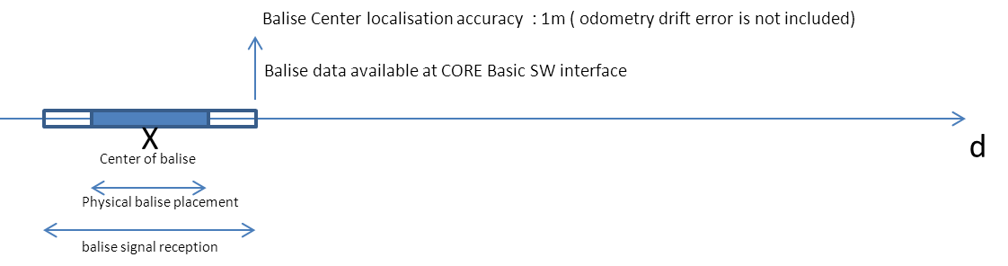
BALISE

Slide 9
On the CORE processing Unit
CYCLE i-1
CYCLE i
CYCLE i+1
Input
Application
Ouput
Input
Application
Ouput
Input
Application
Ouput
The application is activated once per cycle
Constants : T_CYCLE_MIN, T_CYCLE_MAX, T_INPUT_MIN, T_INPUT_MAX, T_APPLICATION_MIN, T_APPLICATION_MAX,
T_OUTPUT_MIN, T_OUTPUT_MAX (all durations)
T_CYCLE_MIN < T_CYCLE (current cycle) < T_CYCLE_MAX
T_INPUT_MIN < T_INPUT (current cycle) < T_INPUT_MAX
T_APPLICATION_MIN (current cycle) < T_APPLICATION < T_APPLICATION_MAX
T_OUTPUT_MIN < T_OUTPUT (current cycle) < T_OUTPUT_MAX

Slide 10
On the CORE processing Unit; more abstract view
CYCLE i-1
CYCLE i
CYCLE i+1
Application
Application
Application
Constants : T_CYCLE_MIN, T_CYCLE_MAX, T_APPLICATION_MIN, T_APPLICATION_MAX
T_CYCLE_MIN < T_CYCLE (current cycle) < T_CYCLE_MAX
T_APPLICATION_MIN < T_APPLICATION (current cycle) < T_APPLICATION_MAX
Those constants / performance / SW design (buffering, …) are related.
Safety : it is assumed there is a watchdog macanism

Slide 11
Peripherals + CORE processing Unit (1/2)
Input_I1 at
ETCS external
interface
Input_I1 acquisition
CYCLE i-1
CYCLE i
CYCLE i+1
application
treatment
Input
Application
Ouput
Input
Application
Ouput
Input
Application
Ouput
Output_O1 processing
Output_O1 at
ETCS external
interface

Slide 12
Peripherals + CORE processing Unit (2/2)
(« input treatment at next cycle »)
Input_I1 at
ETCS external
interface
Input_I1 acquisition
CYCLE i-1
CYCLE i
CYCLE i+1
application
treatment
Input
Application
Ouput
Input
Application
Ouput
Input
Application
Ouput
Output_O1 processing
Output_O1 at
ETCS external
interface

Slide 13
Peripherals + CORE processing Unit; more abstract view
(in case of application treatment at cycle i)
Can be more than 1 cycle !!!
Cycle independant.
Input_I1 at
ETCS external
interface
Input acquisition (T_INPUT_I1_ACQUISITION_MIN)
Input acquisition (T_INPUT_I1_ACQUISITION_MAX)
CYCLE i-1
CYCLE i
CYCLE i+1
application
treatment
Application
Application
Application
Output processing (T_OUTPUT_O1_PROCESSING_MIN)
Output processing (T_OUTPUT_O1_PROCESSING_MAX)
Output_O1 at
ETCS external
interface
Output_O1 at
ETCS external
interface
Constants : T_CYCLE_MIN, T_CYCLE_MAX, T_APPLICATION_MIN, T_APPLICATION_MAX;
For each INPUT (I1, I2, ….) : T_INPUT_ACQUISITION_MIN, T_INPUT_ACQUISITION_MAX
For each OUTPUT (O1, O2, …) : T_OUTPUT_PROCESSING_MIN, T_OUTPUT_PROCESSING_MAX
T_CYCLE_MIN < T_CYCLE < T_CYCLE_MAX
T_APPLICATION_MIN < T_APPLICATION < T_APPLICATION_MAX
For each INPUT (I1, I2, ….) : T_INPUT_ACQUISITION_MIN < T_INPUT_ACQUISITION < T_INPUT_ACQUISITION_MAX
For each OUTPUT (O1, O2, …) : T_OUTPUT_PROCESSING_MIN< T_OUTPUT_PROCESSING < T_OUTPUT_PROCESSING_MAX
Can be more than 1 cycle !!!
Cycle independant.

Slide 14
Peripherals + CORE processing Unit; other view
(in case of application treatment at cycle i)
Input_I1 at
ETCS external
interface
Can be more than 1 cycle !!!
Cycle independant.
Input_I1 at
ETCS external
interface
Input acquisition (T_INPUT_I1_ACQUISITION_MIN)
Input acquisition (T_INPUT_I1_ACQUISITION_MAX)
CYCLE i-1
CYCLE i
CYCLE i+1
application
treatment
Application
Application
Application
Output processing (T_OUTPUT_O1_PROCESSING_MIN)
Output processing (T_OUTPUT_O1_PROCESSING_MAX)
Output_O1 at
ETCS external
interface
Output_O1 at
ETCS external
interface
Constants : T_CYCLE_MIN, T_CYCLE_MAX, T_APPLICATION_MIN, T_APPLICATION_MAX;
For each INPUT (I1, I2, ….) : T_INPUT_ACQUISITION_MIN, T_INPUT_ACQUISITION_MAX
For each OUTPUT (O1, O2, …) : T_OUTPUT_PROCESSING_MIN, T_OUTPUT_PROCESSING_MAX
T_CYCLE_MIN < T_CYCLE < T_CYCLE_MAX
T_APPLICATION_MIN < T_APPLICATION < T_APPLICATION_MAX
For each INPUT (I1, I2, ….) : T_INPUT_ACQUISITION_MIN < T_INPUT_ACQUISITION < T_INPUT_ACQUISITION_MAX
For each OUTPUT (O1, O2, …) : T_OUTPUT_PROCESSING_MIN< T_OUTPUT_PROCESSING < T_OUTPUT_PROCESSING_MAX
Can be more than 1 cycle !!!
Cycle independant.

Slide 15
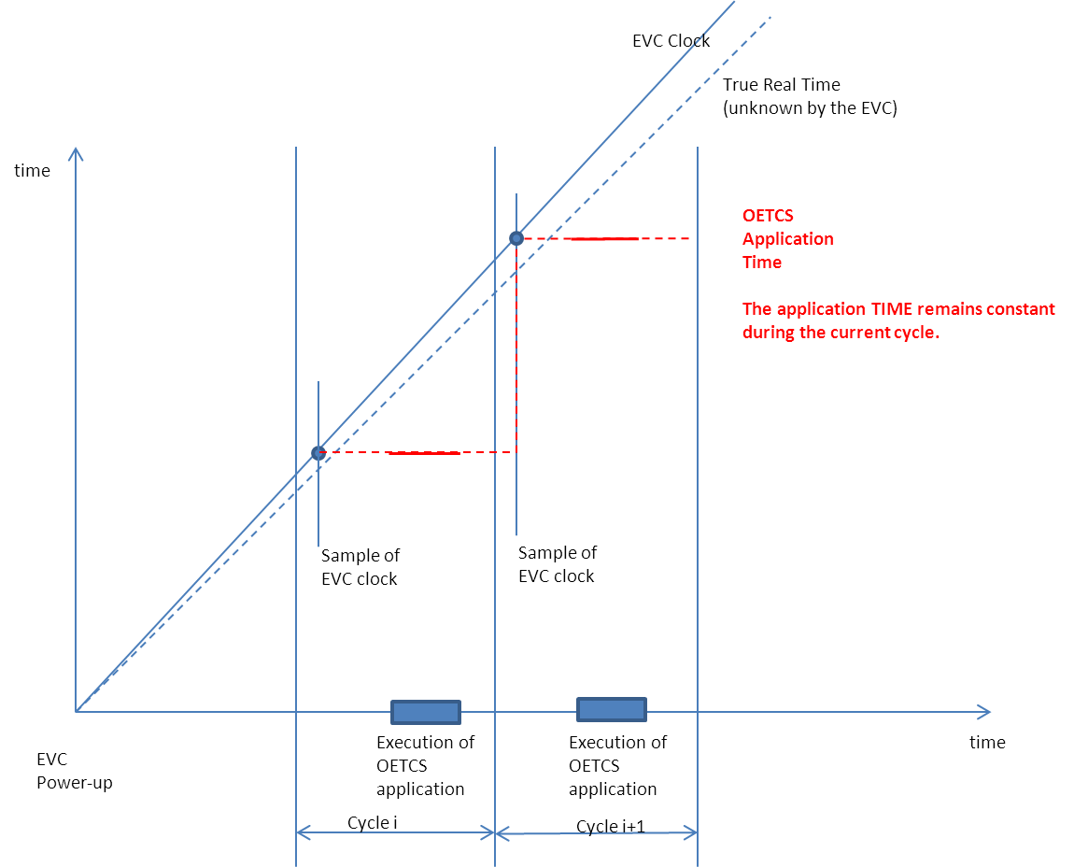
Providing TIME to the Application

Slide 16
Time, MMU & Balise : Putting all together
T_CYCLE_MIN, T_CYCLE_MAX (constant)
T_APPLICATION_MIN, T_APPLICATION_MAX (constant)
ETCS time data for application
T_Time_input_acquisition_min (constant)
T_Time_input_acquisition_max (constant)
MMU data (distance, speeed, ..) min, nom, max
MMU data Timestamp (time related to the MMU data computation)
T_MMU_input_acquisition_min (constant)
T_MMU_input_acquisition_max (constant)
Open ETCS
Application
OUTPUTS
Open ETCS
Application
Balise telegram
Balise Center Timestamp (Time when the train antenna passed the center of the balise)
Balise Center Odo_stamp (position) minimum, maximum, nominal
Max error on Balise center position detection (constant = 1m)
T_Balise_input_acquisition_min (constant)
T_Balise_input_acquisition_max (constant)
All Time values are taken in the same referential => can be compared together
All distance values are taken in the same referential => can be compared together

