Slide 1
Open-ETCS
Meeting and Report
09-10 Sept 2014
Brussel
Provisional…..

Slide 2
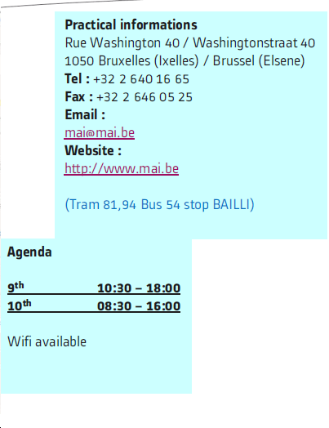
Open-ETCS

Slide 3
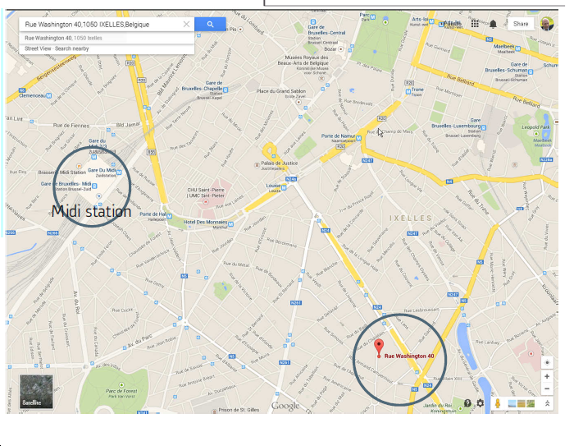
OpenETCS

Slide 4
OpenETCS
First day on 9th :
10.30 to 12.30 AM :
Train Positioning and API of MMU and BTM
Break from 12.30 AM to 1 PM.
1 to 4 PM :
Overall Structure / Internal Data Structure.
Short break from 4 to 4.15 PM.
4.15 to 6.30 PM :
Balise receiving.

Slide 5
OpenETCS
First day on 9th , details :
10.30 to 12.30 AM :
Train Positioning and API of MMU and BTM document from All4Tec:
Train Position Vx.pdf
document from Lloyds :
Train Position and Locations.odt
DetermineTrainLocationProcedures.docx
scade model from Uwe : To be found at
https://github.com/openETCS/modeling/blob/master/model/sysml/WP3-Initial-Architecture/WP3-Initial-Architecture.di
Break from 12.30 AM to 1 PM.

Slide 6
OpenETCS
First day on 9th , details :
1 to 4 PM :
Overall Structure / Internal Data Structure.
document from Lloyds :
Internal data structure[1].pdf
Comments_Datastructure.docx
Short break from 4 to 4.15 PM.
4.15 to 6.30 PM :
Balise receiving.
document from Uwe :
To be found in Gitub

Slide 7
OpenETCS
Second day on 10th:
Starting at 8.30 AM
Review of WP3 OpenETCS Database version V9,
Remarks from All4Tec
Remarks from Uwe
up to 11 AM
Feedback of On-going Actions
Feedback on New Actions
up to 12.30 AM
Break up to 1 PM
Planning of Objectives up to 4 PM

Slide 8
OpenETCS
Second day on 10th, details :
Starting at 8.30 AM
Review of WP3 OpenETCS Database version V9,
Objectives
Context
Data
Process
SysML
Excel
up to 11 AM

Slide 9
OpenETCS
Second day on 10th, details :
Starting at 11 AM
Feedback of On-going Actions
SysML diagram rework
Subset inaccuracy
Mock-up (train position & balise receiving)
Vector and Matrix in Scade
Feedback on New Actions : to be redefined
up to 12.30 AM
Break up to 1 PM
Planning of Objectives up to 4 PM

Slide 10
OpenETCS
Technical details

Slide 11
OpenETCS
Balise track layout
Linking normal track 1
Linking normal track 1
01
03
05
Linking reverse track 1
Linking normal track 2
Linking normal track 2
Linking reverse track 2
02

Slide 12
OpenETCS
Comments on track layout :
A track of double direction is equipped with beacons all oriented in same way
Beacons describing track in one direction are linked together
There is no need to link all beacons in both direction
It is always possible to invert both beacons and running direction

Slide 13
OpenETCS
The MMU provides at the beginning of each real time cycle :
Coordinate : 3 absolute counters of distance :
C_estimate : nominal estimated value, so-called “Cn”,
C_doubt-over : maximal value, so-called “Cmax”,
C_doubt-under : minimal value. so-called ”Cmin”.
Speed : vital speed so-called “Vn”,
Acceleration : not vital (?) so-callled ”Acc”,
Motion_State : vital boolean so-called “Motion”,
Motion_Direction : vital boolean so-called “Q_DIRTRAIN”,
Time_Stamp : Timer value “Tn” when evaluating MMU Data
( Cn, Vn, Tn).

Slide 14
OpenETCS
Coordinate is absolute and signed counters of distance
Signed means value is : -2exp(n-1)..0..+2exp(n-1)-1
1 is 10 cm, with n = number of bit = 32
Overflow is : 2exp(n-1) = 2147483648 = 214748364 meters
overflow impossible : 214 748 km
Time is also one signed counter over 32 bits
1 is 10 ms , with n = number of bit = 32
Overflow is : 2exp(n-1) = 2147483648 = 21474836 seconds
overflow impossible : 248 jours
Any event can (must) be “time_stamped”
Any delay between 2 events can be evaluated by difference of time stamps
Any distance between 2 events can be evaluated by difference of counters

Slide 15
OpenETCS
MMU / BTM Timing Diagram
Distance
MMU (odometry) gives Coordinate values with speed and time-stamp at beginning of each real time cycle
Cycle_n
Cn, Vn
Tn
Cycle_n+1
Cn+1, Vn+1
Tn+1
Cycle_n+2
Cn+2, Vn+2
Tn+2
Time
BTM (balise reader) gives Telegrams and time stamp when balise axle and antenna axle are alined
B-1
Tel-1
T1
C1 ?
B-2
Tel-2
T2
C2 ?
B-3
Tel-3
T3
C3 ?
B-4
Tel-4
T4
C4 ?

Slide 16
OpenETCS 24/25 june 2014
Cycle “n” : LRBG is positionned by C0,
MMU provides Cn, Vn, Tn,
BTM has provided Tel-1, T1,
Balise B1 position is : C1 = Cn – Vn * (Tn – T1),
Compute C1 with Doubt-Over and Doubt-Under.
Cycle “n+1” : LRBG is still positionned by C0,
MMU provides Cn+1, Vn+1, Tn+1,
BTM has provided Tel-2, T2,
Balise B2 position is : C2 = Cn+1 – Vn+1 * (Tn+1 – T2),
Compute C2 with Doubt-Over and Doubt-Under.
Cycle”n+2” : BG becomes LRBG
B3 and B4 position are computed (same way)
C4 becomes C0

Slide 17
EVC
Fixed Values
To Store System Data
Additional Data (changeable on-board)
To Manage DMI
Train Data
A6
A1
DMI Data
System Data
Orders / Display
National Values
Balise Content
To check and Store Balise Content
To Store Track Description in Database
A2
Packets
A4
Linking and
re-positionning
Database
Radio Message
To check and Store Radio Message
To Achieve Processes
Messages
A3
TIU Data
A5
To Manage TIU
Synchro Odo / Balise
Train Position & Speed
Command / Control
A7
To Position Train
Odometry
A8

Slide 18
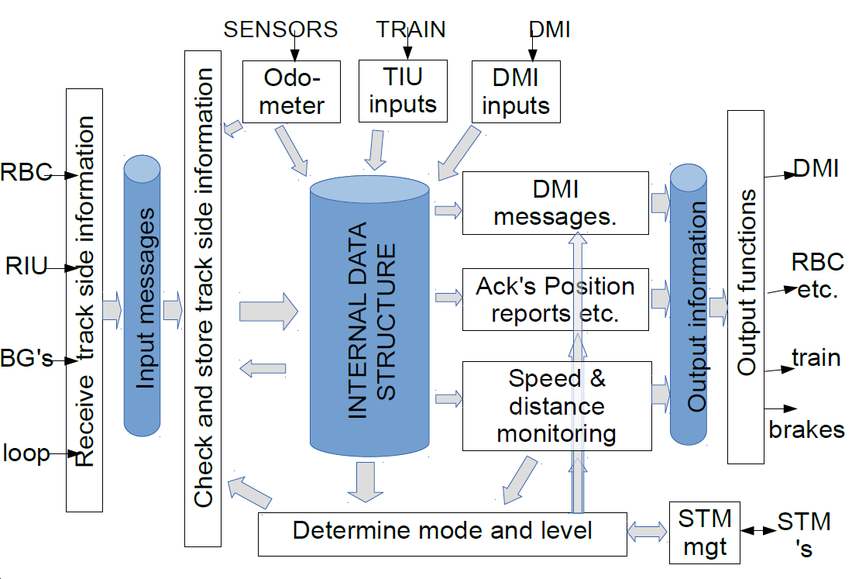
OpenETCS 24/25 june 2014
SysML IBD Diagram is a formalisation of un-formal diagram extracted from SRS analysis/
Boxes A2 and A4 need to be specified by I/O and function. Matrix structure has to be defined more. Boxe A5 is split into 2 parts.

Slide 20
To Achieve Processes A.5
Asafe
Computation
Asafe (x, v )
SRS-026 3-13-3
System Data
Classify DataBase
& MRSP Computation
MRSP (x)
SRS-026 3-13-7
Database
SRS-026 3-13-8
Orders / Display
Train Position
& Speed
Target and Curves Computation
Curves & Target
SRS-026 3-13-9 & 3-13-10
Supervision Limits Computation
Orders / Display
A5.1
SvL
& over speed
& overide
SRS-026 3-13-14-2
Protection
A5.2
Mode request
& EB request
SRS-026 3-12-4 & SRS-026 4
Mode and Level
Messages
A5.3
Mode & Level
SRS-026 3-13-14-1
Command / Control
Brake Handling
A5.4
SRS-026 3-12 & 3-15
Special & Radio
Functions
A5.5 & 6
SRS-026 3-13-17
Version Management
A5.7
Defaut

Slide 21
OpenETCS 24/25 june 2014
Asafe
Computation
Asafe (x, v )
SRS-026 3-13-3
System Data
Classify DataBase
& MRSP Computation
MRSP (x)
SRS-026 3-13-7
Database
SRS-026 3-13-8
Orders / Display
Train Position
& Speed
Target and Curves Computation
Curves & Target
SRS-026 3-13-9 & 3-13-10
Supervision Limits Computation
Orders / Display
A5.1
SvL
& over speed
& overide

Slide 22
OpenETCS 24/25 june 2014
Actions on-going :
SysML Diagram rework (3) :
Christian G & Jaime & All4tec (sep 1st)
Overal Architecture (boxes empty & evident)
Subset inaccuracy (1) :
Ian Walverts (sept 1st)
Positioning inaccuracy, Eb deceleration
Mock-up of Train Position & Balise Content (1) :
‘Uwe (1st Aug)
1st step as defined
Vector & Matrix in SCADE (4) :
Bernd (next meeting)
Use vector and matrix in Scade
Classification of element

Slide 23
OpenETCS 24/25 june 2014
Actions on-going :
SysML Diagram rework (3) :
Progress-on-going :
Boxes A2 and A4 to be refined
Subset inaccuracy (1) :
Ian Walverts (sept 1st)
Positioning inaccuracy, Eb deceleration
Mock-up of Train Position & Balise Content (1) :
‘Uwe (1st Aug) on Going
1st step as defined
Vector & Matrix in SCADE (4) :
Bernd (next meeting)
Use vector and matrix in Scade : to be examinated
Classification of element : to be examinated

Slide 24
OpenETCS 24/25 june 2014
New Actions :
To fix and close API : Alstom
To fix all positioning variables, and
To address re-positioning : All4Tec
To fix Data Architecture : Lloyds
To examine SCADE with Table : Alstom to be trained…
and Papyrus

