Slide 1

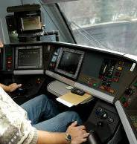
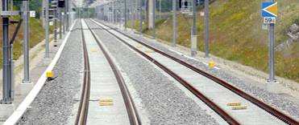
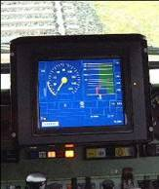
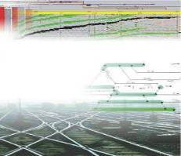




openETCS itea2 Review
WP7 – Toolchain Development
supported by:
openETCS@ITEA2 Project
Michael Jastram
Munich, June 12th, 2014

Slide 2
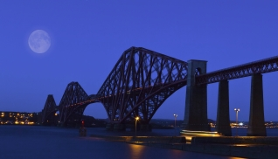
The Big Picture
WP2
Requirements
WP7
Toolchain
RM Tool
WP3
Modeling
Modeling Tools
Safety Analysis Tools
Requirements
WP4
V&V
Traceability
Integration
Qualification
V&V Tools
Feedback
Model Transformation
Tools
WP5
Demonstrator
Code Generation Tools
Image courtesy of -Marcus- / FreeDigitalPhotos.net

Slide 3

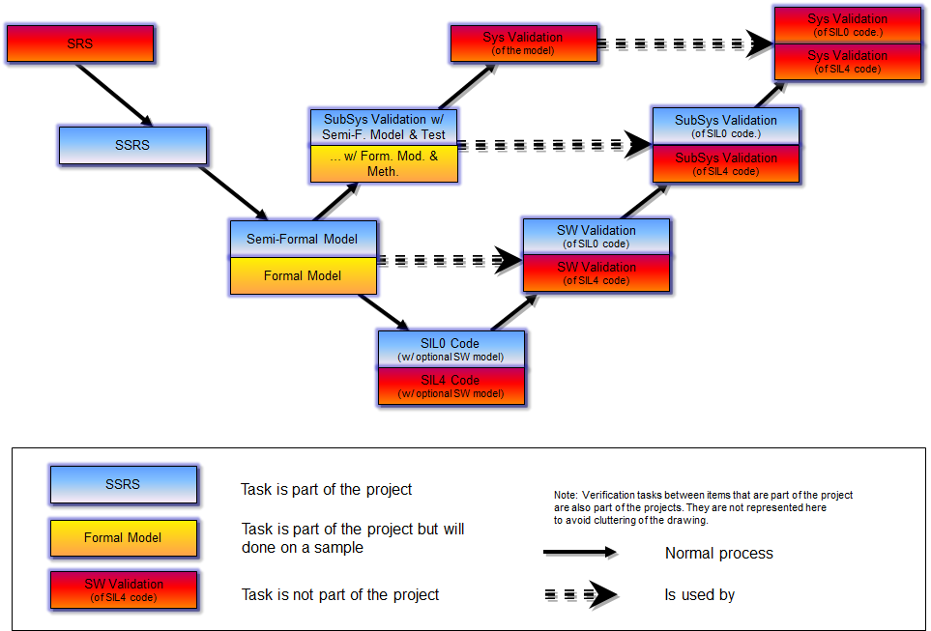
An Integrated Tool Chain
Source: https://github.com/openETCS/requirements/tree/master/D2.6-9
Image courtesy of graur codrin / FreeDigitalPhotos.net

Slide 4
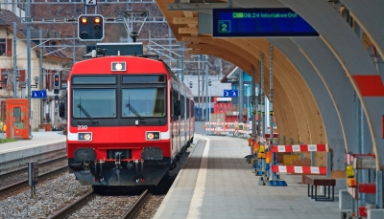
Workpackage Structure
WP7 Toolchain
Michael Jastram / Formal Mind
T7.1 Primary Toolchain
Marielle Petit-Doche / Systerel
T7.2 Secondary Toolchain
Marielle Petit-Doche / Systerel
T7.3 Toolchain Development
Cécile Braunstein / University Bremen
T7.4 Ecosystem
Jonas Helming / EclipseSource
Image courtesy of Vichaya Kiatying-Angsulee / FreeDigitalPhotos.net

Slide 5
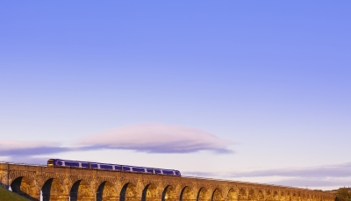
Timeline
OpenETCS
Kick-Off
First benchmark started
Decision on Primary Tooling
Second Release of tool chain
WP7: Tooling
12 benchmarks underway
Decision on Secondary Tooling
WP3: Modeling
Split of WP3
First release of tool chain
2012
2013
2014
Q3
Q4
Q1
Q2
Q3
Q4
Q1
Development Infrastructure
WP7 DoW complete
WP2 deliverables complete
Architecture
1st Scrum Sprint
First preliminary WP2 deliverables
Decomposition & Distribution of work
Image courtesy of -Marcus- / FreeDigitalPhotos.net

Slide 6
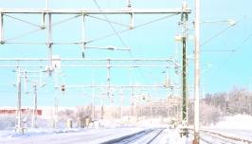
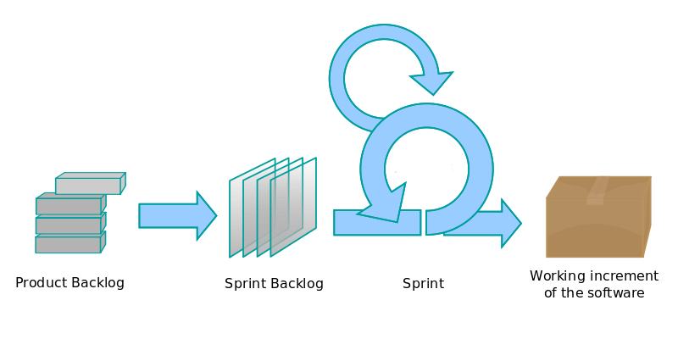
2014 – 2015: Regular releases
20
14
2015
Project
ends
Q2
Q3
Q4
Q1
Q2
Q3
Q4
Today (Toolsprint 13)
milestone releases
2 weeks
Image courtesy of Vichaya Kiatying-Angsulee / FreeDigitalPhotos.net
Source: https://en.wikipedia.org/wiki/File:Scrum_process.svg

Slide 7
Status Deliverables
D7.1: Evaluation Primary Tools: Delivered
D7.2: Evaluation Secondary Tools: Delivered
D7.4: First Toolchain Release: Delivered
D7.3: Qualification Process: Delayed
  Draft available since January 2014
  Lack of resources prompted to focus on too chain development process
  Lack of feedback from the partners
  Lack of expert on tool qualification

Slide 8
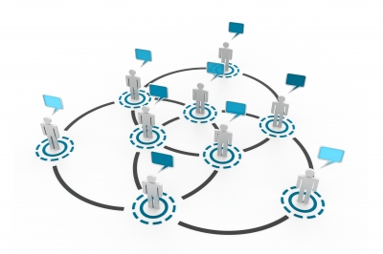
Collaborations https://github.com/openETCS/toolchain/wiki/Collaborations
Delegates maintain contact with these projects:
Polarsys (aka OPEES, aka Topcased)
shift2rail
Crystal
SAFE
SafeCap
VeTeSS
EATS FP7 project
OpenRBC
Amalthea
OpenCOSS
Image courtesy of hywards Kiatying-Angsulee / FreeDigitalPhotos.net

Slide 9
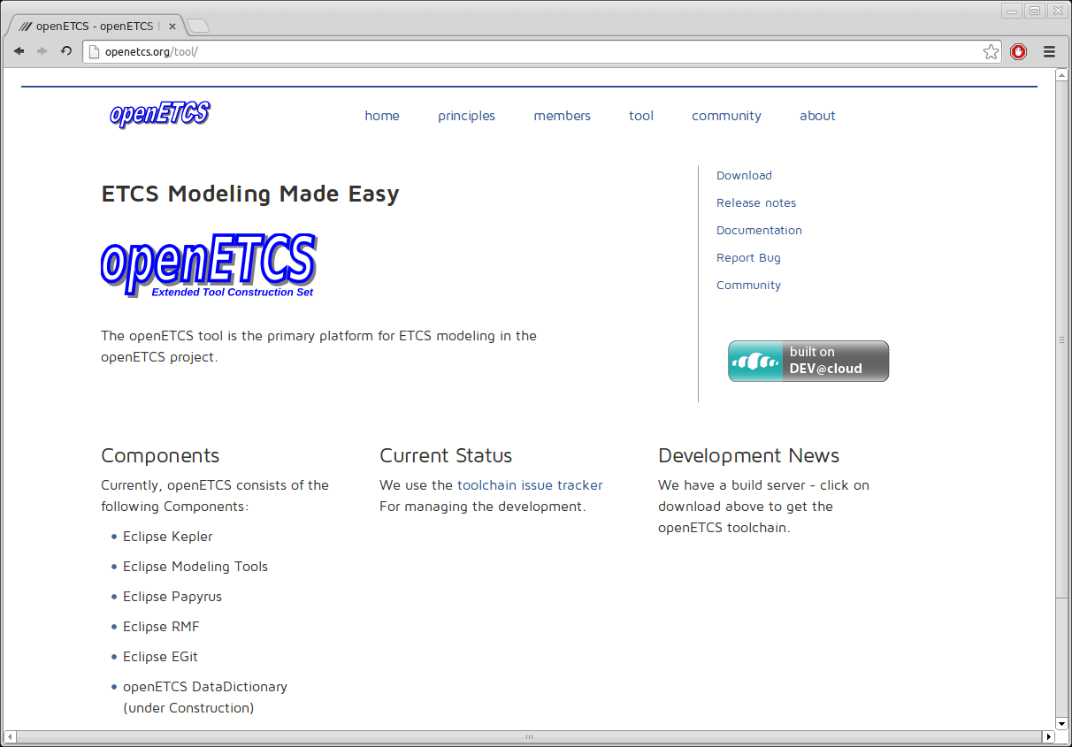

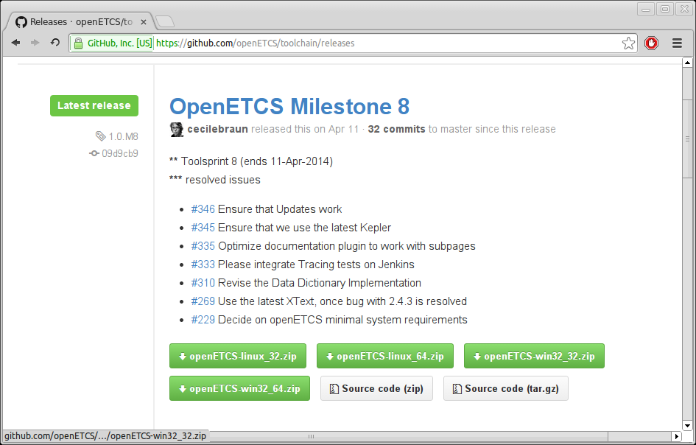
openETCS: open Extended Tool Construction Set

Slide 10
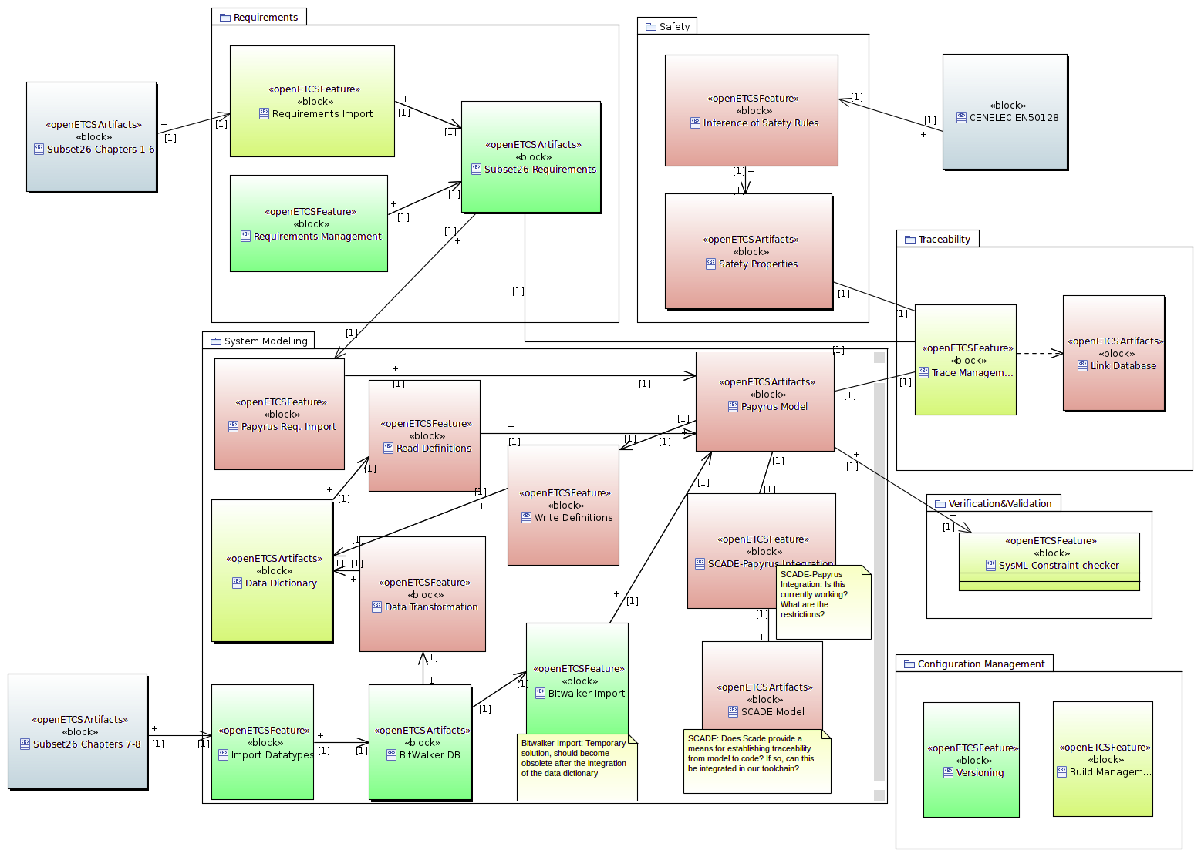
Feature Overview https://github.com/openETCS/toolchain/wiki/Feature%20Overview
Requirements
Safety
EN
50128
Subset
26, 1-6
Traceability
System Modeling
V&V
Subset
26, 7-8
Configuration
Management

Slide 11
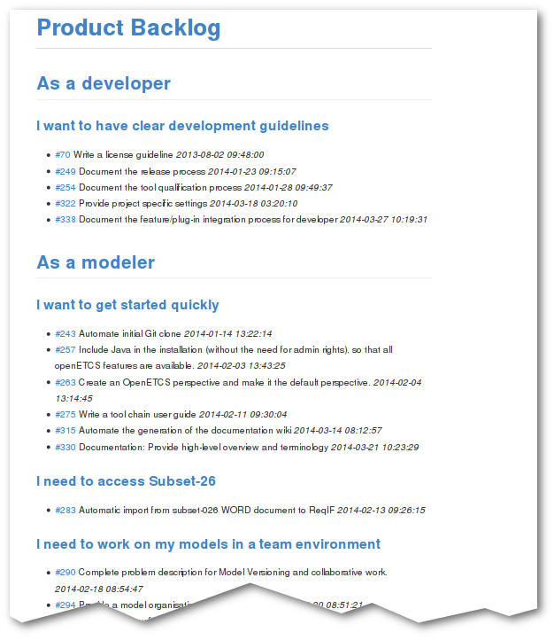
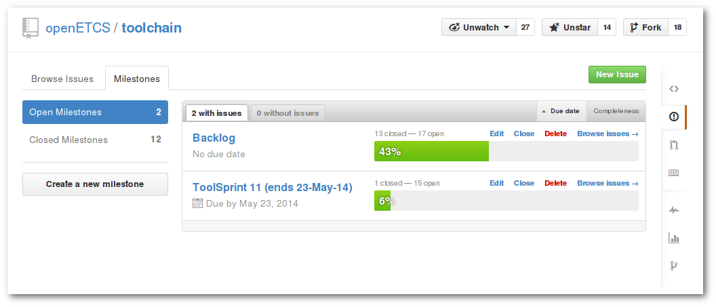
Product Backlog (uses gitHub infrastructure)

Slide 12

Demo
Image courtesy of Stuart Miles / FreeDigitalPhotos.net

Slide 13

Escalation: WP Objectives endangered
Transition from Phase 1 (Analysis) to Phase 2 (Tool Development) unveiled problems:
  Technology not as mature as expected
  Important Skills are missing
  Resources are Fragmented
Image courtesy of David Castillo Dominici / FreeDigitalPhotos.net

Slide 14
Escalation: Technology Maturity
“You get what you pay for”
Topcased/PolarSys much less mature than expected
      Papyrus is the only usable PolarSys Component
      CEA 100% fixing Papyrus issue (unspecific to openETCS)
      No mature Traceability solution available
ProR/RMF (Requirements) needs significant work
      Many “standard” functions still missing
      Performance issues
Minor issues eating up resources
      Java 7 in enterprise environment is tricky
      Providing cross-platform support
      Building and maintaining infrastructure (update sites, build server, documentation infrastructure, etc.)
Image courtesy of David Castillo Dominici / FreeDigitalPhotos.net

Slide 15
Escalation: Resource Situation
At first glance, not too bad:
60% active (incl. Papyrus)
20% research
20% overhead, exhausted and inactivity
Image courtesy of David Castillo Dominici / FreeDigitalPhotos.net

Slide 16
Escalation: Who can Develop Software?
Reason to worry:
Only 5% of Eclipse development active (excluding Papyrus)
30% of active participants learning
Image courtesy of David Castillo Dominici / FreeDigitalPhotos.net

Slide 17
Escalation: Fragmentation
Image courtesy of David Castillo Dominici / FreeDigitalPhotos.net

Slide 18
Escalation: Possible Solutions
Problem: Technology Maturity
  Use of proprietary technology
Problem: Missing Skills
  Training
  Get new partners with the right skills by picking up French funds
  Spend funds to hire experts
Problem: Fragmentation
  Aggregate resources: Few partners with many resources, not many partners with few.
  Build a core team: Find at least 3 team members (better 4) with the right skills that work full time on WP7.
Image courtesy of David Castillo Dominici / FreeDigitalPhotos.net

Slide 19
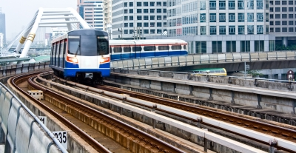
Thanks to the team
Task Leader 7.1 and 7.2
Marielle Petit-Doche / Systerel
Task Leader 7.3
Cécile Braunstein / University of Bremen
Task Leader 7.4
Jonas Helming / Eclipse Source
Thanks
to the openETCS WP7 Team
Image courtesy of sritangphoto / FreeDigitalPhotos.net

