Slide 1

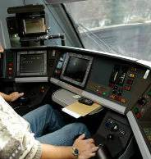
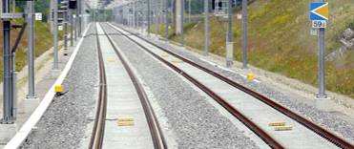
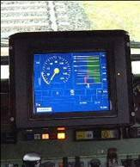
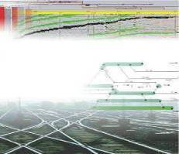




openETCS itea2 Review
WP7 – Toolchain Development
supported by:
openETCS@ITEA2 Project
Michael Jastram
Paris, July 3rd 2013

Slide 2

The Big Picture
WP7
Toolchain
RM Tool
WP3
Modeling
Modeling Tools
WP2
Requirements
Safety Analysis Tools
Requirements
WP4
V&V
Traceability
Integration
Qualification
V&V Tools
Feedback
Model Transformation
Tools
WP5
Demonstrator
Code Generation Tools
Image courtesy of -Marcus- / FreeDigitalPhotos.net

Slide 3

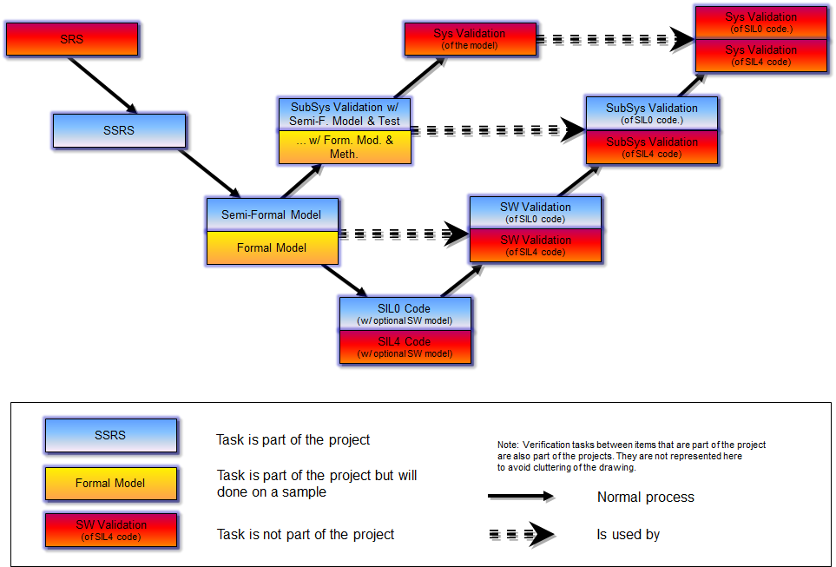
An Integrated Tool Chain
Source: https://github.com/openETCS/requirements/tree/master/D2.6-9
Image courtesy of graur codrin / FreeDigitalPhotos.net

Slide 4
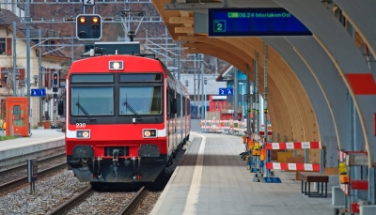
Workpackage Structure
WP7 Toolchain
Michael Jastram / Formal Mind
T7.1 Primary Toolchain
Marielle Petit-Doche / Systerel
T7.2 Secondary Toolchain
Marielle Petit-Doche / Systerel
T7.3 Toolchain Development
Jan Peleska & Cécile Braunstein
University Bremen
T7.4 Ecosystem
Jonas Helming / EclipseSource
Image courtesy of Vichaya Kiatying-Angsulee / FreeDigitalPhotos.net

Slide 5
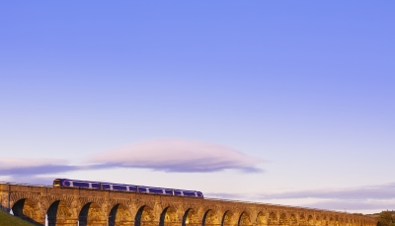
Timeline
OpenETCS
Kick-Off
First benchmark started
Today
Decision on Primary Tooling
Second Release of tool chain
WP7: Tooling
12 benchmarks underway
Decision on Secondary Tooling
WP3: Modeling
Split of WP3
First release of tool chain
2012
2013
2014
Q3
Q4
Q1
Q2
Q3
Q4
Q1
Development Infrastructure
WP7 DoW complete
WP2 deliverables complete
Architecture
1st Scrum Sprint
First preliminary WP2 deliverables
Decomposition & Distribution of work
Image courtesy of -Marcus- / FreeDigitalPhotos.net

Slide 6
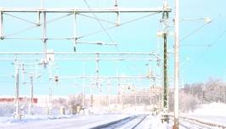
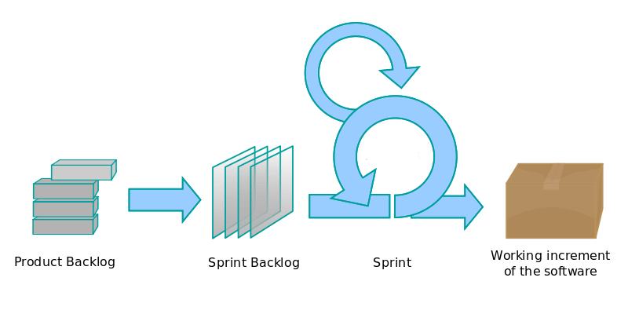
2014 – 2015: Regular releases
2014
2015
Project
ends
Q2
Q3
Q4
Q1
Q2
milestone releases
tbd (1-4)
weeks
Image courtesy of Vichaya Kiatying-Angsulee / FreeDigitalPhotos.net
Source: https://en.wikipedia.org/wiki/File:Scrum_process.svg

Slide 7
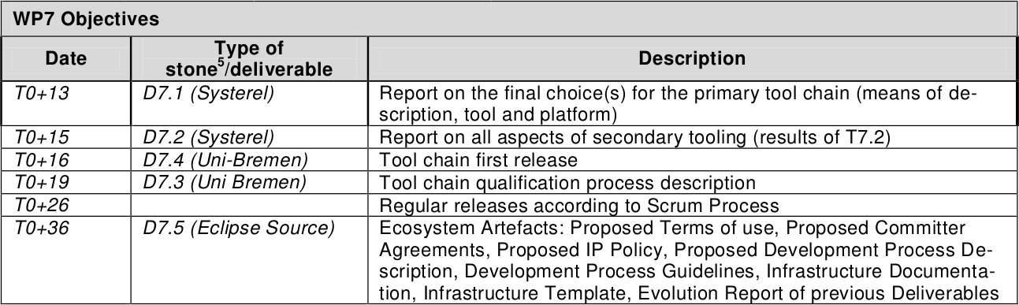

No deliverables yet, but...
Source: https://github.com/openETCS/management/blob/master/FPP/11025_openETCS_FPP_Annex_v301.pdf
Image: ddpavumba / FreeDigitalPhotos.net

Slide 8
… but concrete results (primary tools)
Formalism / Tool | Status
SCADE 6.3.1 | Done
ERTMSFormalSpecs | Done
CORE Workstation 5.1 | Stopped
Event-B / Rodin 2.7 with ProR, ProB or AnimB and toolkit of provers (AtelierB, SMT,...) | Done
ClassicalB / AtelierB 4.0.2 | Done
Why3 0.80 | Stopped
GNATprove | Done
SysML/EA, RT-Tester | Done
GOPRR (GOPPRR) meta meta model / MetaEdit+ | Done
SysML / Papyrus | Done
SystemC | Done
UPPAAL | Moved
Petri Nets / Design/CPN | Done

Slide 9
… but concrete results (secondary tools)
Formalism / Tool | Model transformation | Requirement management | Validation | Verification | Safety Analyses
AtelierB |  |  | X | X
SCADE Suite | X | X | X | X
UPPAAL |  |  | X | X
Rodin + pluggins (ProR, ProB, SMT solvers, IUML,...) | X | X | X | X | X
CPN-Tools & SPENAT |  |  | X | X | X
Goal Structuring Notation (GSN) |  | X |  |  | X
MaTeLo (Model Based Testing tool based on Markov Chains) |  | X | X
Safety Architect (System Safety Analysis tool) |  |  |  |  | X
RT-tester |  |  | X | X
Eclipse ProR |  | X
Fiacre and Tina, model-checking toolbox for Time Petri Nets |  |  |  | X
SPARK Ada

Slide 10
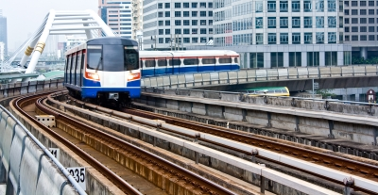
Thanks to the team
WP 7 Leadership
Michael Jastram / Formal Mind
Task Leader 7.1 and 7.2
Marielle Petit-Doche / Systerel
Task Leader 7.3
Jan Peleska & Cécile Braunstein
University of Bremen
Task Leader 7.4
Jonas Helming / Eclipse Source
Thanks
to the openETCS WP7 Team
Image courtesy of sritangphoto / FreeDigitalPhotos.net

