Slide 1
openETCS Review #3
WP7 – openETCS Toolchain
Alexander Stante (Fraunhofer)

Slide 2
WP7 Overview
Goal: Provide a toolchain to model, develop, verify and validate an ETCS System
  Support development on all layers - From system to code
  Toolchain development should reuse existing tools and results from other research project
Tasks
  T7.1 Primary Tool Chain Analyses and Recommendations
  T7.2 Secondary Tools Analyses and Recommendations
  T7.3 Define and Develop Tool Chain
  T7.4 Develop Open Source Ecosystem
openETCS@ITEA2, openETCS Open License Terms apply, 11/07/26

Slide 3
OpenETCS Toolchain
Requirements
Toolchain
Safety
System Modeling
V & V
Code Generation
Software Design
HW/SW Integration
openETCS@ITEA2, openETCS Open License Terms apply, 11/07/26

Slide 4
OpenETCS Toolchain
WP2
WP4
Requirements
Toolchain
Safety
WP3
System Modeling
V & V
Code Generation
WP5
Software Design
HW/SW Integration
openETCS@ITEA2, openETCS Open License Terms apply, 11/07/26

Slide 5
Tool Recommendation
Big Challenge: Develop toolchain AND model / validate ETCS
Major Result of Tool Analysis
  Eclipse Based Toolchain
  System Modeling with Open Source Papyrus from CEA
  Software Design with Commercial Tool SCADE from Esterel
SCADE is however closed Source
  Transition / Alternate Open Source Path in work
openETCS@ITEA2, openETCS Open License Terms apply, 11/07/26

Slide 6

Addressing Issues of 2014 ITEA Review
Transition from Phase 1 (Analysis) to Phase 2 (Tool Development) unveiled problems:
  Technology not as mature as expected
  → more development required
  Important Skills are missing
  → Easy tasks take extremely long
  Resources are Fragmented
  → high relative overhead
openETCS@ITEA2, openETCS Open License Terms apply, 11/07/26
Image courtesy of David Castillo Dominici / FreeDigitalPhotos.net

Slide 7
Maturity and Skills
Addressing Maturity
  Embracing proprietary technologies.
  WP3 explored various modeling approaches (both open and closed)
  WP7 embraced these activities and identified measures to support WP3 as effectively as possible.
Addressing Skills
  Weekly training session
  Covering topics like SysML, Papyrus, git, etc.
  Limited success due to lack of trainers
openETCS@ITEA2, openETCS Open License Terms apply, 11/07/26
Image courtesy of David Castillo Dominici / FreeDigitalPhotos.net

Slide 8
Team Aggregation
Core Team established:
  CEA (Matthieu Perin): Papyrus/Luna
  SQS (Izaskun de la Torre): documentation, quality and testing
  Bremen (Cécile Braunstein): Task leadership and Qualification
  Formal Mind (Michael Jastram): WP leadership, RMF
  LAAS (Lukasz Fronc): EMF-based data dictionary components
  Fraunhofer (Alexander Stante): Scade Integration, SysML Constraints
There were partners that contributed occasionally, but were not part of the core team for justifiable reasons
openETCS@ITEA2, openETCS Open License Terms apply, 11/07/26
Image courtesy of David Castillo Dominici / FreeDigitalPhotos.net

Slide 9
2015 Plan
All Deliverables have been produced
Remaining activities will include:
  Toolchain
    Conclude migration to Luna
    Ensure a usability of tool
    Ongoing work on requirements, traceability data dictionary
  Open Proofs
    Provide a roadmap to a truly open proof approach to ETCS modeling (to be funded by future projects)
openETCS@ITEA2, openETCS Open License Terms apply, 11/07/26
Image courtesy of David Castillo Dominici / FreeDigitalPhotos.net

Slide 10
Outlook
Toolchain is feature freezed
Finalize Plugins
  Bug fixes
  Usability improvements
  Documentation improvements
  Adding of tests
Finalize transition to Luna
Integrate all artefacts into toolchain
openETCS@ITEA2, openETCS Open License Terms apply, 11/07/26

Slide 11
Achievements
Integrated Artefacts
Papyrus
SysML to B Translator
SysML to SCADE
SysML Constraints Checks
ProR Integration
SRS2ReqIF
Documentation Plugin
External Artefacts
RT Tester Integration
SysML to Timed Petri Nets
Eclipse Safety Framework Integration
Documents
D7.3 Qualification Process
Test Plan
Documentation
openETCS@ITEA2, openETCS Open License Terms apply, 11/07/26

Slide 12
Toolchain Development
Statistics
  ~ 1000 Commits
  9 Branches
  25 Contributors
  12 Releases
Automatic Build System
Multi Platform Releases
  Linux 32 and 64 bit
  MacOS X 32 and 64 bit
  Win 32 and 64 bit
Collaboration on Github
  355 Issues closed, 65 open
Training
  Videos on Youtube
Scrum Development
  User Stories
  Sprints
openETCS@ITEA2, openETCS Open License Terms apply, 11/07/26

Slide 13
Demo
Tool Chain Demo
openETCS@ITEA2, openETCS Open License Terms apply, 11/07/26

Slide 14
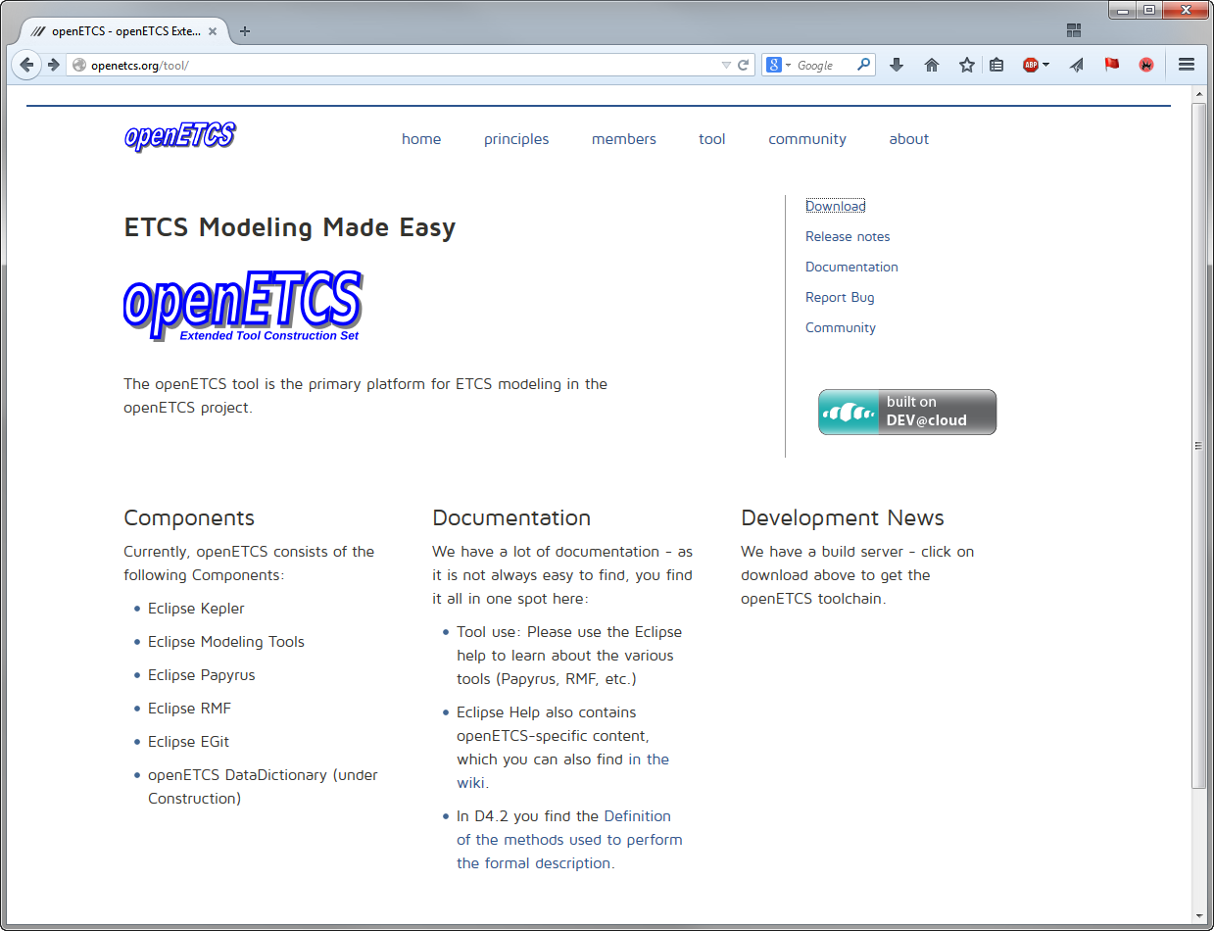
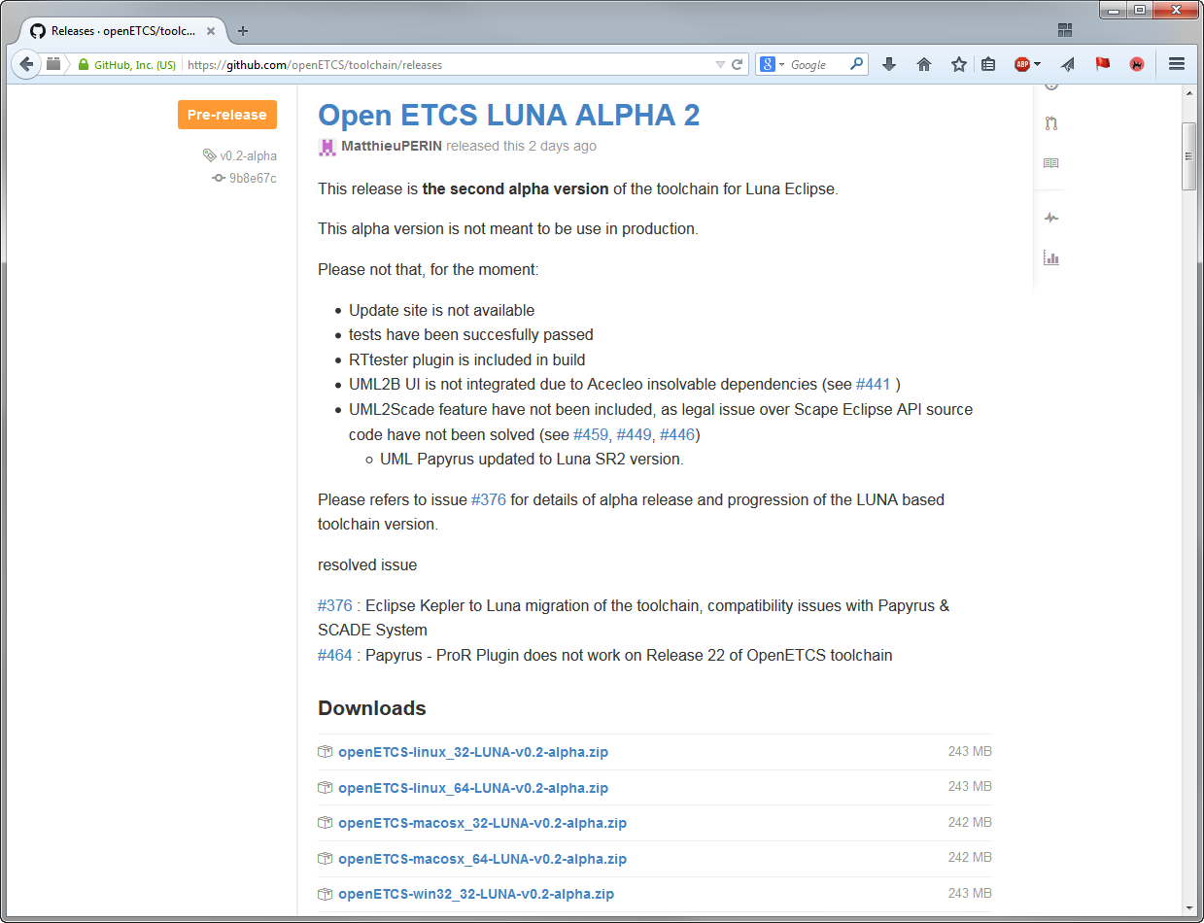
Toolchain Availability
openETCS@ITEA2, openETCS Open License Terms apply, 11/07/26

Slide 15
Thank you for your attention!
openETCS@ITEA2, openETCS Open License Terms apply, 11/07/26

Slide 16
Backup
openETCS@ITEA2, openETCS Open License Terms apply, 11/07/26

Slide 17
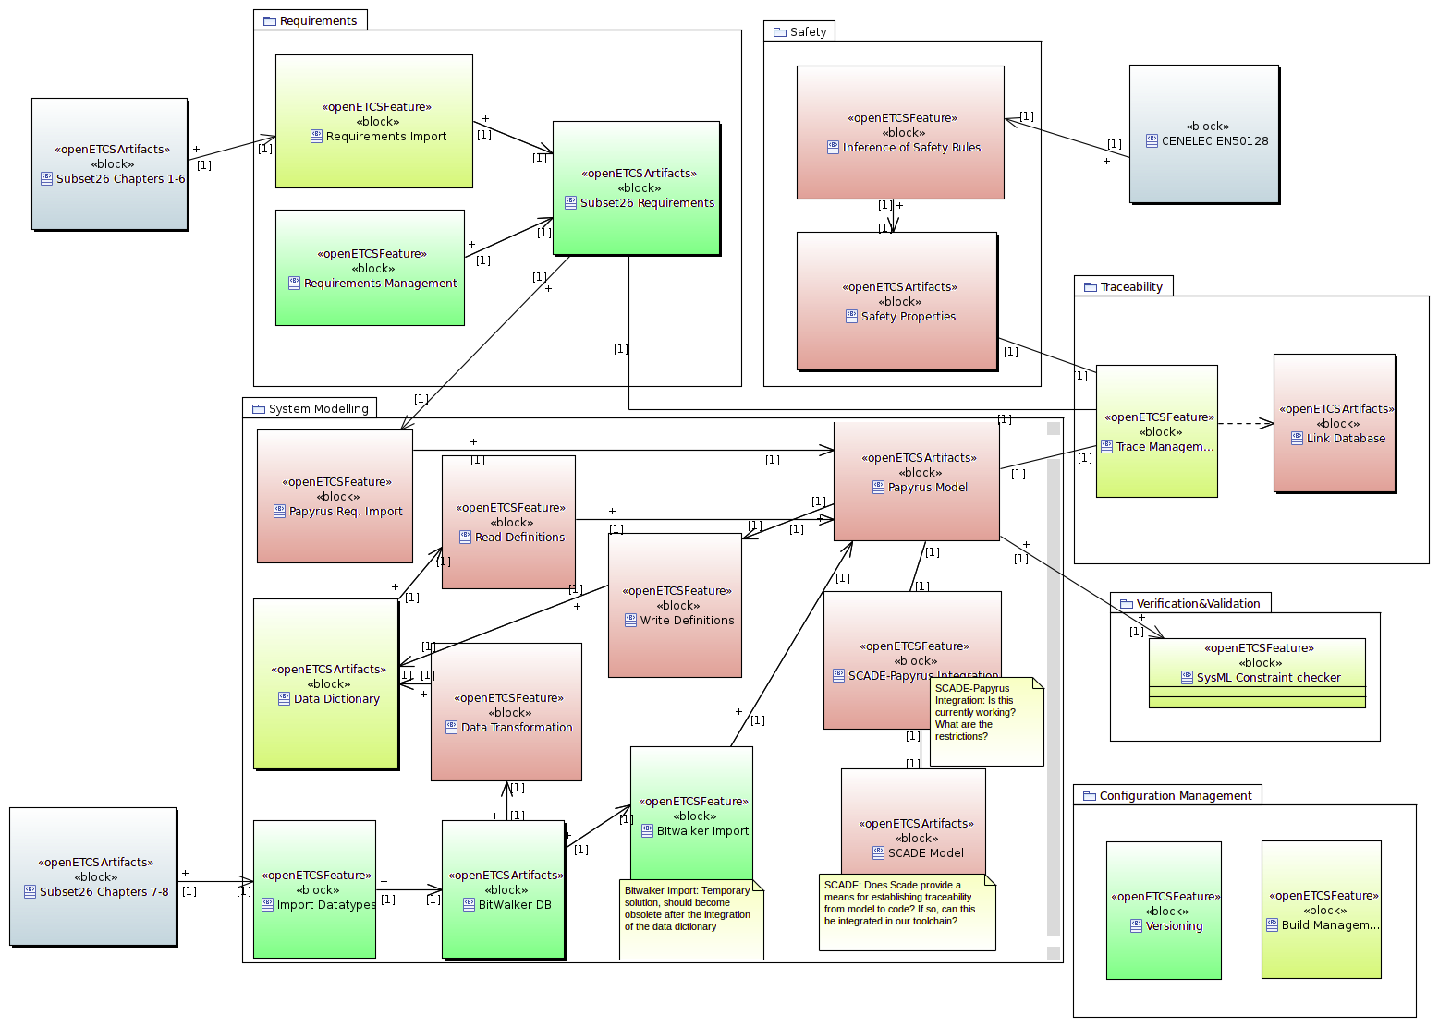
Feature Overview https://github.com/openETCS/toolchain/wiki/Feature%20Overview

Slide 18
Feature Overview https://github.com/openETCS/toolchain/wiki/Feature%20Overview
Requirements
Safety
EN
50128
Subset
26, 1-6
Traceability
System Modeling
V&V
Subset
26, 7-8
Configuration
Management

