Slide 1

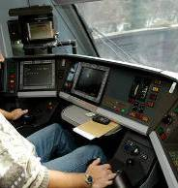
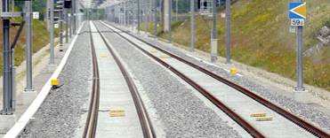
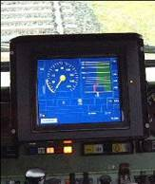
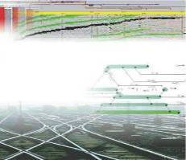




openETCS ITEA final Review
WP7 – Toolchain Development
supported by:
openETCS@ITEA2 Project
Michael Jastram
Munich, December 12th, 2015

Slide 2

The Big Picture
WP2
Requirements
WP7
Toolchain
RM Tool
WP3
Modeling
Modeling Tools
Safety Analysis Tools
Requirements
WP4
V&V
Traceability
Integration
Qualification
V&V Tools
Feedback
Model Transformation
Tools
WP5
Demonstrator
Code Generation Tools
Image courtesy of -Marcus- / FreeDigitalPhotos.net
- <number> -

Slide 3
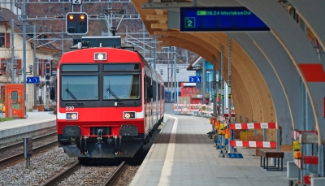
Workpackage Structure
WP7 Toolchain
Michael Jastram / Formal Mind
T7.1 Primary Toolchain
Marielle Petit-Doche / Systerel
T7.2 Secondary Toolchain
Marielle Petit-Doche / Systerel
T7.3 Toolchain Development
Michael Jastram / Formal Mind
Cécile Braunstein / University Bremen
T7.4 Ecosystem
Michael Jastram / Formal Mind
Jonas Helming / EclipseSource
- <number> -
Image courtesy of Vichaya Kiatying-Angsulee / FreeDigitalPhotos.net

Slide 4
Timeline
Split of WP3
WP7 DoW complete
12 benchmarks underway
Decision on Tooling
First release of tool chain
Data Dictionary Plugin
RT Tester Integration
2012
2013
2014
Q3
Q4
Q1
Q2
Q3
Q4
Q1
2014
2015
Project
ends
Q2
Q3
Q4
Q1
Q2
Q3
Q4
- <number> -

Slide 5
Timeline
Split of WP3
WP7 DoW complete
12 benchmarks underway
Decision on Tooling
First release of tool chain
Data Dictionary Plugin
RT Tester Integration
2012
2013
2014
Q3
Q4
Q1
Q2
Q3
Q4
Q1
2014
2015
Project
ends
Q2
Q3
Q4
Q1
Q2
Q3
Q4
Tool Development, Qualification, Documentation, Quality & Test Plans, CI, etc.
Migration to Eclipse Luna
Escalation Resource Bottlenecks
Resolved
- <number> -

Slide 6
Timeline
Split of WP3
WP7 DoW complete
12 benchmarks underway
Decision on Tooling
First release of tool chain
Data Dictionary Plugin
RT Tester Integration
2012
2013
2014
Q3
Q4
Q1
Q2
Q3
Q4
Q1
2014
2015
Project
ends
Q2
Q3
Q4
Q1
Q2
Q3
Q4
Tool Qualification, Documentation, Quality & Test Plans, CI, etc.
Migration to Eclipse Luna
Escalation Resource Bottlenecks
Resolved
Scade Integra-tion Prototype
SysML-to-B translator
Word-to-ReqIF Converter
Scade-to-Open Roadmap
Traceability Plugin
Eclipse Safety Framework Integration
Scade Suite Main Modeling
Traceability Architecture
- <number> -
Image courtesy of -Marcus- / FreeDigitalPhotos.net

Slide 7

Status Deliverables
D7.1: Evaluation Primary Tools: Delivered
D7.2: Evaluation Secondary Tools: Delivered
D7.3: Qualification Process: Delivered
D7.4: First Toolchain Release: Delivered
D7.5: Ecosystem Artefacts: Delivered

Slide 8
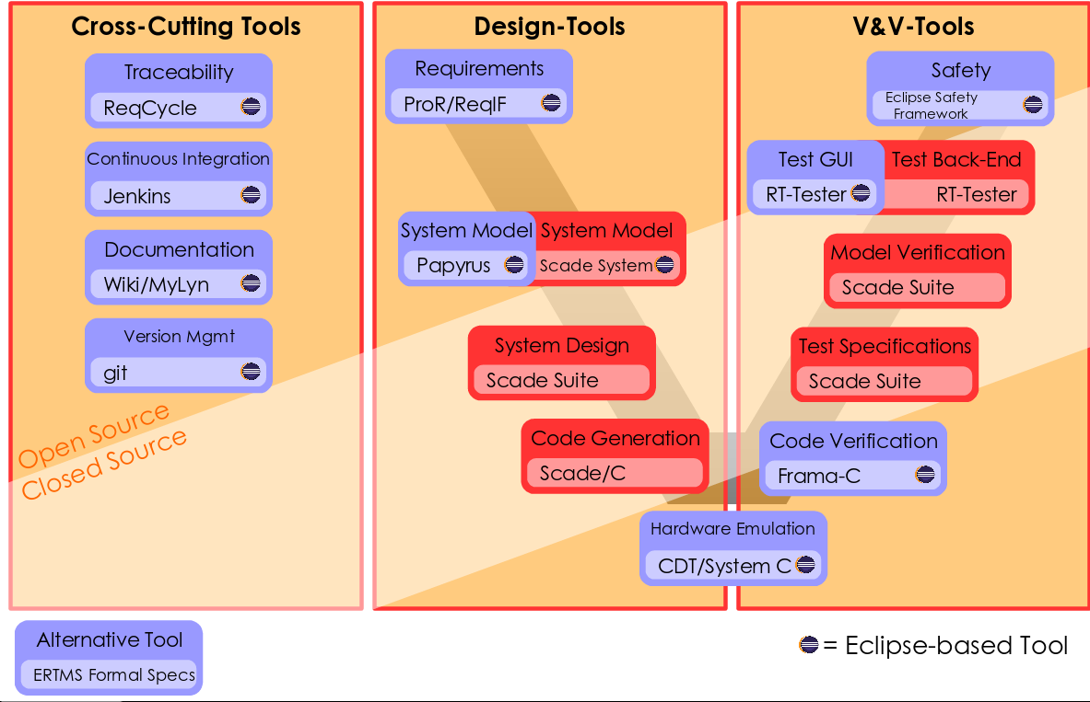
Final Toolchain

Slide 9

Achievements
Production Quality
openETCS Tool (D7.3)
openETCS Tool Build Infrastructure
Tool Documentation Plugin
ERTMSFormalSpecs
Subset-openETCS-Translation
CI for Modeling
Eclipse Safety Framework Integration
RT-Tester Integration
Bitwalker Data Dictionary
Prototypes
SysML Constraints Checks
SysML-to-Scade
SysML-to-B
SysML-to-C/Frama-C
SysML-to-System-C
ReqCycle Integration
Documents/Studies
Tooling Analysis (D7.1, D7.2)
openETCS User Handbook
Traceability Architecture Roadmap
Migration Roadmap Scade2Open
Test-Plan
Qualification-Plan

Slide 10

Demo
- <number> -
Image courtesy of Stuart Miles / FreeDigitalPhotos.net

Slide 11

Safety Architect
/home/jastram/git/toolchain/itea_Reviews/2015/OETCS-TestVideo.mp4

Slide 12
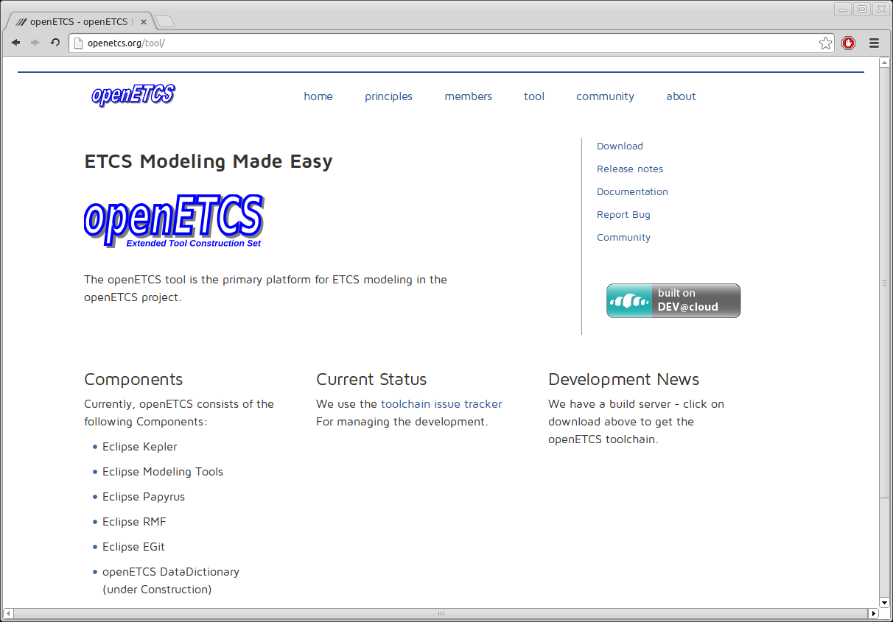

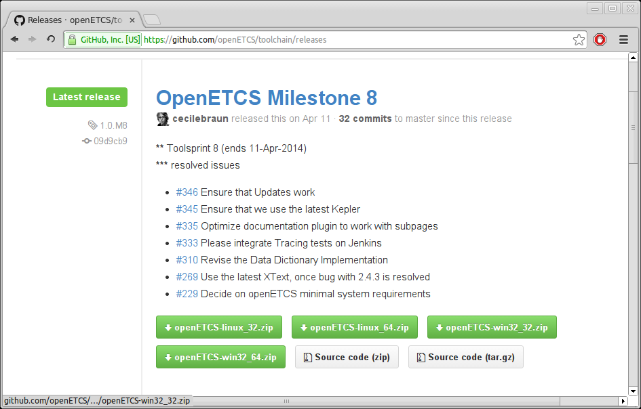
openETCS: open Extended Tool Construction Set

Slide 13

Outlook
Lessons Learned (WP7)
  Starting project without tool choice created challenges
  Required development effort greatly underestimated
Goals for future research project
  Provide Scade alternative
  Encourage tool use
  Improve on ease of use, scalability
  and integration

Slide 14
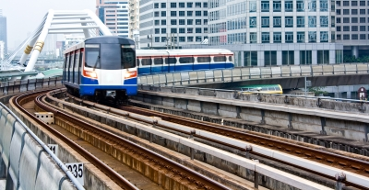

Thank you for your attention
Image courtesy of sritangphoto / FreeDigitalPhotos.net
- <number> -

