Slide 1
Latent Semantic Analysis and Beyond
Mingmin Chi
School of Computer Science
Fudan University

Slide 2
The Problem
Information Retrieval in the 1980s
Given a collection of documents: retrieve documents that are relevant to a given query
Match terms in documents to terms in query
Vector space method

Slide 3

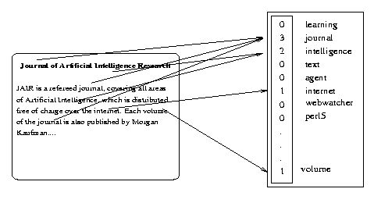
Salton’s Vector Space Model
Represent each document by a high-dimensional vector in the space of words
Gerald Salton
’60 – ‘70

Slide 4
The Problem
The vector space method
  term (rows) by document (columns) matrix, based on occurrence
  translate into vectors in a vector space
    one vector for each document
  cosine to measure distance between vectors (documents)
    small angle = large cosine = similar
    large angle = small cosine = dissimilar

Slide 5
The Problem
A quick diversion
Standard measures in IR
  Precision: portion of selected items that the system got right
  Recall: portion of the target items that the system selected

Slide 6
The Problem
Two problems that arose using the vector space model:
  synonymy: many ways to refer to the same object, e.g. car and automobile
    leads to poor recall
  polysemy: most words have more than one distinct meaning, e.g.model, python, chip
    leads to poor precision
  → The problem is more general: there is a disconnect between topics and words

Slide 7
The Problem
Example: Vector Space Model
  (from Lillian Lee)
auto
engine
bonnet
tyres
lorry
boot
car
emissions
hood
make
model
trunk
make
hidden
Markov
model
emissions
normalize
Synonymy
Will have small cosine
but are related
Polysemy
Will have large cosine
but not truly related

Slide 8
The Problem
Latent Semantic Indexing was proposed to address these two problems with the vector space model for Information Retrieval

Slide 9
Some History
Latent Semantic Indexing was developed at Bellcore (now Telcordia) in the late 1980s (1988). It was patented in 1989.
http://lsi.argreenhouse.com/lsi/LSI.html

Slide 10
Some History
The first papers about LSI:
  Dumais, S. T., Furnas, G. W., Landauer, T. K. and Deerwester, S. (1988), "Using latent semantic analysis to improve information retrieval." In Proceedings of CHI'88: Conference on Human Factors in Computing, New York: ACM, 281-285.
  Deerwester, S., Dumais, S. T., Landauer, T. K., Furnas, G. W. and Harshman, R.A. (1990) "Indexing by latent semantic analysis." Journal of the Society for Information Science, 41(6), 391-407.
  Foltz, P. W. (1990) "Using Latent Semantic Indexing for Information Filtering". In R. B. Allen (Ed.) Proceedings of the Conference on Office Information Systems, Cambridge, MA, 40-47.

Slide 11
LSA
But first:
What is the difference between LSI and LSA???
  LSI refers to using it for indexing or information retrieval.
  LSA refers to everything else.

Slide 12
LSA
Idea (Deerwester et al):
“We would like a representation in which a set of terms, which by itself is incomplete and unreliable evidence of the relevance of a given document, is replaced by some other set of entities which are more reliable indicants. We take advantage of the implicit higher-order (or latent) structure in the association of terms and documents to reveal such relationships.”

Slide 13
LSA
Implementation: four basic steps
  term by document matrix (more generally term by context) tend to be sparse
  convert matrix entries to weights, typically:
    L_{ij} * G_{i} : local and global
  Rank-reduced Singular Value Decomposition (SVD) performed on matrix
    all but the k highest singular values are set to 0
    produces k-dimensional approximation of the original matrix (in least-squares sense)
    this is the “semantic space”
  Compute similarities between entities in semantic space (usually with cosine)

Slide 14


Slide 15
Definition
If a matrix A is not symmetric, not squared, how to diagonalize it?
  Selection of two orthonormal bases, U and V
A = USV^{T}
AV = USV^{T}V = US, U^{T}AV = S
U and V are orthogonal matrices
Left matrix: A A^{T} =USV^{T} (USV^{T} ) ^{T=}USS^{T}U^{T}
Right matrix: A^{T} A= (USV^{T} ) ^{T}USV^{T=}VS^{T}SV^{T}

Slide 16
A
U
S
V^{T}
=

Slide 17
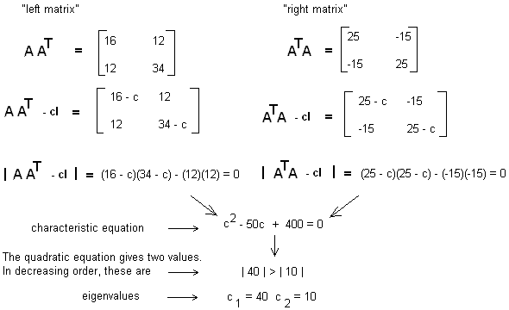
Characteristic equation and eigenvalues for AA^{T} and A^{T}A

Slide 18
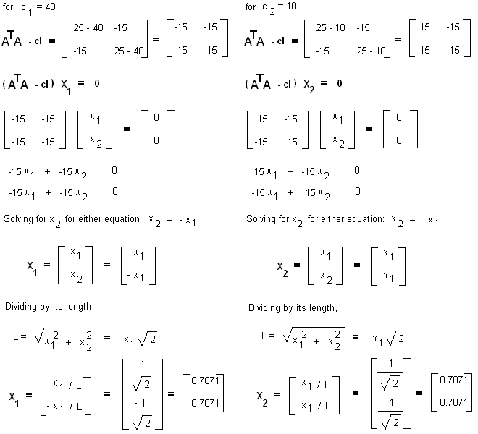
Right eigenvectors of A^{T}A

Slide 19
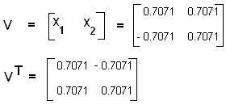
V and its transpose V^{T}

Slide 20
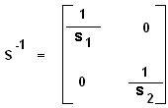
AVS⁻¹ = USS⁻¹
U = AVS⁻¹
Inverted Singular Matrix

Slide 21
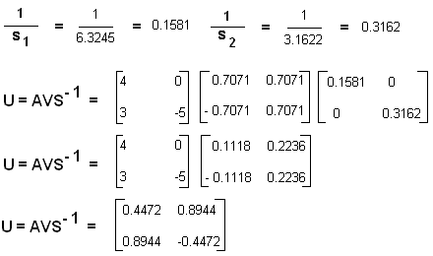
"Left" eigenvectors and U

Slide 22
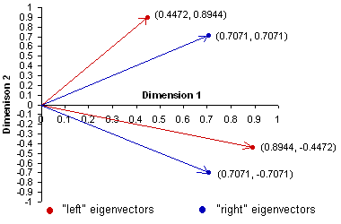
"Right" and "Left" Eigenvectors

Slide 23
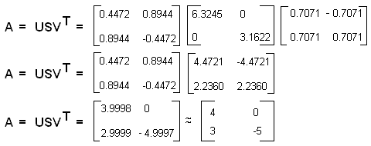
Computing the full SVD

Slide 24
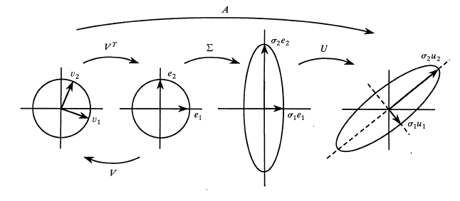
Geometric Interpretation
U and V are rotations and reflections, and S is a stretching matrix

Slide 25
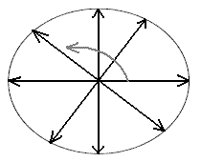
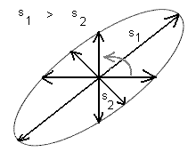
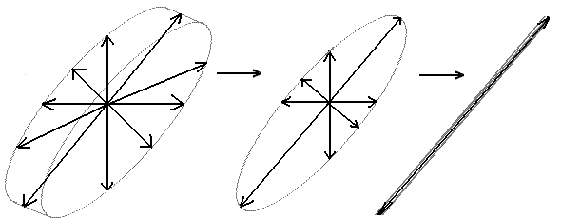
A rotating arrow of fixed length describing a circle
A rotating arrow of variable length describing an ellipsoid
Dimensionality Reduction

Slide 26
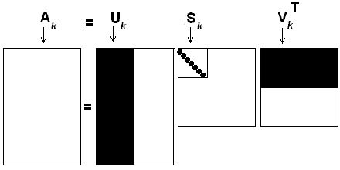
The Reduced SVD or Rank k Approximation
A_{k} = U_{k}S_{k}V^{T}_{k}

Slide 27
m = n and all singular values are greater than zero, the pseudoinverse of A is given by A⁻¹ = VS⁻¹U^{T}.
m < n, S is m x n with last column elements being all zero. The SVD then gives a solution with minimum norm.
m > n, S is n x n, there are more equations than unknowns, and the SVD solution is least square.

Slide 28


Slide 29
documents
topics
A
U
topics
documents
terms
S
V^{T}
terms
=
topics
topics

Slide 30
The Term Count Model
the weight of term i in document j is defined as a local weight (L_{ij}):
  w_{ij} = L_{ij} = tf_{ij}
  where tf_{ij} is term frequency or number of times term i occurs in document j
  Drawback

Slide 31
The Modified Model
w_{ij} = L_{ij}G_{i}N_{j}
where
  L_{i, j} is the local weight for term i in document j.
  G_{i} is the global weight for term i across all documents in the collection.
  N_{j} is the normalization factor for document j.

Slide 32
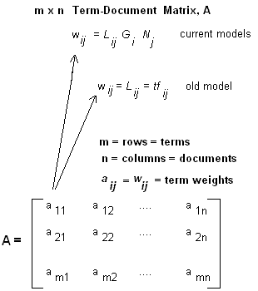
How we define term weights affects Term Vector and LSI implementations.

Slide 33
Constructing the LSI Term-Document Matrix
Collections
  d1: Shipment of gold damaged in a fire.
  d2: Delivery of silver arrived in a silver truck.
  d3: Shipment of gold arrived in a truck.
the query is gold silver truck
document indexing approach:
  (a) stopwords are not ignored,
  (b) text is tokenized and lowercased,
  (c) no stemming is used and
  (d) unique terms are sorted alphabetically

Slide 34
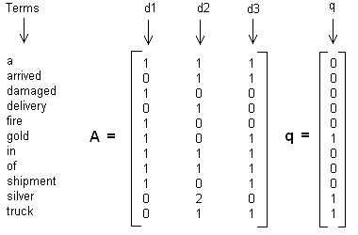

Slide 35
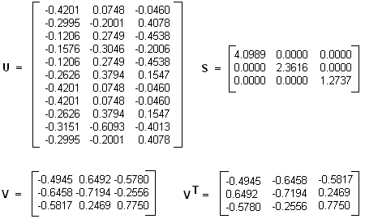
Computing U, S, V and V^{T}

Slide 36
the rows of V holds document vector coordinates
  to compare any two documents and compute cosine similaries.
  document clustering, classification, document duplicates detection
the rows of U holds term vector coordinates
  to compare any two terms and compute cosine similarities.
  term clustering, automatic construction of a thesaurus, finding similar terms, keyword research studies

Slide 37
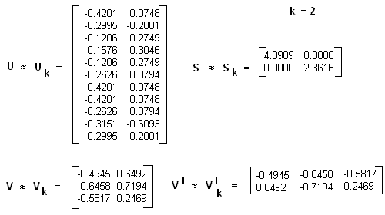
Rank 2 Approximation

Slide 38
Incorporating the Query and Ranking the Documents
A^{T} = (USV^{T})^{T} = VSU^{T}
A^{T}US⁻¹ = VSU^{T}US^{-1,} V = A^{T}US⁻¹
For a given document vector d: d^{T}US⁻¹
Since in LSI a query is treated just as another document, q = q^{T}US⁻¹
in the reduced k-dimensional space:
  d = d^{T}U_{k}S_{k}⁻¹, q = q^{T}U_{k}S_{k}⁻¹
Query-document cosine similarity:
  sim(q, d) = sim(q^{T}U_{k}S_{k}⁻¹, d^{T}U_{k}S_{k}⁻¹)

Slide 39
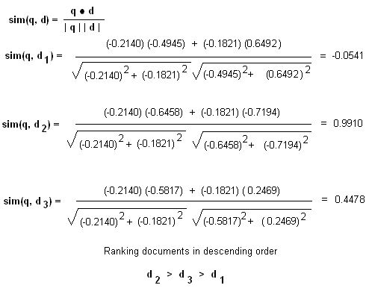
Scoring and ranking documents in LSI

Slide 40
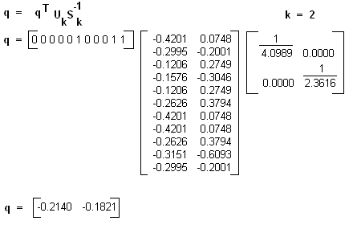
Computing the query vector

Slide 41
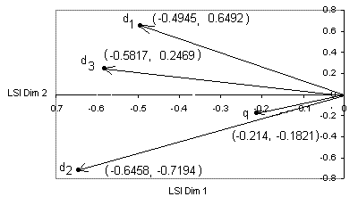
LSI query-document vectors

Slide 42
LSI in Few Easy Steps
compute weights using a specific term weight scoring system.
construct the term-document matrix A.
decompose A, compute and truncate all required matrices.
find new coordinates of query and document vectors in the reduced k-dimensional space.
sort documents in decreasing order of cosine similarity values.

Slide 43
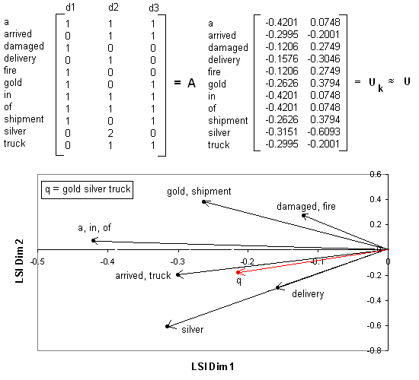
Semantic Space

Slide 44
The first-order co-occurrence
  Damage and fire, co-occur once in d1, but not in d2 and d3
  Arrived and truck, co-occur once in d2 and d3, but not in d1.
  Stopwords a, in, of co-occur once in d1, d2 and d3
The second order co-occurrence
  two terms not co-occurring while co-occurring with a third term is also clear
  E.g., gold and silver do not co-occur in any of the three documents. However, they co-occur with truck (terms happen to maintain a synonymity or relatedness association):
    in d3, gold and truck co-occur, but silver doesn't.
    in d2, silver and truck co-occur, but gold doesn't.

Slide 45
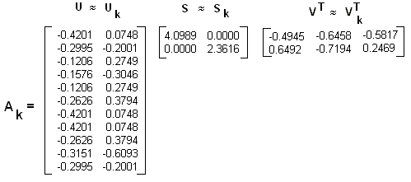
Truncated Matrix for the Rank 2 Approximation

Slide 46
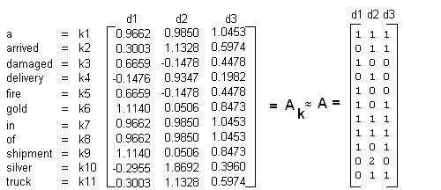
The word silver did not appear in d3, but because d3 did contain arrived and truck and these co-occur with silver its new weight is 0.3960
The value ”1” for arrived and truck, which appeared once in d3, has been replaced by 0.5974, reflecting the fact that these terms co-occur with a word not present in d3
d2: Delivery of silver arrived in a silver truck.
d3: Shipment of gold arrived in a truck.

Slide 47
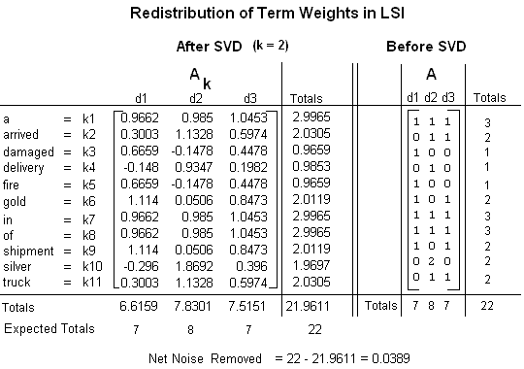

Slide 48
Summary
Some Issues
  SVD Algorithm complexity O(n^2k^3)
    n = number of terms
    k = number of dimensions in semantic space (typically small ~50 to 350)
    for stable document collection, only have to run once
    dynamic document collections: might need to rerun SVD, but can also “fold in” new documents

Slide 49
Summary
Some issues
  Finding optimal dimension for semantic space
    precision-recall improve as dimension is increased until hits optimal, then slowly decreases until it hits standard vector model
    run SVD once with big dimension, say k = 1000
      then can test dimensions <= k
    in many tasks 150-350 works well, still room for research

Slide 50
Summary
Some issues
  SVD assumes normally distributed data
    term occurrence is not normally distributed
    matrix entries are weights, not counts, which may be normally distributed even when counts are not

Slide 51
Summary
Has proved to be a valuable tool in many areas of NLP as well as IR
  summarization
  cross-language IR
  topics segmentation
  text classification
  question answering
  more

Slide 52
Summary
extensions include
  Probabilistic LSA (Hofmann)
  Latent Dirichlet Allocation (Blei)

