Slide 1
Naïve Bayes Classifiers
Mingmin Chi
School of Computer Science
Fudan University

Slide 2
A simple Bayes Net
J
C
Z
R
J | Person is a Junior
C | Brought Coat to Classroom
Z | Live in zipcode 15213
R | Saw “Return of the King” more than once

Slide 3
A simple Bayes Net
J
What parameters are stored in the CPTs of this Bayes Net?
C
Z
R
J | Person is a Junior
C | Brought Coat to Classroom
Z | Live in zipcode 15213
R | Saw “Return of the King” more than once

Slide 4
A simple Bayes Net
P(J) =
J
J | Person is a Junior
C | Brought Coat to Classroom
Z | Live in zipcode 15213
R | Saw “Return of the King” more than once
C
Z
R
P(Z|J) =
P(Z|~J)=
P(R|J) =
P(R|~J)=
P(C|J) =
P(C|~J)=
Suppose we have a database from 20 people who attended a lecture. How could we use that to estimate the values in this CPT?
Notes:
CPT: conditional probability table

Slide 5
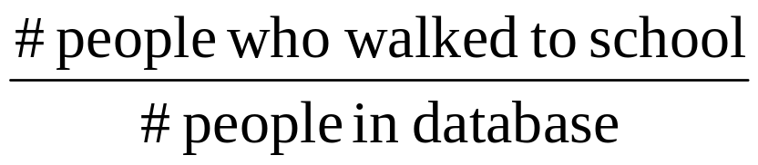
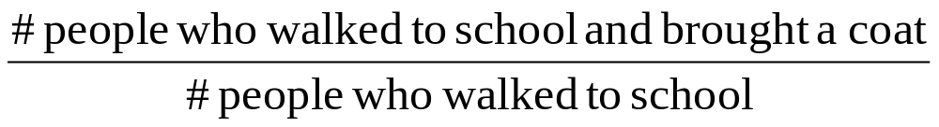
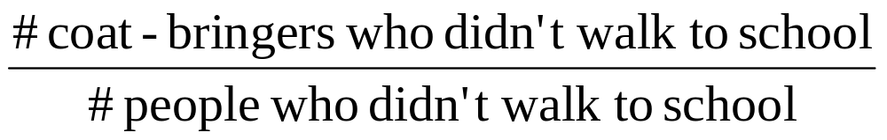
A simple Bayes Net
P(J) =
J
J | Person is a Junior
C | Brought Coat to Classroom
Z | Live in zipcode 15213
R | Saw “Return of the King” more than once
C
F
R
P(Z|J) =
P(Z|~J)=
P(R|J) =
P(R|~J)=
P(C|J) =
P(C|~J)=
Suppose we have a database from 20 people who attended a lecture. How could we use that to estimate the values in this CPT?

Slide 6
A Naïve Bayes Classifier
P(J) =
Output Attribute
J
J | Walked to School
C | Brought Coat to Classroom
Z | Live in zipcode 15213
R | Saw “Return of the King” more than once
C
Z
R
P(Z|J) =
P(Z|~J)=
P(R|J) =
P(R|~J)=
P(C|J) =
P(C|~J)=
Input Attributes
A new person shows up at class wearing an “I live right above the Manor Theater where I saw all the Lord of The Rings Movies every night” overcoat.
What is the probability that they are a Junior?

Slide 7
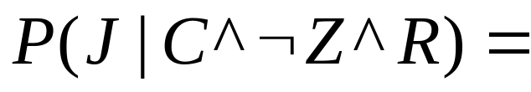
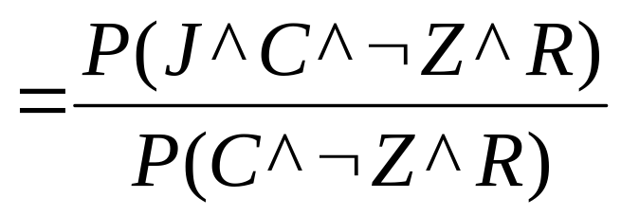
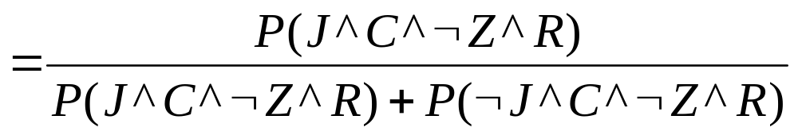
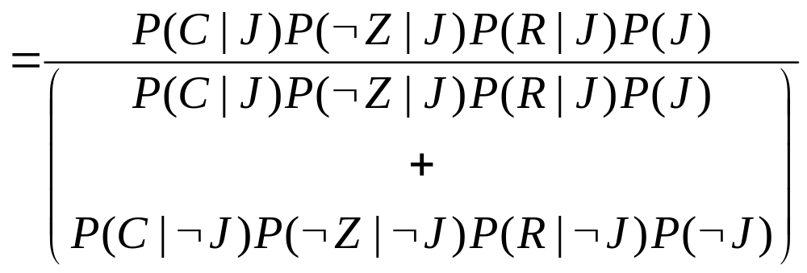
Naïve Bayes Classifier Inference
J
C
Z
R

Slide 8
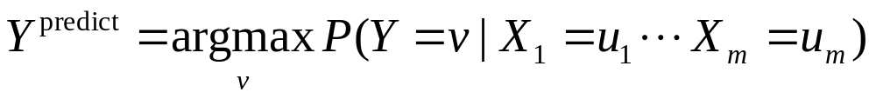
The General Case
Y
X₁
X₂
. . .
X_{m}
Estimate P(Y=v) as fraction of records with Y=v
Estimate P(X_{i}=u | Y=v) as fraction of “Y=v” records that also have X=u.
To predict the Y value given observations of all the X_{i} values, compute

Slide 9
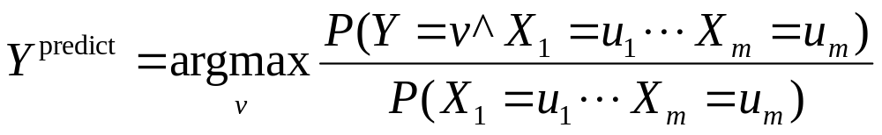
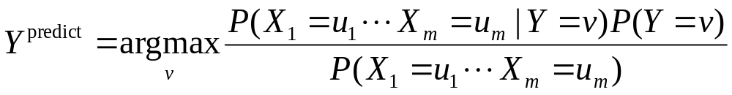
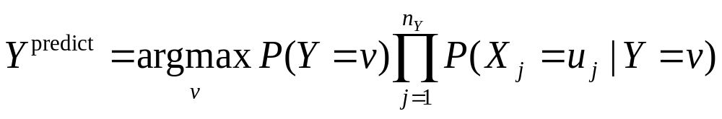
Naïve Bayes Classifier
Because of the structure of the Bayes Net

Slide 10
Example
Classifying days according to whether someone will play tennis
14 training patterns with 4 attributes: Outlook, Temperature, Humidity and Wind
Notes:
The following slides refer to Chap6 of Machine learning by Tom Mitchell, p.177

Slide 11
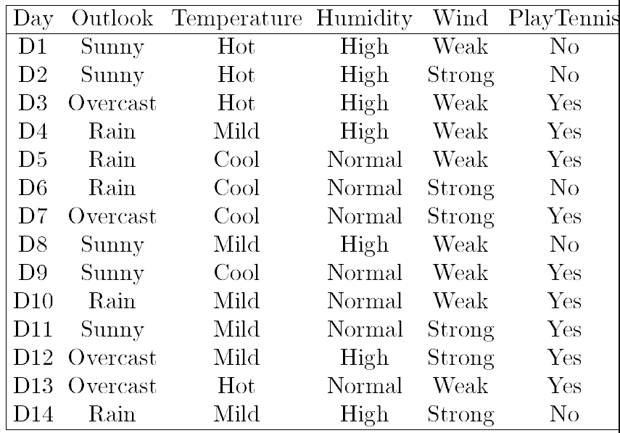
Example
Naïve Bayes Classifiers can be built with real-valued inputs*
Rather Technical Complaint: Bayes Classifiers don’t try to be maximally discriminative---they merely try to honestly model what’s going on*
Zero probabilities are painful for Joint and Naïve. A hack (justifiable with the magic words “Dirichlet Prior”) can help*.
Naïve Bayes is wonderfully cheap. And survives 10,000 attributes cheerfully!

Slide 12
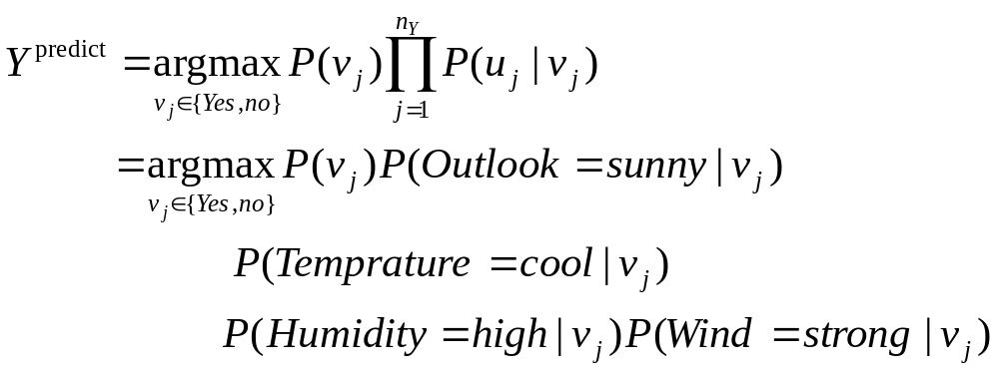
Example
Novel instance
  (Outlook=sunny, Temperature=cool, Humidity=high, Wind=strong)

Slide 13
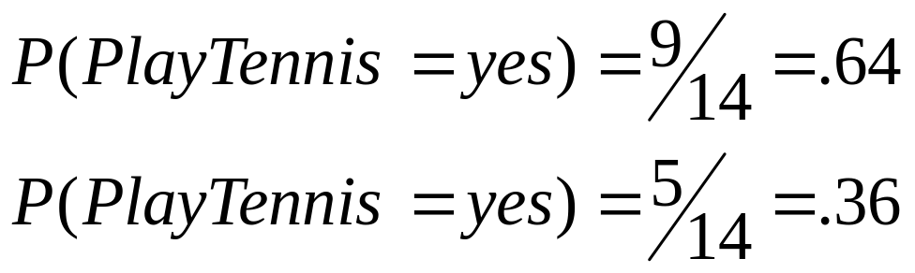
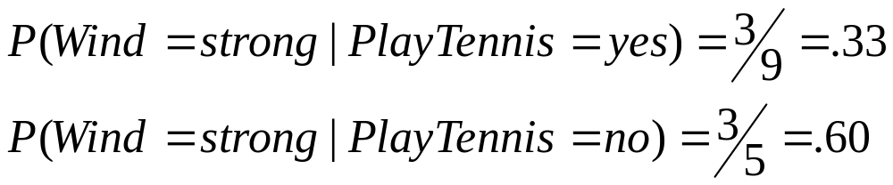
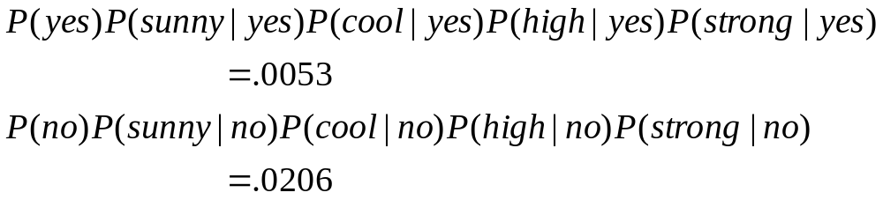
Example
From the training dataset

Slide 14
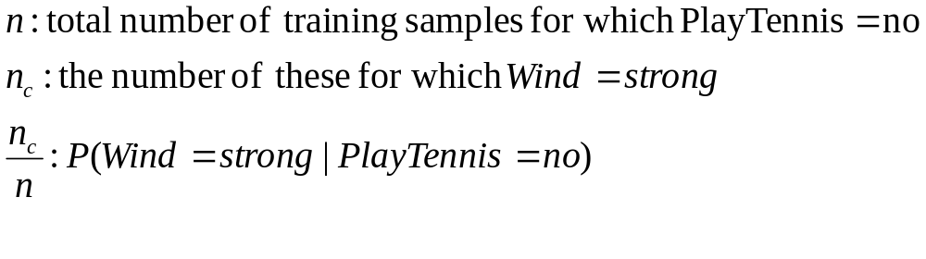
M-Estimate of probability

Slide 15
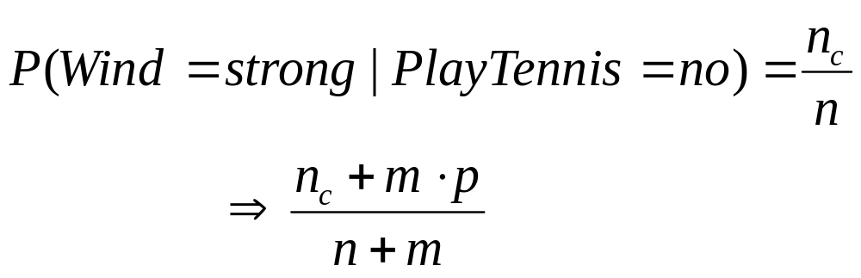
M-Estimate of probability
Poor estimate when n_{c} is small
  The probability produces a biased underestimate of the probability
  When the prob. is zero, the term will dominate the Bayes classifier if the future query contains Wind=strong
Notes:
Ref

Slide 16
What you should know
How to build a Bayes Classifier
How to predict with a BC

