Slide 1
Introduction to Algorithms
Lecture 1

Slide 2
Overview
Instructor: 沙朝锋
cfsha@fudan.edu.cn
Prerequisites
  A strong understanding of programming.
  A solid background in discrete mathematics, including probability.
Textbook: CLRS – Introduction to Algorithms.

Slide 3
Schedule - 1
Lec1: 课程简介、排序算法、算法复杂度分析(渐进运行时间、O等符号定义)、主定理。
Lec2: 主定理证明和应用、分治法(以矩阵乘积，多项式乘积和FFT为例)、以AB=C验证为例引入随机算法思想。
Lec3: Randomized Quicksort, 比较排序下界, order statistics以及线性时间Median算法(Select)，求frequent item的Misra-Gries算法。
Lec4: 哈希函数：全域哈希、Perfect hashing；简介ball-and-bin模型，two-choices扩展，consistent hashing及分析。
Lec5: 开放寻址法(分析linear probe)，Cuckoo hashing及分析，Bloom filter, Count-sketch.

Slide 4
Schedule - 2
Lec6: 平摊分析(以Binary Counter和Dynamic Table为例介绍了aggregating, accounting和potential三种分析)，针对self-adjust list的Move-to-front及分析。
Lec7: 动态规划：强调了memorize方法；例子：weighted interval schedule, 矩阵连乘，最长公共子序列(LCS)，带权重的最优二分查找树，多段线性回归，背包问题。
Lec8: 动态规划：树上的独立集、旅行商问题；贪心法：以单机任务调度、哈夫曼编码、最小生成树算法Prim和Kruskal为例。
Lec9: union-find数据结构的平摊分析；网络流的定义。
Lec10: 网络流算法：Ford-Fulkerson, Edmons-Karp (shortest path, fattest path, capacity scaling), Dinic算法等。

Slide 5
Schedule – 3
Lec11: Min-cut (RCA算法)，网络流的应用。
Lec12: 线性规划：建模、Primal-dual, weak/strong duality定理，应用。
Lec13: Multiplicative update及gradient descent.
Lec14: NP完全问题：P和NP定义、多项式时间归约、SAT问题；NPC问题证明：Clique, Vertex Cover, Independent Set, 3SAT等。
Lec15: NP完全问题证明：3-Coloring, 哈密尔顿回路等；近似算法：近似度定义、Vertex Cover, Set Cover, k-center问题等。
Lec16: 近似算法：Job scheduling, Max SAT问题等；random rounding等方法。

Slide 6
Algorithms
An algorithm is a sequence of computational steps that transform the input into the output.
Applications of Algorithms
  Everywhere!
Hard problems

Slide 7
Analysis of algorithms
The theoretical study of computer-program performance and resource usage.
Also important:
  modularity user-friendliness
  maintainability programmer time
  functionality simplicity
  robustness extensibility
  reliability

Slide 8
Why study algorithms and performance?
Performance often draws the line between what is feasible and what is impossible.
Algorithmic mathematics provides a language for talking about program behavior.
Speed is fun!

Slide 9
The problem of sorting
Input: sequence <a₁, a₂,…, a_{n}> of numbers.
Output: permutation <a’₁, a’₂,…, a’_{n}> such that a’₁≤ a’₂ ≤…≤a’_{n}.
Example:
  Input: 8 2 4 9 3 6
  Output: 2 3 4 6 8 9

Slide 10
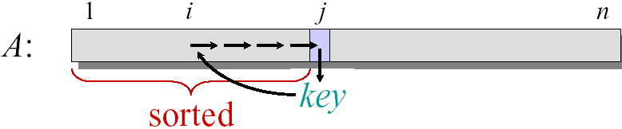
Insertion sort
Insertion-Sort(A, n) // A[1..n]
for j ← 2 to n
do key ← A[j]
i ← j − 1
while i > 0 and A[i] > key
do A[i+1] ← A[i]
i ← i − 1
A[i+1] ← key

Slide 11
Example of insertion sort
8 2 4 9 3 6
2 8 4 9 3 6
2 4 8 9 3 6
2 4 8 9 3 6 2 3 4 8 9 6

Slide 12
Running time
The running time depends on the input: an already sorted sequence is easier to sort.
Parameterize the running time by the size of the input n
Seek upper bounds on the running time T(n) for the input size n, because everybody likes a guarantee.

Slide 13
Kinds of analyses
Worst-case: (usually)
  T(n) = maximum time of algorithm on any input of size n.
Average-case: (sometimes)
  T(n) = expected time of algorithm over all inputs of size n.
  Need assumption of statistical distribution of inputs.
Best-case: (bogus)
  Cheat with a slow algorithm that works fast on some input.

Slide 14
Machine-independent time
What is insertion sort’s worst-case time?
It depends on the speed of our computer:
  relative speed (on the same machine),
  absolute speed (on different machines).
Big Idea:
  Ignore machine-dependent constants.
  Look at growth of T(n) as n→∞.
“Asymptotic Analysis”

Slide 15
Θ-notation
Math:
Θ(g(n)) = {f(n) : there exist positive constants
c₁, c₂, and n₀ such that 0 ≤ c₁g(n) ≤
f(n) ≤ c₂g(n) for all n ≥ n₀}
Engineering:
Drop low-order terms; ignore leading constants.
Example: 2n³ + 150n²−250n + 6024 = Θ(n³)

Slide 16
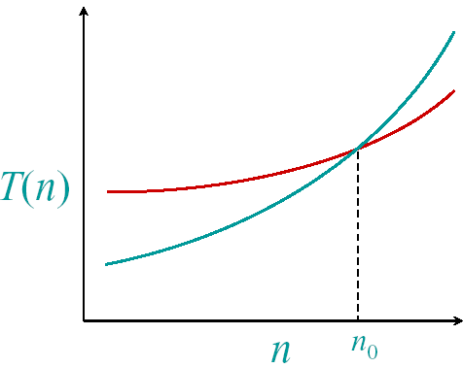
Asymptotic performance
When n gets large enough, a Θ(n²) algorithm always beats a Θ(n³) algorithm
We shouldn’t ignore
asymptotically slower
algorithms, however.
Real-world design
situations often call for a
careful balancing of
engineering objectives.
Asymptotic analysis is a
useful tool to help to
structure our thinking.

Slide 17
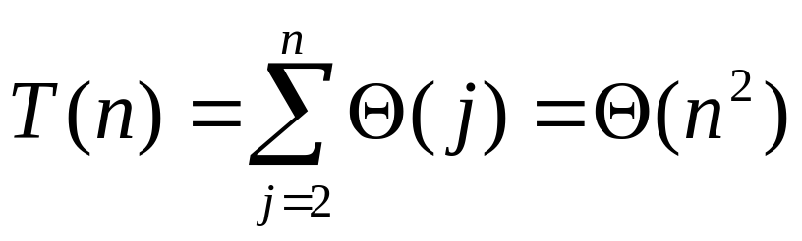
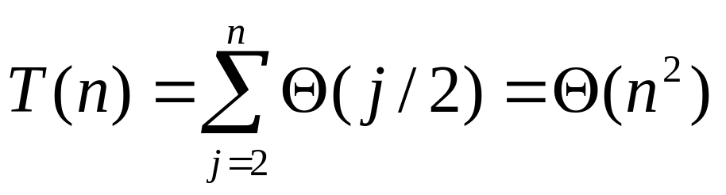
Insertion sort analysis
Worst case: Input reverse sorted.
Average case: All permutations equally likely.
Is insertion sort a fast sorting algorithm?
Moderately so, for small n.
Not at all, for large n.

Slide 18
Merge sort
Merge-Sort A[1..n]
1. If n = 1, done.
2. Recursively sort A[1..[n/2]]
and A[[n/2]+1..n]
3. “Merge” the 2 sorted lists.
Key subroutine: Merge

Slide 19
Merging two sorted arrays
12 20 12 20 12 20 12 20 12 20 12
11 13 11 13 11 13 11 13 11 13
9 7 9 7 9 9
1 2
1 2 7 9 11 12
Time = Θ(n) to merge a total
of n elements (linear time).

Slide 20
Analyzing merge sort
T(n) Merge-Sort A[1..n]
Θ(1) 1. If n = 1, done.
2T(n/2) 2. Recursively sort A[1..[n/2]]
and A[[n/2]+1..n]
Θ(n) 3. “Merge” the 2 sorted lists.
Sloppiness: Should be T([n/2]) + T(n/2), but it turns out not to matter asymptotically.

Slide 21
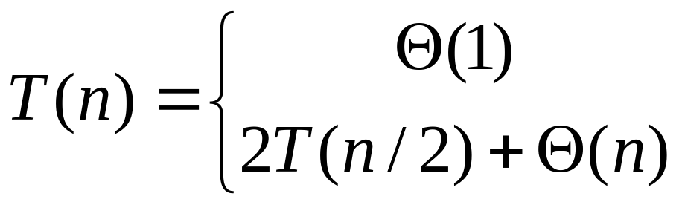
Recurrence for merge sort
We shall usually omit stating the base case when T(n) = Θ(1) for sufficiently small n, but only when it has no effect on the asymptotic solution to the recurrence.
CLRS provides several ways to find good upper bound on T(n).
if n = 1 ;
if n > 1.

Slide 22
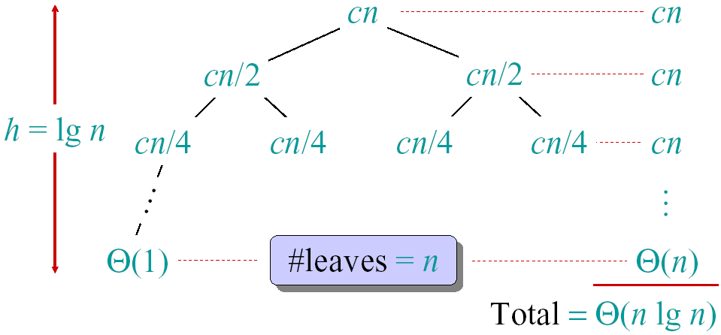
Recursion tree
Solve T(n)=2T(n/2)+cn, where c>0 is constant.

Slide 23
Conclusions
Θ(n*lgn) grows more slowly than Θ(n²).
Therefore, merge sort asymptotically beats insertion sort in the worst case.
In practice, merge sort beats insertion sort for n > 30 or so.
Go test it out for yourself.

Slide 24
Asymptotic notation
O-notation (“big-Oh”, upper bounds)
f(n) = O(g(n)) if ∃ const c, n₀ such that 0≤ f(n) ≤ cg(n), ∀n≥n₀.
e.g. 2n² = O(n³) (c=1, n₀=2)
Think of O(g(n)) as a set of functions:
O(g(n)) = {f(n): ∃ const c, n₀ such that 0≤ f(n) ≤ cg(n), ∀n≥n₀}
Then 2n² ∈ O(n³)

Slide 25
Ω-notation (lower bounds)
Again, think of Ω(g(n)) as a set of functions:
Ω(g(n)) = {f(n): ∃ const c, n₀ such that 0 ≤ cg(n) ≤ f(n), ∀n≥n₀}
e.g. n^{½} = Ω(lgn) (c=1, n₀=16)

Slide 26
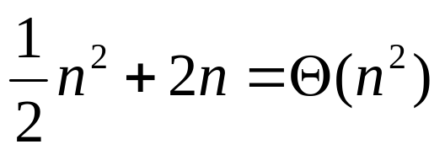
Θ-notation (tight bounds)
Θ(g(n)) = {f(n): ∃ const c₁, c₂, n₀ such that 0 ≤ c₁g(n) ≤ f(n) ≤ c₂g(n), ∀n≥n₀}
Example:
Pick c₁= ¼ , c₂ = ¾ (educated guess),
then find satisfying n₀=8.

Slide 27
Useful Theorems
Theorem: Leading constants and lower-order terms don’t matter.
Theorem: (O and Ω) ⇔ Θ.
Two more asymptotic notations:
  “Little-Oh” notation f(n) = o(g(n))
  “Little-omega” notation f(n) = ω(g(n))

Slide 28
Solving Recurrences
Like solving integrals, differential equations, etc.
Three methods:
  Substitution, Iteration, Master
Substitution Method (most general)
  Guess form of solution
  Verify by induction
  Solve for satisfying constant.

Slide 29
Example of substitution method proof
Example: solve T(n) = 4T(n/2) + n
  Guess that T(n) ∈ O(n³), i.e. that T of form cn³.
  Assume T(k) ≤ ck³ for k < n and
  Prove T(n) ≤ cn³ by induction
  T(n) = 4T(n/2) + n ≤ 4c(n/2)³ + n
  = cn³/2 + n = cn³ − (cn³/2−n)
  ≤ cn³ if c ≥ 2 and n ≥ 1
Thus T(n)=O(n³)!

Slide 30
Substitution Method (cont.)
Notes:
To prove inductive step, try to write expression as
<answer you want> − <something > 0>
In example above:
did not show that T(n) = Ω(n) or Θ(n) thus n³ is not a tight bound!
Can show O(n²).

Slide 31
Substitution: Achieving Tighter Bounds
Try to show T(n)=O(n²)
Assume T(k) ≤ ck²
T(n) = 4T(n/2) + n
≤ 4c(n/2)² + n
= cn² + n
≤ cn² for no choice of c>0. Lose.
What went wrong?

Slide 32
Fallacious argument
The problem? We couldn’t rewrite the equality
T(n) = cn² + n
as
T(n) = cn² − <(something positive)>
in order to show the inequality we wanted:
T(n) ≤ cn²

Slide 33
Corrected Proof
Idea: Strength inductive hypothesis by subtracting lower-order term:
Assume T(k)≤c₁k² − c₂k for k< n
T(n) = 4T(n/2) + n Given
≤ 4(c₁(n/2)² − c₂(n/2)) + n Ind. Hyp.
= c₁n² − 2c₂n + n simplify
= c₁n² − c₂n − (c₂n−n) Rearrange
≤ c₁n² − c₂n if c₂ ≥ 1
Pick c₁ big enough to handle initial conditions.
Thus T(n)=O(n²)!

Slide 34
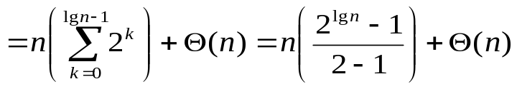
Iterating recurrences
Basic idea: expand, and convert to summation
Example:
T(n)=n+4T(n/2)
=n+4(n/2+4T(n/4))
=n+4(n/2+4(n/4+4T(n/8)))
=n+4(n/2+4(n/4+4(n/8+4T(n/16))))
=n+2n+4n+…+2^{lgn}T(1)
=2⁰n+2¹n+2²n+…+2^{lgn}T(1)
=Θ(n²)+Θ(n)=Θ(n²)

Slide 35
To iterate recurrences
Should know rules and have intuition for arithmetic and geometric series
Math can be messy and hard. Often, use iterating recurrence to generate guess for substitution method.

Slide 36
Iteration method: Visualizing recursion tree
Construction of recursion tree for
T(n) = T(n/4) + T(n/2) + n²:
n²
n²
(n/4)²
(n/2)²
T(n/4)
T(n/2)
n²
T(n/16)
T(n/8)
T(n/8)
T(n/4)
(n/4)²
(n/2)²
5n²/16
(n/16)²
(n/8)²
(n/8)²
(n/4)²
25n²/256
Θ(n²)

Slide 37
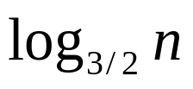
Iteration method: Visualizing recursion tree
Another recurrence:
T(n) = T(n/3) + T(2n/3) + n:
Recursion tree:
n
n
n/3
2n/3
n
n/9
2n/9
2n/9
4n/9
n
Total: O(nlogn)

Slide 38
Next week
Recurrences: Master method
  Reading: Chapter 4, excluding §4.4
Divide and conquer: Strassen’s algorithm, polynomial multiplication
  Reading: §28.2 and §30.1

