Slide 1
Introduction to Algorithms
Lecture 10

Slide 2
Last Time
Amortized Analysis
Aggregate Method
Accounting Method
Potential Method
Binary Counter
Table Update

Slide 3
Today’s Topics
Optimization Problems
Greedy Algorithms
Graph Representation & Algorithms
Minimum Spanning Tree
  Prim’s Algorithm
  Kruskal’s Algorithm

Slide 4
Optimization Problems
A problem that may have many feasible solutions.
Each solution has a value
In maximization problem, we wish to find a solution to maximize the value
In the minimization problem, we wish to find a solution to minimize the value

Slide 5
The Diet Problem
Carbs
Protein
Fat
Iron
Cost
1 slice bread
30
5
1.5
10
30¢
1 cup yogurt
10
9
2.5
0
80¢
2tsp Peanut Butter
6
8
18
6
20¢
US RDA Minimum
300
50
70
100
Minimize 30 x₁ + 80 x₂ + 20 x₃
s.t. 30x₁ + 10 x₂ + 6 x₃ ≥ 300
5x₁ + 9x₂ + 8x₃ ≥ 50
1.5x₁ + 2.5 x₂ + 18 x₃ ≥ 70
10x₁ + 6 x₃ ≥ 100
x₁, x₂, x₃ ≥ 0

Slide 6
Greedy Algorithms
Many optimization problems can be solved more quickly using a greedy approach
  The basic principle is that local optimal decisions may be used to build an optimal solution
  But the greedy approach may not always lead to an optimal solution overall for all problems
  The key is knowing which problems will work with this approach and which will not

Slide 7
Greedy algorithms
A greedy algorithm always makes the choice that looks best at the moment
  The hope: a locally optimal choice will lead to a globally optimal solution
  For some problems, it works
greedy algorithms tend to be easier to code

Slide 8
Interval scheduling.
Job j starts at s_{j} and finishes at f_{j}.
Two jobs compatible if they don't overlap.
Goal: find maximum subset of mutually compatible jobs.

Slide 9
Interval Scheduling: Greedy Algorithms
Greedy template. Consider jobs in some natural order.
Take each job provided it's compatible with the ones already taken.
[Earliest start time] Consider jobs in ascending order of s_{j}.
[Shortest interval] Consider jobs in ascending order of f_{j} - s_{j}.
[Fewest conflicts] For each job j, count the number of conflicting jobs c_{j}. Schedule in ascending order of c_{j}.
[Earliest finish time] Consider jobs in ascending order of f_{j}.

Slide 10
Counterexamples
[Earliest start time]
[Shortest interval]
[Fewest conflicts]

Slide 11
Earliest finish time
Sort jobs by finish times so that f₁ ≤ f₂ ≤ ... ≤ f_{n}.
A ← φ
for j = 1 to n {
if (job j compatible with A)
A ← A ∪ {j}
}
return A
Implementation. O(n log n).
Remember job j* that was added last to A.
Job j is compatible with A if s_{j} ≥ f_{j*}.

Slide 12
Earliest finish time - Analysis
Theorem. Greedy algorithm is optimal.
Pf. (by contradiction)
Assume greedy is not optimal, and let's see what happens.
Let i₁, i₂, ... i_{k} denote set of jobs selected by greedy.
Let j₁, j₂, ... j_{m} denote set of jobs in the optimal solution with
i₁ = j₁, i₂ = j₂, ..., i_{r} = j_{r} for the largest possible value of r.

Slide 13
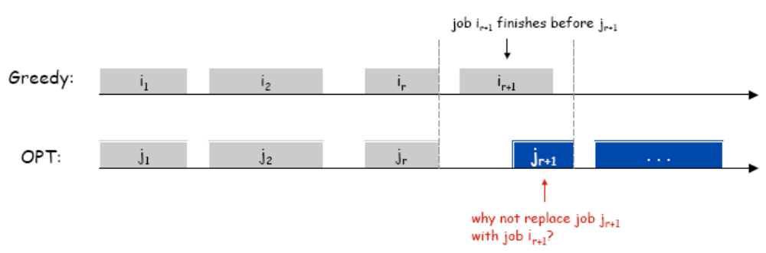
Earliest finish time - Analysis

Slide 14
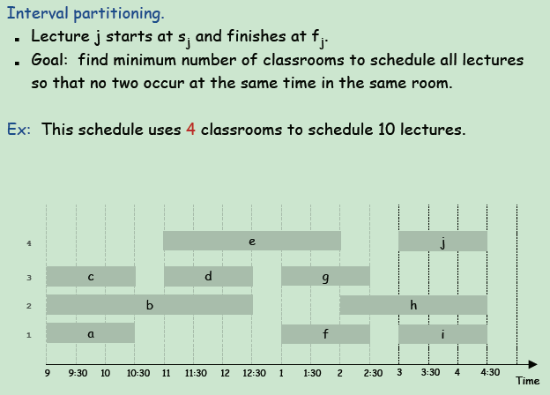
Interval Partitioning

Slide 15
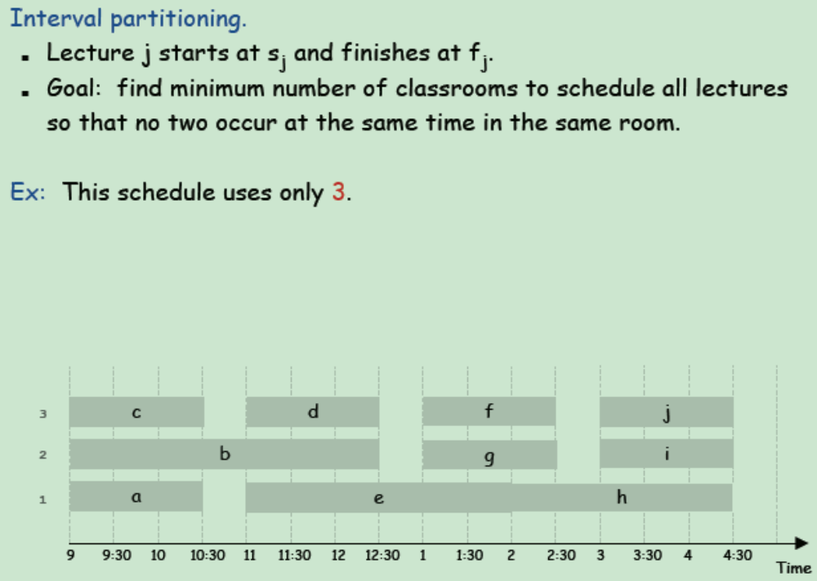
Interval Partitioning

Slide 16
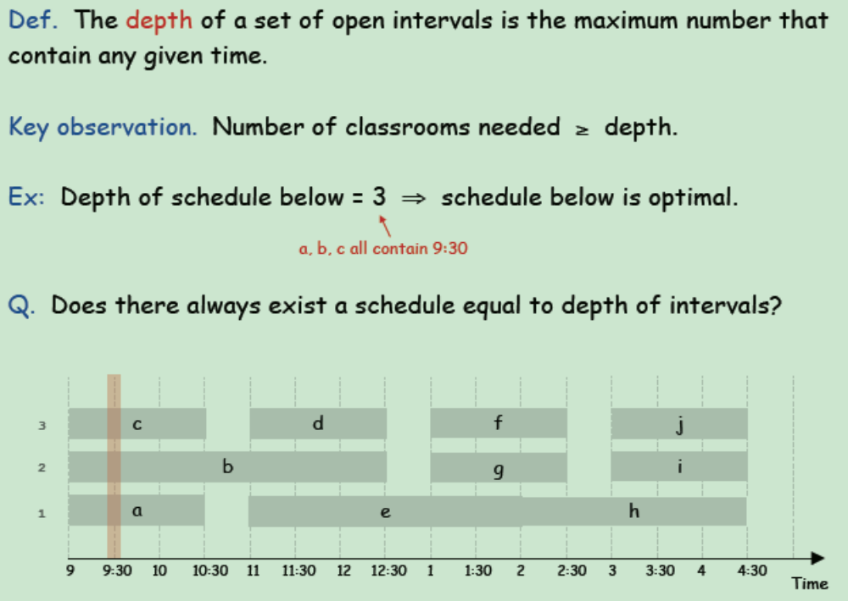
Interval Partitioning – Lower Bound on Optimal Solution

Slide 17
Interval Partitioning – Greedy Algorithm
Greedy algorithm. Consider lectures in increasing order of start time: assign lecture to any compatible classroom.
Implementation. O(n log n).
  For each classroom k, maintain the finish time of the last job added.
  Keep the classrooms in a priority queue.

Slide 18
Interval Partitioning – Greedy Analysis
Observation. Greedy algorithm never schedules two incompatible lectures in the same classroom.
Theorem. Greedy algorithm is optimal.
Let d = number of classrooms that the greedy algorithm allocates.
Classroom d is opened because we needed to schedule a job, say j,that is incompatible with all d-1 other classrooms.
These d jobs each end after s_{j}.
Since we sorted by start time, all these incompatibilities are caused by lectures that start no later than s_{j}.
Thus, we have d lectures overlapping at time s_{j} + ε.
Key observation ⇒ all schedules use ≥ d classrooms.

Slide 19
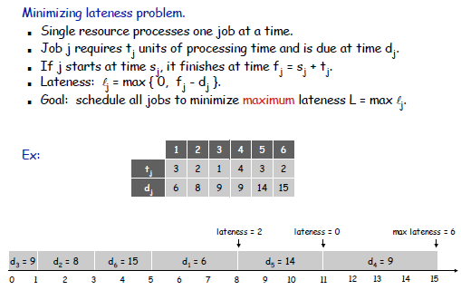
Scheduling to Minimizing Lateness

Slide 20
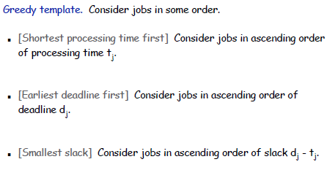
Minimizing Lateness: Greedy Algorithms

Slide 21
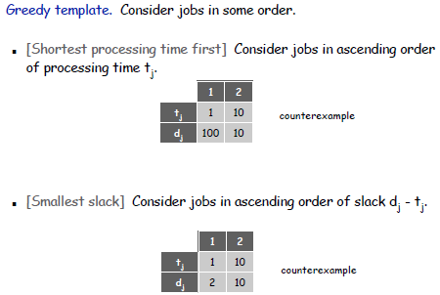
Minimizing Lateness: Greedy Algorithms

Slide 22
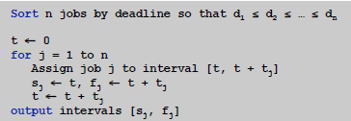

Minimizing Lateness: Greedy Algorithms
Greedy algorithm. Earliest deadline first.

Slide 23
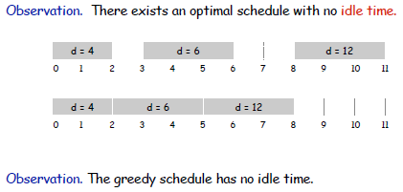
Minimizing Lateness: No Idle Time

Slide 24
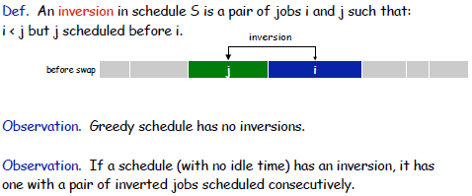

Minimizing Lateness: Inversions

Slide 25
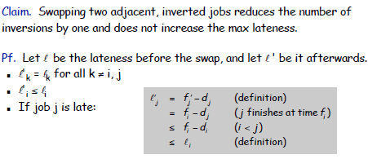
Minimizing Lateness: Inversions

Slide 26
Minimizing Lateness: Analysis of Greedy Algorithm
Theorem. Greedy schedule S is optimal.
Pf. Define S* to be an optimal schedule that has the fewest number of inversions, and let's see what happens.
Can assume S* has no idle time.
If S* has no inversions, then S = S*.
If S* has an inversion, let i-j be an adjacent inversion.
  swapping i and j does not increase the maximum lateness and strictly decreases the number of inversions
  this contradicts definition of S*

Slide 27
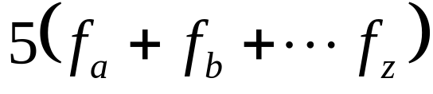
Data Compression
Suppose we have 1000000000 (1G) character data file that we wish to include in an email.
Suppose file only contains 26 letters {a,…,z}.
Suppose each letter α in {a,…,z} occurs with frequency f_{α}.
Suppose we encode each letter by a binary code
If we use a fixed length code, we need 5 bits for each character
The resulting message length is
Can we do better?

Slide 28
Huffman Codes
Most character code systems (ASCII, unicode) use fixed length encoding
If frequency data is available and there is a wide variety of frequencies, variable length encoding can save 20% to 90% space
Which characters should we assign shorter codes; which characters will have longer codes?

Slide 29
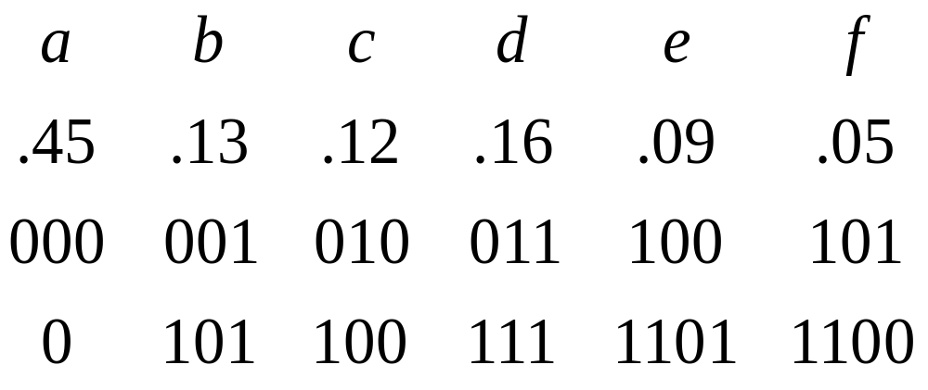
Data Compression: A Smaller Example
Suppose the file only has 6 letters {a,b,c,d,e,f} with frequencies
Fixed length 3G=3000000000 bits
Variable length
Fixed length
Variable length

Slide 30
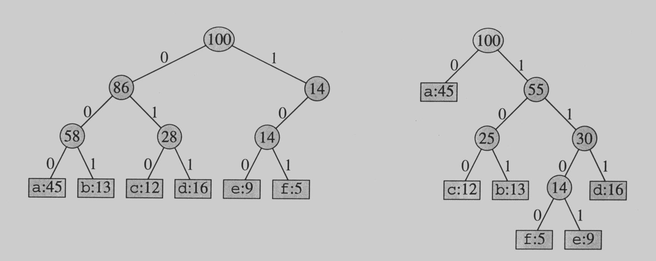
Prefix Codes
No encoding of a character can be the prefix of the longer encoding of another character, for example, we could not encode t as 01 and x as 01101 since 01 is a prefix of 01101
By using a binary tree representation we will generate prefix codes provided all letters are leaves

Slide 31
Prefix codes
A message can be decoded uniquely.
Following the tree until it reaches to a leaf, and then repeat!
Draw a few more tree and produce the codes!!!

Slide 32
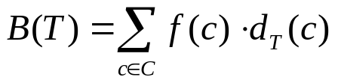
Some Properties
Prefix codes allow easy decoding
  Given a: 0, b: 101, c: 100, d: 111, e: 1101, f: 1100
  Decode 001011101 going left to right, 0|01011101, a|0|1011101, a|a|101|1101, a|a|b|1101, a|a|b|e
An optimal code must be a full binary tree (a tree where every internal node has two children)
For C leaves there are C-1 internal nodes
The number of bits to encode a file is
where f(c) is the freq of c, d_{T}(c) is the tree depth of c, which corresponds to the code length of c

Slide 33
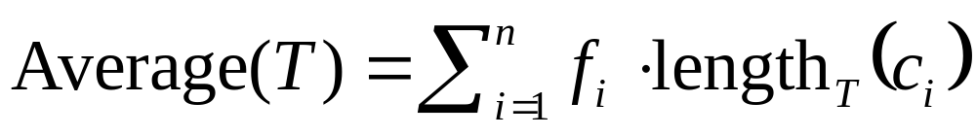
Optimal Prefix Coding Problem
Input: Given a set of n letters (c₁,…, c_{n}) with frequencies (f₁,…, f_{n}).
Construct a full binary tree T to define a prefix code that minimizes the average code length

Slide 34
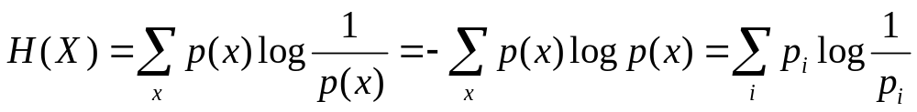
Entropy
Entropy is a measure of the average uncertainty associated with a random variable
The entropy of a discrete random variable X:
By convention, 0log0 = −0log(1/0) = 0

Slide 35
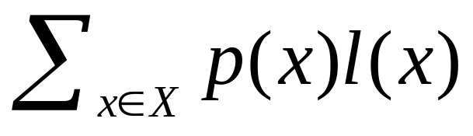
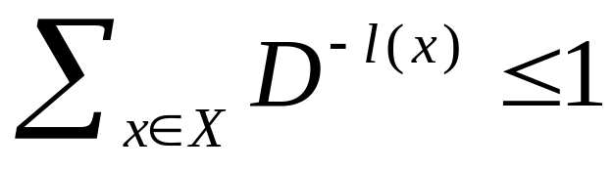
Optimal codes
Optimal code is defined as code with smallest
possible L(C) with respect to p(x)
Optimization:
minimize
subject to
and l(x)s are integers

Slide 36
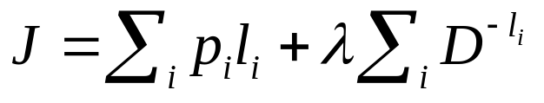
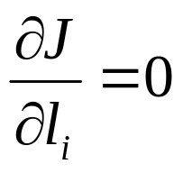
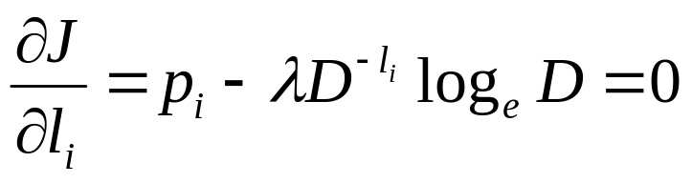
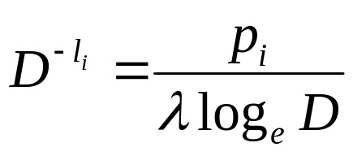
Optimal codes
Let us relax the integer constraint and replace the
first constraint by equality to obtain a lower bound.
Use Lagrange multipliers, define
and set
equivalently

Slide 37
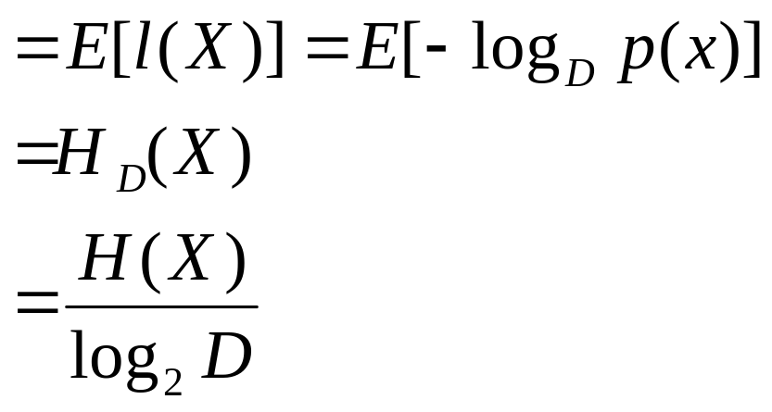
Optimal codes
solve for λ=1/log_{e}D, yielding l_{i} = −log_{D}(p_{i})
The expected codeword length
L(C)

Slide 38
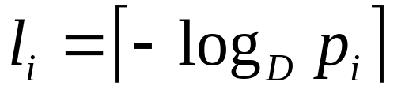
Shannon Code
Ideal codeword length l_{i} = −log_{D}(p_{i}), this is optimal when −log_{D} p_{i} is an integer for any i.
For general distribution, set
Bounds for the codeword length.
−log_{D} p_{i} ≤ l_{i} ≤ −log_{D} p_{i} + 1, ∀i
  {l_{i}} satisfy Kraft’s inequality, corresponding prefix code exists.
  Average codeword length
  H(X) ≤ E[l(X)] ≤ H(X)+1

Slide 39
Shannon Code
Example X takes four possible values with
probabilities (1/3, 1/3, ¼, 1/12)
Comparing to the obvious codeword length assignment (2,2,2,2), lose 1/6 pit per source symbol.
H(X) = 1.8554
= (2,2,2,4)
E[l(X)] = 13/6 = 2.1667

Slide 40
Bounds on the Optimal Codelength
Theorem. Let l₁*,l₂*,…,l*_{m} be the optimal
codeword length for a source distribution p
and a D-ary alphabet, and let L* be the
associated expected length of the optimal
code. Then
H_{D}(X) ≤ L* < H_{D}(X) + 1

Slide 41
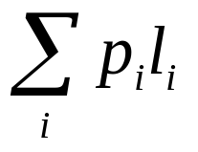
Constructing the Optimal Prefix Code
X has probability masses p₁ ≥ p₂ ≥…≥ p_{m},
construct binary code to minimize
What should the optimal code look like?
If p_{i} > p_{j}, then l_{i} ≤ l_{j}.
The two longest codewords have the same length.
The two longest codewords differ only in the last bit.

Slide 42
Constructing the Optimal Prefix Code
Construction:
Take the two least likely symbols, merge them
to get a size m – 1 problem.
{p₁,…,p_{m–1}, p_{m}} → {p₁,…, p_{m–2},p_{m–1}+p_{m}}

Slide 43
The Huffman Algorithm
Huffman(C)
n ← |C|
Q ← C
for i ← 1 to n – 1
do allocate a new node z
left[z] ← x ← Extract-Min(Q)
right[z] ← y ← Extract-Min(Q)
f[z] ← f[x] + f[y]
Insert(Q, z)
return Extract-Min(Q) //return the root of the tree

Slide 44
The Huffman Algorithm
An appropriate data structure is a binary min-heap
Rebuilding the heap is lgn and n-1 extractions are made, so the complexity is O(n lg n)
The encoding is NOT unique, other encoding may work just as well, but none will work better

Slide 45
Quality of the Huffman Code
The Huffman code is an optimal prefix code.
The Huffman code is within one bit of the entropy lower bound:
H_{D}(P) ≤ L_{HC} < H_{D}(P) + 1.
If all the probabilities are powers of two then:
H_{D}(P) = L_{HC}.

Slide 46
Graph Representation
Graph G = (V, E)
V = set of vertices
E = set of edges = subset of V × V
If G is connected, then
|E| ≥ |V| − 1 ⇒ lg|E| = Θ(lgV)
1
4
2
3

Slide 47
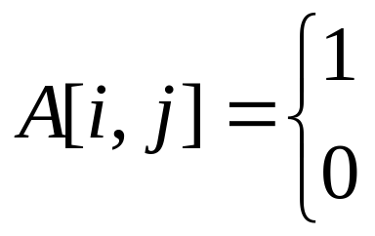
Graph Representation
Graph can be directed or undirected
Assume vertices V = {1,2,…,n}
Define “Adjacency matrix” A[1..n, 1..n]
1
4
2
3
if (i, j) ∈ E
if (i, j) ∉ E

Slide 48
Graph Representation
Adjacency matrix:
Θ(V²) storage → dense representation
 | j=1 | 2 | 3 | 4
i=1 | 0 | 1 | 1 | 0
2 | 0 | 0 | 1 | 0
3 | 0 | 0 | 0 | 0
4 | 0 | 0 | 1 | 0

Slide 49
Sparse Graph Representation
Adjacency list: Θ(V+E) storage → sparse representation
For each vertex v, keep a list Adj[v] of vertices adjacent to v.
1
4
2
3

Slide 50
Sparse Graph Representation
Adj[1] = {2, 3}
Adj[2] = {3}
Adj[3] = {}
Adj[4] ={3}
Adj[v] = degree(v) [for undirected graphs]
Adj[v] = out-degree(v) [for digraphs]
1
4
2
3

Slide 51
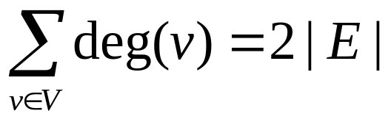
Handshaking Lemma
For undirected graphs,
Thus adjacency list uses Θ(V+E) storage.
1
4
2
3

Slide 52
Spanning Tree
Undirected, connected graph G = (V, E)
Weight function W : E → R
Spanning Tree: Tree that connects all vertices.
What is ST of the above graph?
6
12
5
9
14
8
7
15
3
10

Slide 53
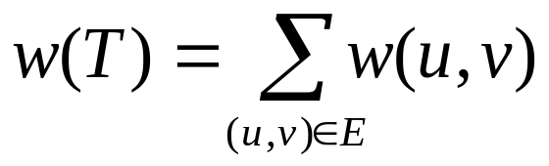
Minimum Spanning Tree
6
12
Minimum Spanning Tree:
Tree that connects all vertices, and minimizes
What is MST of above graph?
5
9
14
8
7
15
3
10

Slide 54
Optimal Substructure
T (Note: some other edges omitted):
Removing (u, v) partitions T into T₁ and T₂.
Claim: T₁ is MST of G₁ = (V₁, E₁), the subgraph of G induced by vertices in T₁.
V₁ = vertices in T₁
E₁ = {(x, y) ∈ E : x, y ∈ V₁}
T₂ is an MST of G₂.
u
v

Slide 55
Optimal Substructure
Proof: w(T) = w(u,v) + w(T₁) + w(T₂)
(There can’t be a better tree than T₁ or T₂, or T would be suboptimal)
(Overlapping subproblems? Dynamic Programming? Yes, but…)

Slide 56
Greedy Choice
Greedy choice property:
Locally optimal (greedy) choice
yields a globally optimal solution!
Theorem: Let T be MST of G, and let A ⊆ V. Let (u, v) be min weight edge in G connecting to V – A.
Then, (u, v) ∈ T.
Proof: “cut and paste”

Slide 57
Greedy Choice
in V – A
Suppose (u, v) ∉ T
Look at path from u to v in T. Swap (u, v) with first edge on path from u to v in T that crosses from A to V – A. This improves T!
in A
v
u

Slide 58
Prim’s Algorithm
Keep V – A in priority queue Q, sorted by weight of lightest edge connecting to A
Q ← V
key[v] ← ∞, ∀v ∈ V
key[s] ← 0, for arbitrary s ∈ V
while Q ≠ Φ
do u ← Extract-Min(Q)
for each v ∈ Adj[u]
do if v ∈ Q and w(u, v) ≤ key[v]
then key[v] ← w(u, v)
π[v] ← u
At end, {(v, π[v])} forms MST.

Slide 59
Example
A
key[H] = 6
6
4
key[B] = 4
key[C] = ∞
H
5
B
9
C
14
2
10
G
E
15
D
key[C] = ∞
3
8
key[E] = ∞
key[D] = ∞
F
key[F] = ∞

Slide 60
Example
A
key[H] = 5
6
4
key[B] = 4
key[C] = 9
H
5
B
9
C
14
2
10
G
E
15
D
key[C] = ∞
3
8
key[E] = 2
key[D] = ∞
F
key[F] = ∞

Slide 61
Example
A
key[H] = 5
6
4
key[B] = 4
key[C] = 9
H
5
B
9
C
14
2
10
G
E
15
D
key[C] = ∞
3
8
key[E] = 2
key[D] = 15
F
key[F] = 8

Slide 62
Example
A
key[H] = 5
6
4
key[B] = 4
key[C] = 9
H
5
B
9
C
14
2
10
G
E
15
D
key[C] = 14
3
8
key[E] = 2
key[D] = 15
F
key[F] = 8

Slide 63
Example
A
key[H] = 5
6
4
key[B] = 4
key[C] = 9
H
5
B
9
C
14
2
10
G
E
15
D
key[C] = 3
3
8
key[E] = 2
key[D] = 15
F
key[F] = 8

Slide 64
Example
A
key[H] = 5
6
4
key[B] = 4
key[C] = 9
H
5
B
9
C
14
2
10
G
E
15
D
key[C] = 3
3
8
key[E] = 2
key[D] = 15
F
key[F] = 8

Slide 65
Example
A
key[H] = 5
6
4
key[B] = 4
key[C] = 9
H
5
B
9
C
14
2
10
G
E
15
D
key[C] = 3
3
8
key[E] = 2
key[D] = 15
F
key[F] = 8

Slide 66
Example
A
key[H] = 5
6
4
key[B] = 4
key[C] = 9
H
5
B
9
C
14
2
10
G
E
15
D
key[C] = 3
3
8
key[E] = 2
key[D] = 15
F
key[F] = 8

Slide 67
Complexity of Prim
Time = |V| × T(Extract-Min) + Θ(E)
× T(Decrease-Key)
Q | T(Extract-Min) | T(Descreas-Key)
array | Θ(V) | Θ(1) | 1
binary heap | Θ(lgV) | Θ(lgV) | 1
Fibonacci heap | Θ(lgV) | Θ(1) | Θ(VlgV + E)

Slide 68
Kruskal’s algorithm for MST
Disjoint-set data structure
Sets S = {S_{i}}, S_{i} intersects S_{j} = empty set
Operations:
Insert(x): S ← § ∪ {{x}}
Union(S_{i}, S_{j}): S ← S − {S_{i}, S_{j}} ∪ {S_{i} ∪ S_{j}}
FindSet(x): return unique S_{i} ∈ S where x∈S_{i}

Slide 69
Kruskal’s algorithm for MST
T ← empty set
for each v ∈ V
do Insert(v)
Sort E by edge weight
for each edge (u, v) ∈ E
do if FindSet(u) ≠ FindSet(v)
then T ← T ∪ {(u, v)}
Union(FindSet(u), FindSet(v))
That is adds cheapest edge that connects two trees of “forest”.
Why is this algorithm correct?

Slide 70
Example
A
6
4
H
5
B
9
C
14
2
10
G
E
15
D
3
8
F
{A}, {B}, {C}, {D}, {E}, {F}, {G}, {H}

Slide 71
Example
A
6
4
H
5
B
9
C
14
2
10
G
E
15
D
3
8
F
{A}, {B, E}, {C}, {D}, {F}, {G}, {H}

Slide 72
Example
A
6
4
H
5
B
9
C
14
2
10
G
E
15
D
3
8
F
{A}, {B, E}, {C}, {D}, {F, G}, {H}

Slide 73
Example
A
6
4
H
5
B
9
C
14
2
10
G
E
15
D
3
8
F
{A, B, E}, {C}, {D}, {F, G}, {H}

Slide 74
Example
A
6
4
H
5
B
9
C
14
2
10
G
E
15
D
3
8
F
{A, B, E, H}, {C}, {D}, {F, G}

Slide 75
Example
A
6
4
H
5
B
9
C
14
2
10
G
E
15
D
3
8
F
{A, B, E, H, F, G}, {C}, {D}

Slide 76
Example
A
6
4
H
5
B
9
C
14
2
10
G
E
15
D
3
8
F
{A, B, E, H, F, G, C}, {D}

Slide 77
Example
A
6
4
H
5
B
9
C
14
2
10
G
E
15
D
3
8
F
{A, B, E, H, F, G, C, D}

Slide 78
Kruskal’s Running Time
Sort: Θ(E × lgE) = Θ(E × lgV), since |E| ≤ |V|²
Θ(V) calls to Insert
Θ(E) calls to FindSet
Θ(V) calls to Union
Thus Θ(E × α(E, V)) time using best data structure.
m operations on n sets require Θ(m · α(m, n)) time.
α(m, n) is “functional inverse” of Ackermann’s fn.
α(m, n) ≤ 4 even for m, n = 10⁸⁰
α(m, n) grows very slowly, but not constant!
Best MST to date: 1993 Karger, Klein, Tarjan Θ(n) time
randomized.

