Slide 1
Introduction to Algorithms
Lecture 12

Slide 2
Last Time
Shortest paths
Dijkstra’s algorithm
Breadth-First-Search
Depth-First-Search

Slide 3
Today’s Topics
Connected Components
Flow networks
Residual networks
Augmenting paths
Max-flow Min-cut theorem
Ford-Fulkerson algorithm
Edmond-Karp algorithm

Slide 4
Strongly Connected Component
Strongly Connected Component of digraph G = (V, E) is maximal set of vertices C ⊆ V such that all pairs of vertices of C are reachable from each other.
a
b
c
d
e
f
g
h

Slide 5
Strongly Connected Component
abe
cd
In analysis of certain types of engineering systems, want to examine state space and find whether appropriate states of system are reachable from one another and others appropriately unreachable.
fg
h

Slide 6
Strongly Connected Component
Note: G^{T} is transpose of G = (V, E). G^{T} = (V, E^{T}), so all edges have direction reversed. Can compute in Θ(V + E) from adjacency list, G and G^{T} have some strongly connected components.

Slide 7
Strongly Connected Component
Strongly-Connected-Components(G)
Call DFS(G) ⇒ f[u]
Compute G^{T}
Call DFS(G^{T}), but in main loop
consider vertices in decreasing
f[u] order.
Output vertices of each tree in
depth-first forest as s.c.c.
Θ(V + E)
Θ(V + E)
Θ(V + E)
Θ(V)
Total: Θ(V + E)

Slide 8
Key Idea
Consider G^{SCC}: Strongly connected components of G represented as single vertex; edges in G^{SCC} correspond to edges in G.
a
b
c
d
cd
abe
⇒
fg
h
e
f
g
h
G
G^{SCC}

Slide 9
Key Idea
Lemma: C, C’ distinct S.C.C.’s with u, v ∈ C, u’, v’ ∈ C’, and path u~~~>u’ exists in G. Then v’~~~>v does not exist in G.
Proof: v’~~~>v existing ⇒ u~~~>u’~~~>v’ and v’~~~> v~~~>u.
Thus, u and v reachable from each other. Contradiction.
C’
C
u’
u
v
v’

Slide 10
Analysis
Notation: d(U) = min_{u∈U}{d[u]}
f(U) = max_{u∈U}{f[u]}
Lemma: Let C & C’ be distinct S.C.C’s of digraph G = (V, E). Let edge (u, v) ∈ E with u ∈ C and v ∈ C’. Then f(C) > f(C’) in G.

Slide 11
Analysis
Case 1: d(C) < d(C’)
By white path theorem, all vertices in C’ are
descendant of x and thus have earlier finishing time
f(C) = f[x] > f(C’)
x is first discovered
d[x] = d[C]
C
C’
x
exists white
path
u
v
white path
all white

Slide 12
Analysis
Case 2: d(C) > d(C’)
No vertex in C reachable from C’ (previous lemma), so at f[y], C is all white. Thus f(C) > f(C’)
So, whether we begin C or C’ first, C’ will always finish first!
C’
C
y is first discovered
y
white path to
all of C’
f[y] = f(C’)
u
v

Slide 13
Analysis
Corollary: Let C & C’ be distinct S.C.C’s of digraph G = (V, E). Let edge (u, v) ∈ E^{T} with u ∈ C and v ∈ C’. Then f(C) < f(C’) in G.

Slide 14
Strongly-Connected-Component
So, here’s how Strongly-Connected-Component works:
DFS of G^{T} starts with f(C) with maximum finishing time and explores this SCC completely.
By previous corollary, there are no edges leading out of this SCC in G^{T}.
When we finish, we start new tree with an element of next S.C.C (C), whose only edges out (if any) return to C’, which has already been finished.

Slide 15
Flow networks
Model fundamental notion of material being transported across finite-capacity channels
Examples: water, current, data, etc.
Single source/sink, multi-source/sink, “multi-commodity”

Slide 16
Flow networks
2
Model as network (digraph G = (V, E)) with:
“source” node s and “sink” node t
Non-negative capacities c(u, v)
If (u, v) ∉ E, then c(u, v) = 0.
v
3
3
s
3
2
t
1
3
1
u
2
2
3

Slide 17
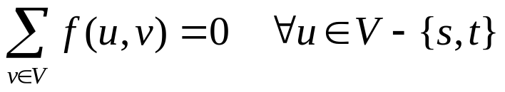
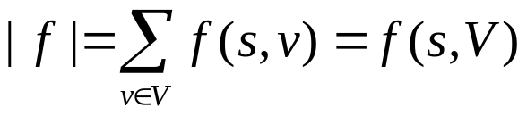
Flow
Flow on G is a function f: V × V → R satisfying
Capacity constraint: f(u,v) ≤ c(u,v) ∀u,v∈V.
Flow conservation:
Skew symmetry: f(u,v) = −f(v,u).
Flow value, is total flow out of source.
Goal: Finding Maximum Flow Value.

Slide 18
Example
2:2
v
1:3
2:3
s
1:3
0:2
t
0:1
1:1
1:3
2:2
u
1:2
2:3
|f| = 1 + 2 = 3

Slide 19
Flow Cancellation
Without loss of generality, positive flow goes either from u to v, or from v to u, but not both.
The capacity constraint and flow conservation are preserved by this transformation.
INTUITION: View flow as a rate, not a quantity.
v
v
Net flow from
u to v in both
case is 1.
2:3
1:2
1:3
0:2
u
u

Slide 20
Residual Network
Residual Capacity of (u, v):
c_{f}(u,v) = c(u,v) – f(u,v) ≥ 0
Residual Network G_{f} is graph of edges with strictly positive residual capacity (that can support more flow)
Its edges come from G∪G^{T}, then |E_{f}| ≤ 2|E|.

Slide 21
Residual Network
G:
12:12
11:16
15:20
s
0:10
1:4
t
4:9
7:7
8:13
4:4
11:14
G_{f}:
12
5
5
4
15
s
11
11
3
t
5
7
5
8
11
4
3

Slide 22
Augmenting Path
An augmenting path is a path p from s to t in G_{f} (or “in G with respect to f”)
Increase flow in G by c_{f}(p) = min_{(u,v)∈p}c_{f}(u,v)
G_{f}:
12
5
5
4
15
s
11
11
3
t
5
7
5
8
11
4
3

Slide 23
Augmenting Path
G:
12:12
19:20
11:16
15:20
s
0:10
1:4
t
4:9
7:7
0:9
8:13
4:4
12:13
11:14

Slide 24
Augmenting Path
Suggests an algorithm (method):
Start with Zero Flow.
Find an augmenting path p in corresponding G_{f}.
Augment f by c_{f}(p) and loop.
(Ford-Fulkerson Algorithm)

Slide 25
Potential Problems
Convergence? Can it enter infinite loop? No, because we only accept augmenting paths.
Can we be guaranteed of finding an augmenting path if one exists? BFS finds all shortest paths from a source. If none are found to sink, then none exist.
  Do we want a shortest path?
  Do we want a longest path?
  We really want a path of maximum capacity.
Global optimum? When no more augmenting paths can be found, how do we know we haven’t found a local optimum rather than the global optimum?

Slide 26
Properties of Flows
Lemma
For G=(V, E) a flow network and f a flow in G.
f(X, X) = 0 for all X ⊆ V.
f(X, Y) = − f(Y, X) for all X, Y ⊆ V.
f(X∪Y, Z) = f(X, Z) + f(Y, Z) for all X, Y, Z ⊆ V and X ∩ Y = Φ.
where f(X, Y) = Σ_{x∈X, y∈Y}f(x, y).

Slide 27
Illustrate Use
Flow is defined as net flow leaving source; show equal to that entering sink.
|f| ≡ f(s, V) = f(V, t).
Proof.
|f| ≡ f(s, V)
= f(V, V) – f(V–{s}, V)
= 0 + f(V, V–{s})
= f(V, t) + f(V, V – {s,t}) = f(V, t)

Slide 28
Illustrate Use
Slightly more intuitive proof:
|f| ≡ f(s, V) + f(V, t) – f(V, t)
= f(V, t) – (f(V, s) + f(V, t))
= f(V, t) – f(V, {s,t}) + f(V, V)
= f(V, t) + f(V, V – {s,t})
= f(V, t)

Slide 29
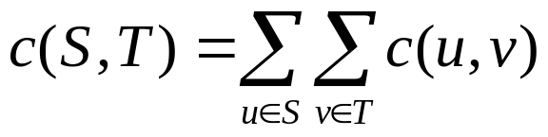
Cut
Cut is a partition of V into S and T = V – S with s ∈ S and t ∈ T.
Capacity of cut
Small capacity cuts serve as “barrier” to large flows.
A minimum cut of a network is that whose capacity is a minimum over all cuts in network.
Forward direction only

Slide 30
Cut
Lemma: Given any flow f, |f| = f(S, T) for and any (S, T).
Proof: f(S, T) = f(S, V) – f(S, S)
= f(s, V) + f(S – s, V)
= f(s, V) = |f|
This is like another conservation of flow idea
  by definition for flow out of source (S={s})
  already proven for flow into sink (T={t})
  have proven for any partition (cut) dividing s, t

Slide 31
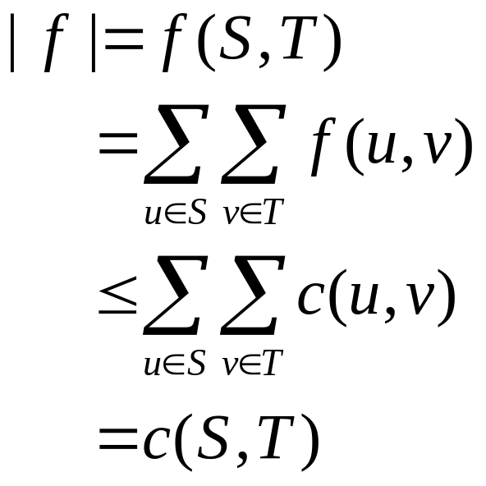
Cut
Corollary: The value of any flow is bounded above by the capacity of any cut.
f(S, T) ≤ c(S, T) for all cuts (S, T)
Proof:

Slide 32
The Max-Flow Min-Cut Theorems
The following are equivalent:
f is a maximum flow in G.
The residual network G_{f} contains no augmenting paths.
|f| = c(S, T) for some cut (S, T) of G.
Proof sketch
1⇒2 Augmenting path would allow flow in G to be increased above f, contradicting its being a maximum flow .

Slide 33
The Max-Flow Min-Cut Theorems
3⇒1 By corollary, |f| is bounded from above by the capacity of any cut, so |f| = c(S,T) means it can’t be increased.
2⇒3 G_{f} has no augmenting path. Let S = {u∈V:
∃path from s to u in G_{f}} and T = V – S.
s∈S and t ∈ T (otherwise would be augmenting path).
(S, T) is a cut.
c_{f}(u, v)=0 for u∈S, v∈T (otherwise v would be in S).

Slide 34
The Max-Flow Min-Cut Theorems
∴ f(u,v)=c(u,v), since c_{f}(u, v) = c(u,v) – f(u,v).
|f| = f(S, T) = c(S, T).
summation
path in G_{f}
v
s
u
S
T

Slide 35
Ford-Fulkerson Algorithm
f(u, v) ← 0 ∀u, v
while ∃ augmenting path p in G_{f}
do augment f by c_{f}(p)
Thus, the Ford-Fulkerson algorithm is guaranteed to result in successive improvements. When no more improvements are possible, the maximum flow has been found.

Slide 36
Ford-Fulkerson Algorithm
Notice: F-F doesn’t specify which path!
Analysis (with Integer Capacities):
Cost per path: O(E) using DFS or BFS
Thus run time is O(E |f*|), where f* is max flow
This is not polynomial in |V|, |E|!

Slide 37
Possible Efficiency Problem
10⁹
10⁹
10⁹-1
10⁹
s
1
t
s
1
1
t
1
10⁹
10⁹
10⁹
10⁹ -1
10⁹-1
10⁹-1
1
s
1
1
t
1
2*10⁹ iterations!
1
10⁹-1
10⁹ -1

Slide 38
Edmonds-Karp Algorithm
Use BFS to find breadth-first augmenting path
Time to find an augmenting path Θ(V + E) ⇒ Θ(E) if all vertices reachable from source.
Claim: number of augmentations limited to Θ(VE)
⇒ Running time Θ(VE²).

Slide 39
Edmonds-Karp Analysis
Monotonicity Lemma
Let δ(v) = δ_{f}(s, v)
= B-F distance from s to v in G_{f}.
Then δ(v) increases monotonically during E-K.
Suppose algorithm augments f to produce f’.
Prove by δ’(v) ≥ δ(v) induction on δ(v).

Slide 40
Monotonicity Lemma
Base: δ’(s) = δ(s) = 0
Inductive Step: Consider BF-path s→…u → v in G_{f’}
δ’(v) = δ’(u) + 1
(u, v) ∈ E_{f’} [What about E_{f}?]
Case 1: (u, v) ∈ E_{f}
Then δ(v) ≤ δ(u) + 1 [triangle ineq.]
≤ δ’(u) + 1 [induction]
= δ’(v) [BF path]

Slide 41
Monotonicity Lemma
Case 2: (u, v) ∉ E_{f}
Augmenting path must have included (v,u)
s→…v → u →… → t
Then δ(v) = δ(u) − 1 [BF path]
≤ δ’(u) − 1 [induction]
= δ’(v) – 2 [BF path]
< δ’(v)

Slide 42
Edmonds-Karp Analysis
Theorem: #Augmenting Steps in E-K algorithm is Θ(VE).
Proof: Let p be an augmenting path.
Residual capacity of some edge (u,v) ∈ p is c_{f}(p) = c_{f}(u, v) ⇒ (u,v) called critical
Augmentation removes (u,v) from critical path (for now)
Must wait until (v,u) augmented before re-appears.

Slide 43
Edmonds-Karp Analysis
Before p augmented (u,v): δ(v)=δ(u)+1 (p: BF path)
Before augmenting (v,u) later:
δ’(u) = δ’(v) + 1
≥ δ(v) + 1
≥ δ(u) + 2
⇒ δ(u) increases ≥ 2 between twice when (u,v) is critical. Each δ(u) starts ≥ 0, never decreases, and remains ≤ |V| − 1 until unreachable.
⇒(u, v) is critical at most Θ(V) times
Θ(E) edges in G_{f} ⇒ Θ(VE) augmentation

Slide 44
Cuts in Graphs
Focus on undirected graphs
A cut is a vertex partition
Value is number (or total weight) of crossing edges

Slide 45
Minimum Cut
Smallest cut of graph
Cheapest way to separate into 2 parts
Various applications:
  network reliability (small cuts are weakest)
  subtour elimination constraints for TSP
  separation oracle for network design
Not s-t min-cut

Slide 46
Contraction
Find edge that doesn’t cross min-cut
Contract (merge) endpoints to 1 vertex
Notes:
9

Slide 47
Contraction Algorithm
Repeat n - 2 times:
  find non-min-cut edge
  contract it (keep parallel edges)
Each contraction decrements #vertices
At end, 2 vertices left
  unique cut
  corresponds to min-cut of starting graph
Notes:
10

Slide 48
Notes:
11

Slide 49
Picking an Edge
Must contract non-min-cut edges
[NI]: O(m) time algorithm to pick edge
  n contractions: O(mn) time for min-cut
  slightly faster than flows
  If only could find edge faster….
Idea: min-cut edges are few
Notes:
13

Slide 50
Randomize
Repeat until 2 vertices remain
  pick a random edge
  contract it
Notes:
14

Slide 51
Analysis I
Min-cut is small---few edges
  Suppose graph has min-cut c
  Then minimum degree at least c
  Thus at least nc/2 edges
Random edge is probably safe
Pr[min-cut edge] ≤ c/(nc/2)
= 2/n
(easy generalization to capacitated case)
Notes:
15

Slide 52
Analysis II
Algorithm succeeds if never accidentally contracts min-cut edge
Contracts #vertices from n down to 2
When k vertices, chance of error is 2/k
  thus, chance of being right is 1-2/k
Pr[always right] is product of probabilities of being right each time
Notes:
16

Slide 53
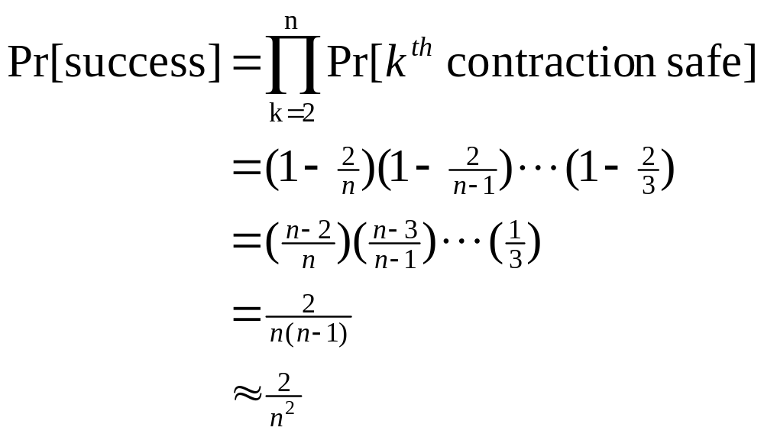
Analysis III
…not too good!
Notes:
17

Slide 54
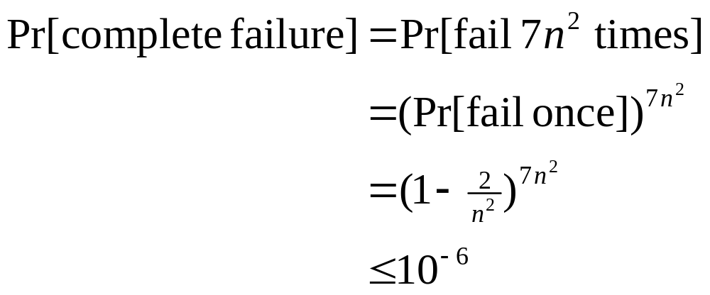
Repetition
Repetition amplifies success probability
  basic failure probability 1 - 2/n²
  so repeat 7n² times
  output the minimum size cut found in all the iterations
Notes:
18

Slide 55
How fast?
Easy to perform 1 trial in O(m) time
  just use array of edges, no data structures
But need n² trials: O(mn²) time
Simpler than flows, but slower
Notes:
19

Slide 56
An improvement [KS]
When k vertices, error probability 2/k
  big when k small
Idea: once k small, change algorithm
  algorithm needs to be safer
  but can afford to be slower
Amplify by repetition!
  Repeat base algorithm many times
Notes:
20

Slide 57
Recursive Algorithm
Algorithm RCA ( G, n )
{G has n vertices}
repeat twice
randomly contract G to n/2^{½} vertices
RCA(G,n/2^{1/2})
(50-50 chance of avoiding min-cut)
Notes:
21

Slide 58
Main Theorem
On any capacitated, undirected graph, Algorithm RCA
  runs in O*(n²) time with simple structures
  finds min-cut with probability ≥ 1/log n
Thus, O(log n) repetitions suffice to find the minimum cut (failure probability 10⁻⁶) in O(n² log² n) time.
Notes:
22

Slide 59
Proof Outline
Graph has O(n²) (capacitated) edges
So O(n²) work to contract, then two subproblems of size n/2^{½}
  T(n) = 2 T(n/2^{½}) + O(n²) = O(n² log n)
Algorithm fails if both iterations fail
  Iteration succeeds if contractions and recursion succeed
  P(n)=1 - [1 - ½ P(n/2^{½})]² = Ω (1 / log n)

Slide 60
Failure Modes
Monte Carlo algorithms always run fast and probably give you the right answer
Las Vegas algorithms probably run fast and always give you the right answer
To make a Monte Carlo algorithm Las Vegas, need a way to check answer
  repeat till answer is right
No fast min-cut check known (flow slow!)

Slide 61
Application: Image segmentation
Image segmentation.
  Central problem in image processing.
  Divide image into coherent regions.
Ex: Three people standing in front of complex background scene.
Identify each person as a coherent object.

Slide 62
Image segmentation
Foreground / background segmentation.
  Label each pixel in picture as belonging to foreground or background.
  V = set of pixels, E = pairs of neighboring pixels.
  a_{i} ≥ 0 is likelihood pixel i in foreground.
  b_{i} ≥ 0 is likelihood pixel i in background.
  p_{ij} ≥ 0 is separation penalty for labeling one of i and j as foreground, and the other as background.

Slide 63
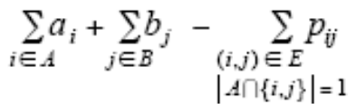
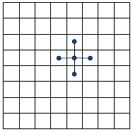
Image segmentation
Goals.
  Accuracy: if a_{i} > b_{i} in isolation, prefer to label i in foreground.
  Smoothness: if many neighbors of i are labeled foreground, we should be inclined to label i as foreground.
  Find partition (A, B) that maximizes:
foreground
background

Slide 64
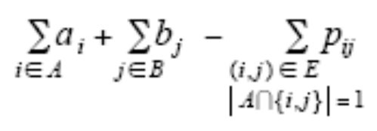
Image segmentation
Formulate as min cut problem.
  Maximization.
  No source or sink.
  Undirected graph.
Turn into minimization problem.
Maximizing:

Slide 65
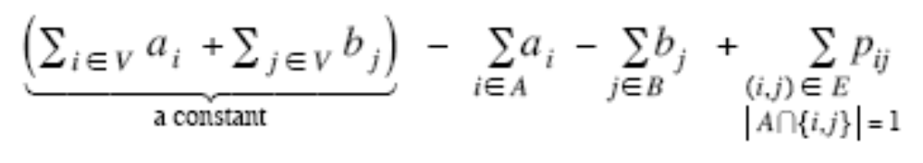
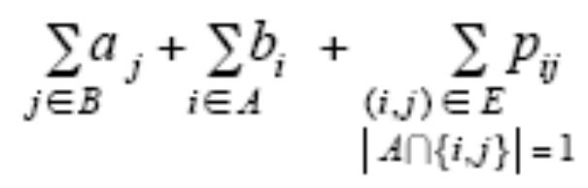
Image segmentation
Is equivalent to minimizing
or alternatively

Slide 66
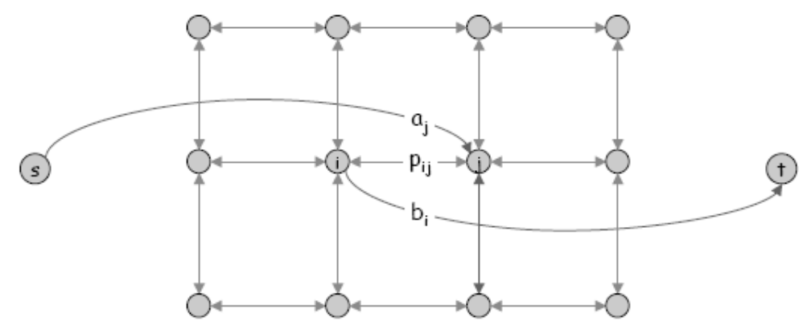
Image segmentation
Formulate as min cut problem. G' = (V', E').
Add source to correspond to foreground; add sink to correspond to background
Use two anti-parallel edges instead of undirected edge.

Slide 67

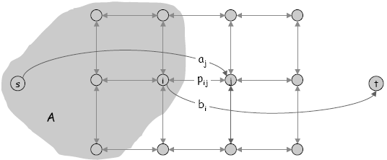
Image segmentation
Consider min cut (A, B) in G'.
  A = foreground.
Precisely the quantity we want to minimize.

Slide 68
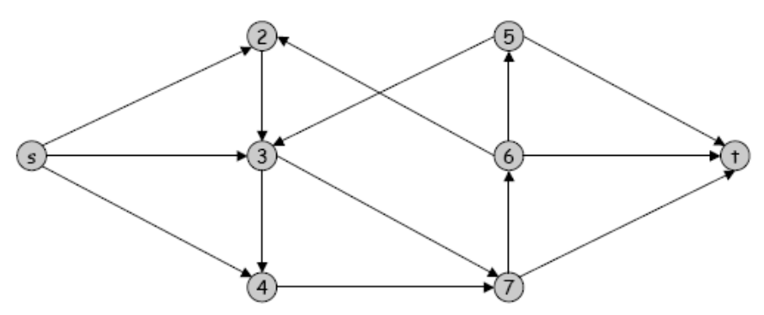
Edge Disjoint Paths
Disjoint path problem. Given a digraph G = (V, E) and two nodes s and t, find the max number of edge-disjoint s-t paths.
Def. Two paths are edge-disjoint if they have no edge in common.
Ex: communication networks.

Slide 69
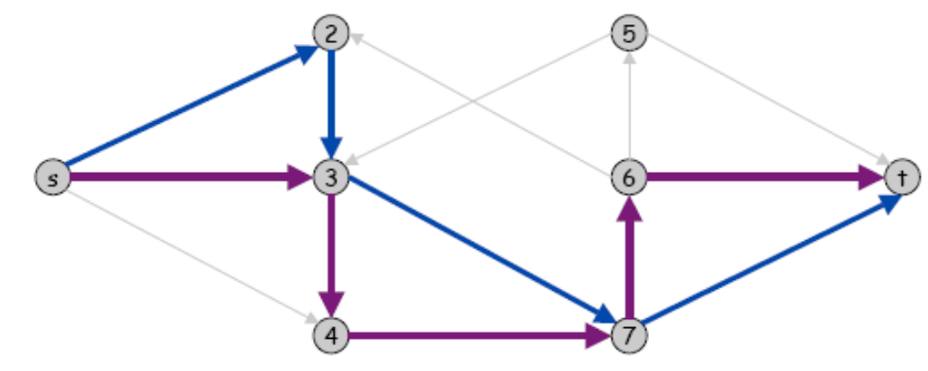
Edge Disjoint Paths
Disjoint path problem. Given a digraph G = (V, E) and two nodes s and t, find the max number of edge-disjoint s-t paths.
Def. Two paths are edge-disjoint if they have no edge in common.
Ex: communication networks.

Slide 70
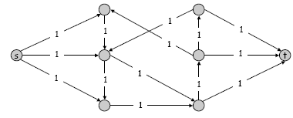
Edge Disjoint Paths
Max flow formulation: assign unit capacity to every edge.
Theorem. Max number edge-disjoint s-t paths equals max flow value.
Pf. →
  Suppose there are k edge-disjoint paths P₁, . . . , P_{k}.
  Set f(e) = 1 if e participates in some path P_{i}; else set f(e) = 0.
  Since paths are edge-disjoint, f is a flow of value k.

Slide 71
Edge Disjoint Paths
Max flow formulation: assign unit capacity to every edge.
Theorem. Max number edge-disjoint s-t paths equals max flow value.
Pf. ←
  Suppose max flow value is k.
  Integrality theorem → there exists 0-1 flow f of value k.
  Consider edge (s, u) with f(s, u) = 1.
  by conservation, there exists an edge (u, v) with f(u, v) = 1
  continue until reach t, always choosing a new edge
  Produces k (not necessarily simple) edge-disjoint paths.

Slide 72
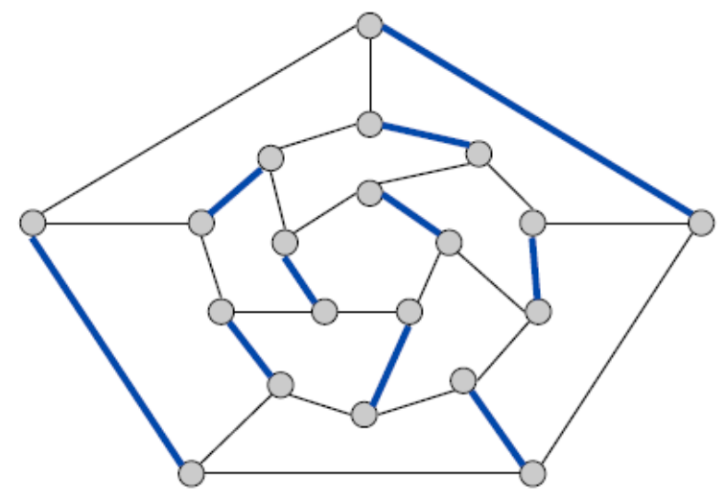
Matching
Input: undirected graph G = (V, E).
M ⊆ E is a matching if each node appears in at most edge in M.
Max matching: find a max cardinality matching.

Slide 73
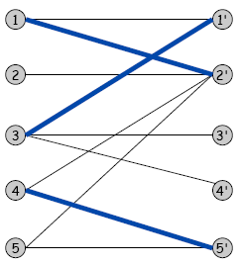
Bipartite Matching
Input: undirected graph G = (L ∪ R, E).
M ⊆ E is a matching if each node appears in at most edge in M.
Max matching: find a max cardinality matching.
L
R

Slide 74
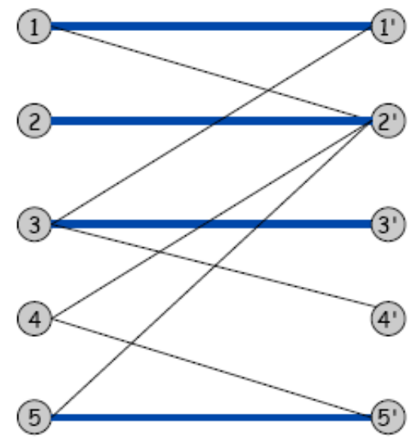
Bipartite Matching
Input: undirected graph G = (L ∪ R, E).
M ⊆ E is a matching if each node appears in at most edge in M.
Max matching: find a max cardinality matching.
Max matching
L
R

Slide 75
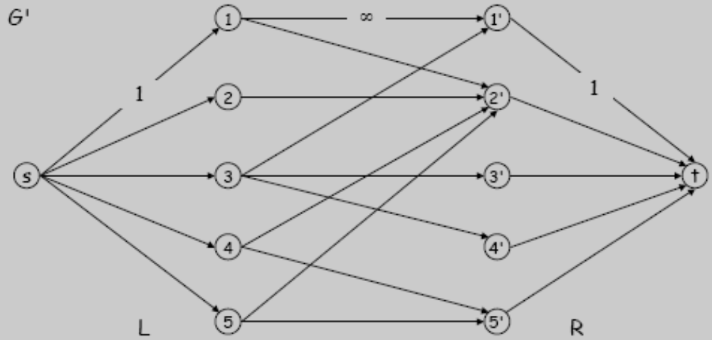
Bipartite Matching
Max flow formulation.
  Create digraph G' = (L ∪ R ∪{s, t}, E' ).
  Direct all edges from L to R, and assign infinite (or unit) capacity.
  Add source s, and unit capacity edges from s to each node in L.
  Add sink t, and unit capacity edges from each node in R to t.

Slide 76
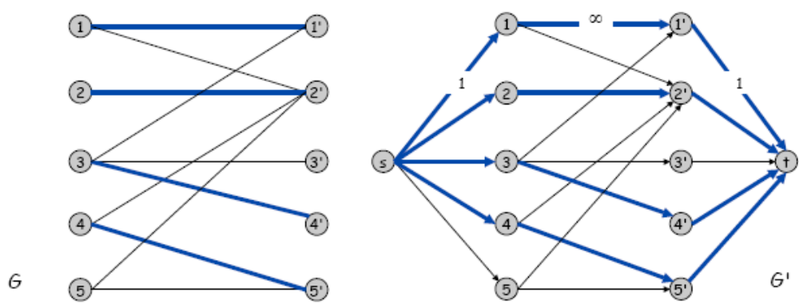
Bipartite Matching: Proof of Correctness
Theorem. Max cardinality matching in G = value of max flow in G'.
Pf. →
  Given max matching M of cardinality k.
  Consider flow f that sends 1 unit along each of k paths.
  f is a flow, and has cardinality k.

Slide 77
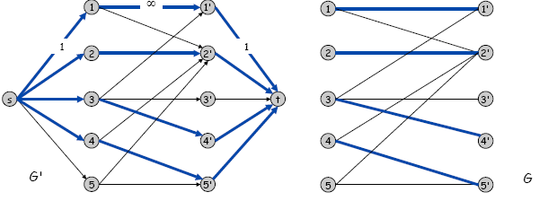
Bipartite Matching: Proof of Correctness
Theorem. Max cardinality matching in G = value of max flow in G'.
Pf. ←
  Let f be a max flow in G' of value k.
  Integrality theorem → k is integral and can assume f is 0-1.
  Consider M = set of edges from L to R with f(e) = 1.
  each node in L and R participates in at most one edge in M
  |M| = k: consider cut (L ∪ s, R ∪ t)

Slide 78
Bipartite Matching: Running Time
Which max flow algorithm to use for bipartite matching?
  Generic augmenting path: O(m|f*|) = O(mn).
  Capacity scaling: O(m² logC ) = O(m²).
  Shortest augmenting path: O(mn^{1/2}).

