Slide 1
Introduction to Algorithms
Lecture 13

Slide 2
Last Time
Connected Components
Flow networks
Residual networks
Augmenting paths
Max-flow Min-cut theorem
Ford-Fulkerson algorithm
Edmond-Karp algorithm

Slide 3
Today’s Topics
String Matching
Karp-Rabin Algorithm
Fast Fourier Transform
Polynomial multiplication

Slide 4
String Matching
Input: Two strings T[1…n] and P[1…m], containing symbols from alphabet Σ
Goal: find all “shifts” 1≤ s ≤ n-m such that T[s+1…s+m] = P
Example:
  Σ = { , a, b,…, z}
  T[1…18] = “to be or not to be”
  P[1..2] = “be”
  Shifts: 3, 16

Slide 5
Simple Algorithm
for s ← 0 to n-m
Match ← 1
for j ← 1 to m
if T[s+j] ≠ P[j] then
Match ← 0
exit loop
if Match=1 then output s

Slide 6
Results
Running time of the simple algorithm:
  Worst-case: O(nm)
  Average-case (random text): O(n)
Is it possible to achieve O(n) for any input?
  Knuth-Morris-Pratt’77: deterministic
  Karp-Rabin’81: randomized

Slide 7
Karp-Rabin Algorithm
A very elegant use of an idea that we have encountered before, namely…
HASHING !
Idea:
  Hash all substrings T[1…m], T[2…m+1], T[3…m+2], etc.
  Hash the pattern P[1…m]
  Report the substrings that hash to the same value as P
Problem: how to hash n - m substrings, each of length m, in O(n) time?

Slide 8
Implementation
Attempt I:
  Assume Σ = {0,1}
  Think about each T^{s} = T[s+1…s+m] as a number in binary representation, i.e., t_{s} = T[s+1]2⁰ + T[s+2]2¹ + … + T[s+m]2^{m-1}
  Find a fast way of computing t_{s+1} given t_{s}
  Output all s such that t_{s} is equal to the number p represented by P

Slide 9
The great formula
How to transform
t_{s}=T[s+1]2⁰+T[s+2]2¹+…+T[s+m]2^{m-1}
into
t_{s+1}=T[s+2]2⁰+T[s+3]2¹+…+T[s+m+1]2^{m-1} ?
Three steps:
  Subtract T[s+1]2⁰
  Divide by 2 (i.e., shift the bits by one position)
  Add T[s+m+1]2^{m-1}
Therefore: t_{s+1}= (t_{s} − T[s+1]2⁰)/2 + T[s+m+1]2^{m-1}

Slide 10
Algorithm
Can compute t_{s+1} from t_{s} using 3 arithmetic operations
Therefore, we can compute all t₀, t₁,…, t_{n−m} using O(n) arithmetic operations
We can compute a number corresponding to P using O(m) arithmetic operations
Are we done?

Slide 11
Problem
To get O(n) time, we would need to perform each arithmetic operation in O(1) time
However, the arguments are m-bit long!
It is unreasonable to assume that operations on such big numbers can be done in O(1) time
We need to reduce the number range to something more manageable

Slide 12
Hashing
We will instead compute
t’_{s}=T[s+1]2⁰+T[s+2]2¹+…+T[s+m]2^{m-1}mod q
where q is an “appropriate” prime number
One can still compute t’_{s+1} from t’_{s} :
t’_{s+1}= (t’_{s}−T[s+1]2⁰)*2⁻¹+T[s+m+1]2^{m−1} mod q
If q is not large, i.e., has O(log n) bits, we can compute all t’_{s} (and p’) in O(n) time

Slide 13
Problem
Unfortunately, we can have false positives, i.e., T^{s} ≠ P but t’_{s}=p’
Need to use a random q
We will show that the probability of a false positive is small → randomized algorithm

Slide 14
False positives
Consider any t_{s} ≠ p. We know that both numbers are in the range {0…2^{m-1}}
How many primes q are there such that t_{s} mod q = p mod q ≡ (t_{s}-p) =0 mod q?
Such prime has to divide x=(t_{s}-p) ≤ 2^{m}
Represent x=p₁^{e1}p₂^{e2}…p_{k}^{ek}, p_{i} prime, e_{i}≥1
Since 2 ≤ p_{i} , we have 2^{k} ≤ x ≤ 2^{m} → k ≤ m
There are ≤ m primes dividing x

Slide 15
Algorithm
Let Π be a set of 2nm primes, each having O(log n) bits
Choose q uniformly at random from Π
Compute t’₀, t’₁, …., and p’
For each s, the probability that t’_{s}=p’ while T^{s} ≠ P is at most m/2nm = 1/2n
The probability of any false positive is at most (n-m)/2n ≤ 1/2

Slide 16
“Details”
How do we know that such Π exists ?
How do we choose a random prime from Π in O(n) time ?

Slide 17
Prime density
Primes are “dense”. I.e., if PRIMES(N) is the set of primes smaller than N, then asymptotically
|PRIMES(N)|/N ~ 1/log N
If N large enough, then
|PRIMES(N)| ≥ N/(2log N)

Slide 18
Prime density (cont.)
If we set N = 9mn log n, and N large enough, then
|PRIMES(N)|≥ N/(2log N) ≥ 2mn
All elements of PRIMES(N) are log N = O(log n) bits long

Slide 19
Prime selection
Still need to find a random element of PRIMES(N)
Solution:
  Choose a random element from {1 … N}
  Check if it is prime
  If not, repeat

Slide 20
Prime selection analysis
A random element q from {1…N} is prime with probability ~1/log N
We can check if q is prime in time polynomial in log N
Therefore, we can generate random prime q in o(n) time
The rest of the algorithm takes O(n) time

Slide 21
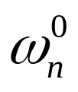

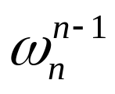

Fast Fourier Transform
Discrete Fourier Transform (DFT):
  Given: coefficients of a polynomial
a(x) = a₀ + a₁x + … + a_{n-1}x^{n-1}
  Goal: compute a( ), a( ) …a( ), is the “principal n-th root of unity”
Challenge: Perform DFT in O(n log n) time.

Slide 22
Motivation I
FFT is essential for digital signal processing
  a₀, a₁, … , a_{n-1}: signal in the “time domain”
  a( ), a( ) … a( ): signal in the “frequency domain”
  FFT enables quick conversion from one domain to the other
Used in Compact Disks, Digital Cameras, Synthesizers, etc, etc.

Slide 23
FFT
Very elaborate implementations
(e.g., FFTW, “the Fastest Fourier Transform in the West”, done at MIT)
Hardware implementations

Slide 24
Motivation II: Computer Science
We will see how to multiply two polynomials in O(n log n) time using FFT
Multiplication of polynomials → mult. of (large) integers - cryptography
Also: pattern matching, etc.

Slide 25
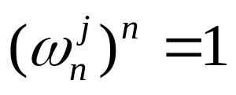
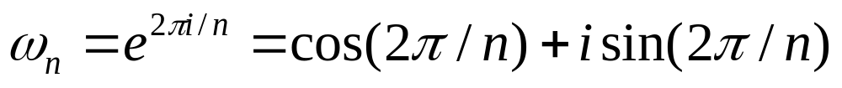
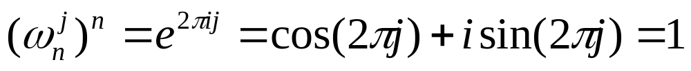
DFT
Recall: want a( ), a( ) … a( )
is the “principal n-th root of unity, i.e., for j=0…n-1 we have
We will work in the field of complex numbers where
is indeed the principal n-th root of unity:

Slide 26
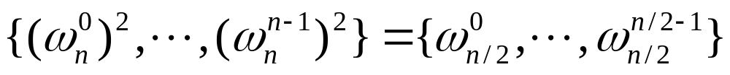
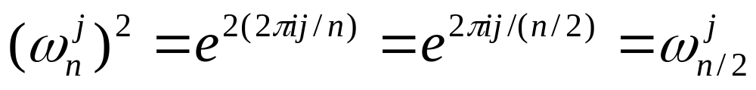
Halving Lemma
If n > 0 is even, then the squares of the n complex n-th roots of unity are the n/2 complex (n/2)-th roots of unity, i.e.:
Proof:

Slide 27
FFT
Divide-and-conquer algorithm
“Split” a(x) into a^{[0]}(x) and a^{[1]}(x):
a^{[0]}(x) = a₀ + a₂x + … + a_{n-2}x^{n/2-1}
a^{[1]}(x) = a₁ + a₃x + … + a_{n-1}x^{n/2-1}
Therefore
a^{[0]}(x²) + x a^{[1]}(x²) = a(x)

Slide 28
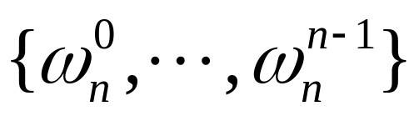
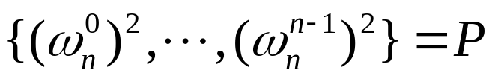
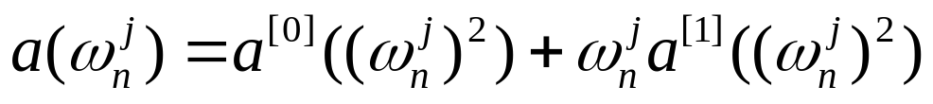
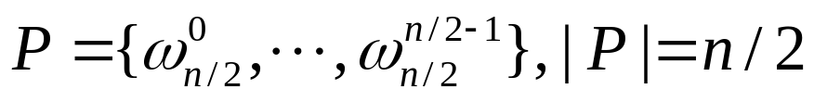
FFT: the algorithm
Recall we need to evaluate the polynomial a at points
Suffices to
  Evaluate polynomials a^{[0]} and a^{[1]} at points
  Compute
However,
Thus, we just need to recursively evaluate two polynomials with degree n/2-1 at n/2 points!
Time: T(n) = 2T(n/2) + O(n) → T(n) = O(n log n)

Slide 29
Comments
We assumed that n is a power of 2
This is NOT without loss of generality

Slide 30
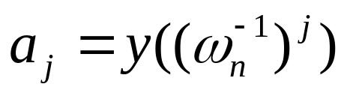
Inverse DFT
Given: the values a( ), a( ) … a( ), denoted by y₀, y₁, … , y_{n-1}.
Goal: compute the coefficients a₀, a₁,…,a_{n-1}
Algorithm:
  “Observe” that , y(x) is a polynomial with coefficients y₀,…, y_{n-1} (see CLRS for proof)
  Run FFT

Slide 31
Polynomial multiplication
Input: a(x) = a₀ + a₁x + … + a_{n-1}x^{n-1},
b(x) = b₀ + b₁x + … + b_{n-1}x^{n-1},
Output: c(x)=a(x)*b(x)=c₀+c₁x+…+c_{2n-2}x^{2n-2}
c_{i}=a₀b_{i}+a₁b_{i-1}+…+a_{i-1}b₁+a_{i}b₀
How to solve it in O(n log n) time ?

Slide 32
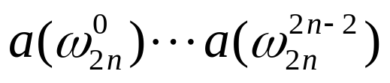
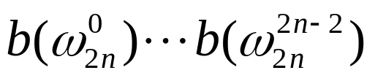
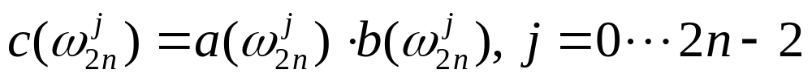
FFT-based algorithm
Extend a, b to degree 2n-2 (by adding 0’s)
Compute and
(via FFT)
Compute
Compute c₀, c₁,…,c_{2n-2} (via inverse FFT)
Same time as FFT

Slide 33
Uniqueness of c
Can show (CLRS) that if we fix the values of a (d-1)-degree polynomial at d different points, then the polynomial is unique
E.g., there is only one line passing through 2 points
Therefore, the algorithm is correct

