Slide 1
Introduction to Algorithms
Lecture 15

Slide 2
Last Time
Introduction to Computational Geometry
Computational Model
Closest Pair problem
Close Pair problem
Segment intersection problem
Orthogonal segments

Slide 3
Today’s Topics
Some difficult problems
P and NP
Polynomial-time reductions
Cook’s Theorem (SAT Problem)
NP-complete problem
  Clique
  Independent set
  Vertex cover

Slide 4
P vs NP
(interconnectedness of all things)
A whole course by itself
We’ll do just one lecture
More in “Theory of Computation”, “Computational Complexity”, etc.

Slide 5
Have seen so far
Algorithms for various problems
  Running times O(nm²), O(n²) , O(n log n), O(n), etc.
  I.e., polynomial in the input size
Can we solve all (or most of) interesting problems in polynomial time ?
Not really…

Slide 6
Example difficult problem
Traveling Salesperson Problem (TSP)
  Input: undirected graph with lengths on edges
  Output: shortest tour that visits each vertex exactly once
Best known algorithm: O(n 2^{n}) time.

Slide 7
Another difficult problem
Clique:
  Input: undirected graph G = (V, E)
  Output: largest subset C of V such that every pair of vertices in C has an edge between them
Best known algorithm: O(n 2^{n}) time

Slide 8
What can we do ?
Spend more time designing algorithms for those problems
  People tried for a few decades, no luck
Prove there is no polynomial time algorithm for those problems
  Would be great
  Seems really difficult
  Best lower bounds for “natural” problems:
    Ω(n²) for restricted computational models
    4.5n for unrestricted computational models

Slide 9
What else can we do ?
Show that those hard problems are essentially equivalent. I.e., if we can solve one of them in poly time, then all others can be solved in poly time as well.
Works for at least 10 000 hard problems

Slide 10

The benefits of equivalence
Combines research efforts
If one problem has polytime solution, then all of them do
P₁
P₂
P₃

Slide 11

A more realistic scenario
Once an exponential lower bound is shown for one problem, it holds for all of them
But someone is happy…
P₁
P₂
P₃

Slide 12
Summing up
If we show that a problem Π is equivalent to ten thousand other well studied problems without efficient algorithms, then we get a very strong evidence that Π is hard.
We need to:
  Identify the class of problems of interest
  Define the notion of equivalence
  Prove the equivalence(s)

Slide 13
Class of problems: NP
Decision problems: answer YES or NO. E.g.,”is there a tour of length ≤ K” ?
Solvable in non-deterministic polynomial time:
  Intuitively: the solution can be verified in polynomial time
  E.g., if someone gives as a tour T, we can verify if T is a tour of length ≤ K.
Therefore, TSP is in NP.

Slide 14
Formal definitions of P and NP
A problem Π is solvable in poly time (or Π ∈ P), if there is a poly time algorithm V(.) such that for any input x:
Π(x) = YES iff V(x) = YES
A problem Π is solvable in non-deterministic poly time (or Π ∈ NP), if there is a poly time algorithm V(. , .) such that for any input x:
Π(x)=YES iff there exists a certificate y of size poly(|x|) such that V(x, y)=YES

Slide 15
Examples of problems in NP
Is “Does there exist a clique in G of size ≥ K” in NP ?
Yes: V(x, y) interprets x as a graph G, y as a set C, and checks if all vertices in C are adjacent and if |C| ≥ K
Is Sorting in NP ?
No, not a decision problem.
Is “Sortedness” in NP ?
Yes: ignore y, and check if the input x is sorted.

Slide 16
Reductions: Π’ to Π
YES
YES
x’
f(x’) = x
f
A for Π
f
NO
NO
A’ for Π’

Slide 17
Reductions
Π’ is poly time reducible to Π (Π’ ≤ Π) iff there is a poly time function f that maps inputs x’ of Π’ into inputs x of Π, such that for any x’
Π’(x’) = Π(f(x’))
Fact 1: if Π ∈ P and Π’ ≤ Π then Π’ ∈ P
Fact 2: if Π ∈ NP and Π’ ≤ Π then Π’ ∈ NP
Fact 3: if Π’ ≤ Π and Π” ≤ Π’ then Π” ≤ Π

Slide 18
Showing equivalence between difficult problems
Options:
  Show reductions between all pairs of problems
  Reduce the number of reductions (!) using transitivity of “≤”
  Show that all problems in NP a reducible to a fixed Π. To show that some problem Π’∈NP is equivalent to all difficult problems, we only show Π ≤ Π’.
TSP
Clique
Π
P₃
P₄
Π’
P₅

Slide 19
The first problem Π
Satisfiability problem (SAT):
  Given: a formula ϕ with m clauses C₁,…, C_{m} over n variables.
Example: x₁ ∨ x₂ ∨ x₅ , x₃ ∨ ¬ x₅
  Check if there exists TRUE/FALSE assignments to the variables that makes the formula satisfiable

Slide 20
SAT is NP-complete
Fact: SAT ∈NP
Theorem [Cook’71]: For any Π’ ∈ NP , we have Π’ ≤ SAT.
Definition: A problem Π such that for any Π’∈NP we have Π’ ≤ Π, is called NP-hard
Definition: An NP-hard problem that belongs to NP is called NP-complete
Corollary: SAT is NP-complete.

Slide 21
What we will prove
SAT
Clique
Independent Set
Follow from Cook’s Theorem
Vertex Cover
Conclusion: all of the above problems are
NP-complete

Slide 22
Clique again
Clique:
  Input: undirected graph G = (V, E), K
  Output: is there a subset C of V, |C| ≥ K, such that every pair of vertices in C has an edge between them

Slide 23
SAT ≤ Clique
Given a SAT formula ϕ = C₁, …, C_{m} over x₁, …, x_{n}, we need to produce G = (V, E) and K, such that ϕ satisfiable iff G has a clique of size ≥ K.
Notation: a literal is either x_{i} or ¬x_{i}

Slide 24
SAT ≤ Clique reduction
For each literal t occurring in ϕ, create a vertex v_{t}
Create an edge v_{t} – v_{t’} iff:
  t and t’ are not in the same clause, and
  t is not the negation of t’

Slide 25
SAT ≤ Clique example
Formula: x₁∨ x₂ ∨ x₃, ¬x₂ ∨ ¬x₃, ¬x₁ ∨ x₂
Graph:
Claim: ϕ satisfiable iff G has a clique of size ≥ m
¬x₂
x₁
¬x₃
x₂
x₃
x₂
¬x₁

Slide 26
Proof
“→” part:
  Take any assignment that satisfies ϕ.
E.g., x₁ = F, x₂ = T, x₃ = F
  Let the set C contain one satisfied literal per clause
  C is a clique
¬x₂
x₁
¬x₃
x₂
x₃
x₂
¬x₁

Slide 27
Proof
“←” part:
  Take any clique C of size m (i.e., = m)
  Create a set of equations that satisfies selected literals.
E.g., x₃ = T, x₂ = F, x₁= F
  The set of equations is consistent and the solution satisfies ϕ
¬x₂
x₁
¬x₃
x₂
x₃
x₂
¬x₁

Slide 28
Altogether
We constructed a reduction that maps:
  YES inputs to SAT to YES inputs to Clique
  NO inputs to SAT to NO inputs to Clique
The reduction works in poly time
Therefore, SAT ≤ Clique→ Clique NP-hard
Clique is in NP → Clique is NP-complete

Slide 29
Independent set (IS)
Input: undirected graph G = (V, E)
Output: is there a subset S of V, |S| ≥ K such that no pair of vertices in S has an edge between them

Slide 30
Clique ≤ IS
Given an input G = (V, E), K to Clique, need to construct an input G’=(V’,E’), K’ to IS, such that G has clique of size K iff G’ has IS of size K’.
Construction: K’= K, V’= V, E’= E^{c}
Reason: C is a clique in G iff it is an IS in G’s complement.

Slide 31
Vertex cover (VC)
Input: undirected graph G = (V, E)
Output: is there a subset C of V, |C| ≤ K such that each edge in E is incident to at least one vertex in C.

Slide 32
IS ≤ VC
Given an input G=(V, E), K to IS, need to construct an input G’=(V’, E’), K’ to VC, such that G has an IS of size K iff G’ has VC of size K’.
Construction: V’ = V, E’ = E, K’ = |V| − K
Reason: S is an IS in G iff V − S is a VC in G.

Slide 33
3SAT
3SAT:
  Given: a formula ϕ with m clauses C₁,…, C_{m} over n variables such that |C_{i}| = 3 for 1 ≤ i ≤ m.
Example: x₁ ∨ x₂ ∨ x₃ , ¬x₁ ∨ ¬x₂ ∨ ¬x₃,
¬x₁∨ ¬x₂ ∨ ¬x₃
  Check if there exists TRUE/FALSE assignments to the variables that makes the formula satisfiable.

Slide 34
SAT ≤ 3SAT

Slide 35
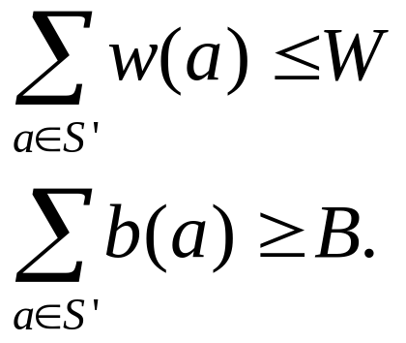
Knapsack
Given a finite set S, integer weight function w: S → N, benefit function b: S → N, weight limit W ∈ N, and desired benefit B ∈ N, determine whether there exists a subset S’ ⊆ S such that

Slide 36
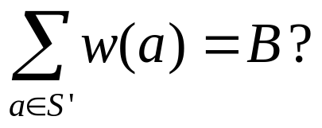
Subset Sum
Given a finite set S, integer weight function w: S → N, and target integer B, determine whether there exists a subset S’ ⊆ S such that

Slide 37
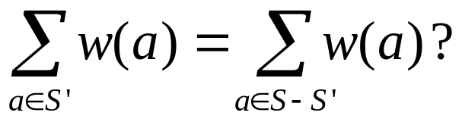
Partition
Given a finite set S and integer weight function w: S → N, determine whether there exists a subset S’ ⊆ S such that

Slide 38
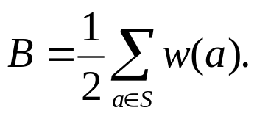
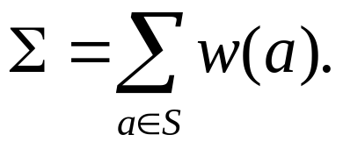
Reductions
Partition ≤ Subset Sum:
Subset Sum ≤ Partition: introducing two new elements of weight N – B and N – (Σ – B) (N > Σ), respectively, where
Partition ≤ Knapsack: b = w, and W=B= Σ/2.

Slide 39
Bin Packing
Given a finite set S, volumes w: S → N, and bin size B ∈ N, what is minimum number of bins needed to contain all the elements of S?
Decision version?
Reduction: Partition ≤ Bin Packing.

Slide 40
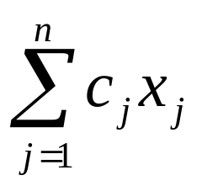
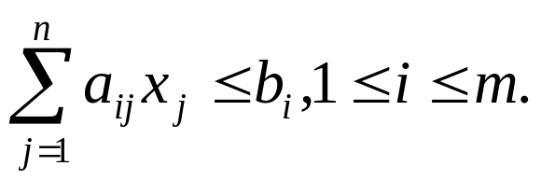
Integer Programming
Given rational numbers a_{ij}, c_{j}, and b_{i}, 1 ≤ i ≤ m, 1 ≤ j ≤ n, find integers x₁, x₂, …, x_{n} that maximizes the linear function
subject to the linear constraints
Reduction: Subset Sum ≤ IP.

Slide 41
Hamiltonian Circuit
A Hamiltonian circuit in a directed or undirected graph G = (V, E) is a circuit that visits each vertex in the graph exactly once.
The Hamiltonian circuit problem is to determine for a given graph G whether a Hamiltonian circuit exists.
Reduction: Vertex Cover ≤ Hamiltonian Circuit.

Slide 42
Traveling Salesman (TSP)
Given a number k ≥ 0 and a directed graph G = (V, E) with nonnegative edge weight w: E → N, does there exist a tour of total weight at most k visiting each vertex exactly once and returning home?
Reduction: Hamiltonian Circuit ≤ TSP.

Slide 43
Further Reading
Michael Garey and David Johnson, Computers and Intractability: A Guide to the Theory of NP-Completeness.
Michael Sipser, Introduction to the Theory of Computation, 中信出版社, 2002.
Christos Papadimitriou, Computational Complexity, 清华大学出版社, 2004.

Slide 44
The Diet Problem
Carbs
Protein
Fat
Iron
Cost
1 slice bread
30
5
1.5
10
30¢
1 cup yogurt
10
9
2.5
0
80¢
2tsp Peanut Butter
6
8
18
6
20¢
US RDA Minimum
300
50
70
100
Minimize 30 x₁ + 80 x₂ + 20 x₃
s.t. 30x₁ + 10x₂ + 6x₃ ≥ 300
5x₁ + 9x₂ + 8x₃ ≥ 50
1.5x₁ + 2.5x₂ + 18x₃ ≥ 70
10x₁ + 6 x₃ ≥ 100
x₁, x₂, x₃ ≥ 0

Slide 45
LP – Standard Form
Given rational numbers a_{ij}, c_{j}, and b_{i}, 1 ≤ i ≤ m, 1 ≤ j ≤ n, find x₁, x₂, …, x_{n} (decision variables) that maximizes the linear function (objective)
subject to the linear constraints

Slide 46
LP – Standard Form
max c^{T}x (Primal)
subject to
Ax ≤ b.
x ≥ 0.
where
c = (c₁,…,c_{n})^{T}, b = (b₁,…,b_{m})^{T}.
A = [a_{ij}]_{m×n}.

Slide 47
Applications of LP
Network Flow

Slide 48
Linear Programming Duality
Consider the following LP:
In an attempt to solve P we can produce upper bounds on its optimal value.
(P) max x₁ + x₂
st.
4x₁ + x₂ ≤ 2
x₁ + 2x₂ ≤ 1
x₁, x₂ ≥ 0

Slide 49
Some Upper Bounds
x₁ + x₂ ≤ 4x₁ + x₂ ≤ 2
x₁ + x₂ ≤ x₁ + 2x₂ ≤ 1
x₁ + x₂ ≤ 1/7(4x₁ + x₂) + 3/7(x₁ + 2x₂) ≤ 5/7

Slide 50
Linear Programming: Duality
Introducing decision variables: y₁,y₂,…,y_{m}.
The dual problem:
min b^{T}y
s.t.
A^{T}y ≥ c.
y ≥ 0.

Slide 51
Linear Programming Duality
Dual problem:
(D) min 2y₁ + y₂
st.
4y₁ + y₂ ≥ 1
y₁ + 2y₂ ≥ 1
y₁, y₂ ≥ 0

Slide 52
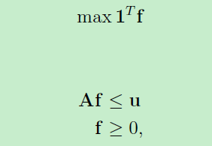
Example: Primal
Max Flow
(P) max Σ_{p ∈P} f_{p}
subject to:
Σ_{p ∈P:e∈P} f_{p} ≤ c_{e} for all e∈E
f_{p}≥ 0 for all p∈P.
s.t.

Slide 53
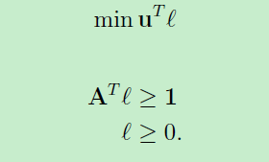
Example: Dual
Min Cut: decision variables {l_{e}}_{e∈E}.
(D)
Rewrite it as follows:
min Σ_{e ∈E} c_{e}l_{e}
subject to:
Σ_{e∈P} l_{e} ≥ 1 for all p∈P
l_{e}≥ 0 for all e∈E.
s.t.

Slide 54
Weak Duality
If x is a feasible solution to the primal LP and y is a feasible solution to the dual LP then
c^{T}x ≤ b^{T}y.
Proof.
c^{T}x ≤ (A^{T}y)^{T}x = y^{T}Ax ≤ y^{T}b.

Slide 55
Strong Duality Theorem
Suppose the primal LP is feasible (i.e., it has at least one solution) and bounded (i.e., the optimal value is not ∞). Then the dual LP is also feasible and bounded.
Moreover, if x* is the optimal primal solution, and y* is the optimal dual solution, then
c^{T}x* = b^{T}y*.

Slide 56
LP Algorithms
Simplex method (Dantzig)
Ellipsoid method (Khachian)
Interior point method (Karmarkar)
Yin Tat Lee and Aaron Sidford. Path Finding Methods for Linear Programming: Solving Linear Programs in Õ(vrank) Iterations and Faster Algorithms for Maximum Flow. FOCS 2014.

