Slide 1
Introduction to Algorithms
Lecture 16

Slide 2
Last Time
Some difficult problems
P and NP
Polynomial-time reductions
Cook’s Theorem (SAT Problem)
NP-complete problem
  Clique
  Independent set
  Vertex cover

Slide 3
Today’s Topic
Approximation Algorithms
Load Balancing
Vertex Cover
TSP
Set Cover
MAX SAT

Slide 4
Solving Hard Problems
We would like the algorithms for NP-hard optimization problems to:
  find optimal solutions
  in polynomial
  for any instance
However, if P ≠ NP, no algorithm meets more than two out of the three requirements.

Slide 5
Approximation Algorithms
An algorithm is an α-approximation algorithm for an optimization problem Π if
  The algorithm runs in polynomial time
  The algorithm always produces a solution which is within a factor of α of the value of the optimal solution.
For minimization problems, α > 1.
A(I) ≤ α·OPT(I)
For maximization problems, α < 1.
A(I) ≥ α·OPT(I)

Slide 6

Load Balancing
Input: m identical machines; n jobs, job j has processing time t_{j}.
  Job j must run contiguously on one machine.
  A machine can process at most one job at a time.
Def. Let J(i) be the subset of jobs assigned to machine i. The load of machine i is L_{i} = .
Def. The makespan is the maximum load on any machine L = max_{i} L_{i}.
Load balancing: Assign each job to a machine to minimize makespan.

Slide 7
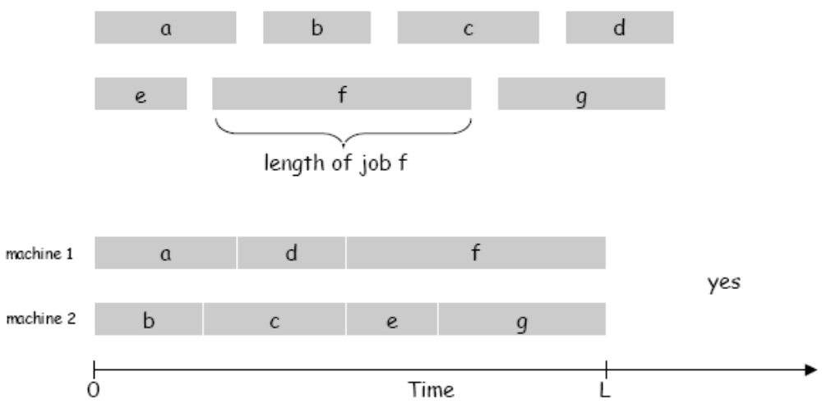
Load Balancing on 2 Machines
Claim. Load balancing is NP-hard even if only 2 machines.
Proof. PARTITION ≤ LOAD-BALANCE.

Slide 8
Load Balancing: List Scheduling
List-scheduling algorithm.
  Consider n jobs in some fixed order.
  Assign job j to machine whose load is smallest so far.
List-Scheduling(m, n, t₁,t₂,…,t_{n})
for i = 1 to m
L_{i} ← 0
J(i) ← φ
for j = 1 to n
i = argmin_{k} L_{k}
J(i) ← J(i) ∪ {j}
L_{i} ← L_{i} + t_{j}
Implementation. O(n log n) using a priority queue.

Slide 9
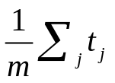
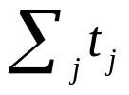
Load Balancing: List Scheduling Analysis - I
Theorem. [Graham, 1966] Greedy algorithm is a 2-approximation.
  First worst-case analysis of an approximation algorithm.
  Need to compare resulting solution with optimal makespan L*.
Lemma 1. The optimal makespan L* ≥ max_{j} t_{j}.
Pf. Some machine must process the most time-consuming job.
Lemma 2. The optimal makespan L* ≥ .
Pf.
  The total processing time is .
  One of m machines must do at least a 1/m fraction of total work.

Slide 10
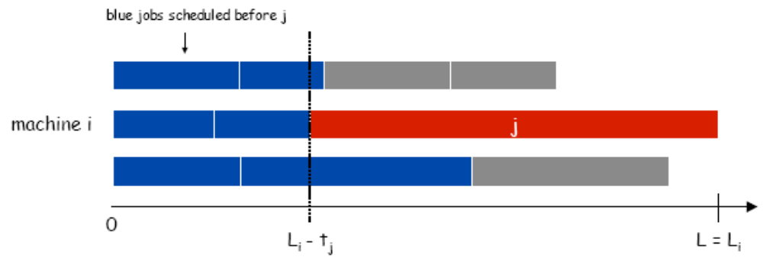
Load Balancing: List Scheduling Analysis - II
Theorem. Greedy algorithm is a 2-approx.
Pf. Consider load L_{i} of bottleneck machine i.
  Let j be last job scheduled on machine i.
  When job j assigned to machine i, i had smallest load. Its load before assignment is L_{i} - t_{j} ⇒ L_{i} - t_{j} ≤ L_{k} for all 1 ≤ k ≤ m.

Slide 11
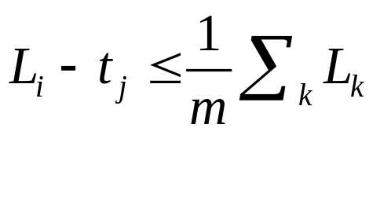
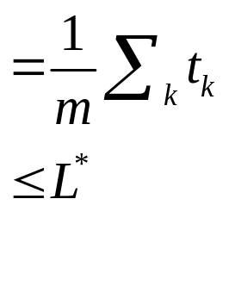
Load Balancing: List Scheduling Analysis - III
Sum inequalities over all k and divide by m:
So, L_{i} = (L_{i} – t_{j}) + t_{j} ≤ 2L*.
Lemma 2
≤ L*
≤ L* (Lemma 1)

Slide 12
Load Balancing: List Scheduling Analysis - IV
Q. Is our analysis tight?
A. Essentially yes.
Ex: m machines, m(m-1) jobs length 1 jobs, one job of length m.

Slide 13
Load Balancing: LPT Rule - I
Longest processing time (LPT). Sort n jobs in descending order of processing time (t₁ ≥ t₂ …, ≥ t_{n}), and then run list scheduling algorithm.
Observation. If at most m jobs, then list-scheduling is optimal.
Pf. Each job put on its own machine.

Slide 14
Load Balancing: LPT Rule - II
Lemma 3. If there are more than m jobs, L* ≥ 2t_{m+1}.
Pf.
Consider first m+1 jobs t₁, …, t_{m+1}.
Since the t_{i}'s are in descending order, each takes at least t_{m+1} time.
There are m+1 jobs and m machines, so by pigeonhole principle, at least one machine gets two jobs.

Slide 15
Load Balancing: LPT Rule - III
Theorem. LPT rule is a 3/2 approximation algorithm.
Pf. Same basic approach as for list scheduling.
L_{i} = (L_{i} – t_{j}) + t_{j} ≤ 3/2 L*.
Theorem. [Graham, 1969] LPT rule is a 4/3-approximation.
Pf. More sophisticated analysis of same algorithm.
≤ L*
≤ L*/2 (Lemma 3)

Slide 16
Vertex Cover
Input: An undirected graph G = (V, E).
Goal: Find a vertex cover of minimum size in G.
Example:
b
c
d
b
c
d
a
e
f
g
a
e
f
g
Optimal solution

Slide 17
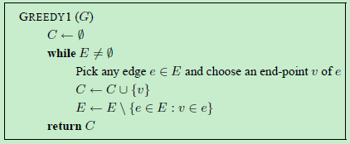
Simplest Greedy
Repeatedly picks an edge that has not yet been covered, and places one of its end-points in the current covering set.

Slide 18
Analysis of Greedy1
Consider the following bipartite graph B = (L,R,E).
  The vertex set L consists of r vertices.
  The vertex set R is further subdivided into r sets called R₁, …,R_{r}. Each vertex in R_{i} has an edge to i vertices in L and no two vertices in R_{i} have a common neighbor in L; thus, |R_{i}| = [r/i].
  It follows that each vertex in L has degree at most r and each vertex in R_{i} has degree i.
  The total number of vertices n = Θ(r log r).

Slide 19
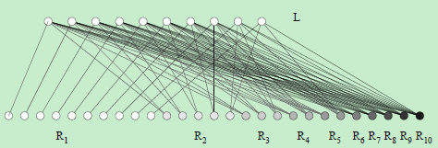
Analysis of Greedy1
Suppose that the algorithm considers an edge out of R_{r} first, choosing the end-point in R as the vertex to be placed in the cover.
Then it picks an edge out of R_{r−1}, again choosing its end-point in R for the cover C; and, so on.

Slide 20
Analysis of Greedy1
Therefore the vertex cover chosen is C = R.
But L is itself a vertex cover since the graph is bipartite.
It follows that the ratio achieved by this algorithm is no better than |R|/|L| = Ω(log r).

Slide 21
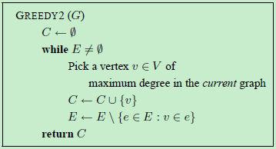
Clever Greedy Algorithm
Repeatedly choose vertices which are incident to the largest number of currently uncovered edges.

Slide 22
Analysis of Greedy2
Consider the behavior of this algorithm on the graph B.
It should be easy to see that Greedy2 could also output R as a vertex cover. It could choose vertices from R_{r} at the very first stage. After this, it could choose vertices from R_{r−1}.
In general, it would choose the highest degree vertices from R at each stage.

Slide 23
2-approximation algorithm
Approx-Vertex-Cover(G)
C ← φ, A ← φ
E’ ← E[G]
while E’ ≠ φ
do let (u, v) be an arbitrary edge of E’
C ← C ∪ {u, v}, A ← A ∪ {(u, v)}
remove from E’ every edge incident on
either u or v
return C

Slide 24
Example
The operation of Approx-Vertex-Cover:
b
c
d
b
c
d
a
e
f
g
a
e
f
g
C = φ
C = {b, c}
b
c
d
b
c
d
a
e
f
g
a
e
f
g
C = {b, c, e, f}
C = {b, c, e, f, d, g}

Slide 25
Proof
Theorem: Approx-Vertex-Cover is a polynomial time 2-approximation algorithm.
Proof.
  Approx-Vertex-Cover return a vertex cover C.
  For an optimal cover C*, |C*| ≥ |A|.
  |C| = 2|A|.
  Then, |C| = 2|A| ≤ 2|C*|.
  Note: A is a maximal matching.

Slide 26
Traveling Salesperson Problem
Traveling Salesperson Problem (TSP)
  Input: undirected graph with lengths on edges
  Output: shortest tour that visits each vertex exactly once
Best known algorithm: O(n²2^{n}) time.

Slide 27
TSP
Theorem 1 (bad news):
For any α, finding an α-approximation algorithm for TSP is NP-hard.
Theorem 2 (good news):
If input graph satisfies triangle inequality then we can find a 1.5-approximation in polynomial time.
w(u,v) = 1 for (u,v) ∈ E
= α|V|+1, otherwise

Slide 28
A simple 2-approx. algorithm
Algorithm (Metric TSP – factor 2)
  Find an MST, T, of G.
  Double every edge of the MST to obtain an Eulerian graph.
  Find a Eulerian tour, T, on this graph.
  Output the tour that visits vertices of G in the order of their first appearance in T. Let C be this tour.

Slide 29
Proof
Theorem. The above algorithm is a factor 2 approximation algorithm for metric TSP.
Proof.
cost(T) ≤ OPT.
cost(T) = 2·cost(T) (T contains each edge of T twice)
After the “short-cutting” step, cost(C) ≤ cost(T) (triangle inequality) →
cost(C) ≤ 2·OPT

Slide 30
Tight Example
Thick edges have cost 1.
The remaining edges have cost 2.
Optimal solution
MST T
tour C

Slide 31
Christofides’ Algorithm
Algorithm (Metric TSP – factor 3/2)
  Find an MST, T, of G.
  Compute a minimum cost perfect matching, M, on the set of odd-degree vertices of T. Add M to T and obtain an Eulerian graph.
  Find a Eulerian tour, T, on this graph.
  Output the tour that visits vertices of G in the order of their first appearance in T. Let C be this tour.

Slide 32
Second Lower Bound on OPT
Lemma: Let V’ ⊆ V, such that |V’| is even, and let M be a minimum cost perfect matching on V’. Then, cost(M) ≤ OPT/2.
Then, cost(C) ≤ cost(T) ≤ cost(T) + cost(M) ≤ OPT + OPT/2 = 3/2 * OPT.

Slide 33
More Results
Sanjeev Arora. Polynomial-time Approximation Schemes for Euclidean TSP and other Geometric Problems. Journal of the ACM 45(5) 753-782, 1998..
S. Oveis Gharan, A. Saberi, M. Singh. A Randomized Rounding Approach to the Traveling Salesman Problem. FOCS 2011.
http://homes.cs.washington.edu/~shayan/tsp.pdf

Slide 34
Weighted Set Cover
Input:
  Ground elements E = {e₁, e₂, …, e_{n}}
  Subsets S₁, S₂, …, S_{m} ⊆ E
  Weights w₁, w₂, …, w_{m} ≥ 0
Goal: Find a set I ⊆ {1, 2, …, m} that minimizes ∑_{i∈I}w_{i}, such that ∪_{i∈I}S_{i} = E.
Note: vertex cover is a special case of set cover.

Slide 35
Example of Weighted Set Cover
Set E = {1, 2, 3, 4, 5, 6, 7, 8}
Available subsets:
S₁ = {1, 2, 3}, w₁ = 1
S₂ = {2, 7, 8}, w₂ = 2
S₃ = {4, 5, 6, 7}, w₃ = 3
S₄ = {4, 5, 6, 8}, w₄ = 4
Solutions: C = {S₁, S₂, S₃}, C = {S₁, S₂, S₄}
Optimal Solution is C = {S₁, S₂, S₃}

Slide 36
Greedy Algorithm
Greedy-Set-Cover:
U ← E
I ← φ
while U ≠ φ
do select an S_{i} that minimizes w_{i}/|S_{i}∩U|
U ← U – S_{i}
I ← I ∪ {i}
return I

Slide 37
Greedy Algorithm
U ← E
I ← φ
while U ≠ φ
do select an S_{i} that minimizes w_{i}/|S_{i}∩U|
U ← U – S_{i}
I ← I ∪ {i}
z_{j} ← w_{i}/|S_{i}∩U| for all j in S_{i}∩U
y_{j} ← z_{j}/(1 + ln(max_{1≤i≤m} |S_{i}|))
return I

Slide 38
H_{g}-approximation Algorithm
Theorem: Greedy-Set-Cover is a polynomial time H_{g}-approximation algorithm, where H_{n} = 1 + ½ + 1/3 + … + 1/n, and g = max{|S_{i}|: i = 1..m}.
Proof…

Slide 39
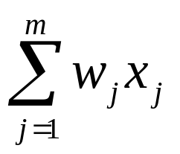
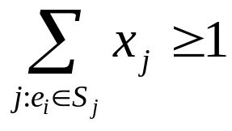
An Integer Programming Formulation
We create a variable x_{j} for each subset S_{j}.
  If j ∈ I, then x_{j} = 1, otherwise x_{j} = 0.
min
subject to:
∀e_{i} ∈ E
x_{j} ∈ {0, 1}

Slide 40
Relaxation
IP can’t be solved in polynomial time, so we relax the integrality requirement.
LP:
min
subject to:
∀e_{i} ∈ E
x_{j} ≥ 0

Slide 41
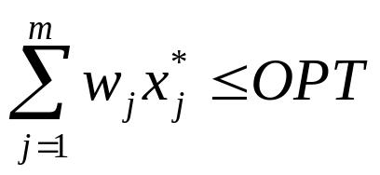
Lower Bound of OPT
We use any polynomial time LP solver to get a solution x*.
Let OPT be the optimal objective value for the integer program.
Let Z*_{LP} be the optimal objective value for the linear program.
Then, Z*_{LP} ≤ OPT. ⇒

Slide 42
Rounding
Define f_{i} = |{j : e_{i} ∈ S_{j}}| and f = max_{i} f_{i}.
Idea: round up any variable x*_{j} that is sufficiently large.
Lemma: I is a set cover.
I = {j : x*_{j} ≥ 1/f}

Slide 43
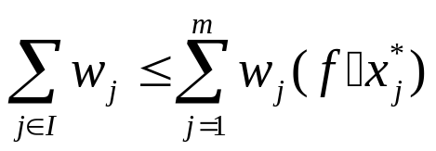
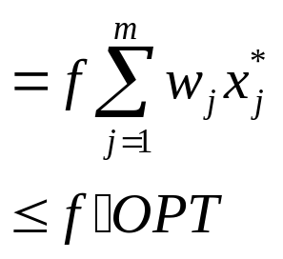
An f-approximation Algorithm
Theorem: Rounding is an f-approximation algorithm for set cover.

Slide 44
Dual
Dual:
min
subject to:
∀e_{i} ∈ E
x_{j} ≥ 0

Slide 45
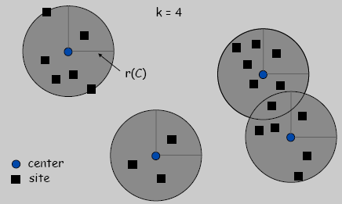
Center Selection Problem
Input: Set of n sites s₁, …, s_{n}.
Center selection problem: Select k centers C so that maximum distance from a site to nearest center is minimized.

Slide 46
Center Selection Problem
Notation.
dist(x, y) = distance between x and y.
dist(s_{i}, C) = min_{c ∈ C} dist(s_{i}, c) = distance from s_{i} to closest center.
r(C) = max_{i} dist(s_{i}, C) = smallest covering radius.
Goal. Find set of centers C that minimizes r(C), subject to |C| = k.
Distance function properties:
dist(x, x) = 0 (identity)
dist(x, y) = dist(y, x) (symmetry)
dist(x, y) ≤ dist(x, y) + dist(y, z) (triangle inequality)

Slide 47
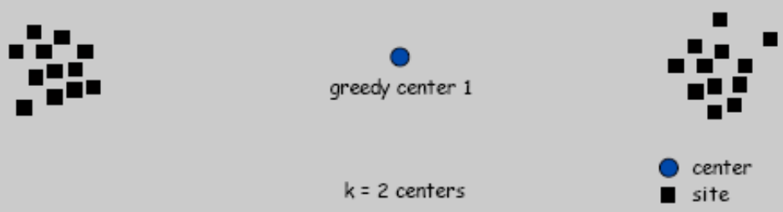
Greedy Algorithm: A False Start
Greedy algorithm:
  Put the first center at the best possible location for a single center,
  and then keep adding centers so as to reduce the covering radius each time by as much as possible.
Remark: arbitrarily bad!

Slide 48
Center Selection: Greedy Algorithm
Farthest-first Traversal: Repeatedly choose the next center to be the site farthest from any existing center.
Greedy-Center-Selection(k, n, s₁,s₂,…,s_{n})
C = φ
repeat k times
Select a site s_{i} with maximum dist(s_{i}, C)
Add s_{i} to C
return C

Slide 49
Center Selection: Analysis of Greedy Algorithm
Observation. Upon termination all centers in C are pairwise at least r(C) apart.
Proof. By construction of algorithm.
Theorem. Let C* be an optimal set of centers. Then r(C) ≤ 2r(C*).
Proof. (by contradiction) Assume r(C*) < r(C)/2.

Slide 50
Center Selection: Analysis of Greedy Algorithm
For each site c_{i} in C, consider ball of radius r(C)/2 around it.
Exactly one c_{i}* in each ball; let c_{i} be the site paired with c_{i}*.
Consider any site s and its closest center c_{i}* in C*.
dist(s, C) ≤ dist(s, c_{i}) ≤ dist(s, c_{i}*) + dist(c_{i}*, c_{i}) ≤ 2r(C*).
Thus r(C) ≤ 2r(C*).

Slide 51
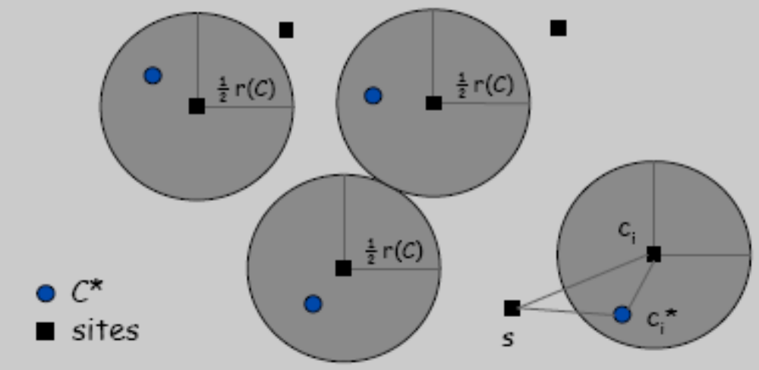
Center Selection: Analysis of Greedy Algorithm

Slide 52
Center Selection
Theorem. Greedy algorithm is a 2-approximation for center selection problem.
Remark. Greedy algorithm always places centers at sites, but is still within a factor of 2 of best solution that is allowed to place centers anywhere.
Question. Is there hope of a 3/2-approximation? 4/3?
Theorem. Unless P = NP, there no ρ-approx for center-selection problem for any ρ < 2.

Slide 53
Max SAT
Input:
  n boolean variables x₁, x₂, …, x_{n}
  m clauses C₁, C₂, …, C_{m}
  weight w_{i} ≥ 0 for each clause C_{i}
Goal: Find an assignment of TRUE/FALSE for the x_{i} that maximizes total weight of satisfied clauses.

Slide 54
Flipping Coins (Johnson’s Algorithm)
Set x_{i} to true with probability ½ independently.
Theorem: This randomized algorithm is a ½-approximation algorithm.

Slide 55
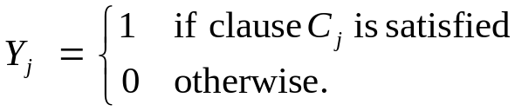
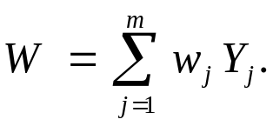
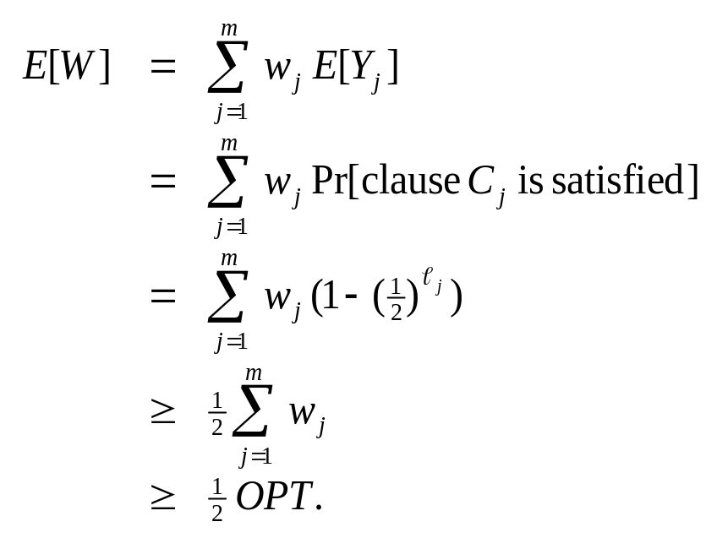
Maximum Satisfiability: Johnson's Algorithm
Proof: Consider random variable
  Let
  Let OPT = weight of the optimal assignment.
  Let _{j} be the number of distinct literals in clause C_{j}.
linearity of expectation

Slide 56
Maximum Satisfiability: Johnson's Algorithm
Corollary. If every clause has at least k literals, Johnson's algorithm is a 1 − (½)^{k} approximation algorithm.
  7/8 approximation algorithm for MAX E3SAT.
Theorem (Håstad, 1997). If MAX ESAT has an ρ-approximation for ρ > 7/8, then P = NP.
  Johnson's algorithm is best possible in some cases.

Slide 57
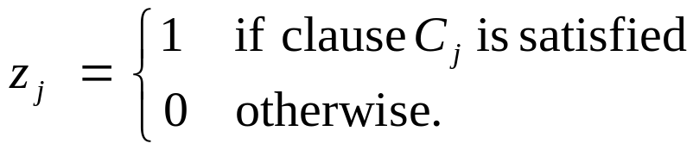
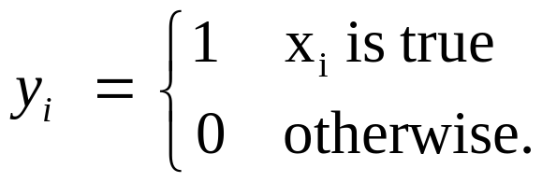
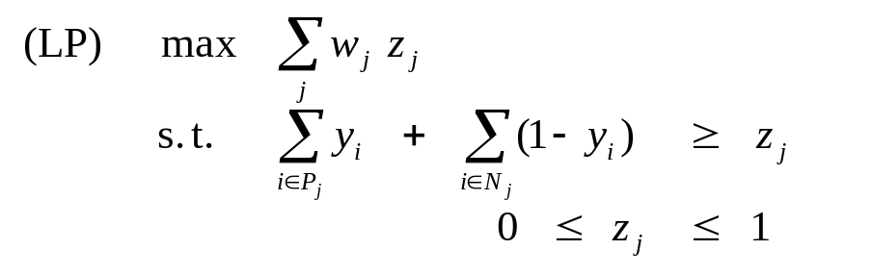
Maximum Satisfiability: Randomized Rounding
Idea 1. Used biased coin flips, not 50-50.
Idea 2. Solve linear program to determine coin biases.
P_{j} = indices of variables that occur un-negated in clause C_{j}.
N_{j} = indices of variables that occur negated in clause C_{j}.
Theorem (Goemans-Williamson, 1994). The algorithm is an (1−1/e)-approximation algorithm.

Slide 58

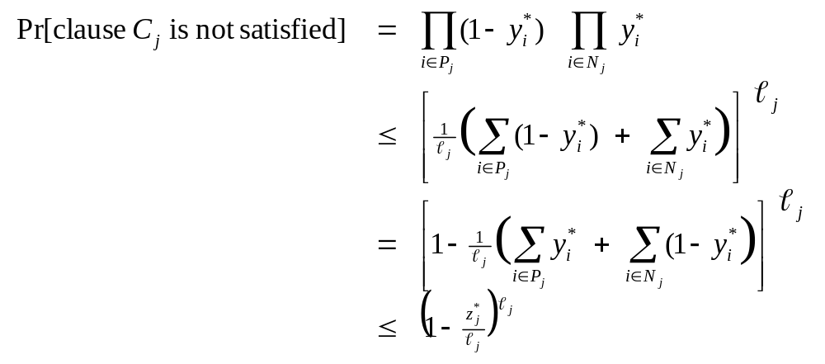
Maximum Satisfiability: Randomized Rounding
Fact 1. For any nonnegative a₁, . . . a_{k}, the geometric mean is ≤ the arithmetic mean.
Theorem (Goemans-Williamson, 1994). The algorithm is an (1−1/e)-approximation algorithm for MAX-SAT.
Proof. Consider an arbitrary clause C_{j}.
geometric-arithmetic mean
LP constraint

Slide 59
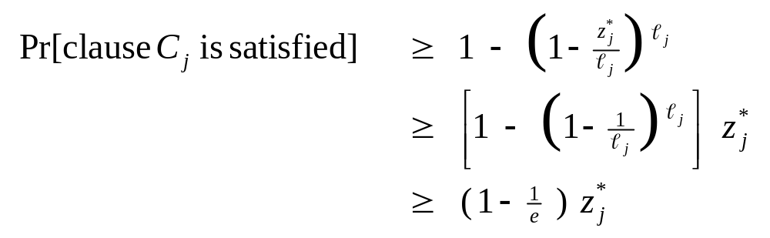
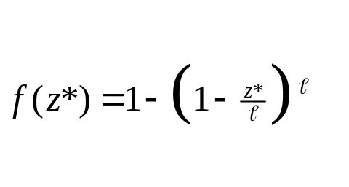
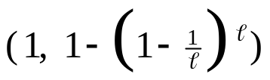

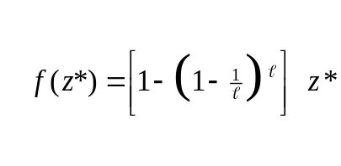

Maximum Satisfiability: Randomized Rounding
Proof (continued).
1 - (1 - z*/) is concave
(1-1/x)^{x} converges to e⁻¹
(0, 0)

Slide 60
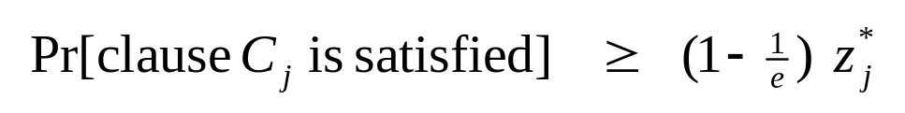
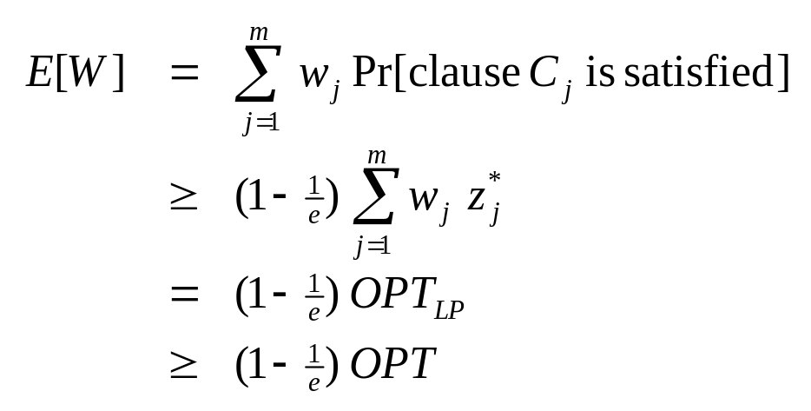
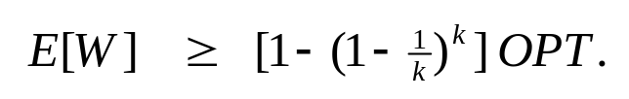
Maximum Satisfiability: Randomized Rounding
Proof (continued).
  From previous slide:
  Let W = weight of clauses that are satisfied.
  Corollary. If all clauses have length at most k

Slide 61
Maximum Satisfiability: Best of Two
Observation. Two approximation algorithms are complementary.
  Johnson's algorithm works best when clauses are long.
  LP rounding algorithm works best when clauses are short.
How can we exploit this?
  Run both algorithms and output better of two.
  Re-analyze to get 3/4-approximation algorithm.
  Better performance than either algorithm individually!

Slide 62
Best of Two
(x¹, W¹) ← Johnson(C₁,…,C_{m})
(x², W²) ← LPround(C₁,…,C_{m})
IF (W¹ > W²)
RETURN x¹
ELSE
RETURN x²
Best-of-Two (C₁, C₂,..., C_{m})

Slide 63
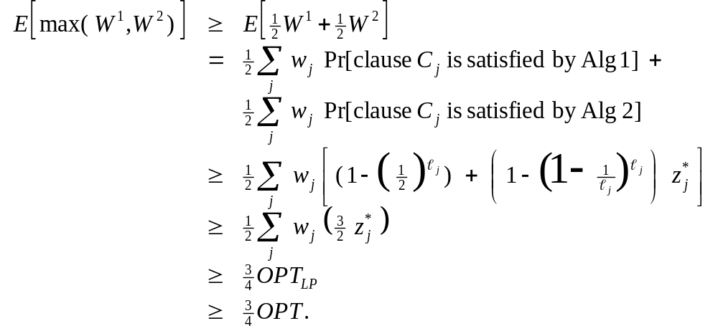
Maximum Satisfiability: Best of Two
Theorem (Goemans-Williamson, 1994). The Best-of-Two algorithm is a 3/4-approximation algorithm for MAX-SAT.
Proof.
next slide

Slide 64
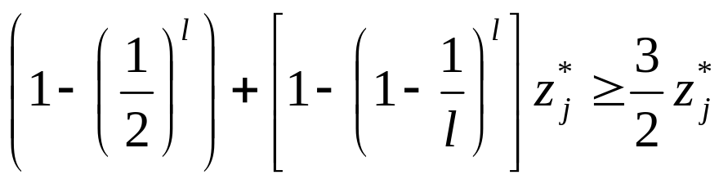
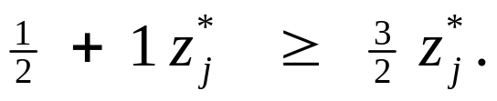
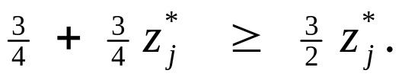
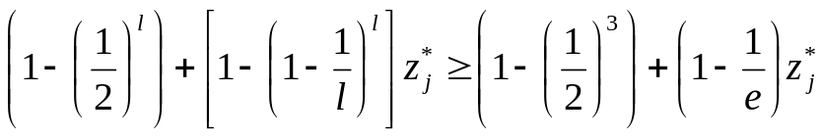
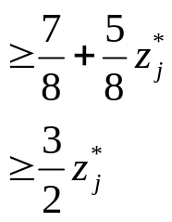
Maximum Satisfiability: Best of Two
Lemma. For any integer  ≥ 1,
Proof.
  Case 1 ( = 1):
  Case 2 ( = 2):
  Case 3 ( ≥ 3):

Slide 65
Further Reading
V. Vazirani, Approximation Algorithms, Springer, 2001.

