Slide 1
Introduction to Algorithms
Lecture 2

Slide 2
Recap

Slide 3
Today
Master Theorem
Divide-and-conquer paradigm
Strassen’s algorithm
Polynomial multiplication

Slide 4
Master method
Idea: solve class of recurrences of form
T(n) = aT(n/b) + f(n)
a≥0 and b>0, and f asymptotically positive.
Abstractly: T(n) is runtime for an algorithm; it’s unknown, but we do know that:
  a subproblems of size n/b are solved recursively, each in time T(n/b).
  f(n) is the cost of dividing problem (beforehand) and combining the results (afterward).

Slide 5



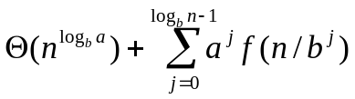
Recursion tree
f(n)
a
f(n)
f(n/b)
f(n/b)
………..
f(n/b)
af(n/b)
a
a
f(n/b²)
…
f(n/b²)
………..
f(n/b²)
…
f(n/b²)
a²f(n/b²)
a
a
a
a
………..
Θ(1)
Θ(1)
Θ(1)
Θ(1)
Θ(1)
………..
Θ(1)
Total:

Slide 6
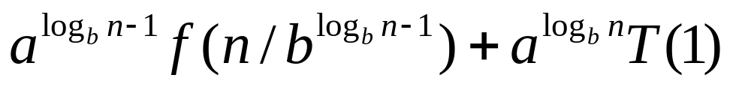
Analysis
#of leaves =
Iterating the recurrence (expanding the tree) yields
T(n) = f(n) + aT(n/b)
= f(n) + af(n/b) + a²T(n/b²)
= f(n) + af(n/b) + a²f(n/b²) +…
+

Slide 7
Intuition
Three common cases:
  Running time dominated by cost at leaves.
  Running time evenly distributed throughout tree
  Running time dominated by cost at root
Thus, to solve recurrence we need only characterize the dominant term in each case!

Slide 8
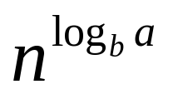

In each case, compare f(n) and
Case 1:
for some constant ε > 0.
  f(n) grows polynomially slower than
  Weight of each level increases geometrically from root to leaves (1,a¹,a²,…)
  Leaves contain constant fraction of total weight; i.e., total is constant × #of leaves.
the work at leaves dominates.

Slide 9
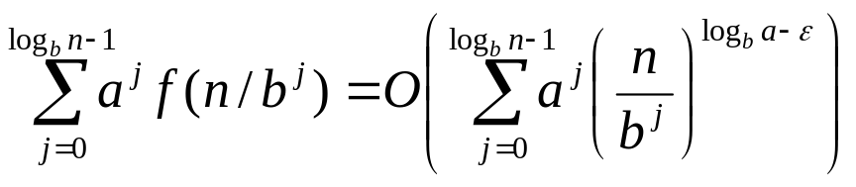
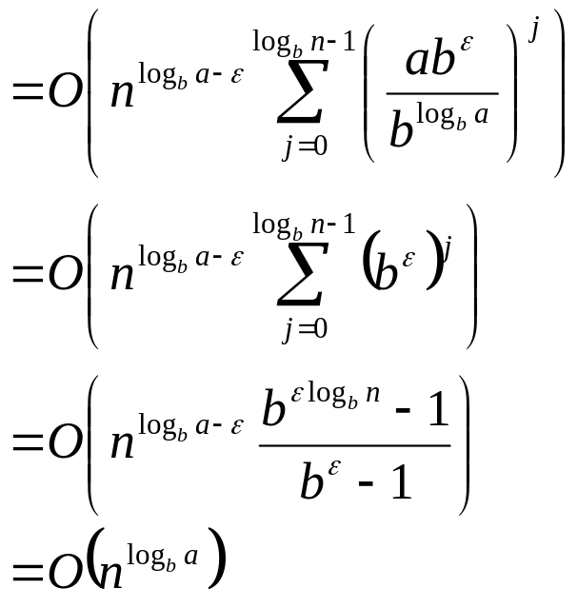
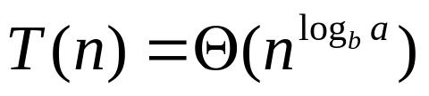
Analysis of Case 1
Thus

Slide 10
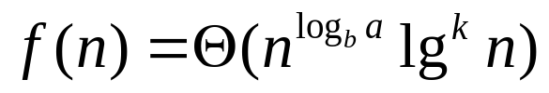
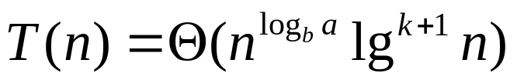
Case 2
for some constant k≥0
f(n) and same to within a polylogarithmic factor (log to a power)
Weight decreases from root to leaves
Thus
Work is distributed evenly throughout tree

Slide 11


Case 3
for some constant ε>0
Also, need “regularity condition”:
∃c<1 and n₀>0 such that
af(n/b) ≤ cf(n) ∀n > n₀
f(n) grows polynomially faster than
Weight is geometrically decreasing from root to leaves
Root contains constant fraction of total weight
Thus, Cost at root dominates.

Slide 12
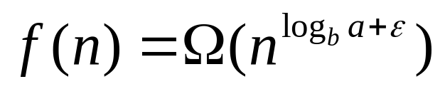
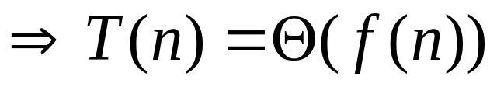
Master Theorem, Summarized
Master Theorem: T(n) = aT(n/b) + f(n)
1.
2.
3.
and af(n/b) ≤ cf(n)

Slide 13
MT Strategy
Basic strategy:
Extract a, b, and f(n) from given recurrence
Determine
Compare f(n) and asymptotically
Determine appropriate MT case (if any), and apply it.

Slide 14
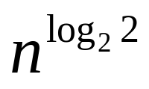
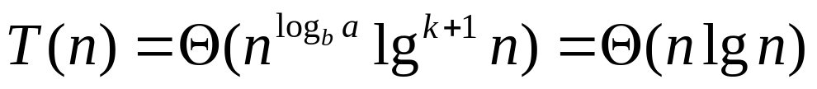
MT examples
For merge sort:
T(n) = 2T(n/2) + Θ(n); a=2, b=2
= = n
⇒Case 2, with k=0

Slide 15
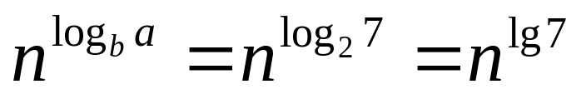
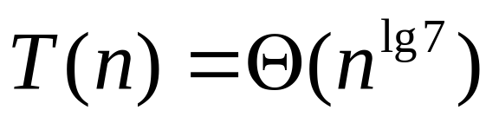
MT examples (cont.)
T(n) = 7T(n/2) + Θ(n²)
⇒ Case 1, applies

Slide 16
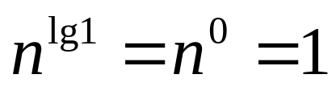
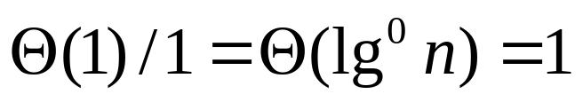
MT examples (cont.)
Binary search (not sort!):
T(n) = T(n/2) + Θ(1); (a=1, b=2)
⇒ Case 2,
T(n) = Θ(lgn)

Slide 17

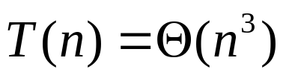
MT examples (cont.)
T(n) = 4T(n/2) + n³; (a=4, b=2)
Are we done?
No… Need to check regularity condition:
4f(n/2) ≤ cf(n)
4n³/8 ≤ cn³
n³/2 ≤ cn³
c=3/4<1
⇒Case 3

Slide 18
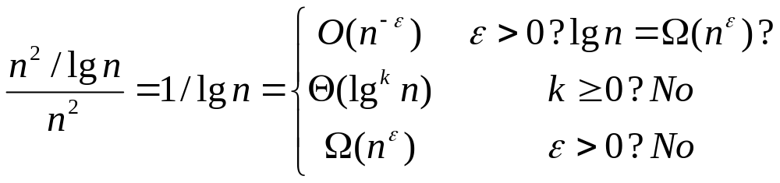
MT examples (cont.)
One more recurrence:
T(n) = 4T(n/2) + n²/lgn
No MT case applies!
Solution: T(n) = Θ(n²lglgn) – substitution.

Slide 19
Merge Sort (review)
To sort n numbers:
1. if n=1, done.
2. recursively sort 2 lists of numbers with n/2 and n/2 elements
3. merge 2 sorted lists in Θ(n) time
Example: 1 5 2 4 6 3 2 6

Slide 20
Example of Merge Sort
1 5 2 4 6 3 2 6
1 5 2 4
6 3 2 6
1 5
2 4
6 3
2 6
1
5
2
4
6
3
2
6
1 5
2 4
3 6
2 6
1 2 4 5
2 3 6 6
1 2 2 3 4 5 6 6

Slide 21
Structure of merge sort algorithm
break problem into similar (smaller) subproblems
recursively solve subproblems
combine solutions to produce final answer

Slide 22
Divide-and-conquer paradigm
1. Divide problem into subproblems.
2. Conquer subproblems by solving recursively.
3. Combine subproblem solutions.

Slide 23
Example of D&C Paradigm
Merge sort as Divide-and-conquer algorithm
1. Divide: Divide n-array into two n/2-
subarrays.
2. Conquer: Sort the two subarrays recursively.
3. Combine: Linear-time merge.

Slide 24
Recurrence for Merge sort
subproblem size
T(n) = 2 T( n/2 )
#subproblems
+ Θ(n)
work dividing & combining
T(n) = 2T(n/2) + Θ(n)

Slide 25
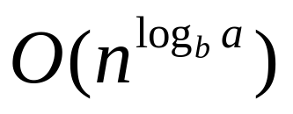
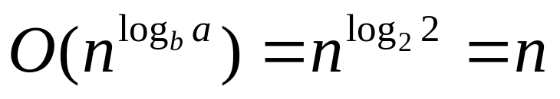
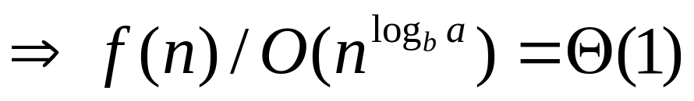
Merge sort analysis
write recurrence T(n) = 2T(n/2) + Θ(n)
solve using MT
Characterize
a=2 and b=2 ⇒
⇒ Case 2 of MT ⇒ T(n) = Θ(nlgn)

Slide 26
Binary search
Search for a key in a sorted array
Example: Given array:
3 5 7 8 9 12 15
Find key 9

Slide 27
Binary search
Binary search as Divide-and-conquer
algorithm:
1. Divide: Check middle element.
2. Conquer: Search one subarray.
3. Combine: Trivial.

Slide 28
Recurrence for binary search
subproblem size
T(n) = 1 T( n/2 )
#subproblems
+ Θ(1)
work dividing & combining
T(n) = T(n/2) + Θ(1)

Slide 29
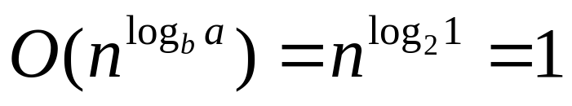
Binary search analysis
solve using MT:
Characterize
a=1 and b=2 ⇒
⇒ Case 2 of MT ⇒ T(n) = Θ(lgn)

Slide 30
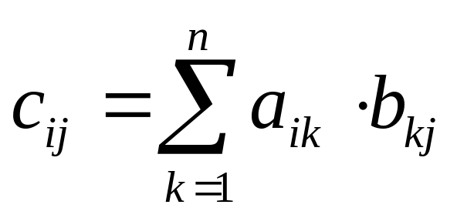
Matrix multiplication
Multiply A, B to produce C – all n×n matrices
Input: A=(a_{ij}), B=(b_{ij})
Output: C=(c_{ij})=AB

Slide 31
Standard algorithm
for i ← 1 to n
do for j ← 1 to n
do c_{ij} ← 0
for k ← 1 to n
do c_{ij} ← c_{ij} + a_{ik}•b_{kj}
Running time = Θ(n³)

Slide 32
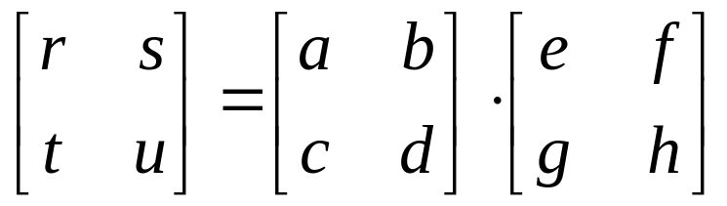
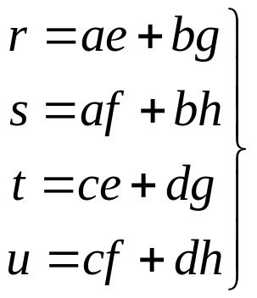
Divide-and-conquer algorithm
Idea:
n×n matrix = 2×2 matrix of (n/2)×(n/2)
submatrices:
8 mults of (n/2)×(n/2) submatrices
4 adds of (n/2)×(n/2) submatrices

Slide 33
Analysis of D&C algorithm
submatrix size
T(n) = 8 T( n/2 )
#submatrices
+ Θ(n²)
work adding submatrices
T(n) = Θ(n³). No better than the ordinary algo.

Slide 34
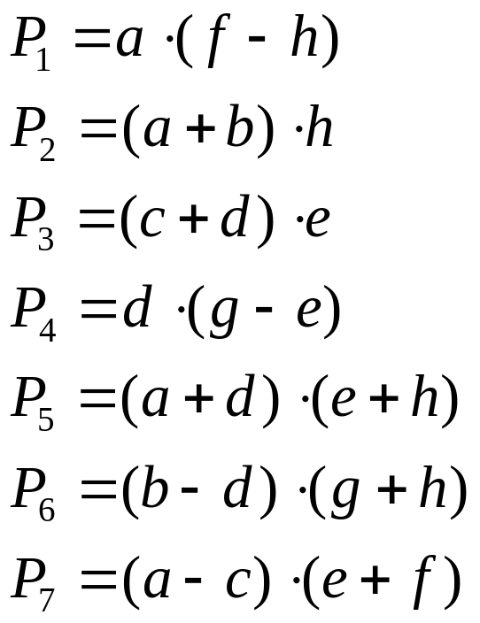
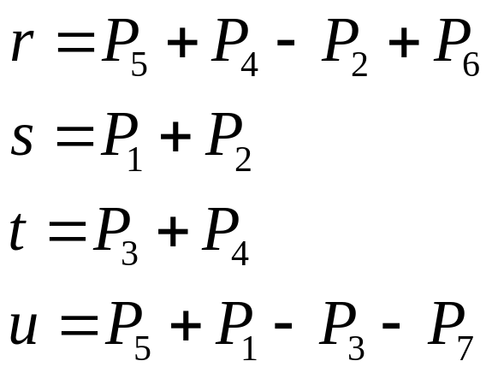
Strassen’s idea
Multiply 2×2 matrices with only 7 recursive mults.

Slide 35
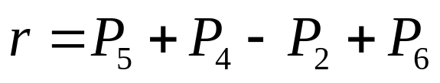

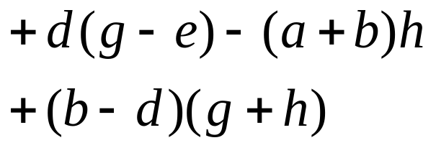

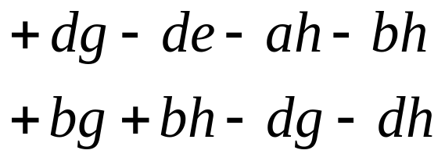

Strassen’s idea (cont.)
Multiply 2×2 matrices with only 7 recursive mults.

Slide 36
Counting primitives in Strassen’s algorithm
Old method: 8 Mults, 4 Adds
New method: To compute P₁,…,P₇, r, s, t, u
need
7 multiplications
18 additions (and subtractions)
  14 more adds! – cost of eliminating 1 multiplication
Note: No reliance on commutativity of mult.

Slide 37
Strassen’s algorithm
Divide: Partition A and B into (n/2)×(n/2)
submatrices. Use + and − to form terms to be multiplied.
2. Conquer: Perform 7 multiplications of (n/2)×(n/2) submatrices recursively.
3. Combine: Form C using + and − on (n/2)×(n/2) submatrices.

Slide 38
Analysis
subproblem size
T(n) = 7 T( n/2 )
#multiplications
+ Θ(n²)
work combining, i.e. adding
T(n) = 7T(n/2)+Θ(n²)=Θ(n^{lg7})= Θ(n^{2.81}) (case 1)
Θ(n^{2.81}) vs Θ(n³), wins for n≥50 in practice.
Best algorithm to date: Θ(n^{2.376}) (not practical)

Slide 39
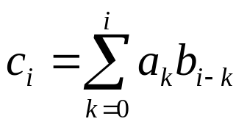
Polynomial multiplication
A, B – n-th order poly, C – 2n-th order poly
A(x) = a₀ + a₁x + a₂x² +…+ a_{n}x^{n}
B(x) = b₀ + b₁x + b₂x² +…+ b_{n}x^{n}
C(x) = A(x)•B(x) = c₀ + c₁x₁ +c₂x²+…+ c_{2n}x^{2n}
Convention: a_{j}, b_{j}=0 when j > n.
Ordinary algorithm: Θ(n²) running time.
for i = 0,…,2n

Slide 40
How to multiply two polynomials
Faster? Use divide and conquer
  A(x) = (a₀+…+a_{n/2-1}x^{n/2-1}) +
  x^{n/2}(a_{n/2}+a_{n/2+1}x+…+a_{n}x^{n/2})
  = P(x) + x^{n/2}Q(x)
  B(x) = R(x) + x^{n/2}S(x)
  C(x) = P(x)·R(x)
  + x^{n/2}(P(x)·S(x) + R(x)·Q(x))
  +x^{n}Q(x)·S(x)

Slide 41
Divide-and-conquer algorithm
Divide: Partition A, B into sum of a n/2-th order poly and x^{n/2}×(n/2-th order poly).
Conquer: Perform 4 multiplications (P·R, P·S, R·Q, and Q·S) recursively.
Combine: Form C using + and −.
Analysis: T(n)=4T(n/2)+Θ(n) ⇒ T(n)=Θ(n²)

Slide 42
Clever divide-and-conquer
(a+by)(c+dy) = ac + (ad + bc)y + bdy²
Let
m₁ = (a+b)·(c+d)
m₂ = a·c
m₃ = b·d
then can avoid 4th multiplication, since:
ad + bc = m₁ − m₂ − m₃

Slide 43
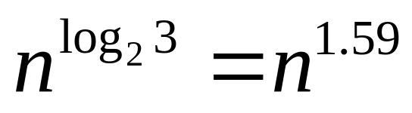
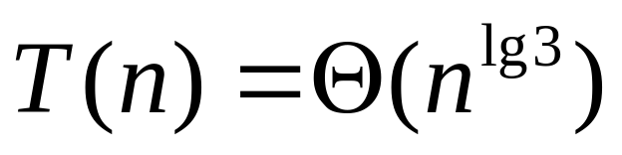
Analysis
T(n) = 3T(n/2) + Θ(n)
⇒ Case 1 of MT

Slide 44
作业：4.2-5,4-1,4-7,30.2-7,30-2
预习：ch5, 7, 9.

