Slide 1
Introduction to Algorithms
Lecture 3

Slide 2
Recap
Master Theorem
Unbalanced recursion trees
Divide-and-conquer paradigm
Strassen’s algorithm
Polynomial multiplication

Slide 3
Today
Heaps and Heapsort
Priority Queues
Quicksort
Probability
Randomized Algorithms

Slide 4
Heapsort
Properties:
  O(nlgn) – like merge sort, but unlike insertion
  Sorts in place – like insertion, but unlike merge
  Heapsort combines better attributes of these sorting algorithms

Slide 5
Heapsort
Data Structure: binary heap A
  Simple array
  Viewed as a nearly complete binary tree
  heap property:
  A[parent(x)] ≥ A[x]
  This defines a max-heap
There are also min-heaps and k-ary heaps

Slide 6
Heaps: Example
1
16
Notice the implicit tree links: Children of node i are 2i and 2i+1
Why is this useful?
Multiplication by 2 is a left shift in binary or add to self - fast
2
3
4
14
10
7
5
6
8
7
9
3
8
9
10
2
4
1

Slide 7
Heaps: Extract-Max
Heap-Extract-Max(A)
  //Removes and returns largest element of A
  max ← A[1]
  A[1] ← A[n]
  n ← n−1
  Heapify(A,1) //Remakes heap
  return max
Running time? Θ(1) + Heapify time.

Slide 8
Heaps: Heapify
Heapify(A,i):
i is index into array A
Binary trees rooted at Left(i) and Right(i) are heaps
But, A[i] may be smaller than its children, thus violating the heap property.
Heapify makes A a heap once more.
How?
Move A[i] down in heap until heap property is satisfied.

Slide 9
Heaps: Heapify
Heapify(A, i) //n is total number of elements
  //Left & Right subtrees of i are heaps
  //Makes subtree rooted at i a heap
  l←Left(i) //l=2i
  r←Right(i) //r=2i+1
  if l≤n and A[l]>A[i]
  then largest←l
  else largest←i
  if r≤n and A[r]>A[largest]
  then largest←r
  if largest≠i
  then exchange A[i]↔A[largest]
  Heapify(A, largest)

Slide 10
Heapsort – comments
Correctness: induction on the height of i
Analysis: time proportional to height of i = O(lgn)
For faster code, use a loop instead of recursion.

Slide 11
Heaps: Heapify Example
Call Heapify(A, 2)
1
16
2
3
i
4
4
10
7
5
6
14
7
9
3
8
9
10
2
8
1

Slide 12
Heaps: Heapify Example (cont.)
Exchange A[2] with A[4] and recursively call Heapify(A, 4)
1
16
2
3
4
14
10
7
5
6
i
4
7
9
3
8
9
10
2
8
1

Slide 13
Heaps: Heapify Example (cont.)
Exchange A[4] with A[9] and recursively call Heapify(A, 9)
1
16
2
3
4
14
10
7
5
6
8
7
9
3
8
9
10
i
2
4
1

Slide 14
Heaps: Heapify Example (cont.)
Node 9 has no children, so we are done.
1
16
2
3
4
14
10
7
5
6
8
7
9
3
8
9
10
2
4
1

Slide 15
Heaps: Heapsort
Heapsort(A) Analysis
  Build-Heap(A) ??
  for i←n downto 2 n times
  do exchange A[1]↔A[i] O(1)
  n←n–1 O(1)
  Heapify(A,1) O(lgn)
Total Running time:
O(nlgn) + Build-Heap(A) time

Slide 16
Heaps: Building a heap
Convert an array A[1..n], where n = length[A], into a heap.
Notice that the elements in the subarray A[(n/2+1)..n] are already 1-element heaps to begin with.
Build-Heap(A)
  for i←n/2 downto 1
  do Heapify(A, i)

Slide 17
Build-Heap: Example
A
4 1 3 2 16 9 10 14 8 7
1
1
4
4
2
3
2
3
1
3
1
3
⇒
4
5
6
7
4
5
6
7
2
16
9
10
2
16
9
10
8
9
10
8
9
10
14
8
7
14
8
7

Slide 18
Build-Heap: Example (cont.)
1
1
4
4
2
3
2
3
1
3
1
10
⇒
4
5
6
7
4
5
6
7
14
16
9
10
14
16
9
3
8
9
10
8
9
10
2
8
7
2
8
7

Slide 19
Build-Heap: Example (cont.)
1
1
4
16
2
3
2
3
16
10
14
10
⇒
4
5
6
7
4
5
6
7
14
7
9
3
8
7
9
3
8
9
10
8
9
10
2
8
1
2
4
1

Slide 20
Heaps: Build-Heap: Rough Analysis
Correctness: induction on i. All trees rooted at m > i are heaps.
Running time: n calls to Heapify = nO(lgn) = O(nlgn)
This is good enough for an O(nlgn) bound on Heapsort, but sometimes we build heaps for other reasons, so…

Slide 21
Heaps: Build-Heap: Tighter Analysis
height of node: longest path from node to leaf
height of tree: height of root
Build-Heap(A)
  for i←n/2 downto 1
  do Heapify(A, i)
Time of Heapify = O(height of subtree rooted at i)
Assume n=2^{k} – 1 (a complete binary tree)

Slide 22
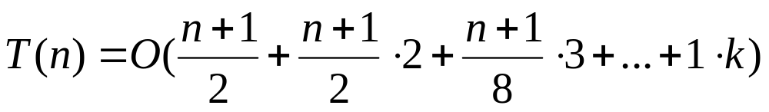
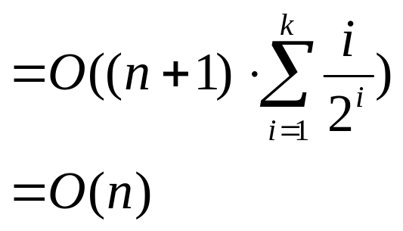
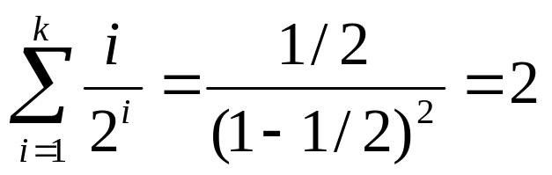
Heaps: Build-Heap: Tighter Analysis
since

Slide 23
Data Structures for Dynamic Sets
Support these Operations:
Dynamic Sets/Operations
  Insert(x, S): S←S ∪ x
  Delete(x, S): S←S – x
Static Sets/Operations
  Min(S): smallest x∈S
  Search(k, S): return x∈S with key[x] = k

Slide 24
Priority Queue
Support these Operations:
Insert
Extract-Min – Remove and return minimum
Insert – O(n) time (Ω(n))
Extract-Min – O(1)
Linked List
4
9
52
36

Slide 25
Priority Queue
A min-heap makes an excellent priority queue
Heap-Insert(A, key)
1 heap-size[A] ← heap-size[A] + 1
2 i ← heap-size[A]
3 while i>1 and A[Parent(i)] > key
4 do A[i] ← A[Parent(i)]
5 I ← Parent(i)
6 A[i] ← key
like insertion method of insertion sort.
O(lgn) time for n element heap.
Extract-Min – like Extract-Max: O(lgn) time

Slide 26
Heap-Insert: Example
1
16
2
3
14
10
4
5
6
7
8
7
9
3
8
9
10
2
4
1
1
16
2
3
14
10
4
5
6
7
8
7
9
3
8
9
10
11
2
4
1
15

Slide 27
Heap-Insert: Example (cont.)
1
16
2
3
14
10
4
5
6
7
8
15
9
3
8
9
10
11
2
4
1
7
1
16
2
3
15
10
4
5
6
7
8
14
9
3
8
9
10
11
2
4
1
7

Slide 28
Quicksort
Proposed by C.A.R. Hoare in 1962.
Divide-and-conquer algorithm.
Sorts “in place”
  like insertion sort
  unlike merge sort
Very practical (with tuning)

Slide 29
Divide-and-conquer
Divide: Partition the array into two subarrays around a pivot x such that elements in lower subarray ≤ x ≤ elements in upper subarray.
Conquer: Recursively sort the two subarrays.
Combine: Trivial (because in place).
Key: Linear-time partitioning procedure.
≤ x
x
≥ x

Slide 30
Partition procedure
Partition(A, p, r)
//Partition A[p..r] around last element x=A[r]
//Return q s.t. A[q] = x and A[q+1] > x.
x←A[r]
i←p
while A[i] ≤ x and i ≤ r
do i ← i + 1
for j ← i + 1 to r
do if A[j] ≤ x
then exchange A[i] ↔ A[j]
i ← i +1
return i–1

Slide 31
Example of partition
shows elements to be exchanged.
7 8 2 6 5 1 3 4
x←4 (pivot)
i
j
2 8 7 6 5 1 3 4
i
j
2 1 7 6 5 8 3 4
i
j
2 1 3 6 5 8 7 4
move pivot
i
2 1 3 4 5 8 7 6
≤pivot
pivot
>pivot

Slide 32
Correctness proof idea
Loop invariant:
Time = Θ(n) for n-element subarray
j increment n – 1 times, Θ(1) work each time
≤ x
> x
?
x
p
i
j
r

Slide 33
Quicksort
Quicksort(A, p, r)
if p < r
then q ← Partition(A, p, r)
Quicksort(A, p, q−1)
Quicksort(A, q+1, r)
Initial call: Quicksort(A, 1, length[A])

Slide 34
Analysis of Quicksort
Assume all input elements are distinct. Picking index of element is equivalent to picking element.
Running time depends on distribution of splits. Assume all splits have same probability.

Slide 35
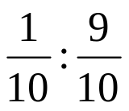
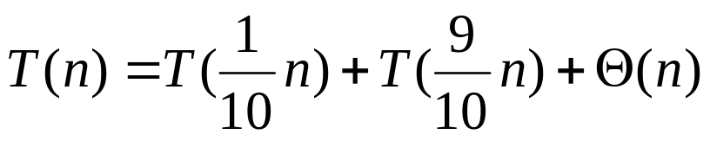
Analysis of Quicksort (best case)
If we’re lucky, Partition splits the array evenly:
T(n) = 2T(n/2) + Θ(n)
= Θ(n lgn) (same as merge sort)
What if the split is always ?
What is the solution to this recurrence?

Slide 36
Analysis of “almost-best” case
T(n)

Slide 37
Analysis of “almost-best” case
cn
T(n/10)
T(9n/10)

Slide 38
Analysis of “almost-best” case
cn
cn/10
9cn/10
T(n/100)
T(9n/100)
T(9n/100)
T(81n/100)

Slide 39
Analysis of “almost-best” case
cn
cn
cn/10
9cn/10
cn
log_{10/9}n
cn/100
9cn/100
9cn/100
81cn/100
cn
O(n) leaves
Θ(1)
Θ(1)

Slide 40
Analysis of “almost-best” case
cn
cn
cn/10
9cn/10
cn
log_{10/9}n
log₁₀n
cn/100
9cn/100
9cn/100
81cn/100
cn
O(n) leaves
Θ(1)
Θ(1)
cnlog₁₀n ≤ T(n) ≤ cnlog_{10/9}n + O(n)

Slide 41
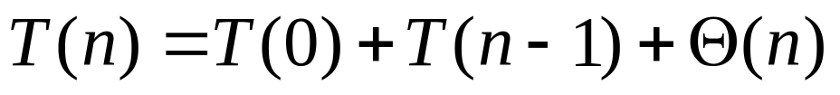
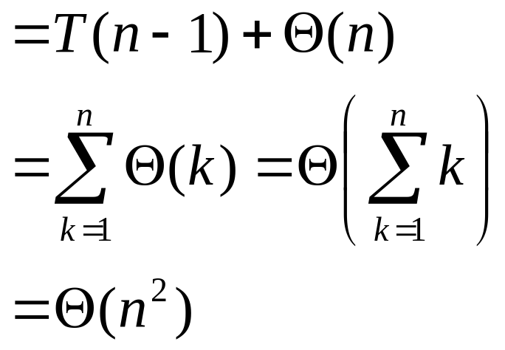
Analysis of Quicksort (worst case)
How might we be unlucky?
one side of partition has no elements
because T(0) = Θ(1)

Slide 42
When does worst case occur?
input is already sorted (or reverse sorted)
same recurrence for worst case of insertion sort, but input already sorted is best case for insertion.

Slide 43
Analysis of Quicksort
Suppose we alternate lucky, unlucky, lucky,
unlucky…
L(n) = 2U(n/2) + Θ(n) lucky
U(n) = L(n–1) + Θ(n) unlucky
then
L(n) = 2(L(n/2–1) + Θ(n/2)) + Θ(n)
= 2L(n/2–1) + Θ(n)
= Θ(n lgn)

Slide 44
How to avoid the bad cases?
How can we make sure we are usually lucky?
Partition around “middle” (n/2th) element. (Attempt to avoid the bad cases of sorted or reverse-sorted data.)
No, still has bad input permutation.
What is it?
Partition around random element.
Works well in practice.

Slide 45
“Randomized” algorithm
running time is independent of input ordering
no specific input elicits worst-case behavior (adversary argument)
worst case determined only by output of random number generator

Slide 46
Randomized Quicksort
Assume all elements are distinct
Partition around random element
⇒ all splits (0 : n–1, 1 : n–2,…, n–1 : 0) are equally likely with probability 1/n.

Slide 47
Randomized Quicksort
New “randomized” partitioning: swap before
actually partitioning.
Randomized-Partition(A, p, r)
  i←Random(p, r)
  exchange A[r]↔A[i]
  return Partition(A, p, r)
Randomized-Quicksort(A, p, r)
  if p<r
  then q←Randomized-Partition(A, p, r)
  Randomized-Quicksort(A, p, q–1)
  Randomized-Quicksort(A, q+1, r)

Slide 48
Analysis of randomized algorithms
interested in average or expected running time
Need to review the key ideas from probability

Slide 49
Probability
sample space (set) A of elementary events (elements)
e.g. the (set of) 36 ways 2 dice can fall
An event A is a subset of S
e.g. rolling 7 with 2 dice
A probability distribution Pr{} is a mapping from events of S to R.

Slide 50
Probability axioms
Pr{A} ≥ 0
Pr{S} = 1
Pr{A∪B} = Pr{A} + Pr{B} if A∩B = ∅
e.g. in dice example, Pr{A} = |A|/36.

Slide 51
Probability
Pr{A∪B} = Pr{A} + Pr{B} − Pr{A∩B}
≤ Pr{A} + Pr{B}
e.g.
Pr{roll 4 or doubles}
= Pr{roll 4} + Pr{roll doubles}
− Pr{roll (2,2)}
= 3/36 + 6/36 − 1/36 = 8/36

Slide 52
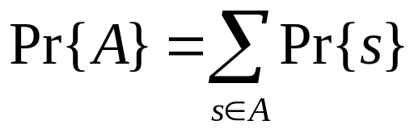
Probability
For discrete probability distributions (S finite
or countable infinite)
A (discrete) random variable (RV) X is a
function from sample space S to R.
The event “X=x” is defined to be
{s∈S : X(s) = x}

Slide 53
Probability
Example: Roll 2 dice
|S|=36 possible outcomes
Uniform distribution: Each element has probability 1/|S| = 1/36.
Let X be sum of dice.
Pr{X=5} = 4/36
{(1,4), (2,3), (3,2), (4,1)}

Slide 54
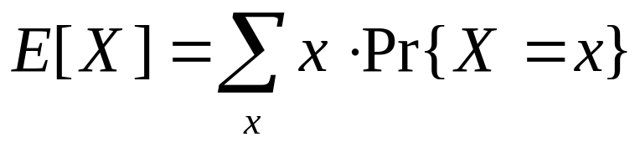
Expectation
Expected value:
Linearity of expectation:
E[aX+Y] = aE[X] + E[Y] for constant a

Slide 55
Independence of two r.v.s
Two random variables X and Y are independent, if ∀x, y
Pr{X=x and Y=y} = Pr{X=x}·Pr{Y=y}
If X and Y are independent,
E[XY] = E[X]·E[Y]

Slide 56
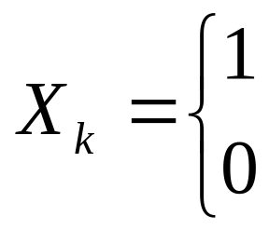
Back to Randomized Quicksort
Assume all element are distinct.
Partition around random element
⇒ all splits (0 : n–1, 1 : n–2,…, n–1 : 0) are equally likely with probability 1/n.
For k=0,…,n–1, let X_{k} be RV s.t.:
Then
E[X_{k}] = Pr{X_{k}=1} = 1/n
if Partition generates k:n–k–1 split
otherwise

Slide 57
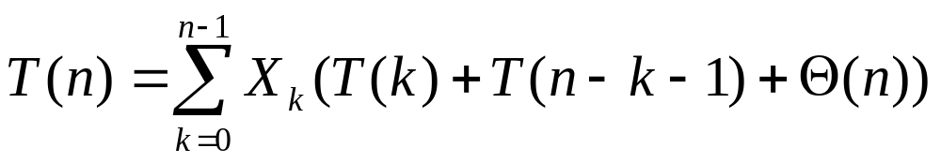
Analysis of Randomized Quicksort
Assume random number generates independent
choices throughout algorithm.
Let
T(n) = random variable (RV)
for running time on input of size n
then
interested in expected running time E[T(n)].

Slide 58
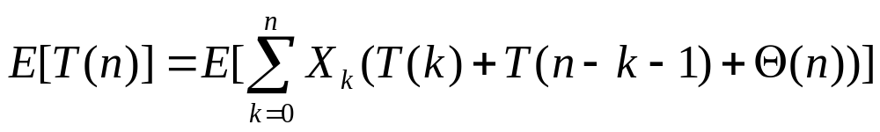
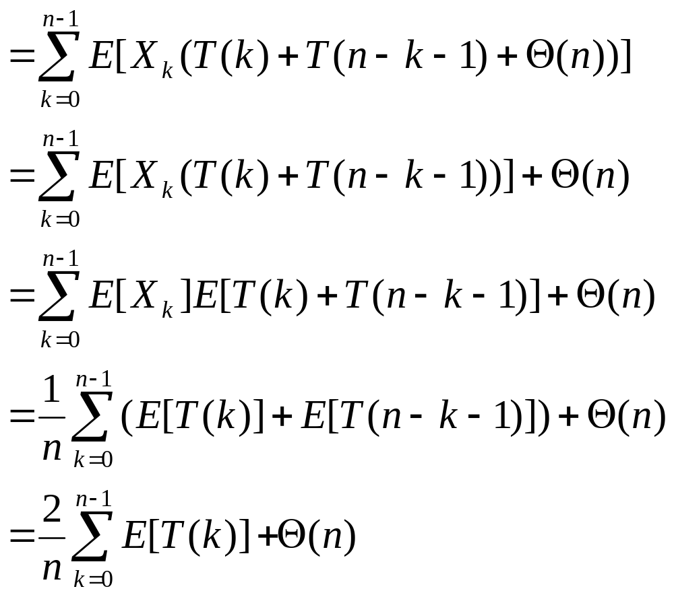
Analysis of Randomized Quicksort

Slide 59
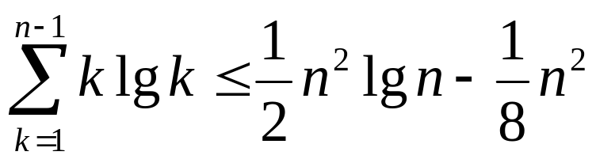
Analysis of Randomized Quicksort
Want to show E[T(n)] = Θ(n lgn), i.e. average
running time is Θ(n lgn).
Will prove:
E[T(n)] ≤ anlgn + b for constant a,b
Using fact:

Slide 60
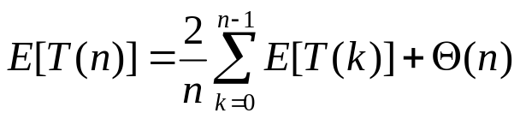
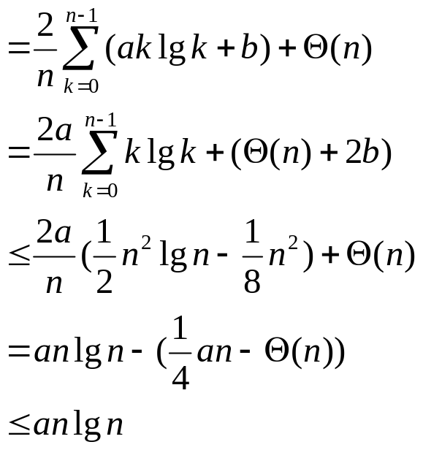
Analysis of Randomized Quicksort
by picking a large enough
Pick b large enough to handle initial conditions. Then pick a
to handle final inequality above.

Slide 61
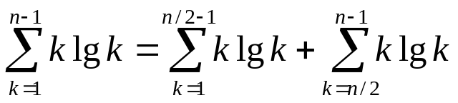
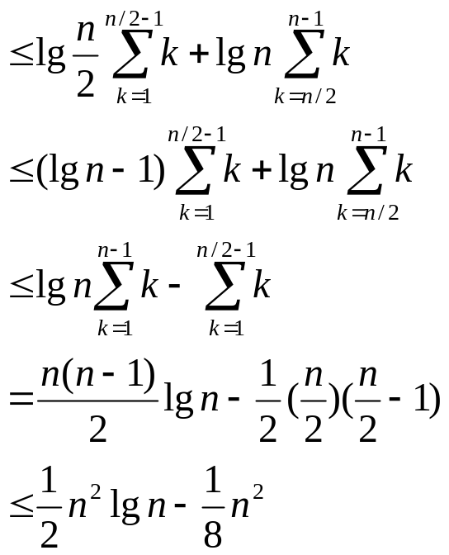
Proving fact…

Slide 62
Quicksort in practice
Quicksort is great general-purpose sorting algorithm.
Quicksort is typically over twice as fast as merge sort.
Quicksort can benefit substantially from code tuning.
Quicksort behaves well even with caching and virtual memory.

