Slide 1
Introduction to Algorithms
Lecture 4

Slide 2
Last time
Heaps and Heapsort
Priority Queues
Quicksort
Probability
Randomized Algorithms
Randomized Quicksort

Slide 3
Outline
Show that Θ(nlogn) is the best possible running time for a sorting algorithm.
Design an algorithm that sorts in linear time.
Hint: maybe the models are different?
Order statistics

Slide 4
Comparison sort
All the sorting algorithms we have seen so far
are comparison sorts: only use comparisons to
determine the relative order of elements
e.g., insertion sort, merge sort, quicksort, heapsort.
The best worst-case running time that we’ve
seen for comparison sorting is O(nlogn).
Is O(nlogn) the best we can do?
Decision trees can help us answer this question.

Slide 5
Decision-tree example
Sort <a₁,a₂,…,a_{n}>
1:2
Each internal node is labeled i:j for i,j∈{1,…,n}.
The left subtree shows subsequent comparisons if a_{i} ≤ a_{j}.
The right subtree shows subsequent comparisons if a_{i} ≥ a_{j}.
2:3
1:3
123
1:3
213
2:3
132
312
231
321

Slide 6
Decision-tree example
Sort <a₁,a₂,…,a_{n}>
=<9,4,6>:
1:2
9≥4
Each internal node is labeled i:j for i,j∈{1,…,n}.
The left subtree shows subsequent comparisons if a_{i} ≤ a_{j}.
The right subtree shows subsequent comparisons if a_{i} ≥ a_{j}.
2:3
1:3
123
1:3
213
2:3
132
312
231
321

Slide 7
Decision-tree example
Sort <a₁,a₂,…,a_{n}>
=<9,4,6>:
1:2
Each internal node is labeled i:j for i,j∈{1,…,n}.
The left subtree shows subsequent comparisons if a_{i} ≤ a_{j}.
The right subtree shows subsequent comparisons if a_{i} ≥ a_{j}.
2:3
1:3
9≥6
123
1:3
213
2:3
132
312
231
321

Slide 8
Decision-tree example
Sort <a₁,a₂,…,a_{n}>
=<9,4,6>:
1:2
Each internal node is labeled i:j for i,j∈{1,…,n}.
The left subtree shows subsequent comparisons if a_{i} ≤ a_{j}.
The right subtree shows subsequent comparisons if a_{i} ≥ a_{j}.
2:3
1:3
123
1:3
213
2:3
4≤6
132
312
231
321

Slide 9
Decision-tree example
Sort <a₁,a₂,…,a_{n}>
=<9,4,6>:
1:2
Each leaf contains a permutation <π(1),π(2),…,
π(n)> to indicate that the ordering a_{π(1)}≤a_{π(2)}≤…
≤a_{π(n)} has been established.
2:3
1:3
123
1:3
213
2:3
132
312
231
321
4 ≤ 6 ≤ 9

Slide 10
Decision-tree model
A decision tree can model the execution of any
comparison sort:
One tree for each input size n.
View the algorithm as splitting whenever it compares two elements.
The tree contains the comparisons along all possible instruction traces.
The running time of the algorithm = the length of the path taken.
worst-case running time = height of tree.

Slide 11
Lower bound for decision-tree sorting
Theorem. Any decision tree that can sort n elements
must have height Ω(n lg n) .
Proof.
The tree must contain ≥ n! leaves, since there
are n! possible permutations.
A height-h binary tree has ≤ 2^{h} leaves. Thus, n! ≤ 2^{h}.
h ≥ lg(n!) (lg is mono. increasing)
≥ lg ((n/e)^{n}) (Stirling’s formula)
= n lg n – n lg e
= Ω(n lg n) .

Slide 12
Lower bound for comparison sorting
Corollary. Merge sort is an asymptotically
optimal comparison sorting algorithm.

Slide 13
Sorting in linear time
Counting sort: No comparisons between elements.
Input: A[1 . . n], where A[ j]∈{1, 2, …, k}.
Output: B[1 . . n], sorted*
Auxiliary storage: C[1 . . k] .
*Actually, we require the algorithm to construct a permutation of the input array A that produces the sorted array B. This permutation can be obtained by making small changes to the last loop of the algorithm.

Slide 14
Counting sort
for i ←1 to k
do C[i] ← 0
for j ←1 to n
do C[A[ j]] ← C[A[ j]] + 1 //C[i] = |{key = i}|
for i ←2 to k
do C[i] ← C[i] + C[i–1] //C[i] = |{key ≤ i}|
for j ←n downto 1
do B[C[A[ j]]] ← A[ j]
C[A[ j]] ← C[A[ j]] – 1

Slide 15
Counting-sort example
1 2 3 4 5
1 2 3 4
A:
4
1
3
4
3
C:
B:

Slide 16
Loop 1
for i ←1 to k
do C[i] ← 0
1 2 3 4 5
1 2 3 4
A:
4
1
3
4
3
C:
0
0
0
0
B:

Slide 17
Loop 2
for j ←1 to n
do C[A[ j]] ← C[A[ j]] + 1 //C[i] = |{key = i}|
1 2 3 4 5
1 2 3 4
A:
4
1
3
4
3
C:
0
0
0
1
B:

Slide 18
Loop 2
for j ←1 to n
do C[A[ j]] ← C[A[ j]] + 1 //C[i] = |{key = i}|
1 2 3 4 5
1 2 3 4
A:
4
1
3
4
3
C:
1
0
0
1
B:

Slide 19
Loop 2
for j ←1 to n
do C[A[ j]] ← C[A[ j]] + 1 //C[i] = |{key = i}|
1 2 3 4 5
1 2 3 4
A:
4
1
3
4
3
C:
1
0
1
1
B:

Slide 20
Loop 2
for j ←1 to n
do C[A[ j]] ← C[A[ j]] + 1 //C[i] = |{key = i}|
1 2 3 4 5
1 2 3 4
A:
4
1
3
4
3
C:
1
0
1
2
B:

Slide 21
Loop 2
for j ←1 to n
do C[A[ j]] ← C[A[ j]] + 1 //C[i] = |{key = i}|
1 2 3 4 5
1 2 3 4
A:
4
1
3
4
3
C:
1
0
2
2
B:

Slide 22
Loop 3
for i ←2 to k
do C[i] ← C[i] + C[i–1] //C[i] = |{key ≤ i}|
1 2 3 4 5
1 2 3 4
A:
4
1
3
4
3
C:
1
0
2
2
B:
C’:
1
1
2
2

Slide 23
Loop 3
for i ←2 to k
do C[i] ← C[i] + C[i–1] //C[i] = |{key ≤ i}|
1 2 3 4 5
1 2 3 4
A:
4
1
3
4
3
C:
1
0
2
2
B:
C’:
1
1
3
2

Slide 24
Loop 3
for i ←2 to k
do C[i] ← C[i] + C[i–1] //C[i] = |{key ≤ i}|
1 2 3 4 5
1 2 3 4
A:
4
1
3
4
3
C:
1
0
2
2
B:
C’:
1
1
3
5

Slide 25
Loop 4
for j ←n downto 1
do B[C[A[ j]]] ← A[ j]
C[A[ j]] ← C[A[ j]] – 1
1 2 3 4 5
1 2 3 4
A:
4
1
3
4
3
C:
1
0
2
2
B:
3
C’:
1
1
2
5

Slide 26
Loop 4
for j ←n downto 1
do B[C[A[ j]]] ← A[ j]
C[A[ j]] ← C[A[ j]] – 1
1 2 3 4 5
1 2 3 4
A:
4
1
3
4
3
C:
1
0
2
2
B:
3
4
C’:
1
1
2
4

Slide 27
Loop 4
for j ←n downto 1
do B[C[A[ j]]] ← A[ j]
C[A[ j]] ← C[A[ j]] – 1
1 2 3 4 5
1 2 3 4
A:
4
1
3
4
3
C:
1
0
2
2
B:
3
3
4
C’:
1
1
1
4

Slide 28
Loop 4
for j ←n downto 1
do B[C[A[ j]]] ← A[ j]
C[A[ j]] ← C[A[ j]] – 1
1 2 3 4 5
1 2 3 4
A:
4
1
3
4
3
C:
1
0
2
2
B:
1
3
3
4
C’:
0
1
1
4

Slide 29
Loop 4
for j ←n downto 1
do B[C[A[ j]]] ← A[ j]
C[A[ j]] ← C[A[ j]] – 1
1 2 3 4 5
1 2 3 4
A:
4
1
3
4
3
C:
1
0
2
2
B:
1
3
3
4
4
C’:
0
1
1
3

Slide 30
Analysis of Counting-sort
for i ←1 to k
do C[i] ← 0
for j ←1 to n
do C[A[ j]] ← C[A[ j]] + 1
for i ←2 to k
do C[i] ← C[i] + C[i–1]
for j ←n downto 1
do B[C[A[ j]]] ← A[ j]
C[A[ j]] ← C[A[ j]] – 1
Θ(k)
Θ(n)
Θ(k)
Θ(n)
Θ(n+k)

Slide 31
Running time
If k = O(n), then counting sort takes Θ(n) time.
But, sorting takes Ω(n lg n) time!
Where’s the fallacy?
Answer:
Comparison sorting takes Ω(n lg n) time.
Counting sort is not a comparison sort.
In fact, not a single comparison between elements occurs!

Slide 32
Stable sorting
Counting sort is a stable sort: it preserves the
input order among equal elements.
Exercise: What other sorts have this property?
A:
4
1
3
4
3
B:
1
3
3
4
4

Slide 33
Radix sort
Origin: Herman Hollerith’s card-sorting machine for the 1890 U.S. Census.
Digit-by-digit sort.
Hollerith’s original (bad) idea: sort on most-significant digit first.
Good idea: Sort on least-significant digit first with auxiliary stable sort.

Slide 34
Operation of radix sort
3
4
6
8
4
7
3
2
5
5
3
3
2
5
9
7
7
9
6
0
5
7
3
4
4
6
3
8
2
5
3
5
5
2
3
0
5
6
7
7
9
9
7
3
4
8
3
4
6
2
2
3
3
5
5
5
0
9
6
9
5
7
7
3
3
4
4
6
7
8
2
5
3
5
5
2
3
9
5
6
7
7
0
9

Slide 35
Correctness of radix sort
Induction on digit position
Assume that the numbers are sorted by their lower-order t-1 digits.
Sort on digit t.
7
3
4
8
3
4
6
2
2
3
3
5
5
5
0
9
6
9
5
7
7
3
3
4
4
6
7
8
2
5
3
5
5
2
3
9
5
6
7
7
0
9

Slide 36
Correctness of radix sort
Induction on digit position
Assume that the numbers are sorted by their lower-order t-1 digits.
Sort on digit t.
  Two numbers that differ in digit t are correctly sorted.
7
3
4
8
3
4
6
2
2
3
3
5
5
5
0
9
6
9
5
7
7
3
3
4
4
6
7
8
2
5
3
5
5
2
3
9
5
6
7
7
0
9

Slide 37
Correctness of radix sort
Induction on digit position
Assume that the numbers are sorted by their lower-order t-1 digits.
Sort on digit t.
  Two numbers that differ in digit t are correctly sorted.
  Two numbers equal in digit t are put in the same order as the input ⇒ correct order.
7
3
4
8
3
4
6
2
2
3
3
5
5
5
0
9
6
9
5
7
7
3
3
4
4
6
7
8
2
5
3
5
5
2
3
9
5
6
7
7
0
9

Slide 38
Analysis of radix sort
Assume counting sort is the auxiliary stable sort.
Sort n computer words of b bits each.
Each word can be viewed as having b/r base-2^{r} digits.
Example: 32-bit word
r = 8 ⇒ b/r = 4 passes of counting sort on
base-2⁸ digits; or r = 16 ⇒ b/r = 2 passes of
counting sort on base-2¹⁶ digits.
How many passes should we make?
8 8 8 8

Slide 39
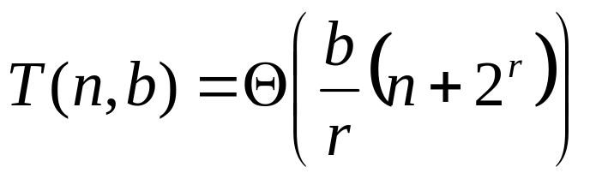
Analysis (continued)
Recall: Counting sort takes Θ(n + k) time to sort n
numbers in the range from 0 to k – 1.
If each b-bit word is broken into r-bit pieces, each
pass of counting sort takes Θ(n + 2^{r}) time.
Since there are b/r passes, we have
Choose r to minimize T(n, b):
• Increasing r means fewer passes, but as r >>lg n, the time grows exponentially.

Slide 40
Choosing r
Minimize T(n, b) by differentiating and setting to 0.
Or, just observe that we don’t want 2^{r} >> n, and
there’s no harm asymptotically in choosing r as large
as possible subject to this constraint.
Choosing r = lg n implies T(n, b) = Θ(bn/lg n) .
For numbers in the range from 0 to n^{d} – 1, we have b = d lg n ⇒ radix sort runs in Θ(d n) time.

Slide 41
Conclusions
In practice, radix sort is fast for large inputs, as
well as simple to code and maintain.
Example (32-bit numbers):
At most 3 passes when sorting ≥ 2000 numbers.
Merge sort and quicksort do at least lg 2000 = 11 passes.
Downside: Unlike quicksort, radix sort displays
little locality of reference, and thus a well-tuned
quicksort fares better on modern processors,
which feature steep memory hierarchies.

Slide 42


Order statistics
Select the i th smallest of n elements (the element with rank i).
• i = 1: minimum;
• i = n: maximum;
• i = or : median.
Naive algorithm: Sort and index ith element.
Worst-case running time = O(n lg n) + O(1)
= O(n lg n),
using merge sort.

Slide 43
Randomized divide-and-conquer
RAND-SELECT(A, p, q, i) _ ith smallest of A[ p…q]
if p = q then return A[ p]
r←RAND-PARTITION(A, p, q)
k ← r – p + 1 _ k = rank(A[r])
if i = k then return A[ r]
if i < k
then return RAND-SELECT( A, p, r – 1, i )
else return RAND-SELECT( A, r + 1, q, i – k )
k
≤ A[r]
≥ A[r]
p
r
q

Slide 44
Example
Select the i = 7th smallest:
Partition:
Select the 7 – 4 = 3rd smallest recursively.
6
10
13
5
8
3
2
11
pivot
2
5
3
6
8
13
10
11
k=4

Slide 45
Intuition for analysis
Assume that all elements are distinct.
Lucky:
T(n) = T(9n/10) + Θ(n)
= Θ(n)
Unlucky:
T(n) = T(n – 1) + Θ(n)
= Θ(n²)
Worse than sorting!

Slide 46
Analysis
The probability that a random pivot induces lucky partition is at least 8/10
Let t_{i} be the number of partitions performed between the (i-1)-th and the i-th lucky partition
The total time is at most:
t₁n + t₂(9/10)n + t₃(9/10)²n + …
The total expected time is at most:
10/8 n + 10/8 (9/10) n + 10/8 (9/10)² n + …
=O(n)

Slide 47
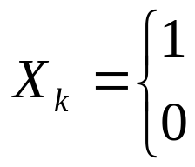
Alternative analysis of expected time
The analysis follows that of randomized quicksort,
but it’s a little different.
Let T(n) = the random variable for the running time
of RAND-SELECT on an input of size n, assuming
random numbers are independent.
For k = 0, 1, …, n–1, define the indicator random
variable
if PARTITION generates a k:n–k–1 split,
otherwise.

Slide 48
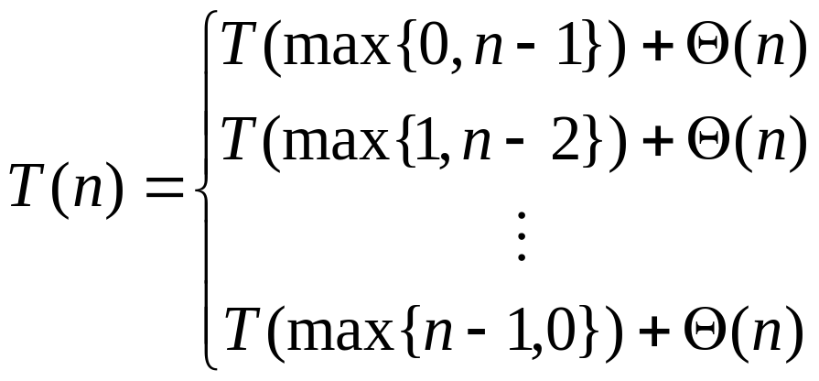
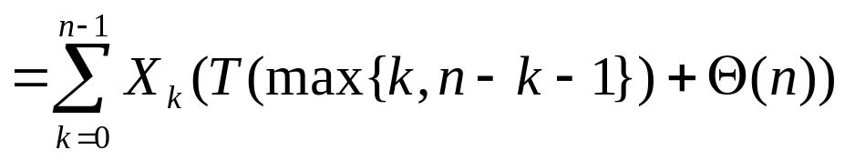
Analysis (continued)
To obtain an upper bound, assume that the ith
element always falls in the larger side of the
partition:
if 0:n–1 split,
if 1:n–1 split,
if n–1:0 split,

Slide 49
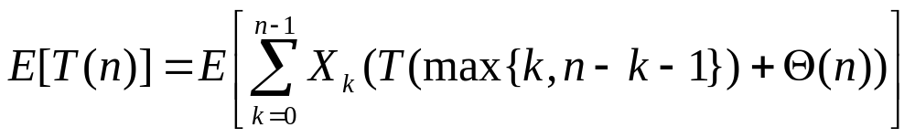
Calculating expectation
Take expectations of both sides.

Slide 50
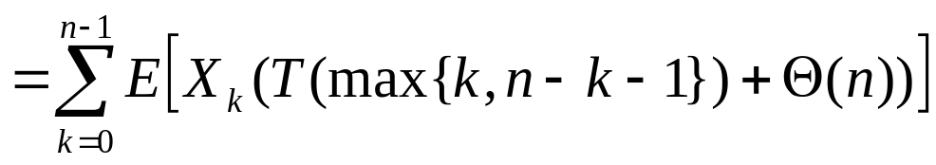
Calculating expectation
Linearity of expectation.

Slide 51
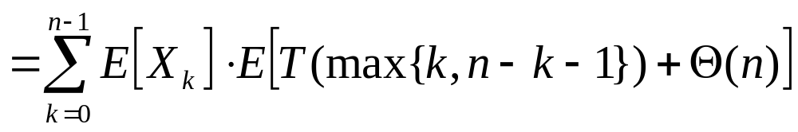
Calculating expectation
Independence of X_{k} from other random
choices.

Slide 52
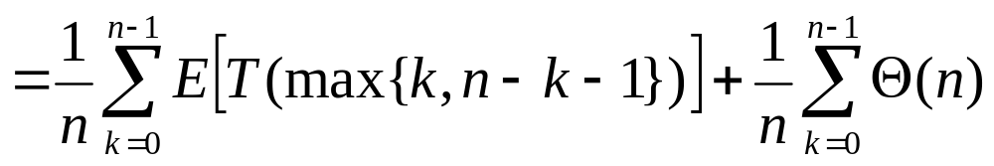
Calculating expectation
Linearity of expectation; E[X_{k}] = 1/n .

Slide 53
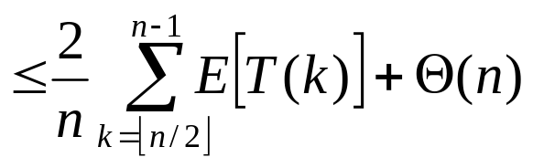
Calculating expectation
Upper terms
appear twice.

Slide 54
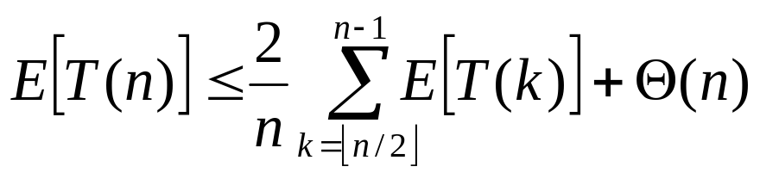
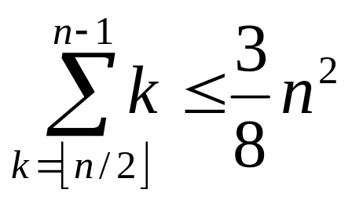
Hairy recurrence
Prove: E[T(n)] ≤ cn for constant c > 0 .
The constant c can be chosen large enough so that E[T(n)] ≤ cn for the base cases.
Use fact:

Slide 55
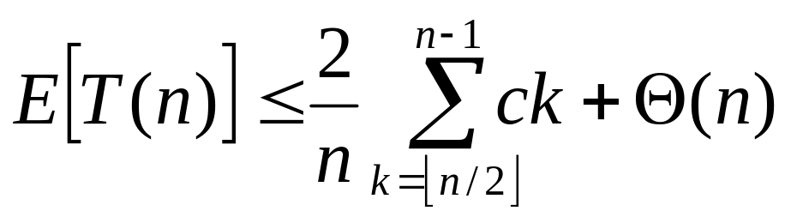
Substitution method
Substitute inductive hypothesis.

Slide 56
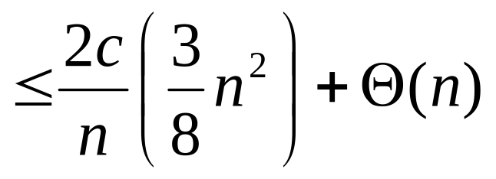
Substitution method
Use fact.

Slide 57
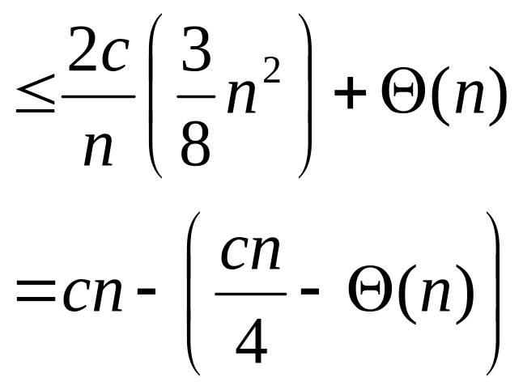
Substitution method
Express as desired – residual.

Slide 58
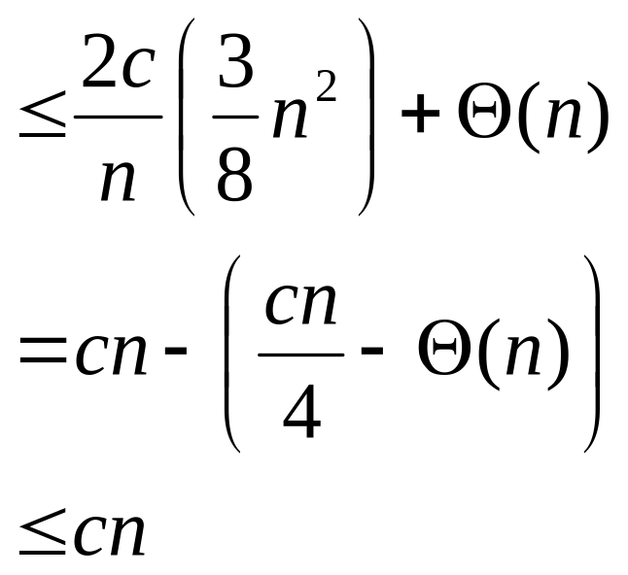
Substitution method
if c is chosen large enough so that
cn/4 dominates the Θ(n).

Slide 59
Summary of randomized order-statistic selection
Works fast: linear expected time.
Excellent algorithm in practice.
But, the worst case is very bad: O(n²).
Q. Is there an algorithm that runs in linear time in the
worst case?
A. Yes, due to Blum, Floyd, Pratt, Rivest, and Tarjan
[1973].
IDEA: Generate a good pivot recursively.

Slide 60
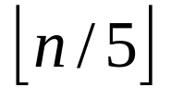

Worst-case linear-time order statistics
SELECT(i, n)
1.Divide the n elements into groups of 5. Find the
median of each 5-element group by rote.
2.Recursively SELECT the median x of the
group medians to be the pivot.
3.Partition around the pivot x. Let k = rank(x).
4.if i = k then return x
elseif i < k
then recursively SELECT the ith smallest
element in the lower part
else recursively SELECT the (i–k)th smallest
element in the upper part
Same as
RAND-
SELECT

Slide 61
Choosing the pivot

Slide 62
Choosing the pivot
1. Divide the n elements into groups of 5.

Slide 63
Choosing the pivot
1. Divide the n elements into groups of 5.
Find the median of each 5-element group by rote.
lesser
greater

Slide 64
Choosing the pivot
x
lesser
1. Divide the n elements into groups of 5.
Find the median of each 5-element group by rote
2. Recursively SELECT the median x of the
group medians to be the pivot.
greater

Slide 65

Analysis
At least half the group medians are ≤ x, which
is at least group medians.
x
lesser
greater

Slide 66

Analysis (Assume all elements are distinct)
At least half the group medians are ≤ x, which
is at least group medians.
Therefore, at least elements are ≤ x.
x
lesser
greater

Slide 67
Analysis (Assume all elements are distinct)
At least half the group medians are ≤ x, which
is at least group medians.
Therefore, at least elements are ≤ x.
Similarly, at least elements are ≥ x.
x
lesser
greater

Slide 68
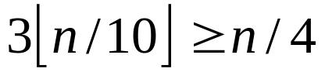
Minor simplification
For n ≥ 50, we have .
Therefore, for n ≥ 50 the recursive call to SELECT in Step 4 is executed recursively on ≤ 3n/4 elements.
Thus, the recurrence for running time can assume that Step 4 takes time T(3n/4) in the worst case.
For n < 50, we know that the worst-case time is T(n) = Θ(1).

Slide 69


Developing the recurrence
T(n)
SELECT(i, n)
Divide the n elements into groups of 5. Find the median of each 5-element group by rote.
Recursively SELECT the median x of the group medians to be the pivot.
Partition around the pivot x. Let k = rank(x).
if i = k then return x
elseif i < k
then recursively SELECT the i th
smallest element in the lower part
else recursively SELECT the (i–k)th
smallest element in the upper part
Θ(n)
T(n/5)
Θ(n)
T(3n/4)

Slide 70
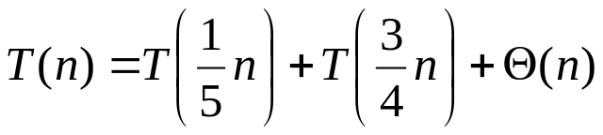
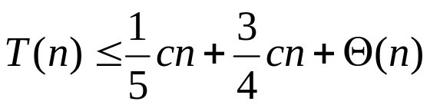
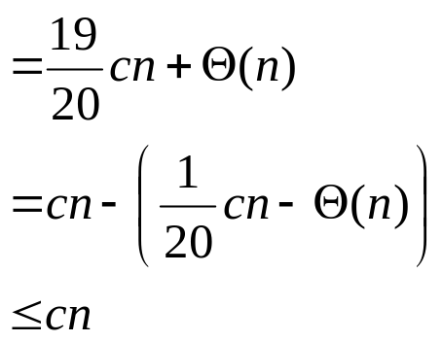
Solving the recurrence
if c is chosen large enough to handle both the Θ(n)
and the initial conditions.
Substitution:
T(n) ≤ cn

Slide 71
Conclusions
Since the work at each level of recursion is a constant fraction (19/20) smaller, the work per level is a geometric series dominated by the linear work at the root.
In practice, this algorithm runs slowly, because the constant in front of n is large.
The randomized algorithm is far more practical.

Slide 72
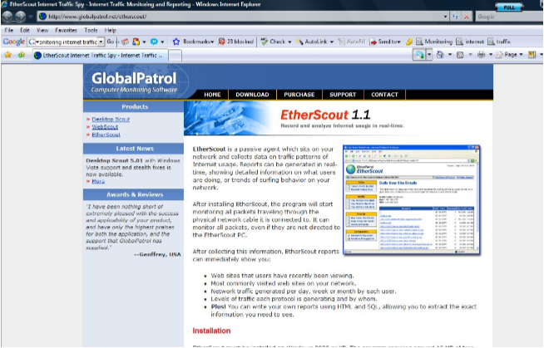


Motivation
  Monitoring internet traffic

Slide 73


Problem
2⁵⁰ BPS
2⁵⁰ BPS
We can't store the whole input
so
We seek methods which requires small space

Slide 74
Synopsis (Summary) Structures
A small summary of a large data set that (approximately) captures some statistics/properties we are interested in.
Data Set D
Synopsis d

Slide 75
Synopsis: Desired Properties
  Easy to add an element
  Mergeable : can create summary of union from summaries of data sets
  Easy to delete elements
  Flexible: supports multiple types of queries

Slide 76
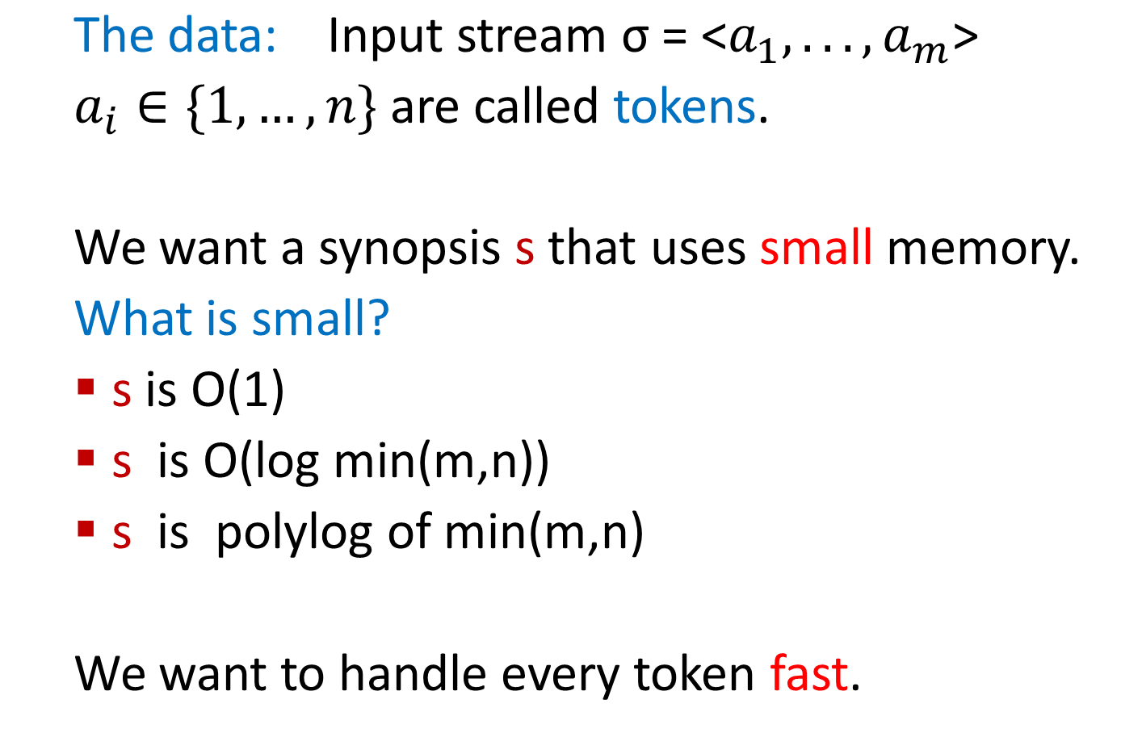
The Data Stream Model

Slide 77
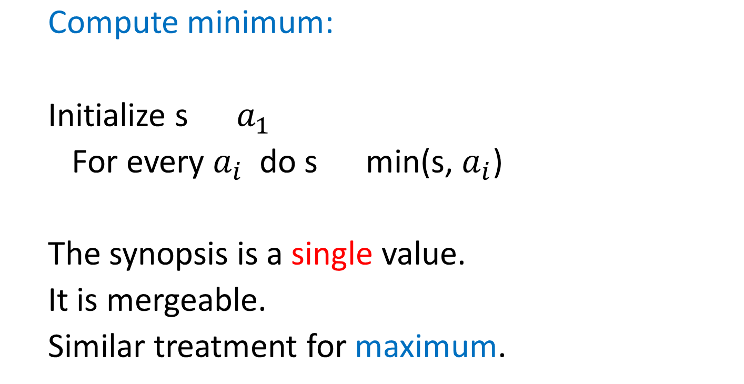
What can we do easily?
32,
112,
14,
9,
37,
83,
115,
2,

Slide 78
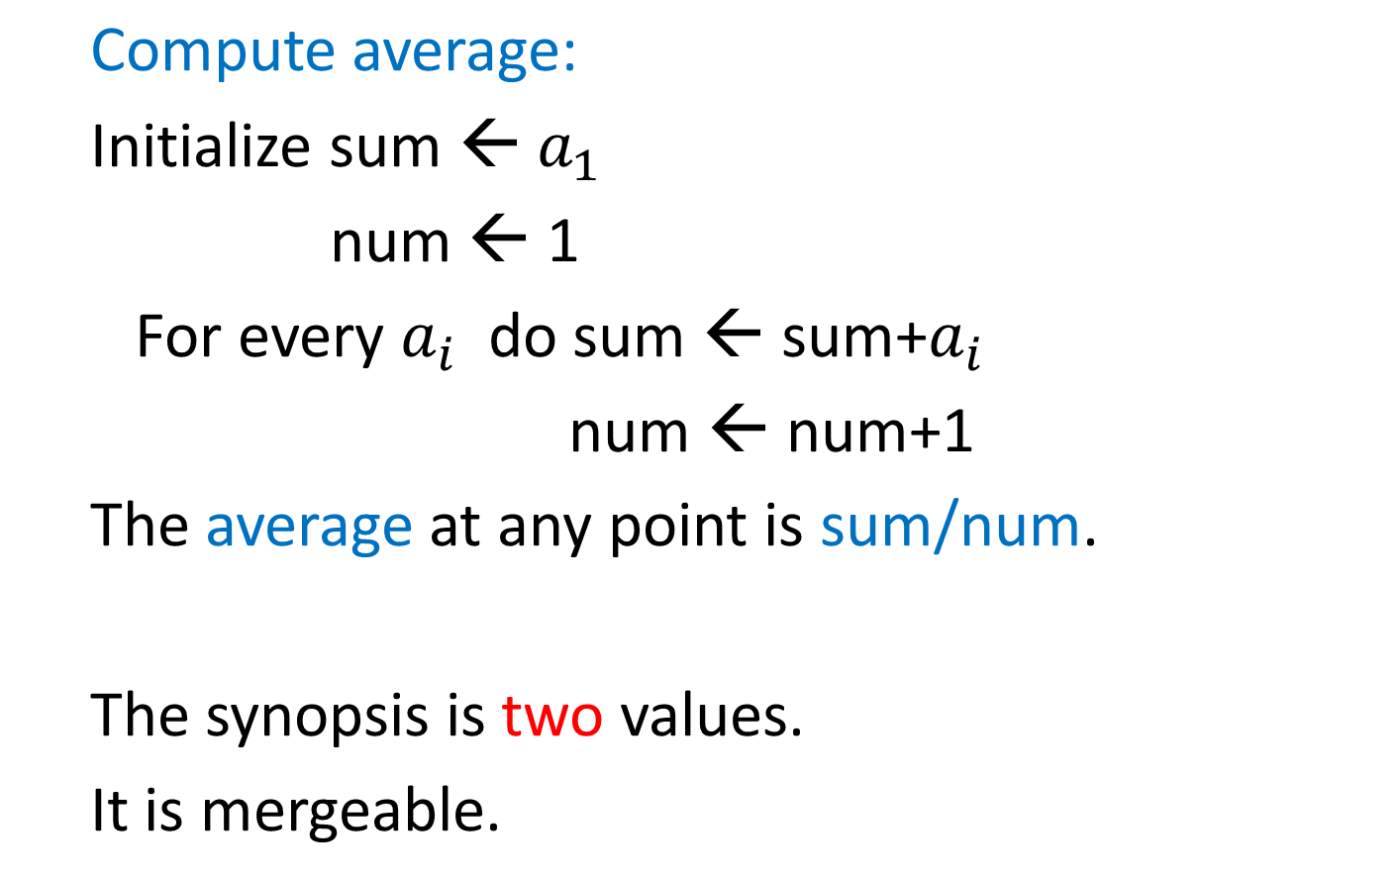
What can we do easily?

Slide 79
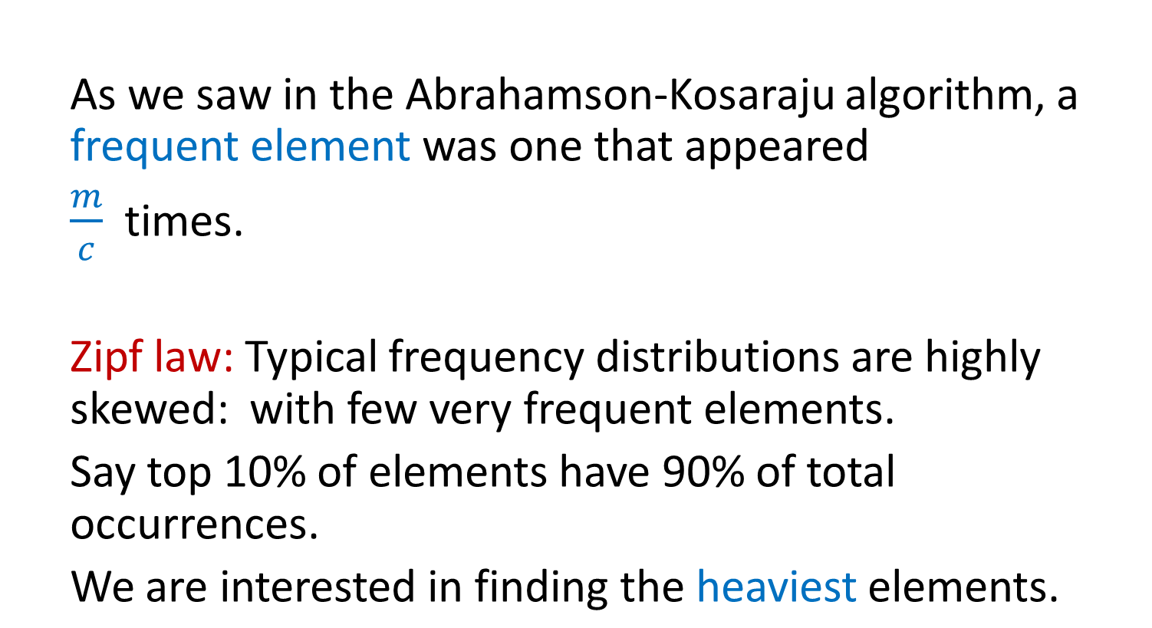
Finding Frequent Items

Slide 80

Frequent Items: Exact Solution
32,
12,
14,
32,
7,
12,
32,
7,
6,
12,
4,
Exact solution:
Create a counter for each distinct token on its first occurrence
When processing a token, increment the counter
32
12
14
7
6
4

Slide 81
Deterministic Streaming Algorithm for Finding Frequent Items
  The Misra-Gries algorithm [1982] finds these frequent elements deterministically, using
  O(c log m) bits, in two passes.

Slide 82
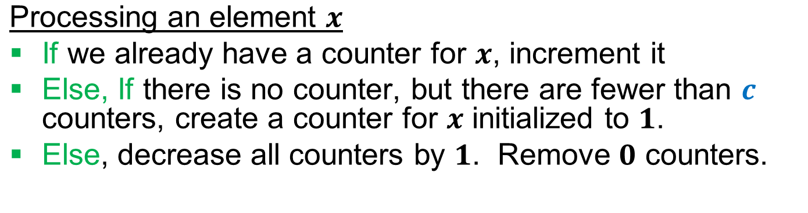
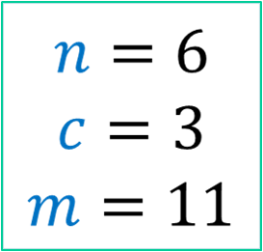
Frequent Elements: Misra Gries 1982
32,
12,
14,
32,
7,
12,
32,
7,
6,
12,
4,
32
12
14
12
7
12
4

Slide 83
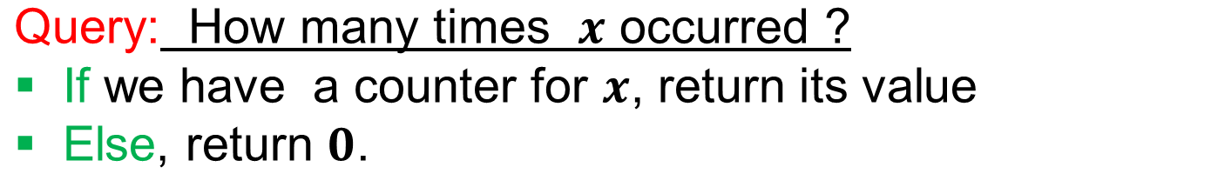
Frequent Elements: Misra Gries 1982
32,
12,
14,
32,
7,
12,
32,
7,
6,
12,
4,
This is clearly an under-estimate.
What can we say precisely?

Slide 84
Algorithm Analysis
Space: c counters of log m + log n bits, i.e.
O(c(log m + log n))
Time: O(log c) per token.
Output quality?

Slide 85
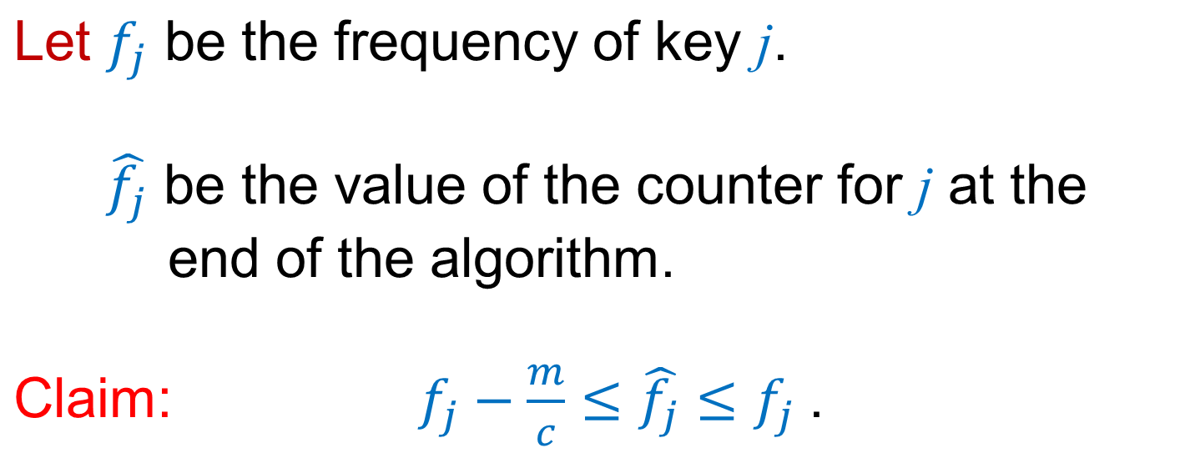
Algorithm Analysis

Slide 86
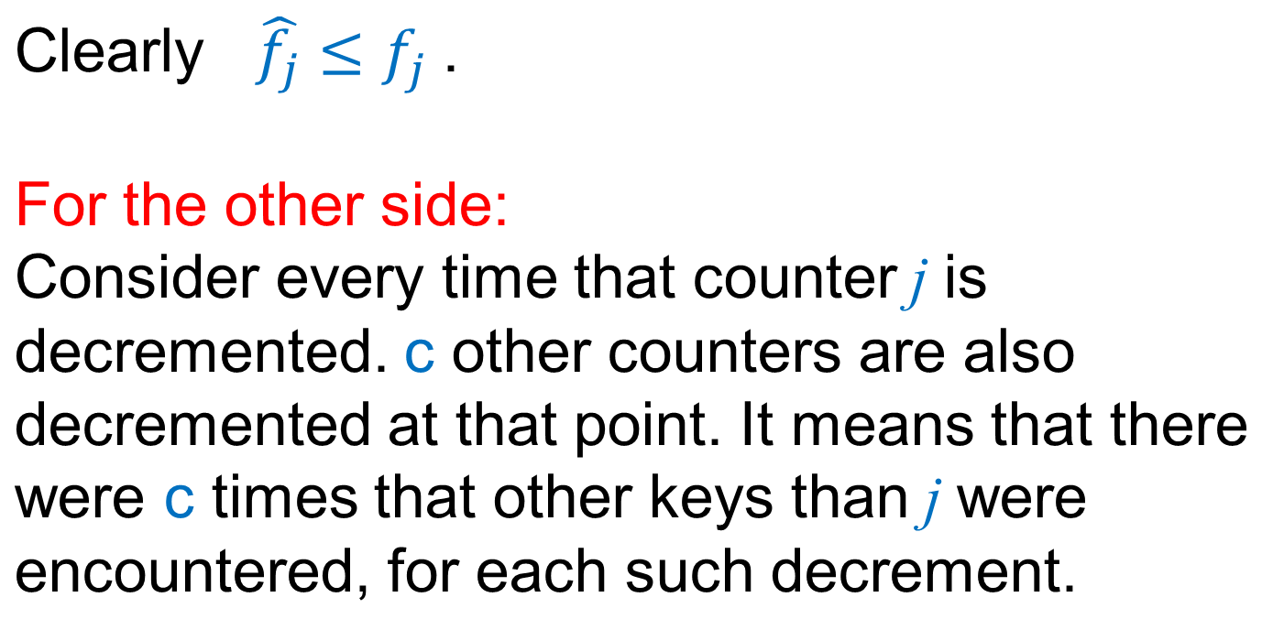
Proof

Slide 87
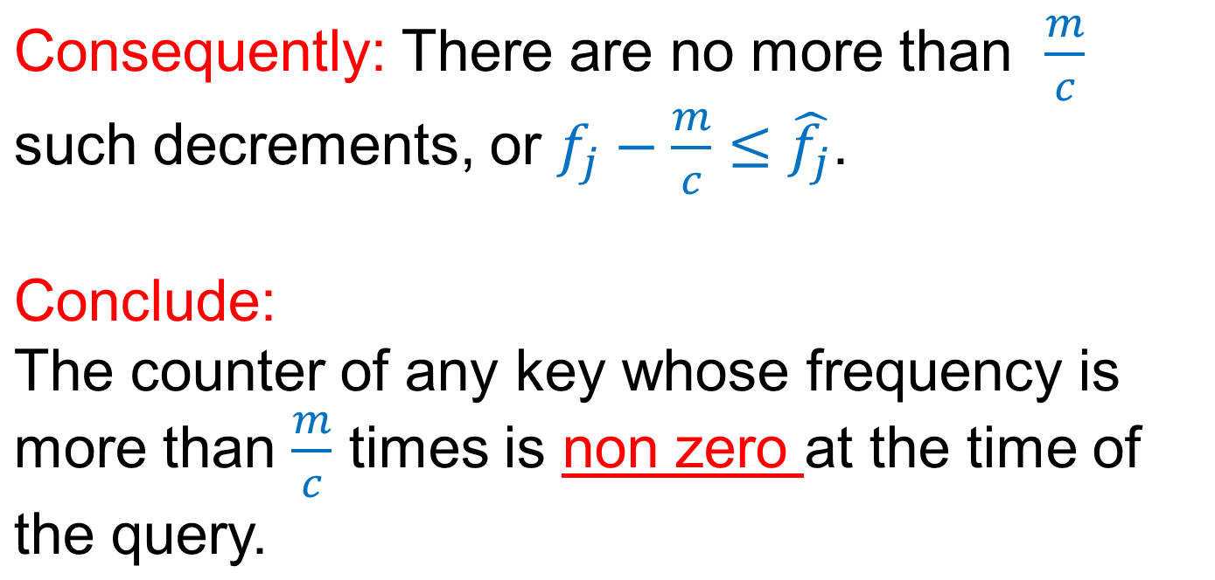
Proof

Slide 88
Finding Frequent Elements
How do we verify that all elements in the counters are frequent?
-- Another pass.

