Slide 1
Introduction to Algorithms
Lecture 5

Slide 2
Recap
Show that Θ(nlogn) is the best possible running time for a sorting algorithm.
Design an algorithm that sorts in linear time.
Order statistics

Slide 3
Today’s topics
Direct-accessible table
Hash tables
Hash functions
  Universal hashing
Perfect Hashing
Open addressing

Slide 4
Data Structures
Role of data structures:
  Encapsulate data
  Support certain operations (e.g., INSERT, DELETE, SEARCH)
Our focus: efficiency of the operations
Algorithms vs. data structures

Slide 5

Symbol-table problem
Symbol table T holding n records:
How should the data structure T be organized?
record
Operations on T:
INSERT(T,x)
DELETE(T,x)
SEARCH(T,k)
x
key[x]
Other fields
containing
satellite data

Slide 6
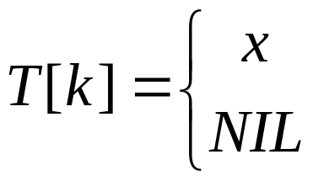
Direct-accessible table
IDEA: Suppose that the set of keys is K ⊆ {0,
1, …, m–1}, and keys are distinct.
Set up an array T[0 . . m–1]:
Then, operations take Θ(1) time.
Problem: The range of keys can be large:
64-bit numbers (which represent 18,446,744,073,709,551,616 different keys),
character strings (even larger!).
if k∈K and keys[x] = k
otherwise.

Slide 7
Hash functions
Solution: Use a hash function h to map the
universe U of all keys into
{0, 1, …, m–1}:
When a record to be inserted maps to an already
occupied slot in T, a collision occurs.
T
 | 0
 | h(k₁)
 | h(k₄)
 | h(k₂) = h(k₅)
 | h(k₃)
 | m-1
k₁
k₅
k₄
k₂
k₃
K

Slide 8
Resolving collisions by chaining
Records in the same slot are linked into a list.
T
i
49
86
52
h(49) = h(86) = h(52) = i

Slide 9
Analysis of chaining
We make the assumption of simple uniform
hashing:
Each key k ∈ K of keys is equally likely to be hashed to any slot of table T, independent of where other keys are hashed.
Let n be the number of keys in the table, and
let m be the number of slots.
Define the load factor of T to be
α = n/m
= average number of keys per slot.

Slide 10
Search cost
Expected time to search for a record with
a given key = Θ(1 + α).
Expected search time = Θ(1) if α = O(1),
or equivalently, if n = O(m).
apply hash
function and
access slot
search
the list

Slide 11
Choosing a hash function
The assumption of simple uniform hashing is hard to
guarantee, but several common techniques tend to
work well in practice as long as their deficiencies
can be avoided.
Desirata:
A good hash function should distribute the keys uniformly into the slots of the table.
Regularity in the key distribution should not affect this uniformity.

Slide 12
Division method
Assume all keys are integers, and define
h(k) = k mod m.
Deficiency: Don’t pick an m that has a small
divisor d. A preponderance of keys that are
congruent modulo d can adversely affect
uniformity.

Slide 13

Division method
Extreme deficiency: If m = 2^{r}, then the hash
doesn’t even depend on all the bits of k:
If k = 1011000111011010₂ and r = 6, then
h(k) = 011010₂ .
h(k)

Slide 14
Division method
h(k) = k mod m.
Pick m to be a prime not too close to a power of 2 or
10 and not otherwise used prominently in the
computing environment.
Annoyance:
Sometimes, making the table size a prime is inconvenient.
But, this method is popular, although the next
method we’ll see is usually superior.

Slide 15
Multiplication method
Assume that all keys are integers, m = 2^{r}, and our
computer has w-bit words. Define
h(k) = (A·k mod 2^{w}) rsh (w – r),
where rsh is the “bit-wise right-shift” operator
and A is an odd integer in the range 2^{w–1} < A < 2^{w}.
Don’t pick A too close to 2^{w}.
Multiplication modulo 2^{w} is fast.
The rsh operator is fast.

Slide 16
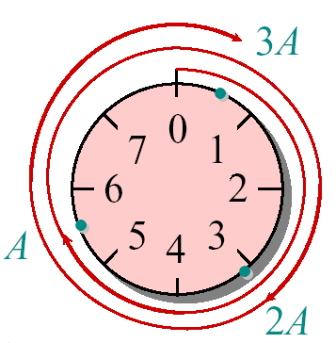

Multiplication method example
h(k) = (A·k mod 2^{w}) rsh (w – r)
Suppose that m = 8 = 2³ and that our computer
has w = 7-bit words:
1 0 1 1 0 0 1 = A
1 1 0 1 0 1 1 = k
×
1 0 0 1 0 1 0 0 1 1 0 0 1 1
h(k)
Modular wheel

Slide 17
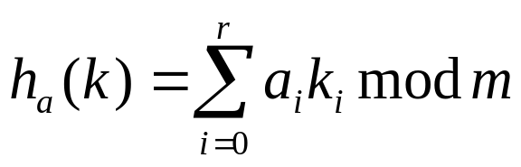
Dot-product method
Randomized strategy:
Let m be prime. Decompose key k into r + 1 digits,
each with value in the set {0, 1,…, m–1}.
That is, let k = <k₀, k₁, …, k_{r}>, where 0 ≤ k_{i} < m.
Pick a = <a₀, a₁, …, a_{r}> where each a_{i} is chosen
randomly from {0, 1, …, m–1}.
Excellent in practice, but expensive to compute.
Define

Slide 18
A weakness of hashing “as we saw it”
Problem: For any hash function h, a set of
keys exists that can cause the average access
time of a hash table to skyrocket.
An adversary can pick all keys from
{k ∈ U : h(k) = i} for some slot i.

Slide 19
A weakness of hashing “as we saw it”
IDEA: Choose the hash function at random,
independently of the keys.
Even if an adversary can see your code, he or she cannot find a bad set of keys, since he or she doesn’t know exactly which hash function will be chosen.

Slide 20
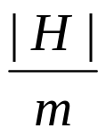

Universal hashing
Definition. Let U be a universe of keys, and
let H be a finite collection of hash functions,
each mapping U to {0, 1, …, m–1}. We say
H is universal if for all x, y∈U, where x ≠ y,
we have |{h ∈ H: h(x) = h(y)}| = |H|/m.
H
That is, the chance
of a collision
between x and y is
1/m if we choose h
randomly from H.
{h: h(x) = h(y)}

Slide 21
Universality is good
Theorem. Let h be a hash function chosen
(uniformly) at random from a universal set H
of hash functions. Suppose h is used to hash
n arbitrary keys into the m slots of a table T.
Then, for a given key x, we have
E[#collisions with x] < n/m

Slide 22
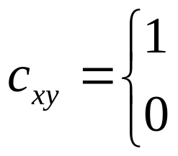
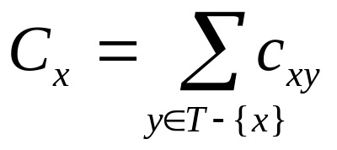
Proof of the theorem
Proof. Let C_{x} be the random variable denoting
the total number of collisions of keys in T
with x, and let
Note: E[c_{xy}] = 1/m and
if h(x) = h(y),
otherwise.

Slide 23
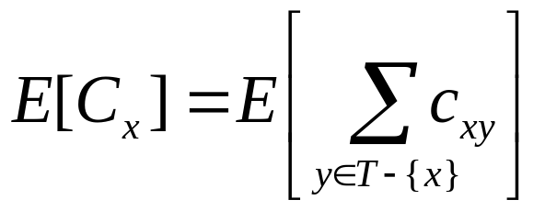
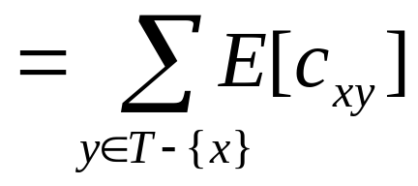
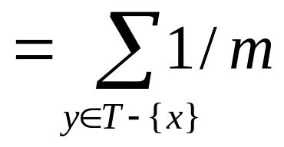
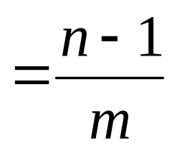
Proof (cont.)
Take expectation of
both sides.
Linearity of
expectation.
E[c_{xy}] = 1/m
Algebra.

Slide 24
Constructing a set of universal hash functions
Let m be prime. Decompose key k into r + 1
digits, each with value in the set {0, 1, …, m–1}.
That is, let k = k₀, k₁, …, k_{r}, where 0 ≤ k_{i} < m.
Randomized strategy:
Pick a = a₀, a₁, …, a_{r} where each a_{i} is chosen
randomly from {0, 1, …, m–1}.
Dot product,
modulo m
Define
How big is H = {h_{a}}?
|H| = m^{r+1}

Slide 25
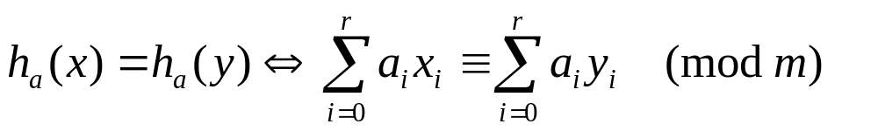
Universality of dot-product hash functions
Theorem. The set H = {h_{a}} is universal.
Proof. Suppose that
x = x₀, x₁, …, x_{r} and
y = y₀, y₁, …, y_{r} are distinct keys. Thus,
they differ in at least one digit position, wlog
position 0. For how many h_{a} ∈ H do x and y
collide?

Slide 26
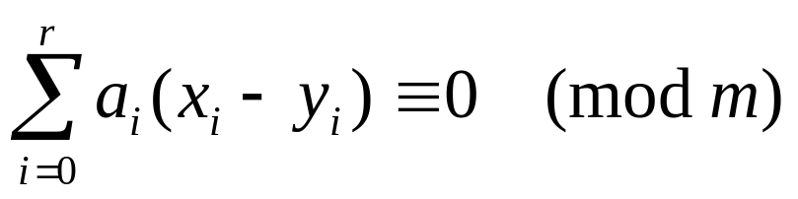
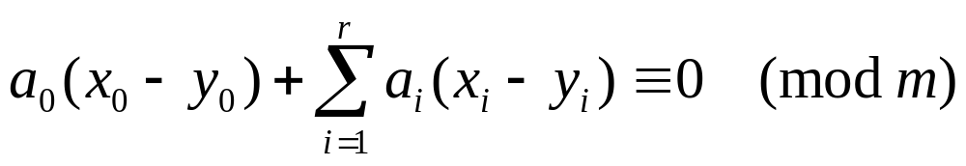
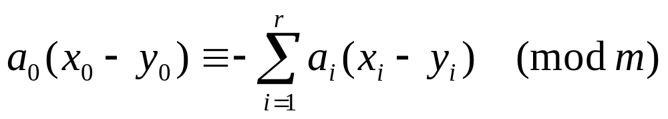
Proof (cont.)
Equivalently, we have
or
which implies that

Slide 27
Fact from number theory
Theorem. Let m be prime. For any z ∈ Z_{m}
such that z ≠ 0, there exists a unique z^{–1} ∈ Z_{m}
such that
z · z^{–1} ≡ 1 (mod m).
Example: m = 7.
z | 1 | 2 | 3 | 4 | 5 | 6
z^{–1} | 1 | 4 | 5 | 2 | 3 | 6

Slide 28
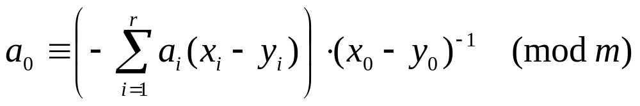
Back to the proof
We have
and since x₀ ≠ y₀ , an inverse (x₀ – y₀ )^{–1} must exist,
which implies that
Thus, for any choices of a₁, a₂, …, a_{r}, exactly
one choice of a₀ causes x and y to collide.

Slide 29
Proof completed
Q. How many h_{a}’s cause x and y to collide?
A. There are m choices for each of a₁, a₂, …, a_{r} ,
but once these are chosen, exactly one choice
for a₀ causes x and y to collide, namely
Thus, the number of h_{a}’s that cause x and y
to collide is m^{r} · 1 = m^{r} = |H|/m.

Slide 30

Perfect hashing
Given a set of n keys, construct a static hash table of
size m = O(n) such that SEARCH takes Θ(1) time in
the worst case.
T
S₁
0
IDEA: Two-
level scheme
with universal
hashing at
both levels.
1
4
31
14
27
2
h₃₁(14) = h₃₁(27) = 1
S₄
3
4
1
00
26
S₆
No collisions
at level 2!
5
6
9
86
40
37
22
m a
0 1 2 3 4 5 6 7 8

Slide 31
Collisions at level 2
Theorem. Let H be a class of universal hash
functions for a table of size m = n². Then, if
we use a random h ∈ H to hash n keys into the
table, the expected number of collisions is at
most 1/2.

Slide 32
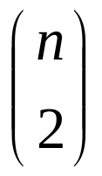
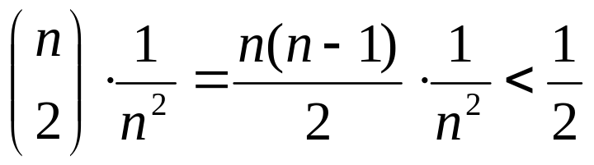
Collisions at level 2
Proof. By the definition of universality, the
probability that 2 given keys in the table
collide under h is 1/m = 1/n². Since there are
pairs of keys that can possibly collide, the
expected number of collisions is

Slide 33
No Collisions at level 2
Corollary. The probability of no collisions is at least
1/2.
Proof. Markov’s inequality says that for any
nonnegative random variable X, we have
Pr{X ≥ t} ≤ E[X]/t.
Applying this inequality with t = 1, we find that the
probability of 1 or more collisions is at most 1/2.
Thus, just by testing random hash functions
in H, we’ll quickly find one that works.

Slide 34
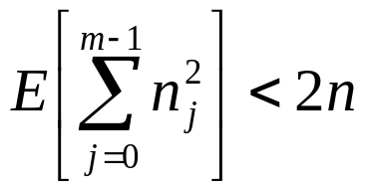
Analysis of storage
Theorem. If we store n keys in a hash table of size m
= n using a hash function h randomly chosen from a
universal class of hash functions, then
where n_{j} is the number of keys hashing to slot j.

Slide 35
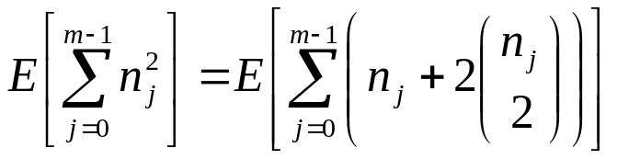
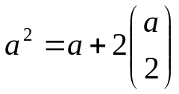
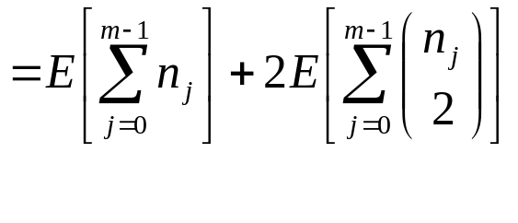
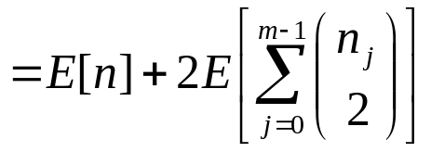
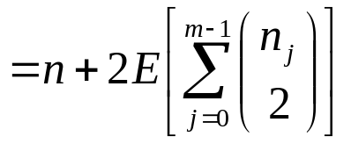
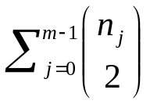
Proof of the Theorem
The summation is just the total numbers of collisions.
Use fact
Linearity of expectation
n is not a random variable

Slide 36
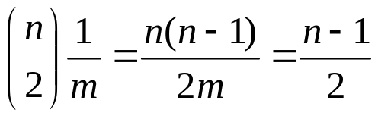
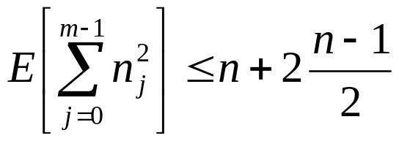
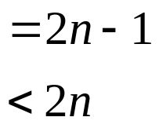
Proof of the Theorem (cont.)
By the properties of universal hashing, the
expected value of the summation is at most:
since m = n, thus

Slide 37
Analysis of storage (cont.)
Corollary. If we store n keys in a hash table of
size m = n using a hash function h randomly
chosen from universal class of hash functions
and we set the size of each secondary hash
table to m_{j} = n_{j}² for j = 0,1,…,m-1, then the
expected amount of storage required for all
secondary hash tables in a perfect hashing
scheme is less than 2n.

Slide 38
Resolving collisions by open addressing
No storage is used outside of the hash table itself.
Insertion systematically probes the table until an empty slot is found.
The hash function depends on both the key and probe number:
h : U × {0, 1, …, m–1} → {0, 1, …, m–1}.
The probe sequence <h(k,0), h(k,1), …, h(k,m–1)> should be a permutation of {0, 1, …, m–1}.
The table may fill up, and deletion is difficult (but not impossible).

Slide 39
Example of open addressing
Insert key k = 496:
0. Probe h(496, 0)
T
 | 0
586
133
204 | collision
481
 | m-1

Slide 40
Example of open addressing
Insert key k = 496:
0. Probe h(496, 0)
1. Probe h(496, 1)
T
 | 0
586 | collision
133
204
481
 | m-1

Slide 41
Example of open addressing
Insert key k = 496:
0. Probe h(496, 0)
1. Probe h(496, 1)
2. Probe h(496, 2)
T
 | 0
586
133
204
496 | insertion
481
 | m-1

Slide 42
Example of open addressing
Insert key k = 496:
0. Probe h(496, 0)
1. Probe h(496, 1)
2. Probe h(496, 2)
T
 | 0
586
133
204
496
481
 | m-1
Search uses the same probe
sequence, terminating
successfully if it finds the
key and unsuccessfully if it encounters an empty slot.

Slide 43
Probing strategies
Linear probing:
Given an ordinary hash function h′(k), linear probing
uses the hash function
h(k,i) = (h′(k) + i) mod m.
This method, though simple, suffers from primary
clustering, where long runs of occupied slots build
up, increasing the average search time. Moreover,
the long runs of occupied slots tend to get longer.

Slide 44
Probing strategies
Double hashing
Given two ordinary hash functions h₁(k) and h₂(k),
double hashing uses the hash function
h(k,i) = (h₁(k) + i×h₂(k)) mod m.
This method generally produces excellent results,
but h₂(k) must be relatively prime to m. One way
is to make m a power of 2 and design h₂(k) to
produce only odd numbers.

Slide 45
Analysis of open addressing
We make the assumption of uniform hashing:
Each key is equally likely to have any one of the m! permutations as its probe sequence.
Theorem. Given an open-addressed hash
table with load factor α = n/m < 1, the
expected number of probes in an unsuccessful
search is at most 1/(1–α).

Slide 46
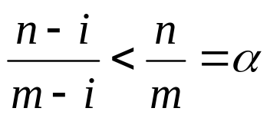
Proof of the theorem
Proof.
At least one probe is always necessary.
With probability n/m, the first probe hits an occupied slot, and a second probe is necessary.
With probability (n–1)/(m–1), the second probe hits an occupied slot, and a third probe is necessary.
With probability (n–2)/(m–2), the third probe hits an occupied slot, etc.
Observe that for i = 1, 2, …, n.

Slide 47
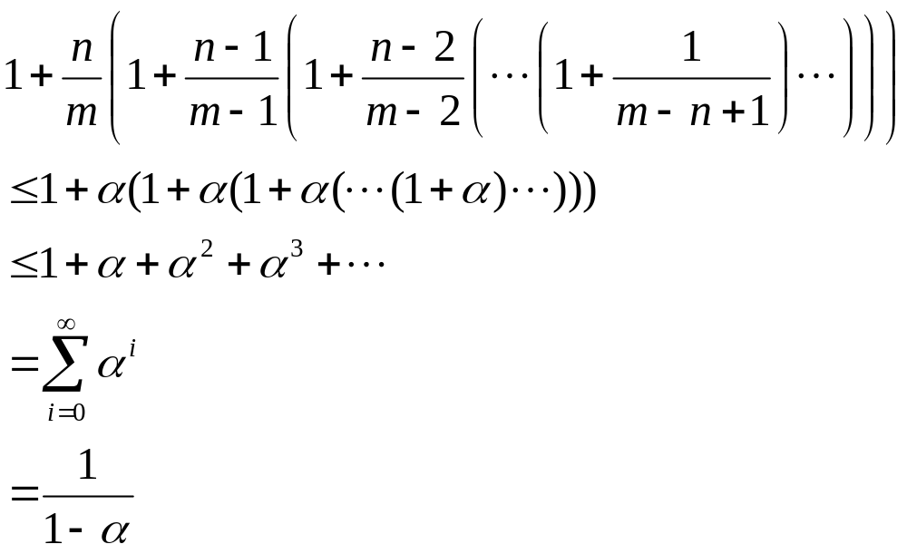
Proof (continued)
Therefore, the expected number of probes is

Slide 48
Implications of the theorem
If α is constant, then accessing an open addressed hash table takes constant time.
If the table is half full, then the expected number of probes is 1/(1–0.5) = 2.
If the table is 90% full, then the expected number of probes is 1/(1–0.9) = 10.

Slide 49
Lookup Problem
Given a set S = {x₁, x₂, x₃,…,x_{n}} on a universe U, want to answer queries of the form:
Example: a set of URLs from the universe of all possible URL strings.
Bloom filter provides an answer in
  “Constant” time (time to hash).
  Small amount of space.
  But with some probability of being wrong.
Is y ∈ S ?

Slide 50
Bloom Filters
Start with an m bit array, filled with 0s.
B
0
0
0
0
0
0
0
0
0
0
0
0
0
0
0
0
Hash each item x_{j} in S k times. If H_{i}(x_{j}) = a, set B[a] = 1.
B
0
1
0
0
1
0
1
0
0
1
1
1
0
1
1
0
To check if y is in S, check B at H_{i}(y). All k values must be 1.
B
0
1
0
0
1
0
1
0
0
1
1
1
0
1
1
0
Possible to have a false positive; all k values are 1, but y is not in S.
B
0
1
0
0
1
0
1
0
0
1
1
1
0
1
1
0

Slide 51
Errors
Assumption: We have good hash functions, look random.
Given m bits for filter and n elements, choose number k of hash functions to minimize false positives:
  Let
  Let
As k increases, more chances to find a 0, but more 1’s in the array.
Find optimal at k = (ln 2)m/n by calculus.

Slide 52
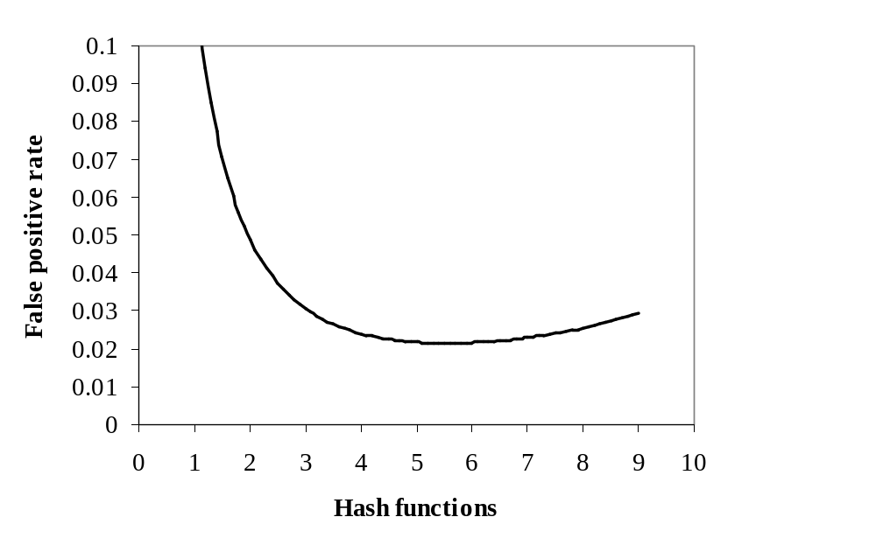
Example
m/n = 8
Opt k = 8 ln 2 = 5.45...

Slide 53

Bloom Filters: Distributed Systems
Send Bloom filters of URLs.
False positives do not hurt much.
  Get errors from cache changes anyway.
Web Cache 1
Web Cache 2
Web Cache 3
Web Cache 4
Web Cache 5
Web Cache 6

Slide 54
Tradeoffs
Three parameters.
  Size m/n : bits per item.
  Time k: number of hash functions.
  Error f: false positive probability.

