Slide 1
Introduction to Algorithms
Lecture 8

Slide 2
Last time
Red-black trees
Rotations
Insertion
Deletion
AVL-Trees

Slide 3
Today
Dynamic programming
  Matrix Chain Multiplication
  Longest common subsequence
  Optimal BST

Slide 4
Dynamic Programming
Dynamic programming is a metatechnique (not an algorithm) – like divide and conquer.
Here, “programming” isn’t computer programming; word comes from table-based solution method.
Divide & Conquer: break up into smaller problems
Dynamic Programming: solve all smaller problems but only reuse optimal subproblem solutions.

Slide 5
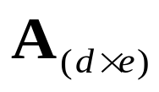
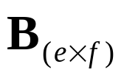
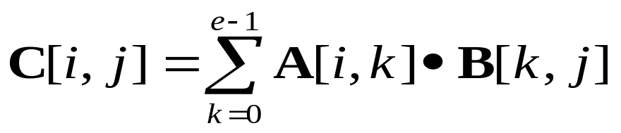
Matrix Chain Multiplication - Review
Recall how to multiply matrices.
Given two matrices
The product is
Time is O(def).
d
A
X
e
B
=
C
f
d
e
f

Slide 6
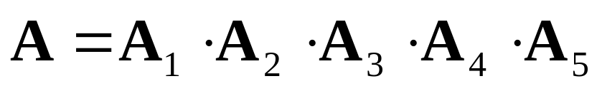





Matrix Chaining contd.
What about multiplying multiple matrices?
We know matrix multiplication is associative. Can we use this to help minimize calculations?
Sure, consider
If we multiply we do 4000 operations
But instead if we try we do 1575 operations

Slide 7
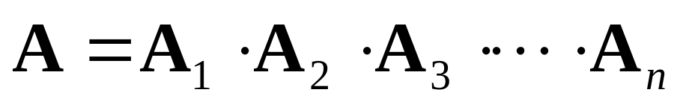
How do we parenthesize
Brute force - try all ways to parenthesize
Find out which has smallest number of operations by doing multiplication, then pick the best one.
But how many ways can we parenthesize these?
Equivalent to the number of ways to make a binary tree with n nodes. This is Ω(2^{n}). see Catalan numbers.

Slide 8
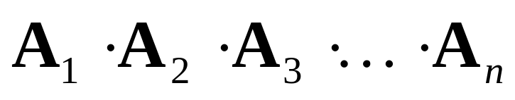
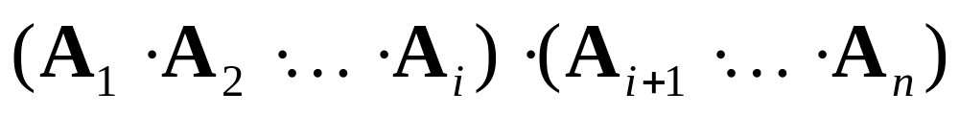


Optimality of Subproblems
Consider general question again, we want to parenthesize
Now suppose somehow we new that the last multiplication we need to do was at the i^{th} position.
Then the problem is the same as knowing the best way to parenthesize and

Slide 9
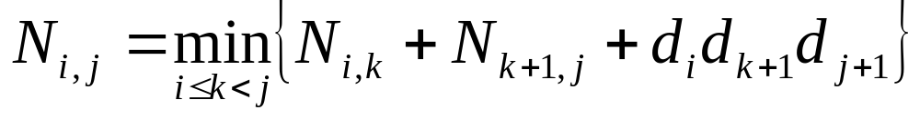
Overlapping Subproblems
We know how to break problem into smaller pieces, why doesn’t divide and conquer work?
Again suppose we know where the final multiply is and we want to generalize the cost with a recurrence, consider
But notice these subproblems overlap.

Slide 10
Try Dynamic Programming
Since subproblems overlap we can not use divide and conquer method.
Instead work from the “bottom up.”
We know how to parenthesize one matrix, two matrices, we can build from there…

Slide 11
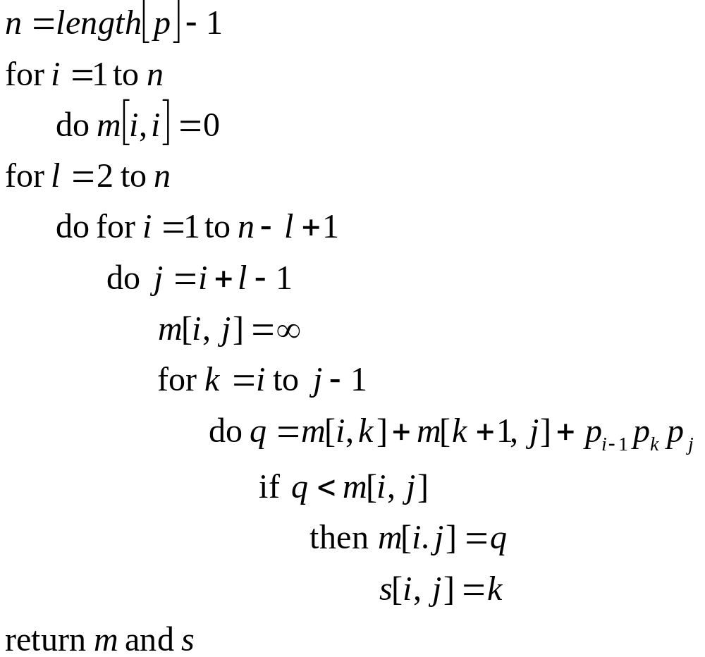
Matrix Chain Order

Slide 12
What have we noticed
Optimal solution depends on optimal subproblems
Subproblems overlap.
So a “top down” divide and conquer doesn’t seem to work.
Somehow we need to build up from bottom by remembering solution from subproblem.

Slide 13
Example
Biologists need to measure how similar strands of DNA are to determine how closely related an organism is to another.
They do this by considering DNA as strings of letters A,C,G,T and then comparing similarities in the strings.
Formally they look at common subsequences in the strings.
Example. X = AGTCAACGTT, Y=GTTCGACTGTG
Both S = AGTG and S’=GTCACGT are subsequences
How to do find these efficiently?

Slide 14
Example: Longest common subsequence (LCS)
Problem: Given two sequences x[1..m] and y[1..n],
find a longest subsequence common to both.
x: A B C B D A B
y: B D C A B A
Brute-force algorithm: For every subsequence of x,
check if it’s a subsequence of y.
Worst-case running time: Θ(n2^{m})
(2^{m} subsequences of x to check; each check takes Θ(n) time)

Slide 15
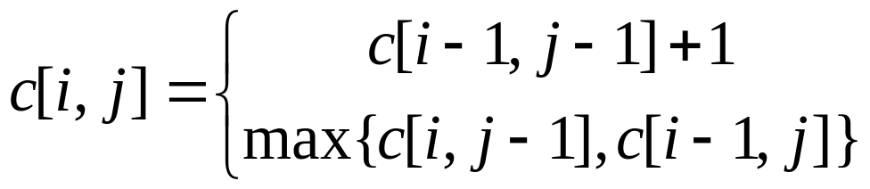
Recursive Algorithm
Better way:
For now, compute only length, not actual sequence.
Define c[i, j] = length of LCS of “prefixes”
x[1..i] and y[1..j].
Then c[m, n] = length of LCS of x and y.
Theorem:
if x[i] = y[j],
otherwise.

Slide 16
Proof
Proof of case where x[i] = y[j]
Let z[1..k] be LCS of x[1..i] and y[1..j]
(i.e., c[i, j] = k).
Now, z[k] = x[i] (= y[j]) (else could extend z by x[i]).
if x[i] = y[j],
otherwise.

Slide 17
Proof
Thus z[1..k−1] is CS of x[1..i−1] and y[1..j−1].
If ∃ a CS w longer than z[1..k−1], <w,x[i]> would be a CS longer than z.
Thus z[1..k−1] is LCS of x[1..i−1] and y[1..j−1]
(i.e., c[i−1, j−1] = k − 1).

Slide 18
Recursive Algorithm
Use recursive formulation directly.
Example (for length 3, length 4 sequence):
What is running time of this algorithm? (Why?)
How many distinct subproblems are there?
One for each position in strings x, y, for O(mn).
Each encountered many times in recursion tree!
3,4
2,3
2,4
3,3
1,2
1,3
2,2
1,3
1,4
2,3
2,2
2,3
3,2
1,2
1,3
2,2

Slide 19
Dynamic Programming Algorithm
LCS-Length(X, Y)
m ← length[X]
n ← length[Y]
for i ← 1 to m
do c[i, 0] ← 0
for j ← 0 to n
do c[0, j] ← 0
for i ← 1 to m
do for j ← 1 to n
do if x_{i} = y_{j}
then c[i, j] ← c[i − 1, j − 1] + 1
b[i, j] ← “ ”
else if c[i − 1, j] ≥ c[i, j − 1]
then c[i, j] ← c[i − 1, j]
b[i, j] ← “ ↑ ”
else c[i, j] ← c[i, j − 1]
b[i, j] ← “←”
return c and b

Slide 20
Example
X = <A, B, C, B>
Y = <B, D, C, A, B>
Which table entries must be known to compute c[i, j]?
j 0 1 2 3 4 5
i
y_{j}
B
D
C
A
B
0
x_{i}
0
0
0
0
0
0
A
1
0
0
0
0
1
1
2
B
0
1
1
1
1
2
3
C
0
1
1
2
2
2
4
B
0
1
1
2
2
3

Slide 21
Reconstructing the Sequence
Print-LCS(b,X,i,j)
if i = 0 or j = 0
then return
if b[i,j] = “ ”
then Print-LCS(b,X,i−1,j–1)
print x_{i}
elseif b[i,j] = “↑”
then Print-LCS(b,X,i–1,j)
else Print-LCS(b,X,i,j–1)

Slide 22
Dynamic Programming
Why can you apply it?
Computational task must have recursive formulation.
No cycles in formulation (usually, problem should be reduced to “smaller” problems).
Total number of problem instances to be solved must be small, say N.
Then running time is O(N * time to compute recursion rule).

Slide 23
Example: Optimal BST (Sedgewick)
Suppose we are doing string searching, and
know relative key frequencies
Example: spell; cc
Use Dynamic Programming to optimize BST.

Slide 24
Weighted Internal Path Length
Example BST, with search frequencies
Define “cost” of tree as frequency-weighted sum of node distance from root.
This is WIPL; here
1*1 + 4*2 + 2*2 + 2*3 + 3*3 +1*3 + 5*4 = 51
C
1
F
A
4
2
B
D
G
2
3
1
E
5

Slide 25
Intuition
Want to put highest-frequency keys near root
But must balance against cost of increased path lengths
First try: insert in order of decreasing frequency
WIPL is
1*5 + 4*2 + 2*2 + 3*3 + 1*3 + 2*4 + 5*1 =42
E
A
5
F
4
2
D
G
3
1
F
2
G
1

Slide 26
Algorithm
Given: keys K₁<K₂<…<K_{n}, 1≤ i ≤n and frequencies f_{i}, 1≤ i ≤n.
Find BST that minimizes, over all keys, of frequency times distance from root (access cost).
Idea: for subsequences of length 1,2,3,…,N-1, Find Optimal BST for search subsequence.
How?

Slide 27
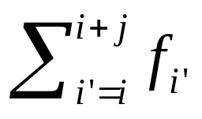
Algorithm
Idea:
For each k, i ≤ k ≤ i+j [j+1 is length]
Place K_{k} at root of T
Lookup optimal BST L of K_{i}…K_{k–1} (left)
Lookup optimal BST R of K_{k+1}…K_{i+j} (right)
WIPL(T) = WIPL(L) + WIPL(R) +
so compare to current optimum and update

Slide 28
Optimal BST
Puts high-frequency keys near root,
But…keeps tree reasonably balanced!
N = 7; f_{k} = 4,2,1,3,5,2,1
D
3
A
E
4
5
B
F
2
2
C
G
1
1
WIPL is
1*3 + 4*2 + 5*2 + 2*3 + 2*3 +1*4 + 1*4 = 41

Slide 29
Optimal substructure
A problem exhibits optimal substructure if an optimal solution contains optimal solutions to its subproblems.
Build an optimal solution from optimal solutions to subproblems
Example - Matrix-chain multiplication: An optimal parenthesization of A_{i}A_{i+1}…A_{j} that splits the product between A_{k} and A_{k+1} contains within it optimal solutions to the problem of parenthesizing A_{i}A_{i+1}…A_{k} and A_{k+1}A_{k+2}…A_{j.}

Slide 30
Illustration of Optimal Substructure
Minimal
Cost_A_{1..6} + Cost_A_{7..9}+p₀p₆p₉
A₁A₂A₃A₄A₅A₆A₇A₈A₉
Suppose
((A₁A₂)(A₃((A₄A₅)A₆)))
((A₇A₈)A₉)
is optimal
Then
(A₁A₂)
(A₃((A₄A₅)A₆))
must be optimal for A₁A₂A₃A₄A₅A₆
Otherwise, if
(A₁(A₂ A₃))
((A₄A₅)A₆)
is optimal for A₁A₂A₃A₄A₅A₆
Then
((A₁(A₂ A₃)) ((A₄A₅)A₆))
((A₇A₈)A₉)
will be better than
((A₁A₂)(A₃((A₄A₅)A₆)))
((A₇A₈)A₉)

Slide 31
Recognizing subproblems
Show a solution to the problem consists of making a choice. Making the choice leaves one or more subproblems to be solved.
Suppose that for a given problem, the choice that leads to an optimal solution is available.
Notice something in common with a greedy solution.

