Slide 1
Introduction to Algorithms
Lecture 9

Slide 2
Last Time
Dynamic programming
  Matrix Chain Multiplication
  Longest common subsequence
  Optimal BST

Slide 3
Today’s Lecture
Amortized Analysis
Aggregate Method
Accounting Method
Potential Method
Binary Counter
Table Update

Slide 4
Amortized Analysis
Scenario: Maintaining data structure over a sequence of n operation.
Operation cost: Cost per operation may be large (e.g. Θ(n)).
Total cost: But total cost may not be as much as n × (worst-case cost of one operation).
Amortized analysis: How to do tight analysis in such scenarios?
Examples: Heapify vs. Build-Heap.

Slide 5
Three techniques
Today we will describe three techniques that can be used to analyze such scenarios.
Aggregate method
Accounting method
Potential method
Motivate by the “Binary Counter” example.
Explain the differences.
Move to “Dynamic Table” problem.

Slide 6
Binary Counter
Data Structure: k-bit array, counting numbers from 0 to 2^{k} – 1.
Operation: Increment.
Cost: # of bits flipped.
(Toy problem! Motivates the ideas clearly!)
Example:
00000
00001 Cost = 1
00010 Cost = 2
00011 Cost = 1
00100 Cost = 3

Slide 7
Aggregate method
Idea: Count the total cost for n operations directly.
Technique: Ad-hoc. Possibly try to count from a different way.

Slide 8
Example of Aggregate method
0 0 0 0 0
0 0 0 0 1
Cost = 1
0 0 0 1 0
Cost = 2
0 0 0 1 1
Cost = 1
0 0 1 0 0
Cost = 3
0 0 1 0 1
Cost = 1
1 1 1 1 1
Cost = 5
1
2
4
8
16
Cost

Slide 9
Aggregate method (cont.)
Count per row varies. Hard to sum up.
Instead count by columns.
i.e., count how many times ith bit is flipped.
Add the costs.
For a sequence of n increments:
ith l.s.b. flipped ⎣n/2^{i}⎦ times.

Slide 10
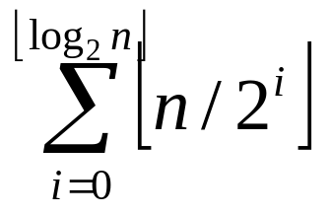
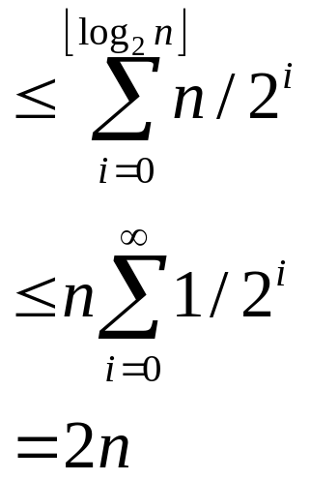
Aggregate method (cont.)
Total Cost =
Thus total cost = O(n).
Amortized cost per insertion = O(n)/n = O(1).

Slide 11
Amortized cost
Definition: Average cost of an operation over a sequence of n operations, maximized over all n and all sequences.
Warning:
Not average case analysis!
No assumptions about input sequence.
Amortization is still a worst-case principle.
In aggregate method, counted the total to bound the amortized cost. Usually do this the other way.

Slide 12
Accounting method
Data structure comes with a “bank account”.
Every operation allotted a fixed $ cost (its amortized cost).
If actual cost less than allotted amount, deposit extra $’s into bank.
If actual cost more than allotted amount, withdraw from bank to pay for the operation.
Prove: Always have a non-negative balance.
Conclude: Sequence of n operations costs at most n times the amortized cost!

Slide 13
Example: Binary Counter
Amortized Cost of flipping 0 → 1 = 2$.
Amortized Cost of flipping 1 → 0 = 0$.
When flipping 0 to 1: Pay 1$ for operation, and put 1$ in bank account (earmarked to the newly set bit).
When flipping 1 to 0: Withdraw from the bank to pay the operation.

Slide 14
Example: Binary Counter
Invariant: Every 1 in the counter has 1$ earmarked for it in the bank account. So always have money to pay for the operation.
Finally: Increment makes only one 0 → 1 flip. So amortized cost of increment = 2.

Slide 15
Potential Method
In this method, we associate a potential energy with every data structure.
Potential energy is “Potential to do damage”.
Amortized cost = actual cost + new potential – old potential.
i.e., Must pay to increase the potential of the data structure.
If operation has large actual cost but reduces the potential a lot, then amortized cost is low.
How to find potential: Look for what makes a data structure bad.

Slide 16

Potential functions
Basic rules:
  Must always be non-negative.
  Must start at zero.
  Implies a sequence of n operations cost at most n times the amortized cost.
Proof: Suppose n operations modify data structure from D₀ to D₁ to…D_{n}.
Let Φ(D) be the potential of data structure D.
Let c_{i} be actual cost of ith operation.
Let be amortize cost of ith operation.

Slide 17
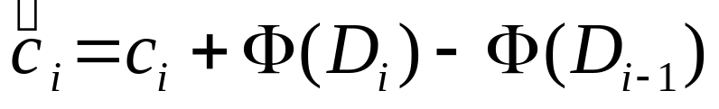
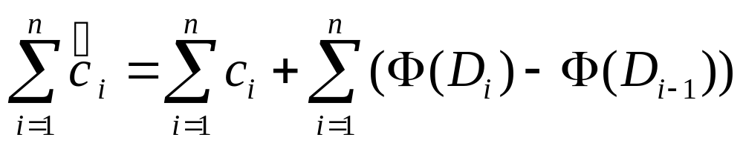
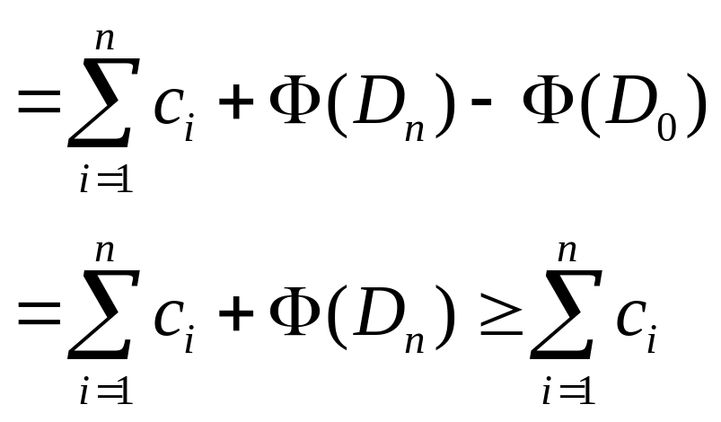
Potential functions (cont.)
Then
Summing we get:

Slide 18
Example: Binary Counter
Data structure is bad if it has a lot of 1’s in it.
Let Φ(Counter) = # 1’s in Counter.
Potential increase on increment
= # (0 → 1) flips − # (1 → 0) flips
= 1 − # (1 → 0) flips
Thus amortized cost of increment
= Actual cost + Potential increase
= (1 + # (1 → 0)) flips + ( 1 − # (1 → 0)) flips
= 2
Thus amortized cost = 2, and cost of n increment is at most 2n.

Slide 19
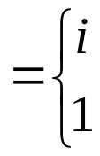
Example: Dynamic tables
Idea: “Grow” table with system call to allocate more memory. Reinsert old items.
Sequence of n Inserts:
Worst-case cost = Θ(n)
Total cost << n·Θ(n) = Θ(n²)
= Θ(n)
Let c_{i} = cost of ith Insert
if i – 1 is exact power of 2
otherwise

Slide 20
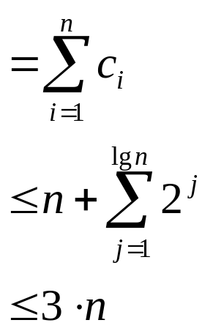
Dynamic tables (cont.)
i Size Cost
Aggregate Analysis:
1 1
2 1+1
4 1+2
4 1
8 1+4
8 1
8 1
8 1
16 1+8
16 1
Cost of n inserts

Slide 21
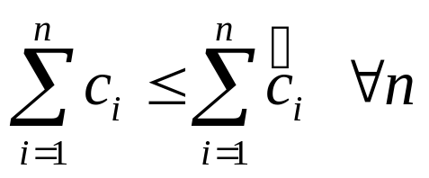
Accounting analysis
Charge each operation a fictitious amortized amount.
Amount not immediately used is stored in bank.
Later operations use bank reserve.
Balance must not go negative.
Must have

Slide 22

Dynamic table
Charge $3 for ith Insert
amortized cost
$1 pays for immediate Insert, $2 stored for later.
When table doubles:
$1 reinserts item $1 reinserts old item
Therefore, balance is never negative.
Amortized costs are upper bound on true cost.
0 0 0 0 | 2 2 2 2
0 0 0 0 0 0 0 0 |  | 2 2 2 2

Slide 23
Accounting vs. Aggregate
Advantage of accounting over aggregate:
Each operation can be assigned a specific amortized cost.
Note: Different amortized costs may work.
Expansion and Contraction

Slide 24
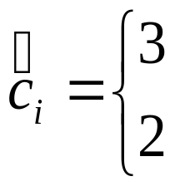
Accounting analysis
Inserts and Deletes
Table overflows ⇒ double
Table < ½ full → halve (cause thrashing) →¼
Accounting analysis:
Always can pay ⇒ n operations cost O(n)
Potential analysis:
Stored work viewed as potential energy of data structure.
if Insert
if Delete

Slide 25
Potential analysis
Most flexible and powerful.
Framework: Start with data structure D₀
operation i transforms D_{i–1} to D_{i}
cost of operation i is c_{i}
Idea: Define potential function Φ: {D_{i}) → R such that Φ(D₀) = 0 and Φ(D_{i}) ≥ 0 ∀i.

Slide 26
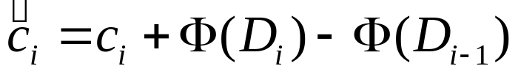
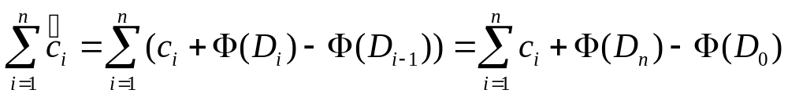
Potential analysis
Amortize cost defined by:
If ΔΦ > 0, then > c_{i}, and operation i stores work in data structure.
If ΔΦ < 0, then < c_{i}, and operation i delivers up work from data structure to help pay for c_{i}.
Total amortized cost of n operation is
potential difference ΔΦ

Slide 27
Potential analysis
So amortized costs upper bound true costs.
Key: Find useful potential function.
Example: Table doubling (Insert only)
Definition: Φ(D_{i})=2i − 2^{⎡lgi⎤} (Assume 2^{⎡lg 0⎤}=0)
Note: Φ(D₀) = 0
Φ(D_{i}) ≥ 0 ∀i

Slide 28
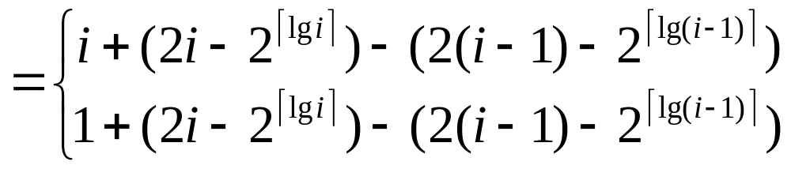

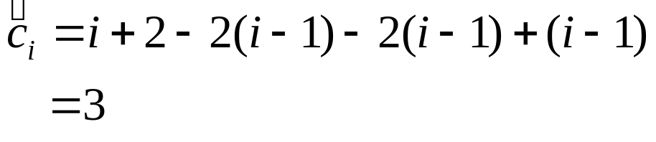

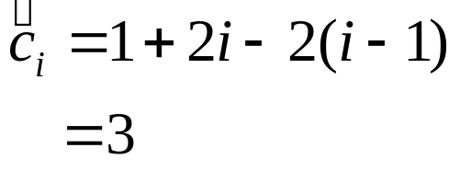
Potential analysis
Amortized cost of ith Insert
Case 1:
⇒
Case 2:
⇒

Slide 29
Amortized Analysis: Disjoint Sets
Disjoint-set data structure:
  maintains a collection of disjoint sets {S₁,…,S_{r}}
  each set has a representative element rep[S_{i}]
  supported operations:
    MakeSet(x)
    Find(x)
    Union(x,y)

Slide 30
Disjoint Sets
MakeSet(x)
  Given object x, create a new set whose only element (and representative) is pointed to by x
Find(x)
  Given object x, return (a pointer to) the representative of the set containing x
  Assumption: there is a pointer to each x so we never have to look for an element in the structure

Slide 31
Disjoint Sets
Union(x,y)
  Given two elements x, y, merge the disjoint sets containing them.
  The original sets are destroyed.
  The new set has a new representative (usually one of the representatives of the original sets)
  At most n-1 Unions can be performed where n is the number of elements

Slide 32
Disjoint Sets Example
Find the connected components of the undirected graph G=(V,E) (maximal subgraphs that are connected).
for (each vertex v in V)
Makeset(v): put v in its own set
for (each edge (u,v) in E)
if (find(u) ~= find(v))
union(u,v)
Now we can find if two vertices x and y are in the same connected component by testing:
find(x) = find(y)

Slide 33
Disjoint Sets:Implementation #1
Using linked lists:
  The first element of the list is the representative
  Each node contains:
    an element
    a pointer to the next node in the list
    a pointer to the representative

Slide 34
Disjoint Sets:Implementation #1
Using linked lists:
  MakeSet(x)
    Create a list with only one node, for x
    Time O(1)
  Find(x)
    Return the pointer to the representative (assuming you are pointing at the x node)
    Time O(1)

Slide 35
Disjoint Sets:Implementation #1
Using linked lists:
  Union(x,y)
    . Append y’s list to x’s list.
    . Pick x as a representative
    . Update y’s “representative” pointers
    A sequence of m operations may take O(m²) time
    Improvement: let each representative keep track of the length of its list and always append the shorter list to the longer one.
      Now, a sequence of m operations takes O(m+nlgn) time

Slide 36
Disjoint Sets:Implementation#1
An Improvement
Let each representative keep track of the length of its list and always append the shorter list to the longer one.
Theorem: Any sequence of m operations takes O(m+n log n) time.
  Use Amortized analysis

Slide 37
Up-tree
A simple data structure for implementing disjoint sets is the up-tree.
H
X
A
W
F
B
R
H, A and W belong to the same set. H is the representative
X, B, R and F are in the same set. X is the representative

Slide 38
A Set As A Tree
S = {2, 4, 5, 9, 11, 13, 30}
Some possible tree representations:
4
5
13
2
9
11
30
5
13
4
11
13
2
4
5
9
9
11
30
30
2

Slide 39
Operations in Up-Trees
Find is easy. Just follow pointer to representative element. The representative has no parent.
find(x)
if (parent(x) exists) // not the root
return(find(parent(x));
else return x;
Worst case, height of the tree.

Slide 40
Steps For find(i)
13
Start at the node that represents element i and climb up the tree until the root is reached
Return the element in the root
To climb the tree, each node must have a parent pointer
4
5
9
11
30
2

Slide 41
Result Of A Find Operation
find(i) is to identify the set that contains element i
In most applications of the union-find problem, the user does not provide set identifiers
The requirement is that find(i) and find(j) return the same value iff elements i and j are in the same set
4
2
9
11
30
5
13
find(i) will return the element that is in the tree root

Slide 42
Possible Node Structure
Use nodes that have two fields:
element and parent
Use an array table[] such that table[i] is a pointer to the node whose element is i
To do a find(i) operation, start at the node given by table[i] and follow parent fields until a node whose parent field is null is reached
Return element in this root node

Slide 43
Example
13
4
5
9
11
30
2
1
table[]
0
5
10
15
(Only some table entries are shown.)

Slide 44
Better Representation
Use an integer array parent[] such that parent[i] is the element that is the parent of element i
13
4
5
9
11
30
2
1
parent[]
2
9
13
13
4
5
0
0
5
10
15

Slide 45
Union
Union is more complicated.
Make one representative element point to the other, but which way?
Does it matter?
In the example, some elements are now deeper away from the root

Slide 46
Union(H,X)
H
X
F
X points to H
B, R and F are now deeper
A
W
B
R
H
X
F
H points to X
A and W are now deeper
A
W
B
R

Slide 47
A worse case for Union
Union can be done in O(1), but may cause find to become O(n)
A
B
C
D
E
Consider the result of the following sequence of operations:
Union (A, B)
Union (C, A)
Union (D, C)
Union (E, D)

Slide 48
Two Heuristics
There are two heuristics that improve the performance of union-find.
  Union by weight or height
  Path compression on find

Slide 49
Height Rule
Make tree with smaller height a subtree of the other tree
Break ties arbitrarily
13
7
4
5
8
3
22
6
9
11
30
2
10
1
union(7,13)
20
16
14
12

Slide 50
Weight Rule
Make tree with fewer number of elements a subtree of the other tree
Break ties arbitrarily
7
13
8
3
22
6
4
5
9
10
11
30
2
20
16
14
12
1
union(7,13)

Slide 51
Implementation
Root of each tree must record either its height or the number of elements in the tree.
When a union is done using the height rule, the height increases only when two trees of equal height are united.
When the weight rule is used, the weight of the new tree is the sum of the weights of the trees that are united.

Slide 52
Height Of A Tree
If we start with single element trees and perform unions using either the height or the weight rule. The height of a tree with p elements is at most floor (log₂p) + 1.
Proof is by induction on p.

Slide 53
Union by Weight Heuristic
Always attach smaller tree to larger.
union(x,y)
rep_x = find(x);
rep_y = find(y);
if (weight[rep_x] < weight[rep_y])
A[rep_x] = rep_y;
weight[rep_y] += weight[rep_x];
else
A[rep_y] = rep_x;
weight[rep_x] += weight[rep_y];

Slide 54
Path Compression
Each time we do a find on an element E, we make all elements on path from root to E be immediate children of root by making each element’s parent be the representative.
find(x)
if (A[x]<0)
return(x);
A[x] = find(A[x]);
return (A[x]);
When path compression is done, a sequence of m operations takes O(m log n) time. Amortized time is O(log n) per operation.

Slide 55
Path Compression
7
13
8
3
22
6
4
5
9
f
g
10
11
30
2
e
d
20
16
14
12
1
a, b, c, d, e, f, and g are subtrees
a
b
c
find(1)
Do additional work to make future finds easier

Slide 56
Path Compression
Make all nodes on find path point to tree root.
find(1)
7
13
8
3
22
6
4
5
9
g
10
f
11
30
e
2
20
16
14
12
d
1
a, b, c, d, e, f, and g are subtrees
a
b
c
Makes two passes up the tree

Slide 57
Ackermann’s Functions
The Ackermann’s function is the simplest example of a well-defined total function which is computable but not primitive recursive.
"A function to end all functions" -- Gunter Dötzel.
  1. If m = 0 then A(m, n) = n + 1
  2. If n = 0 then A(m, n) = A(m-1, 1)
  3. Otherwise, A(m, n) = A(m-1, A(m, n-1))
The function f(n) = A(n, n) grows much faster than polynomials or exponentials or any function that you can imagine

Slide 58
Ackermann’s Function
Ackermann’s function.
  A(m,n) = 2^{n}, m = 1 and n ≥ 1
  A(m,n) = A(m-1, 2), m ≥ 2 and n = 1
  A(m,n) = A(m-1, A(m, n-1)), m, n ≥ 2
Ackermann’s function grows very rapidly as m and n increase
  A(2,4) = 2^{65,536}

Slide 59
Time Complexity
Inverse of Ackermann’s function.
  α(n) = min{k>=1 | A(k,1) > n},
  The inverse function grows very slowly
  α(n) < 5 until n = 2^{A(4,1)} + 1
  A(4,1) >> 10⁸⁰
For all practical purposes, α(n) < 5

Slide 60
Time Complexity
Theorem [Tarjan and Van Leeuwen]
Let T(n, m) be the maximum time required to process any intermixed sequence of n finds and unions.
T(n, m) = O(m α(n))
when we start with singleton sets and use either the weight or height rule for unions and any one of the path compression methods for a find.

Slide 61
Online Problems
Ski Problem
The Stanford Professor’s Lost Car Problem
Paging Problem
…

