Slide 1
Introduction to Algorithms
Lecture 9

Slide 2
Last Time
Dynamic programming
  Matrix Chain Multiplication
  Longest common subsequence
  Optimal BST

Slide 3
Today’s Lecture
Amortized Analysis
Aggregate Method
Accounting Method
Potential Method
Binary Counter
Table Update

Slide 4
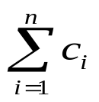
Amortized Analysis
Scenario: Maintaining data structure over a sequence of n operation o₁, o₂, …, o_{n}.
Operation cost: Cost per operation may be large (e.g. Θ(n)), worst-case cost = max c(o_{i}).
Total cost: But total cost may not be as much as n × (worst-case cost of one operation).
Amortized analysis: How to do tight analysis in such scenarios? (Total cost/n)
Examples: Heapify vs. Build-Heap.

Slide 5
Three techniques
Today we will describe three techniques that can be used to analyze such scenarios.
Aggregate method
Accounting method
Potential method
Motivate by the “Binary Counter” example.
Explain the differences.
Move to “Dynamic Table” problem.

Slide 6
Binary Counter
Data Structure: k-bit array, counting numbers from 0 to 2^{k} – 1.
Operation: Increment.
Cost: # of bits flipped.
(Toy problem! Motivates the ideas clearly!)
Example:
00000
00001 Cost = 1
00010 Cost = 2
00011 Cost = 1
00100 Cost = 3

Slide 7
Aggregate method
Idea: Count the total cost for n operations directly.
Technique: Ad-hoc. Possibly try to count from a different way.

Slide 8
Example of Aggregate method
0 0 0 0 0
0 0 0 0 1
Cost = 1
0 0 0 1 0
Cost = 2
0 0 0 1 1
Cost = 1
0 0 1 0 0
Cost = 3
0 0 1 0 1
Cost = 1
1 1 1 1 1
Cost = 5
1
2
4
8
16
Cost

Slide 9
Aggregate method (cont.)
Count per row varies. Hard to sum up.
Instead count by columns.
i.e., count how many times ith bit is flipped.
Add the costs.
For a sequence of n increments:
ith l.s.b. flipped ⎣n/2^{i}⎦ times.

Slide 10
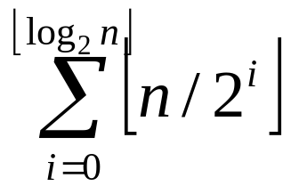
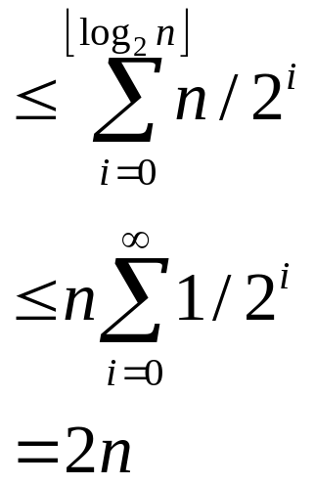
Aggregate method (cont.)
Total Cost =
Thus total cost = O(n).
Amortized cost per insertion = O(n)/n = O(1).

Slide 11
Amortized cost
Definition: Average cost of an operation over a sequence of n operations, maximized over all n and all sequences.
Warning:
Not average case analysis!
No assumptions about input sequence.
Amortization is still a worst-case principle.
In aggregate method, counted the total to bound the amortized cost. Usually do this the other way.

Slide 12
Accounting method
Data structure comes with a “bank account”.
Every operation allotted a fixed $ cost (its amortized cost).
If actual cost less than allotted amount, deposit extra $’s into bank.
If actual cost more than allotted amount, withdraw from bank to pay for the operation.
Prove: Always have a non-negative balance.
Conclude: Sequence of n operations costs at most n times the amortized cost!

Slide 13
Example: Binary Counter
Amortized Cost of flipping 0 → 1 = 2$.
Amortized Cost of flipping 1 → 0 = 0$.
When flipping 0 to 1: Pay 1$ for operation, and put 1$ in bank account (earmarked to the newly set bit).
When flipping 1 to 0: Withdraw from the bank to pay the operation.

Slide 14
Example: Binary Counter
Invariant: Every 1 in the counter has 1$ earmarked for it in the bank account. So always have money to pay for the operation.
Finally: Increment makes only one 0 → 1 flip. So amortized cost of increment = 2.

Slide 15
Potential Method
In this method, we associate a potential energy with every data structure.
Potential energy is “Potential to do damage”.
Amortized cost = actual cost + new potential – old potential.
i.e., Must pay to increase the potential of the data structure.
If operation has large actual cost but reduces the potential a lot, then amortized cost is low.
How to find potential: Look for what makes a data structure bad.

Slide 16

Potential functions
Basic rules:
  Must always be non-negative.
  Must start at zero.
  Implies a sequence of n operations cost at most n times the amortized cost.
Proof: Suppose n operations modify data structure from D₀ to D₁ to…D_{n}.
Let Φ(D) be the potential of data structure D.
Let c_{i} be actual cost of ith operation.
Let be amortize cost of ith operation.

Slide 17
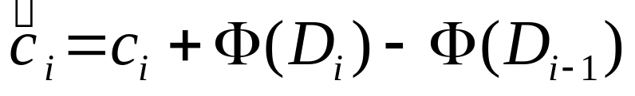
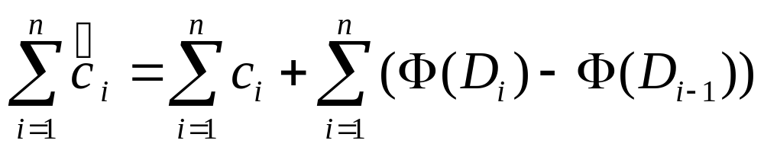
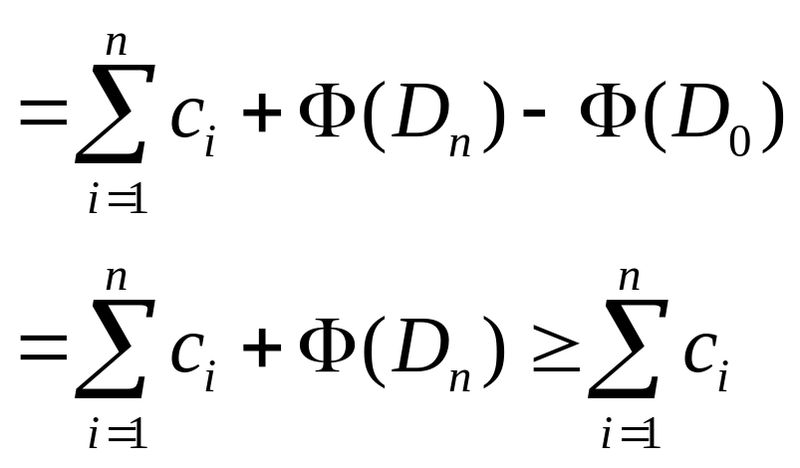
Potential functions (cont.)
Then
Summing we get:

Slide 18
Example: Binary Counter
Data structure is bad if it has a lot of 1’s in it.
Let Φ(Counter) = # 1’s in Counter.
Potential increase on increment
= # (0 → 1) flips − # (1 → 0) flips
= 1 − # (1 → 0) flips

Slide 19
Example: Binary Counter
Thus amortized cost of increment
= Actual cost + Potential increase
= (1 + # (1 → 0)) flips + ( 1 − # (1 → 0)) flips
= 2
Thus amortized cost = 2, and cost of n increment is at most 2n.

Slide 20
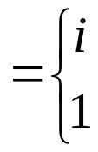
Example: Dynamic tables
Idea: “Grow” table with system call to allocate more memory. Reinsert old items.
Sequence of n Inserts:
Worst-case cost = Θ(n)
Total cost << n·Θ(n) = Θ(n²)
= Θ(n)
Let c_{i} = cost of ith Insert
if i – 1 is exact power of 2
otherwise

Slide 21
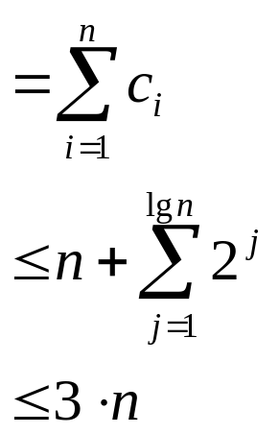
Dynamic tables (cont.)
i Size Cost
Aggregate Analysis:
1 1
2 1+1
4 1+2
4 1
8 1+4
8 1
8 1
8 1
16 1+8
16 1
Cost of n inserts

Slide 22
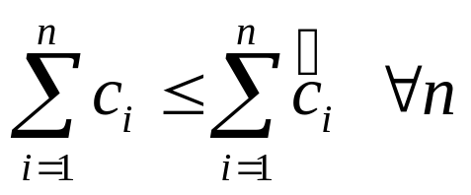
Accounting analysis
Charge each operation a fictitious amortized amount.
Amount not immediately used is stored in bank.
Later operations use bank reserve.
Balance must not go negative.
Must have

Slide 23

Dynamic table
Charge $3 for ith Insert
amortized cost
$1 pays for immediate Insert, $2 stored for later.
When table doubles:
$1 reinserts item, $1 reinserts old item
Therefore, balance is never negative.
Amortized costs are upper bound on true cost.
0 0 0 0 | 2 2 2 2
0 0 0 0 0 0 0 0 |  | 2 2 2 2

Slide 24
Accounting vs. Aggregate
Advantage of accounting over aggregate:
Each operation can be assigned a specific amortized cost.
Note: Different amortized costs may work.
Expansion and Contraction

Slide 25
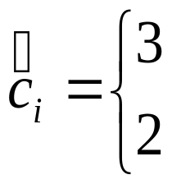
Accounting analysis
Inserts and Deletes
Table overflows ⇒ double
Table < ½ full → halve (cause thrashing) →¼
Accounting analysis:
Always can pay ⇒ n operations cost O(n)
Potential analysis:
Stored work viewed as potential energy of data structure.
if Insert
if Delete

Slide 26
Potential analysis
Most flexible and powerful.
Framework: Start with data structure D₀
operation i transforms D_{i–1} to D_{i}
cost of operation i is c_{i}
Idea: Define potential function Φ: {D_{i}) → R such that Φ(D₀) = 0 and Φ(D_{i}) ≥ 0 ∀i.

Slide 27
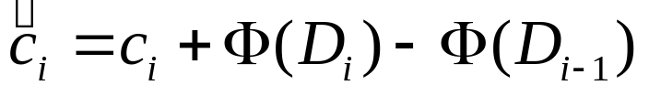
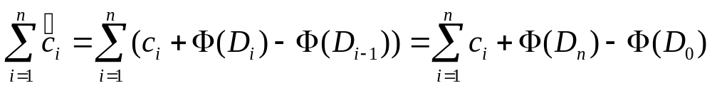
Potential analysis
Amortize cost defined by:
If ΔΦ > 0, then > c_{i}, and operation i stores work in data structure.
If ΔΦ < 0, then < c_{i}, and operation i delivers up work from data structure to help pay for c_{i}.
Total amortized cost of n operation is
potential difference ΔΦ

Slide 28
Potential analysis
So amortized costs upper bound true costs.
Key: Find useful potential function.
Example: Table doubling (Insert only)
Definition: Φ(D_{i})=2i − 2^{⎡lgi⎤} (Assume 2^{⎡lg 0⎤}=0)
Note: Φ(D₀) = 0
Φ(D_{i}) ≥ 0 ∀i

Slide 29
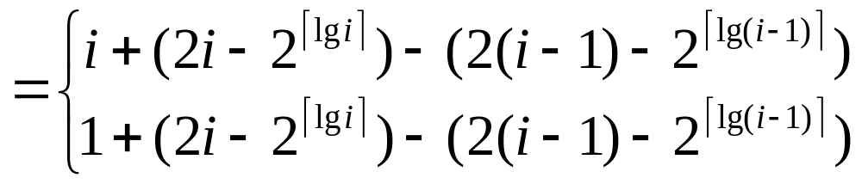

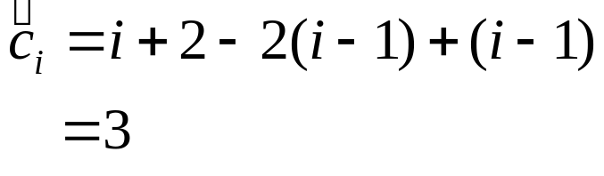

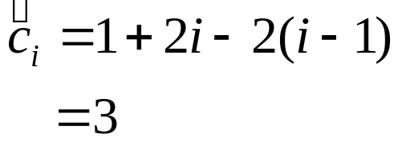
Potential analysis
Amortized cost of ith Insert
Case 1:
⇒
Case 2:
⇒

Slide 30
Online Problems
Ski Problem
The Stanford Professor’s Lost Car Problem
Paging Problem
…

Slide 31


Lost Car Problem
Where is my car?

Slide 32
Finding the car – online algorithm
d = 1; current_side = left
repeat
  walk distance d on current_side
  if find car then exit
  d = 2d
  flip current_side
Claim: cost_{ON} ≤ 9 × cost_{OPT}

