Slide 1
Coding and Information Theory
《Coding and Information Theory》
Notes:
CS & Eng. Fudan Univeristy

Slide 2
Overview
Instructor: Xueqing Chen （陈学青）
Email: xqchen@fudan.edu.cn
Tel: 65643022-106(O)
Lectures:Wednesday, 1:30-3:10PM in Z2209A
Textbook: Coding and Information Theory, by S. Roman
《Coding and Information Theory》

Slide 3
课件下载:
以用户名:xqchen访问现代教育中心的网络课堂
《Coding and Information Theory》

Slide 4

Chapter 1：Entropy
1.1 Entropy of a Source
Definition: Source is an ordered pair ,
where S={x₁,…,x_{n}} is a finite set, the source alphabet, and P is the probability distribution on S. Denote the probability of x_{i} by p_{i} or p(x_{i})
Amount of
Amount of
Uncertainty (before)
Output
Information (after)
X_{i} according
to probability Distribution
《Coding and Information Theory》

Slide 5
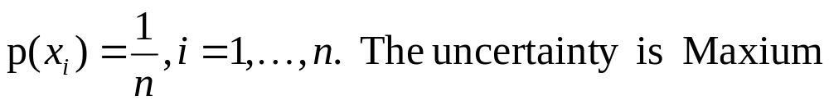
Example for uncertainty
1)
2)
3) Uncertainty = Information
《Coding and Information Theory》

Slide 6
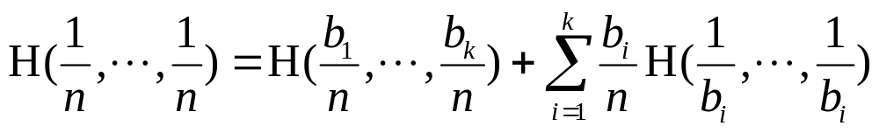
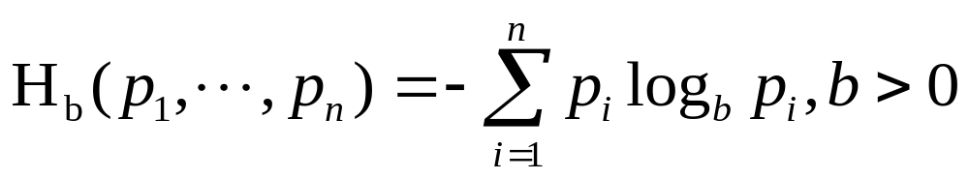
Entropy Function H(p₁,…,p_{n}) has the following properties
1) H(p₁,…,p_{n}) is defined and continuous for all p₁,…,p_{n} satisfying 0≤p_{i}≤1,∑p_{i}=1
2) H(1/n,…,1/n) < H(1/(n+1),…,1/(n+1)), for n in Z⁺
3) For b_{i} in Z⁺, ∑b_{i}=n
Theorem 1.1.1
《Coding and Information Theory》

Slide 7
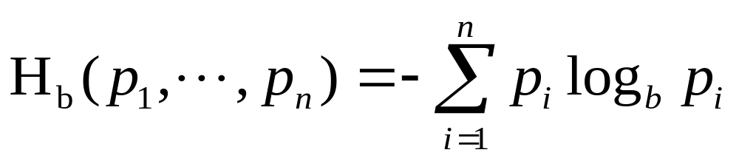

Theorem 1.1.1 Introduction
A function H satisfies properties 1)-3) if and only
if it has the form
Where b>1 , and where we set
《Coding and Information Theory》

Slide 8
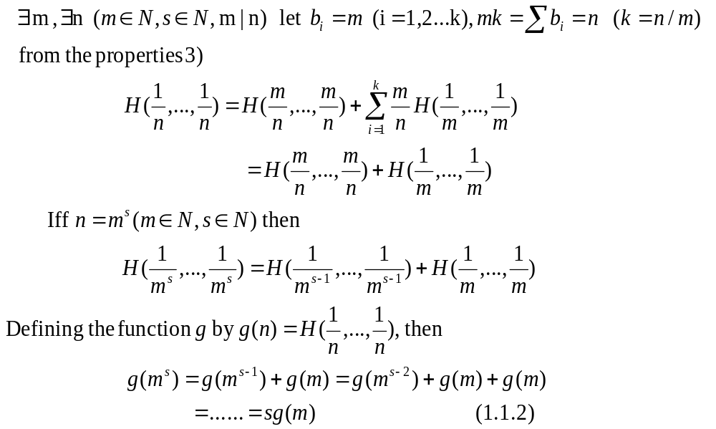
Proof :Theorem 1.1.1
《Coding and Information Theory》

Slide 9
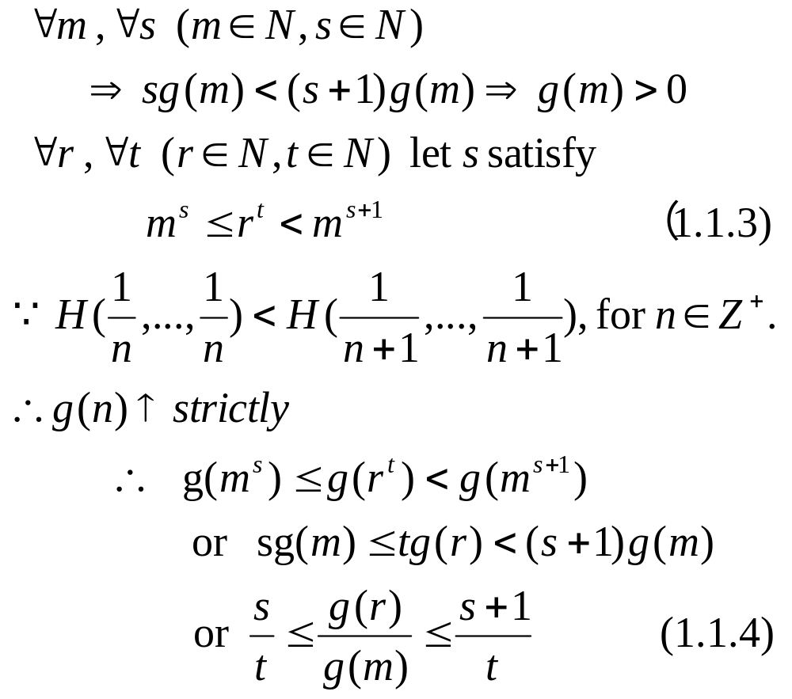
《Coding and Information Theory》

Slide 10
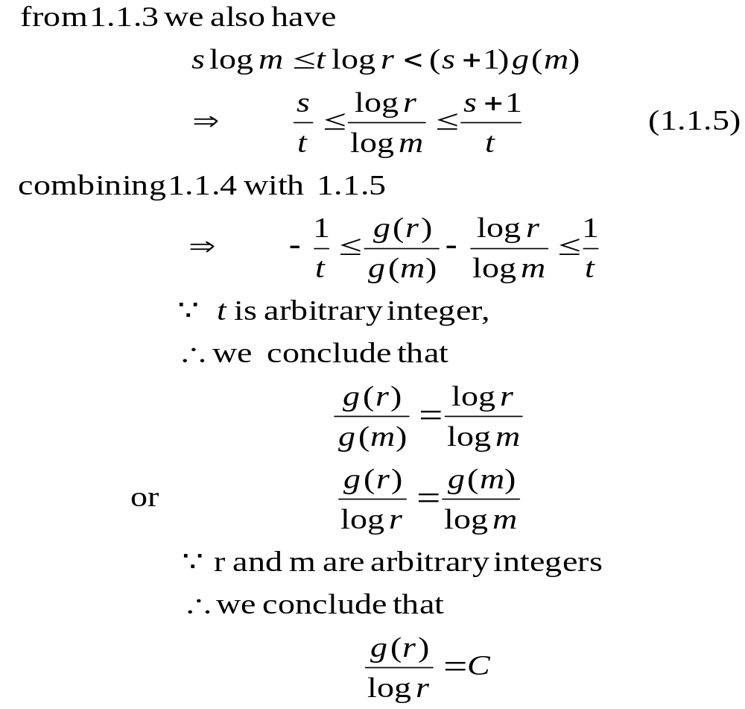
《Coding and Information Theory》

Slide 11

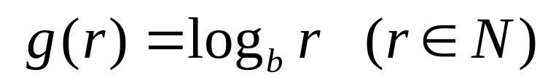
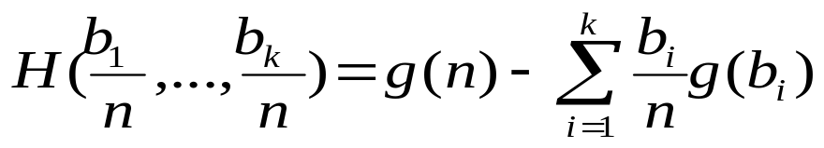
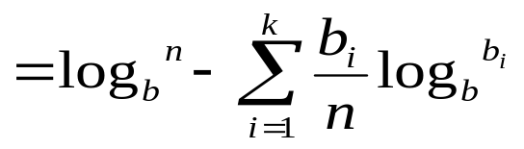
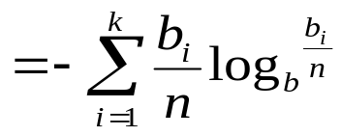
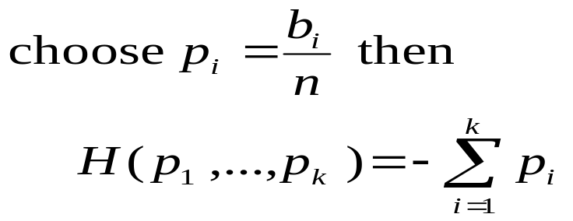

Then:
Now the properties 3) can be written as:
（证毕）
《Coding and Information Theory》

Slide 12
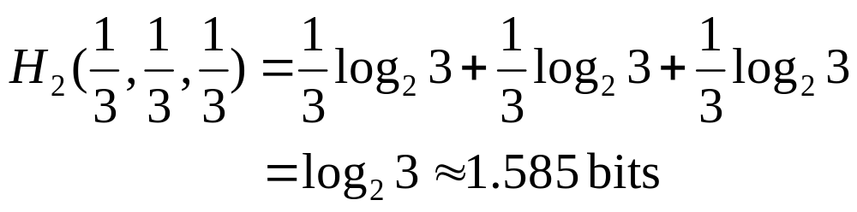
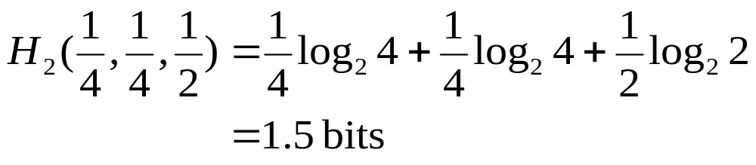
Units of Entropy
H_{k} measures the number of k-ary units of information.
Example 1.1.1 S={x₁,x₂,x₃}, p_{i}=1/3, gives
If p₁=p₂=1/4, p₃=1/2 , then it gives
《Coding and Information Theory》

Slide 13
Example 1.1.2 How many bits are enough to represent an English character?
Letter | Prob. | Letter | Prob. | Letter | Prob. | Letter | Prob.
Space | 0.1859 | S |  | F |  | V
E | 0.1031 | R |  | M |  | K
T | 0.0796 | H |  | W |  | X
A | 0.0642 | L |  | Y |  | Q
O | 0.0632 | D |  | P |  | J
I | 0.0575 | U |  | G |  | Z | 0.0005
N | 0.0574 | C |  | B
H(p₁,…,p₂₇)=4.07991 bits
每个ASC 码字符用几个比特表示？
《Coding and Information Theory》

Slide 14
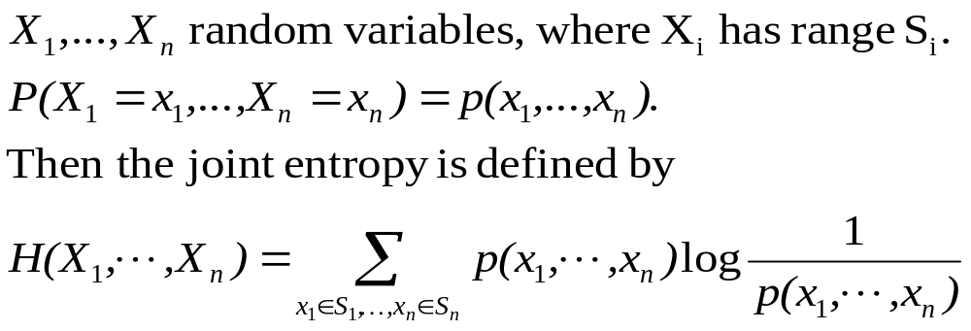
Definition of Entropy
《Coding and Information Theory》

Slide 15

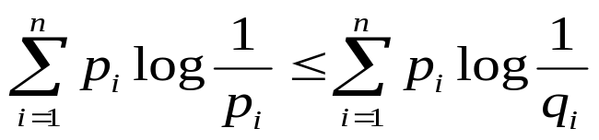
1.2 Properties of Entropy
Lemma 1.2.1 If ln x denotes the natural logarithm of x, then
for all , with equality holding if and only if x=1.
Lemma 1.2.2 Let P={p₁,…,p_{n}} be a prob. distr., and let Q={q₁,…,q_{n}} have the properties that 0≤q_{i}≤1, and ∑q_{i}≤1. Then
Furthermore the equality holds if and only if q_{i}=p_{i} for all i.
《Coding and Information Theory》

Slide 16
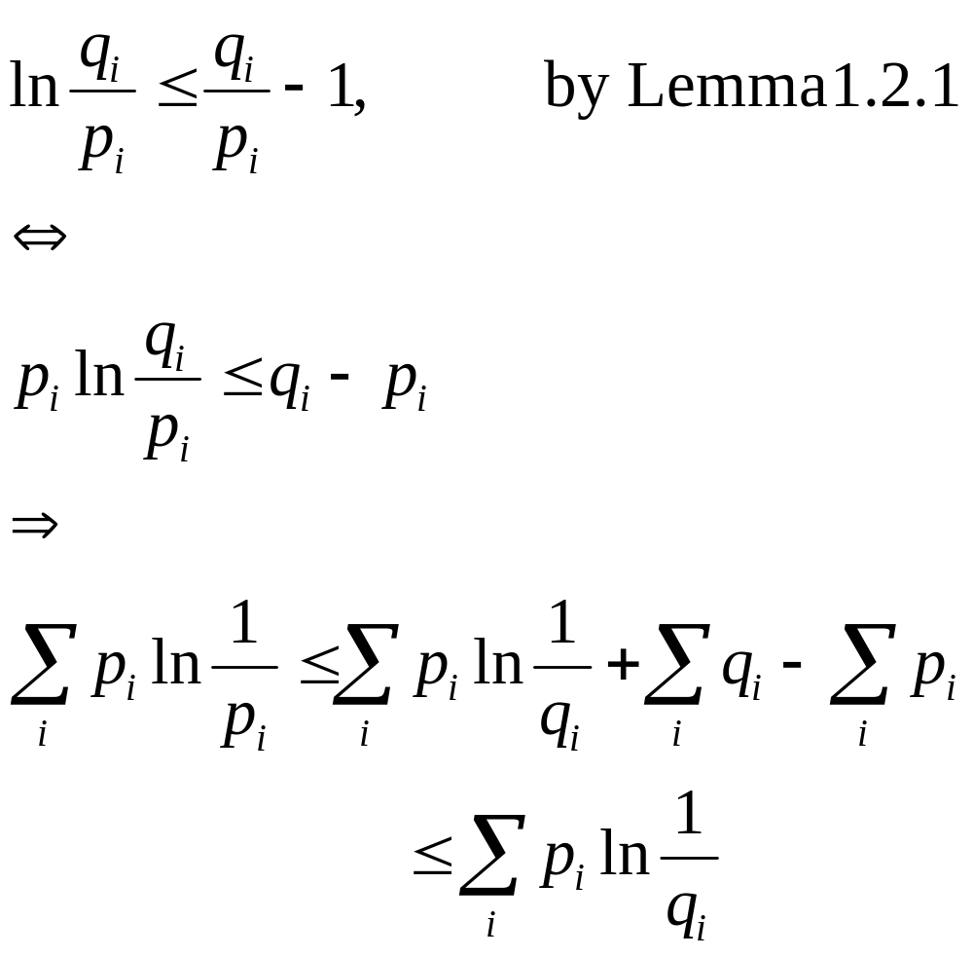
Proof:
《Coding and Information Theory》

Slide 17
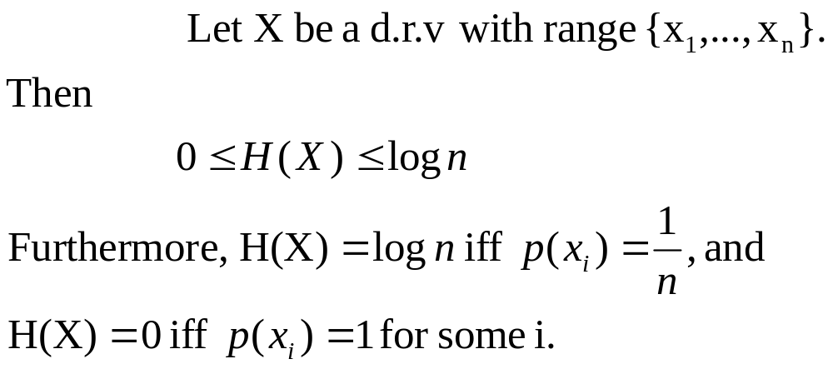
The Range of the Entropy Function
Theorem 1.2.3.
《Coding and Information Theory》

Slide 18
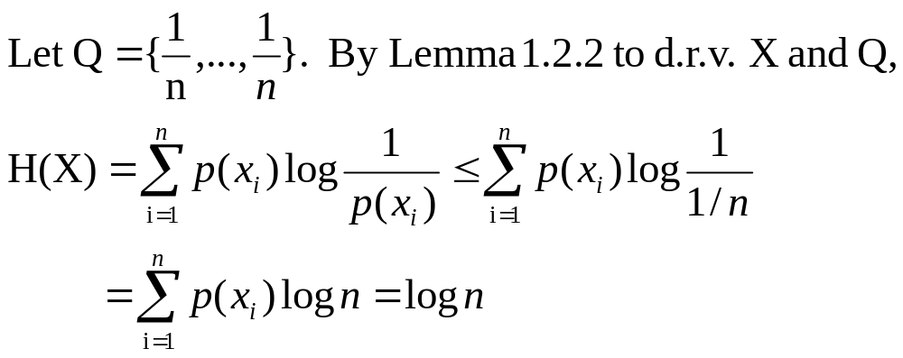
Proof:
Thus, H(X)=log n iff p_{i}=1/n, for all i.
《Coding and Information Theory》

Slide 19
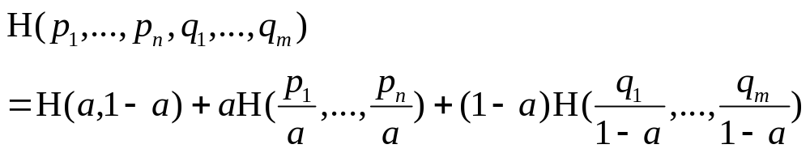
Grouping Axiom
Theorem 1.2.4. Let {p₁,…, p_{n},q₁,…,q_{m}} be a p.d. If a=p₁+…+p_{n} then
证明：直接验证。
《Coding and Information Theory》

Slide 20

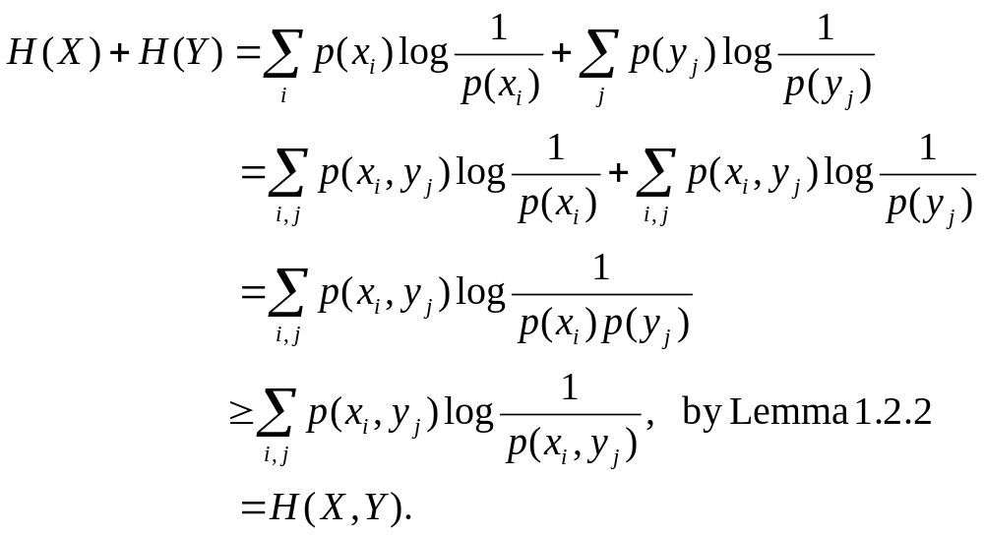
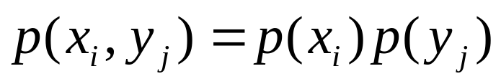
Joint Entropy
Theorem 1.2.5 Let X and Y be d.r.v. Then
The equality holds iff X and Y are independent.
Proof:
The equality holds iff
《Coding and Information Theory》

Slide 21
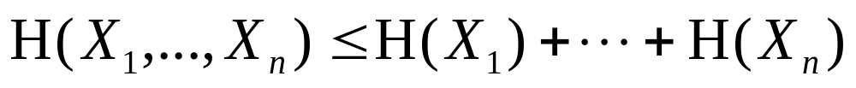
Corollary 1.2.6 Let X₁,…,X_{n} be d.r.v. Then
with equality holding iff the X_{i} are independent.
Corollary 1.2.7 Let X₁,…,X_{n,} Y₁,…,Y_{m} be d.r.v. Then
with equality holding iff the X=(X₁,…,X_{n}) and Y=(Y₁,…,Y_{n})
are independent.
《Coding and Information Theory》

Slide 22
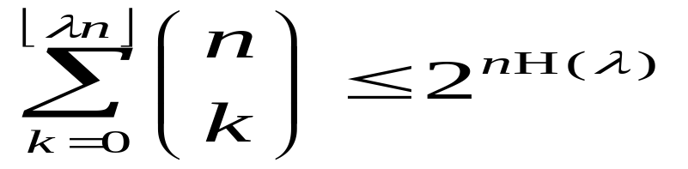
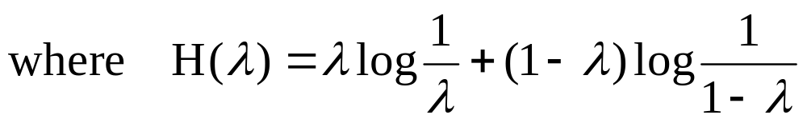
The Entropy Function H(p)
Theorem 1.2.8 For 0≤λ≤1/2, we have
《Coding and Information Theory》

Slide 23
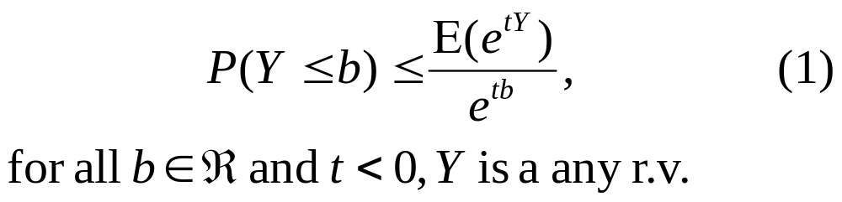
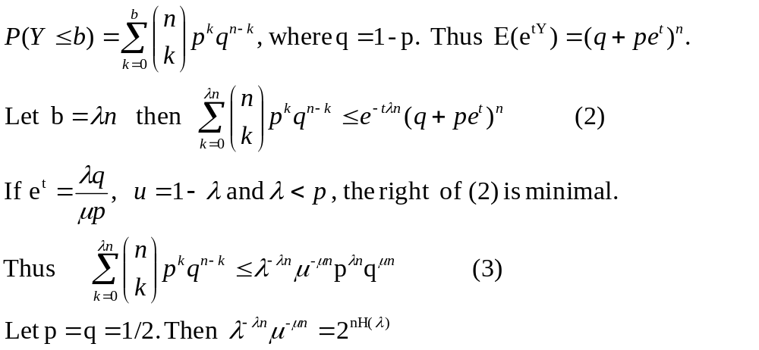
Proof: By Chebyshev’ inequality
Let Y is a binomial r.v., then
《Coding and Information Theory》

Slide 24
y
x
y
x
Convex
Not Convex
Definition: Let K be a subset of R^{n}. K is convex if x,y in K implies ax+(1-a)y in K for 0≤a ≤1.
Definition: Let K be a convex set. A real function f: K—> R is convex up if f(ax+(1-a)y) ≤ af(x)+(1-a)f(y) for every x,y in K and 0≤a ≤1.
A real function f: K—> R is convex down if f(ax+(1-a)y) >= af(x)+(1-a)f(y) for every x,y in K and 0≤a ≤1.
Lemma: The set K={p=(p₁,…,p_{n})|p is prob distr} is convex.
We call K the pd set.
《Coding and Information Theory》

Slide 25
Theorem 1.2.9 The entropy function H is
convex down on the pd set K
Proof: Let p=(p₁,…,p_{n}) and Q=(q₁,…,q_{n}) in K, and 0≤a ≤1. Then
H(ap+(1-a)q)=∑_{i}(ap_{i}+(1-a)q_{i})log 1/(ap_{i}+(1-a)q_{i})
=a∑_{i}p_{i}log 1/(ap_{i}+(1-a)q_{i})
+ (1-a)∑_{i}q_{i}log 1/(ap_{i}+(1-a)q_{i})
≥aH(p)+(1-a)H(q) by lemma 1.2.2
《Coding and Information Theory》

Slide 26
Entropy as an Expected Value
The expected value of the random variable W(x_{i})=log 1/p(X=x_{i}); The average bits to represent each the character in {x₁,…x_{n}}.
《Coding and Information Theory》

Slide 27
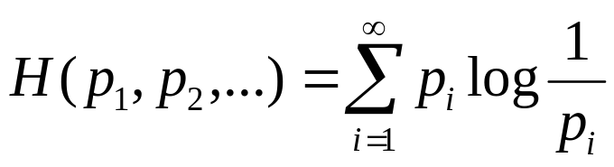
1.3 Additional Properties of Entropy
The entropy of countably infinity distributions
设{p₁,p₂,…}是 可数无限的PD。
《Coding and Information Theory》

Slide 28
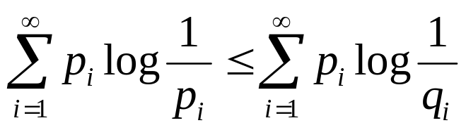
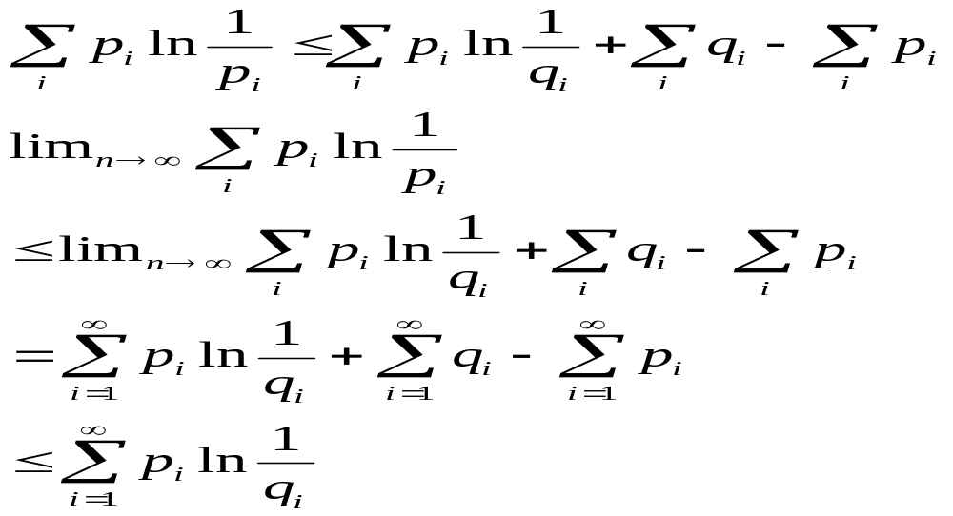
Lemma 1.3.1 Let {q1,q2,…} have the property that q_{i}>= 0 and ∑q_{i}<=1, 如果下列的和式收敛，则
with equality if and only if p_{i}=q_{i}.
Proof:
《Coding and Information Theory》

Slide 29
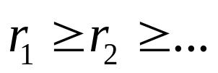
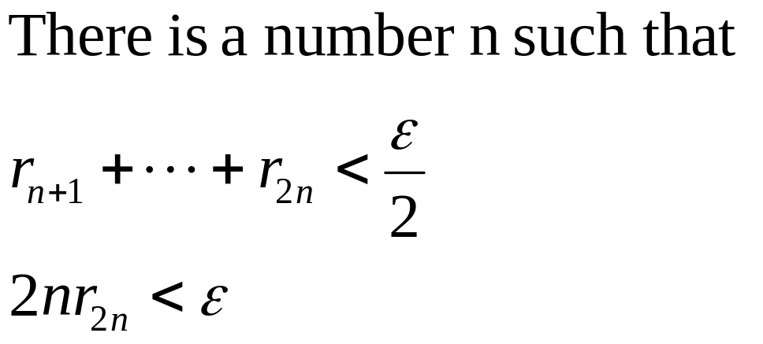
Lemma 1.3.2 Let be a monotonically decreasing sequence of positive real numbers. If the series ∑r_{i} converges, then ir_{i}→0 as i →∞.
Proof:
《Coding and Information Theory》

Slide 30
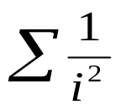
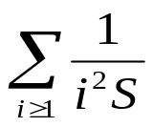
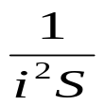
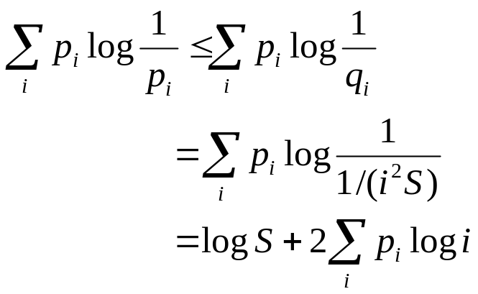

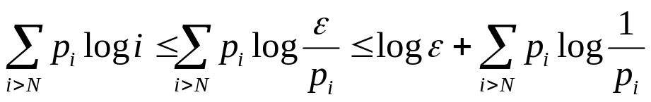
Theorem 1.3.3 Let {p1,p2,…} be a countably infinite prob. dist.
If the sum ∑p_{i} log i converges, then so does ∑pi log pi
If p₁ >= p₂ >= … and if ∑p_{i} log 1/p_{i} converges, then so does ∑p_{i} log i
Proof: 1) converges. Let S= . Then = 1
Let q_{i}=
2) 由于 所以 ip_{i}→0. 对任意小的ε，存在N, 当n>N, 则ip_{i}< ε于是
《Coding and Information Theory》

Slide 31
Example 1.3.1
Example 1.3.1: Consider a situation where countably infinite sources arise naturally. Suppose we have a source ζ₁=(S₁,P₁), where S₁={0,1} and P₁(0)=p, that is outputting a stream of independent source symbols.
Suppose further that a counting device intercepts this output and counts the number of 0’s that occur before each 1.
For example, the stream of independent source symbols is:
001011000100000111…
then the counter will output the sequence :
2103500…
The counter can also be thought as a source ζ₂=(S₂,P₂), where S₂={0,1,2,3,……} and P₂ is the geometric distribution.
Question: Compare the entropy of these two sources ζ₁ and ζ_{2.}
《Coding and Information Theory》

Slide 32

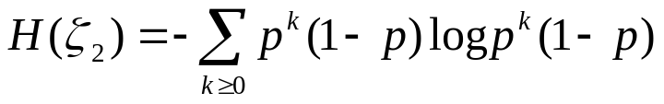
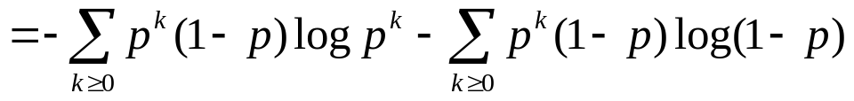
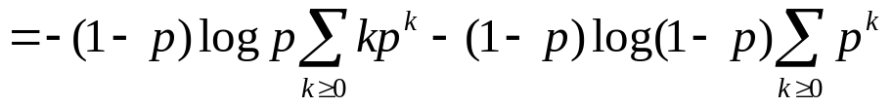
《Coding and Information Theory》

Slide 33
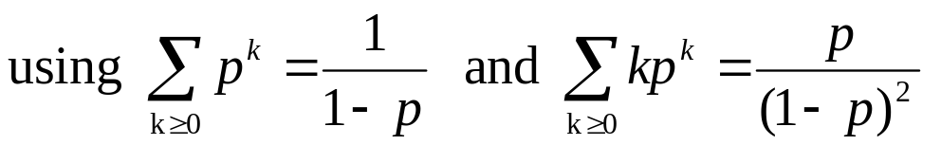
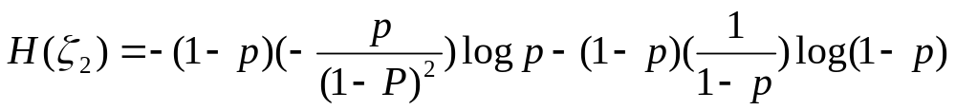
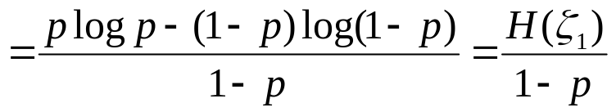
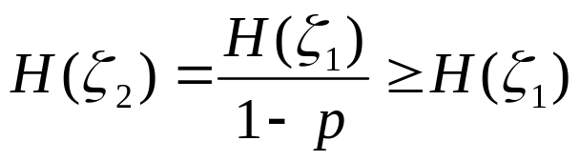
Then:
《Coding and Information Theory》

