Slide 1

Chapter 2 Noisless Coding
2.1 Variable Length Encoding

Slide 2
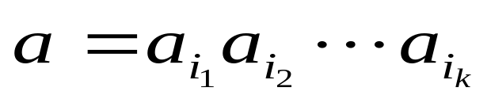
Let A={a₁,…,a_{n}} be a finite set, the alphabet.
A string, or word is a sequence of elements of A in the form.
Empty string θ is also a word.
Length of a string a is denoted by len(a)
A* the set of all strings over A.
Definition: Let A={a₁,…,a_{r}} be a code alphabet.
An r-ary code is a nonempty subset C of the set A*
of all strings over A.
The number r is called the code radix.
Binary code when r=2, ternary code when r=3.

Slide 3
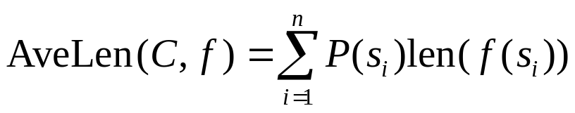
Definition: Let φ=(S,P) be a source. An
encoding scheme for φ is an ordered pair
(C, f), where C is a code and f: S —> C is
an injective function, called an encoding
function. 其中S={s₁,s₂,…,s_{n}}
Definition: The average codeword length:
f将信源与码字对应

Slide 4
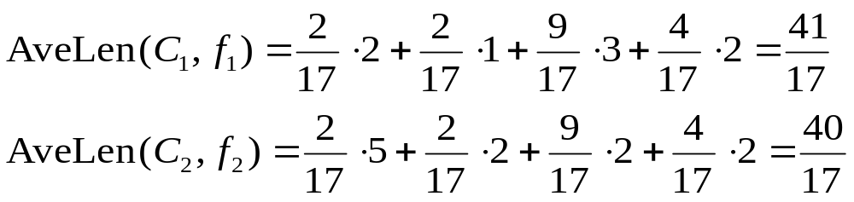
Example 2.1.1
S={a,b,c,d}, P(a)=P(b)=2/17, P(c)=9/17 P(d)=4/17
f₁: S →C₁, C₁={0,11,100,10}
f₁(a)=11 f₁(b)=0 f₁(c)=100 f₁(d)=10
f₂: S → C₂ C₂={00, 10, 11, 01010}
f₂(a)=01010 f₂(b)=00 f₂(c)=10 f₂(d)=11
Conclusion: The average codeword length of a code depends on the coding map.

Slide 5
本章的目的
在给定信源条件下、确定一个使得平均码长最小的“良好”的编码策略

Slide 6
Fixed Length Code C: If all codewords in C have the same len. Also called block code
Variable Length Code C: The lengths of the codewords in C are different.
Example: Let S={s₁,…,s₅}, whose pd is
P(s₁)=1-e and P({s₂,…,s₅})=e
如果采用固定码长的编码，则每个码字的长度至少是3 bits
但如果作如下的编码映射：
f:S → C;
s₁→0, s₂→100, s₃→101, s₄→110 s₅→111
则平均码长是 1(1-e)+3e=1+2e.
因此，如果 e<1 则 AveLen( C,f )<3.

Slide 7
Unique Decipherability
S={a,b,c}, C={0,01,001}
f(a)= 0, f(b)=01, f(c)=001
How to decipher the string 001 ?
Is it ab or c ?

Slide 8
唯一可译码
一个编码C是唯一可译码，满足如下条件：如果c₁c₂…c_{k} 和d₁d₂…d_{j}都是C中的码字，且c₁c₂…c_{k}=d₁d₂…d_{j}
则：k=j, c_{i}=d_{i} , i=1,…,j.

Slide 9
Example 2.1.2 S={a,b,c}, C={1,01,001}
f(a)= 1, f(b)=01, f(c)=001
It is a unique decipherable code. The Decoding Rule:
Reading a codeword string from left to right,
Decoding when and only when 1 is encountered.
Example 2.1.3 S={a,b,c,d}, C={0,01,011,0111}
f(a)= 0, f(b)=01, f(c)=011, f(d)=0111. It’s unique decipherable.
It may be necessary to wait until the entire message has been completely received before we can begin to decode.

Slide 10
Instantaneous codes;
The Prefix Property
Definition: A code is instantaneous if each codeword in any string of codewords can be decoded (reading from left to right) as soon as it is received.
一个编码是即时的则它一定是唯一可译的。 反之不然。
Definition: A code is said to have the prefix property if no codeword is a prefix of any other codeword, that is, if whenever c= x₁x₂…x_{n} is a codeword, then x₁x₂…x_{k} is not a codeword for 1≤ k < n.

Slide 11
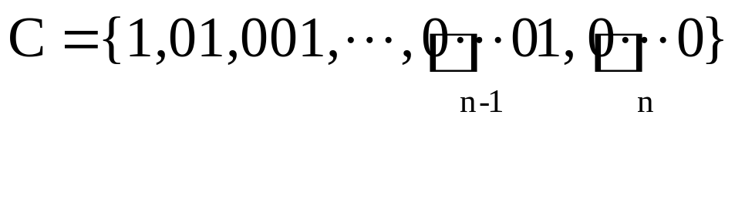
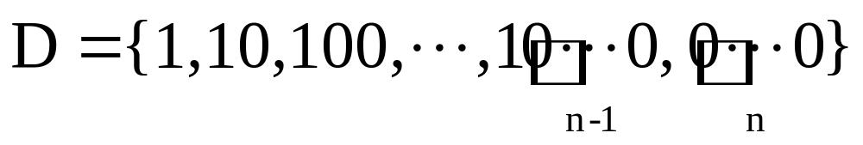
Theorem 2.1.1 A code C is instanteous if and only if
it has prefix property.
Example 2.1.4 Comma code C is instanteous.
C={1,01,001,…,0…01, 0…001,0…0}
But the code D is not instanteous.

Slide 12
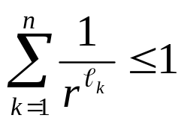
KRAFT’s THEOREM
Theorem 2.1.2
If C is an r-ary instantaneous code with codeword lengths l_{1,}… , l_{n}, then these lengths must satisfy Kraft’s inequality
If the number l_{1,}… , l_{n} satisfy Kraft’s inequality, then there is an instantaneous r-ary code with codeword length l_{1,}… , l_{n} .

Slide 13
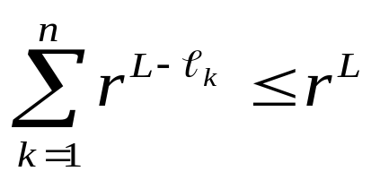


Proof:
Let C={c₁,…,c_{n}}, len(c_{i})= ℓ_{i} , and L=max{ℓ_{i}}.
If c_{i} =x₁x₂…x_{ℓi}, then r^{L- ℓi} words of the form
x₁x₂…x_{ℓi} y_{ℓi+1}…Y_{L} are not in C.
Thus
Conversely, if Kraft’s inequality holds, we construct a code which is instantaneous. Let α_{j} be the number of codewords of length j. Thus,
α₁ ≤r
α₁ r+ α₂ ≤r² 只要这个不等式成立，则一定能找到a₂个不与前面码长1的码为前缀的码字。
…… α₁ r^{n-1} +…+α_{n-1} r + α_{n} ≤r^{n}
α₁ r^{n-2} +…+α_{n-2} r + α_{n-1} ≤r^{n-1} α₁ r⁻¹ +…+α_{n-1} r^{-(n-1)} + α_{n}r^{-n} ≤1
α₁ r^{n-1} +…+α_{n-1} r + α_{n} ≤r^{n}

Slide 14
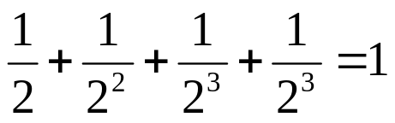
Example 2.1.5
C={0,11,100,110} ℓ₁=1, ℓ₂ =2, ℓ₃ =3, ℓ₄ =3
Since |A|=2
满足Kraft 不等式，但不是即时可译码。

Slide 15
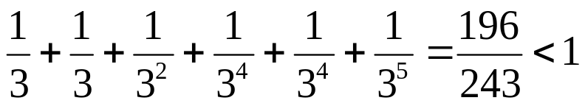
Example 2.1.6
A={0,1,2} ℓ₁= ℓ₂ =1, ℓ₃ =2, ℓ₄ = ℓ₅ =4, ℓ₆ =5
C1=0
C2=1
C3=20
C4=2100
C5=2101
C6=21100
0
1
2
0
1
0
1
0
0
1
0

Slide 16
McMillan’s Theorem
Theorem 2.1.3 If C={c₁,c₂,…,c_{n}} is an r-ary uniquely decipherable code with codeword lengths ℓ₁… ℓ_{n}, then these lengths must satisfy Kraft’s inequality
反之 不一定

Slide 17
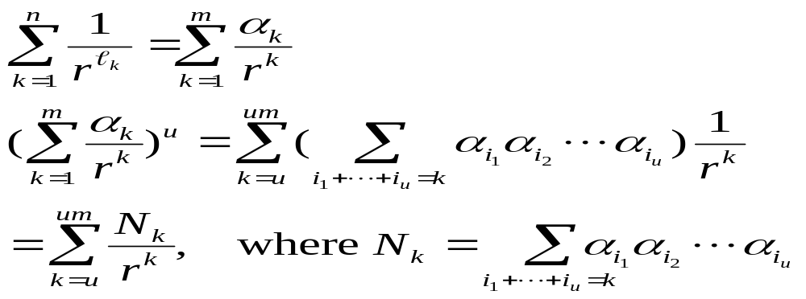

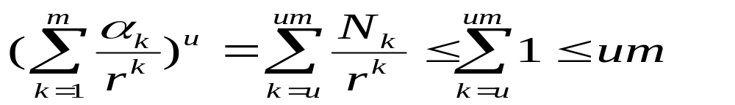
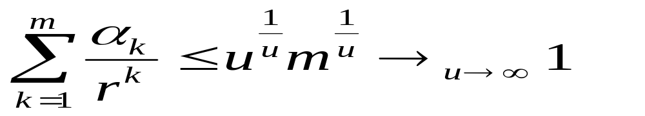
Proof:
设
则 N 是由u个码字组成的长度是k的字符串集合。
|N|=N_{k} （唯一可译码性质）
每个长度是k的字符串最多可以划分成一个由u个码字组成的串。所以
因此

Slide 18
定理2.1.4: 如果存在一个唯一可译码，其码长是ℓ₁… ℓ_{n，}则存在一个有相同码长的即时码。
推论：唯一可译码的最小平均码长等于即时可译码的最优码长

Slide 19
2.2 Huffman Encoding
(c₁,c₂,…,c_{n}) encoding scheme, (p₁,p₂,…,p_{n}) Prob. Distribution,
平均码长： AveLen (c₁,c₂,…,c_{n})=∑_{i}p_{i}len(c_{i})
极小平均码长： MinAveLen_{r}(p₁,p₂,…,p_{n})
最优码是平均码长达到极小平均码长的编码。

Slide 20
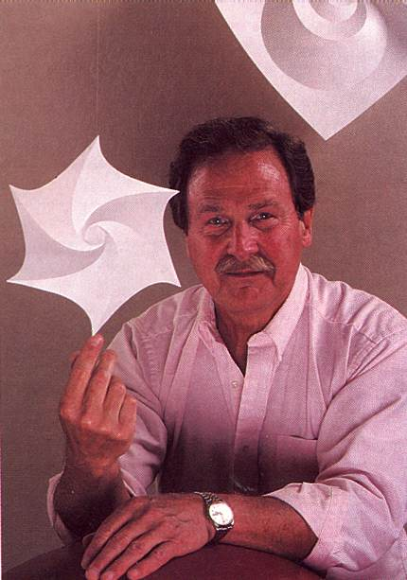
DAVID A. HUFFMAN
A modest Massachusetts Institute o
f Technology graduate student。
In 1951 he and his classmates in an
electrical engineering Graduate course
on IT were given the choice of a term
paper or a final exam，老师是Fano
Students were asked to find the most
efficient method of representing numbers,
letters or other symbols using a binary code
经过几个月几乎绝望的探索，完成了作业。
“Huffman code is one of the fundamental ideas that people in computer science and data communications are using all the time,"
says Donald E. Knuth

Slide 21
Huffman 说，如果他当时知道该问题是 Fano, Shannon等教授一直在奋斗而还没有解决的问题，则他肯定不做这个题目了。
Although others have used Huffman code to
help make millions of dollars, Huffman‘s main
compensation 是免除了a final exam.
He never tried to patent an invention
from his work

Slide 22
A 4-ary Code with probability distribute
P=(0.24, 0.2, 0.18, 0.13, 0.1, 0.06, 0.05, 0.03, 0.01)
. How to find a way to construct an instantaneous code with minimal average length of each word.
Prob. | Code | Prob | Code | Prob | Code
0.24 | 1 | 0.24 | 1 | 0.38* | 0
0.20 | 2 | 0.20 | 2 | 0.24 | 1
0.18 | 3 | 0.18 | 3 | 0.20 | 2
0.13 | 00 | 0.13 | 00 | 0.18 | 3
0.10 | 01 | 0.10 | 01
0.06 | 03 | 0.09* | 02
0.05 | 020 | 0.06 | 03
0.03 | 021
0.01 | 022

Slide 23
最优编码思路
符号集合{0,1,…,r-1}. 概率分布P={p₁,…,p_{n}}
递归: 概率分布
Q={p₁,…, p_{n-s,} q} --> 最优编码D={c₁,…, c_{n-s,} d}
D有前缀性质(prefix property), 其中
q= p_{n-s+1}+…+ p_{n,}
扩展码字d --> s个码字: d0,d1,…,d(s-1), 其中 s≤ r.
形成编码:
P={p₁,…,p_{n}} --> C={c₁,…, c_{n-s,} d0,d1,…,d(s-1)}
现要证明: 只要概率q, 和整数s取得恰当, 则如果D是最优码，则C也是最优编码.

Slide 24

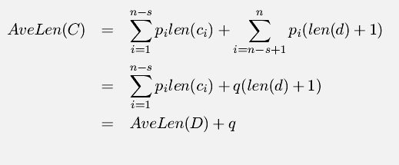


D的平均码长是
而C的平均码长是
因此
只要证明
则就能得到
因此表明C是 的最优编码

Slide 25


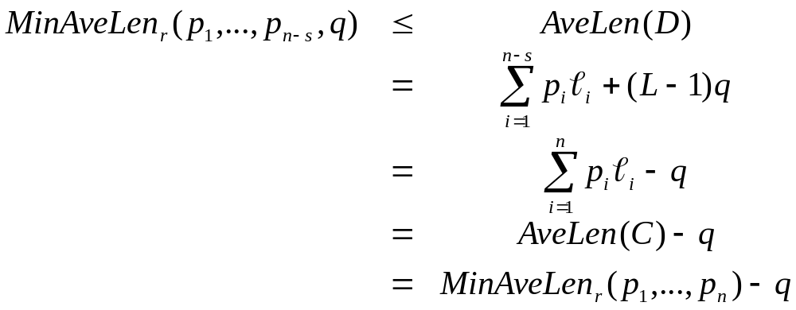
Let be an encoding scheme for
假定C中码字的最大码长是L. 且恰好有s 个L长度, 形式如下的码字
d0,d1,…,d(s-1)
其中d是一个长度是L-1的字符串. 收缩C码成为
D={c₁,…, c_{n-s,} d}
是概率分布(p₁,…, p_{n-s,} q) 的编码. 因为
所以， 如果D是最优编码，则C也是最优编码。

Slide 26
从递归的效率角度考虑，除第一次例外，每叠代一次最好能将r概率值并成一个。
设共叠代u次，则
n-(s-1)-u(r-1)=r
s 三 n mod (r-1)， 2≤s≤r
所以s是唯一确定的。
定理2.2.1 设P=(p₁,…,p_{n}) 是概率分布且p1≥p₂≥…≥p_{n}. 则存在一个适合P 的r-元最优编码 C={c₁,…, c_{n}}, 使得C中有s个形式为d0,d1,…,d(s-1) 的最长码字。 因此

Slide 27
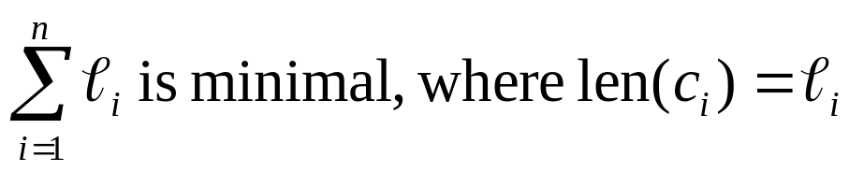

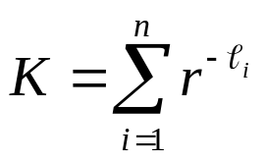



Proof: Let C={c₁,…, c_{n}} be an optimal r-ary code for P and 其全局码长达到最小
We must have
设k是C中最长码字的个数。因此
下证： k≥s.
设Kraft sum ,
如果：
则存在一个即时码满足Kraft不等式。与总体码长极小矛盾。所以

Slide 28
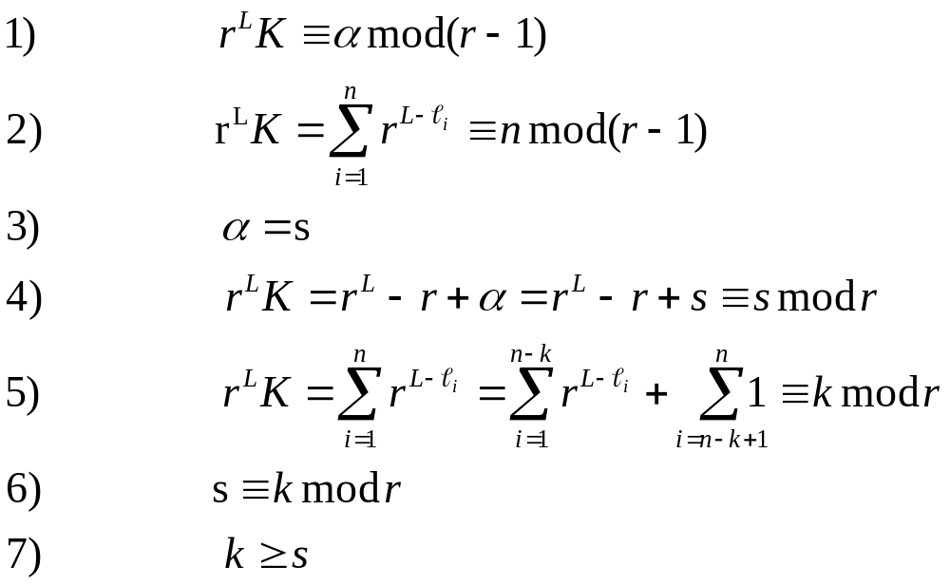
最后，对C的最长码作适当替换，保持前缀性质，并使得
d0,d1,…,d(s-1) є C

Slide 29
Huffman 算法
设H是Huffman递归算法。C 是对概率分布P={p₁,…,p_{n}}
的最优编码
1） 如果n≤r 则C={0,…,n-1}
2）如果n>r, 则
a) 排序使得p₁≥p₂≥…≥p_{n}.
b) 计算s=n mod(r-1), 并设 Q={p₁,…, p_{n-s,} q},
其中 q= p_{n-s+1}+…+ p_{n,}
c) 将H作用在概率分布Q上, 得到最优编码
D={c₁,…, c_{n-s,} d}
d) 设
C={c₁,…, c_{n-s,} d0,d1,…,d(s-1)}

Slide 30
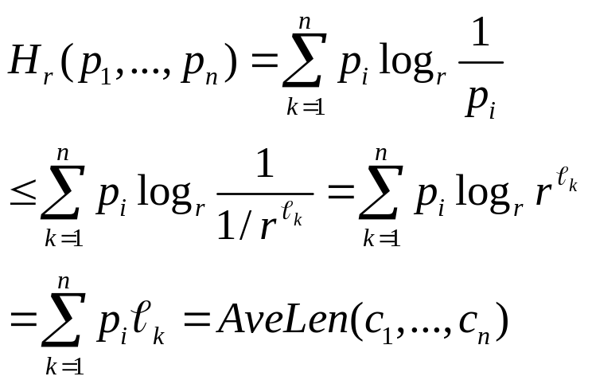
2.3 Noiseless Coding Theorem
定理2.3.1 Let C={c₁,…, c_{n}} 是概率分布P={p₁,…,p_{n}}的最优瞬时编码. 则 H_{r}(p₁,…,p_{n})≤AveLen(c₁,…, c_{n})
且等式成立 iff len(c_{i})=log_{r}(1/p_{i})
证明: 由Kraft定理:

Slide 31
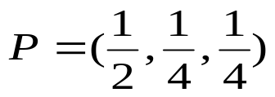
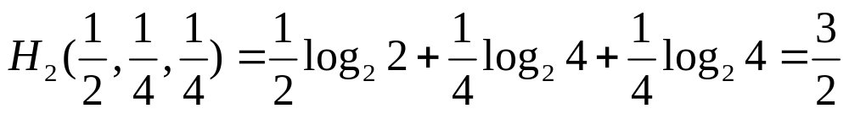
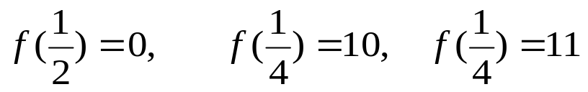
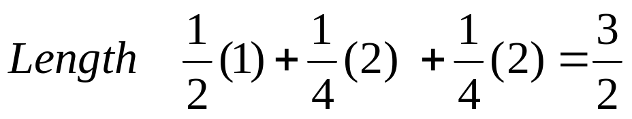
Example 2.3.1
Example 2.3.1 The Entropy of the pd
The Huffman Coding scheme:

Slide 32
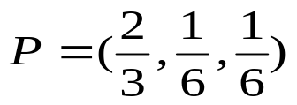
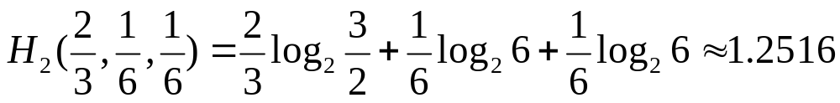
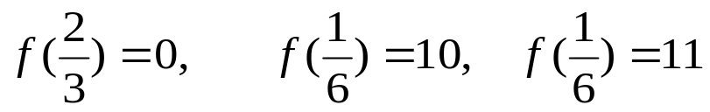
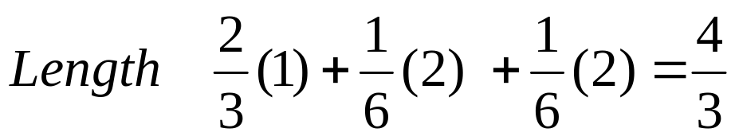
Example 2.3.2
Example 2.3.2 The Entropy of the pd
The Huffman Coding scheme:

Slide 33
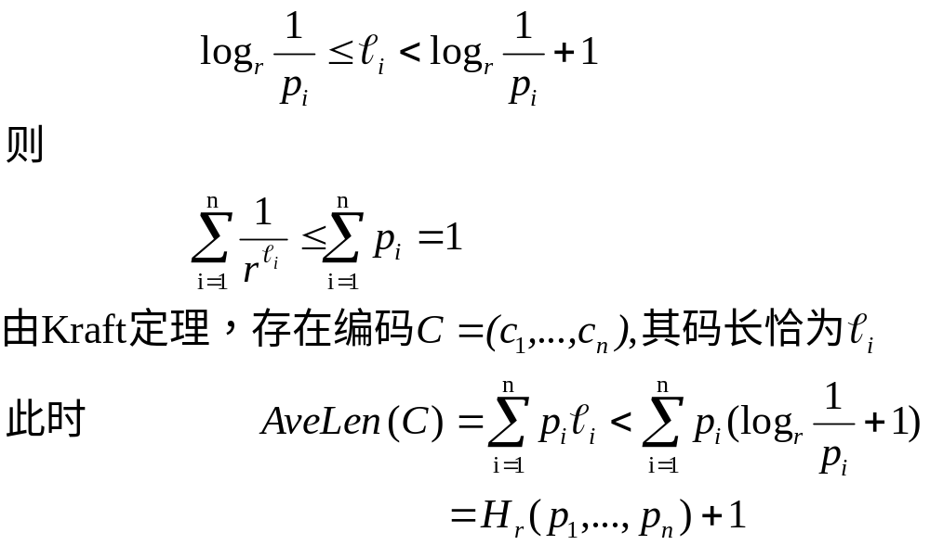
Theorem2.3.2 (The Noiseless Coding Theorem) 对任意概率
分布P={p₁,…,p_{n}}, 存在一个最优瞬时编码 C={c₁,…, c_{n}}, 使得
H_{r}(p₁,…,p_{n})≤AveLen(c₁,…, c_{n}) < H_{r}(p₁,…,p_{n})+1
证明: 取整数

Slide 34
信源的扩展
Definition Let Φ=(S,P) be a source. The n-th
extension of Φ is Φ^{n}=(S^{n},P^{n}), where S^{n} is the set of all words of length n over S, and P^{n} is the pd defined for x=x₁…x_{n} by
P^{n}(x)=P(x₁)…P(x_{n})
P^{n} 是独立无记忆的随机变量X=(X₁,…,X_{n})

Slide 35
定理2.3.3 Let Φ be a source, Let Φ^{n} be its n-th extension
Then H_{r}(Φ^{n} )=nH_{r}(Φ)
In terms of probability distribution:
H_{r}(P^{n})=nH_{r}(P)

Slide 36
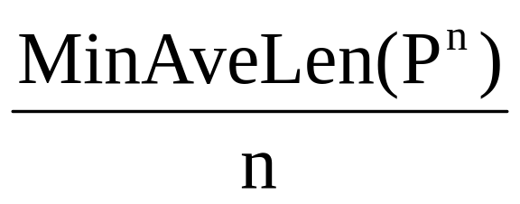
定理 2.3.4 Let P be a pd , let P^{n} be its n-th extension. Then
H_{r}(P) ≤ < H_{r}(P) +1/n
If Let Φ=(S,P) is a source with pd P, and Φ^{n}=(S^{n},P^{n}) is
its n-th Extension
Then the quantity is the minimum averave
codeword length per source symbol of Φ

Slide 37
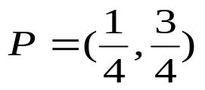
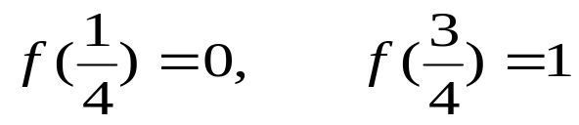
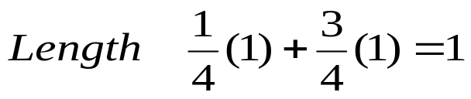
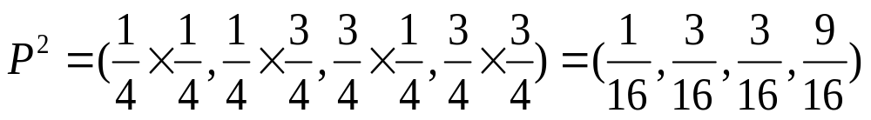
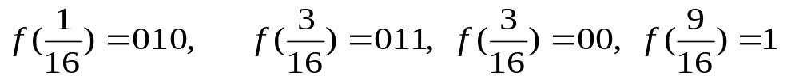
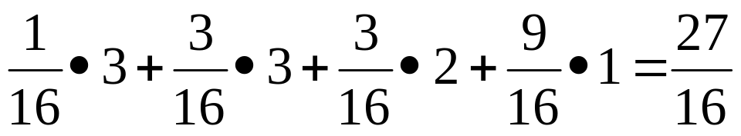
Example 2.3.4
Example 2.3.4 The Entropy of the pd
The Huffman Coding scheme:
The extension P² is
A Huffman encoding scheme for P² is
Which have the average codeword length:

