Slide 1
Chapter 5 Linear Codes

Slide 2
5.1 Linear Codes and their Duals
Block Code： A^{n}的任意非空子集合C称之为 A上的q-元分组码, 简称C是分组码. C的元素是码字。
Linear Code：如果L是V(n,q)的子空间，则L是
线性分组码。
[n,k]－code:如果L在V(n,q)上有维度,则说L是
[n,k]-code
[n,k,d]-code：如果L是[n,k]-code并且有最小距离d, 则说L是[n,k,d]-code

Slide 3
Definition: Let L be an [n,k]-code. A k × n Matrix G whose
Rows form a basis for L is called a Generator matrix for L
L is an [n,k]-code with Generator matrix G
Then
L={xG| x∈V(k,q)}
如果信息源可以被表示成长度为k的q基码字，那么我们可以把信息源x∈V(k,q)编码为xG

Slide 4
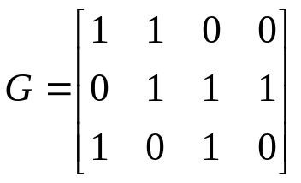
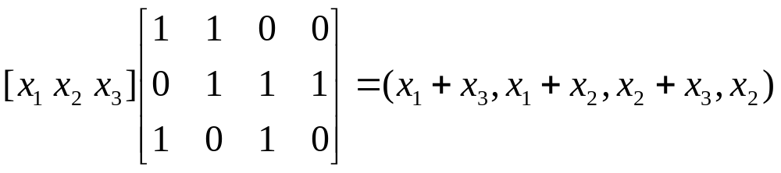
Example 5.1.1 Consider the binary code with generator matrix
This code can encode source symbols from V(3,2)
In particular, for each x=(x₁,x_{2,}x₃) ∈V(3,2)

Slide 5
Theorem 5.1.1 Let L be a linear [n,k]-code. Given any k coordinate
Positions,there is a code equivalent to L that is systematic on
those positions.
Theorem 5.1.2 Tow linear codes L1 and L2 ,with generating matrices G1
and G2, respectively, are scalar multiple equivalent if and only if G1 can
be transformed into G2 by elementary row operations,by permuting the
Columns of G1, and by multiplying the columns of G1 by nonzero scalars.

Slide 6
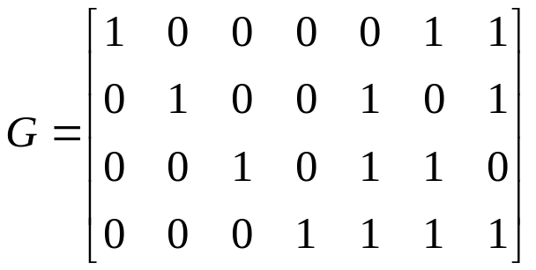
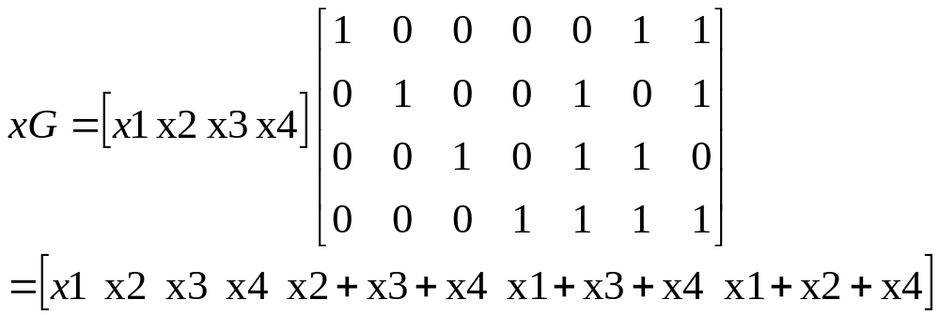
Example 5.1.2 As we will see in the next chapter, the matrix
This is a generator matrix for the H₂(3) . G is in standard form.
The Hamming code H₂(3) can encode source words from V(4,2) as
follows.

Slide 7
线性分组码对偶
向量空间V(n,q) 有自然的内部乘积。
特别地，如果x=x₁…x_{n} 和y=y₁..y_{n}属于V(n,q)空间,
我们定义x和y的点乘为
x·y=x₁y₁+…+x_{n}y_{n}
我们将用<x,y> 表示x·y
Definition Let L be a linear [n,k]-code, the set
L⊥={x∈V(n,q)| x·c=0 for all c∈L } is called the dual code of L

Slide 8
Theorem 5.1.3
1)if G is a generator matrix for L ,then L⊥ ={x ∈V(n,q)| xG^{T}=0}
2)The dual L⊥ of a linear [n,k]-code is a linear [n,n-k]-code.
3)For any linear code L, we have L⊥⊥=L.
Example 5.1.3 for the binary [4,2]-code L={0000,1100,0011,1111}
We have L包含于L⊥ , then we get L⊥=L.
Here ,a linear code L for which L= L⊥ is said to be self-dual.
From the theorem 5.1.3 2) dim(L)+dim(L⊥ )=n
Let L be a linear code with k x n generator matrix G=(I_{k}|A) in standard form
And let H be the matrix H=(-A^{T}| I_{n-k}) , where A^{T}是A的转置. Then
GH^{T}=(I_{k}|A)(-A | I_{n-k})^{T}=-A+A=0 因此，H的行和G的行正交
由于rank(H)=n-k=dim(L⊥ ), H is a generator matrix for the dual code L⊥
The matrix H is also called a parity check matrix for L

Slide 9
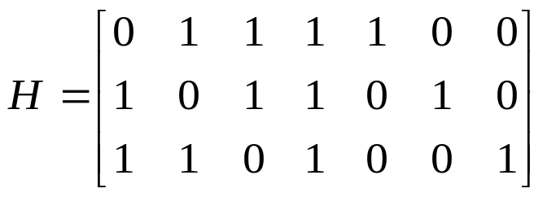
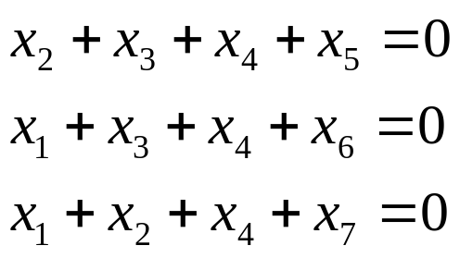
Example 5.1.4 Since the generator matrix G for the code H₂(3) of Example5.1.2 is in standard form, H₂(3) has parity check matrix (in the standard form)
In this case, the parity check equations are
Use Parity check matrix H for L to determine the minimum distance
(weight) of a linear code
Let H be k₁,…,k_{n} and suppose that a particular choice of w of the columns
are linearly dependent.then there exist coefficients c₁,…c_{n} for which
C₁k₁+…+c_{n}k_{n}=0 , namely , cH^{T}=0 where c= c₁,…c_{n} We have d(L)=w(L)<=w

Slide 10
Theorem 5.1.4
Let L be a linear [n,k,d]-code ,with parity check matrix H. Then d is the smallest integer r for which there are r linearly dependent columns in H.(Thus, H has d linearly dependent columns ,but any d-1 columns are linearly independent.)

Slide 11
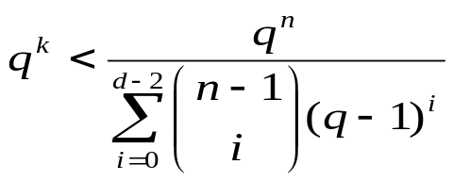
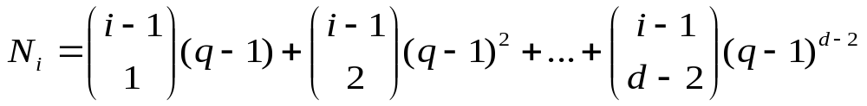


Theorem 5.1.5
(The Gibert-Varshamov Bound)
There exists a q-ary linear[n,k]-code with minimum distance at least d provided that
Hence, if k is the largest integer for which this inequality holds, then A_{q}(n,d)≥q^{k}.
Proof:According to Theorem 5.1.4, we can establish this theorem by constructing an (n-k)×n parity check matrix for which any set of d-1 columns is linearly independent………..
Since we also cannot choose the zero column,there are available choices.
As long as for i=n ,we may complete the matrix H.

Slide 12
Syndrome Decoding
Definition: Let L be an [n,k]-code ,with parity check matrix H. For any x∈V(n,q), the word xH^{T} is called the syndrome of x.
Thus x∈L iff the Syndrome of x is 0.
If L包含于V(n,q) is a linear code,the quotient space of V(n,q) modulo L is defined by V(n,q)/L={x+L| x∈V(n,q)}
The set x+L={x+c|c∈L} is called a coset (陪集) of L.
The quotient(商数） space is also a vector space over F_{q}, where
a(x+L)=ax+L and (x+L)+(y+L)=(x+y)+L
x+L=y+L iff x-y∈L
Theorem 5.1.7 Let L be a linear code with parity check matrix H. Then minimum distance decoding is equivalent to decoding a received word x as a word c=x-a, where a is a word of smallest weight in the coset x+L, or equivalently , where a is a word of smallest weight with the same syndrome as x.

Slide 13
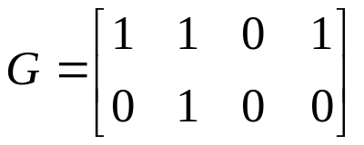


Example 5.1.5 Let L be the binary [4,2]-code with generator matrix
The cosets of L are
0+C={0000,0100,1101,1001}
1000+C={1000,1100,0101,0001}
0010+C={0010,0110,1111, 1011 }
1010+C={1010, 1110, 0111, 0011}
Since the coset leaders were chosen with minimum weight, the standard array is
0000 0100 1101 1001
1000 1100 0101 0001
0010 0110 1111 1011
1010 1110 0111 0011
Add the second row of G to the first row , we obtain a generating matrix in
Standard form
Which gives the parity check matrix

Slide 14
From above we can create a table of coset leaders and their syndromes.
Coset leader Syndrome
0000 00
1000 01
0010 10
1010 11
To decode the received word x=1110, for instance, we compute its syndrome
1110·H^{T}=11
Hence, according to the syndrome table, the coset leader is 1010,and so we decode x as
1110+1010=0100

Slide 15
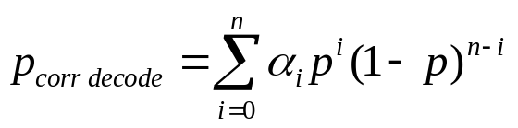
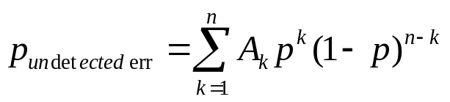
The Probability of Correct Decoding
Let L be a linear code .
Assuming a binary symmetric,with crossover probability p
Let a_{i} be the number of coset leaders that have weight i, for i=0,..,n, then
The probability of correct decoding is the probability that the error is one
Of these coset leaders ,which is
For a linear code L , an undetected error occurs iff the error vector d-c
Is a nonzero codeword. A_{k} denotes the number of codewords in L of weight k,
Then the probability of an undetected error, for the binary symmetric
Channel with crossover probability p, is

Slide 16
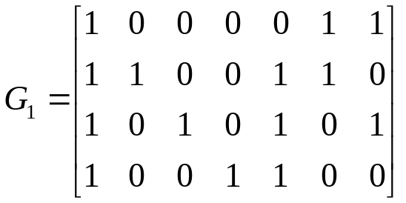
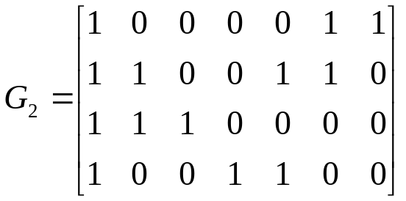
Majority Logic Decoding
Describe majority logic decoding using the following example:
G is the generating matrix of the Hamming code H₂(3).it is also the parity
Check matrix of the dual code which we simply denote by C.
Now ,对G做一些初等的变换后，仍然是C的奇偶校验矩阵。
Add row 1 to the other rows gives G1
Add row 1 and 2 to row 3 gives G2

Slide 17
The parity check equations that correspond to row3,4 and 1, respectively ,are
x₁+x₂+x₃ =0
x₁ +x₄+x₅ =0
x₁ +x₆+x₇ =0
Notice the coefficient (系数)
Definition: A system of parity check equations for a binary linear code is said to be orthogonal with respect to the variable x_{i} provided x_{i} appears in every equation of the system with
coefficient 1, but all other variable in exactly one equation with
coefficient 1.
Now,
suppose that a single error occurs in transmission
i)error in the first position
ii)error in other position
2. Suppose we have r parity check equations for a binary [n,k]-code L, suppose these equations are orthogonal with respect to the variable x_{i} ,suppose t<=r/2 errors have occurred in transmission.

Slide 18
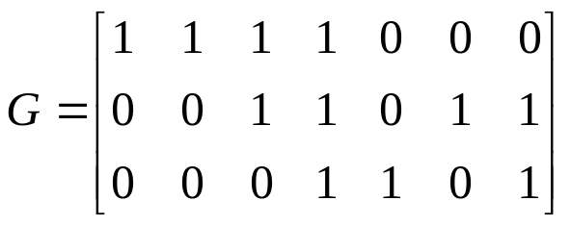
Self-Dual Codes
If a linear code L and L包含于L⊥,then we can say L is self-orthogonal
Theorem 5.1.8 Let G be a generator matrix for a q-ary linear code L.
Then L is self-orthogonal iff distinct rows of G are orthogonal and have
weight divisible by q.
Theorem 5.1.9 if distinct rows of a generator matrix for a binary linear
code L are orthogonal and have weight divisible by 4, then L is self-orthogonal
And all weights in L are divisible by 4.
Proof in brief :
w(u+v)=w(u)+w(v)-2w(u∩v)
That 2w(u∩v) is even ,since u and v are orthogonal.
Example 5.1.6 According to the previous theorem , the binary [7,3]-code
L with generator matrix G is self-orthogonal and all codeword weights are
Divisible by 4. Hence ,all seven nonzero
codewords in L have weight 4. Furthermore,
Since L⊥ is a [7,4]-code that contains L ,as
Well as the string 1,we deduce that L⊥is
generated by the rows of G ,along wigh the
string 1.

Slide 19
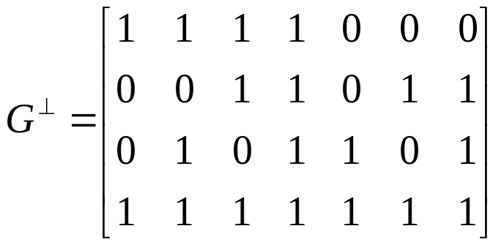
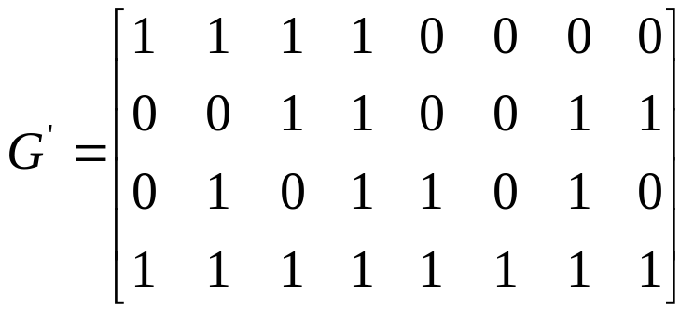
If a linear code L =L⊥, then we can say L is self-dual
In fact , a linear [n,k]-code L is self-dual iff it is self-orthogonal and k=n/2
Example 5.1.7 the code L in Example 5.1.6 is self-orthogonal , and its dual code L⊥ has generator matrix
By adding an overall parity check to this code ,we obtain a code L’ with generator matrix (self-dual)

Slide 20
Theorem 5.1.10
A q-ary self-dual [n,n/2]-code exists iff One of the following holds
1) q and n are both even(偶数)
2) q≡1 mod 4 and n is even
3) q≡3 mod 4 and n is divisible by 4.
Theorem 5.1.11
An even [n, n/2]-code exists if and only if n is divisible by 8.

Slide 21
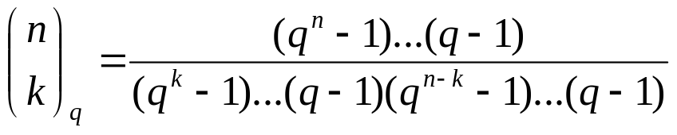
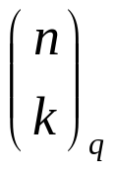
The Number of Binary Self-Dual Codes
Definition: A linear code L is weakly self-dual if 1∈L包含于L⊥
Theorem 5.1.12: if q is a prime power, then there are
Subspaces of V(n,q) of dimension k. the expressions are called Gaussian
Coefficients
Proof:Let S(n,k) be the number of k-dimensional subspaces of V(n,q).
Let N(n,k) be the number of k-tuples of linearly independent vectors
(v₁,..,v_{k}) in V(n,q).
For v₁ can be chosen in q^{n}-1 ways, v₂can be chosen in q^{n}-q ways and so on. Hence
N(n,k)=(q^{n}-1 )(q^{n}-q)..(q^{n}-q^{n-k+1})
=S(n,k) (q^{k}-1 )(q^{k}-q)..(q^{k}-q^{k-1})

Slide 22
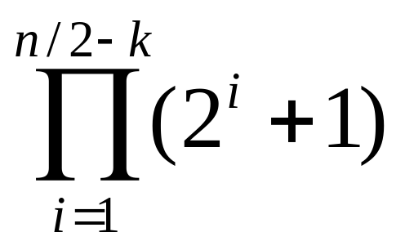
Theorem 5.1.13 : Let L be a binary weakly self-dual [n,k]-code . The total number of binary weakly self-dual [n,n/2]-codes containing L is:
Proof : γ_{m,n}be the number of weakly self-dual [n,m]-codes C containing L,
k<=m<=n/2. Ordered pairs (D,E),where L包含于D包含于E
First we fixed D.
A single nonzero vector x not in D. if x∈E-D ,then E=D∪(x+D) is the code
Generated by x and D. E is weakly self-dual ,we have x∈E包含于E⊥包含于
D⊥……
Let us fix E.

Slide 23
Corollary 5.1.14 :
The total number of binary self-dual [n,n/2]-codes is

Slide 24
Burst Error Detection and Correction
Definition: A burst in V(n,q) of length b is a string in V(n,q) whose nonzero
Coordinates are confined to b consecutive positions, the first and last of
Which must be nonzero.
Lemma 5.1.15: Let L be a linear [n,k]-code. If L contains no bursts of length
b or less, then we must have k<=n-b.
Proof:
Consider the set S of all strings in V(n,q) with 0’s in the last n-b positions.
If any two distinct strings in S lie in the same coset of L, then their difference
Would be a nonzero burst of length at most b,which is not possible. Hence ,the
Number of cosets of L, which is q^{n-k},must be greater than or equal to the size
of S, which is q^{b}.In other words q^{n-k} >=q^{b}

Slide 25

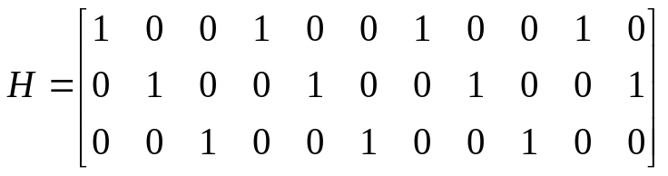
Theorem 5.1.16 If a linear [n,k]-code L can detect all burst errors of length b or less,then we must have k<=n-b.Furthermore, there is a linear
[n,n-b]-code that will detect all burst errors of length b or less.
Proof:
1.)by lemma 5.1.15, we have k<=n-b.
2.) consider the parity check matrix H of size b×n whose first row is
and each of whose remaining rows is a right shift of the previous row(
adding a 0 to the beginning of the row). For instance ,when b=3 and n=11
We have :
Let e be a burst of length b or less in V(n,q). Since any b consecutive
Columns of H form a b X b permutation matrix,the syndrome eH^{T} is
just a reordering of the vector e, and so is nonzero. Hence,
any burst error of length b or less will be detected.

Slide 26
Theorem 5.1.17: If a linear [n,k]-code L can correct all
burst errors of length b or less (using minimum distance
decoding ) then we must have k<=n-2b
Proof:
if 2<=l<=2b, then any burst e of length l can be written as the difference e1-e2 of two distinct bursts of length at most b.Since L can correct e1 and e2, they cannot lie in the same coset of L,and so their difference e cannot be a codeword. Since a burst of length l cannot be a codeword,we may apply Lemma 5.1.15(with b replaced by 2b) ,to get k<=n-2b.

Slide 27
Theorem 5.1.18
If a linear [n,k]-code L can correct all burst
errors of length b or less then we must have
k<=n-b+1-log_{q}[(q-1)(n-b+1)+1].

Slide 28
The Main Coding Theory Problem
Definition: A_{q}(n,d) denotes the largest possible size M for which there exists a q-ary (n,M,d)-code.
Theorem 4.5.1 For any n>=1
1) A_{q}(n,1)=q^{n} ;
2) A_{q}(n,n)=q;
Theorem 4.5.2 For any n>=2
A_{q}(n,d)<=q A_{q}(n-1,d)
Theorem 4.5.3 for binary codes
A₂(n,2t+1)= A₂(n+1,2t+2)

Slide 29
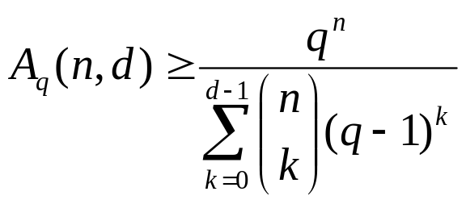
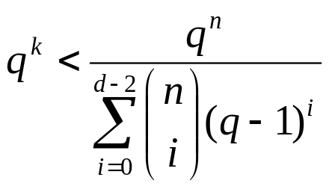

The Main Coding Theory Problem
Theorem 4.5.4 (The Gilbert-Varshamov Bound)
Theorem 4.5.5 (The Gilbert-Varshamov Bound) For q a prime power, there exists a q-ary linear [n,k]-code with minimum distance at least d provided that
Hence, if k is the largest integer for which this inequality holds,then

Slide 30

The Main Coding Theory Problem
Theorem 4.5.6 (The Singleton Bound)

Slide 31
5.3 MDS codes
Theorem 5.3 .1 For a linear[n,k]-code, we must have d<=n-k+1.
Definition: A linear [n,k,n-k+1]-code, that is an [n,k]-code with largest possible minimum distance, is called a maximum distance separable or MDS code.
Theorem 5.3.2 Let L be an [n,k]-code, with parity check matrix H. Then L is MDS if and only if any n-k columns of H are linearly independent.
Theorem 5.3.3 If a code L is MDS, then so is its dual code L⊥.
Proof.Suppose that L is an [n,k]-code.Let H be a parity check matrix for L and , therefore, a generator matrix for L⊥. Since any (n-k)(n-k) submatrix of H is invertible, all nontrivial linear combinations of the rows of H have at most n-k-1 zero coordinates. Therefore, all non trivial linear combinations of H have weight at least n-(n-k-1)=k+1. In other words, the minimum weight of L⊥ is k+1=n-(n-k)+1, which says that L⊥ is an MDS code.

Slide 32
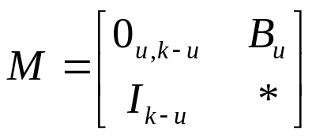
Theorem 5.3.4 Let L be an [n,k]-code , with generator matrix G. Then L is MDS if and only if any k columns of G are linearly independent.
Theorem 5.3.5 Let L be an [n,k]-code with generator matrix G=(I_{k}|A) in standard form. Then L is a MDS code if and only if every square submatrix of A is nonsingular.
Proof:Let L be an MDS code, and let B_{u} be a u×u submatrix of A. By interchanging rows and columns of G, we may assume that B_{u} occupies the upper left corner of A. Now let us consider the matrix M consisting of the last k-u columns of I_{k} and the columns of G containing B_{u} . This is a k×k matrix of the form
Since L is MDS, Theorem 5.3.4 implies that det(M)≠0, and since det(B_{u})=±det (B_{u}), the result follows .

Slide 33

Theorem 5.3.6 A linear [n,k,d]-code L is an MDS code if and only if given any d coordinate positions, there is a (minimum weight) codeword whose support is precisely these positions.
Proof: suppose that L is an MDS [n,k]-code .Choose d=n-k+1 coordinate positions, say i₁,…,i_{d}. Consider the position i₁, together with the k-1 non-chosen positions ,say j₁,…j_{k-1}. Since the k positions i₁,j₁,..,j_{k-1} are information symbols, there is a codeword c that has a 1 in position i₁ and 0’s in the positions j₁,…j_{k-1.} Hence, c has support i₁,…,i_{d.}
For the converse ,consider the n-d+1 rows of the matrix
where I_{n-d+1} is an identity matrix and 1_{d-1} is the (d-1)×(d-1) matrix all of whose entries are 1’s. These rows are linearly independent and have weight d. Since there is a code word c_{i} in L that has the same support as the i-th row of M, we deduce that k>=n-d+1, which shows that L is MDS.

Slide 34
Theorem 5.3.7 Let L be an [n,k,d]-code over F_{q .} The following statements are equivalent.
L is an MDS code.
Any k columns of a generator matrix for L are linearly independent.
Any n-k columns of a parity check matrix for L are linearly independent.
L^{T} is an MDS code.
If G=(I|A) is a standard form generator matrix L , then every square submatrix of A is nonsingular.
Given any d coordinate positions, there is a (minimum weight) codeword whose support is precisely these positions.

Slide 35
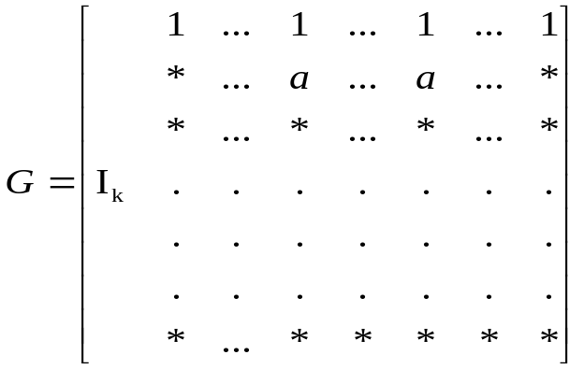
Theorem 5.3.8 There are no nontrivial MDS [n,k]-codes for which 1<=k<=n-q.
Proof: Assume that 1<k<=n-q and that L is a q-ary [n,k] MDS code, with generator matrix G in standard form. Thus, G=(I_{k}|A), where A has n-k>=q columns. Now lets consider the second row of A. Since it contains no 0 entries and has n-k>=q columns ,there must be two columns with the same nonzero entry a. Thus, G has the form
But then the codeword formed by subtracting a⁻¹ times the second row from the first row of G has weight at most n-k, which implies that L is not MDS. This contradiction shows that no q-ary MDS [n,k]-odes exist with 2<=k<=n-q.

Slide 36
Corollary 5.3.9 There are no nontrivial MDS [n,k]-codes for which q<=k<=n.
Theorem 5.3.10 If a nontrivial MDS [n,k]-code exists ,then n-q+1<=k<=q-1 put another way , if a nontrivial MDS [n,k]-code exists ,then 2<=k<=q-1 and 2<=n-k<=q-1
Corollary 5.3.11 The only binary MDS [n,k]-codes are the trivial codes .
与MDS 编码相关的最重要的问题是: 给定k和q ,找出存在q-ary MDS [n,k]-code时候的最大的n值

Slide 37
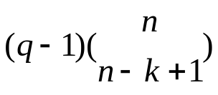
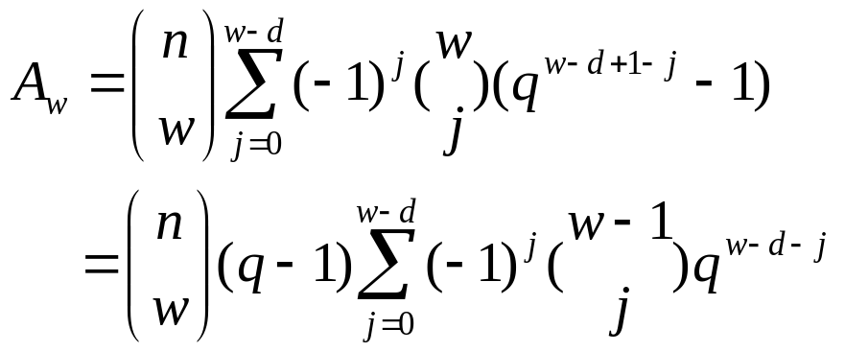
Corollary 5.3.12 Let L be an MDS [n,k]-code. The number of codewords in L of minimum weight n-k+1 is
Theorem 5.3.13 Let L be a q-ary MDS [n,k]-code. If A_{w} denotes the number of codewords in L of weight w, then

Slide 38
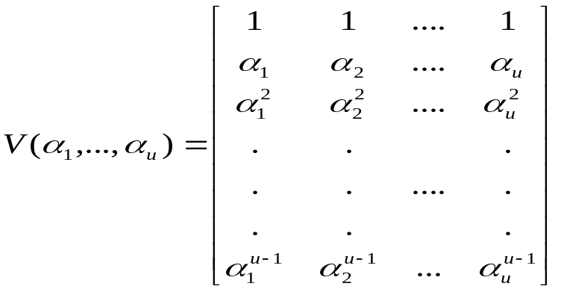
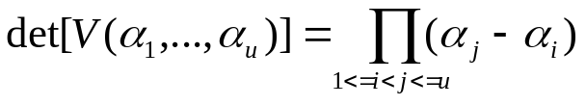


The Vandermonde matrix based on these elements is
Lemma 5.3.14 The determinant of the Vandermonde matrix is
In particular ,if the are distinct ,then is nonsingular.
（证明见下一页）

Slide 39
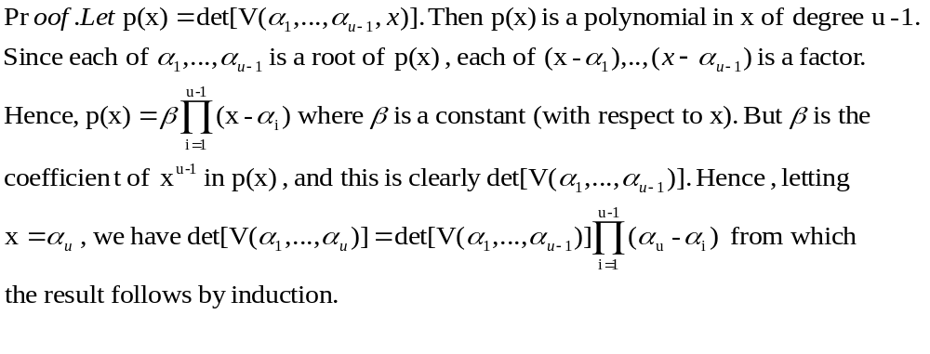
Theorem 5.3.15 For 1<=k<=q, the matrix H₁ is the parity check matrix of a
q-ary MDS [q+1,k]-code
Theorem 5.3.16 For q=2^{m}, the matrix H₂ is the parity check matrix of a q-ary
MDS [q+2,q-1]-code.
Corollary 5.3.17 For 1<=k<=q , there exist q-ary MDS [q+1,k] and [q+1, q-k+1]
Codes . For q=2^{m}, ther exist q-ary MDS [q+2,q-1] and [q+2,3]-codes.

Slide 40
Theorem 5.3.18 If L is a nontrivial q-ary MDS [n,k]-code, where k>=3 and q is odd, then n<=q+k-2.

Slide 41
Thank you

