Slide 1
Chapter 6
Some Linear Codes
Hamming and Golay Codes
Reed-Muller Codes

Slide 2
6.1 Hamming and Golay Codes
Fq: code alphabet ,
Construct a matrix:
1) pick any nonzero column c₁ in V1=F_{q}^{r}
2) pick any nonzero column c₂ in V2=V1-{ac₁|a≠0}
3) …. Until V_{n+1}=Ф
We get parity check matrix H: c₁,c₂,…,c_{n} as its columns , where n=(q^{r}-1)/(q-1).

Slide 3
当q=2时, n=2^{r}-1, 校验矩阵的列恰好是小于2^{r}的正整数的2进制表示
定义: 以上述矩阵H为校验矩阵的线性码称为r阶q-元Hamming [2^{r}-1, 2^{r}-1-r, 3]码
该码能纠一个错. 译码方法如下: 设H的列是整数从小到大的2进制排列. 则当错误向量e只有一个错时
eH^{T}=错误位置

Slide 4
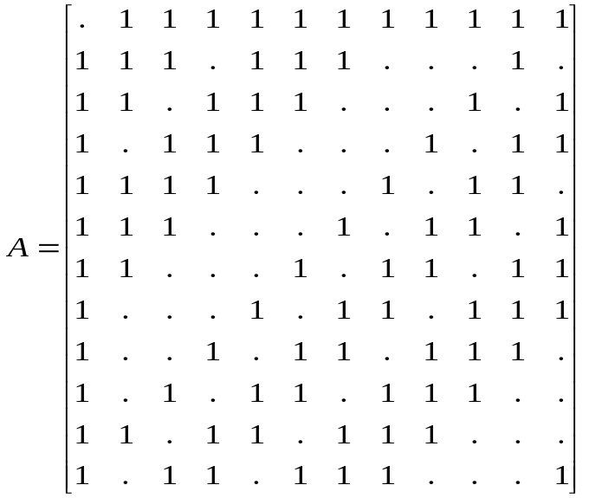
Golay 码
二元Golay码的生成矩阵G=[ I₁₂| A ], 其中

Slide 5
引理6.1.2: G₂₄是自对偶的.
引理6.1.3: G₂₄由矩阵[ A | I₁₂ ]生成.
证明: 因为G₂₄ =G^{T}₂₄
引理6.1.4: G₂₄的每个码字的重量是4的倍数.
证明 w(r+s)=w(r)+w(s)-2w(rпs)
w(rпs) 三 r.s= 0 mod 2
引理6.1.5: G₂₄没有重量是4的码字.
定理6.1.6 G₂₄是一个[24,12,8]码.

Slide 6
Golay 码G₂₄的译码
1) 求26次伴随式, 然后判断
或
2)求1次伴随式, 然后查表(表的大小是2048x3 byte)

Slide 7
6.2 Reed-Muller Codes
真值表
x1 | x2 | x3 | f
0 | 0 | 0 | 0
0 | 0 | 1 | 0
0 | 1 | 0 | 1
0 | 1 | 1 | 0
1 | 0 | 0 | 0
1 | 0 | 1 | 0
1 | 1 | 0 | 1
1 | 1 | 1 | 0
Boolean 函数: Z₂^{m}到Z₂的函数
Boolean 函数的运算: fg(x)=f(x)g(x), (f+g)(x)=f(x)+g(x).
设B_{m} 是Boolean 函数的集合, 则|B_{m}|=2^{{2^m}}

Slide 8

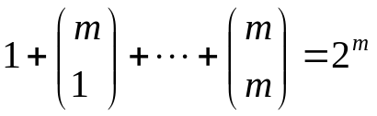
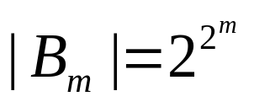
Boolean多项式集合B_{m.}
K次单项式的个数是 .所以所有不同的单项式的个数是:
所以:
定理6.2.1: 对每个bool函数f(x₁,…,x_{m}),存在一个bool多项式p(x₁,…,x_{m})使得
p(x₁,…,x_{m})= f(x₁,…,x_{m})

Slide 9
Reed-Muller Codes
定义: 设0 <= r <= m, 则r阶Reed-Muller码R(r,m)是全体次数小于等于r的bool多项式所对应的函数值.
x₁ | x₂ | x₃
0 | 0 | 0
0 | 0 | 1
0 | 1 | 0
0 | 1 | 1
1 | 0 | 0
1 | 0 | 1
1 | 1 | 0
1 | 1 | 1
例如: x₁ -> (00001111)
R(0,m)={(0…0), (1…1)}
R(m,m)=Z₂^{n}, 其中n=2^{m}

Slide 10
型为 x_{m}+p(x₁,…,x_{m-1})的bool多项式的值为0和1的个数是相等的.
Example 6.2.2 The 0th order Reed-Muller code R(0,m) consists of the binary strings associated with the constant polynomials o and 1, that is R(0,m)={0,1}=Rep(2^{m})
Thus , R(0,m) is just the repetition code of length 2^{m}.On the other extreme, the m-th order Reed-Muller code R(m,m)=Z^{n}₂ where n=2^{m}
Example 6.2.3 The first order Reed-Muller code of length n=8=2^{m} is the set of all binary strings associated with the Boolean polynomials p(x1,x2,x3) of degree at most 1. These polynomials have the form

Slide 11
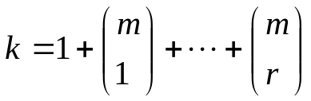
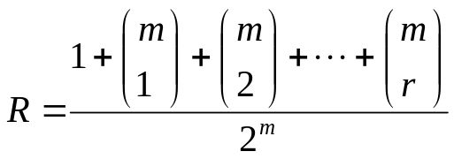
定理6.2.2 R(1,m)中的除了0和1以外的码字的重量是2^{m-1}
定理6.2.2 R(r,m)的码长是2^{m,}维数是
码率是

Slide 12

Reed-Muller码的构造
定义(u,u+v)构造: 设Ci是(n,M_{i},d_{i})码, i=1,2. 定义
C₁ C₂={c(c+d)|c in C₁, d in C₂}
这是一个(2n,M₁M₂,d’)码,其中d’=min{2d₁,d₂}
C1 is included in C1 C2

Slide 13
定理6.2.4
(1) R(0,m)={0,1}=Rep(2^{m})
(2) R(m,m)=Z₂^{n}, 其中n=2^{m}
(3) 对0<r<m, 则
R(r,m)= R(r,m-1) R(r-1,m-1)
证明: 任意一个次数最多为r的多项式p可以表示成为
p(x₁,…,x_{m})=x₁g(x₁,…,x_{m-1})+h(x₂,…,x_{m})
则p所对应的码字a_{p}可以表示成为
a_{p}=0a_{g}+a_{h}a_{h}=a_{h}(a_{g}+a_{h})

Slide 14
推论6.2.5: Reed-Muller码R(m-1,m)包含所有码长是2^{m}的
偶重量的码字. R(r,m)的每个码字的重量是偶数.
证明: 用归纳法. R(0,1)={00,11}.所以结论在m=1时成立.
假设R(m-2,m-1)成立. 则
R(m-1,m)= R(m-1,m-1) R(m-2,m-1)
= Z₂^{n} R(m-2,m-1)
其中n=2^{m-1}. R(m-1,m)中的码字型为
a=b(b+c)=bb+0c
其中b in Z₂^{n}, c in R(m-2,m-1).
w(bb+0c)=w(bb)+w(0c)-2w(bb \cap 0c). 所以是偶数. 又因为dim[R(m-1,m)]=2^{m}-1. 所以包含所有偶数重量的码字.
R(r,m) includes in R(m-1,m)

Slide 15
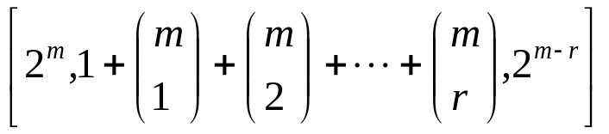
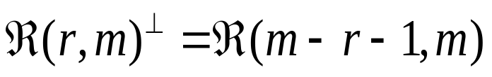
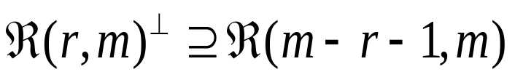
定理6.2.6. R(r,m)是 码
对偶:
定理6.2.7:
证明: 设其中 p,q是次数分别不超过r和m-r-1的多项式. 由于pq的次数不超过m-1, 所以
比较空间维数便知.

Slide 16
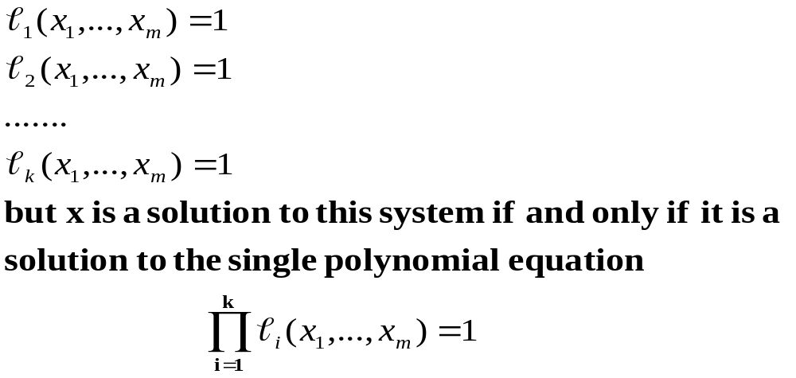
Theorem 6.2.8. If F is an (m-k)-flat in EG(m,2), then the corresponding Boolean polynomial p_{F} has degree k.
Proof. Let F be an (m-k)-flat. Then we have seen that x ∈F if and only if x satisfies a system of k linear equations in m variables, with rank k, which can be written in the form

Slide 17
Theorem 6.2.9. The Reed-Muller code R(r,m) is spanned by the characteristic vectors of all flats of dimension at least m-r.
Theorem 6.2.10
The codewords in R(r,m) of minimum weight are precisely the characteristic vectors of the (m-r)-flats in EG(m,2).
The codewords in R(r,m) of minimum weight span R(r,m)

Slide 18
Lemma 6.2.11 if F and G are flats in EG(m,2), then
a_{F}·a_{G}≡|F∩G|mod 2
Proof. This follows from
a_{F}·a_{G}≡w(a_{F} ∩ a_{G})=w(a_{F∩G})=| F∩G|
Lemma 6.2.12 Let F=b+S and G=c+T be flats in EG(m,2).
Then either F∩G=空 or else F∩G=x+(S∩T) for nay nonzero x in F∩G.
Lemma 6.2.13 All flats in EG(m,2) except one-point flats have an even number of vectors.

Slide 19
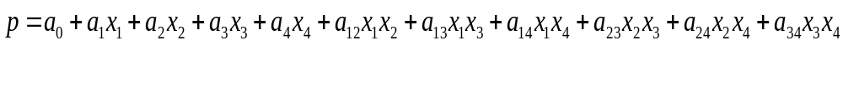
Example 6.2.5 Table 6.2.2 shows the binary strings associated with the monomials used to construct the code R(2,4). (The columns are read from top to bottom.) A polynomial of degree at most 2 has the form
where the coefficients are equal to 0 or 1. Let a_{P}=c₁…c₁₆be the Corresponding codeword. Let us determine the coefficient a₁₃

Slide 20
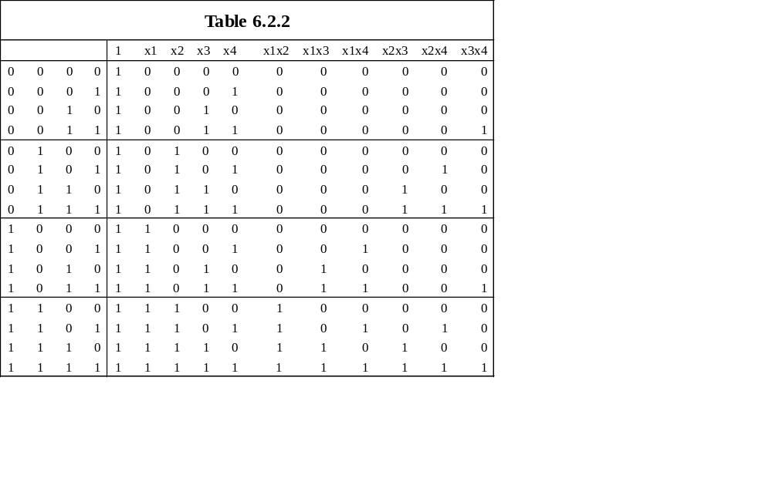

Slide 21
Thank you

