Slide 1
CALL FLOQUETINIT('qubit','U',2,ID,INFO)
D_BARE = ID%D_BARE
MODES_NUM(1) = 1 !(STATIC FIELD)
MODES_NUM(2) = 1 !(DRIVING BY ONE HARMONIC)
FIELDS(1)%X = 0.0
FIELDS(1)%Y = 0.0
FIELDS(1)%Z = 1.0
FIELDS(1)%phi_x = 0.0
FIELDS(1)%phi_y = 0.0
FIELDS(1)%phi_z = 0.0
FIELDS(1)%omega = 0.0
FIELDS(1)%N_Floquet = 0
FIELDS(2)%X = 2.0
FIELDS(2)%Y = 0.0
FIELDS(2)%Z = 0.0
FIELDS(2)%phi_x = 0.0
FIELDS(2)%phi_y = 0.0
FIELDS(2)%phi_z = 0.0
FIELDS(2)%omega = 1.0
FIELDS(2)%N_Floquet = 20
!--- EVALUATE TIME-EVOLUTION OPERATOR IN THE BARE BASIS
T1 = 0.0
T2 =4.0*atan(1.0)
CALL TIMEEVOLUTIONOPERATOR(ID,D_BARE,SIZE(MODES_NUM,1),MODES_NUM,FIELDS,T1,T2,U_AUX,INFO)
WRITE(3,*) T2 ,FIELDS(2)%OMEGA, ABS(U_AUX)**2
Initialize the system, prepare memory arrays
Define modes and harmonics
Set parameters of the Hamiltonian
Calculate time-evolution operator

Slide 2
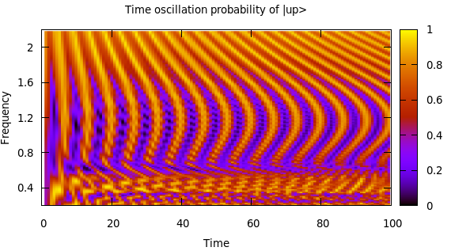
CALL FLOQUETINIT('qubit','U',2,ID,INFO)
D_BARE = ID%D_BARE
MODES_NUM(1) = 1 !(STATIC FIELD)
MODES_NUM(2) = 1 !(DRIVING BY ONE HARMONIC)
FIELDS(1)%X = 0.0
FIELDS(1)%Y = 0.0
FIELDS(1)%Z = 1.0
FIELDS(1)%phi_x = 0.0
FIELDS(1)%phi_y = 0.0
FIELDS(1)%phi_z = 0.0
FIELDS(1)%omega = 0.0
FIELDS(1)%N_Floquet = 0
FIELDS(2)%X = 2.0
FIELDS(2)%Y = 0.0
FIELDS(2)%Z = 0.0
FIELDS(2)%phi_x = 0.0
FIELDS(2)%phi_y = 0.0
FIELDS(2)%phi_z = 0.0
FIELDS(2)%omega = 1.0
FIELDS(2)%N_Floquet = 20
!--- EVALUATE TIME-EVOLUTION OPERATOR IN THE BARE BASIS
T1 = 0.0
T2 =4.0*atan(1.0)
CALL TIMEEVOLUTIONOPERATOR(ID,D_BARE,SIZE(MODES_NUM,1),MODES_NUM,FIELDS,T1,T2,U_AUX,INFO)
WRITE(3,*) T2 ,FIELDS(2)%OMEGA, ABS(U_AUX)**2

Slide 3
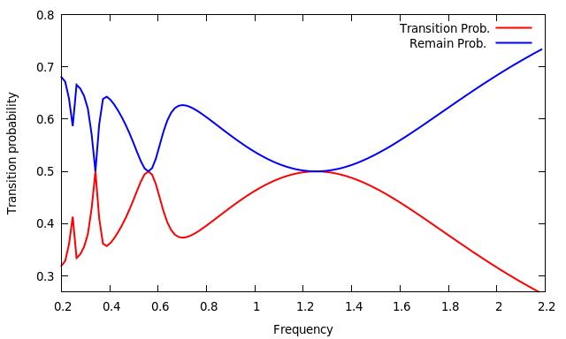
CALL FLOQUETINIT('qubit','U',2,ID,INFO)
D_BARE = ID%D_BARE
MODES_NUM(1) = 1 !(STATIC FIELD)
MODES_NUM(2) = 1 !(DRIVING BY ONE HARMONIC)
FIELDS(1)%X = 0.0
FIELDS(1)%Y = 0.0
FIELDS(1)%Z = 1.0
FIELDS(1)%phi_x = 0.0
FIELDS(1)%phi_y = 0.0
FIELDS(1)%phi_z = 0.0
FIELDS(1)%omega = 0.0
FIELDS(1)%N_Floquet = 0
FIELDS(2)%X = 2.0
FIELDS(2)%Y = 0.0
FIELDS(2)%Z = 0.0
FIELDS(2)%phi_x = 0.0
FIELDS(2)%phi_y = 0.0
FIELDS(2)%phi_z = 0.0
FIELDS(2)%omega = 1.0
FIELDS(2)%N_Floquet = 20
!--- EVALUATE TIME-EVOLUTION OPERATOR IN THE BARE BASIS
T1 = 0.0
T2 =4.0*atan(1.0)
CALL TIMEEVOLUTIONOPERATOR(ID,D_BARE,SIZE(MODES_NUM,1),MODES_NUM,FIELDS,T1,T2,U_AUX,INFO)
WRITE(3,*) T2 ,FIELDS(2)%OMEGA, ABS(U_AUX)**2

Slide 4
CALL FLOQUETINIT('qubit','U',2,ID,INFO)
D_BARE = ID%D_BARE
MODES_NUM(1) = 1 !(STATIC FIELD)
MODES_NUM(2) = 1 !(DRESSING FIELD)
MODES_NUM(3) = 1 !(PROBING FIELD)
FIELDS(1)%X = 0.0
FIELDS(1)%Y = 0.0
FIELDS(1)%Z = 1.0
.
.
FIELDS(2)%X = 2.0
FIELDS(2)%Y = 0.0
FIELDS(2)%Z = 0.0
.
.
FIELDS(3)%X = 0.0
FIELDS(3)%Y = 0.0
FIELDS(3)%Z = 1.0
.
.
CALL DRESSEDBASIS_SUBSET(ID, …. ) !
T1 = 0.0
T2 =4.0*atan(1.0)
CALL TIMEEVOLUTIONOPERATOR(ID,D_BARE, U_BARE ...)
CALL MULTIMODEMICROMOTION(ID,T1,U1 ….)
CALL MULTIMODEMICROMOTION(ID,T2,U2 ….)
U_DRESSED = MATMUL(TRANSPOSE(CONJG(U2)), MATMUL(U_BARE,U1))
Initialize the system, prepare memory arrays
Define modes and harmonics
Set parameters of the Hamiltonian
Define the dressing basis
Calculate the time evolution operator bare basis
Calculate micromotion operators
Calculate evolution in the dressed basis

Slide 5
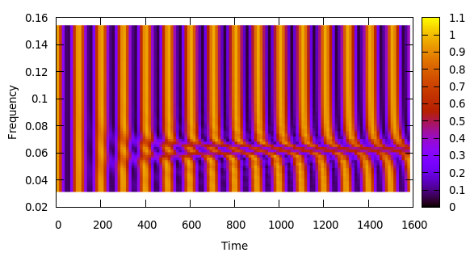
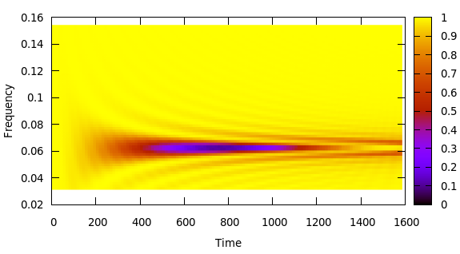
CALL FLOQUETINIT('qubit','U',2,ID,INFO)
D_BARE = ID%D_BARE
MODES_NUM(1) = 1 !(STATIC FIELD)
MODES_NUM(2) = 1 !(DRESSING FIELD)
MODES_NUM(3) = 1 !(PROBING FIELD)
FIELDS(1)%X = 0.0
FIELDS(1)%Y = 0.0
FIELDS(1)%Z = 1.0
.
.
FIELDS(2)%X = 2.0
FIELDS(2)%Y = 0.0
FIELDS(2)%Z = 0.0
.
.
FIELDS(3)%X = 0.0
FIELDS(3)%Y = 0.0
FIELDS(3)%Z = 1.0
.
.
CALL DRESSEDBASIS_SUBSET(ID, …. ) !
T1 = 0.0
T2 =4.0*atan(1.0)
CALL TIMEEVOLUTIONOPERATOR(ID,D_BARE, U_BARE ...)
CALL MULTIMODEMICROMOTION(ID,T1,U1 ….)
CALL MULTIMODEMICROMOTION(ID,T2,U2 ….)
U_DRESSED = MATMUL(TRANSPOSE(CONJG(U2)), MATMUL(U_BARE,U1))

Slide 6
CALL FLOQUETINIT('Rb87','B',8,ID,INFO)
D_BARE = ID%D_BARE
MODES_NUM(1) = 1 !(DC FIELD)
MODES_NUM(2) = 1 !(RF DRESSING FIELD)
MODES_NUM(3) = 1 !(MW PROBING FIELD)
FIELDS(1)%X = 0.0
FIELDS(1)%Y = 0.0
FIELDS(1)%Z = 1.0E-4
.
.
FIELDS(2)%X = 2.0E-5
FIELDS(2)%Y = 0.0
FIELDS(2)%Z = 0.0
.
.
FIELDS(3)%X = 0.0
FIELDS(3)%Y = 0.0
FIELDS(3)%Z = 1.0E-7
.
.
CALL DRESSEDBASIS_SUBSET(ID, …. ) !
T1 = 0.0
T2 =700E-6
CALL TIMEEVOLUTIONOPERATOR(ID,D_BARE, U_BARE ...)
CALL MULTIMODEMICROMOTION(ID,T1,U1 ….)
CALL MULTIMODEMICROMOTION(ID,T2,U2 ….)
U_DRESSED = MATMUL(TRANSPOSE(CONJG(U2)), MATMUL(U_BARE,U1))

