Slide 1
MilkyWay
An offline mobile application

Slide 2
Prepared by
Abdul Rauf
Muhammad Asif Moeen
Muhammad Nouman Shahid
Supervised by
Mr. Furqan Ghauri
Department of Computer Science
Allama Iqbal Open University, Islamabad

Slide 3
Content
Introduction
Problem Statement
Existing System
Drawbacks of existing system
Main analysis diagram
Proposed system
Objectives
Methodology of implementing project
Diagrams
Development Tools
Conclusion

Slide 4
Introduction
Android Video game
Low-end Devices
Offline Mobile game
Children Entertainement
Easy to Play for Childrens
Stay Home Stay Safe

Slide 5
Problem Statement
Video Gaming Centers
Video Gaming Centers Attraction
Middle Class Families
Parent’s budget
Token system to play game

Slide 6
Existing System
Middle class family’s child budget
Video gaming machine
Play Station for video game
Token system to play game

Slide 7
Drawbacks of Existing System
Video Gaming Centers
Token System
Evil Promotion
Alcohol addicts and/or smokers
Poverty feelings
Time waste
Trouble for parents

Slide 8
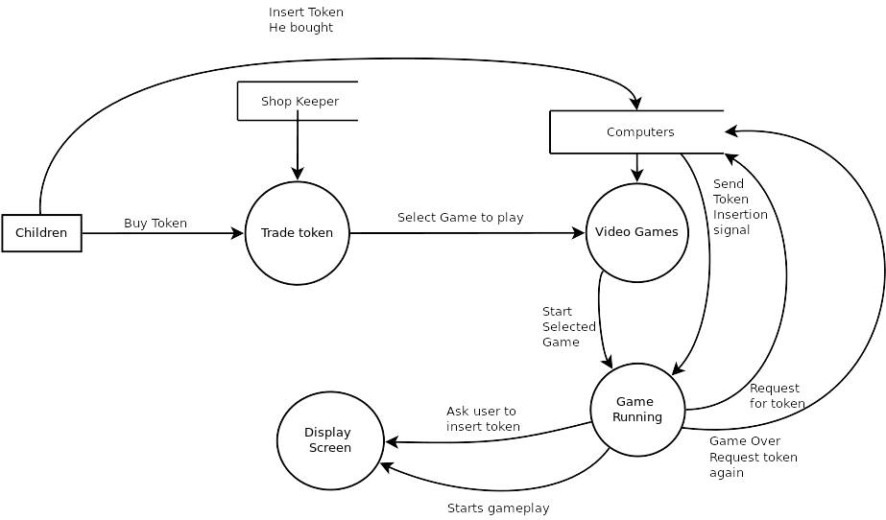
Main Analysis Diagram

Slide 9
Proposed System
Android Video Game
Low-end devices
Complete offline experience

Slide 10
Objectives
Encourage children to stay home
Run-able on low-end android devices
Ensure children interaction
Keep children away from bad society
Unlimited entertainment
Complete Offline Experience

Slide 11
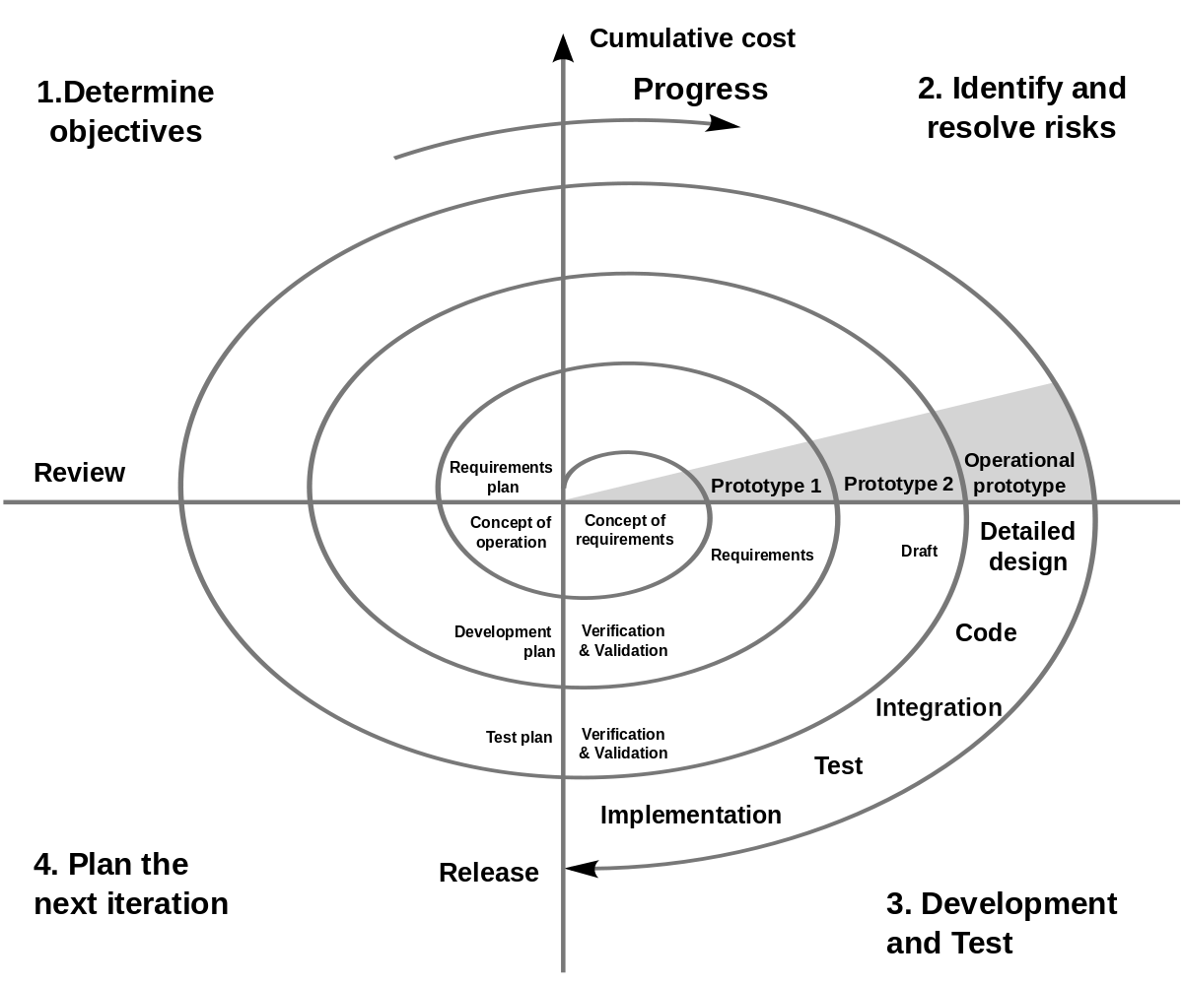
Methodology of implementing project
We propose spiral software modal for implementing MILKYWAY project
Identification
Design
Construct or build
Risk analysis

Slide 12
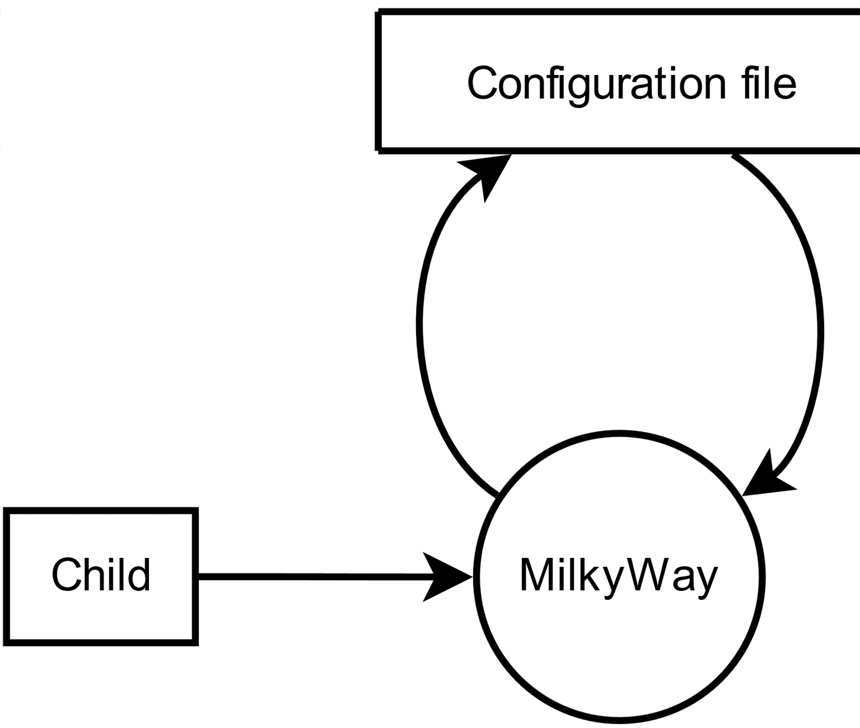
Data Flow Diagram

Slide 13
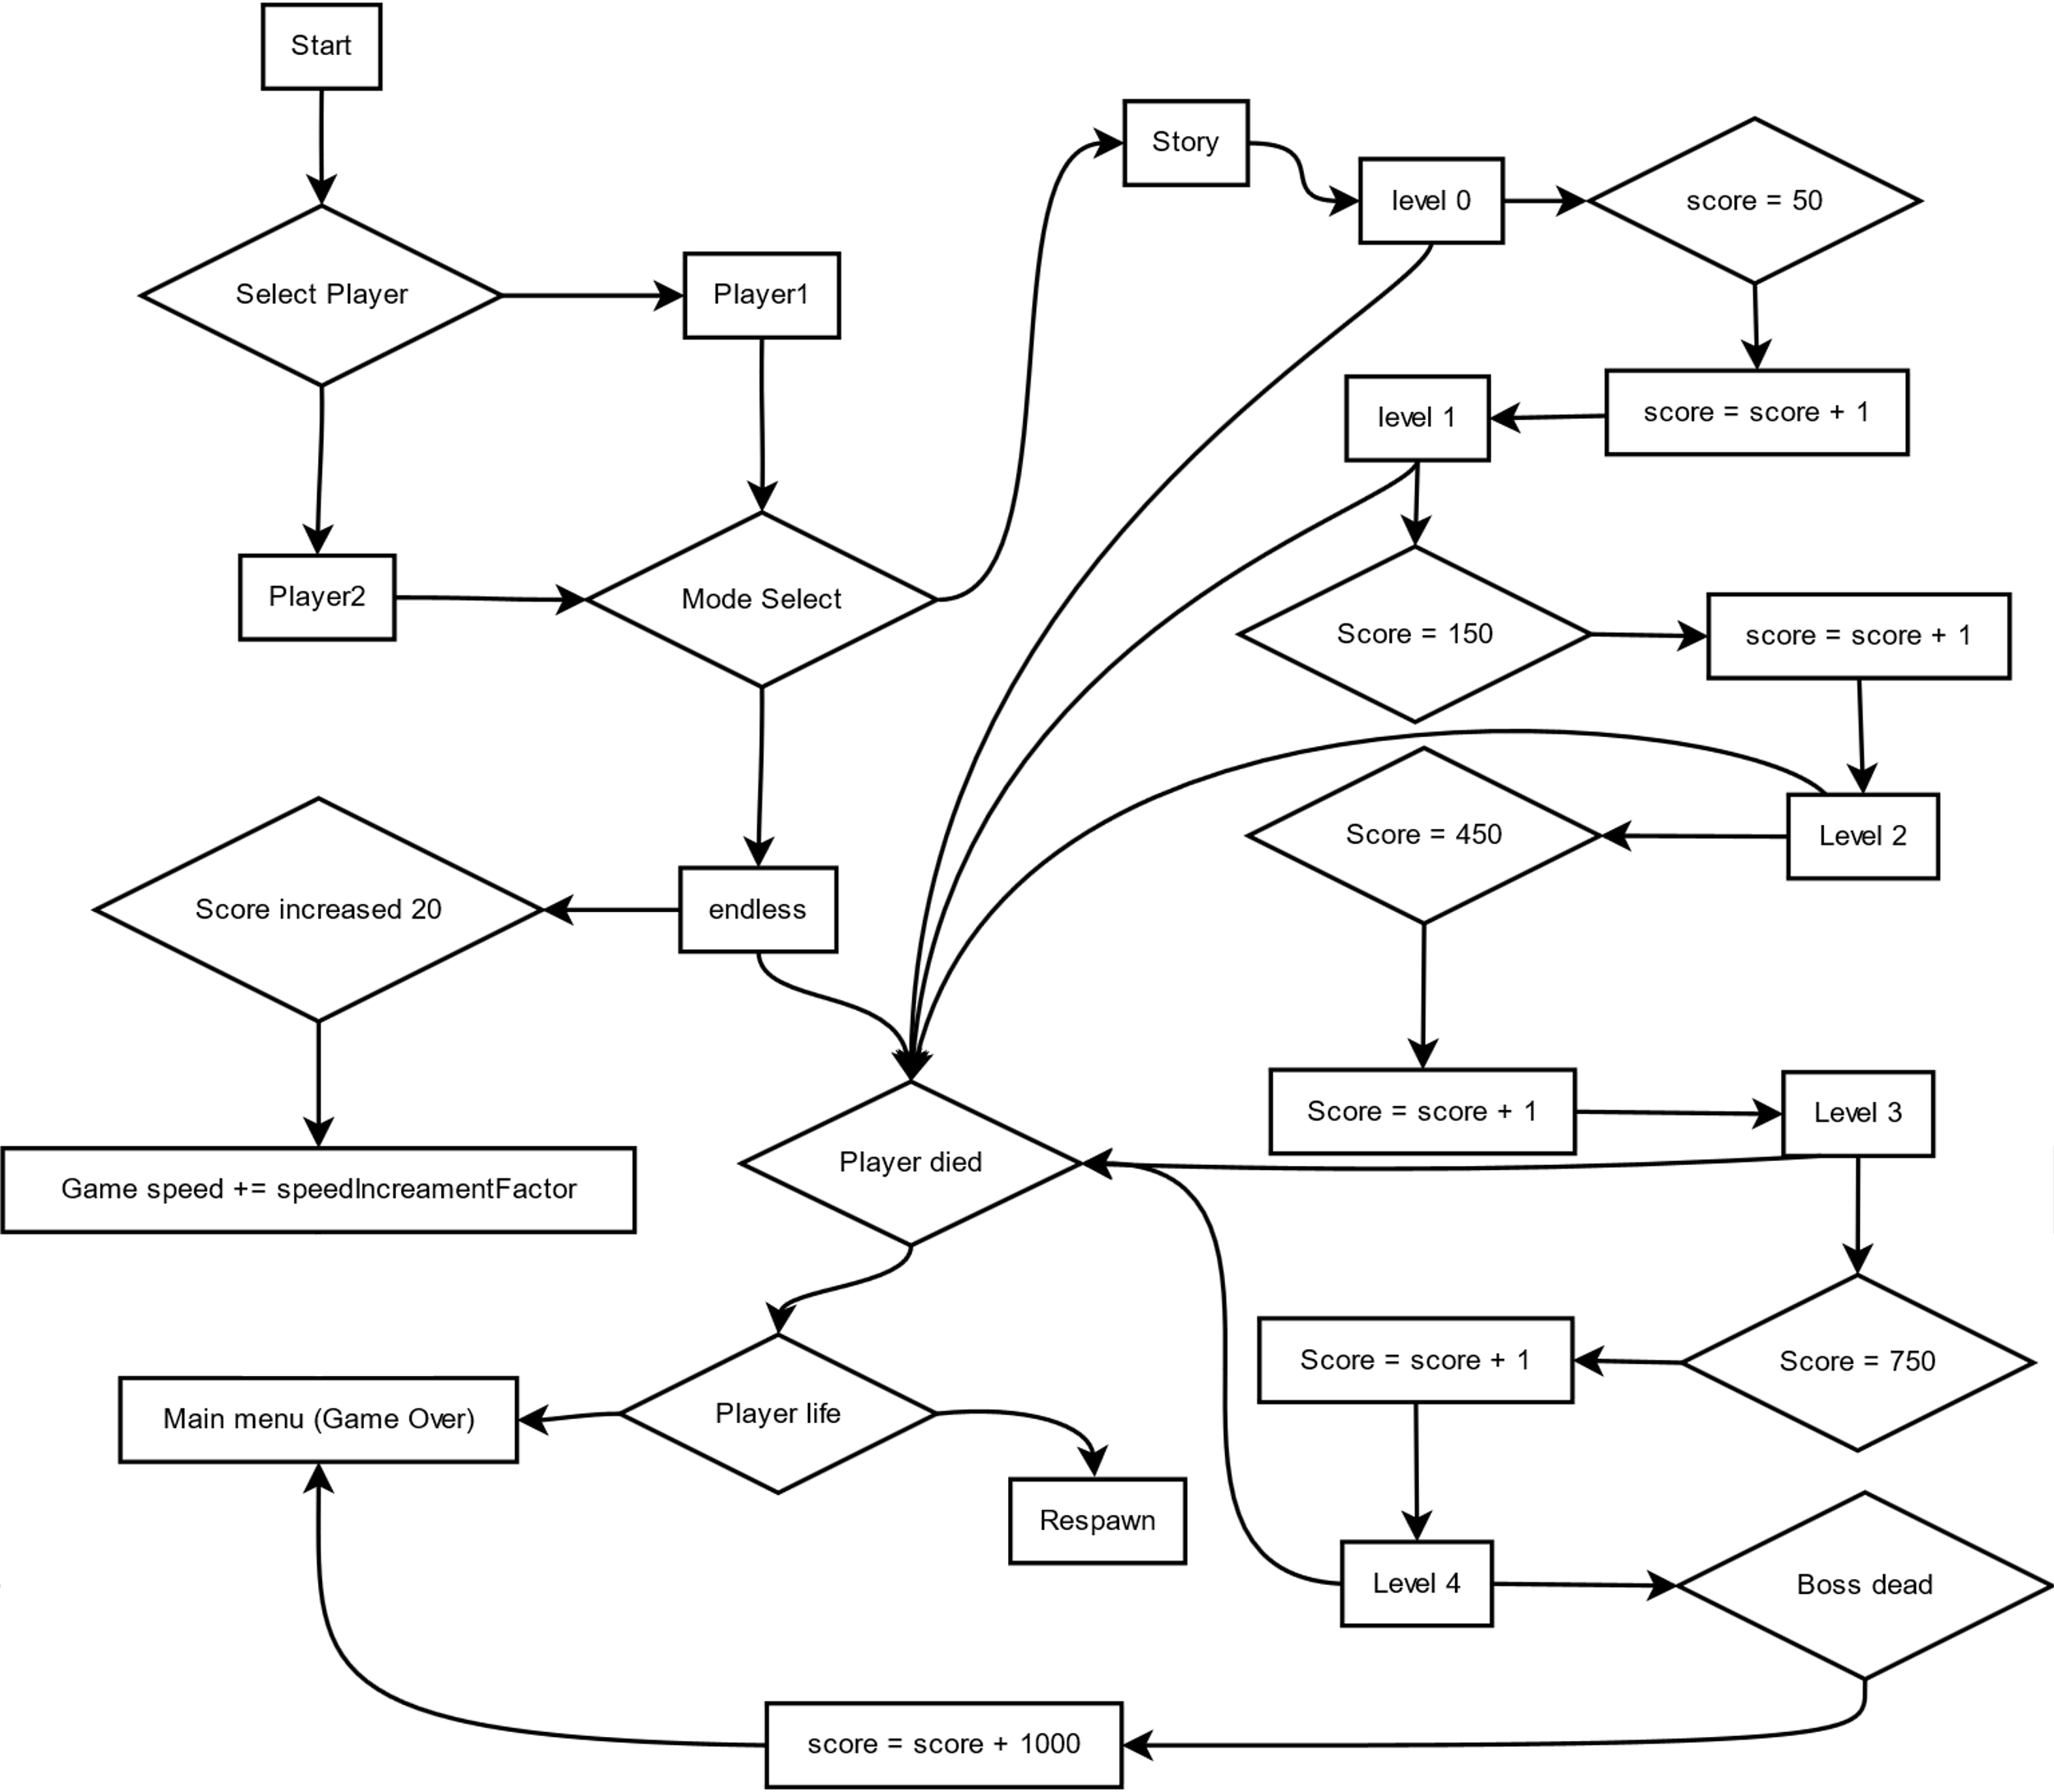
Flow Chart

Slide 14
Development Tools
Godot (recently renamed as godette) game engine
GD Script
GD Shaders
Krita
Blender

Slide 15
Project Conclusion The MilkyWay is designed to facilitate the parents. Mother(s) would no longer need to go out and locate their children, since they won’t go out as they could enjoy at home.

Slide 16
Thank You

