Slide 1
Postgres Upgrade Strategies
11/06/2020
Pablo Hendrickx@Zebanza.be

Slide 2
Contents of presentation
Update policy
What benefits?
Choose your update strategy
  -->About 20 minutes

Slide 3
Postgres update policy
Major release every September
Minor release every 3 months
Wait for first minor update before installing new major version

Slide 4
Postgres update policy
Versioning Numbering
Old:
  9.6.3
  Major.Major.Minor
  Up to version 9.6
New:
  12.2
  Major.Minor
  Version 10 onwards

Slide 5
Benefits
Why should I bother with upgrades?

Slide 6
Benefits
Benefits of new major versions
  More security
  Performance
  New features for developers
  New SQL implementations
  Better management features
  EOL after 5 years
  Frequently upgrading makes it easier

Slide 7
Benefits
Benefits of new minor versions
  Low risk and simple procedure
  Only fixes bugs, security issues, and data corruption problems
  “For minor releases, the community considers not upgrading to be riskier than upgrading.”

Slide 8
Upgrading minor version
Update Postgres
Make sure to update ALL pg packages
Check the release notes

Slide 9
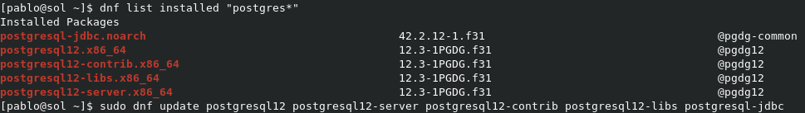
Upgrading minor version
Stop connections
Take a backup
Stop the cluster
Replace the Postgres binaries
Restart the cluster

Slide 10
Upgrading major version
3 options:
  Pg_dump/restore
  In-place upgrade with pg_upgrade
  Online upgrade

Slide 11
Upgrading major version
Pg_dump/restore
pg_dumpall > pg_dump
  pg_dumpall also gets global objects

Slide 12
Upgrading major version
Pg_dump/restore
  Get the new software
  Initiate an empty database on new path
  Use psql to restore the dump

Slide 13
Upgrading major version
Pg_dump/restore
Pro’s:
  Works since v7.0
  Simplicity
  Robust
  Small DB → perfect solution

Slide 14
Upgrading major version
Pg_dump/restore
Contra’s:
  Larger database → slow, larger downtime
  Requires double space

Slide 15
Upgrading major version
In-place upgrade with pg_upgrade
  Detaches pg_clog and pg_catalog
  Moves data files
  Reattaches to new binaries

Slide 16
Upgrading major version
In-place upgrade with pg_upgrade
  Get new software (also for extensions!)
  Create empty db of new postgres version
  Stop old postgres db
  Start pg_upgrade command
  Start new database
  Start analyze statistics script

Slide 17
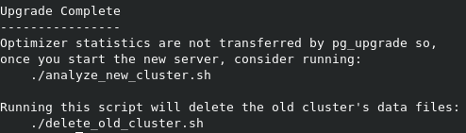
Upgrading major version
In-place upgrade with pg_upgrade

Slide 18
Upgrading major version
In-place upgrade with pg_upgrade
  Hardlink option (-k)
  Blazing fast
  Old database is lost
  Data dirs must be in same filesystem
  No double space

Slide 19
Upgrading major version
In-place upgrade with pg_upgrade
Pro’s
  Much faster for large databases
  Even faster with hardlink option
  Not too complicated

Slide 20
Upgrading major version
In-place upgrade with pg_upgrade
Contra’s
  Double space (unless using hardlink option)
  Risky if using hardlink option
  Buggy in containers

Slide 21
Upgrading major version
Online upgrade
  Setup new database cluster
  Setup replication from old one to new one
  Perform failover

Slide 22
Upgrading major version
Online upgrade
  Replicating from old to new can only be done with logical replication
  Else, third party tool required!

Slide 23
Upgrading major version
Online upgrade
  Enterprisedb replication server
  Slony-I

Slide 24
Upgrading major version
Online upgrade
Pro’s
  Very low down time
  Safe! Can switchover standby

Slide 25
Upgrading major version
Online upgrade
Contra’s
  Complexity
  Double space

Slide 26
Sources
  Ilya Kosmodemiansky
  https://fosdem.org/2020/schedule/event/postgresql_an_ultimate_guide_to_upgrading_your_postgresql_installation/
  https://www.postgresql.org/support/versioning/
  https://www.enterprisedb.com/edb-docs/d/postgresql/reference/manual/9.4.24/pgupgrade.html
  https://www.percona.com/blog/2019/04/04/replication-between-postgresql-versions-using-logical-replication/
  https://www.cybertec-postgresql.com/en/a-primer-on-postgresql-upgrade-methods/

Slide 27
Questions?

