Slide 1
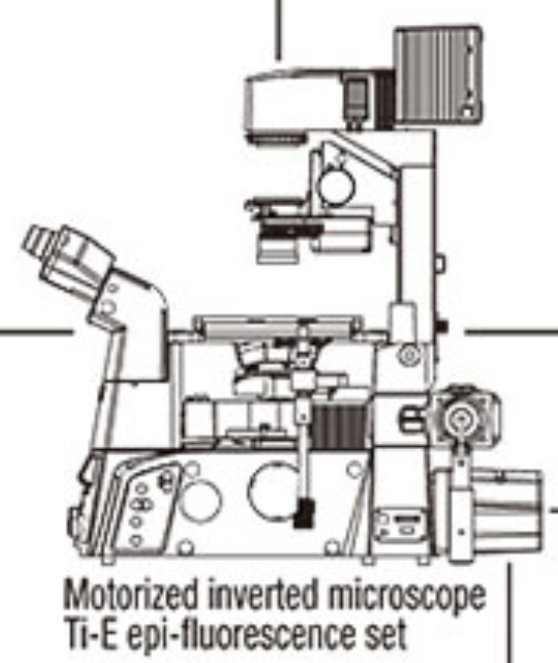
Diameter of
BFPs
Position of
mechanical stop/flange
Position of
BFP
Angle Deviation
Position Deviation w.r.t. optical axis
Tube lens position w.r.t camera/BFP
Position of Principle Plane

