Slide 1
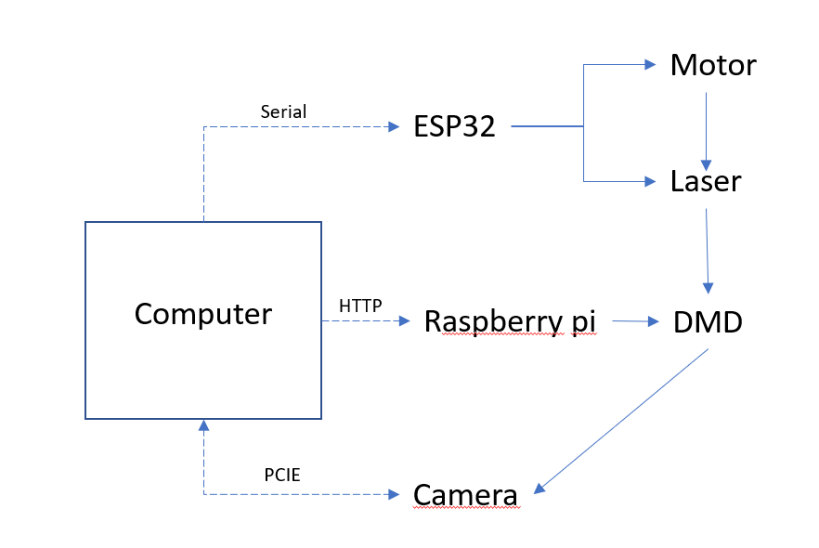
DMD
illustra
DMD on setup
Mounting
parts
Motor On setup
Setup rendering
Hardware wiring?

Slide 2
Motor
Serial
ESP32
Laser
Computer
HTTP
Raspberry pi
DMD
PCIE
Camera

Slide 3
v
Argolight WF
Argolight Recon
v
v
Dualcolor
WF
Dualcolor
Recon

