Slide 1
LibYUI
Manu Gupta
Manipal Institute of Technology
manugupt1@opensuse.org

Slide 2
What we believe in
Simplicity

Slide 3
What we believe in
Simplicity
Power

Slide 4
What we believe in
Simplicity
Power
Choice

Slide 5

YaST
SWISS KNIFE

Slide 6


Problems
ncurses
'

Slide 7
Solution
LibYUI
ncurses
'

Slide 8
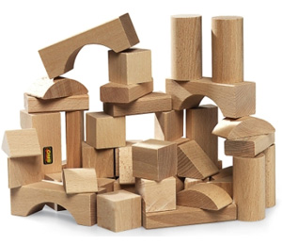
Building Blocks
Testing

Slide 9
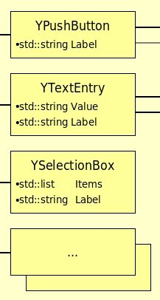
Building Blocks
And more....

Slide 10
Event Handling
First Design
then HANDLE

Slide 11
Not supported by LibYUI
  Multiple Threads
  Signals And Slots
  Advanced Graphics
  Non-blocking event handling

Slide 12
Problems with LibYUI
Not very popular among developers :-(

Slide 13
Problems with LibYUI
Not very popular among developers :-(
Heavily dependent on YaST (ghosts of the past)

Slide 14
Problems with LibYUI
Not very popular among developers :-(
Heavily dependent on YaST (ghosts of the past)
Very small community

Slide 15
Solutions
Build up development

Slide 16
Solutions
Build up development
Package and distribute

Slide 17
Solutions
Build up development
Package and distribute
GsoC Project

Slide 18
Useful Links
*-yui package doc with examples:
/usr/share/doc/packages/*-yui
Source Code
http://svn.opensuse.org/svn/yast/trunk/libyui/
http://svn.opensuse.org/svn/yast/trunk/libyui-bindings/
YaST development mailing list:
yast-devel@opensuse.org

Slide 19
Thanks For
Listening
'

