Slide 1
GNOME 3.2 in openSUSE 12.1
Richard Brown
openSUSE Member & Ambassador
RBrown@openSUSE.org

Slide 2
GNOME & openSUSE
openSUSE supports both KDE and GNOME equally
GNOME 3.0 and 3.2 available for openSUSE 11.4
  We had 3.0 working on openSUSE before it was finished ;-)
openSUSE used for www.gnome.org LiveCD's

Slide 3
GNOME 3.2
New Features
  Online Account Integration
  Contacts (combined Empathy, Evolution & Online Address Book)
  Documents (search, organise and view local & online documents)
  Quick Preview
  Colour management
  Fully Integrated Messaging
  Improved hotplug notifications (aka The Eject-o-matic)
  Lots of minor changes based on user feedback from GNOME 3.0
    Less padding!
    Focus-follows-mouse improved
    Notification counters

Slide 4
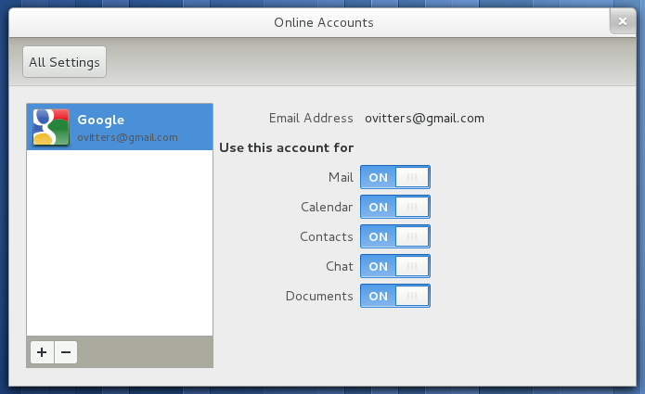
Online Account Integration

Slide 5
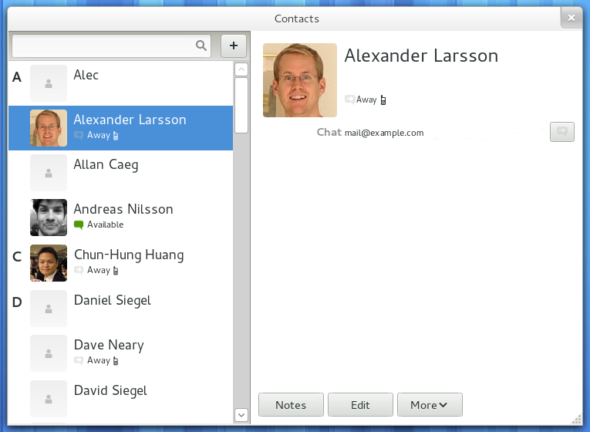
Contacts

Slide 6
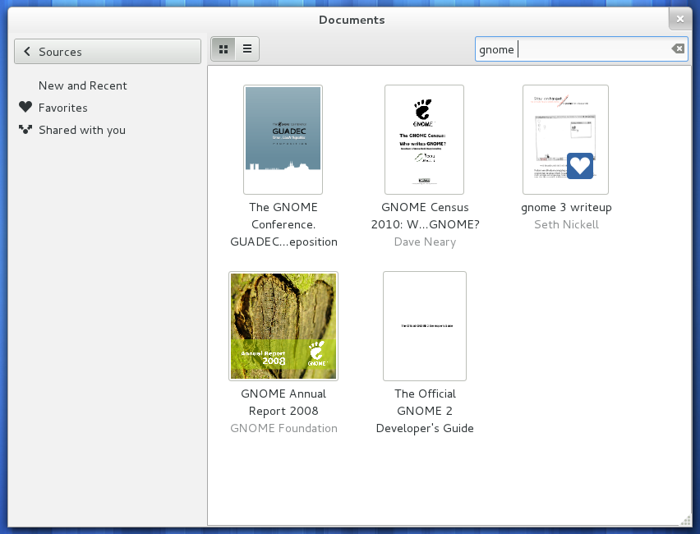
Documents - Search

Slide 7
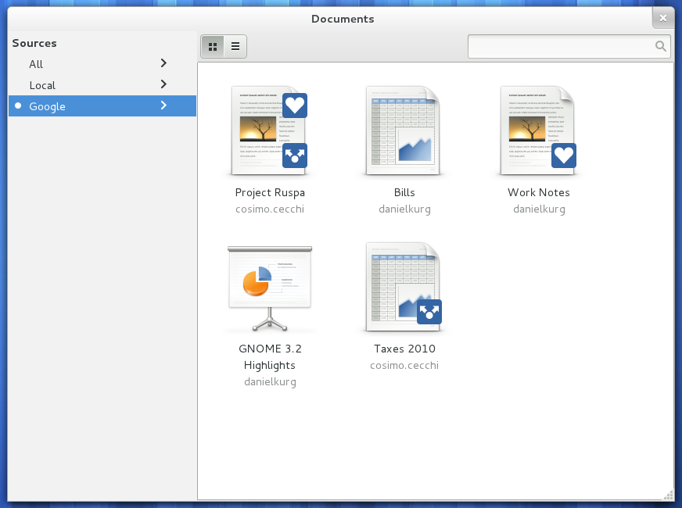
Documents – Online integration

Slide 8
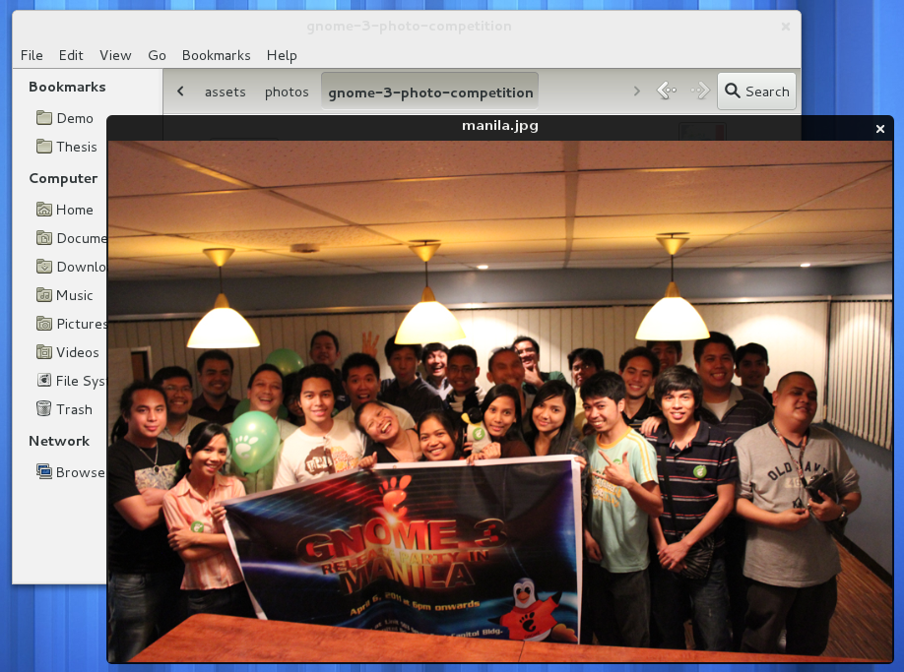
Quick Preview (just press space!)

Slide 9

Eject-o-matic

Slide 10
openSUSE 12.1

Slide 11
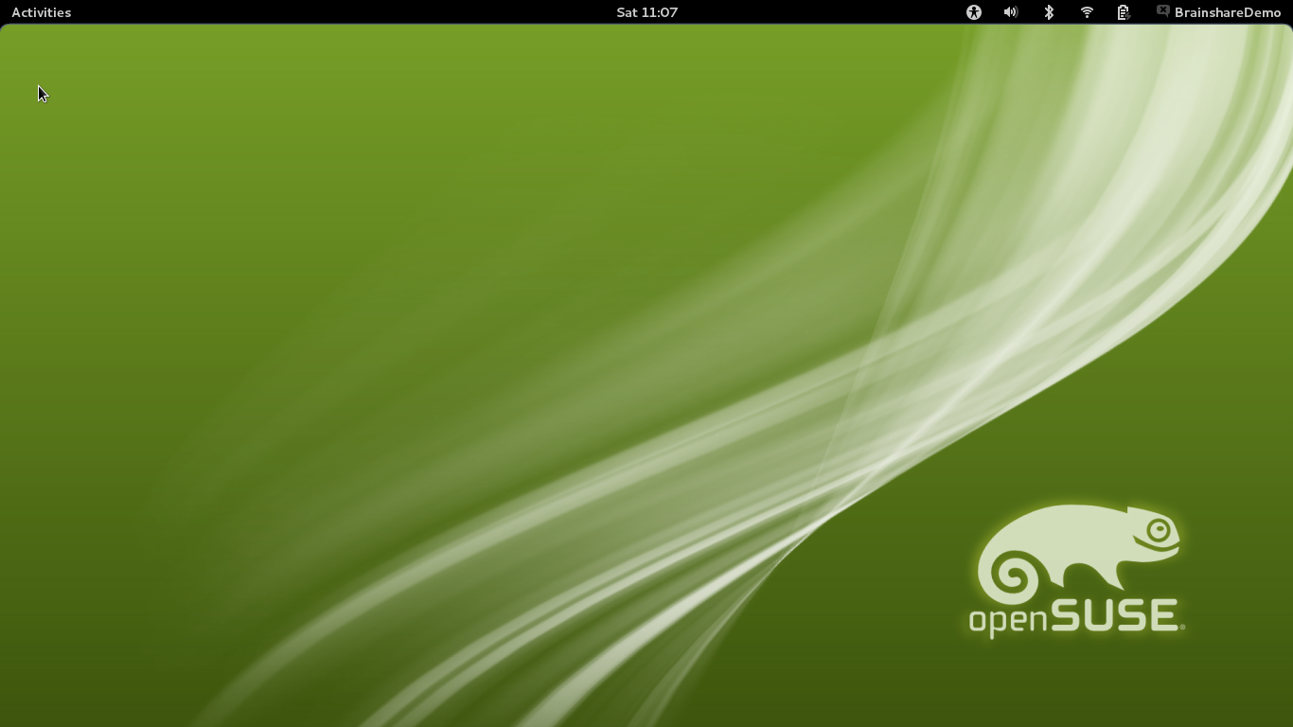
Desktop

Slide 12
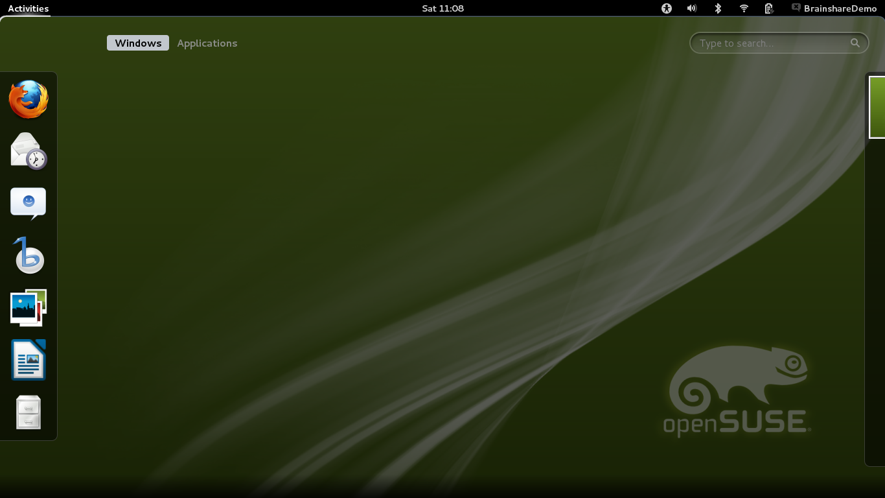
Activities Application Launcher & Task Switcher

Slide 13
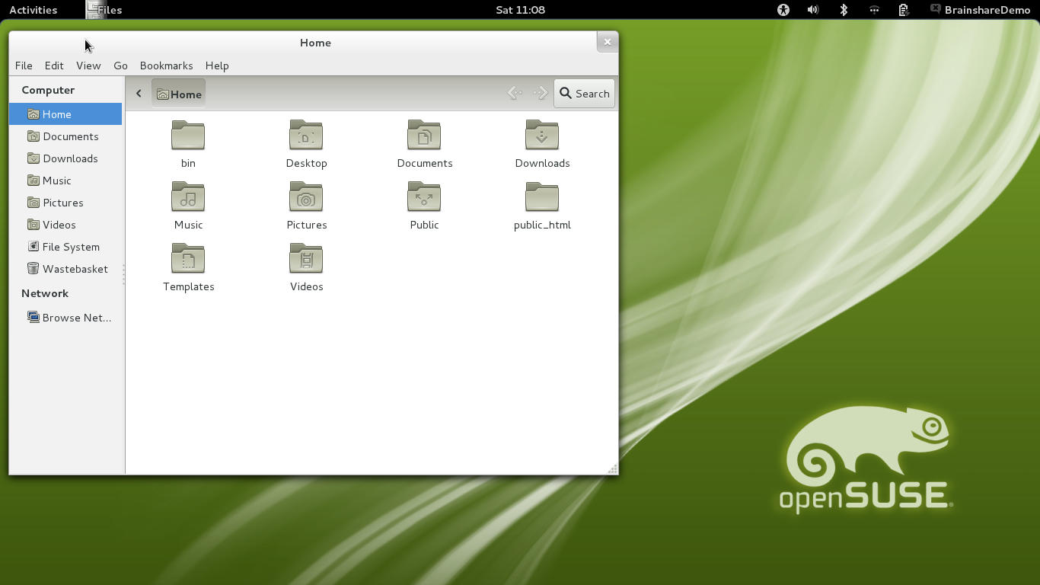
Nautilus File Manager

Slide 14
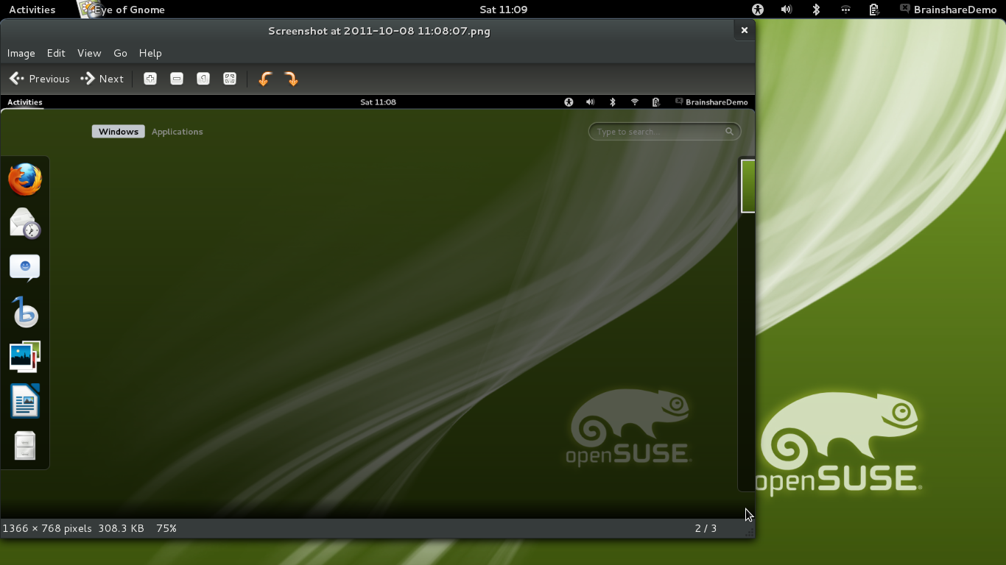
Eye of GNOME Image Viewer

Slide 15
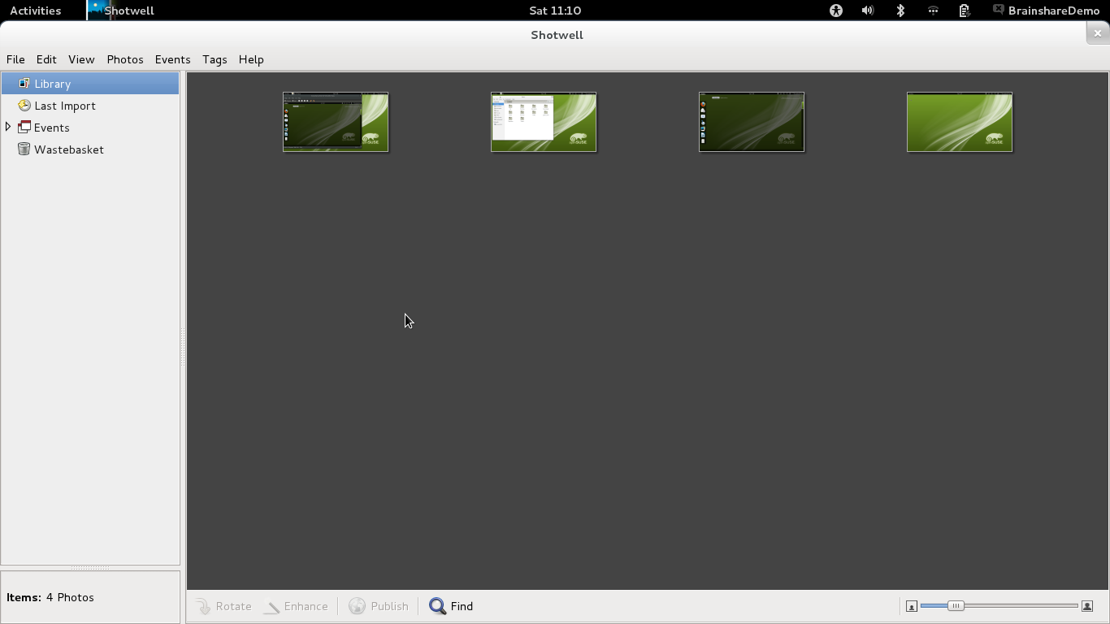
Shotwell Photo Manager

Slide 16

Totem Video Player

Slide 17
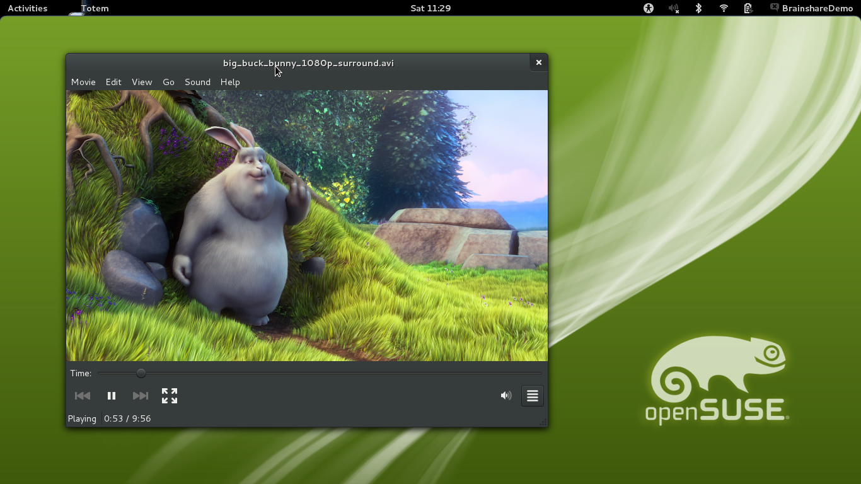
Totem Video Player

