Slide 1
Introduction to SUSE Studio
Your name here!
Notes:
Welcom! I am...

Slide 2
SUSE Studio is...
A web app for building custom Linux distros
Build Live CDs, VM images, EC2 images, disk images
Freely usable at susestudio.com by anybody
Notes:
Easy to use
Distro a bit of a misnomer, in that they're all SUSE based :)
EC2 is interesting – you can upload straight to Amazon from Studio (may be a beta thing right now)
Mention appliance terminology

Slide 3
Notable Features Include...
Configure everything once (users, network, etc.)
Upload custom files, scripts, applications
Test Drive “appliance” directly in your web browser
  Save modifications back to your appliance
Notes:
Timezone, firstboot, installed packages, branding
OBS
Storage – appliance may be deleted (but can be rebuilt)

Slide 4
You Might Care if...
You want repeatable VM deployments
You want to make demo CDs, VM's etc
You want to build your own portable OS
You're an ISV
You've been given a SUSE appliance based application by an ISV
Notes:
I've used it for VMs for HA testing
Likewise for demo CDs for HA stuff
It's perfect to build your own operating system on a stick – given a reasonably fast and big USB stick you have your portable OS anywhere, anytime!
Or to get your software out there in an easy to use, pre-configured form
ISV building software appliance, IHV (“perfect myth box?”, “ultra easy to deploy network monitor”)
Rumour has it some ISVs build “non-upgradeable” appliances, something to watch out for.

Slide 5
I Should Probably Also Mention...
SUSE Studio Onsite is available for purchase
  Use it inside your firewall
  comes with lifecycle management of the appliances (updating, managing etcetera)
SUSE Studio is actually a frontend for KIWI and the Open Build Service
  http://en.opensuse.org/Portal:KIWI
  http://openbuildservice.org
There's also susegallery.com, for
sharing appliances (think of it as
apppstore for appliances)
Notes:
Part of SUSE Appliance Toolkit
WebYaST, SLMS
Export/import KIWI
Get other appliances (LAMP, etc.)

Slide 6
Time for a Walkthrough
Notes:
So let's see what we're talking about here!

Slide 7
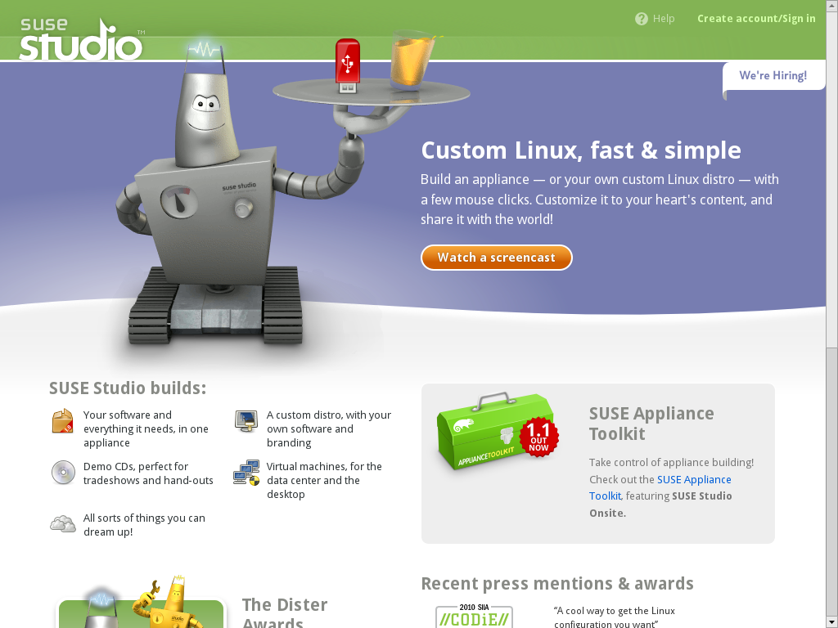
Notes:
Welcome!

Slide 8
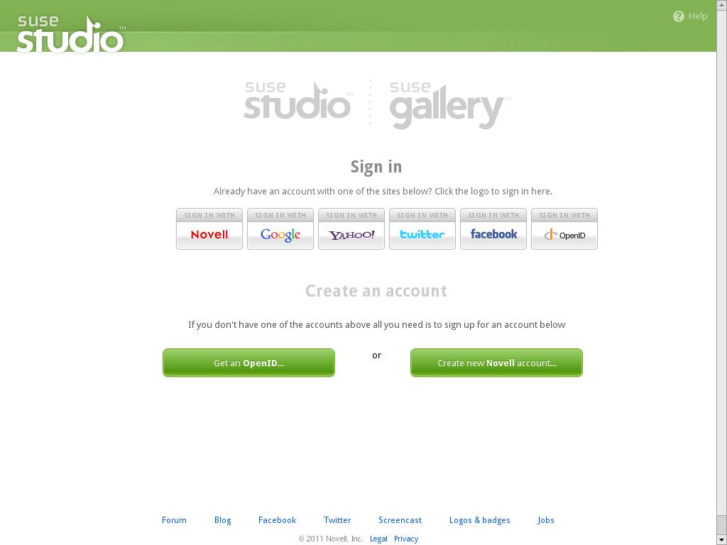
Notes:
Log in any way you want.

Slide 9
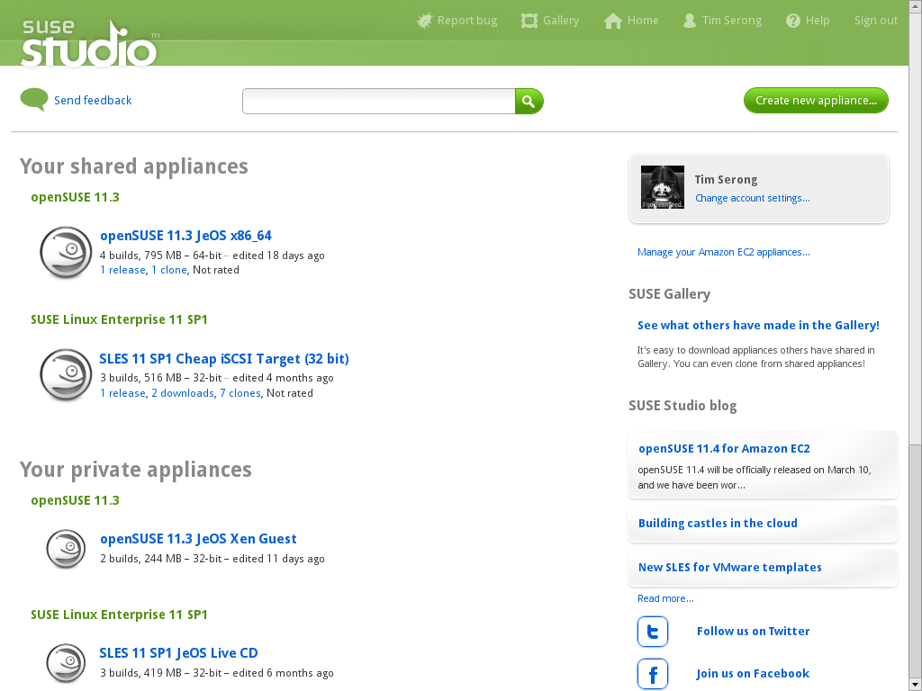
Notes:
Your 'home' overview.
Now let's click 'create new appliance' and get going!

Slide 10
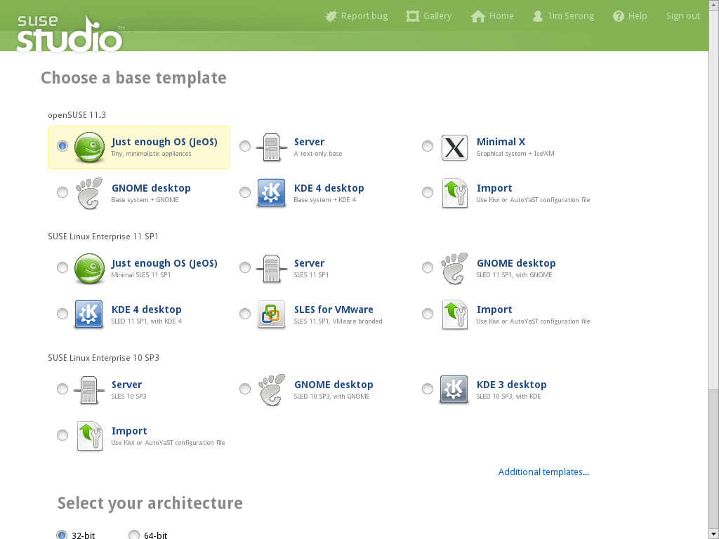
Notes:
We pick a base template...

Slide 11
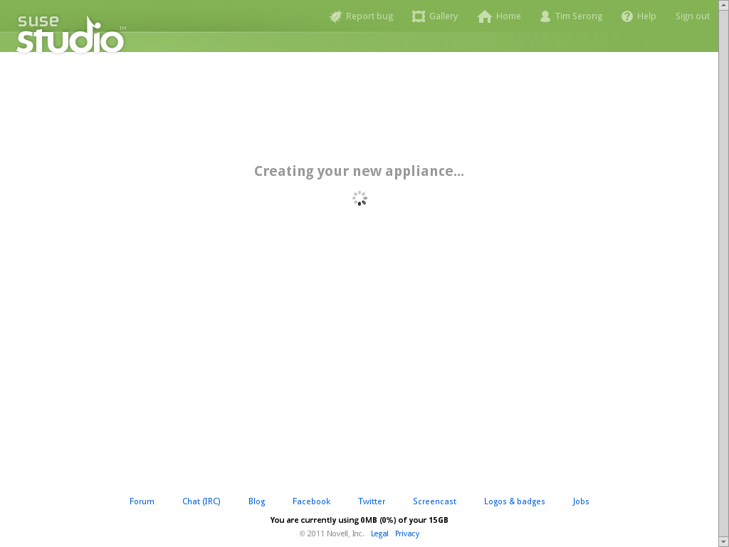
Notes:
Studio loads it...

Slide 12
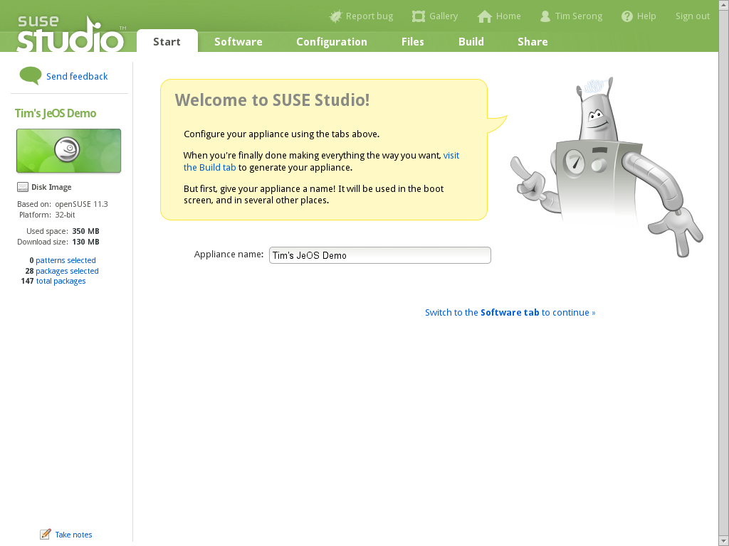
Notes:
And we can get started!

Slide 13
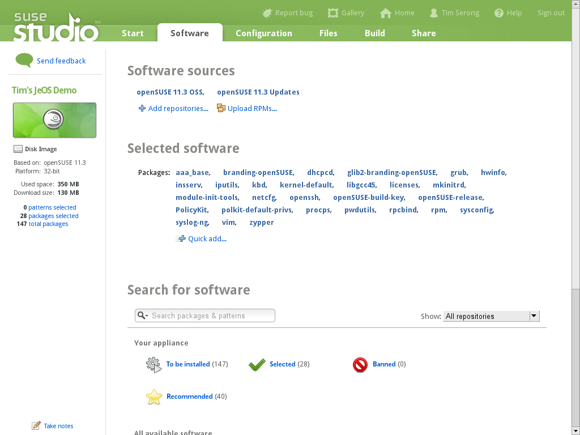
Notes:
Here's the start – only a basic OS is there. You can add repo's and software, if you want...
You have access to all the repo's of the Open Build Service, we're talking about tens of thousands with over a 150.000 packages in them!
Of course you can add external repo's or upload your own packages directly.

Slide 14
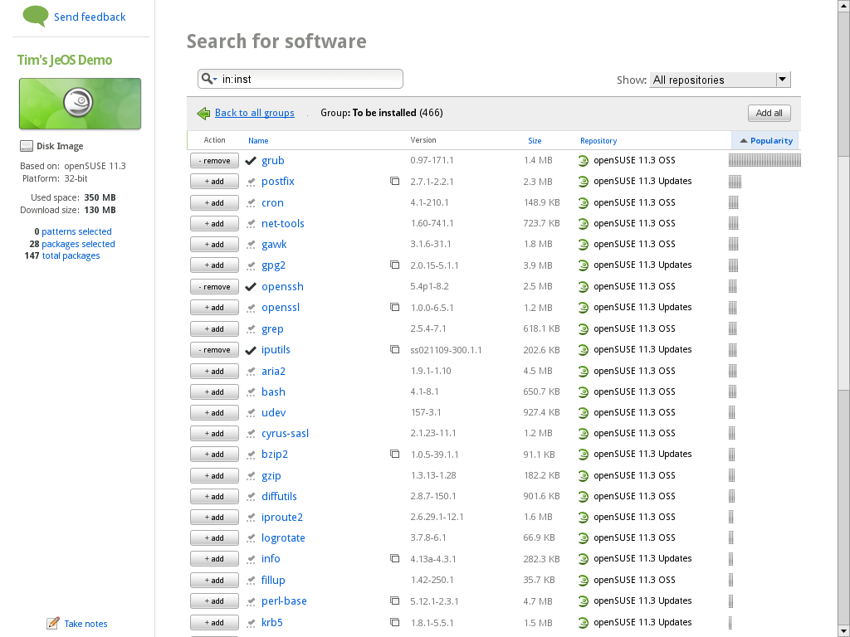
Notes:
Here's a view of the currently (to be) installed software.

Slide 15
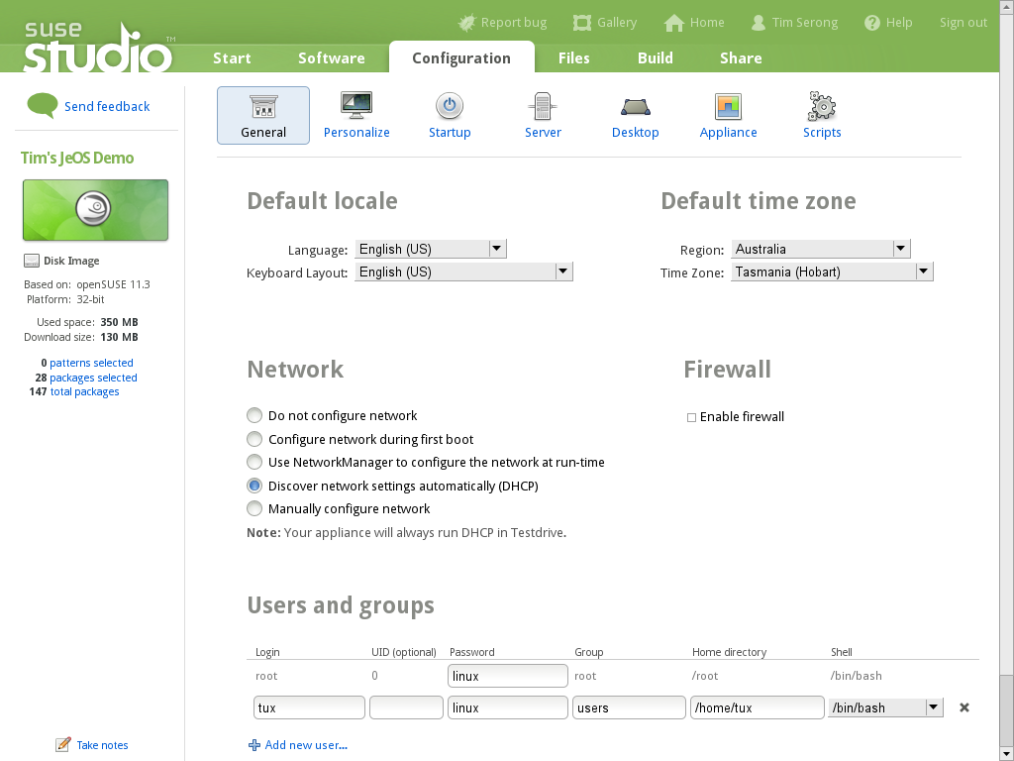
Notes:
After software selection we set up our OS. Language, timezone, network, users... The usual.

Slide 16
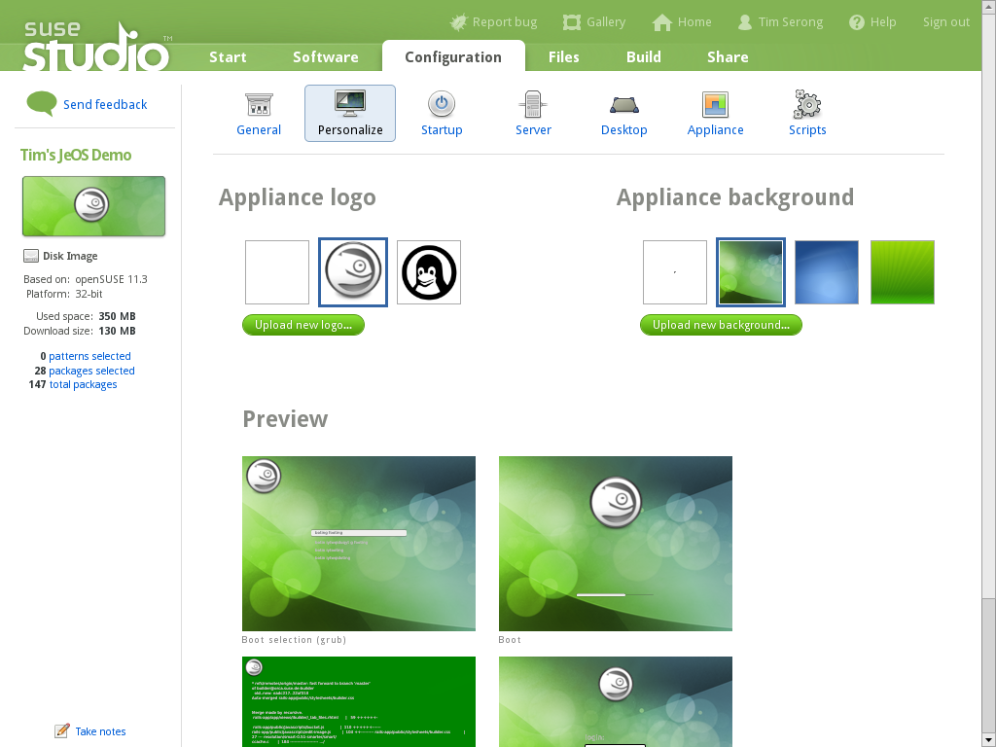
Notes:
Including of cours all branding, as custom as you want!

Slide 17
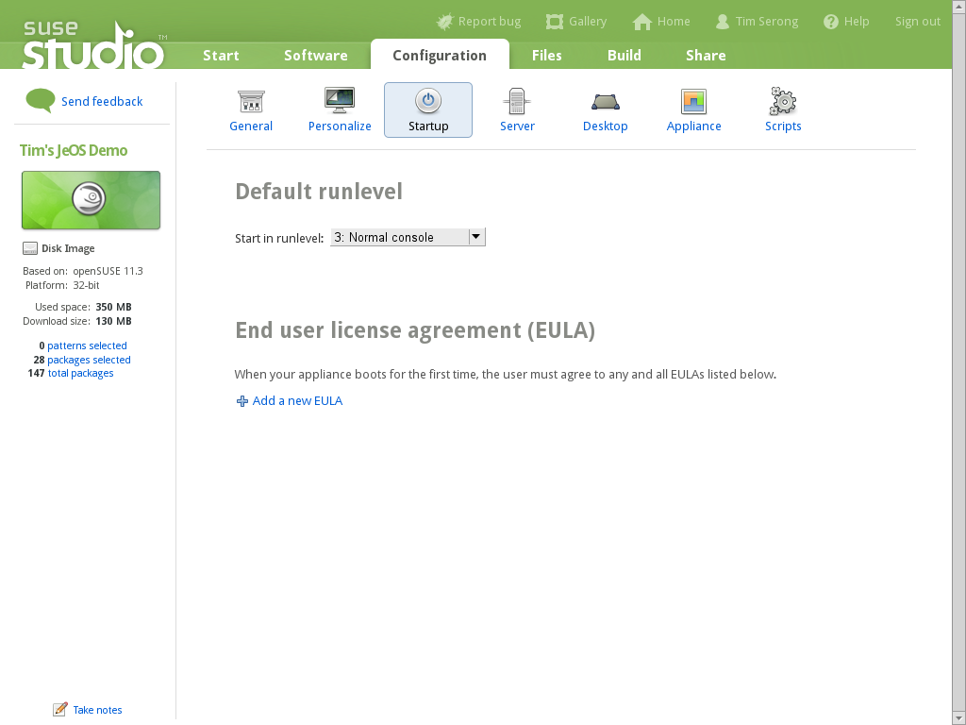
Notes:
You can even add your own EULA's if you like.

Slide 18
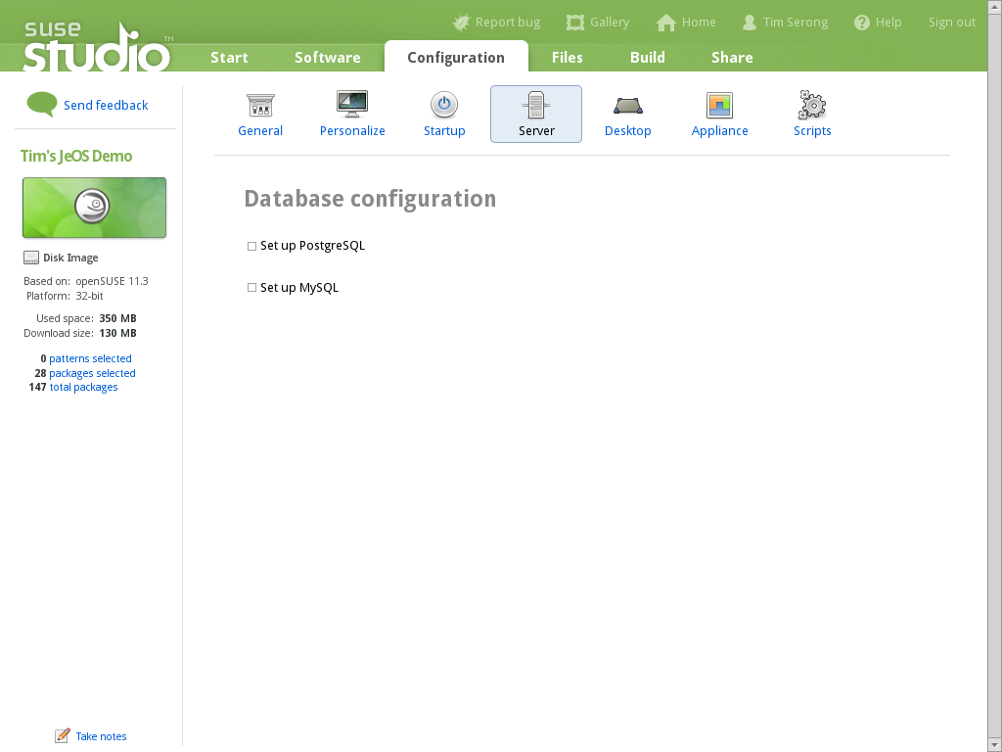
Notes:
… and set up databases

Slide 19

Notes:
If you configure a database which is not installed, Studio will offer a one-click-install-the-database for you.

Slide 20
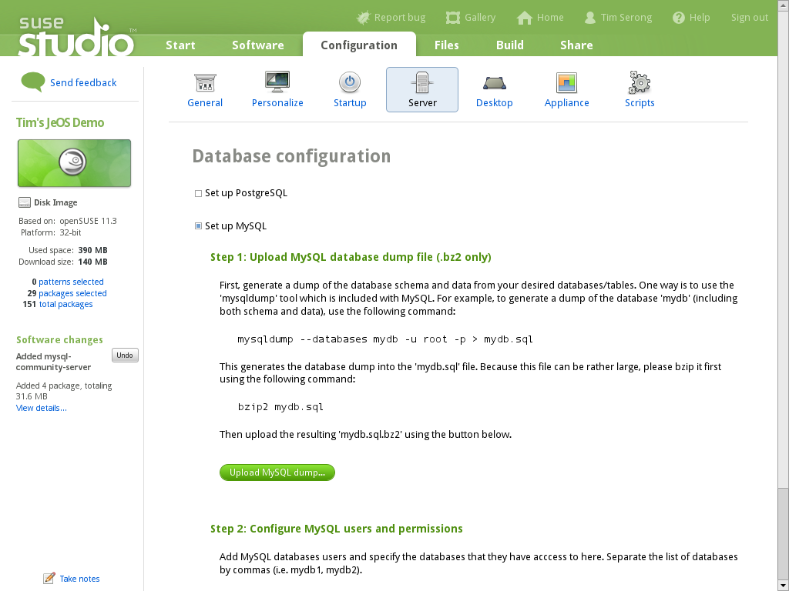
Notes:
All done! Details?

Slide 21
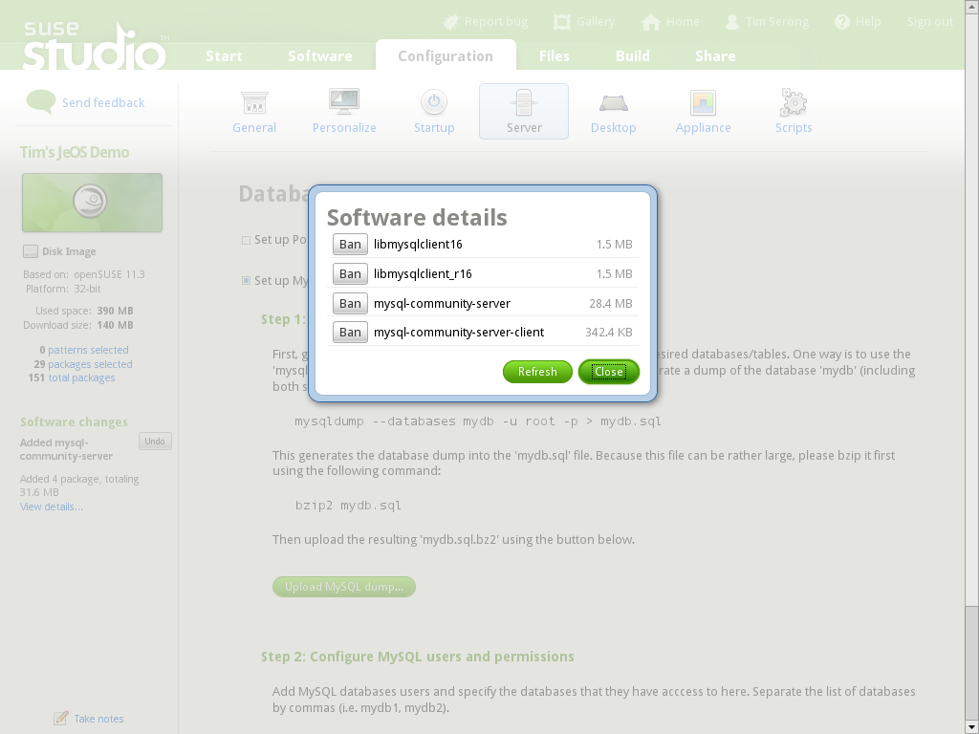
Notes:
Let's see what Studio just did...

Slide 22
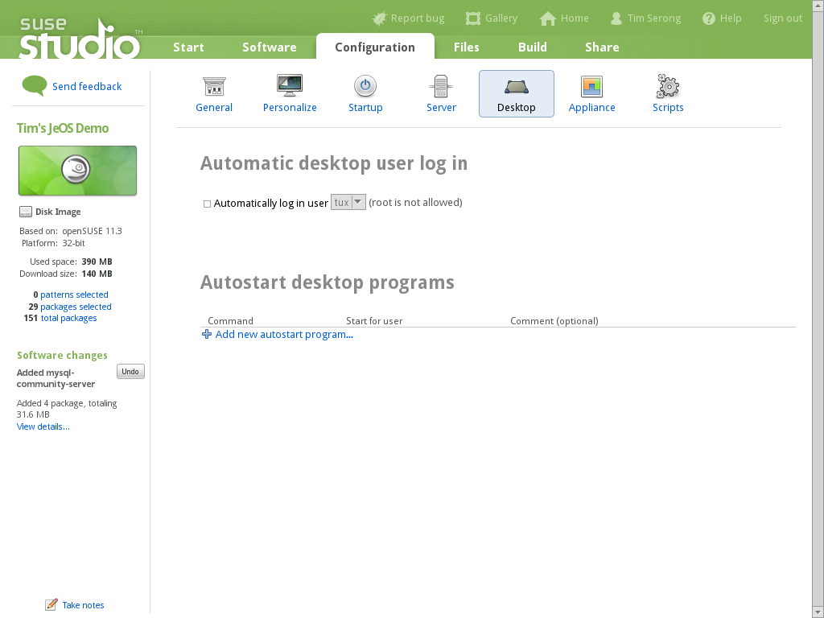

Slide 23


Slide 24
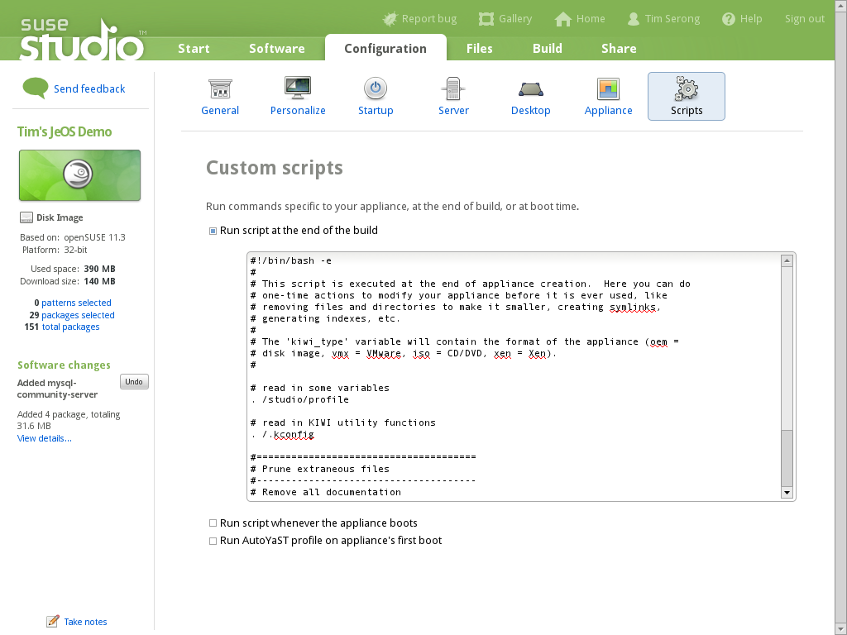
Notes:
Now we can add custom scripts, to be run whenever we want.

Slide 25
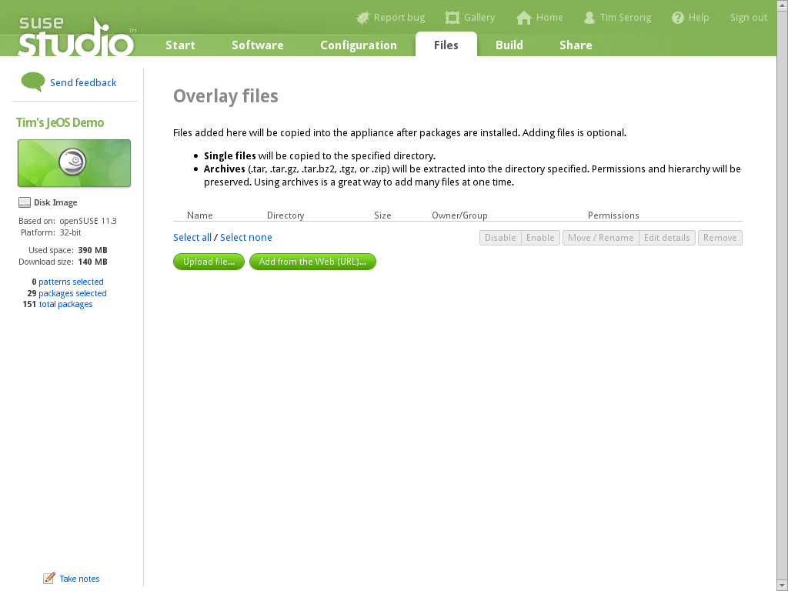
Notes:
And upload our own tarballs with software, to be extracted wherever we want!

Slide 26
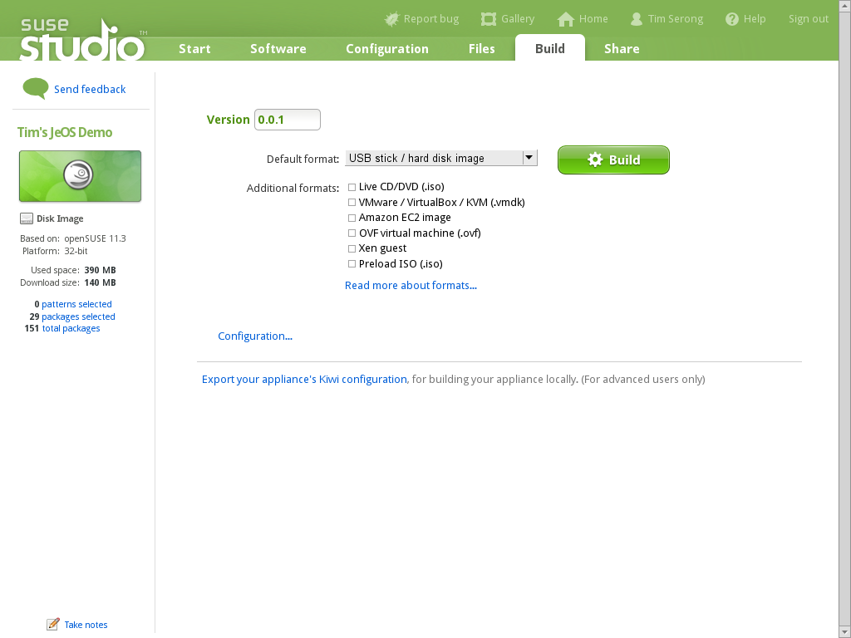
Notes:
After all that, we are ready to build our OS, or rather, let the SUSE servers do that for us.

Slide 27

Notes:
Notice that here you can also download the KIWI specification for further customization or building on your own workstation!
The sizes mentioned are guestimations, by the way.

Slide 28

Notes:
The building will take a while, about 5-20 minutes depending on the size of the OS.

Slide 29

Notes:
Ok, for very small OS'ses a few minutes usually is enough!

Slide 30
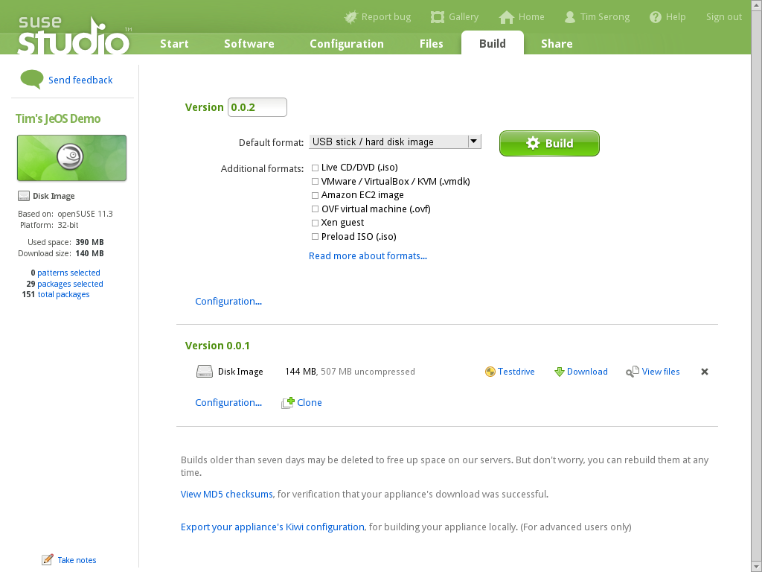
Notes:
Once done, we can start Testdrive!

Slide 31
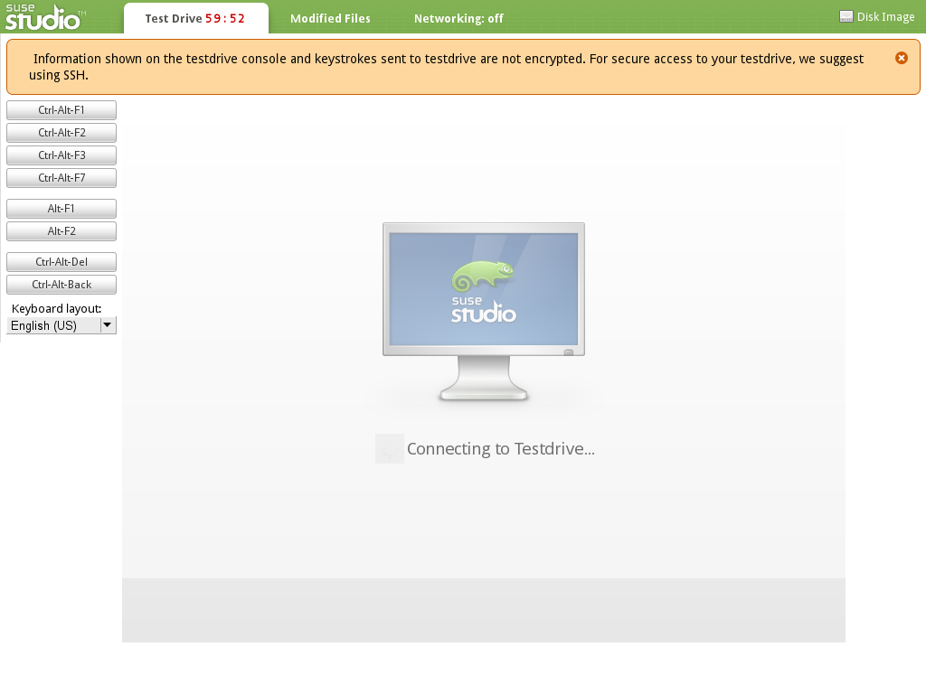
Notes:
Which boots up the appliance on the SUSE Servers...

Slide 32
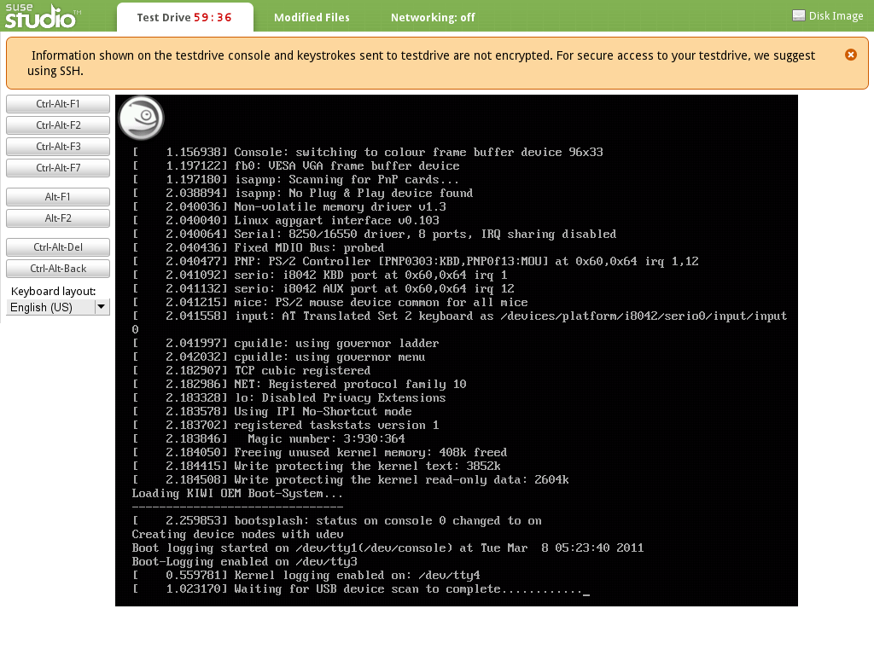
Notes:
And uses a Flash based remote connection to let you monitor boot up...

Slide 33
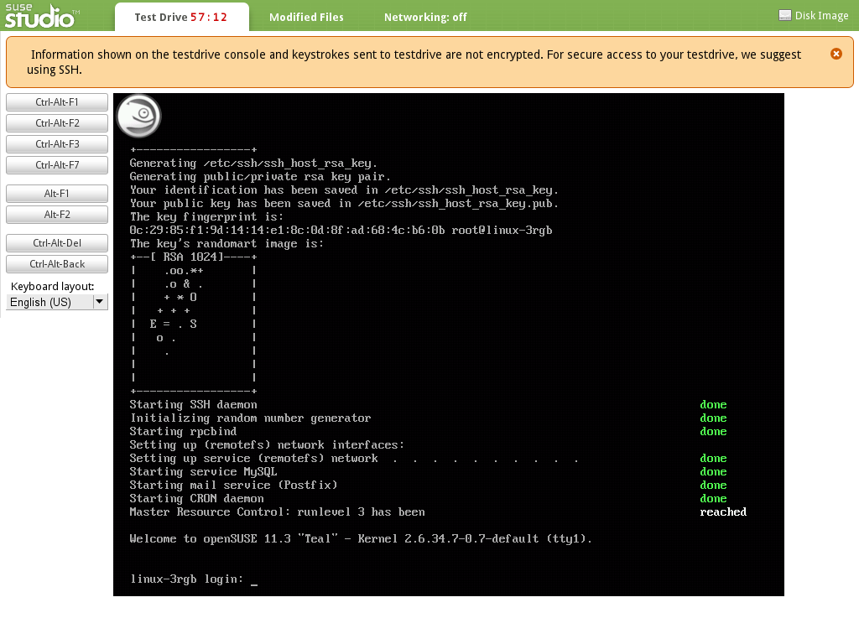
Notes:
And log into your newly build OS!

Slide 34
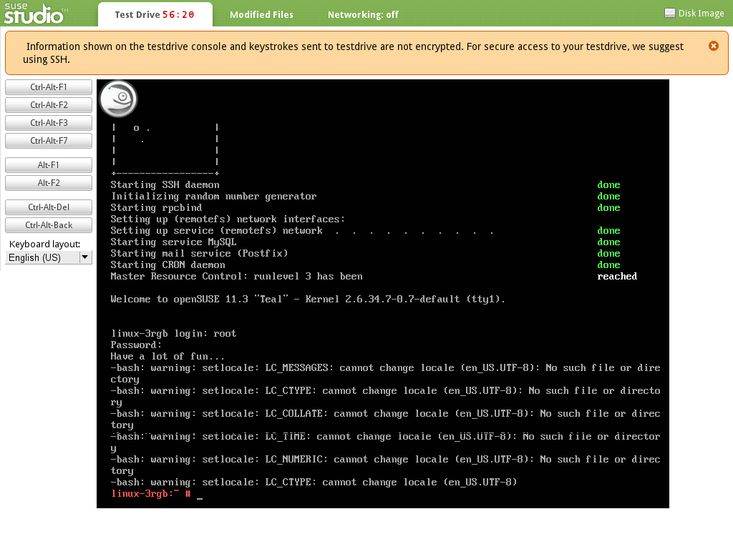
Notes:
Note locale errors. We should fix this...

Slide 35
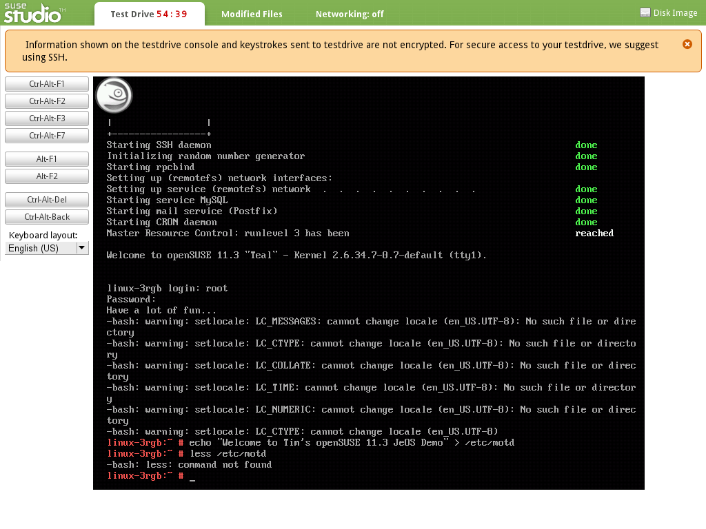
Notes:
Edited file
Note “less” is not installed, it's really minimal, this JeOS image...

Slide 36
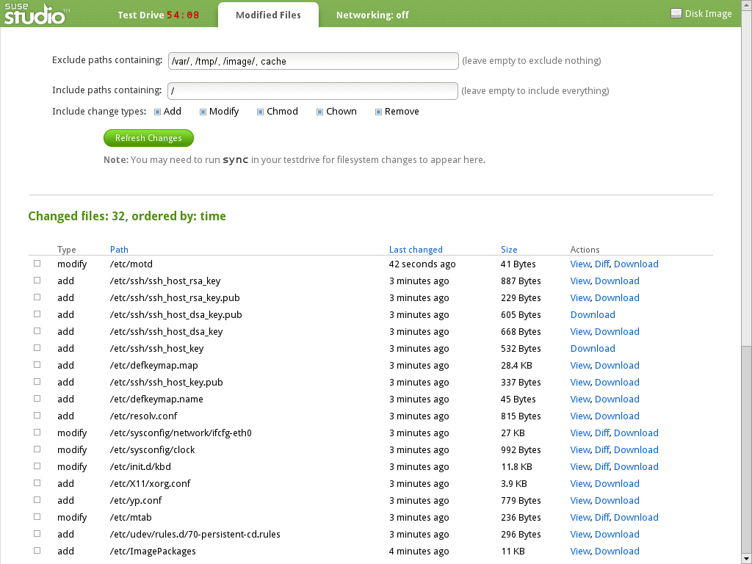
Notes:
Here you can get an overview of all the files changed during your test drive. You can include these in the image.

Slide 37
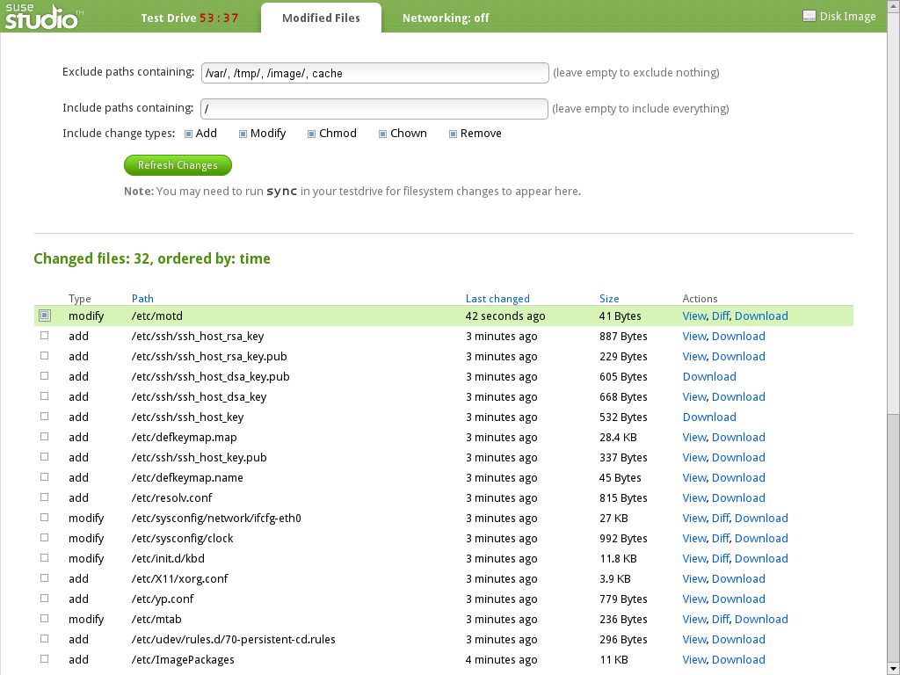
Notes:
Let's add this file to our appliance...

Slide 38
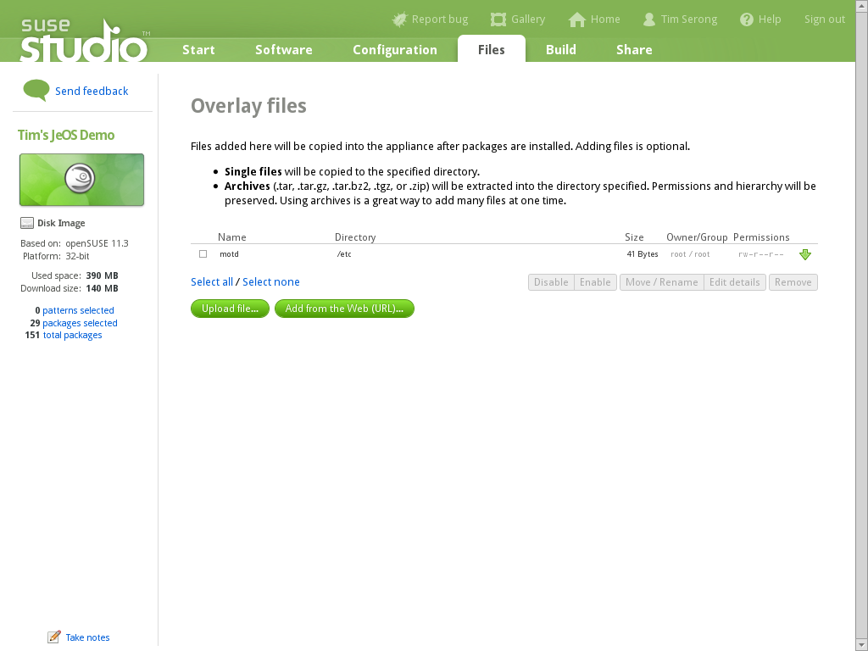
Notes:
Now it will show up here.

Slide 39
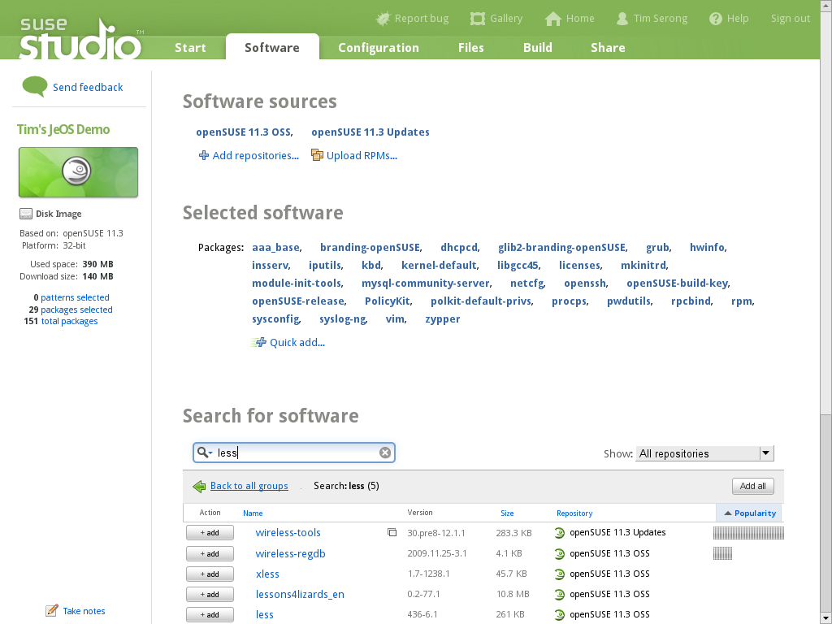
Notes:
And let's add less, we want that, don't we?

Slide 40
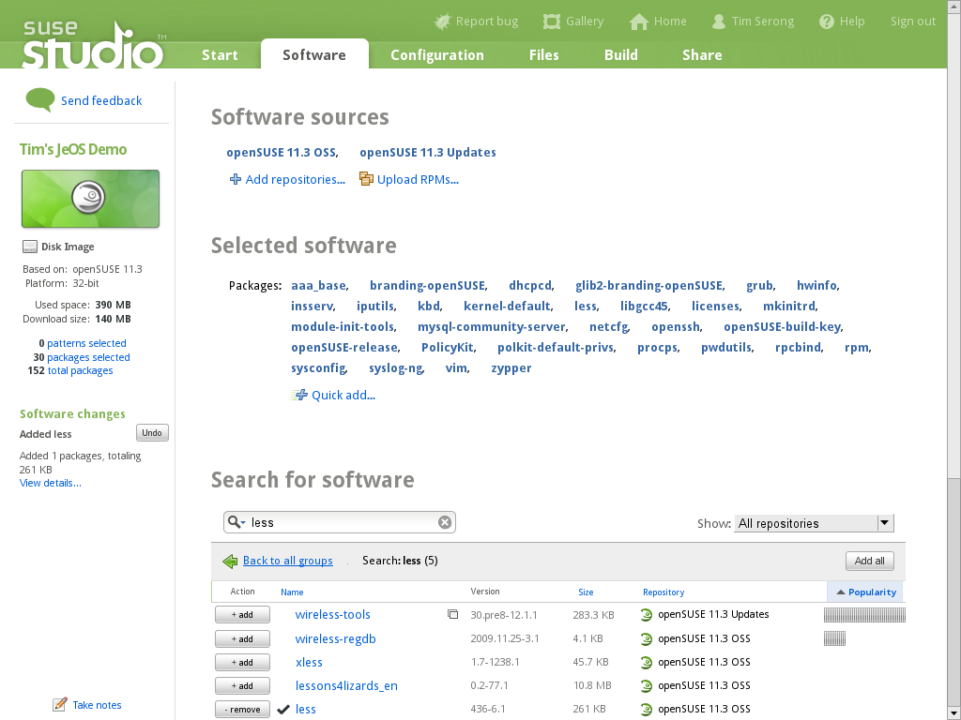
Notes:
Find “less” and add it!

Slide 41
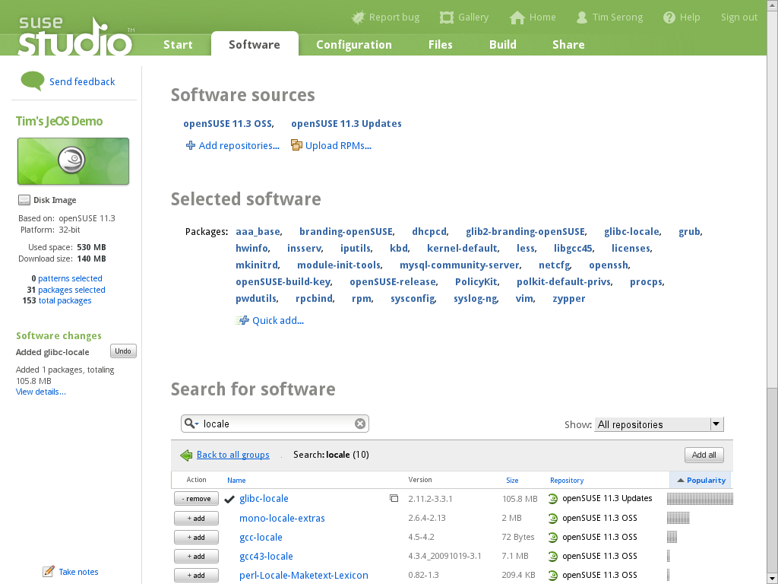
Notes:
Add “glibc-locale” to fix the locale errors too.

Slide 42
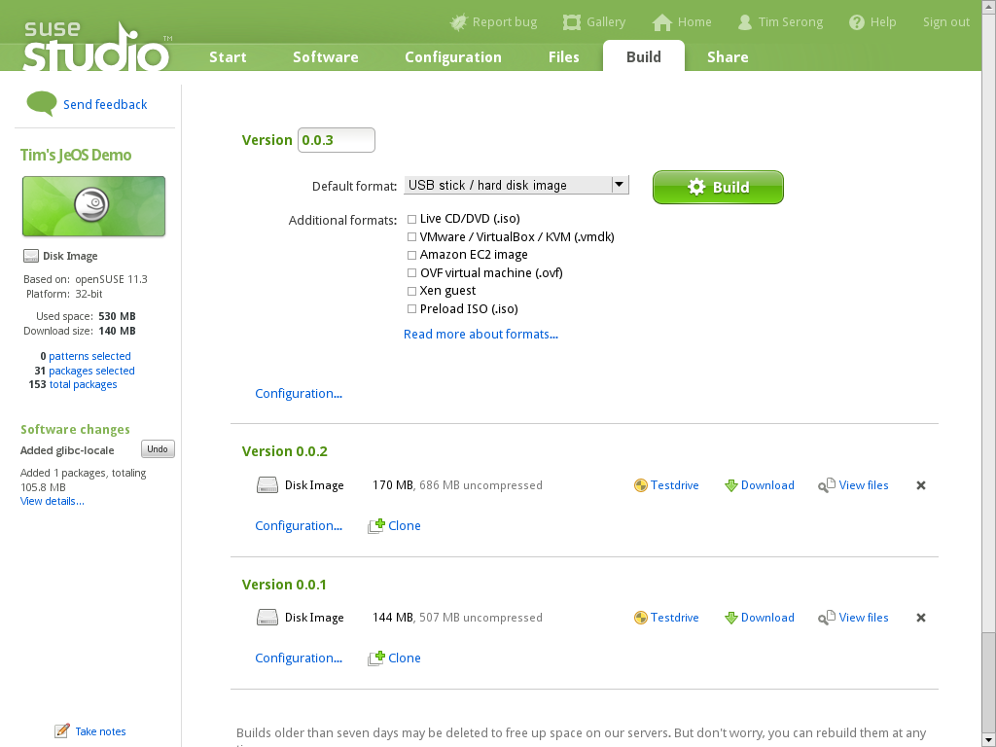
Notes:
Let's rebuild the thing. Note that we can add notes at any point, anywhere, and maintain a changelog. We're lazy so we don't...

Slide 43
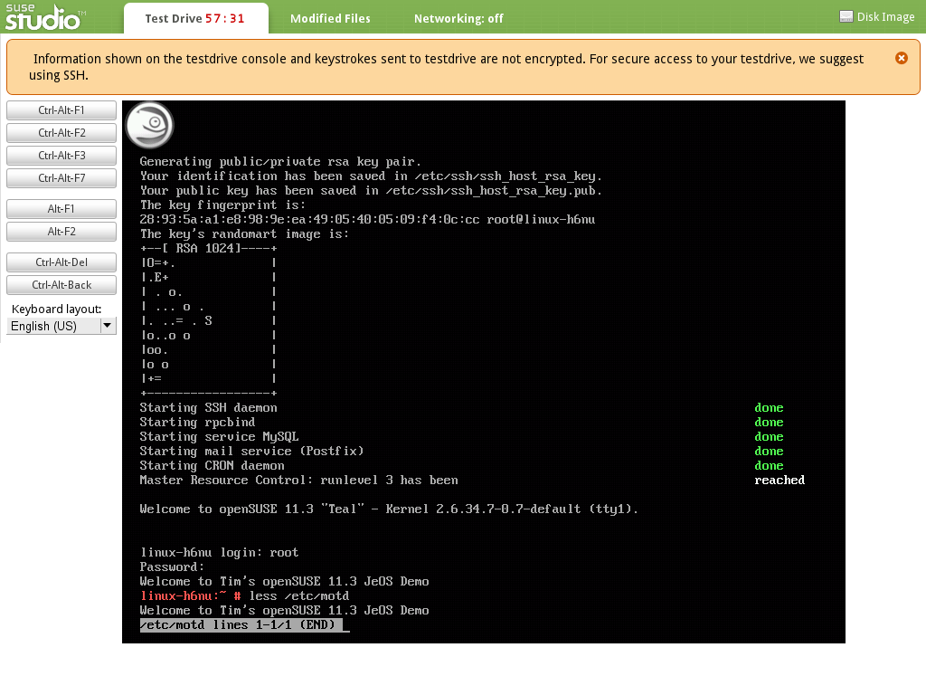
Notes:
File is there, no locale errors, less installed. Much better!

Slide 44
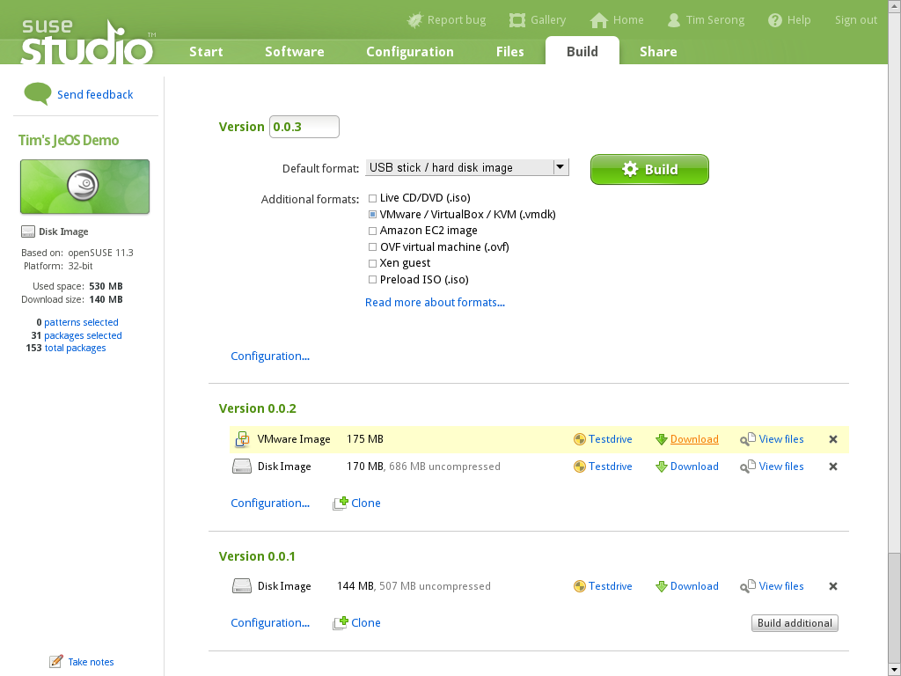
Notes:
Build and download VM so we can have it on our own server and start using it!

Slide 45
Let's Actually Deploy the VM Now...

Slide 46
A Quick Look at SUSE Gallery

Slide 47
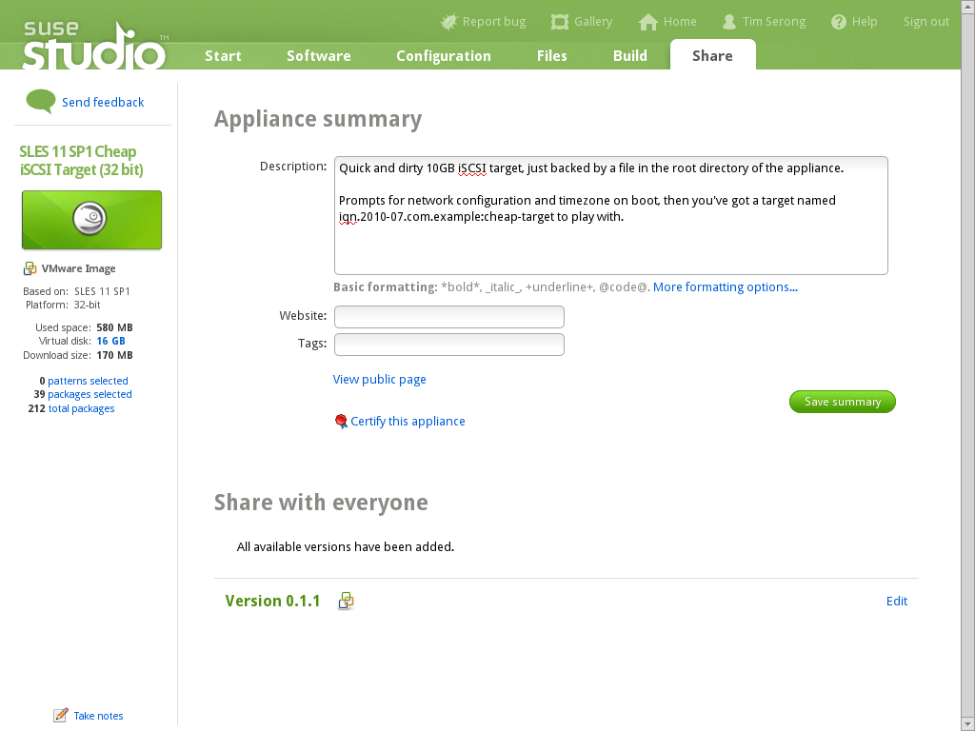
Notes:
Here's what it looks like to share the thing you made.

Slide 48
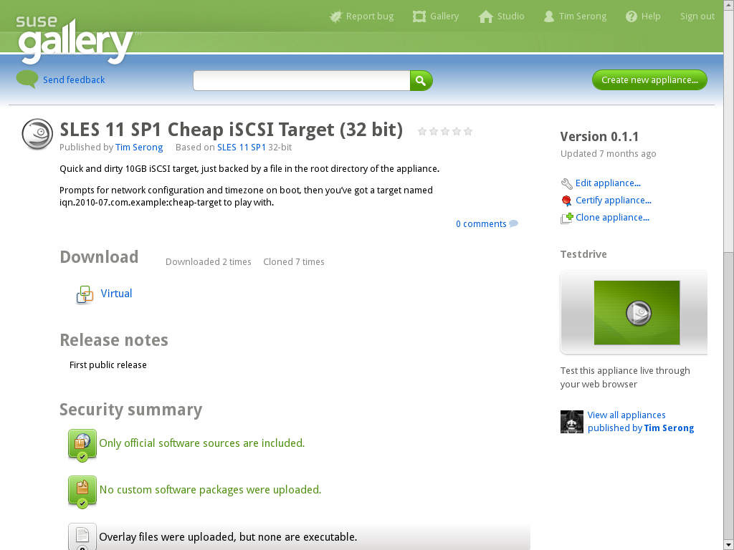
Notes:
Here's what everyone else sees
Note security info

Slide 49
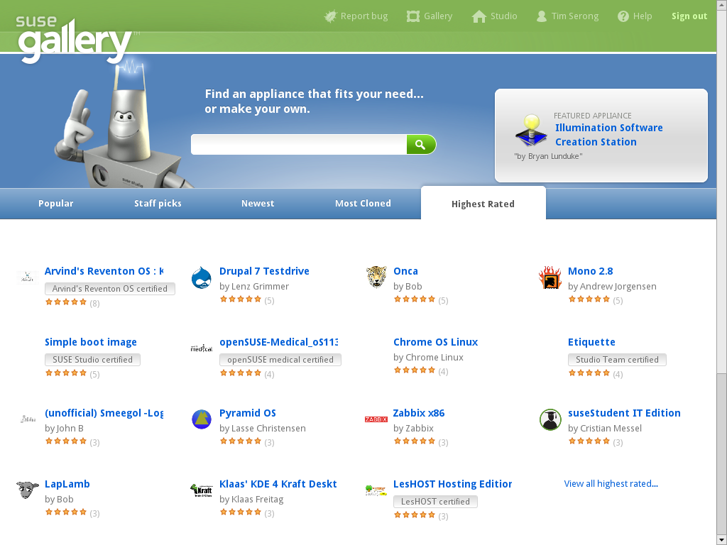
Notes:
Ratings, etc.

Slide 50
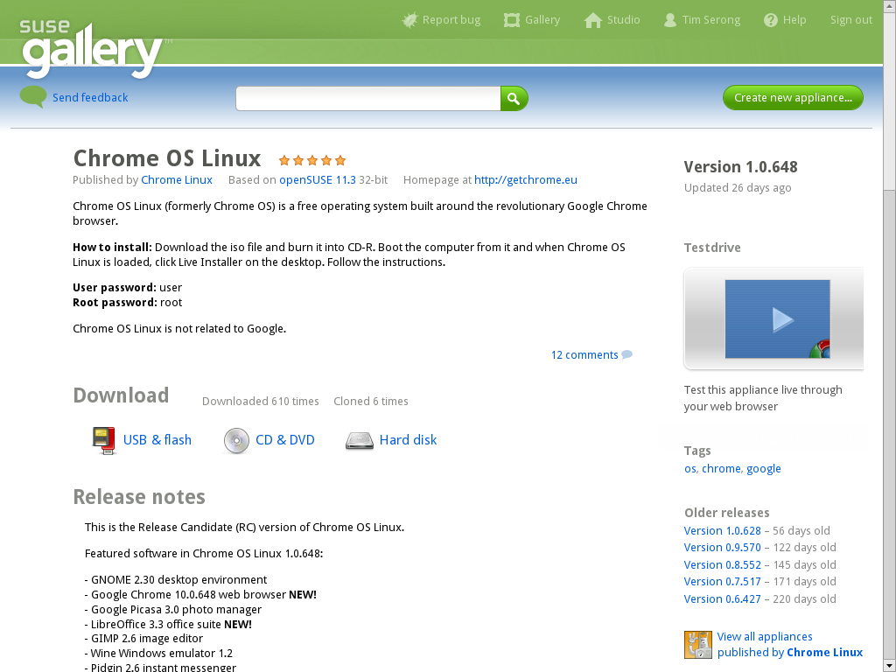
Notes:
e.g.: chrome OS (not the official one)

Slide 51
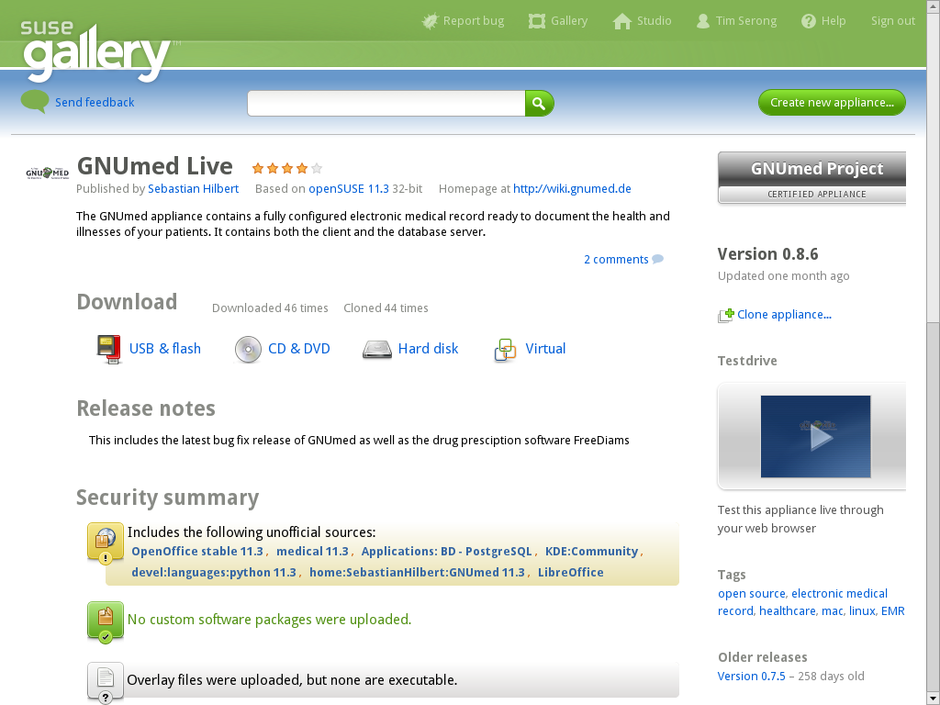
Notes:
And here GNUmed live – yes, anyone can testdrive it or clone it and make changes!

Slide 52
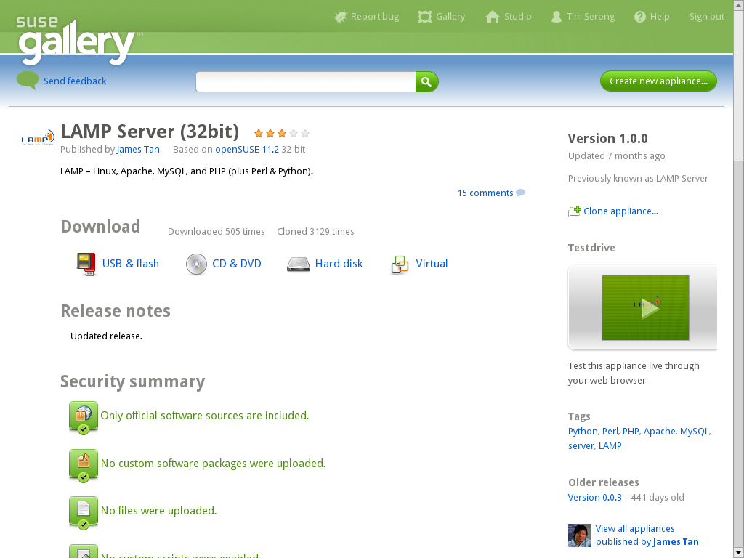
Notes:
Or a super-easy-to-deploy LAMP server.

Slide 53
Any Questions?
Notes:
Yes, I know it was impressive, but you might have questions nonetheless :D

Slide 54
This work is licensed under the Creative Commons Attribution-Noncommercial-Share Alike 2.5 License. To view a copy of this license, visit http://creativecommons.org/licenses/by-nc-sa/2.5/.
For other licenses contact author: Tim Serong, tserong@suse.com

