Slide 1
Trucos y consejos de Dolphin en openSUSE
KDE Akademy Es
Zaragoza 2012
Athanasios – Ilias Rousinopoulos
openSUSE Ambassador
zoumpis@gmail.com
zoumpis @ irc.opensuse.org
http://en.opensuse.org/User:Zoumpis

Slide 2

Dolphin is...
File Manager
KDE4
Icons display
Services
Notes:
While we try to keep things as easy as possible, we don't remove choice.
We ship all the latest desktops and openSUSE features YaST, a graphical tool which offers unique functionality like setting up VM's and webservers, configuring networked printers and advanced security tools.

Slide 3
Services...
Newest
Rating
Installed
Most downloads
Looking for a new one?
Notes:
The Open Build Service is a tool to build packages for ANY linux distribution (or even Windows if you want). It uses a Virtual Machine to cleanly build, has dependency tracking, team collaboration features and is completely useable through an easy to use Web Interface.
If you want to build packages for Fedora, Ubuntu, Mandriva, openSUSE and more – check it out on build.o.o
Of course it is Free Software and you can run your own instance, like Tizen/MeeGo, VLC, Dell and many others do.
BTW, openSUSE recently started an ARM project to port to ARM. We managed to get more than half-way through our packages in 2 weeks or so!

Slide 4
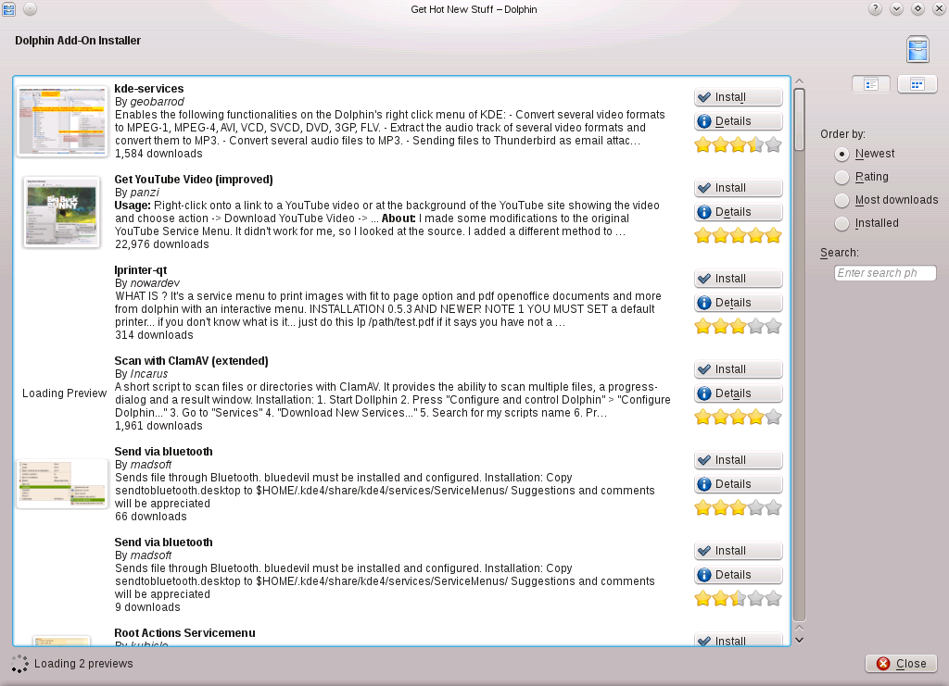
Enable New Service
Browse : Settings → Configure Dolphin → Services → Download New Services
Click “Install” at the service you wish!
Notes:
openQA is a automated testing system which runs daily tests on the openSUSE development tree 'Factory'.
It boots an OS image in a VM, installs the OS, tests some apps and screenshots that whole process. Then it compares the screenshots to reference shots and reports the results.
Of course it is Free Software and can test ANY OS. MS DOS, even, if you want. We maintain it for Fedora, Debian, openBSD and some more.

Slide 5
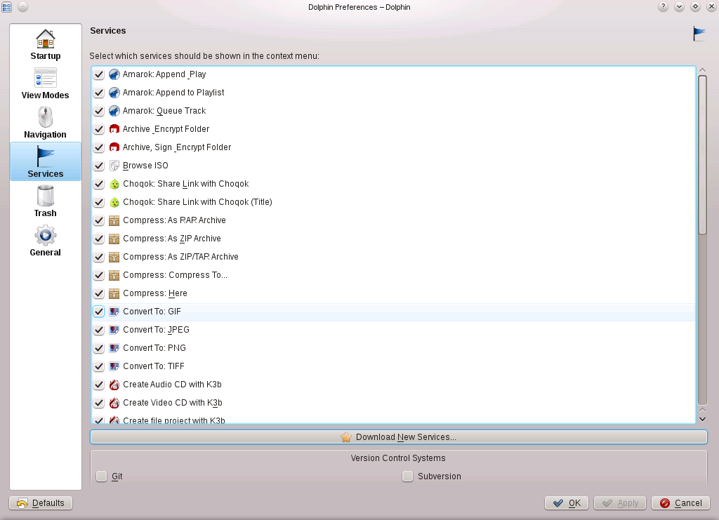
Git plugin
Install the package “dolphin-plugins”
  Sudo zypper install dolphin-plugins

Slide 6

Join the gang
Notes:
... come join us and have fun...
Try openSUSE, Tumbleweed, SUSE Studio, TRY OBS, play with us!

Slide 7
Kitty Image credits
Join the gang: malingering
To be found on Flickr under the above names with a Creative Commons license. Thanks all!

Slide 8
Your next Linux Distribution!

