Slide 1
openSUSE® Mentoring
Get started with Free Software now!
opensuse-project@opensuse.org

Slide 2




Get started with Open Source now!
Interested in Open Source Software and technologies like Linux, Docker, Ruby on Rails or AngularJS?
Apply now for one of our programming stipends!

Slide 3

Google Summer of Code
Programming stipend sponsored by Google
Application deadline: 25. March 2016
Work period: April to August 2016
5500 USD for a successfully completed program

Slide 4

Rails Girls Summer of Code
Stipend to get more women into Open Source
Application deadline: 15. March 2016
Work period: July to September 2016
Up to 1500 USD monthly

Slide 5
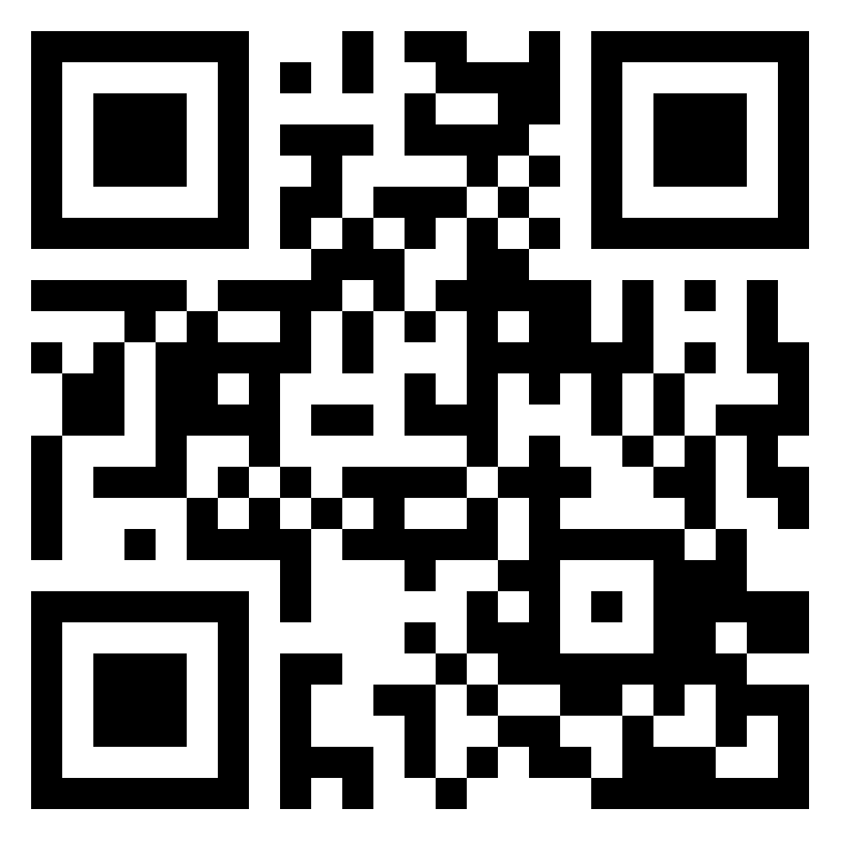
http://bit.ly/opensuse101

