Slide 1
Open Build Service (OBS)
Packager Workshop
Notes:
This workshop is for packagers that want to use the OBS to produce binary packages of their or other peoples sources. Either for personal consumption or as part as a bigger project like a GNU/Linux distribution.
It's an interactive workshop and all you need to know to participate is how to install software on your machine. But don't worry I'm here to help you if you need me. Feel free to ask questions at any time!
After you've completed this workshop you will have learned how to create, build and collaborate on packages in the OBS.

Slide 2



Henne Vogelsang
@henne
hennevogel.de
OBS Developer @SUSE
Notes:
Hi my name is …
I come from...
and I work for …
on the Open Build Service

Slide 3
Adrian Schröter
@henne
hennevogel.de
OBS Developer @SUSE
Notes:
Hi my name is …
I come from...
and I work for …
on the Open Build Service

Slide 4
Michael Schröder
@henne
hennevogel.de
OBS Developer @SUSE
Notes:
Hi my name is …
I come from...
and I work for …
on the Open Build Service

Slide 5
A Packagers OBS Tools
Notes:
So let's start. As you can imagine the OBS is a complex system with a lot of different components. Let me show you what are the most important ones for you as packager.

Slide 6
Components Overview
Hermes
Web UI
Web UI
Command
Line
Client
Your Client
Installer
(YaST,etc.)
OBS API (api.opensuse.org)
Notification
Server
Mirror
Interface
User controller, Database, Search, ...
Storage
Build
Host
Build
Host
Build
Host
Build
Host
Build
Host
Build
Host
Backend
Notes:
This is a schmeatic overview of all the components of the OBS. Below you have the workers who do all the heavy lifting and compiling and the storage component which stores all the data. Both of them are controlled by the backend server which exposes most of it's functionality via the OBS API to different clients.
On the left side you have the notification system and on the right side the mirror interface which delivers the data to the user clients.

Slide 7
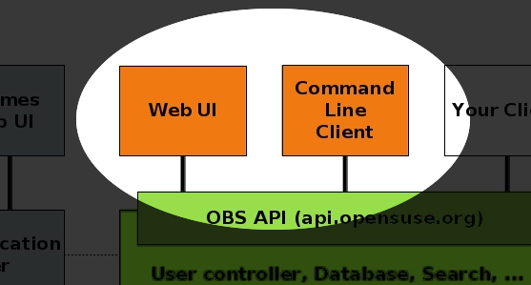
A Packagers OBS Tools
Notes:
As a packager you only come directly in contact with the Web and Commandline client. They are the tools that matter to you.

Slide 8

A Packagers OBS Tools
Reference Server
build.opensuse.org
Notes:
Now of course everyone can run their own Open Build Service. You can download all the components from openbuildservice.org, set up the frontends, API and backend, import the distributions you want to build for and take care of all the nitty gritty details.
Or if you would like to avoid all that you can simply use the reference server the OBS team implements for the openSUSE project at build.opensuse.org
This reference implementation of the OBS is used by almost 30.000 users that are building over 140.000 packages for 21 base distributions on 6 architectures. It also serves as the tool to develop and maintain the openSUSE Distribution.

Slide 9
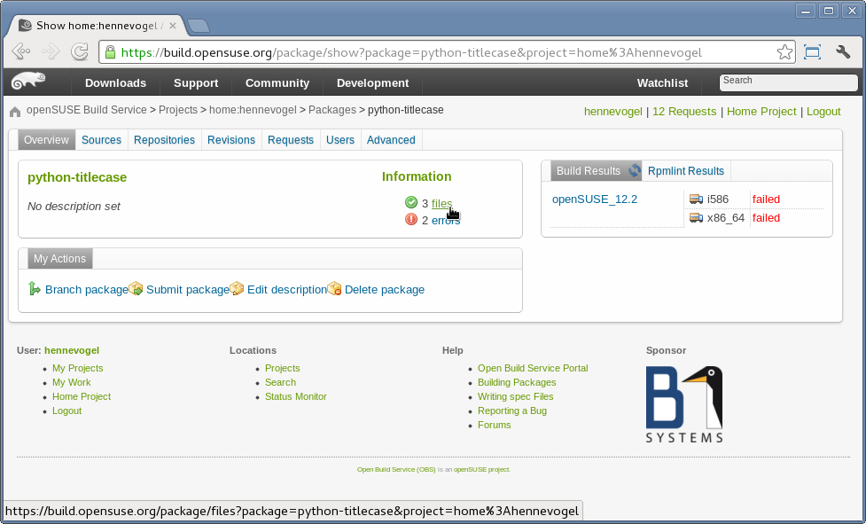
A Packagers OBS Tools
Web Client
Notes:
To work on this reference server you can use your browser and the web client which provides all the functionality you need to create, build and collaborate on packages. The web client is available at build.opensuse.org

Slide 10
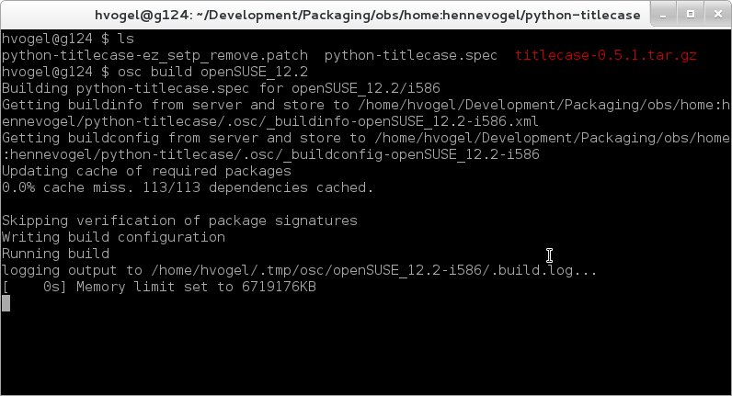
A Packagers OBS Tools osc
http://openbuildservice.org/download
Notes:
Or you can use the command line client OSC which is
a bit more efficient while working on sources and supports local builds to debug failures.
OSC can be downloaded from openbuildservice.org/download and is included in the openSUSE distribution and the SUSE Linux Enterprise SDK.
For this workshop we are going to make heavy use of OSC so please install it now.

Slide 11
Creating Packages
Notes:
The first thing I'm going to show you is how you can create packages in the OBS.

Slide 12
Creating Packages
1
Create a package
in your own home project
on the reference server
Notes:
You're going to learn to create a package in your own project on the reference server

Slide 13
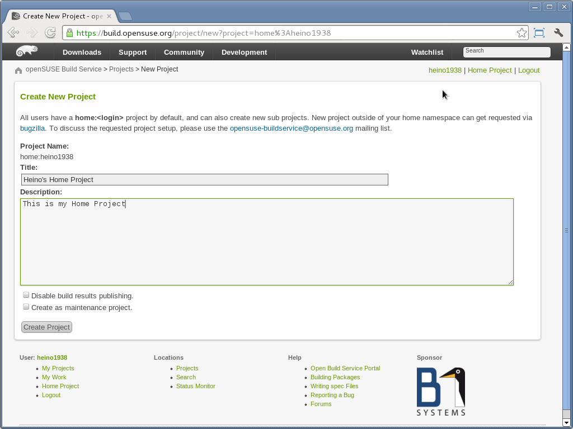
Creating Packages
Create your home project
build.opensuse.org
→ Login
→ Create your home project
Notes:
First let's create your own project. We call this a home: project. Doing this in the web client ist way easier than with OSC so please open a browser and navigate to build.opensuse.org, login/register and create your home project.

Slide 14
Creating Packages
Create a new package
Terminal X
you@laptop $ osc co home:you
A home:you
you@laptop $ cd home:you
you@laptop $ osc mkpac ctris
A ctris
you@laptop $ cd ctris
you@laptop $ vi ctris.spec
Notes:
Now it's time to use the powerfull OSC. Checkout your home project with “osc co”. If you haven't used OSC before it will ask for a username/password. It's of course the same as the one for the web client. After osc has downloaded your home project change dir into it.
There you can create the package you want to build. I'm going to create a package of a tetris like game or the console called ctris. So I call “osc mkpac ctris”, change dir into it and create a RPM specfile.

Slide 15
Creating Packages
Write a specfile
Name: ctris
Summary: Console based Tetris clone
URL: http://www.hackl.dhs.org/ctris/
License: GPL
Group: Amusements/Games/Action/Arcade
Version: 0.42
Release: 1
Source: %{name}-%{version}.tar.bz2
BuildRoot: %{_tmppath}/%{name}-%{version}-build
BuildRequires: ncurses-devel
Requires: ncurses
%description
An ASCII version of the well known game Tetris
%prep
%setup -q
%build
make
%install
make install DESTDIR=$RPM_BUILD_ROOT
%debug_package
%clean
rm -rf $RPM_BUILD_ROOT;
%files
%defattr (-,root,root)
%doc AUTHORS COPYING README TODO
%doc %{_mandir}/man6/ctris.6.gz
/usr/games/ctris
Notes:
Please note that the OBS is not limited to the RPM package manager, it currently also supports the DPKG package manager used by debian based distributions and in the future might even support more systems.
This is a typical RPM spec file. It has a header describing the content of the package, a section on how to build it and a list of included files.

Slide 16
Creating Packages
Create a new package
Terminal X
Terminal X
you@laptop $
you@laptop $ wget -q http://www.hackl.dhs.org/data/download/download.php?file=ctris-0.42.tar.bz2 -O ctris-0.42.tar.bz2
you@laptop $ osc addremove
A ctris.spec
A ctris-0.42.tar.bz2
you@laptop $ osc ci -m “First checkin of the ctris package”
Notes:
Of course I also need to provide the sources for the package somehow. I simply download the tarball from the ctris homepage.
After that is done you just call “osc addremove” which will add all the new files I have created to the package.
Everything you have done up until now is only available on your local machine, let's check the first version of the package into the OBS reference server. Just call “osc ci” and tell people what you have done.
That's it, you have successfully created your first package on the OBS.

Slide 17
Creating Packages
Playtime
Try some stuff on your own:
Import an RPM package with
osc importsrcpkg
Copy an existing package with
osc copypac
Notes:
This is a good time for you to repeat what we have done and to try something on your own. For instance import an RPM source package that you have or copy an already existing package on the OBS. Try out the different options to create packages on the OBS, we'll continue in a short while.

Slide 18
Building Packages
Notes:
After we have created a package let's move on to learn how to build it

Slide 19
Building Packages
2
Build a package
locally on your laptop
and on the reference server
Notes:
I'm going to show you how to build your package, locally on your machine and on the reference server

Slide 20
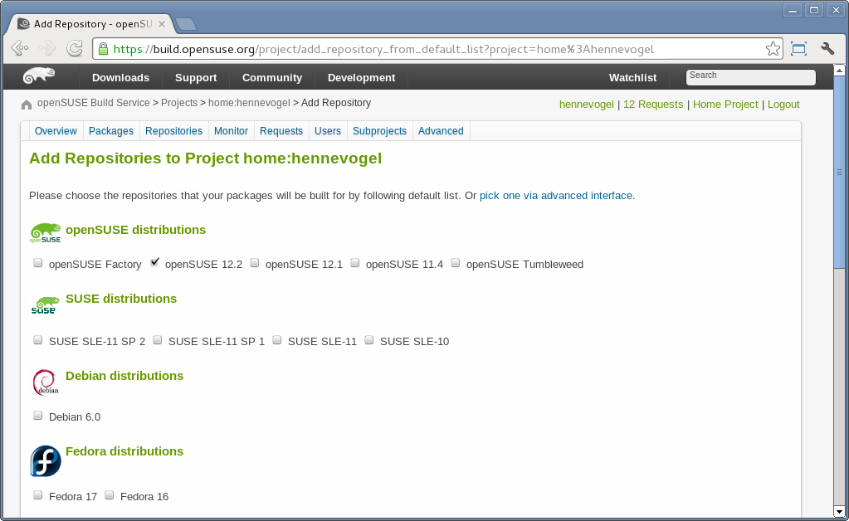
Building Packages
Add Repositories
home:you
→ Repositories
→ Add repositories
Notes:
The first step is to tell the OBS for which repositories we want to build packages in our project. Again we can do that easily with the web client at build.opensuse.org. Just click on the repositories tab and add the repositories you want. For instance openSUSE 12.2 and Fedora 17.

Slide 21
Building Packages
Local Builds
Terminal X
Terminal X
you@laptop $
you@laptop $ osc build
Building ctris.spec for openSUSE_12.2/i586
Getting buildinfo from server and store to /home/you/home:you/ctris/.osc/_buildinfo-openSUSE_12.2-i586.xml
Getting buildconfig from server and store to /home/you/home:you/ctris/.osc/_buildconfig-openSUSE_12.2-i586
Updating cache of required packages
0.0% cache miss. 109/109 dependencies cached.
Verifying integrity of cached packages
using keys from openSUSE:12.2
Writing build configuration
Running build
logging output to /var/tmp/build-root/.build.log...
Notes:
After you have defined repositories to build for you can start a local build on your laptop, by default for the first defined repository.
OSC reads the information and configuration it needs, downloads all the packages that your package needs to build, installs them to a chroot environment, copies your sources to it and starts to build it.
Did you build succeed or did it fail somehow? Let's fix your problems.

Slide 22
Building Packages
Local Builds for foreign distributions
Terminal X
Terminal X
you@laptop $
you@laptop $ osc build Fedora_17
Building ctris.spec for Fedora_17/i586
Getting buildinfo from server and store to /home/heino/home:heino1938/ctris/.osc/_buildinfo-Fedora_17-i586.xml
Getting buildconfig from server and store to /home/heino/home:heino1938/ctris/.osc/_buildconfig-Fedora_17-i586
Updating cache of required packages
0.0% cache miss. 204/204 dependencies cached.
Verifying integrity of cached packages
using keys from Fedora:17
Writing build configuration
Running build
logging output to /var/tmp/build-root/.build.log...
Notes:
Because OSC uses a clean chroot environment and not your currently running OS it's not problem to build for foreign distributions. I, with my openSUSE Laptop, can build for Fedora without a problem. OSC just does the same for Fedora. It reads the information and configuration it needs, downloads all the packages that your package needs to build, installs them to a chroot environment, copies your sources to it and starts to build it.

Slide 23
Building Packages
Checking build results
Terminal X
Terminal X
you@laptop $
you@laptop $ osc results
Fedora_17 i586 failed
Fedora_17 x86_64 failed
openSUSE_12.2 i586 succeeded
openSUSE_12.2 x86_64 succeeded
you@laptop $ osc prjresults
ctris
F Fedora_17 i586 (published)
F Fedora_17 x86_64 (published)
. openSUSE_12.2 i586 (published)
. openSUSE_12.2 x86_64 (published)

Slide 24
Building Packages
Checking build logs
Terminal X
Terminal X
you@laptop $
you@laptop $ osc localbuildlog
you@laptop $ osc remotebuildlog home:you ctris Fedora_17 x86_64

Slide 25
Building Packages
Playtime
Try some stuff on your own:
Examine other projects with
osc pr some:project
Examine the build root with
osc chroot

Slide 26
Collaborating on Packages

Slide 27
Collaborating on Packages
3
Branch a package
Submit a merge request
Review a merge request

Slide 28
Collaborating on Packages
Branching
Terminal X
Terminal X
you@laptop $
you@laptop $ osc branch home:hennevogel ctris
A working copy of the branched package can be checked out with:
osc co home:you:branches:home:hennevogel/ctris
you@laptop $ osc co home:you:branches:home:hennevogel/ctris
A home:you:branches:home:hennevogel
A home:you:branches:home:hennevogel/ctris
A home:you:branches:home:hennevogel/ctris/ctris-0.41.tar.bz2
A home:you:branches:home:hennevogel/ctris/ctris.changes
A home:you:branches:home:hennevogel/ctris/ctris.spec
At revision 2e6f2aea1a884fda8c6e9564c9323ab3.
you@laptop $ cd home:you:branches:home:hennevogel

Slide 29
Collaborating on Packages
Updating
Terminal X
Terminal X
you@laptop $
you@laptop $ vi ctris.spec
you@laptop $ wget -q http://www.hackl.dhs.org/data/download/download.php?file=ctris-0.42.tar.bz2 -O ctris-0.42.tar.bz2
you@laptop $ rm ctris-0.41.tar.bz2
you@laptop $ osc addremove
D ctris-0.41.tar.bz2
A ctris-0.42.tar.bz2

Slide 30
Collaborating on Packages
Testing your changes
Terminal X
Terminal X
you@laptop $
you@laptop $ osc build
you@laptop $ osc ci -m “Update to version 0.42”
you@laptop $ osc results
you@laptop $ osc remotebuildlog home:you:branches:home:hennevogel openSUSE_12.2 i586

Slide 31
Collaborating on Packages
Submitting changes
Terminal X
Terminal X
you@laptop $
you@laptop $ osc submitreq
created request id 0815
you@laptop $ osc request -M
0815 State:new By:you When:2012-08-16T13:21:35
submit: home:you:branches:home:hennevogel/ctris -> home:hennevogel
Descr: Update to version 0.42

Slide 32
Collaborating on Packages
Assess Requests
Terminal X
Terminal X
you@laptop $
hennevogel@work $ osc request list home:hennevogel
0815 State:new By:you When:2012-08-16T13:21:35
submit: home:you:branches:home:hennevogel/ctris -> home:hennevogel
Descr: Update to version 0.42
hennevogel@work $ osc request accept 0815 -m "Thank you for your contribution :-)"
Result of change request state: ok

Slide 33
Collaborating on Packages
Tracking request
Terminal X
Terminal X
you@laptop $
you@laptop $ osc request -M
0815 State:accepted By:hennevogel When:2012-08-16T13:43:04
submit: home:you:branches:home:hennevogel/ctris -> home:hennevogel
From: new(you)
Descr: Update
Comment: Thank you for your contribution :-)

Slide 34
Collaborating on Packages
Playtime
Try some stuff on your own:
Branch/submit a new package with
osc branch -N
Track a request for openSUSE
osc request list openSUSE:Factory

Slide 35
Learn more about the
Open Build Service
www.openbuildservice.org
Notes:
I hope this workshop was worth your time and you picked up how to create, build and collaborate on packages. If you have further questions, suggestions or feedback, don't hesitate to contact me or anyone else from the OBS team. Thank you for your participation!

Slide 36
Slides, Workshops, Screencasts
http://openbuildservice.org/help/materials/

