Slide 1
Open Build Service
Facts, Features, Future
Notes:
This talk is an introduction to the Open Build Service. A generic system to build and distribute binary packages from sources in an automatic, consistent and reproducible way.
You will learn about facts, features and the future of the OBS. But first let me introduce myself

Slide 2

Henne
Vogelsang
@henne
hennevogel.de
Notes:
My name is Henne Vogelsang and I work as OBS developer for SUSE in Nürnberg

Slide 3

Adrian
Schröter
adrian@suse.de
Notes:
My name is Adrian Schröter and I work as OBS developer for SUSE in Nürnberg

Slide 4

Michael
Schröder
mls@suse.de
Notes:
My name is Michael Schröder and I work as OBS developer for SUSE in Nürnberg

Slide 5

Stephan
Kulow
coolo@suse.de
Notes:
My name is Stephan Kulow and I work as OBS developer for SUSE in Nürnberg

Slide 6
Open Build Service
The Long and Short of it
Notes:
So what is the OBS all about? What use is it. Which problem does it solve?
One that sounds rather simple but is actually something that is hard to overcome in an open and free environment.

Slide 7


















Notes:
How do you get all this nice Free and Open Source Software our community produces to the users.
How can I install Gimp, Firefox or Libreoffice if I want to use it.
How can a project like Gimp make sure different people on different architectures, platforms, distributions, get the right stuff.

Slide 8
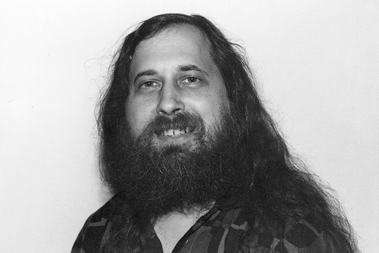
© - usesthis.com - CC-BY-SA 2.5
http://usesthis.com/images/portraits/richard.stallman.jpg
Notes:
In the good ol' days this wasn't really a problem. Everyone was a long haired, bearded, piece lovin' software developer.

Slide 9



010011
Notes:
So developers just released code to their “users” which where also developers.
The “users” compiled the code for their system -> done.
The sun was shining, birds where singing and everybody was happy.

Slide 10

© - Harald Hoyer – CC-BY-SA 3.0
http://en.wikipedia.org/wiki/File:Lennart_Poettering_2012.jpg
Notes:
But nowadays developers are cleanly shaved hipsters

Slide 11

Notes:
and the average computer user knows as much about software development as you know about piloting an airplane.

Slide 12

Notes:
Thats why the FOSS community came up with the concept of packaging.
A developer does not only write the code but also hands it pre-compiled in a “package” to the users.
The user then utilizes a so called package manager to install the packages.

Slide 13





Notes:
For the developer this means that he has now the obligation to produce a lot of packages for a lot of different distributions, versions and architectures.

Slide 14
010011
Notes:
And that is where the build service comes in. It makes it easy for developers to produce packages.

Slide 15
Open Build Service
Meat and Potatoes
Notes:
So now that you know what the Open Build Service is all about, let's explore the fundamental parts of it. Let's have a look at the building blocks of the OBS.

Slide 16

Formats
DEB
RPM
PKGBUILD
Notes:
Packaging formats - The way the individual files are bundled together.
The OBS supports three different package formats. DEB, RPM and PKGBUILD.
This covers the majority of todays Linux distributions.

Slide 17
Distributions
Notes:
Linux distributions - The way individual packages are bundled together.
The OBS supports building for all the major Linux distributions in their various versions and flavours.

Slide 18

Architectures
PPC
ARM
MIPS
X86
IA64
S390
HPPA
Notes:
Instruction Set Architectures (ISA) – The way how to program a computers hardware.
The OBS of course supports the nowadays so popular x86 ISA (Intel/AMD) and it's 64bit variant but also up and coming ISAs like ARMv7/v8.
For the enterprise Linux market the OBS also supports more exotic ISAs like S390(IBM zSeries) or PowerPC.

Slide 19



Output
PACKAGE
DVD
REPOSITORY
IMAGE
Notes:
Output – The way users get your packages.
Sometimes you want to provide individual packages but most likely you bundle packages into a repository.
And you also might want to put repositories onto a DVD or produce a Appliance for your software that you can run in the cloud.
The OBS can deliver all of that.

Slide 20
Open Build Service
Wherewith
Notes:
So now that you know what the Open Build Service does, let's explore the how. Let's have a look at the features of the OBS.

Slide 21
Overview
Hermes
Web UI
Web UI
Command
Line
Client
Your Client
Installer
(YaST,etc.)
OBS API (api.opensuse.org)
Notification
Server
Mirror
Interface
User controller, Database, Search, ...
Storage
Build
Host
Build
Host
Build
Host
Build
Host
Build
Host
Build
Host
Backend
Notes:
This is a schmeatic overview of all the components of the OBS. Below you have the workers who do all the heavy lifting and compiling and the storage component which stores all the data. Both of them are controlled by the backend server which exposes most of it's functionality via the OBS API to different clients.
On the left side you have the notification system and on the right side the mirror interface which delivers the data to the user clients.

Slide 22
Project Model
Applications:Popular
openSUSE_12.3
OFFICE
Fedora_18
GIMP
Firefox
Notes:
The main organizational element of the OBS are projects. Projects contain a set of packages (sources) and define which distributions and architectures to build against.

Slide 23
Project Model
openSUSE:12.3
Applications:Popular
standard
openSUSE_12.3
Fedora_18
Fedora:18
standard
build with
Notes:
Projects are stackable. That means a project can build against other projects.
So for the OBS all the supported distributions I showed you, are just another project.

Slide 24
Project Model
openSUSE:12.3
openSUSE:12.3
standard
standard
build for
X86
X86_64
Notes:
Projects are stackable. That means a project can build against other projects.
So for the OBS all the supported distributions I showed you, are just another project.

Slide 25

Collaboration
SUBMIT
FORK
FIX
Notes:
This project model allows us to provide all the tools to work collaboratively and harness the power of the open source development model.
Fork – Fix – Submit just feels natual for every open source developer.

Slide 26
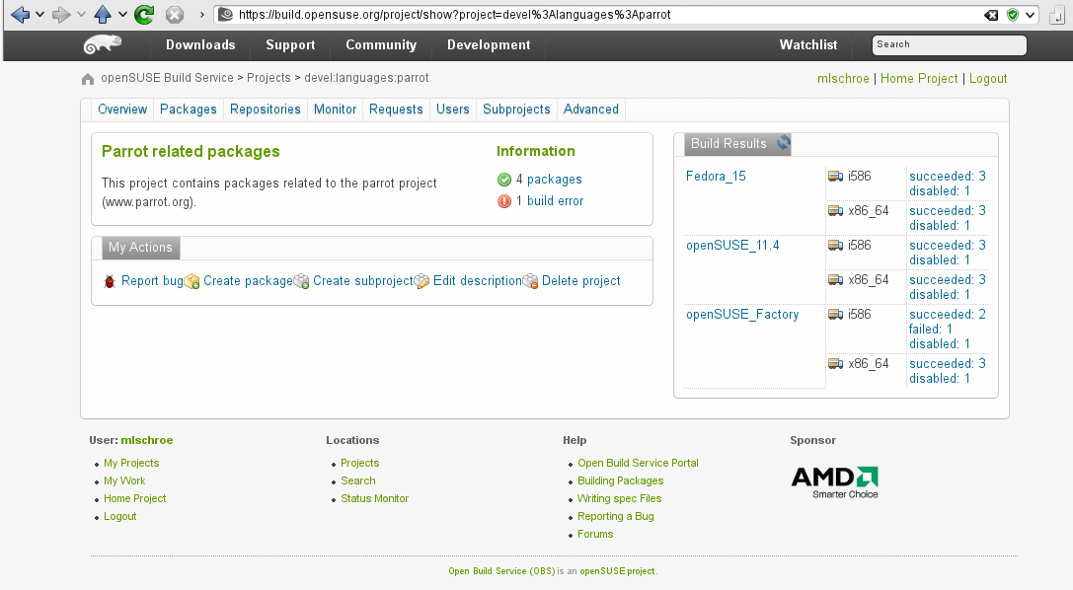
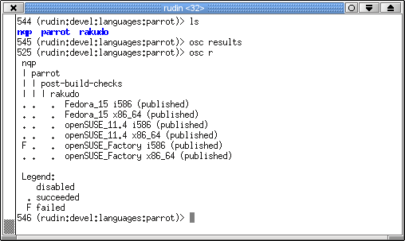
API
Notes:
Another cool feature of the Open Build Service is it's RESTFul API and various clients that connect to it. For instance the web interface I kept showing you commands the OBS over the API, so does the commandline client, the mobile client and various other applications.

Slide 27

Interconnect
Notes:
The API also makes it possible to access remote OBS instances. We call this interconnect.
You can have different OBS instances for different architectures or distributions. You could have proprietary sources that must not leave the company built against a public distribution.
All the collaboration tools also work with interconnected OBS instances.
For instance, our reference server for the openSUSE project, build.opensuse.org, has connections from 90 other instances.

Slide 28
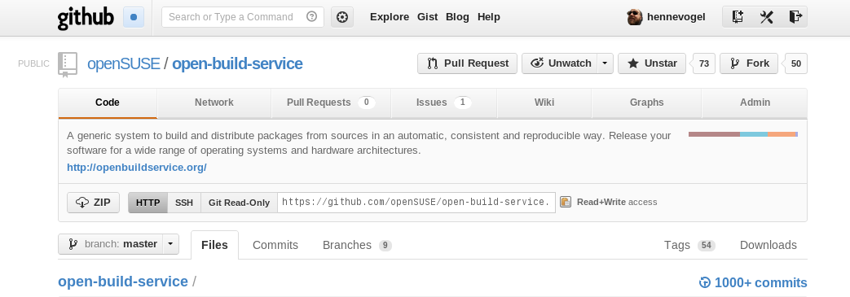
Open Source
Notes:
And of course the Open Build Service is free software licensed under the GNU General Public License (GPL). It’s available for you as source, packages and as easily deployable appliance. You are free to use, fix, extend and re-use the code.

Slide 29
Open Build Service
Who is using it?
Notes:
That are the main features of the OBS. Let's look at how we are developing it and who is using it.

Slide 30

Reference Server
build.opensuse.org
Notes:
Now of course everyone can run their own Open Build Service. You can download all the components from openbuildservice.org, set up the frontends, API and backend, import the distributions you want to build for and take care of all the nitty gritty details.
Or if you would like to avoid all that you can simply use the reference server the OBS team implements for the openSUSE project at build.opensuse.org
This reference implementation of the OBS is used by almost 30.000 users that are building over 140.000 packages for 21 base distributions on 6 architectures. It also serves as the tool to develop and maintain the openSUSE Distribution.

Slide 31
Users
Notes:
There is one open source project, openSUSE, and one Enterprise Linux company, SUSE, that is using the OBS to develop their complete distributions.
They also deliver maintenance updates through it.

Slide 32









Users
Distribution development, Maintenance Updates
Open Source Communities
Add-Ons: Driver Developer and ISVs
Researchers/Universities
Administration Teams

Slide 33
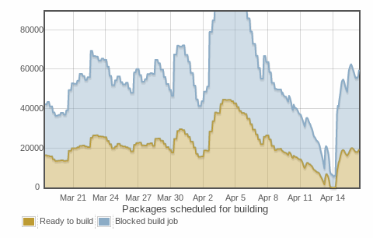
Numbers (from build.opensuse.org)
Confirmed Users: >35.000
Packages: >205.000
Projects: >2.500
Package builds per day: > 51000
  Build farm: ~40 hosts,
  ~250 workers
Storage:
  Sources: 3.3 TBytes
  Binaries: 6.9 TBytes

Slide 34


Support
Community
  opensuse-buildservice@opensuse.org
  Irc: #opensuse-buildservice on freenode
Professional
  http://www.open-build-service.org/contact/
  B1 Systems (L3 backing by SUSE)

Slide 35
Open Build Service Features
Where is it going?
Notes:
So now that you know what the Open Build Service does, let's explore the how. Let's have a look at the features of the OBS.

Slide 36
Future
2.4 Release (mid of 2013)
  Build Capabilities
  Transparent Cross Compiling (by B1-Systems)
  Reworked User Management
2.5 Release (end of 2013)
  Product Tracking
3.0 Release (???)
  On site support
  Merged API/Web-UI
  More package formats, other operating systems

Slide 37
Learn more about the
Open Build Service
www.openbuildservice.org
Notes:
I hope this workshop was worth your time and you picked up how to create, build and collaborate on packages. If you have further questions, suggestions or feedback, don't hesitate to contact me or anyone else from the OBS team. Thank you for your participation!

