Slide 1
Open Build Service (OBS)
Facts, Features, Future
Notes:
Hi my name is … and I work for … on the Open Build Service
This workshop is for packagers that want to use the OBS to produce binary packages of their or other peoples sources. Either for personal consumption or as part as a bigger project like a GNU/Linux distribution.
It's an interactive workshop and all you need to know to participate is how to install software on your machine. But don't worry I'm here to help you if you need me. Feel free to ask questions at any time!
After you've completed this workshop you will have learned how to create, build and collaborate on packages in the OBS.

Slide 2
OBS History
Created in 2005 as a rewrite of SUSE's internal autobuild system
  Goals: transparency, flexibility, openness
  First presented at FOSDEM 2006
2010: OBS-2.0 with features for the MeeGo project
2011: OBS-2.1 with workflow features for openSUSE source handling
Current Release: OBS-2.3
  Support for maintenance updates

Slide 3
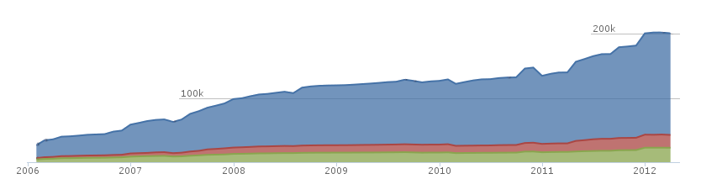
Development
Licensed under GPLv2
  https://github.com/openSUSE/open-build-service/
Lines of Code: > 150000
  Perl/Python/Ruby
Mostly maintained by SUSE, but many contributions
from community members & other companies

Slide 4











Example Users
Distribution development, Maintenance Updates
Open Source Communities
Add-Ons: Driver Developer and ISVs
Researchers/Universities
Administration Teams

Slide 5
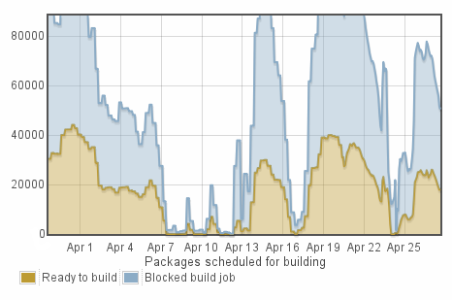
Numbers (from build.opensuse.org)
Confirmed Users: >32000
Package builds per day: > 51000
  Build farm: 38 hosts,
  310 workers
Storage:
  Sources: 3.3 TBytes
  Binaries: 6.9 TBytes

Slide 6
Features
Multiple distributions, multiple architectures
  rpm, deb, archlinux, image creation
Sand-boxed builds (kvm/xen) on a build farm
Easy branching with automatic merges
Continuous Integration
  Automatic rebuilds on changes (both source and build packages), automatic ordering of builds
  Consistent, reproducible builds

Slide 7
User Interface
REST based API, so multiple interfaces can co-exist
Web UI
  Great to get an overview of a project
  Simple package fixes
OSC command line client
  Works like an SCM system (svn, git)
  Supports local builds for testing

Slide 8
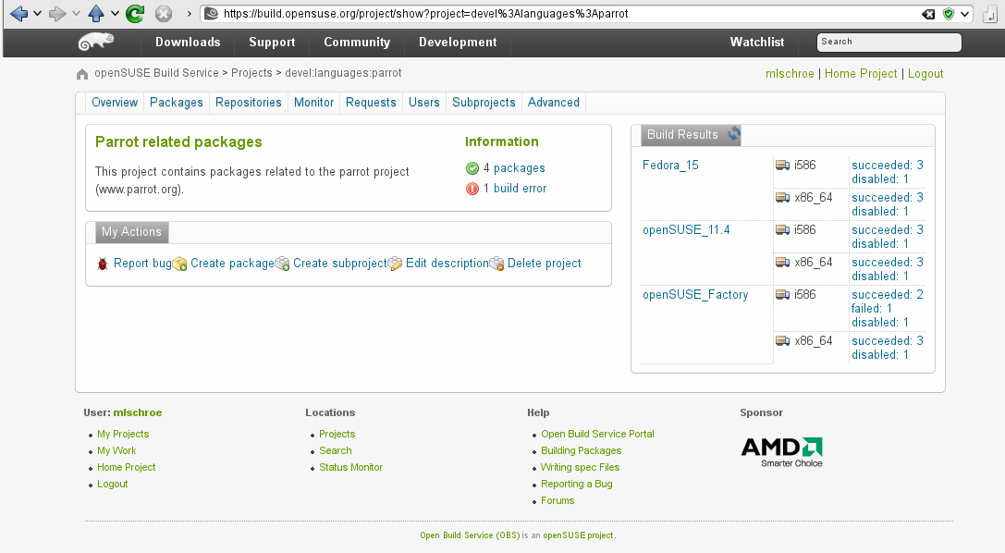
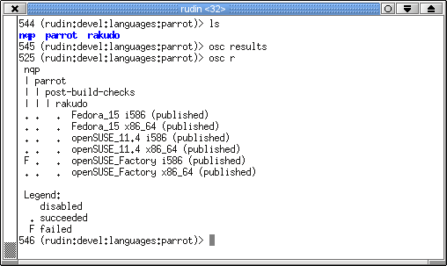
User Interface

Slide 9
Build Service Projects
Main organizational element: projects
  Contains a set of packages with sources
  Defines which repositories and architectures to build
  Defines access control
devel:languages:parrot
parrot
openSUSE_Factory
nqp
Fedora_15
rakudo

Slide 10
Build Service Projects
Repositories can build on top of other projects' repositories
  The “base” distributions are good examples
openSUSE:Factory
devel:languages:parrot
standard
openSUSE_Factory
Fedora_15
Fedora:15
standard
build with

Slide 11
Collaboration
Like SCM if multiple people have write access
Otherwise, create a branch:
devel:languages:parrot
home:mlschroe:myparrot
parrot
rakudo
nqp
rakudo
Source link

Slide 12
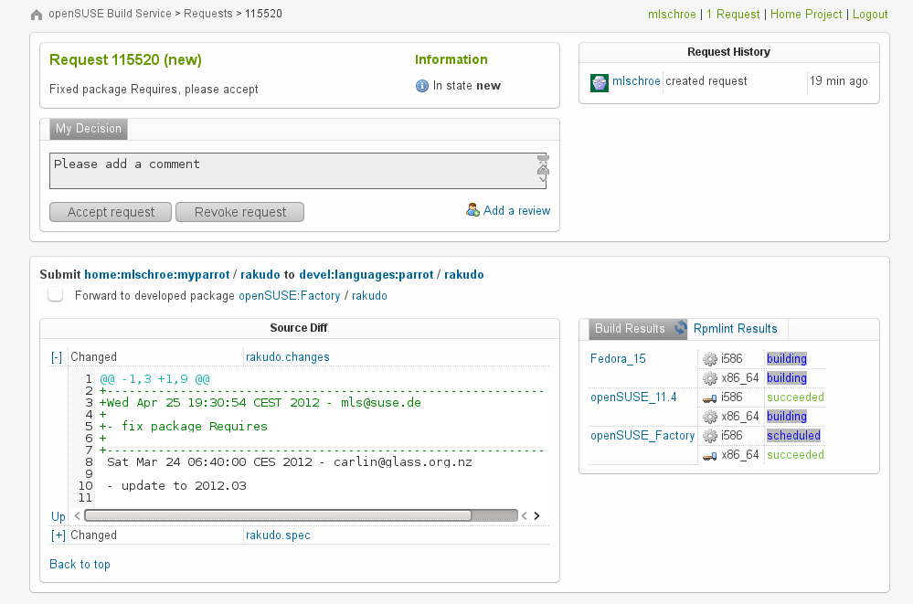
Collaboration
If you're done, ask to
merge your changes
with a “submit request”
Notification through mail
osc, Web UI

Slide 13
Interconnect
Access Sources and Binaries of a remote OBS instance
  Support different architectures and distributions
  Proprietary sources that must not leave the company
Remote Instance is “mounted” in the project space
  Source and binary package caching
  Automatic merging & rebuilds also work with remote data
build.opensuse.org: connections from 90 other instances

Slide 14

Support
Community
  opensuse-buildservice@opensuse.org
  Irc: #opensuse-buildservice on freenode
Professional
  http://www.open-build-service.org/contact/
  B1 Systems (L3 backing by SUSE)

Slide 15
Future
2.5 Release
  Due end of this year
  Product content tracking
  Cross build (implemented by B1-Systems)
2.6 Release
  Improved QA integration
  More package formats, other operating systems

Slide 16
Learn more about the
Open Build Service
www.openbuildservice.org
Notes:
I hope this workshop was worth your time and you picked up how to create, build and collaborate on packages. If you have further questions, suggestions or feedback, don't hesitate to contact me or anyone else from the OBS team. Thank you for your participation!

