Slide 1
- mainly Linux guests (but consider Windows)
- support large servers (x86_64), NUMA, large VM memory sizes (TB ranges)
- both BIOS and UEFI virtual firmware, basic VM lifecycle, live migration
- hugetlbfs for the large VMs
- shared storage only (NFS, iSCSI, FC, NVMe/TCP), no local storage
- networking just consumed as configured, vlans to separate VM groups and mgmt
- Offer a REST API, to write clients, automation, and custom add-ons
- brutally simple to configure and deploy
Requirements

Slide 2
- federation of peers: all KVM nodes are equal
- inventory service: search and filter hosts and VMs in the whole cluster
- REST API service: all nodes can be used as VIRTX_API_SERVER
- NUMA pre-placement: simple on/off switch, compatible with live migration
- storage: provision and de-provision virtual disks and LUNs passed directly to VM
- resource accounting: (MhZ, MiB). Similar to vmware concept.
- simple command line client using API.
- basic host failover
Desired Features

Slide 3

6
virtx
virtxd
serf
libvirt
3
9
virtxd
virtxd
VM Inventory
vmid | hostid
... | ...
1 | 20
libvirt
Shared Storage
libvirt
serf
17
13
virtxd
virtxd
20
libvirt
virtxd
libvirt
serf
serf
libvirt

Slide 4
Serf: cluster membership and distribution of events, + network-based health check
SWIM (Scalable Weakly-consistent Infection-style Membership) https://en.wikipedia.org/wiki/SWIM_Protocol shared storage: register for VMs and hosts, sanlock lockspace and lock files, vdisks sanlock: manage shared lockspace for both vdisks and luns + storage-based health ck virtxd: serves the REST API, comms with serf and libvirt to execute the requests virtx client: connects to virtxd api server for REST ops libvirt: runs the VMs with QEMU, hugepages-aware placement via numa-preplace https://www.youtube.com/watch?v=cnINrLWWFao
Architecture

Slide 5
Shared Storage
NFS Datastore /vms/ds
NFS Datastore… /vms/ds/d2
Cloud Init ISOs /vms/ds/ci
Lockspace /vms/lock/__vx__
VM / Host register /vms/xml
Lockfile /vms/lock/ID/ID LVB
virtxd
sanlock
lockman
storage
vmreg
hypervisor
inventory
serfcomm
HI
Serf Agent
systeminfo (host)
VI/VE
systeminfo (vms)
vmdef
ME
numa-preplace
libvirt
xml
||||| HOST / OS O

Slide 6
Architecture Advantages
- simple automation of the KVM host deployment (out of scope of VirtX): all KVM hosts are from the cluster perspective identical. Main application is one binary.
- debuggable, can reason on the events and the sanlock leases on shared storage. Storage is the final arbiter of correctness, and self-fencing helps avoid split-brain. No etcd, complex database, scheduler or complex control plane to debug.
- no minimum number of hosts or dedicated infra nodes, the deployment can scale down to 1. REST API makes it very easy to interact with the cluster, contacting any arbitrary host.
- Libvirt and vmreg redundancy: leveraging the libvirt per-host register provides a backup for the central vmreg (...and vice versa).
- scope is mostly limited to compute, no complex storage or network abstraction layers to reconcile. Storage is passed as-is to the VMs, whose management is delegated to dedicated external storage infra. Similar with Networks.

Slide 7
Architecture Disadvantages
- no real workload scheduler. Workloads are assumed to be mostly static. Workload assignment is mostly manual.
- serf cluster is only “eventually consistent”, does not have strong consistency.
Failed requests should be retried.
- parallelism: any backend op that affects shared resources needs careful development (vmreg access, lock space initialization or storage resource lease creation…) to avoid race conditions, conflicts, data corruption.
- shared storage is critical – everything relies on it, so if shared storage is not accessible, the whole cluster is not operational.
- no real multi-tenancy model, or API split.

Slide 8
Architecture Unknowns
- scalability: needs to be tested. Should be ok in theory for the assumed limit of ~10000 Vms (100 hosts x 100 VMs), but it as yet unproven.
- ecosystem: none. Large consolidated platforms have connectors and drivers for measurements, automation, deployment, etc. Nothing exists yet for VirtX.
- sanlock locking and self-fencing: locking needs more testing and validation, and the fencing aspects are still to be carefully considered.
- VirtX is still at the prototype stage, no commercial support.

Slide 9
VirtX API is a REST OpenAPI 3.1 specification, maintained as a single openapi-3.1.yaml file.
The API is turned into a set of Go data types called the “model”, using: https://github.com/openapitools/openapi-generator-cli with this incantation: java -jar openapi-generator-cli.jar generate --type-mappings integer+int16=int16 \
--additional-properties=generateMarshalJSON=false,generateUnmarshalJSON=false \
-o client/ -g go -i openapi-3.1.yaml -t templates/
and some customization templates in templates/ after code generation, the model files are extracted to the virtx pkg/model.
There is a small adapter layer in pkg/model/virtx_model.go that extends some of these types with additional methods, mainly .String() and .Parse() to convert to and from a string form.
REST API

Slide 10
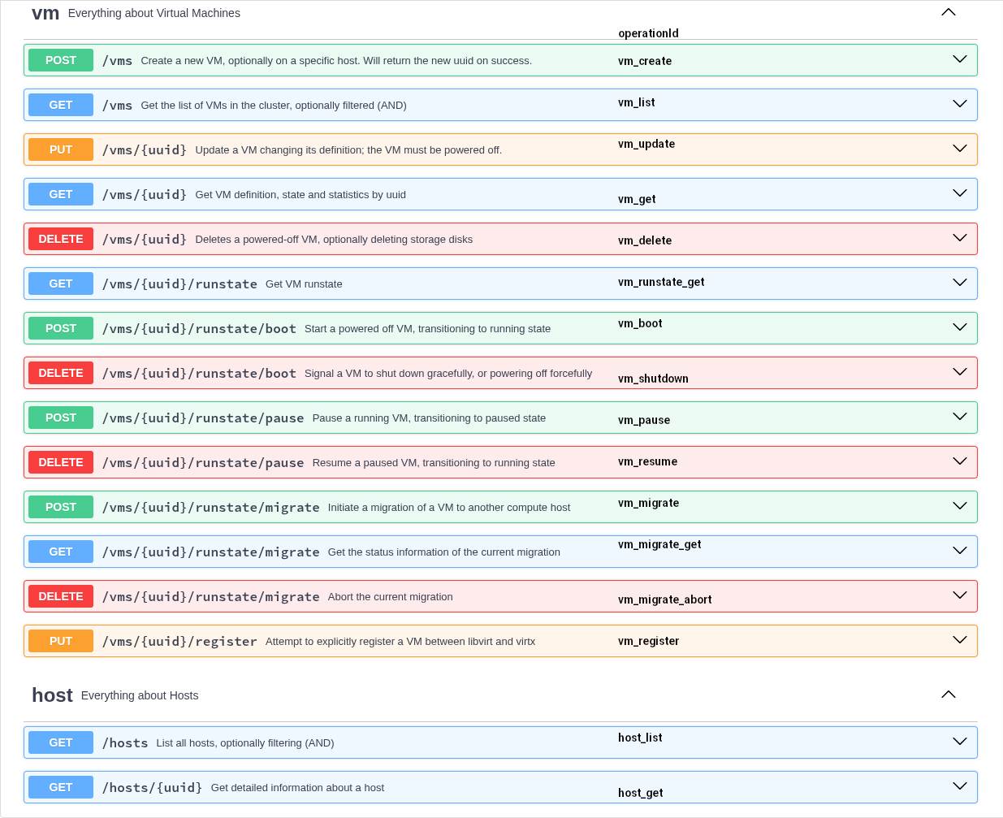

Slide 11
How VirtX calculates KVM Host-level statistics: virtxd collects system information (“system_info”).
System_info includes:
”immutable” host info, only collected once, refreshed only on virtxd restart.
”mutable” host info, refetched at every system_info_loop (15 sec)
Host info: dmidecode UUID, firmware version, date, OS ID and version, hostname, cpufreq/cpuinfo_max_freq, cpu arch, vendor, model, nodes, sockets, cores, threads, tsc freq, sanlock hostid, default hugepage size.
Host resources: Normal Memory MiB, Huge Pages (hugetlbfs) MiB, CPU MHz
Resource fields: Total, Used, Free, ReservedVMs, UsedVMs, UsedOS, AvailableVMs
KVM Host statistics

Slide 12
Host resources: Normal Memory MiB, Huge Pages (hugetlbfs) MiB, CPU MHz
Resource fields: Total, Used, Free, ReservedVMs, UsedVMs, UsedOS, AvailableVMs
HP: /proc/meminfo “HugePages_Total”, “HugePages_Free”, “Hugepagesize"(Total, Free, Used)
Mem total: libvirt, Free: libvirt, sysconf(_SC_AVPHYS_PAGES) or numa_node_size64()
ReservedVMs, UsedVMs: total_memory_capacity and used (sum of all vms)
AvailableVMs: Total – ReservedVMs – UsedOS
CPU total: nodes * sockets * cores * threads * max_freq MHz
Idle counters unreliable: Free calculated by difference
ReservedVMs: ((vcpus * max_freq) / 100.0) * vcpu_load_factor MHz
Used (libvirt): kernel_ns / (interval * 1000000) * max_freq MHz (+ iowait_ns + user_ns)
(libvirt “kernel_ns” = sys + irq + softirq, user = usr + nice)
Free = Total – Used MHz
UsedVMs: (sum_vms_cpu_utilization * max_freq / 100) MHz
UsedOS = Used – UsedVMs MHz
AvailableVMs: Total – ReservedVMs – UsedOS MHz
KVM Host resources

Slide 13
vms info, also refetched at every system_info_loop domain info: uuid, name, runstate stats: disk capacity, allocation, physical (MiB), net bandwidth (KiB/s), vcpus, cpu utilization (% CPU) -> MHz Used, VM memory capacity (/hp), “Used” (RSS MiB)
Some stats are calculated by difference with previous loop iteration: var udelta uint64 = Counter_delta_uint64(vm.cpu_time, old.cpu_time) vm.stats.CpuUtilization = int32((udelta * 100) / (uint64(vm.Ts - old.Ts) * 1000000)) vm.stats.MhzUsed = vm.stats.CpuUtilization * int32(imm.info.MHz) / 100 var delta int64 = Counter_delta_int64(vm.net_rx, old.net_rx) vm.stats.NetRxBw = int32((delta * 1000) / ((vm.Ts - old.Ts) * KiB))
VM statistics

Slide 14
We currently have a distributed cooperative locking, used to govern access to managed storage resources (“disks”, ie virtual disks on NFS, or LUN devices).
Disks in VirtX are managed or unmanaged. Unmanaged disks are not locked by VirtX.
For Managed Disks the goals are: libvirt and virtxd cooperation: libvirt and virtxd need to coordinate so they are both aware of the state of disks and whether they are currently in use (locked). virtxd (de-)provisioning: VirtX takes care of preparing a disk for use, creating it if necessary or taking over an existing disk. When a VM is deleted, VirtX can optionally also de-provision the managed disks.
VM disk ownership: each VM fully owns its managed disks. This means that two VMs cannot use the same managed disk, even if the other VM is shutdown. No “ping-pong”.
Locking in VirtX

Slide 15
libvirt does not offer a public locking API.
It has an internal API with two drivers (lockd, sanlock). Lockd is for internal use (virtlockd).
By using sanlock referring to the same lockspace and resources we solve the problem for the major part, with some edge case caveats.
VirtX will create a resource file (paxos lease file) any time it provisions a new managed disk, and it will delete the resource file when it de-provisions the managed disk.
VirtX will add <lease> elements to the libvirt XML definition of the VM referring to the correct lockspace, resource key and resource path, so that libvirt can acquire the lease on the resource.
This way, VirtX and libvirt can coordinate on when a resource is accessible.
Locking in VirtX: libvirt cooperation

Slide 16
On startup, virtxd checks if the lockspace delta lease file is already existing and properly initialized; if not, it will create a temporary directory, fully initialize the delta lease file, and then attempt a rename operation to the empty final destination directory, so that parallel attempts to initialize are captured by EEXIST or ENOTEMPTY on the rename.
Then it instructs the local sanlock daemon to join the lockspace if not already joined, identifying the host with a unique host_id to be marked in the shared delta lease file.
This host_id can be mapped initially from the host uuid to a (1-2000) host_id, and on collision a linear search of the space is done to find a free slot. Once the lockspace is successfully joined, the host_id is cached in vmreg for future use. It can also be “manually” configured in the cache if desired.
New resource creation (paxos lease file) use the same algorithm with the final rename as per delta lease files, to ensure that a resource file is either visible and fully initialized, or not visible (never visible with partly-initialized contents).
Locking in VirtX: initialization

Slide 17
When a VM is newly created or updated, all disks that are marked as MANAGED go through a provisioning step. a resource is created and acquired for each of those disks, and is initialized with a LVB (lock value block) containing the UUID of the owning VM.
For virtual disks, VirtX will optionally create a new disk (qemu-img create), .qcow2 or .raw are supported, or it can claim existing disks. The disk can be marked as “thin” or “thick” and will be provisioned accordingly, or for existing disks, the provisioning mode is detected.
For LUNs, VirtX will attempt to efficiently clear the disk, using blkdiscard if supported, or wipefs and dd. The provisioning mode cannot be reliably set and currently not even detected from VirtX in all cases (* improvement).
After the disk is fully provisioned, the resource lease will be released.
For de-provisioning, it is all very similar, with the disk being optionally deleted / wiped, and the resource lease file deleted, all while holding the lease.
Locking in VirtX: provisioning and de-provisioning

Slide 18
The LVB of each resource file contains the UUID of the owning VM.
This is checked under lease each time VirtX attempts to acquire the lease, and if the UUID does not match the VM for which it is executing the action, it will immediately fail and release the lease.
This makes it possible to implement the ownership concept, and also helps provide better error messages for problem solving (“cannot acquire lease: disk is owned by VM xxxxxx”).
This concept is not present in libvirt.
If we create or update a VM in VirtX with the same managed disk owned by another VM we catch the issue there, so it should not be a problem in most cases, as long as any access to libvirt is mediated by VirtX. But having libvirt native support would make it more reliable.
Locking in VirtX: VM disk ownership

Slide 19
https://github.com/openSUSE/virtx - OpenSUSE public project
API still unstable. Some immediately actionable missing items:
- test infrastructure (mainly to avoid regressions) - ongoing
- better networking (vlan) support
- Gold Images support of some kind
- better live migration statistics
- security review, API security
- VM resource reservation/limits and enforcement
- console access via API (text, vnc)
- minimal failover and fencing support on host failure
- Some external UI (maybe a cockpit plugin)?
- VM import jobs (from VMWare, other libvirt/QEMU platforms?)
Implementation

