Slide 1
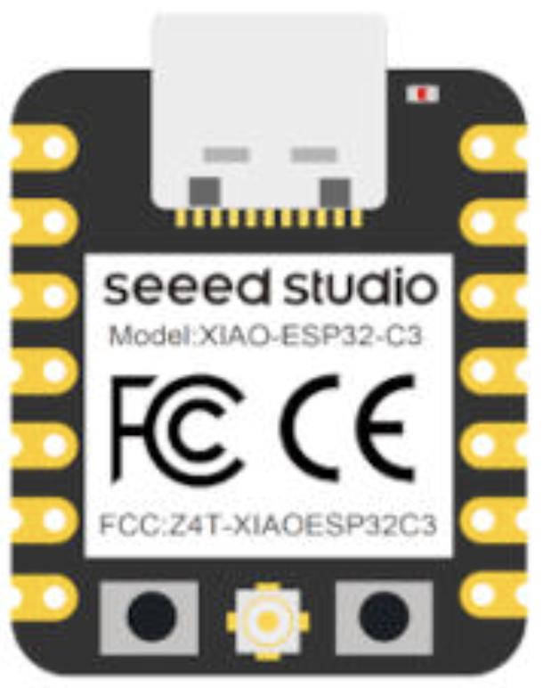
Smartphone / laptop
Browser at 192.168.4.1
WiFi AP
XIAO ESP32-C3
Web server + sweep controller + ADC readout
SPI (D7, D8, D10)
D6
I2C (D4, D5)
ADF4351
NeoPixel LEDs
TSL2591
Frequency synthesiser
Light sensor (IR)
2.2–4.4 GHz
red fluorescence
Optical bench (openUC2 modular cubes)
Green laser
excitation
NV diamond
Dichroic
532 nm
on microwave antenna
beam splitter
~100 µm
microwave drive
Measurement flow (SSE streaming)
Set frequency
PLL settle
Read IR
Stream SSE
Plot
Repeat for each frequency step (f_begin → f_end)

