Slide 1
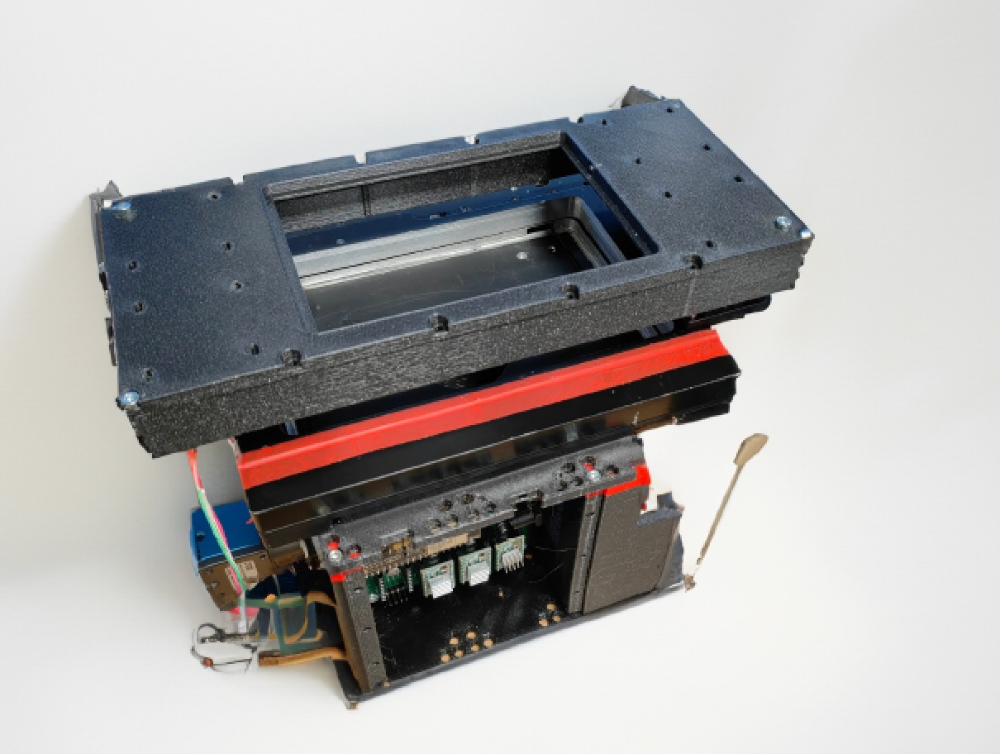




$$y$$
Sample Orientation
$$x$$
$$height$$
$$z$$
Camera Orientation

