Slide 1
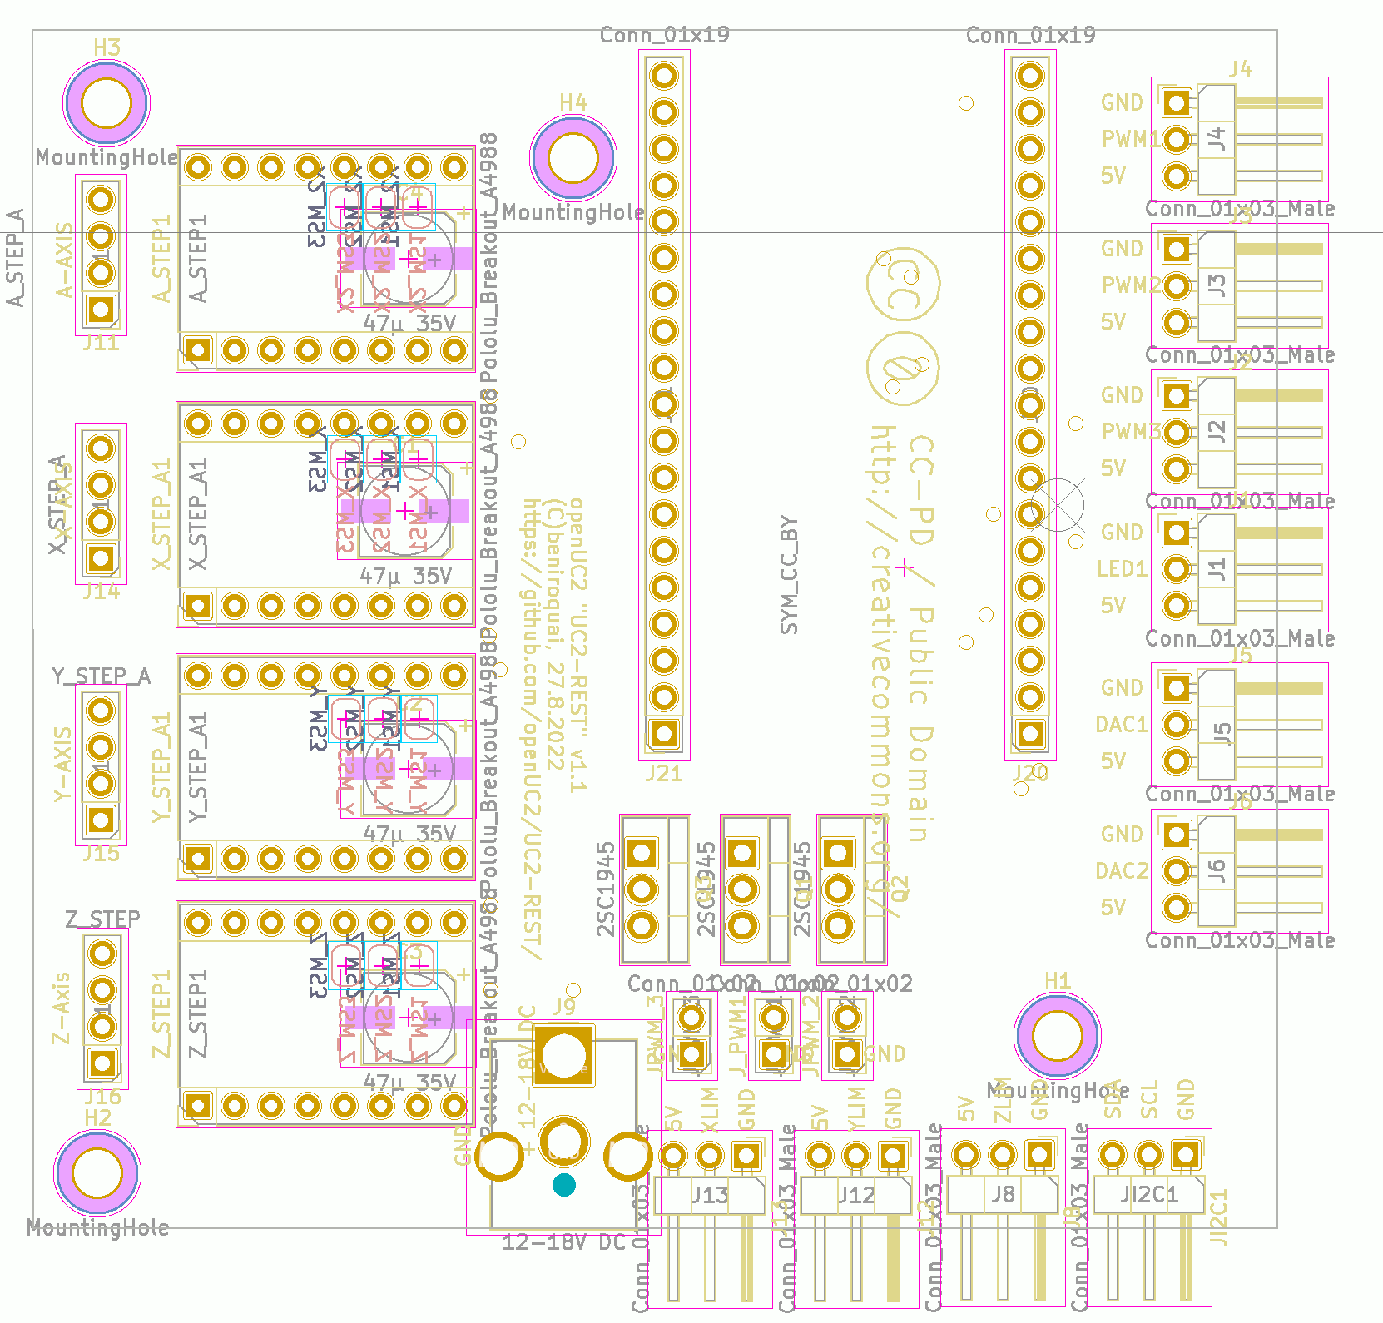
USB
PWM1 / Laser 1
Stepper A
PWM2 / Laser 2
PWM3 / Laser 3
Stepper X
LED1 (Neopixel)
DAC1
Stepper Y
DAC2
Stepper Z
12V
END X
END Y
END Z
I2C

