Slide 1
National Initiatives for Open Science in Europe
Projekat NI4OS-Europe
Branko Marović, Računarski centar Univerziteta u Beogradu (RCUB)

Slide 2

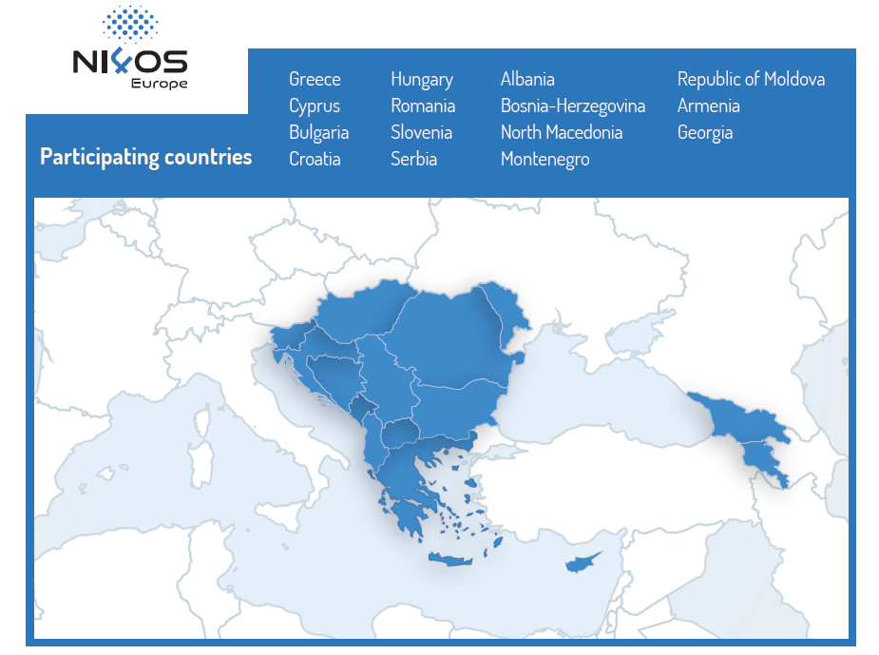
Project administrative summary
Name: National Initiatives for Open Science in Europe
Acronym: NI4OS-Europe (pronounced “NIFOS”)
Call: INFRAEOSC-05 (b) Coordination of EOSC-relevant national initiatives across Europe and support to prospective EOSC service providers - Research and Innovation Actions
Grant number: 857645
Amount of EC funding 5,599,475e
22 Partners from 15 countries

Slide 3

Partnership building blocks
Operators of services for research & technology
Open Science communities & infrastructures
Notes:
Various lines of work in our project, different communities that collaborate: the infras, the network and the open science

Slide 4
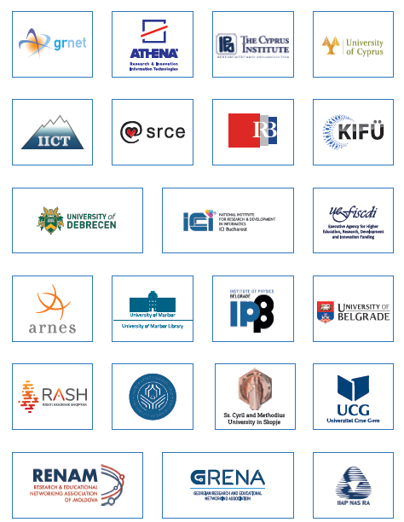
Partnership
1 | National Infrastructures for Research and Technology SA | GRNET | Greece
2 | Athena Research & Innovation Center | ATHENA | Greece
3 | The Cyprus Institute | CYI | Cyprus
4 | University of Cyprus | UCY | Cyprus
5 | Institute of Information and Communication Technologies | IICT | Bulgaria
6 | SRCE - University of Zagreb, University Computing Centre | SRCE | Croatia
7 | Ruđer Bošković Institute | RBI | Croatia
8 | Governmental Agency for IT Development | KIFU | Hungary
9 | University of Debrecen | UD | Hungary
10 | National Institute for Research and Development | ICI | Romania
11 | Executive Agency for Higher Education, Research, Development and Innovation Funding | UEFISCDI | Romania
12 | Academic and Research Network of Slovenia | ARNES | Slovenia
13 | University of Maribor Library | UMUKM | Slovenia
14 | Institute of Physics Belgrade | IPB | Serbia
15 | University of Belgrade | UOB | Serbia
16 | Albanian Academic Network - Interinstitutional ICT Research Centre | RASH | Albania
17 | University of Banja Luka | UNI BL | Bosnia-Herzegovina
18 | Ss. Cyril and Methodius University in Skopje | UKIM | Northern Macedonia
19 | University of Montenegro, Faculty of Electrical Engineering | UOM | Montenegro
20 | Research and Educational Networking Association of Moldova | RENAM | Republic of Moldova
21 | Institute for Informatics and Automation of the Academy of Sciences of Armenia | IIAP | Armenia
22 | Georgian Research and Educational Networking Association | GRENA | Georgia

Slide 5



Mission
Support the development and inclusion of the national Open Science Cloud (OSC) initiatives in 15 Member States and Associated Countries in the overall scheme of EOSC governance
Spread the EOSC and FAIR principles in the community and train it
Provide technical and policy support in on-boarding of the existing and future service providers into EOSC

Slide 6
Konkretne ponude
NI4OS servisi/resursi za istraživače – na https://agora.ni4os.eu/
28 repozitorujuma (neki su specijalizovani)
18 tematskih servisa
16 generičkih servisa
Pristup generičkim resursima, npr. NI4OS COVID-19 fast track
Katalog globalnih servisa (WP4) – 139 alata https://docs.google.com/spreadsheets/d/1Sk8YmcUbxoMDelcyEKyXGPxDG61zEmDc, https://zenodo.org/record/3820880#.YIBfYD-xVQI
Treninzi – najave na sajtu, pozivi nacionalnoj zajednici, materijali sa treninga na https://training.ni4os.eu/
NI4OS alati za istraživače (LCT, RoLECT)

Slide 7
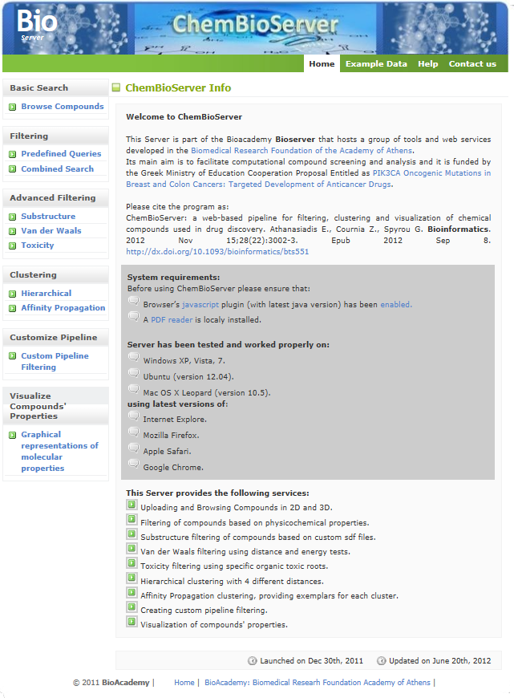
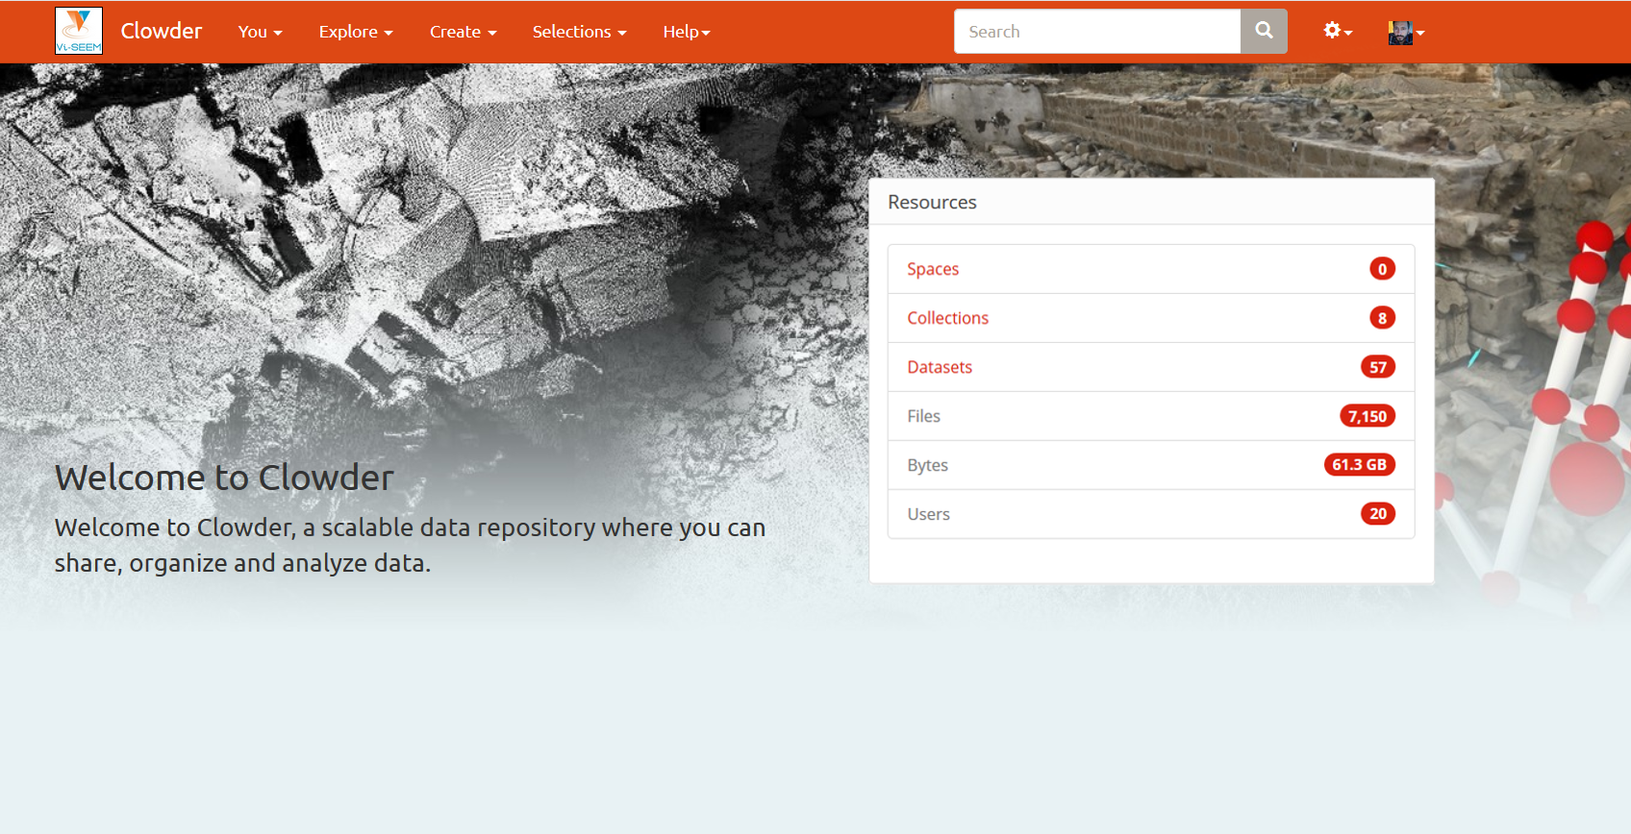
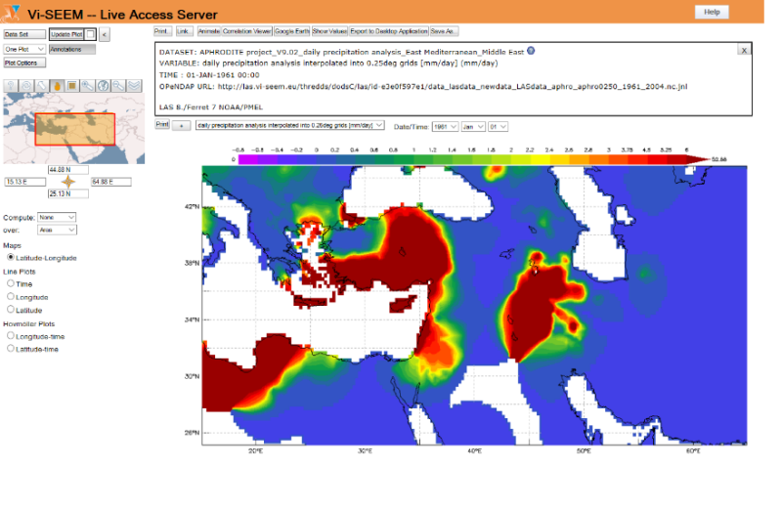
EOSC candidate thematic services: examples (life sciences, digital cultural heritage, climate)
ChemBioServer
Service for filtering, clustering and visualization of chemical compounds used in drug discovery
DCH Clowder
A Digital Culture Heritage repository which also offers integrated interactive visualization tools
Live Access Server
A web server providing flexible access to geo-referenced scientific data, offering visualization & post-processing capabilities for climate data

Slide 8
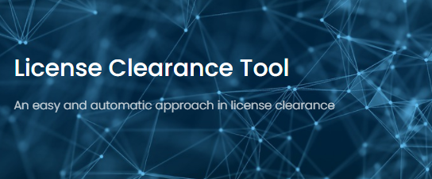
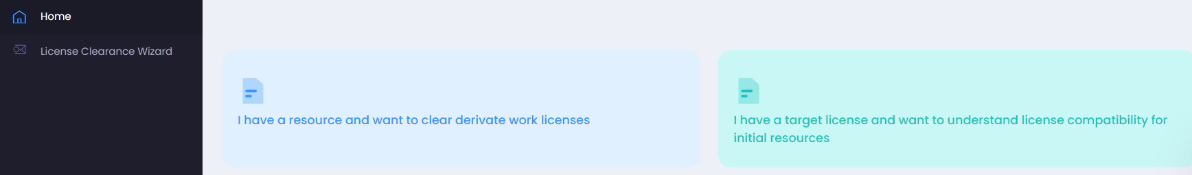
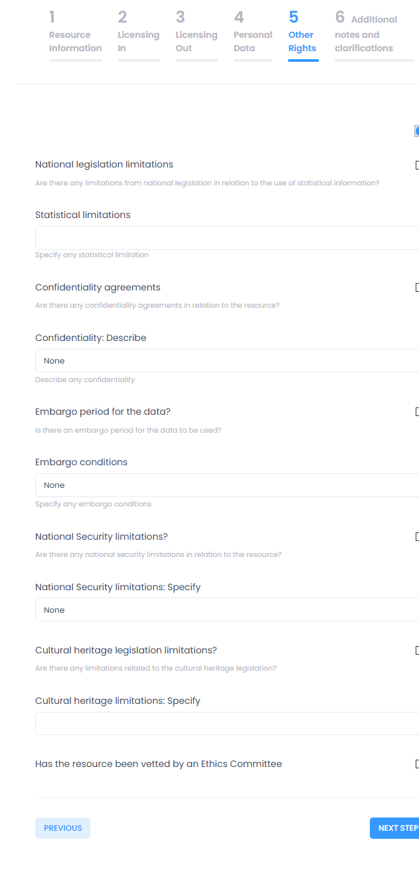
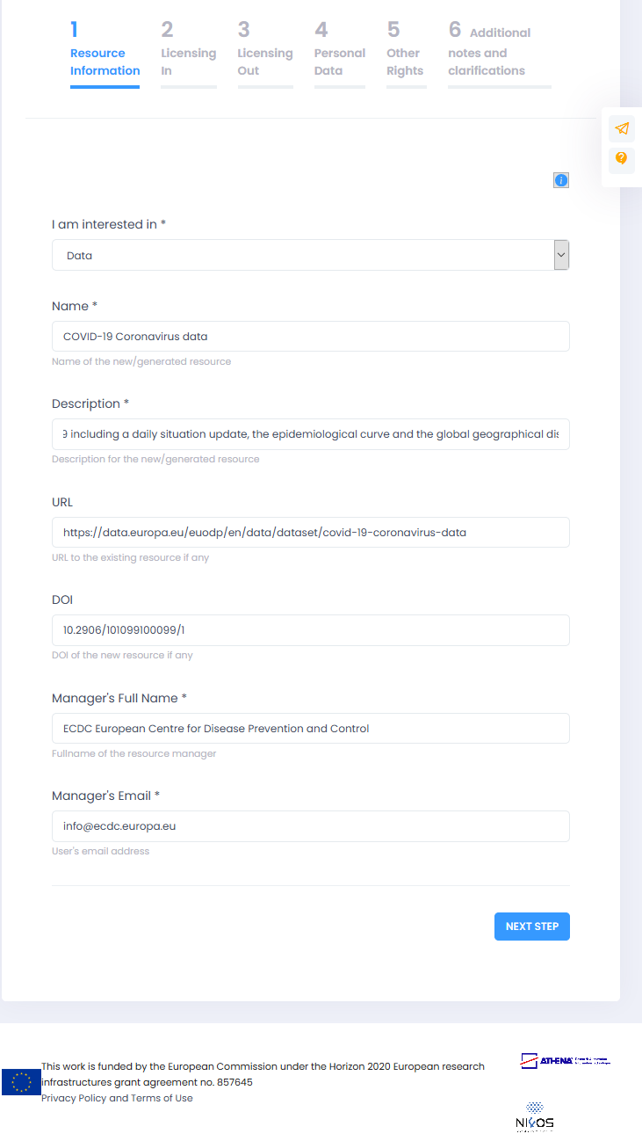
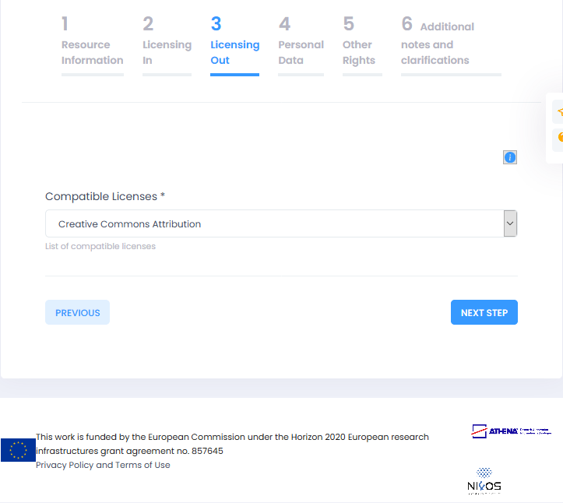
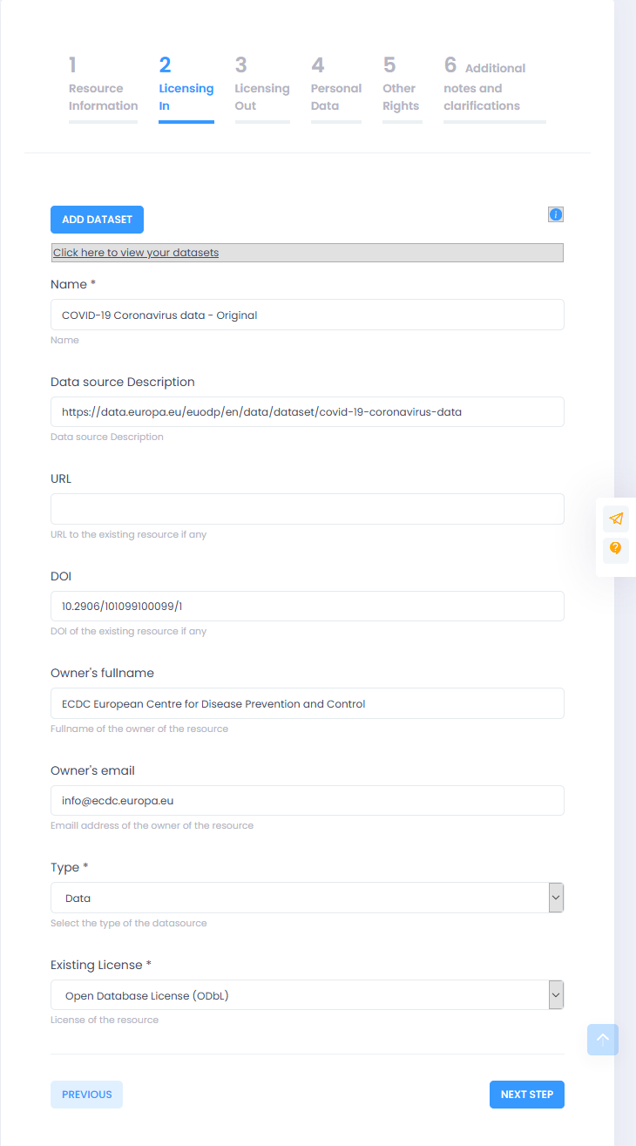
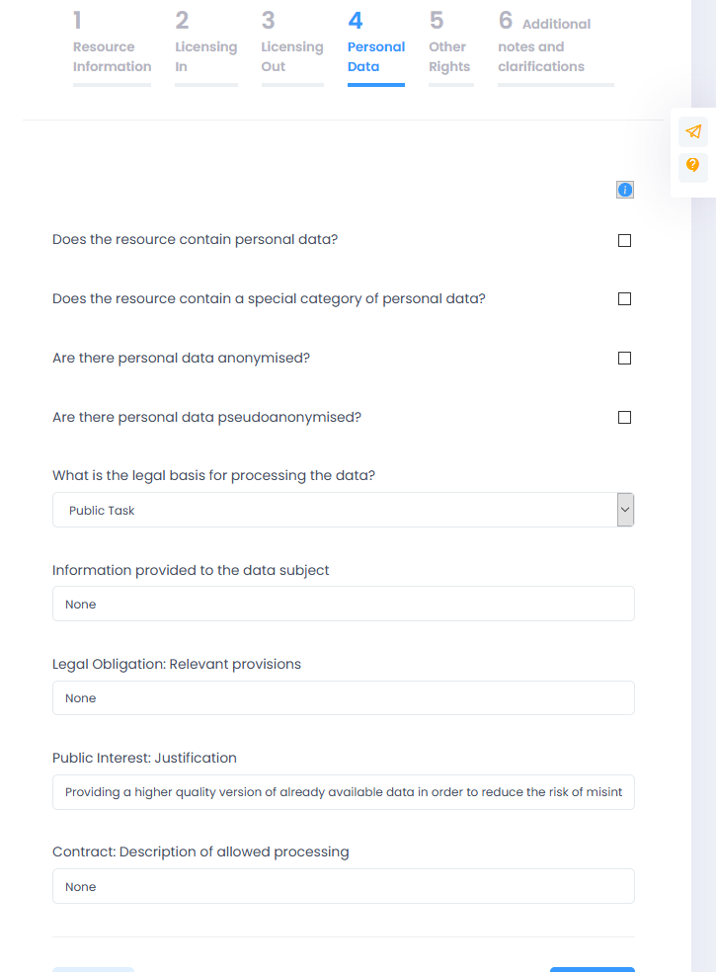
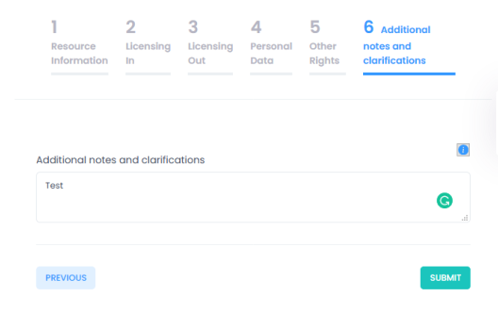
Tools for data and service managers
License Clearance Tool https://lct.ni4os.eu/
Helps in resolving IPR issues and guides you through input licenses, output licenses, personal data, special limitations
Two different workflows: resource-driven and license-driven
Supports reproducibility of research
RoLECT https://rolect.ni4os.eu/
Follows and supports the rules of EOSC RoP
Focuses on legal and ethical aspects of EOSC compliance
Covers an almost unexplored terrain between FAIRness of data and service descriptions
Repository Policy Generator https://repol.ni4os.eu/
Creation of repository policy documents using
Few mandatory inputs
Explained choices
Related options
Carefully redacted templates

Slide 9


Thanks!
NI4OS_eu NI4OS ni4os.eu

