Slide 1

Integrating social science data in Europe
Ron Dekker | CEO, CESSDA ERIC
Dr Aleksandra Bradić-Martinović | Institut ekonomskih nauka, Beograd
Open Science Day
cessda.eu
@CESSDA_Data

Slide 2
Content
European Developments
Positioning of Social Sciences & Humanities
CESSDA ERIC
Serbia
General open data repositories V.S. National infrastructure
Notes:
I will start in Europe and then zoom in on Social Sciences and on Serbia

Slide 3
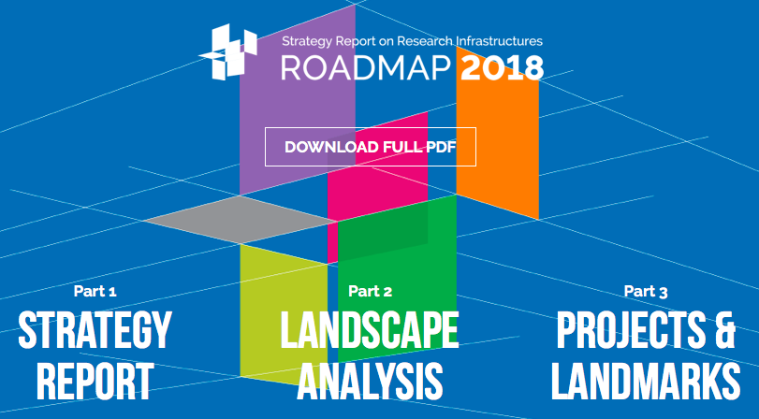
ESFRI – European Strategy Forum on Research Infrastructure
Notes:
ESFRI to canalise and combine initiatives - 2018 Roadmap with 40+ infrastructures.

Slide 4

EOSC - European Open Science Cloud
Increasing agreement among
Member States and major research infrastructures and e-infrastructures
Integrated approach to research data infrastructures is needed
going beyond layers (computing, data storage, use)
national & disciplinary silos
COMPUTING
NETWORKS
SOFTWARE
CONTENT
Notes:
Need and desire to integrate and combine infrastructures – more orientation towards the researchers

Slide 5
EOSC - Mission
To provide members of Europe’s research community with a virtual environment
with free at the point of use, open and seamless services for storage, management, analysis and reuse of research data
across borders and scientific disciplines
To federate existing initiatives and structures
within a single, consolidated and seamless platform
Notes:
Implies coordination among European, national and institutional Research Infrastructures

Slide 6
Social Sciences & Humanities Open Cloud
H2020 funded
All SSH ESFRI’s
CESSDA, CLARIN, DARIAH, ESS, E-RIHS, SHARE
+ EVS, Wage-Indicator, 2 research communities, LIBER, Trust-IT
Coordinate, Cooperate & Complement
Notes:
There was an EOSC-call for ESFRI’s to cluster.
So we did with all SSH ESFRI’s and additional partners

Slide 7
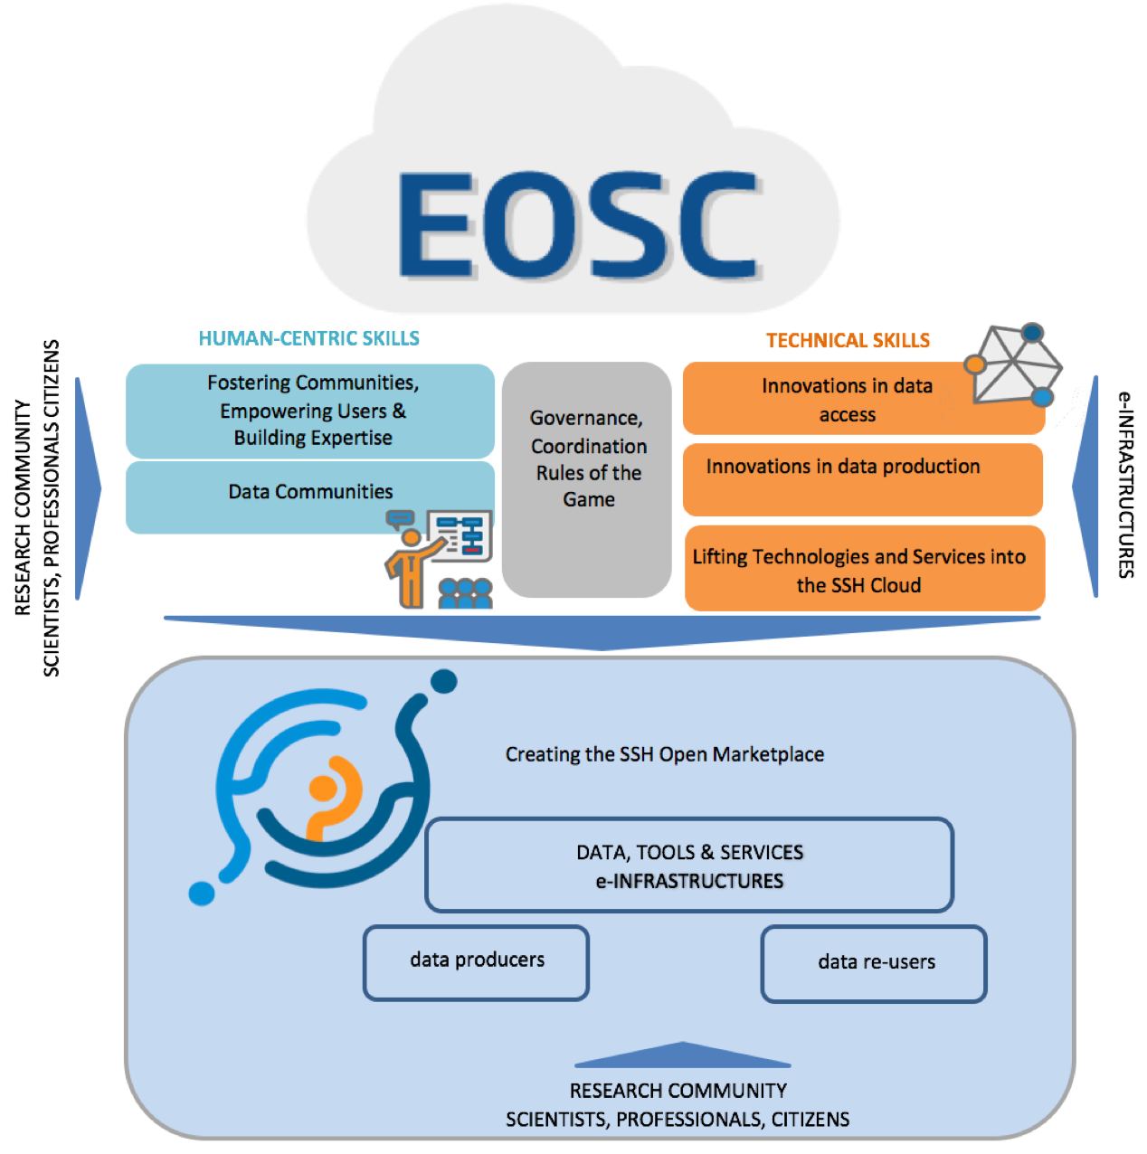
Research (data) communities
e-Infrastructures
Innovation
Training
Tools to the market
Marketplace
Governance
Notes:
Elements of SSHOC: innovate, bringing Tools & Services to the market, create this market place (DARIAH has already experience with this)
Human factor: training - and bring the researchers in (on two topics)

Slide 8
CESSDA – Consortium of European Soc Sci Data Archives
Provide a distributed and sustainable research infrastructure
enabling the research community to conduct high-quality research in the social sciences,
contributing to the production of effective solutions to the major challenges facing society today;
Facilitate teaching and learning in the social sciences.
Notes:
Realise a distributed Research Infrastructure AND facilitate and provide training.
(Data are complex – researchers need training; and within CESSDA we also train ourselves (the Service Providers) and share expertise.

Slide 9
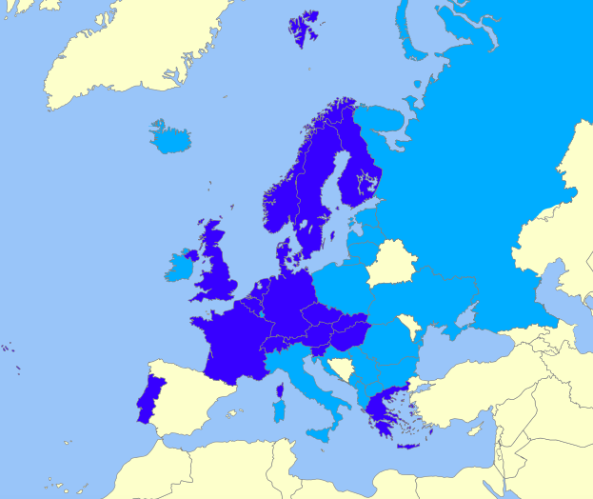
Notes:
Make use of existing infrastructures - 17 SPs + MO
350 experts, 39 M€ operational costs;
Need for a Main Office because Distributed RI’s have additional challenges, like coordination, standardisation

Slide 10
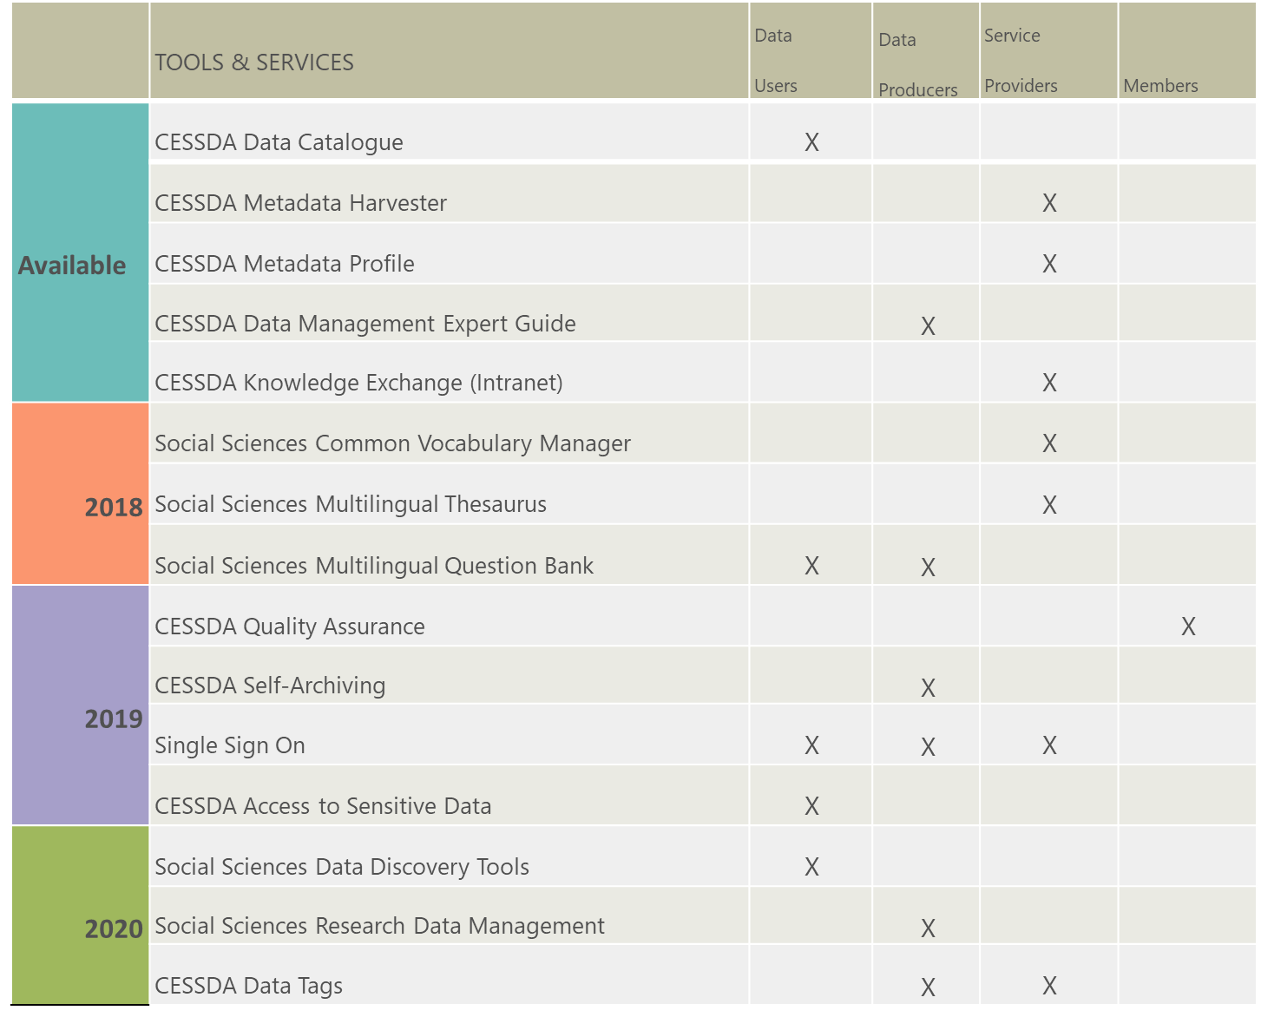

Slide 11

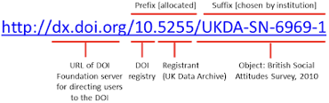
CESSDA Membership
Members
Efficiency, Trusted Repositories
Service Providers
Scale: Efficiency, Standards, EC Funding, Sharing Expertise
Common Technology
Researchers
Easy & Safe Deposit of Data
Visibility, e.g. Data Citation
Find and Re-use Data – incl. Access to Sensitive Data
Training
Notes:
In September, Serbia applied for CESSDA membership.
The CESSDA advisory committee (all Service Providers) was positve, it will now go to the Members – in their General Assembly – on 22 Nov.

Slide 12
Preparations in Serbia
2012 – 2014 SERSCIDA -> SER.DAC
Support for Establishment of l Social Sciences Data Archives
Analysis of existing potentials for establishment of data archive in SSH for each country;
2015 – 2017 SEEDS & CESSDA
South-Eastern European Data Services
Improvement of technical infrastructure
RRPP Data Rescue
CESSDA Strengthening & Widening
Notes:
We took a long road – but needed this to get prepared and build on basic infrastructures.

Slide 13
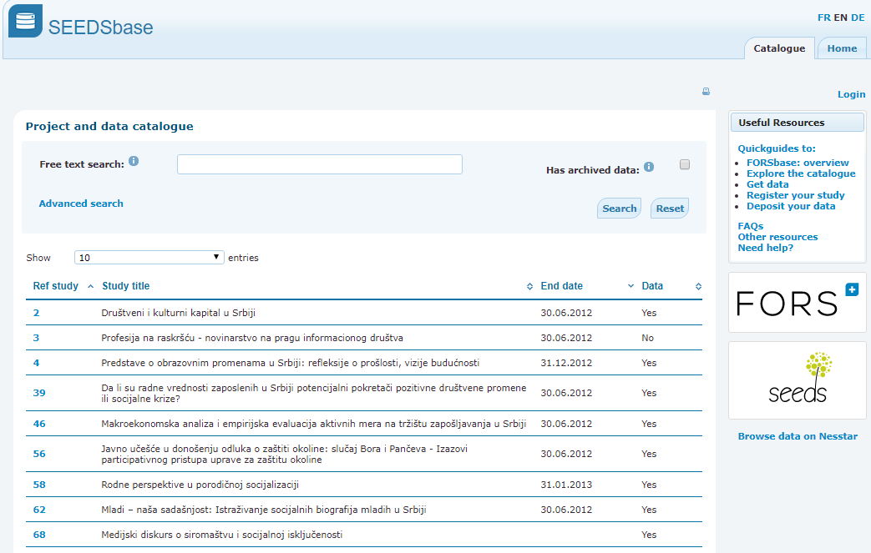

Slide 14
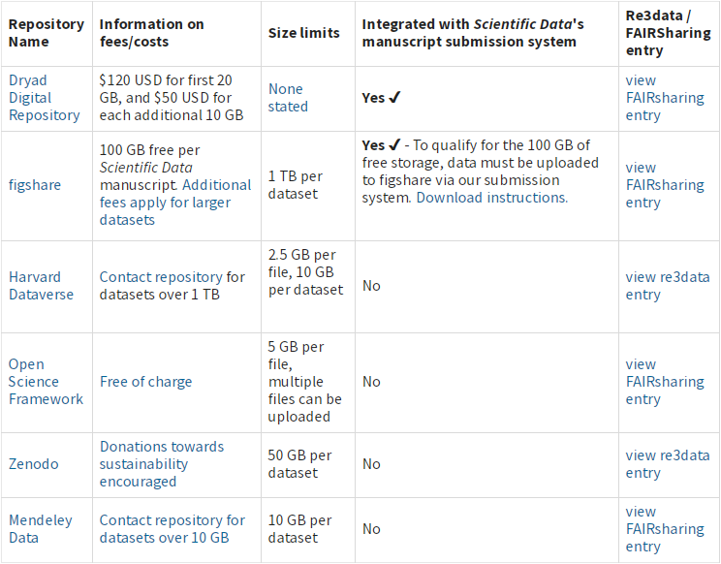
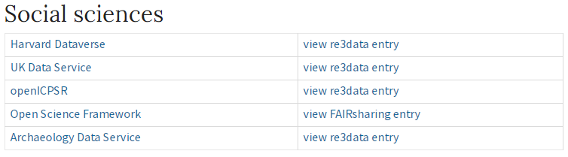

Slide 15
Key issues:
Privacy protection – respondents (Law – Contracts)
Copyright (Law – Contracts)
Sustainability of data format
OAIS compliance (SIP, AIP – Xml, DIP)
Metadata scheme (DDI or CESSDA new scheme – in progress…)
Data visibility (CESSDA platform)
Impact of dataset (No of published papers based on one dataset – how to trace?)

Slide 16
Conclusions
Coordination of Research Infrastructures
Europe: ESFRI/EOSC
SSH Cooperation: SSHOC
Soc. Sc. Infrastructures: CESSDA
National: Serbian Data Center in Social Sciences - SER.DAC
We do all this to support researchers and make high quality research possible
Notes:
Get Researchers involved.
Do realise that Data Support, providing Tools &Services, Catalogues and Training requires expertise and capacity to keep doing this work.
If we want to join developments on infrastructures in Europe, we have to organise ourselves: membership of CESSDA connects to SSHOC and EOSC.

