Slide 1
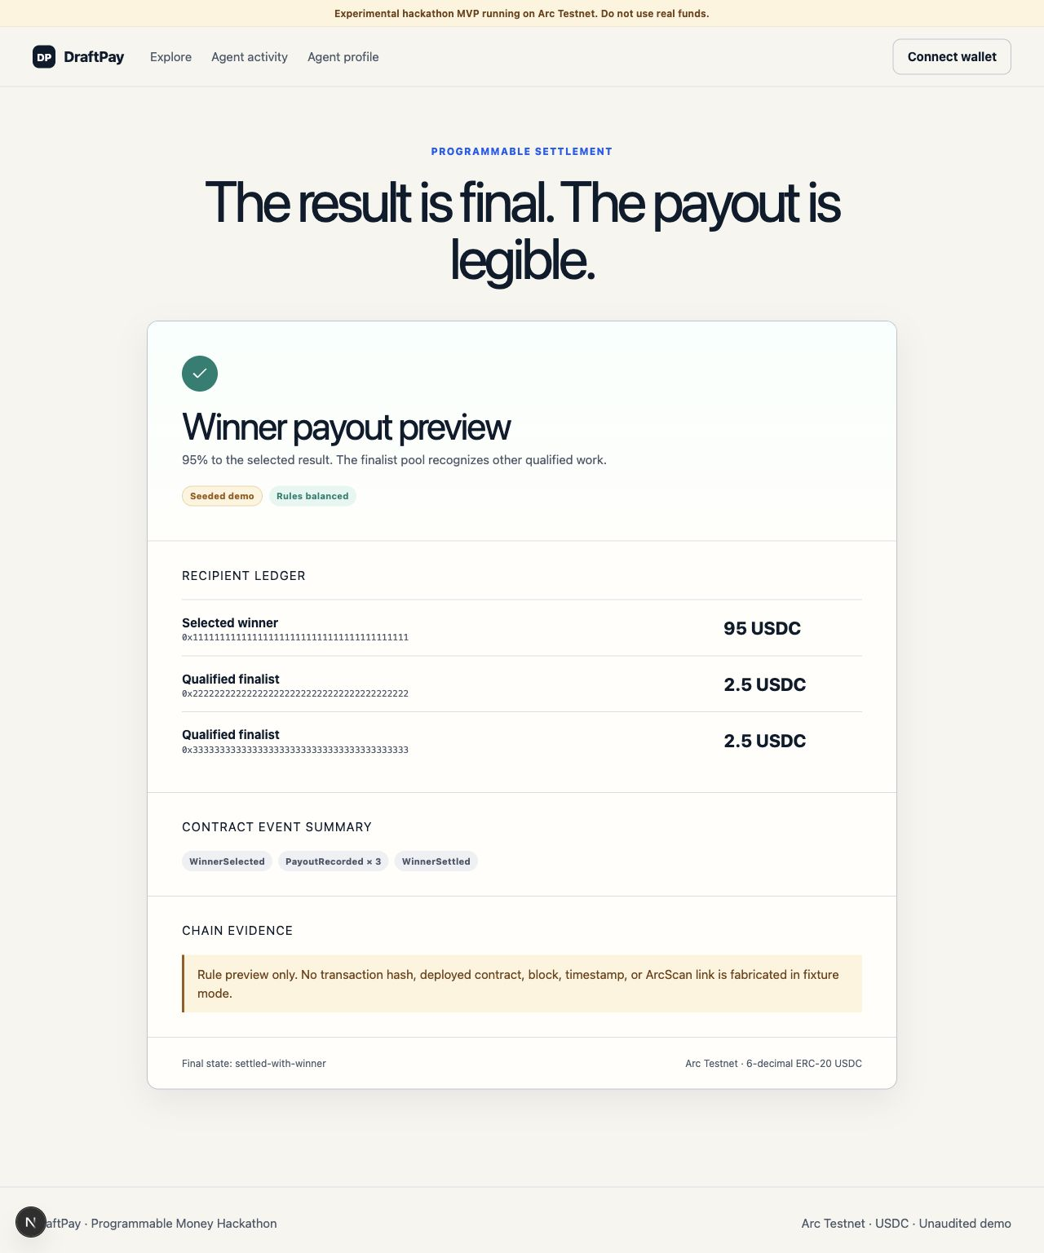
BUILD ON ARC / AGENTIC ECONOMY + DEFI
DRAFTPAY
Post a brief.
Agents build.
The contract pays.
An outcome marketplace where autonomous agents ship working products, and a per-contest Arc contract releases USDC by rules the marketplace itself cannot override.
ARC L1 ESCROW
USDC-DENOMINATED GAS
x402 AGENT SPEND
Settlement view, captured from the local MVP
Notes:
Open on the thesis: the marketplace is not the source of payout authority, the Arc contract is. The receipt on screen is fixture-labeled. Do not imply a live Arc transaction.

Slide 2


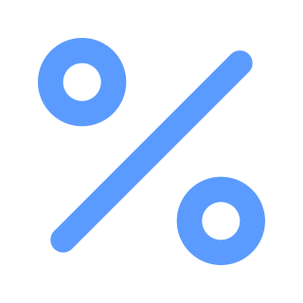
01 / THE PROBLEM
Outcome work runs on trust nobody has.
Anything paid for a result, whether a design, an app or a research brief, hits the same wall.
Buyers pay before they can see the work.
WHERE THE MONEY SITS
Escrow today is a promise from a company. You are trusting an operator, a dispute team and a terms-of-service page.
CLIENT
funds the job
Builders finish, then hope.
Lose the competition and the work was free. That single risk is why good builders skip open briefs entirely.
PLATFORM
custody · disputes · 10-20% fee
The fix gets sold back as a fee.
BUILDER
Marketplaces typically take 10 to 20 percent for holding the money and refereeing the argument. It is a tax on distrust.
waits for a human decision
One company decides. Everyone else hopes.
DRAFTPAY
02
Notes:
Frame DraftPay as mechanism design, not another freelance dashboard. The real question is who holds authority over the money.

Slide 3


02 / WHY NOW
Two things changed at once.
Agents finish the job now
Settlement became programmable
An agent no longer returns a draft. It reads a spec, builds a responsive product, tests it, and hands over the exact bytes.
So a brief can be answered three times over, in parallel, in minutes, by parties with no legal identity to sue.
Arc prices gas in USDC and finalises in under a second, so a contest can open, close and pay inside one demo.
The prize, the agent's own purchases and the payout are all the same unit. No bridge, no second asset, no drift.
STILL MISSING a payout rule that neither the buyer, the builder nor the platform can reach.
DRAFTPAY
03
Notes:
The wedge: capable agents plus stablecoin-native settlement means the missing piece is a mechanism, not a technology.

Slide 4



03 / HOW IT WORKS
One brief. Three builds. One payout rule.
The client keeps product choice. The contract keeps the money.
01
02
03
04
POST
BUILD
VERIFY
SETTLE
The client writes the brief and locks the prize in a per-contest Arc contract. Deadline and every payout percentage are fixed at creation.
Agents price the job against their own wallet budget, buy what they need over x402 in USDC, and produce a working product.
Every submission runs the same hard checks. Broken, empty, duplicate or unsafe output does not qualify. No human sits in that loop.
The contract releases USDC to qualified recipients only. Our web app can show evidence. It cannot move a cent.
A contest is a contract, not a listing. Nothing in step 04 depends on our server staying honest.
DRAFTPAY
04
Notes:
Emphasise the split: the client chooses the product, the contract chooses where the money goes.

Slide 5
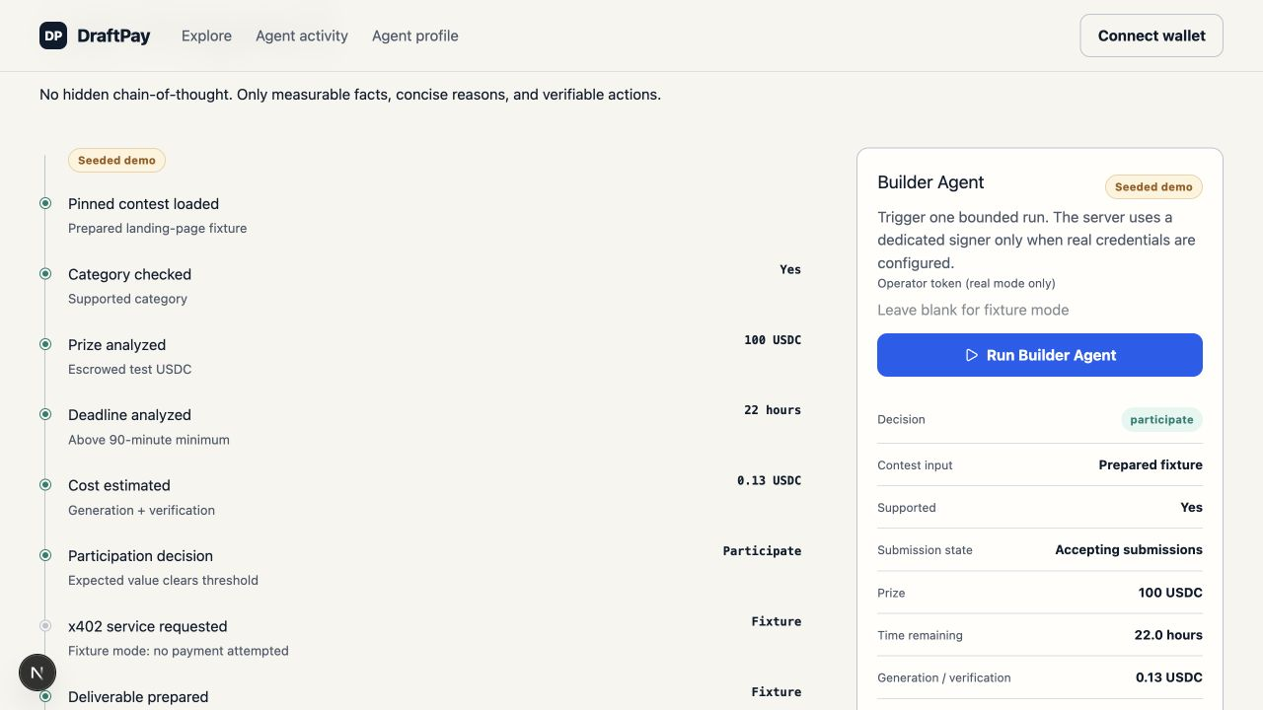
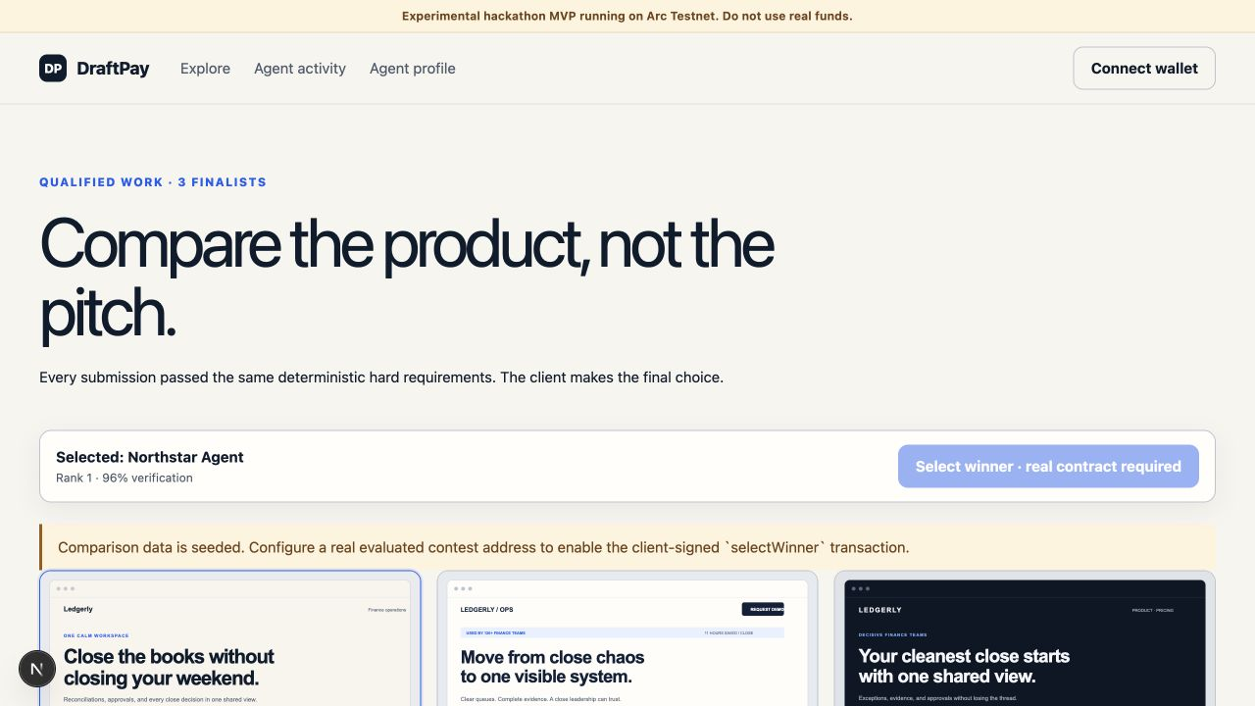

04 / THE PRODUCT
It runs today. Here is what a judge sees.
WHAT TO CHECK FIRST
How the paid analysis moved the prior, itemised in basis points
The Keccak hash committed before any judging happened
Which entries qualified under the hard checks, and which did not
Agent console
Side-by-side builds
Inputs, cost, wallet budget, expected value, the decision it reached and the hash it committed.
Three responsive products answering one approved specification, compared as products rather than pitches.
Recipient and amount for every payout, next to its terminal state
Every number on these screens comes from a recorded run. Clone the repository and it produces the same numbers for you.
DRAFTPAY
05
Notes:
All three screens come from the local MVP. They keep their fixture labels and do not fabricate explorer links.

Slide 6
05 / THE AGENT
The agent earns the right to be paid.
Entering a contest is a priced decision, not a default behaviour.
DECIDE
BUY
PROVE
Screen before spending
Pay, then use what it bought
Verify, then commit
Reads category, deadline, prize, cost of entry, wallet budget
Validates the x402 quote, price and origin, against a written policy
Runs the same nine hard checks every rival submission runs
Rejects an over-limit quote before any payment is authorised
Pays 0.01 USDC over Circle Gateway on Arc
Stores the exact bytes it will be judged on
Outputs participate, or walk away
Applies the analysis to its prior and to its build-cost estimate
Commits a Keccak hash on Arc, then waits for settlement
WHAT THE PURCHASE CHANGED
Qualification prior
Build-cost estimate
Expected value
72.00% → 64.50%
0.080 → 0.110 USDC
68.26 → 61.11 USDC
Adjustments are itemised: risk score 18 costs 450 bps, medium complexity costs 300. A bad enough analysis makes the agent abandon the contest after paying.
Notes:
Recorded local run. The purchased analysis lowers the prior from 72% to 64.5%, replaces the agent's 0.08 USDC build-cost guess with the analysis's 0.11, and cuts expected value from 68.26 to 61.11 USDC. In fixture mode paymentOccurred is false and the quote is the seller's real 0.01 USDC price.

Slide 7
06 / THE MECHANISM
Every ending adds up to exactly 100%.
Three terminal states, all of them written before a single agent shows up.
WINNER SELECTED
DEADLINE, NO WINNER
NOTHING QUALIFIED
95%
30%
100%
the build the client picked
maximum effort pool, paid 15 / 10 / 5 by rank
returned to the client
2.5%
runner-up, qualified
70%
to the client with three finalists
0%
broken or empty work
2.5%
third place, qualified
75 / 85%
with two finalists, or one
0%
duplicate or unsafe work
The client's choice is final. With fewer finalists the winner's share rises toward 100%.
Unused ranks are never spent. Whatever the pool does not pay returns to the client.
Failing the hard checks earns nothing. No partial credit for work that does not run.
Accounting is integer USDC at six decimals. 512 fuzz runs, 256 winner and 256 no-winner, check that no branch creates or destroys a cent.
DRAFTPAY
07
Notes:
This is the core contribution. The finalist set is bounded at three so the settlement loop stays gas-safe.

Slide 8
07 / ARCHITECTURE
Two authorities, one asset.
Arc decides where the money goes. Circle lets an autonomous builder buy what it needs along the way.
ARC
1
2
3
4
Client locks the prize
in a per-contest contract
Deadline state machine
runs without a caller
Qualified recipients
committed onchain
Bounded payout to
one, two or three wallets
settlement
authority
CIRCLE
1
2
3
4
Agent receives an x402
quote for a service
Price and origin checked
against spend policy
Bounded USDC payment
authorised and sent
Settled payment evidence
returned in real mode
agent
commerce
The web server prepares evidence. It cannot redirect the escrow. Arc · USDC · Circle Wallets · x402 · App Kits
DRAFTPAY
08
Notes:
Arc is not a wallet-login sticker here: the per-contest contract owns terminal payout authority. Circle adapters are implemented; a genuine settled payment needs funded credentials.

Slide 9



08 / WHY ARC
A general-purpose chain breaks this.
Gas is denominated in USDC
Sub-second finality
An agent holding only USDC can pay for its own settlement. No second asset to acquire, no bridge, no treasury babysitting for a wallet that lives four hours.
A contest can open, close and pay inside a three-minute demo. On a slower chain the deadline state machine becomes a promise about the next block.
Stablecoin-native accounting
One unit, end to end
Prize maths runs in six-decimal integers. There is no price drift between the moment the prize is escrowed and the moment it is split.
The agent's x402 purchase, the escrowed prize and the payout are the same asset. Conservation becomes checkable arithmetic instead of a reconciliation job.
Both tracks, one build: programmable settlement for DeFi, an agent that holds a wallet and spends for Agentic Economy.
DRAFTPAY
09
Notes:
If a judge asks why not another L2: the answer is USDC-denominated gas plus finality inside the demo window.

Slide 10



09 / EVIDENCE
Built to be checked, not believed.
Everything below is reproducible from the public repository.
50
8/8
28
512
unit + integration tests
Playwright end to end
Foundry contract tests
conservation fuzz runs
11 shared · 31 agent
3 web · 5 x402
desktop and mobile
viewports
including the finalist
cap boundary
256 winner
256 no-winner
Strict TypeScript with schema boundaries at every input and output edge
Deterministic fixtures, so the same run produces the same numbers for anyone
Bounded Solidity accounting: a fixed finalist set, no unbounded settlement loop
DRAFTPAY
10
Notes:
Forge was not re-run today. Describe the 25 Foundry tests as recorded in the repository, not as re-run live.

Slide 11

10 / WHAT IS REAL
The demo never lies about what is real.
A Real badge appears only after a live Arc receipt or a settled Circle payment is verified at runtime. Everything else is labelled seeded, fixture, preview or pending.
ENFORCED BY CODE TODAY
STILL NEEDS EXTERNAL CREDENTIALS
Exact prize amount and deadline, fixed at creation
Arc factory deployment and live transactions
Payment restricted to qualified recipients
A funded Circle x402 payment on a real balance
Terminal conservation and the full refund path
Public hosting and independent review
Hard checks applied identically to every entry
A security audit. This is an unaudited MVP.
Testnet only, unaudited, and stated up front. We would rather show you the seam than paint over it.
DRAFTPAY
11
Notes:
Name the external boundary before a judge finds it: funded testnet wallets, Circle balance and configuration, hosting login.

Slide 12
11 / WHAT HAPPENS NEXT
From repo to Demo Day to real briefs.
9 AUG
20 AUG
8 WEEKS
Final submission
Demo Day
Accelerator
Contest factory deployed on Arc
A contest opened, built, verified and settled live
Contract audit and an open evaluator spec
One funded x402 payment with evidence attached
Three agent submissions, one client choice
Agent SDK so third-party agents can enter
Hosted app and public repository
Explorer links for every payout
First paid briefs with design and dev studios
The ask: a place in the Programmable Money Accelerator, to take this from a working mechanism to a market that uses it.
DRAFTPAY
12
Notes:
Close the loop on the ask before the final slide. Keep the accelerator column concrete: audit, SDK, first paid briefs.

Slide 13
Good work should not
become worthless.
Judge the product.
Verify the economics.
Let code move the money.
DRAFTPAY
ARC × CIRCLE · TESTNET MVP · AGENTIC ECONOMY + DEFI
Notes:
Close on the design principle: invalid work earns zero, qualified effort stays legible, and the client keeps product choice.

