Slide 1

FOR THE
RECORD
Private reflection for
wallet decisions on Seeker
For the record, this is why I did it.
FOR THE RECORD / 0.5.1 / 1
Notes:
CLOCK IN 2026, development preview 0.5.1. SEEKER_LOVER. Original room illustration from assets/room/study.png. App artwork, not a photograph of a physical location.

Slide 2
The missing reason
A transaction history keeps the event.
The explanation can be harder to find later.
For Seeker users who want to reflect on their swaps,
a record needs the original reason and a later review.
FOR THE RECORD attaches personal writing to a supported
transaction and preserves the first saved explanation.
FOR THE RECORD / 0.5.1 / 2
Notes:
Product rationale and initial audience, not a measured demand or psychological-effect claim. No user study, retention cohort or product-market-fit result is claimed. A reason written after a transaction is not proof of prior intent.

Slide 3
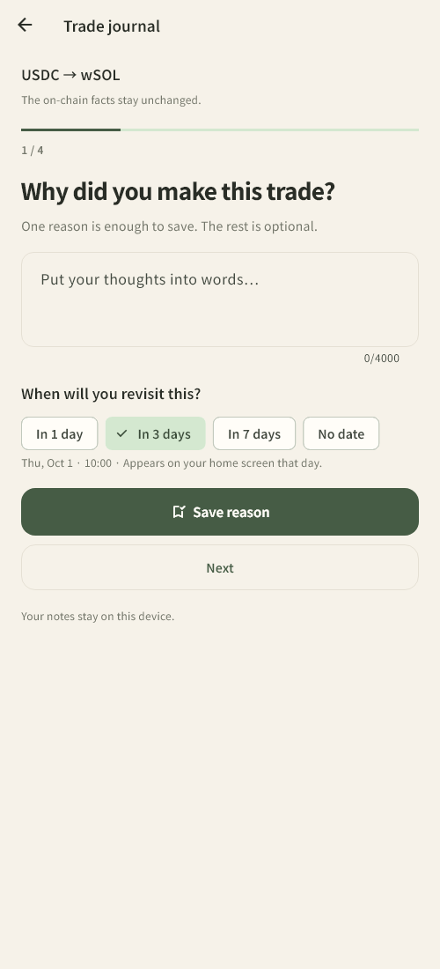
Decision Replay
01 One reason is enough
Choose supported activity and save your reason.
The other writing prompts are optional.
02 A specific moment to revisit
Choose 1, 3 or 7 days. Reopen the first note,
add a reflection, and keep a lesson with its source.
The app shows due records on its home screen.
UI test render / synthetic trade
FOR THE RECORD / 0.5.1 / 3
Notes:
Source: lib/ui/trade_journal.dart, lib/ui/decision_replay.dart, lib/domain/trade_journal.dart. Current UI screenshot uses a synthetic transaction in a widget test and is not a real trade. Dates appear in-app; this does not claim new scheduled push reminders for trade revisits. The original note is the first saved writing, not a pre-trade attestation.

Slide 4
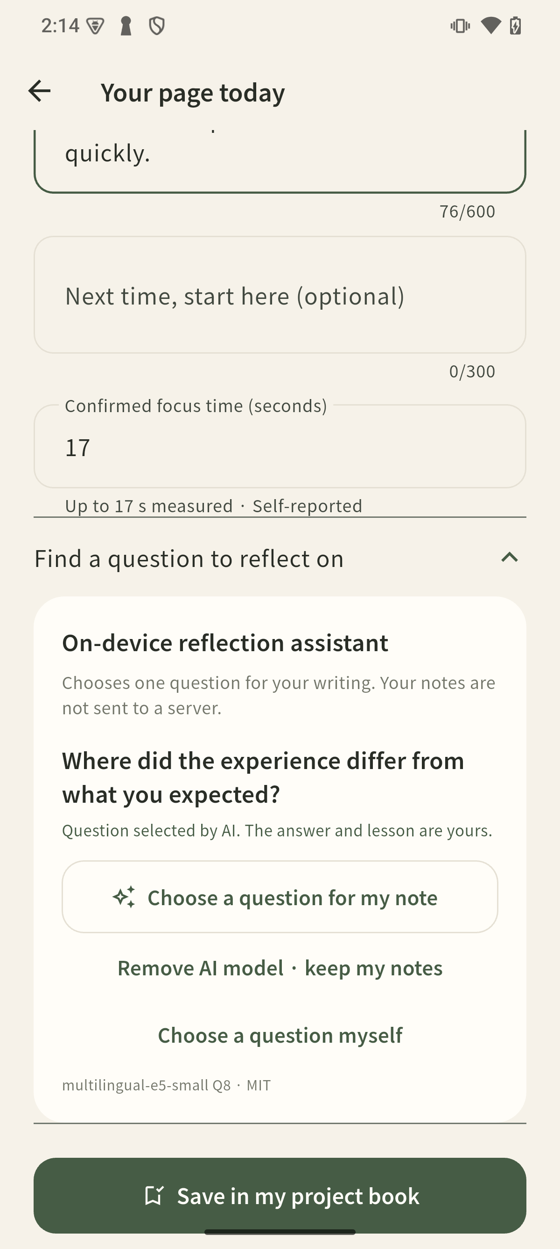
A question for your writing
AI runs on the phone
133 MB optional download
No API account or paid inference service
1.66 s first request
0.03–0.07 s while warm
The model selects a question. You write the answer.
When topics are close, you choose between two.
FOR THE RECORD / 0.5.1 / 4
Notes:
Actual Seeker Android 15. multilingual-e5-small Q8 semantic encoder, llama.cpp v0.5.0 CPU, MIT. Not a generative LLM. Model bytes 132439008. Optimized JNI/Flutter test: first wall time 1661ms including hash, load and topic preparation, 63 subsequent calls 30–67ms, median44ms. Initial download, UI transitions and user choice are excluded. Engine releases after 60 seconds idle or backgrounding. Thirty further English/Korean synthetic cases fixed before final evaluation: 26/30 first-choice matches; nine ambiguous, including all four mistakes with expected topic in other candidate. Development examples are not independent accuracy evidence. Source: https://github.com/openai-lover/seeker_FOR-THE-RECORD/blob/improve/decision-replay/docs/ON_DEVICE_REFLECTION.md and docs/AI_DEVICE_051.json. Original model: https://huggingface.co/intfloat/multilingual-e5-small . Screenshot uses a synthetic work note in the normal release app, not a wallet trade.

Slide 5
Solana context, private writing
Native Mobile Wallet Adapter
The connected account anchors a public activity read.
The journal requests no transaction signature.
Personal writing stays on the device
SQLite keeps the original reason, later review and lesson.
The AI receives bounded note text locally.
Current parser: selected finalized Jupiter v6 swaps with classic SPL tokens. Other activity stays unsupported.
FOR THE RECORD / 0.5.1 / 5
Notes:
Native source: android/app/src/main/kotlin/app/workroom/seeker_workroom/WorkroomActivity.kt. Public RPC/parser: lib/data/direct_activity.dart. Storage: lib/data/repository.dart. Physical Seeker MWA connection and public history retrieval worked on 28 September; the available activity was unsupported, so supported real swap-to-journal completion remains unverified. No funds moved. Wallet public address/signatures go to Solana RPC; note text does not. Official MWA documentation: https://docs.solanamobile.com/developers/mobile-wallet-adapter . Optional shared rooms/SKR purchases are disabled in this edition and are not claimed as a working payment integration.

Slide 6
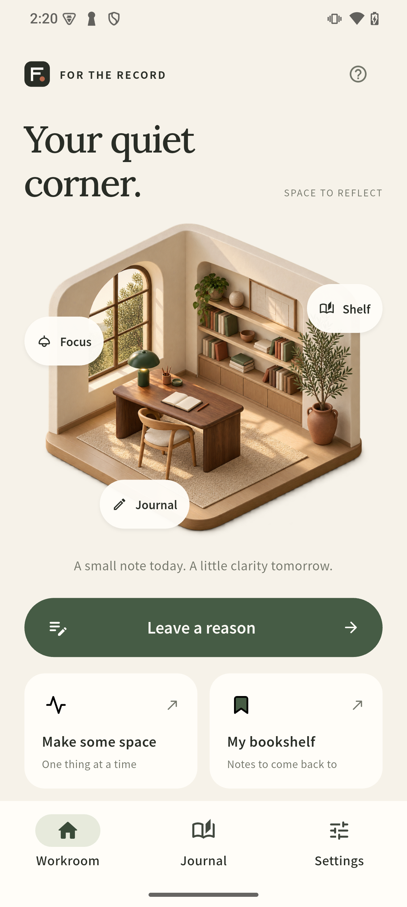
A room worth returning to
A skippable guide introduces the room.
The lamp begins a focus session.
A saved next action starts the next visit.
The same reflection habit works
for building, learning and wallet decisions.
Eight UI languages. Optional reduced motion.
Work notes remain available offline.
Physical Seeker / release 0.5.1
FOR THE RECORD / 0.5.1 / 6
Notes:
Screenshot: physical Seeker home, release0.5.1. Room redesign and onboarding from0.5.0 remain. Core project, focus, outcome, and bookmark flow works offline. UI languages EN,KO,JA,ZH,HI,ES,PT,FR. Large-text tests cover200% text scale; fluent-speaker and broad accessibility review remain release work. App artwork includes generated room assets and attributed motion, documented in assets/ATTRIBUTIONS.md.

Slide 7
Measured on Seeker
93
26 / 30
app tests passed
first AI suggestions matched
in the additional EN / KO synthetic set
Offline AI, cancellation and reuse passed.
The release APK installed and displayed AI questions.
Small authored evaluation on one device. Live supported swap-to-journal completion and user retention remain unverified.
FOR THE RECORD / 0.5.1 / 7
Notes:
Evidence: docs/ON_DEVICE_REFLECTION.md, docs/AI_DEVICE_051.json, docs/SEEKER_DEVICE_041.md. Android15 Seeker.93 Flutter tests and clean static analysis.34 development examples tuned to34/34,30 additional fixed examples26/30. Nine additional cases were ambiguous and all four first-choice misses were in those nine.64 combined examples,15 ambiguous. Do not label top-two coverage as100% accuracy. APK0.5.1 versionCode2008,37811704bytes,SHA256234ba0ca6ae9e93d0ff5767b14098e3211ff197317bde663b894f266d3498ea0. Development signing, not a store production certificate.

Slide 8
Your decisions,
with their reasons
A private journal for a reflection habit on Seeker.
Next: a consented pilot measuring first saved reasons,
completed revisits and second-week return.
workroom-seeker-6984.web.app
FOR THE RECORD / 0.5.1 / 8
Notes:
Source and commit history: https://github.com/openai-lover/seeker_FOR-THE-RECORD. Product-market fit, retention and user traction are hypotheses to test, not measured results. SKR integration is optional under the official competition announcement and disabled in this release: https://solanamobile.com/blog/clock-in-the-solana-mobile-hackathon . This deck supports a submission draft; final contest submission is not authorized. The owner asked to keep the entry editable and stop after AI pre-review.

